Slide 1

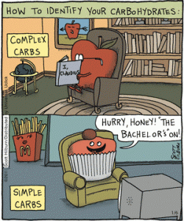
Special Unit: Digestive Day A&P spring 2016 mr. e SRCS

Slide 2

if food labels were honest…

Slide 16
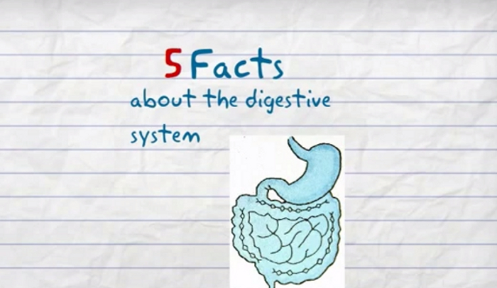

Slide 17
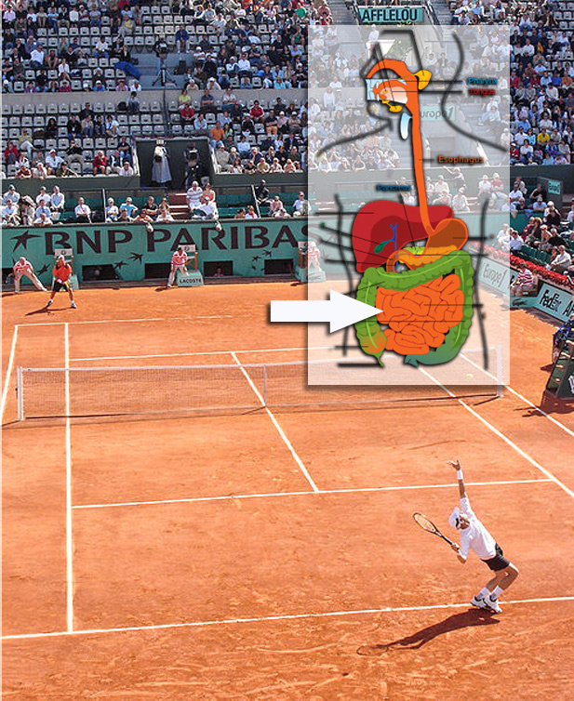
The small intestine contains so many folds that its total surface area is about 2,700 square feet, enough to cover a tennis court!

Slide 18
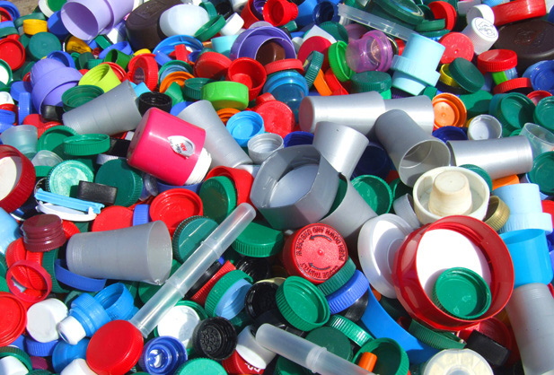
Hydrochloric acid, the primary digestive juice in our stomachs, is capable of dissolving substances as strong as metal, and yet it has no effect whatsoever on plastics!

Slide 19
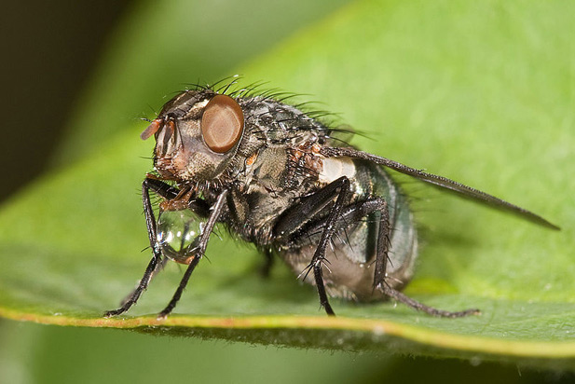
Think your Uncle Ned has lousy table manners? The common house fly vomits on its food before consuming it! This is in so that acids in it's up-chuck can soften the food so it can be sucked up through it's straw like mouth. Want to know something even more horrible than that? Flies excrete digestive juices wherever they land as a means of testing whether or not what they've landed on is edible. Yuck!

Slide 20
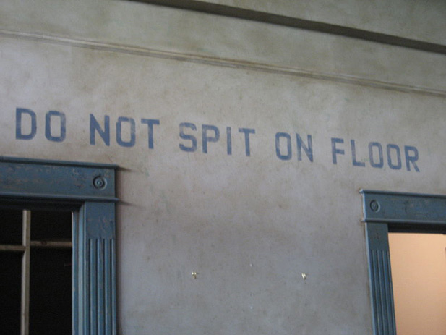

The average adult generates one point seven liters of saliva every day!

Slide 21

In 2005 the Ashden Award for Sustainable Energy Advancement went to a prison in Rwanda that utilized methane from their prisoners excrement to fuel cooking stoves. Incredibly, that one program saved more than one point five million dollars. Nobody said green living was going to be pretty, folks!

Slide 22
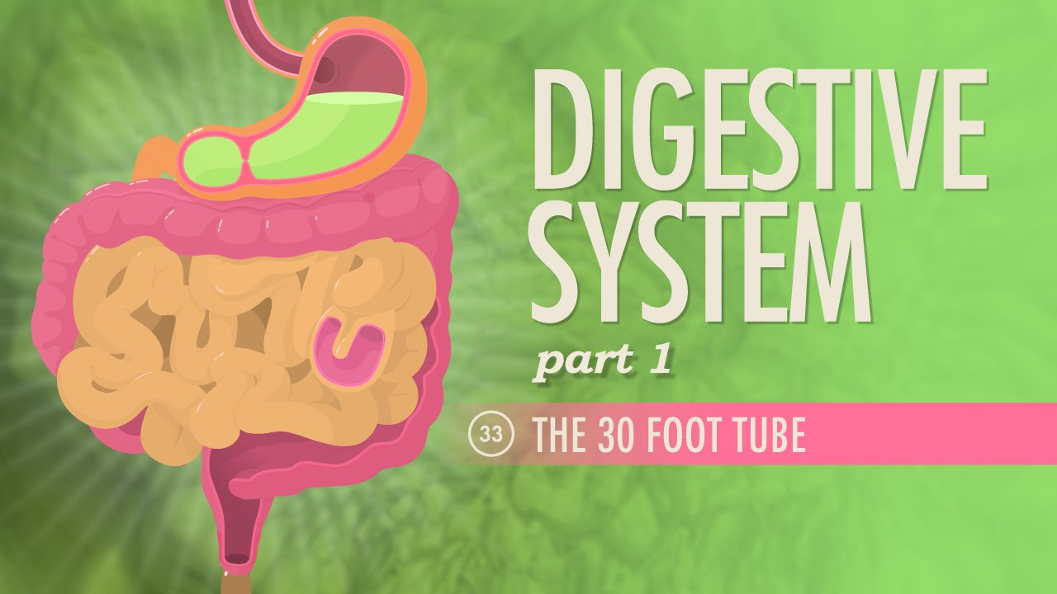
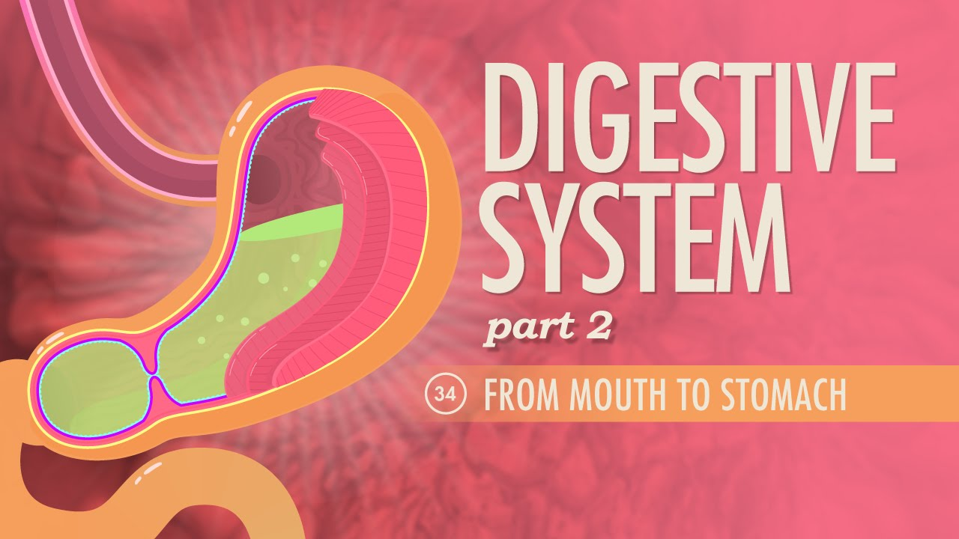
Digestive System, Part 1: Crash Course A&P #33
Digestive System, part 2: Crash Course A&P #34

Slide 23
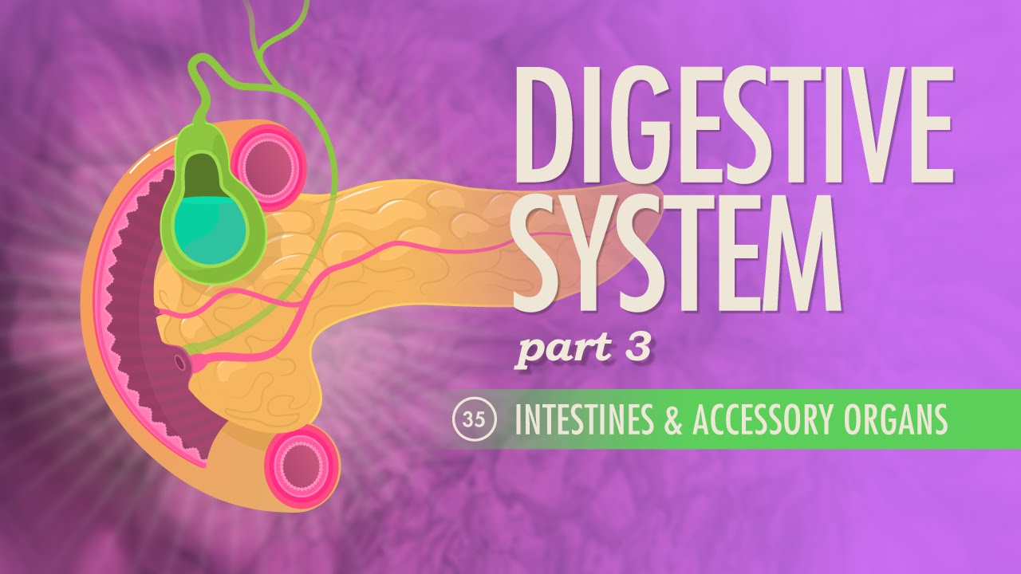

Digestive System, part 3: Crash Course A&P #35
Mark Bittman: What's wrong with what we eat

