Slide 1

A long time ago, in a galaxy far,
far away…

Slide 2
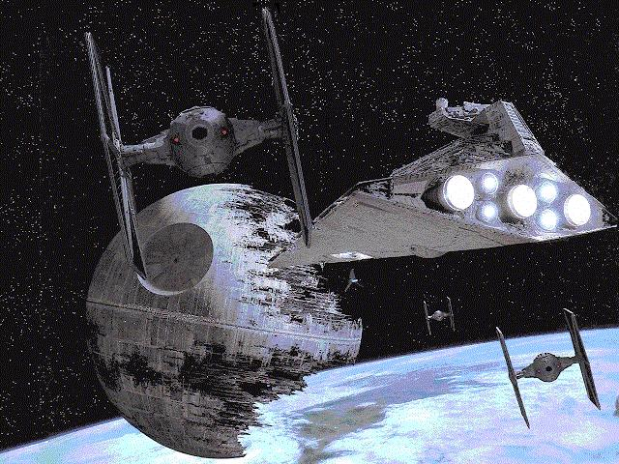



The Physics of

Slide 3
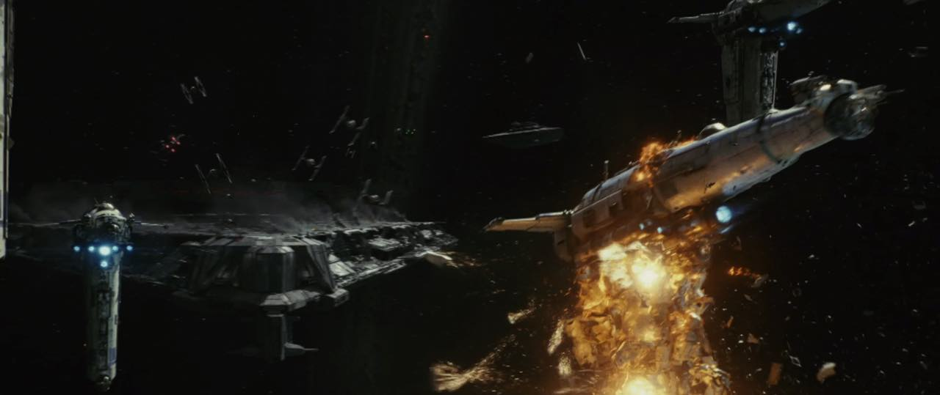
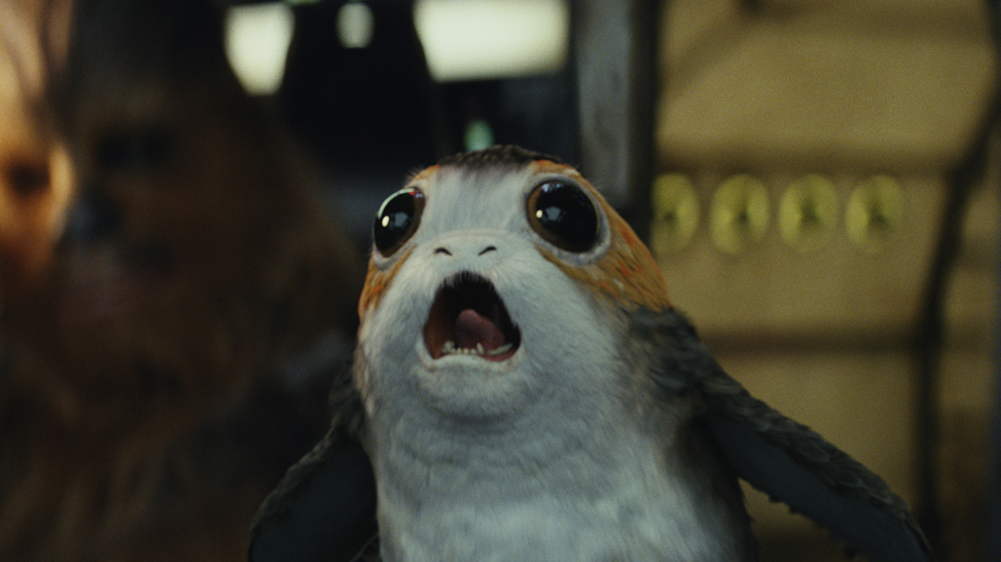
The Physics of
1. Sound in space
If sound requires a medium through which to travel...how is it we hear battle sounds and explosions in the film?

Slide 4
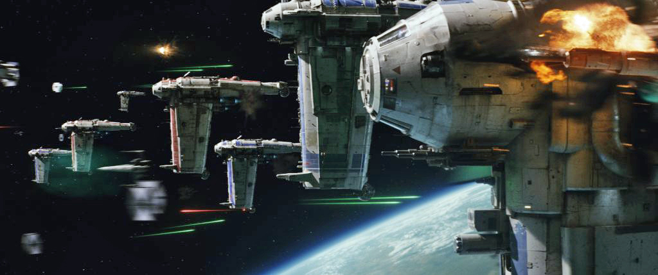
The Physics of
2a. Bombing in space
If objects are weightless in space, how do the bombs drop from the bombers to the Dreadnought?

Slide 5
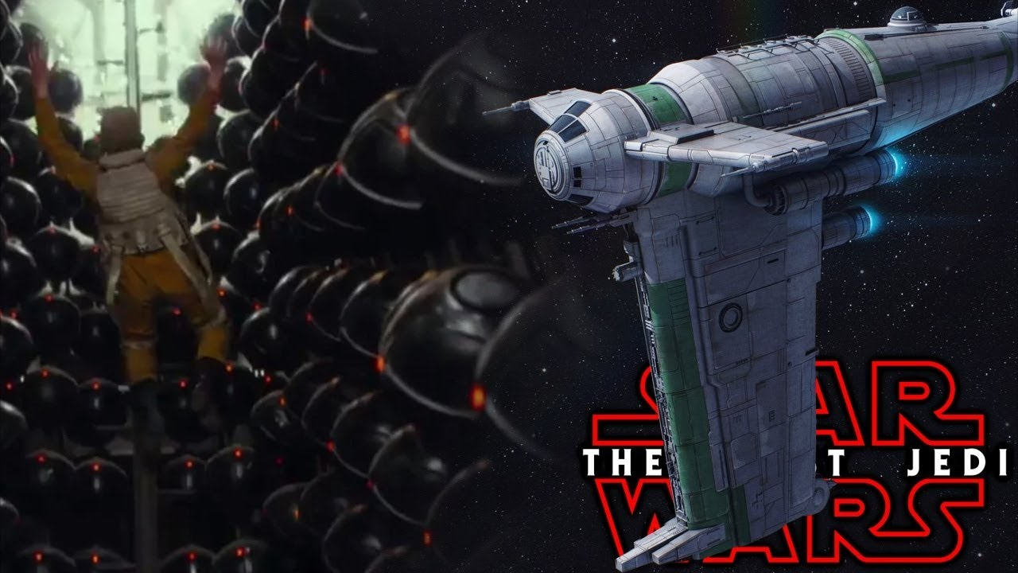
Science vs The Last Jedi “Plot Holes” (play from 4:20-6:49)
The Physics of
The B/SF-17 Heavy Bombers, along with every Star Wars ship I can think of, has artificial gravity. You can tell by the people walking inside.
The bombs fall
according to the artificial gravity of the ship. Their momentum continues in the frictionless environment of space until they hit the other ship. No problemo.

Slide 6
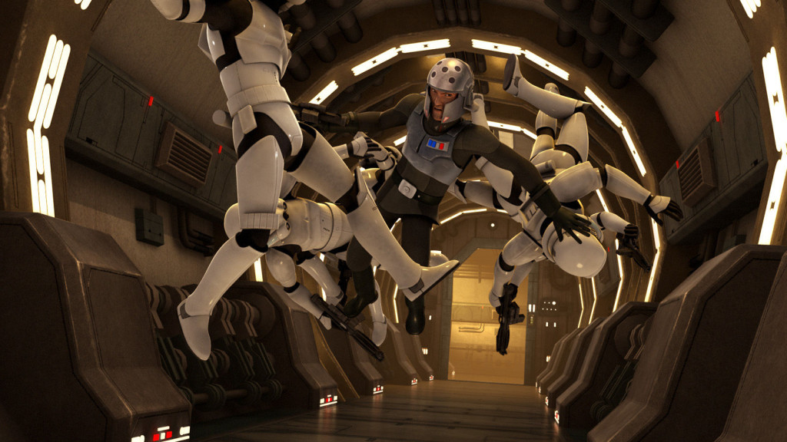
The Physics of
2b. Gravity in space
How do ship inhabitants sit, walk, run, fight, or fall (into a garbage chute) ?
What are three ways gravity can be “manufactured”?

Slide 7
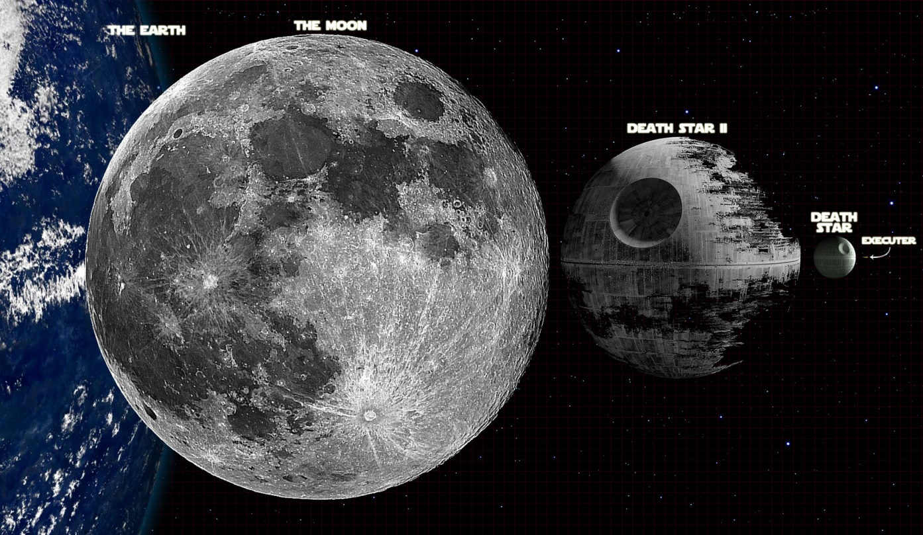
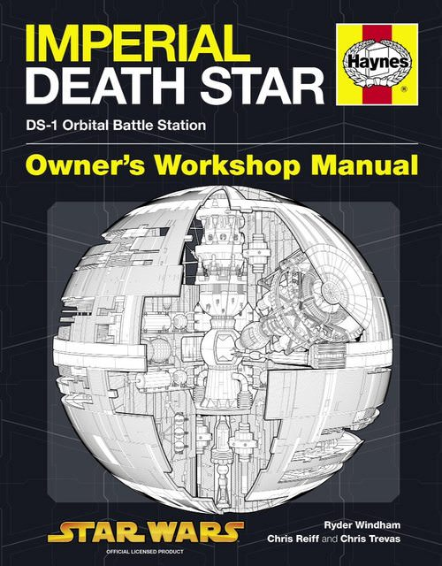
The Physics of
2b. Gravity in space
How do ship inhabitants sit, walk, run, fight, or fall (into a garbage chute) ?
Watch, then consider…if the Death Star were rotating, to which areas would the seemingly sufficient g be limited to…
Would the Death Star Need Artificial Gravity?

Slide 8
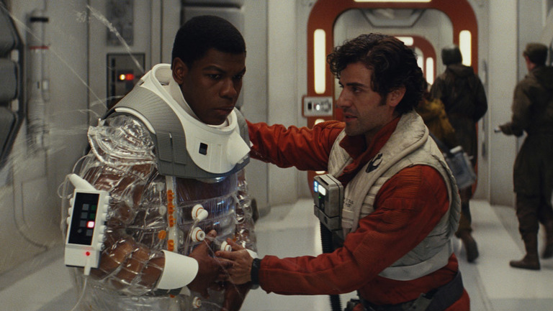
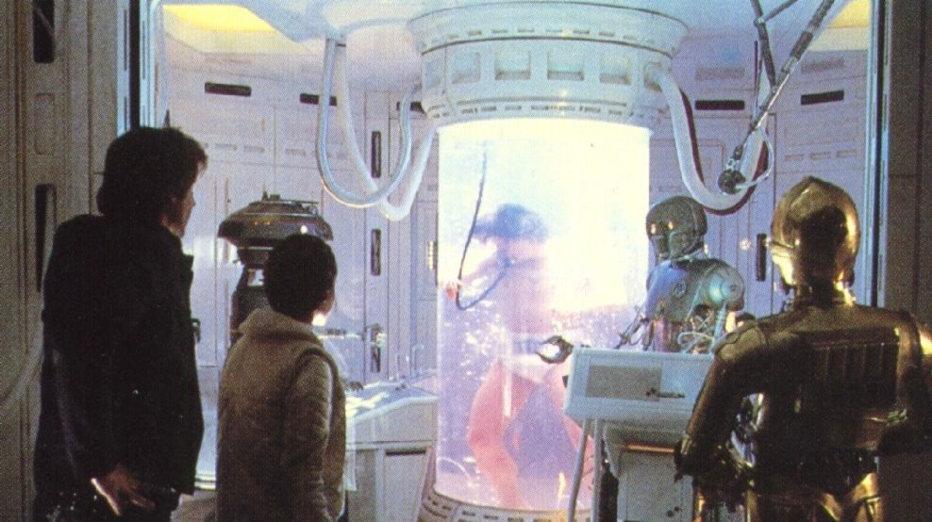
The Physics of
3. Flexpoly Bacta Suit
What’s up with Finn’s awkward entrance?
Bacta is a thick gelatinous material with seemingly miraculous healing properties. It is described as being warm to the touch and has been used systemically as well as body-part specifically. Finn is sporting the newest tech...

Slide 9
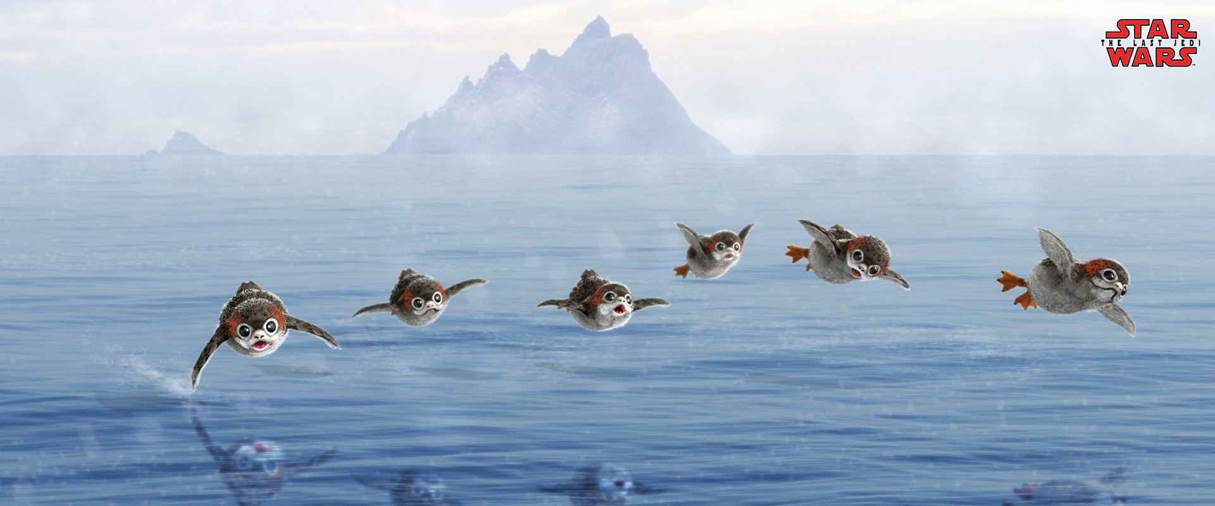
The Physics of
4. Porgs
Can Porgs fly?

Slide 10


The Physics of
4. Porgs
Can Porgs fly?
Keep Away | Star Wars Blips
How the Porgs From 'Star Wars: The Last Jedi' Were Created
The porgs are seen nesting and flying about the treacherous cliffs of Skellig Michael. So, yes, they can fly despite their shape. Hollow bones...

Slide 11

The Physics of
5. Jump to Light-what?
How would this go down?
Its really fast...
Represented by the letter “c”
More?...(is there a difference between light speed & hyperspace?)
Rather than address this completely right now...(we will save this for the last consideration for the film), tell me what you know about light speed.

Slide 12
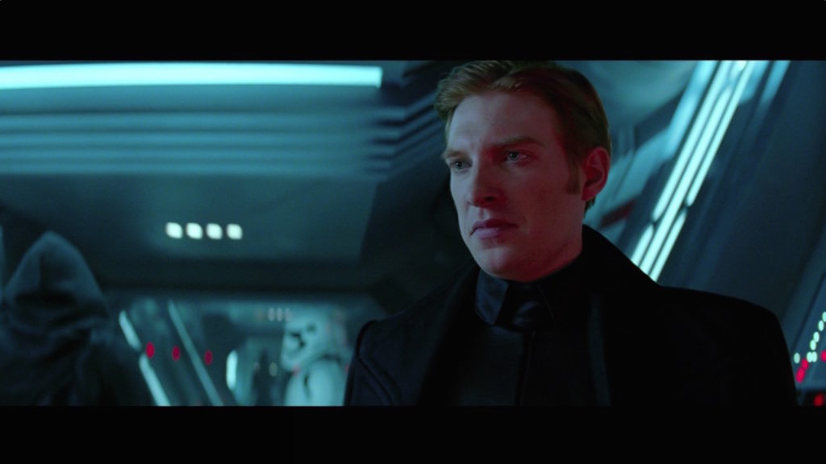
The Physics of
6a. Communicating in space
How do captains communicate ship to ship?
If the “shields are up” in a ship, the electromagnetic force to keep the (supposed) plasma nearby will also reflect all radio waves. Silence. (sorry)

Slide 13
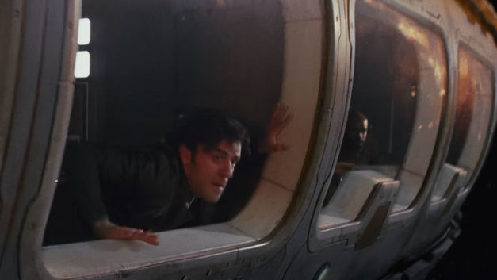
The Physics of
6b. Shields (“while we are here…”)
How can anyone see objects out the window if the shields are up?
Also, since radio waves are below this spectrum, all communication would be lost…
If the “shields are up” you might deflect the latest blast form an enemy ship, but you would lose (at least visual) sight of them as soon as the shields engaged—because the plasma would absorb all light and keep you in total darkness…unless you raised the electromagnet frequency to beyond the visible spectrum (hiding other stuff and requiring more power & cargo space…)

Slide 14

The Physics of
7. Matter in space
When the captain of Hux’s flagship claims the Resistance fleet is “faster” and “lighter”, does this matter in space? (no pun intended)
If matter is weightless in space...how could the terms “faster” and “lighter” make sense? You bet...something fun called p...

Slide 15


The Physics of
8. Princess Leia: Space Wizardess
How did she survive the vagaries of space?

Slide 16



The Physics of
8. Princess Leia: Space Wizardess
How did she survive the vagaries of space?
This actually happened once in a test accident. A NASA technician was decompressed to vacuum, stayed conscious for 12-15 seconds and was saved after 30 seconds. He was perfectly fine afterwards.

Slide 17
The Physics of
8. Princess Leia: Space Wizardess
How did she survive the vagaries of space?
Would you stay conscious?
The time of useful consciousness is 9 to 12 seconds, as quoted by the FAA (lower is active; higher is at rest)
Would your blood boil?
No.
Your blood is at a higher pressure than the outside environment--the blood is at a pressure of 75 Torr (equal to about 100 mbar) above the external pressure. If the external pressure drops to zero, at a blood pressure of 75 Torr the boiling point of water is 46 degrees Celsius (115 F). This is well above body temperature of 37 C (98.6 F). Blood won't boil, because the elastic pressure of the blood vessels keeps it it a pressure high enough that the body temperature is below the boiling point-- at least, until the heart stops beating (at which point you have other things to worry about!).

Slide 18
Surviving in Space: You Don't Need THE FORCE
The Physics of
8. Princess Leia: Space Wizardess
How did she survive the vagaries of space?
A few pointers just in case:
Get back inside pressurized craft, pronto
Wear pressurized suit
If without a helmet, keep mouth open
Pray (make it short and to the point)
"It is very unlikely that a human suddenly exposed to a vacuum would have more than 5 to 10 seconds to help himself. If immediate help is at hand, although one's appearance and condition will be grave, it is reasonable to assume that recompression to a tolerable pressure (200 mm Hg, 3.8 psia) within 60 to 90 seconds could result in survival, and possibly in rather rapid recovery." http://www.geoffreylandis.com/vacuum.html

Slide 19
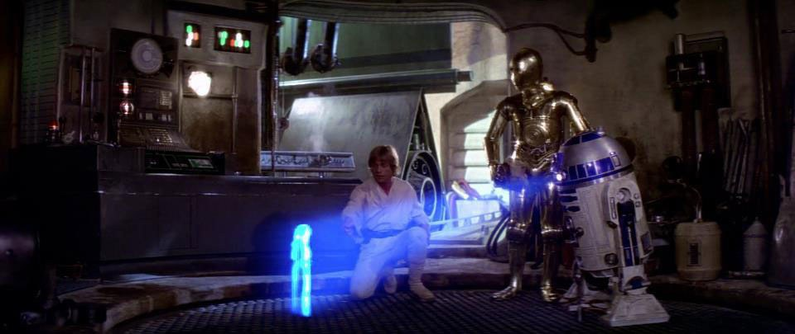

The Physics of
9. The Science of Holograms
How does this work? Do we have this tech today?
INTERESTING TECH NEWS | Voxon Hologram Voxiebox VX1

Slide 20



Can a Lightsaber Block Bullets?
The Physics of
10. Light Sabers
How is such a weapon even possible...doesn’t light just continue until it hits an opaque barrier of some kind?
Sci Fi Science How to Build a Light Saber 2/3 - YouTube
Why Death by Lightsaber Would Be Much Worse in Real Life!

Slide 21
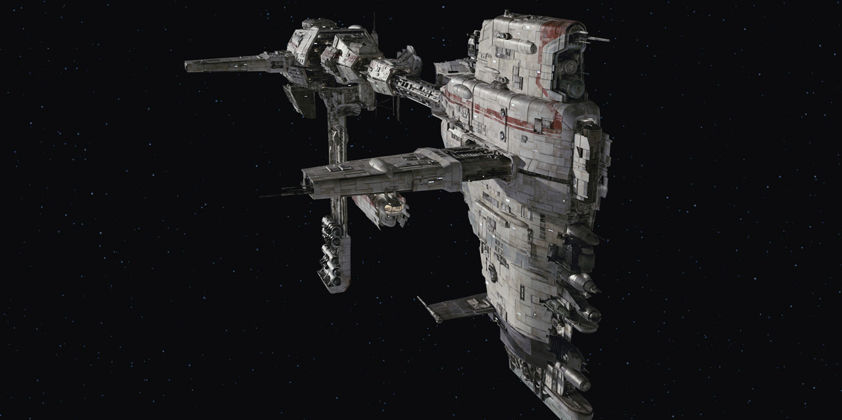
The Physics of
11. Running out of fuel
Does the film accurately show what would happen if a ship in space ran out of fuel?
If the fuel was simply used for thrust….the other resistance ships were still accelerating, hence the appearance of slowing down…
If the fuel included vapors for redirection/ uprightness…
Science vs The Last Jedi “Plot Holes” (play to 4:20)

Slide 22

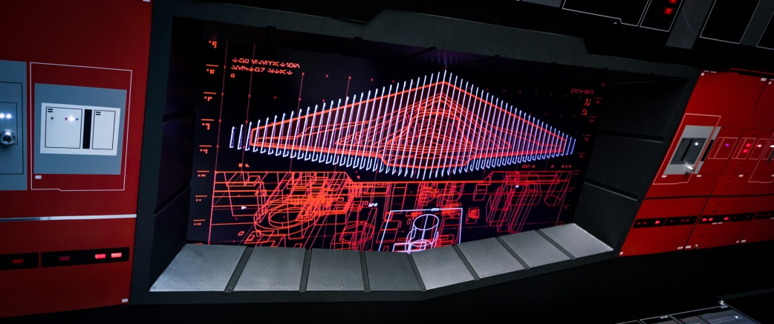
The Physics of
12. Boarding the Supremacy
DJ claims to be able to “cut a slit” in the Supremacy’s shields? Is this possible?
The ship does seem to have segmented areas and, because of its sheer size coupled with the E required, could have allow a section to be disabled…how?
We see a shield monitor flicker in the section through which it is supposed, DJ, Finn, & Rose (&BB-8) enter…

Slide 23
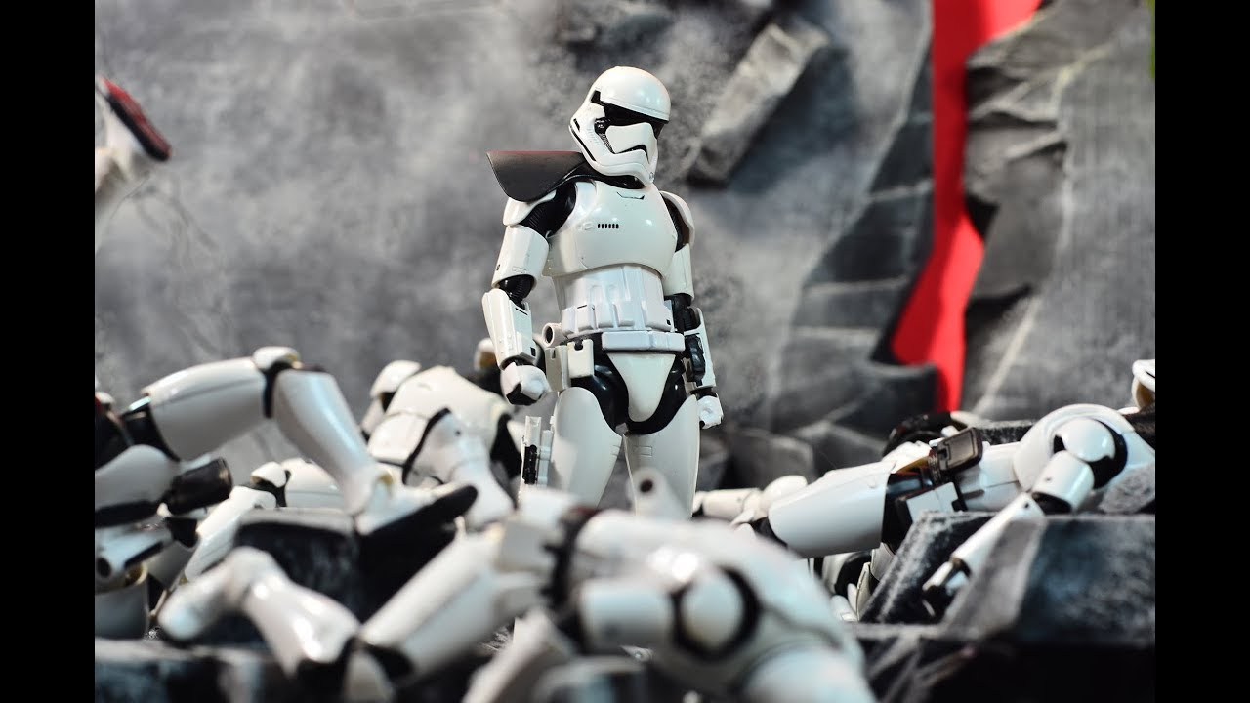
The Physics of
13. Stormtrooper Armour
Why do the Storm Troopers even wear armour if it seems ineffective when it counts?
Why Do Stormtroopers Even Wear Armor?

Slide 24


The Physics of
14. The Holdo Maneuver
Is this how it would go down? Why isn’t this the mode of choice for large-scale ship destruction?
Because Science with Kyle Hill S1 • E172
Hyperspeed Ramming: Does it break Star Wars lore?

Slide 25


The Physics of
Can a Star Wars Blaster Bolt Be Dodged?
The Myth Strikes Back Aftershow

Slide 26
A short time ago in a galaxy far closer than you think…

Slide 27
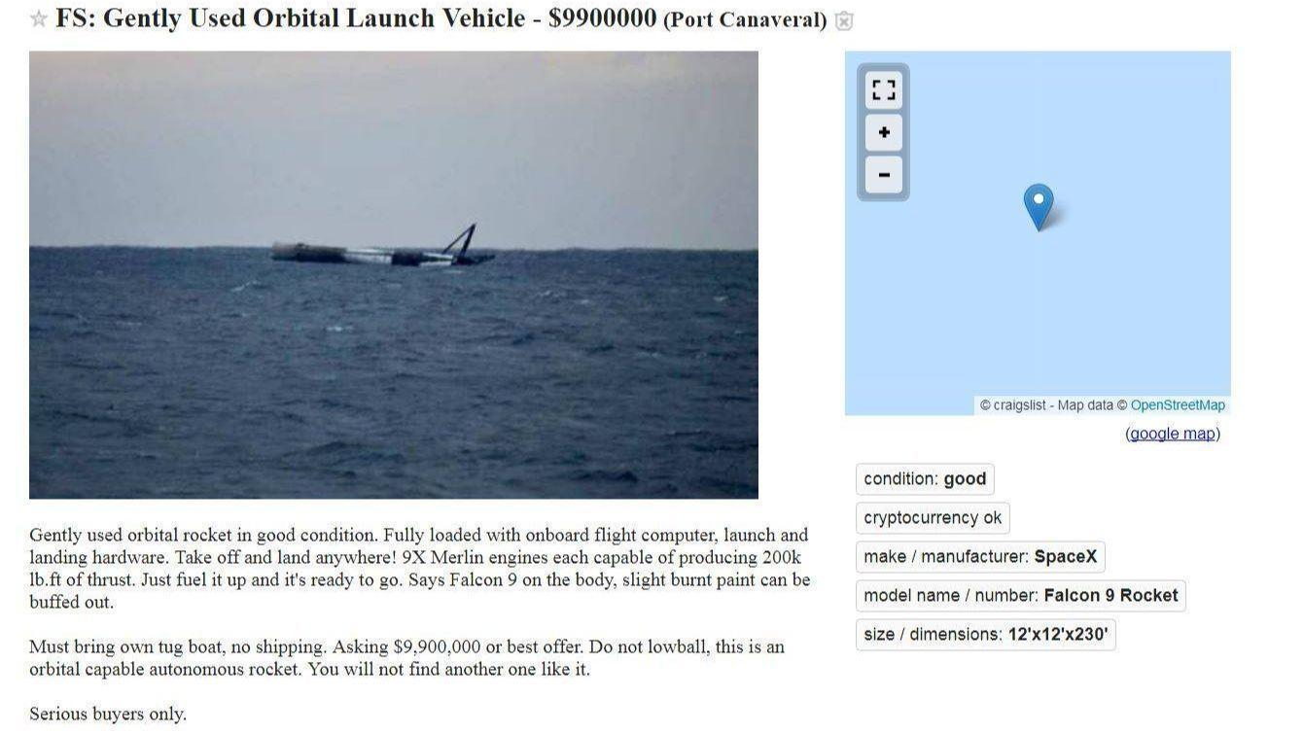
Actual listing found on Craig’s List on an anonymous account…

