Slide 1

Ch 2: Newton’s First Law
mr e~SRCS
~fall 2015

Slide 2
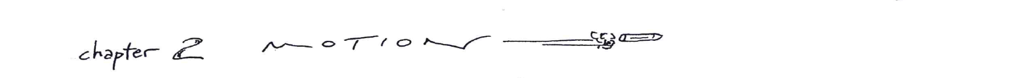
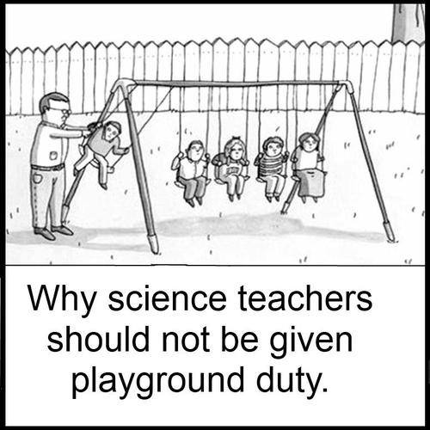
Newton's First Law - TeacherTube
conceptual physics the old tablecloth trick - YouTube
BMW S1000 RR. Dinner for RR. - YouTube

Slide 3

uantity ime
elative
oves espect
osition
How fast are you moving right now? - Tucker Hiatt - YouTube

Slide 4
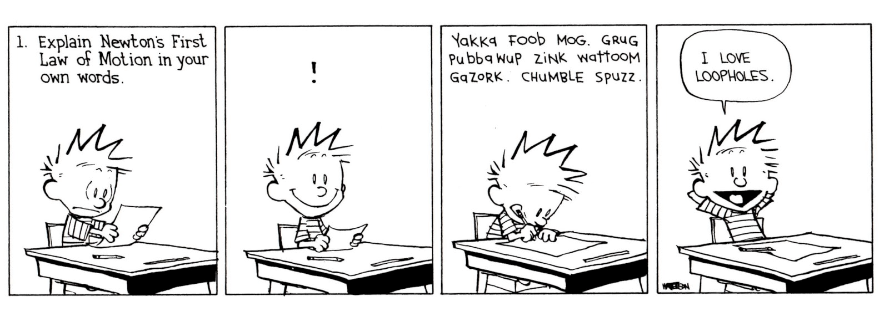
Ch 2: Newton’s First Law

Slide 5
This lecture will help you understand:
Aristotle’s Ideas of Motion
Galileo’s Concept of Inertia
Newton’s First Law of Motion
Net Force
The Equilibrium Rule
Support Force
Equilibrium of Moving Things
The Moving Earth

Slide 6
Essential Questions:
According to Aristotle, why do objects move as they do? Why did this idea last for 2000 years?
Aristotle’s Ideas of Motion
Galileo’s Concept of Inertia
Newton’s First Law of Motion
Net Force
The Equilibrium Rule
Support Force
Equilibrium of Moving Things
The Moving Earth
What did Galileo believe about a moving object? What did Galileo do to prove his theories of motion? (2 things); How does a Christian worldview permit both of these things?
State the law; What are the 2 aspects of Newton’s 1st law?
How does “net F” differ from mere F? How does one calculate it?
Why would metric units become universally adopted in scientific endeavors
State the Rule; Why would God create the universe to behave in this way?
What is a support F? Why is this sometimes called the “normal F”?
State the rule; what must be the case in order for an object to be moving , yet be in dynamic equilibrium?
Why must a friction F be equal to an applied F if an object being pushed is moving at a constant v?
Why can a bird leave a tree branch and not find itself miles away despite earth moving at a staggering speed? Why must a helicopter fly to a location rather than hover & let the earth pass beneath it?

Slide 7
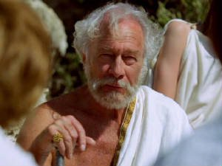
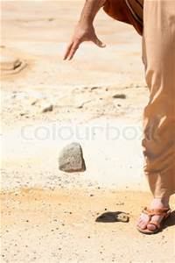

Aristotle’s Ideas of Motion
2.1 Aristotle’s classification of motion
Natural motion
Any object not in its proper place will strive to get there. Examples:
Stones fall. Puffs of smoke rise.
Every object in the universe has a proper place determined by a combination of four elements: earth, water, air, and fire.

Slide 8
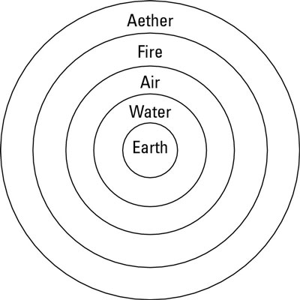
Aristotle’s Ideas of Motion
Natural motion seems to be primarily vertical…
Straight up or straight down for all things on Earth.
(Beyond Earth, motion is circular (due to aether—which is something altogether different) Example: The Sun and Moon continually circle Earth.
Aristotle asserted: “The speed of the fall was proportional to the weight of the object and inversely proportional to the density of the medium it fell through.”
Come again?....let’s say it another way…

Slide 9
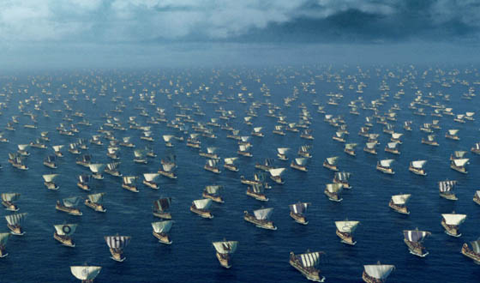
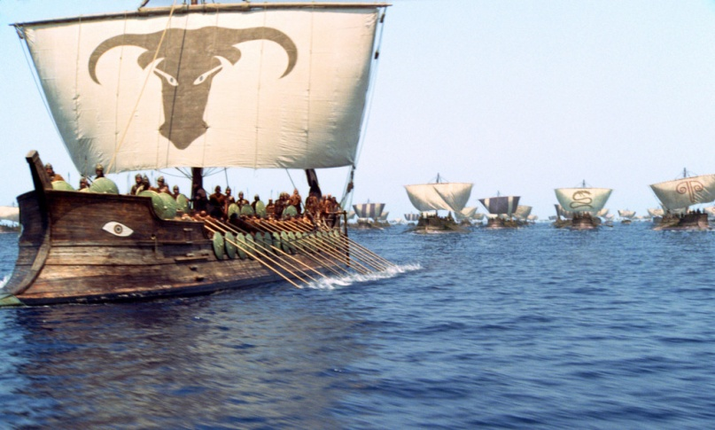
Aristotle’s Ideas of Motion
Violent motion (AKA “unnatural” motion)
Produced by external pushes or pulls on objects.
Example: Wind imposes motion on ships.
How long did Aristotle’s theories last?…

Slide 10
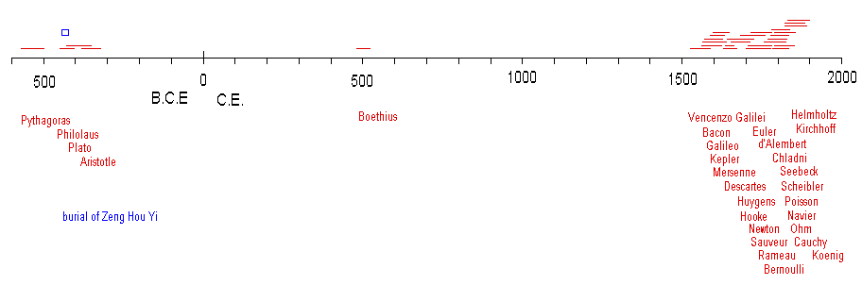
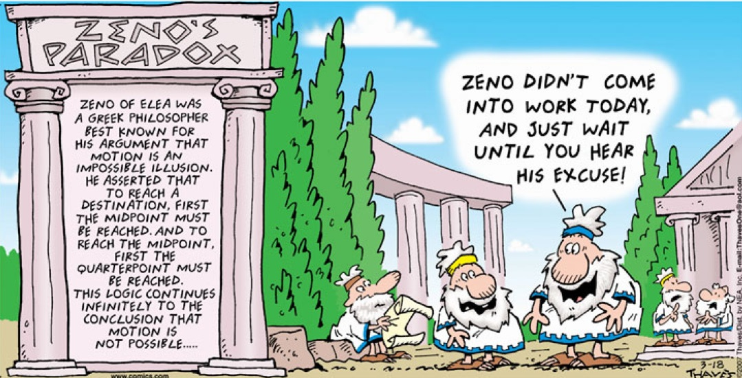
Ancient Ideas of Motion
Why so long?
Remember, ideas have consequences…
The Greek mathematician Zeno had designed his paradoxes to prove that motion could not be treated mathematically, and that any attempt to do so would lead to paradoxes. (He regarded this as an inevitable limitation of mathematics.)

Slide 11
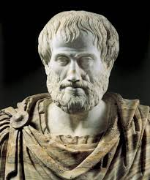
Ancient Ideas of Motion
Why so long?
Remember, ideas have consequences…
Aristotle reinforced Zeno’s belief, saying that mathematics could only deal with abstract objects that were immutable.

Slide 12
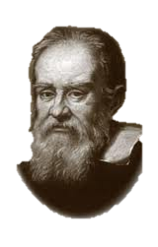
Galileo’s Ideas of Motion
Galileo used the very methods of the Greeks to show that motion could indeed be treated mathematically. His idea was to separate out the paradoxes of the infinite from Zeno's paradoxes. He did this in several steps.
In essence, using Greek style geometry, he showed a short line interval contained as many points as a longer interval…(how?—any ideas)
…formulating the general principle that a smaller infinite set can have just as many points as a larger infinite set containing it.
(This is now referred to as Galileo's paradox)
It was then clear that Zeno's paradoxes on motion resulted entirely from this paradoxical behavior of infinite quantities. Having removed this 2000 year old stumbling block (by resolving the paradox), Galileo went on to introduce his mathematical laws of motion, anticipating Newton.
Conclusion? …the attributes "equal," greater," and "less," are not applicable to infinite, but only to finite, quantities

Slide 13
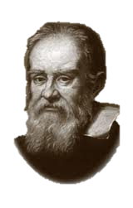


2.2 Galileo’s Ideas of Motion
Galileo set out his ideas about falling bodies, and about projectiles in general, in 2 books:
The first, published in 1632, was called “Dialogue Concerning the Two Chief World Systems”
compared the Copernican system with the traditional Ptolemaic system.
Placed on the Index of forbidden books by the Roman Inquisition
Galileo was told to publish no more…
The second, called "Discourses and Mathematical Demonstrations Relating to Two New Sciences".
The two sciences were the science of motion, which became the foundation-stone of physics, and
the science of materials and construction, an important contribution to engineering.
How does Galileo present his ideas in his books?

Slide 14
Galileo’s Ideas of Motion
Dialogues…The book is presented as a series of discussions, over a span of four days, among two philosophers and a layman:
Salviati argues for the Copernican position and presents some of Galileo's views directly…
Sagredo is an intelligent layman who is initially neutral…
Simplicio, a dedicated follower of Ptolemy and Aristotle, presents the traditional views and the arguments against the Copernican position…
Discourses…written in a style similar to Dialogues, in which three men (Simplicio, Sagredo, and Salviati) discuss and debate the various questions Galileo is seeking to answer.
There is a notable change in the men, however; Simplicio, in particular, is no longer quite as simple-minded and stubborn an Aristotelian as his name implies. His arguments are representative of Galileo's own early beliefs, as Sagredo represents his middle period, and Salviati proposes Galileo's newest models.

Slide 15
Galileo Shifts the Perspective
Galileo demolished Aristotle’s assertions that had lasted almost 2000 years…
Former idea former test
Heavier objects fall faster than light ones…
Theorize based on observation when possible
new idea new test
Neglecting air resistance, objects fall at the same rate regardless of mass
Experiment with objects that, for all practical purposes, are not heavily influenced by air resistance

Slide 16
Galileo Shifts the Perspective
Galileo demolished Aristotle’s assertions that had lasted almost 2000 years…
Former idea former test
Forces keep objects in motion
Theorize based on observation when possible
new idea new test
Moving objects, neglecting friction, will keep moving (AKA Forces are needed to stop objects!)
Perform with friction; observe objects tested under near friction-free conditions

Slide 17
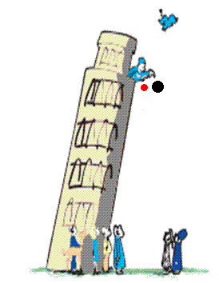
Galileo’s Concept of Inertia
Galileo tests
Galileo’s discovery:
Objects of different weight fall to the ground at the same time in the absence of air resistance.
A moving object needs no force to keep it moving in the absence of friction.

Slide 18
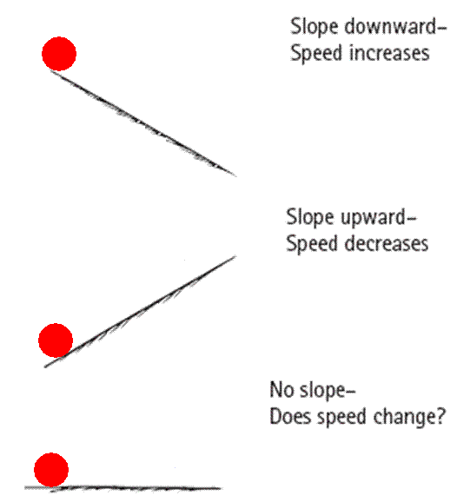
Galileo’s Concept of Inertia
Balls rolling on downward-sloping planes picked up speed.
Balls rolling on upward-sloping planes lost speed.
So a ball on a horizontal plane must maintain speed forever.
If the ball comes to rest, it is not due to its “nature,” but due to friction.

Slide 19
Galileo’s Concept of Inertia
CHECK YOUR NEIGHBOR
The use of inclined planes for Galileo’s experiments helped him to
eliminate the acceleration of free fall.
discover the concept of energy.
discover the property called inertia.
discover the concept of momentum.
Notes:
Answer: C

Slide 20
Galileo’s Concept of Inertia
CHECK YOUR NEIGHBOR
The use of inclined planes for Galileo’s experiments helped him to
eliminate the acceleration of free fall.
discover the concept of energy.
discover the property called inertia.
discover the concept of momentum.
Comment:
Note that inertia is a property of matter, not a reason for the behavior of matter.
Notes:
20
Inertia is a property of matter.
It is not a reason for the behavior of matter.

Slide 21
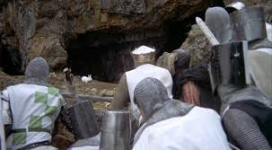
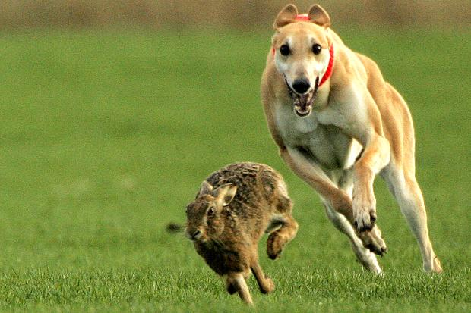
2.3 Galileo’s Formulation of the concepts of speed & velocity
Galileo adds to motion’s vocab
Prior to Galileo:
“Yea how the bunny runneth quickly!”
After Galileo:
I pray 17 m/s (~40 mph) is fast enough!!

Slide 22

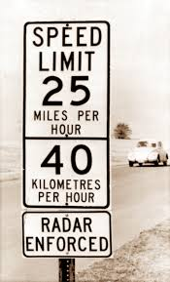
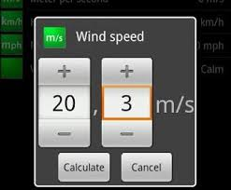

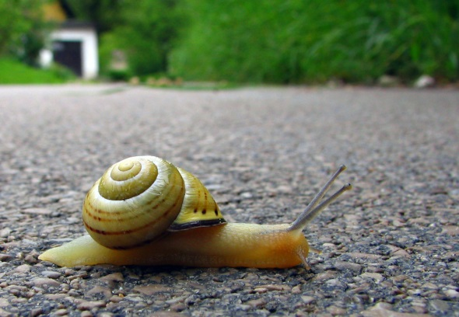
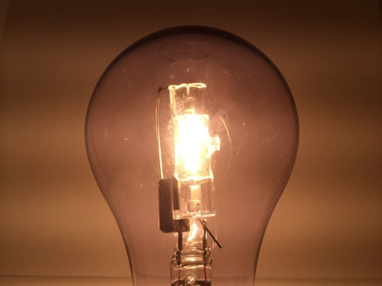
2.3 Galileo’s Formulation of the concepts of speed & velocity
Speed: think of a unit of speed…any…and write it down…
speed =
distance/time
mph
Speed = d/t
miles per hour
miles/hr = rate
Rate = quantity/t
Some common metric speeds:

Slide 23
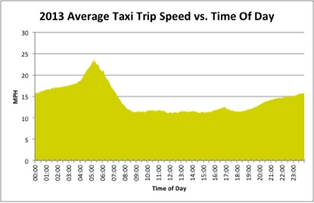
2.3 Galileo’s Formulation of the concepts of speed & velocity
Instantaneous speed vs. average speed:
“the speed at any one instant”
“the whole distance divided by the total time of travel”
After Galileo:
Avg speed = d_{total}/t_{total}
_{Avg. speed = 365miles/24 hrs}
=15.2 miles/hr
Suppose the driver had driven a total of 365 miles?

Slide 24

2.3 Galileo’s Formulation of the concepts of speed & velocity
Velocity:
In science, can one use the terms “speed” and “velocity” interchangeably?
Let’s see:
VELOCITY: speed in a given direction.
Velocity is a vector quantity b/c it involves both magnitude & direction…
Speed is a scalar quantity b/c it involves only magnitude

Slide 25
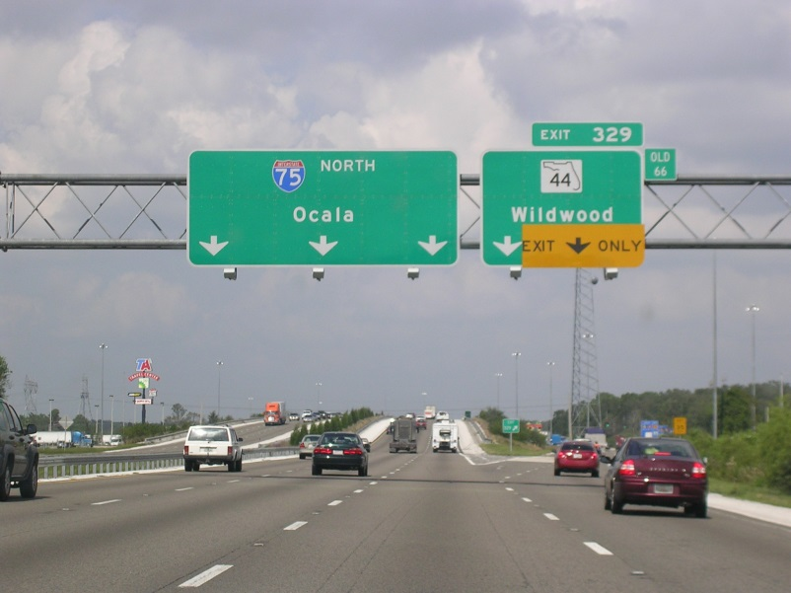

2.3 Galileo’s Formulation of the concepts of speed & velocity
Eg.
The car is moving 80 km/hr North…
The llama is moving 2 km/hr in a SSW direction.
VELOCITY: speed in a given direction.
Let’s see:

Slide 26
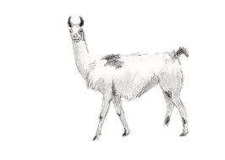
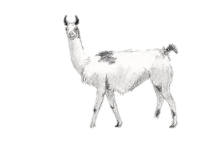
2.3 Galileo’s Formulation of the concepts of speed & velocity
Eg.
Vectors are to be drawn with two things in mind:
Arrow points in direction of speed
Length of arrow reveals quantity relative to other vectors present
10 km/h
? km/h
5 km/h
Let’s see:
VELOCITY: speed in a given direction.

Slide 27
2.3 Galileo’s Formulation of the concepts of speed & velocity
Eg.
Suppose both llamas were going the same speed in opposite directions. Would they be going the same velocity?
10 km/h
10 km/h
Remember—if either condition changes, we have a change in v!
Let’s see:
VELOCITY: speed in a given direction.

Slide 28
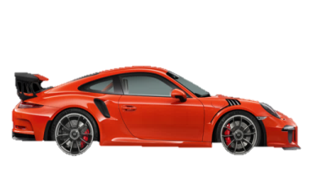
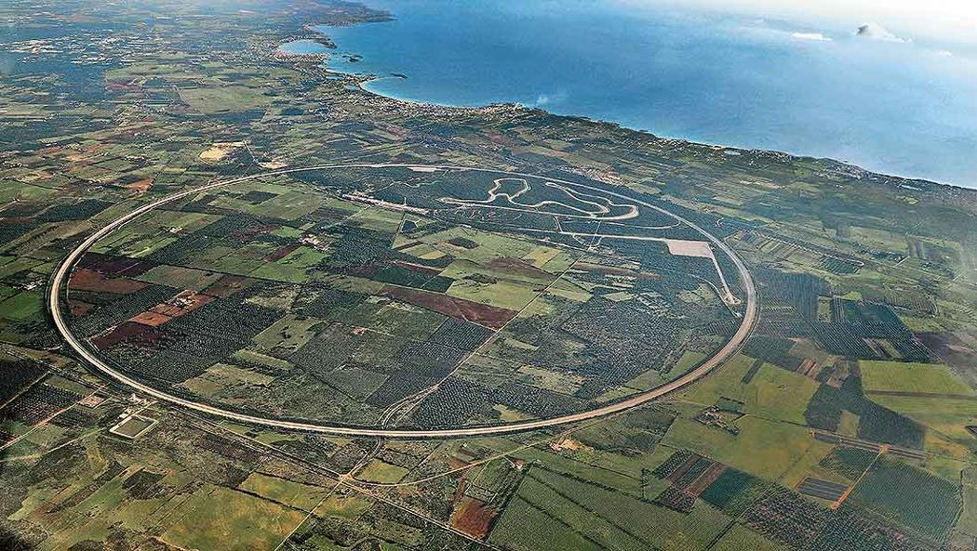
2.3 Galileo’s Formulation of the concepts of speed & velocity
Constant v
Consider a car on a highway and one on the circular test track. Are they going the same velocity?
Are they both experiencing a constant v?
160 km/h
160 km/h
Remember—if either condition changes, we have a change in v!
Let’s see:
VELOCITY: speed in a given direction.

Slide 29
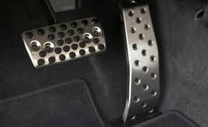
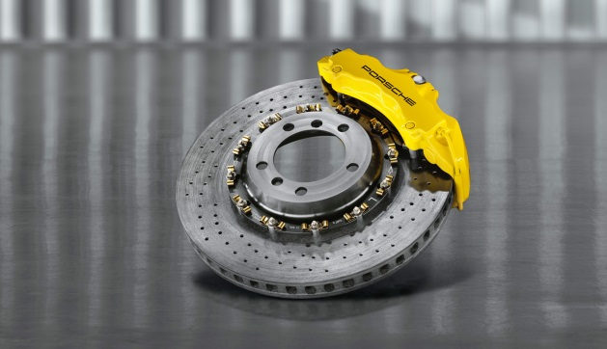
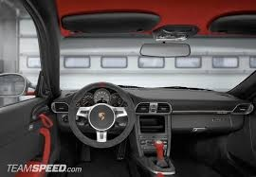
2.3 Galileo’s Formulation of the concepts of speed & velocity
Constant v
What components, then, in a car can change its v?
160 km/h
CONSTANT V: no change in speed or direction.
What does one call a change in v?...

Slide 30

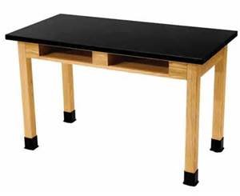
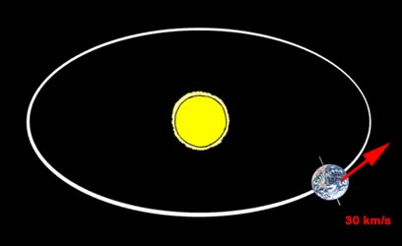
2.4 Motion is relative
Is the book in front of you moving?
Relative to the desk?
Relative to the surface of the Earth?
Relative to the Sun?
What, exactly, in the universe is moving?
Notes:
The key word in this law is continues: An object continues to do whatever it happens to be doing unless a force is exerted upon it.
If it is at rest, it continues in a state of rest.
If an object is moving, it continues to move without turning or changing its speed.

Slide 31

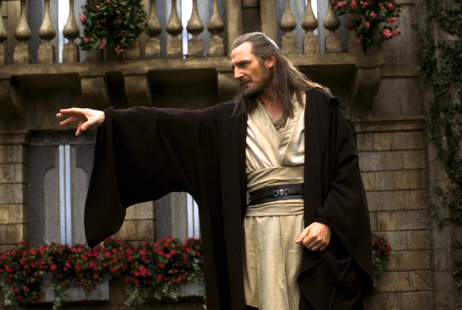
Galileo’s Concept of Inertia
Force
is a push or a pull.
Inertia
is a property of matter to resist changes in motion.
depends on the amount of matter in an object (its mass).

Slide 32


2.5 Newton’s First Law of Motion
An object at rest tends to stay at rest and an object in motion tends to stay in motion with the same speed and in the same direction unless acted upon by an unbalanced force
There are two parts to this statement - one which predicts the behavior of stationary objects and the other which predicts the behavior of moving objects
Notes:
The key word in this law is continues: An object continues to do whatever it happens to be doing unless a force is exerted upon it.
If it is at rest, it continues in a state of rest.
If an object is moving, it continues to move without turning or changing its speed.

Slide 33
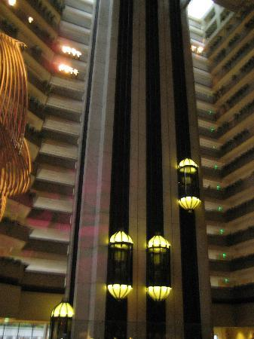
There are many more applications of Newton's first law of motion:
What happens to your blood as you quickly descend?
blood rushes from your head to your feet while quickly stopping when riding on a descending elevator.

Slide 34
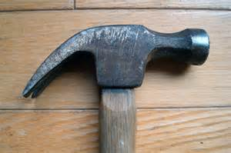
There are many more applications of Newton's first law of motion:
The head keeps coming off the handle…best way to put it back on without external aids?
the head of a hammer can be tightened onto the wooden handle by banging the bottom of the handle against a hard surface.

Slide 35
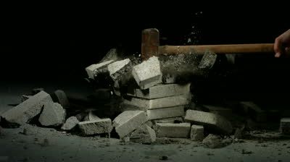
There are many more applications of Newton's first law of motion:
Why is this painless even if done stacked on your body?
a brick is painlessly broken over the body of a physics teacher by slamming it with a hammer. (CAUTION: do not attempt this at home!)
conceptual physics Bed of Nails demo

Slide 36
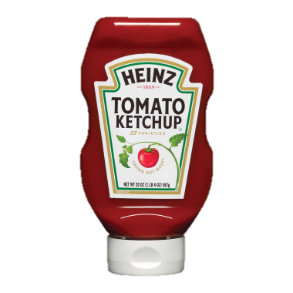
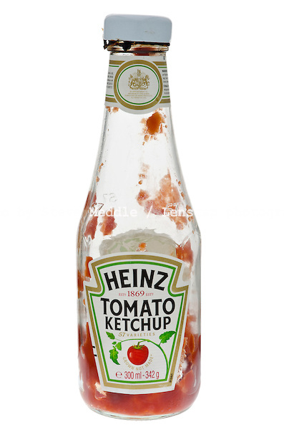
There are many more applications of Newton's first law of motion:
What is the best way to get the last of the yummy condiment without having to wait?
to dislodge ketchup from the bottom of a ketchup squeeze bottle, it is often turned upside down and, thrusted downward at high speeds and then abruptly halted.

Slide 37
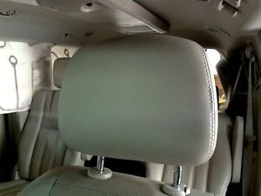
There are many more applications of Newton's first law of motion:
What are head rests for?
headrests are placed in cars to prevent whiplash injuries during rear-end collisions.

Slide 38
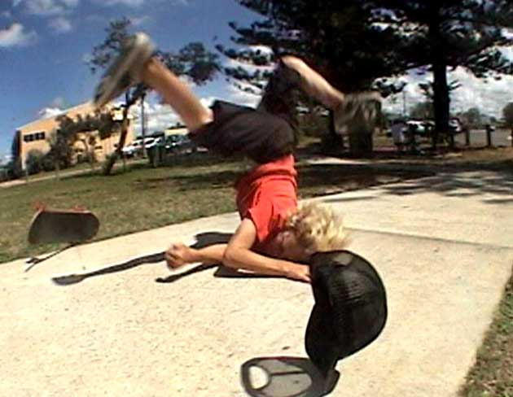
There are many more applications of Newton's first law of motion:
What happens if you are skating and you hit a stone?
while riding a skateboard (or wagon or bicycle), you fly forward off the board when hitting a curb or rock or other object which abruptly halts the motion of the skateboard.

Slide 39
Force
A force is a push or pull upon an object resulting from the object's interaction with another object.
Whenever there is an interaction between two objects, there is a force upon each of the objects.
When the interaction ceases, the two objects no longer experience the force. Forces only exist as a result of an interaction

Slide 40
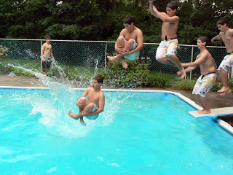
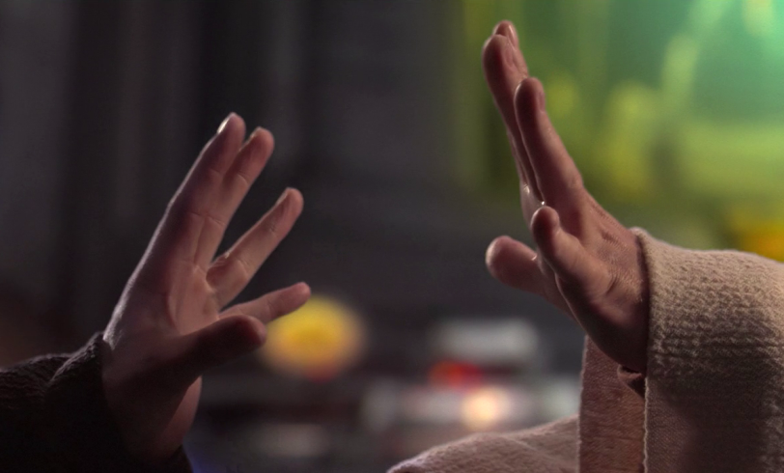
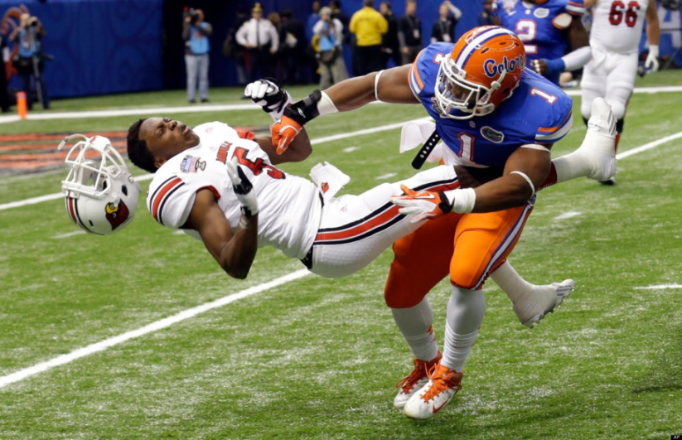
Force
For simplicity sake, all forces (interactions) between objects can be placed into two broad categories:
contact forces
forces resulting from action-at-a-distance

Slide 41
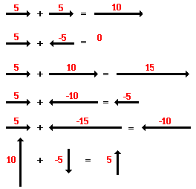
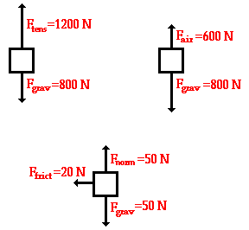
2.6 Net Force: “The Sum of All Forces”
The net force is the vector sum of all the forces which act upon an object. Here are some examples….
In each of the above situations, there is an unbalanced force. Is is commonly said that in each situation there is a net force acting upon the object.

Slide 42
Net Force
CHECK YOUR NEIGHBOR
A cart is pushed to the right with a force of 15 N while being pulled to the left with a force of 20 N. The net force on the cart is
5 N to the left.
5 N to the right.
25 N to the left.
25 N to the right.
Notes:
42
Answer: A

Slide 43
Net Force
CHECK YOUR NEIGHBOR
A cart is pushed to the right with a force of 15 N while being pulled to the left with a force of 20 N. The net force on the cart is
5 N to the left.
5 N to the right.
25 N to the left.
25 N to the right.
Two forces are in opposite directions, so they subtract.
The direction is determined by the direction of the larger force.
Notes:
43
When you take a 15N force to the right added to a 20 N force to the left, because the two forces are in opposite directions, they in fact subtract, rather than add.
So, the larger 20 force to the left is cut back by the 15N force to the right, so that the remaining force i.e. the Net force is only 5N to the left.

Slide 44
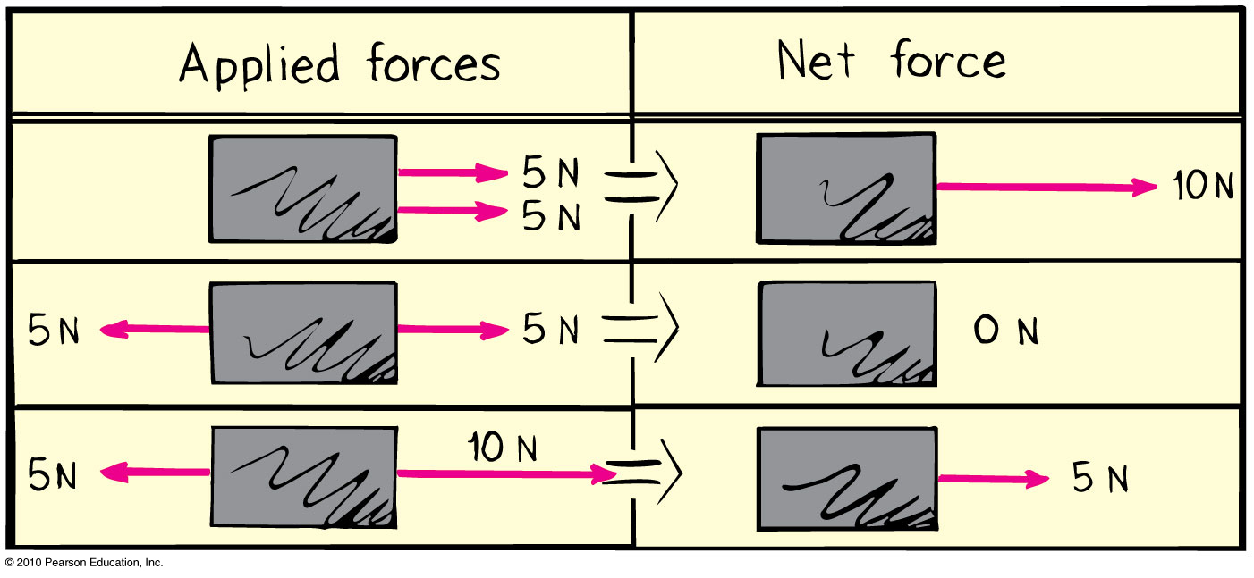
Net Force
CHECK YOUR NEIGHBOR
What is the net force acting on the box?
15 N to the left
15 N to the right
5 N to the left
5 N to the right
?
Notes:
44
Answer: D

Slide 45
Net Force
CHECK YOUR NEIGHBOR
What is the net force acting on the box?
15 N to the left
15 N to the right
5 N to the left
5 N to the right
Notes:
45
When you take a 10N force to the right added to a 5 N force to the left, because the two forces are in opposite directions, they in fact subtract, rather than add.
So, the larger 10N force to the right is cut back by the 5N force to the left, so that the remaining force i.e. the Net force is only 5N to the right.

Slide 46
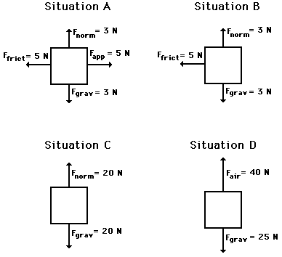
Check your Understanding
Free-body diagrams for four situations are shown below. For each situation, determine the net force acting upon the object.
Write the answers inside each box after canceling out the appropriate vectors.

Slide 47
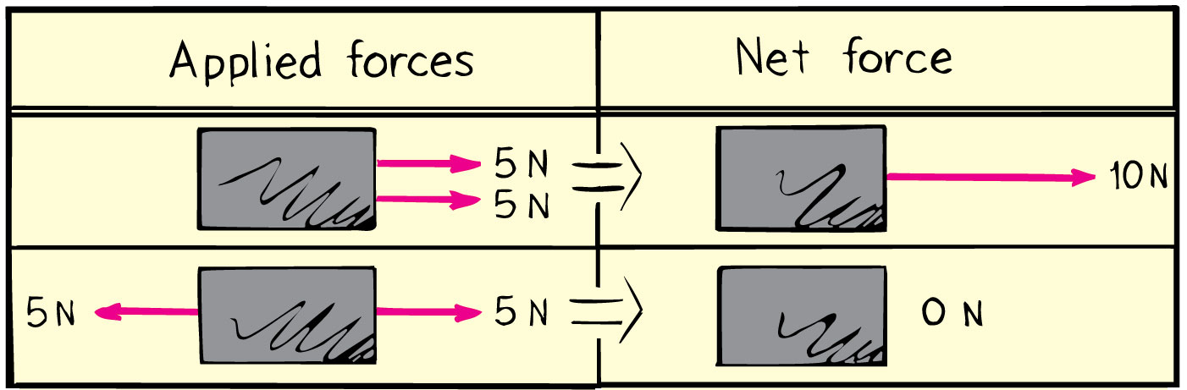
Net Force
Net force is the combination of all forces that change an object’s state of motion.
What if there is a balance of forces (or NO net force [F_{net}])? AKA: the F cancel out…
then the system is said to be in EQUILIBRIUM.

Slide 48
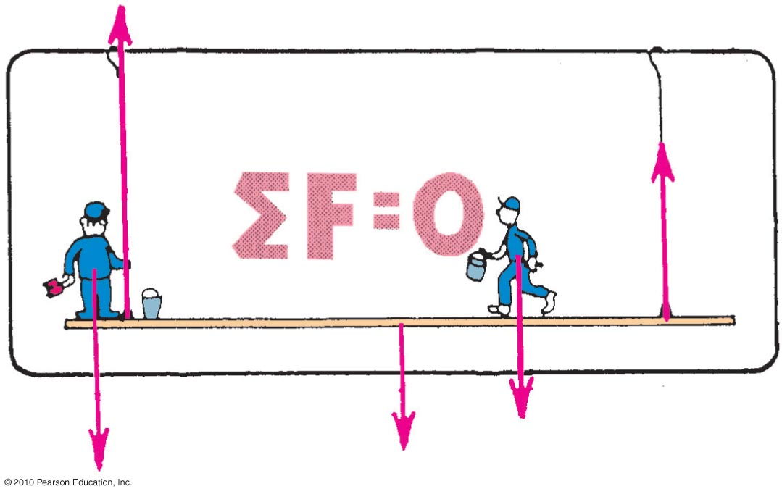
2.7 Equilibrium for Objects at rest & The Equilibrium Rule
The vector sum of forces acting on a non-accelerating object equals zero.
In equation form: ΣF = 0.
Hewitt-Drew-it! PHYSICS 1. Equilibrium Rule

Slide 49
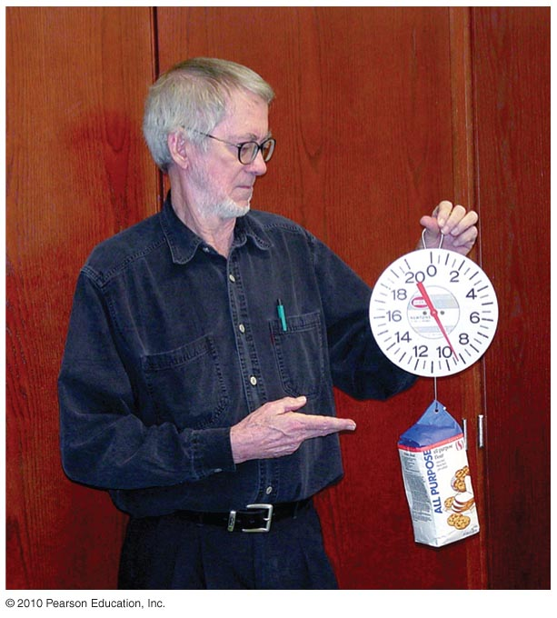
The Equilibrium Rule : Example
Two forces act on the bag of flour:
Tension force acts upward.
Weight acts downward.
Both are equal in magnitude and opposite in direction.
When added, they cancel to zero.
So, the bag of flour remains at rest.
A string holding up a bag of flour

Slide 50
The Equilibrium Rule
CHECK YOUR NEIGHBOR
The equilibrium rule, ΣF = 0, applies to
vector quantities.
scalar quantities.
Both of the above.
None of the above.
Notes:
50
Answer: A

Slide 51
The Equilibrium Rule
CHECK YOUR NEIGHBOR
The equilibrium rule, ΣF = 0, applies to
vector quantities.
scalar quantities.
Both of the above.
None of the above.
Explanation:
Vector addition accounts for + and – quantities.
So, two vectors in opposite direction can add to zero.
Notes:
51
Vector addition takes into account the signs of quantities. So quantities, such as forces can be either positive or negative. In this way, two forces (forces), one positive and the other negative, can add to zero. But there is no way that two masses (scalars) can add to zero.

Slide 52

2.8 Support Force
Support force (normal force) is an upward force on an object that is opposite to the force of gravity.
Example: A book on a table compresses
Atoms in the table, and the compressed
atoms produce the support force.

Slide 53

Understanding Support Force
When you push down on a spring, the spring pushes back up on you.
Similarly, when a book pushes down on a table, the table pushes back up on the book.

Slide 54

Support Force
CHECK YOUR NEIGHBOR
When you stand on two bathroom scales with one foot on each scale and with your weight evenly distributed, each scale will read
your weight.
half your weight.
zero.
more than your weight.
Notes:
54
Answer: B

Slide 55
Support Force
CHECK YOUR NEIGHBOR
When you stand on two bathroom scales with one foot on each scale and with your weight evenly distributed, each scale will read
your weight.
half your weight.
zero.
more than your weight.
Explanation:
You are at rest, so ΣF=0.
Forces from both scales add to cancel your weight.
Force from each scale is one-half your weight
Notes:
55
You are at rest on the scales, so ΣF = 0. The sum of the two upward support forces is equal to your weight.
Your weight is distributed over the two scales. So, each scale reads half your weight.

Slide 56

2.9 Equilibrium of Moving Things
Equilibrium test: whether something undergoes changes in motion
Example: A crate at rest is in static equilibrium.
Example: When pushed at a steady speed, it is in dynamic equilibrium.

Slide 57
Equilibrium as a formula
F = 0 (sigma) “The Sum of”
That is, all (F) forces equals zero
Σ
Σ
Types of Equilibrium
Static: when an object is at rest
Dynamic: when an object is moving at a constant velocity (no acceleration)
Problem: If a plane flies at a constant velocity … is this static or dynamic equilibrium? (circle one)
Which is greater: its thrust or its drag? (circle one)

Slide 58
Equilibrium of Moving Things
CHECK YOUR NEIGHBOR
A bowling ball is in equilibrium when it
is at rest.
moves steadily in a straight-line path.
Both of the above.
None of the above.
Notes:
58
Answer: C

Slide 59
Equilibrium of Moving Things
CHECK YOUR NEIGHBOR
A bowling ball is in equilibrium when it
is at rest.
moves steadily in a straight-line path.
Both of the above.
None of the above.
Explanation:
Equilibrium means no change in motion, so there are two options:
If at rest, it continues at rest.
If in motion, it continues at a steady rate in a straight line.
Notes:
59
For an object to be in equilibrium, it does not necessarily have to be at rest.
It can be in equilibrium as long as it is not changing its motion.
If it is initially at rest it must continue to remain at rest.
If it is initially in motion it must continue in motion at a steady rate in a straight line path.

Slide 60

Equilibrium of Moving Things
CHECK YOUR NEIGHBOR
You are pushing a crate at a steady speed in a straight line. If the friction force is 75 N, how much force must you apply?
more than 75 N
less than 75 N
equal to 75 N
not enough information
Notes:
60
Answer: C

Slide 61

Equilibrium of Moving Things
CHECK YOUR NEIGHBOR
You are pushing a crate at a steady speed in a straight line. If the friction force is 75 N, how much force must you apply?
A. more than 75 N
B. less than 75 N
C. equal to 75 N
D. not enough information
Explanation:
The crate is in dynamic equilibrium, so, ΣF = 0.
Your applied force balances the force of friction.
Notes:
61
Crate is in dynamic equilibrium, So there is no NET force acting on it
So you must apply a force that balances out the force of friction. Which means it must be equal and opposite to the force of friction. So if Friction is 75N to the left, the Applied Force from you is 75N to the right.

Slide 62

2.10 The Moving Earth
Copernicus proposed that Earth was moving.
This idea was refuted by people.
Example: If Earth moved, how can a bird swoop from a branch to catch a worm?
Solution: As it swoops, due to inertia, it continues to go sideways at the speed of Earth along with the tree, worm, etc.

Slide 63
Revisiting planetary motion and its effect on us!
Consider these conundrums…
If a helicopter wishes to fly from San Francisco to Washington DC, why can’t it ascend, hover for 3 hours and descend into the capital?
Remember…it took humanity centuries to wrestle with these concepts (much was unnoticeable until the advent of high speed vehicles where we could finally notice the effects of inertia)..so don’t despair if it takes you days or weeks to grasp this!

Slide 64

The Moving Earth
CHECK YOUR NEIGHBOR
You are riding in a van at a steady speed and toss a coin up. Where will the coin land?
behind you
ahead of you
back in your hand
There is not enough information.
Notes:
64
Answer: C

Slide 65
The Moving Earth
CHECK YOUR NEIGHBOR
You are riding in a van at a steady speed and toss a coin up. Where will the coin land?
behind you
ahead of you
back in your hand
There is not enough information.
Explanation:
The coin has inertia. It continues sideways with the van and your hand and lands back in your hand.
Notes:
65

Slide 66

Clearing the Temple of the mind: Turning over the misconceptionmoneychangers
Is a F needed to keep an object in motion?
Newton's first law of motion declares that a force is not needed to keep an object in motion. Slide a book across a table and watch it slide to a rest position.
If I give your text a shove on the desk, why does it come to rest?
The book in motion on the table top does not come to a rest position because of the absence of a force; rather it is the presence of a force - that force being the force of friction - which brings the book to a rest position. In the absence of a force of friction, the book would continue in motion with the same speed and direction - forever! (Or at least to the end of the table top.)
A force is not required to keep a moving book in motion; and a force is not required to keep a moving sled in motion; and a force is not required to keep any object horizontally moving object in motion.

