Slide 1
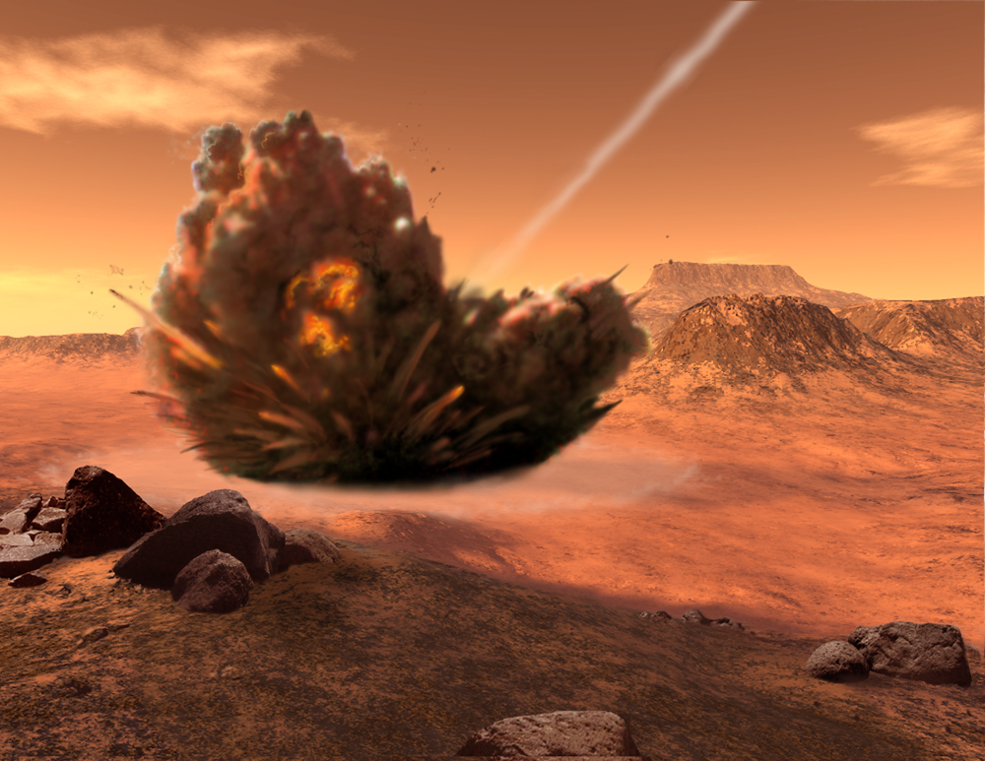
Scientists at Arizona State University's Mars Space Flight Facility are developing a mission named THOR (Tracing Habitability, Organics, and Resources) for NASA's Mars Scout program. THOR will send a projectile to strike Mars at high speed, while instruments aboard the observer study both the debris plume and crater made by the impactor.
chapter 8
projectile & satellite motion

Slide 2

questions considered
What is a projectile?
Why is a projectile’s motion as it is? What if there was no g? What if there was no R_{air}?
Suppose I want maximum range—at which angle do I kick a ball? Maximum height?
What affect does R_{air} have on a projectile?
Is there a connection between the speed of a projectile and an Earth Satellite? How fast does something have to be moving to become an Earth satellite?
How is an elliptical orbit accomplished? How does a satellite in an elliptical orbit behave differently from one in a circular path?
Escape speed. Huh?

Slide 3
outline
What is a projectile?
Projectile Motion
  Projectile Defined
  Examples
  Ch 2 reality check
    Without g
    With g
  Components
    Horizontal
    Vertical
    Effective vs. Ineffective?
    Examples
Projectile Altitude & Range
  Angles& Velocities
  Q&A
Affect of Air Drag
Satellites
Elliptical Orbits
Escape Speed
Why is a projectile’s motion as it is? What if there was no g? What if there was no R_{air}?
Suppose I want maximum range—at which angle do I kick a ball? Maximum height?
What affect does R_{air} have on a projectile?
Is there a connection between the speed of a projectile and an Earth Satellite? How fast does something have to be moving to become an Earth satellite?
How is an elliptical orbit accomplished? How does a satellite in an elliptical orbit behave differently from one in a circular path?

Slide 4

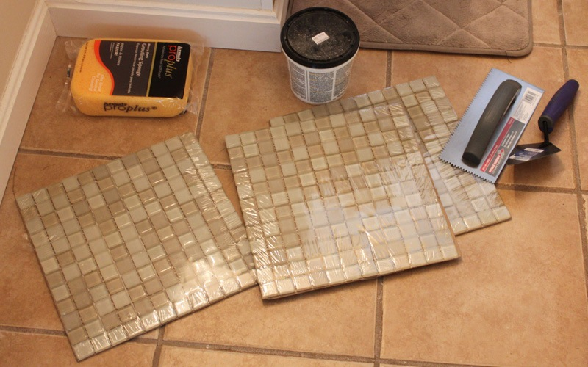
Projectile Motion
What exactly is a projectile?
A projectile is any object which, once projected, continues in motion by its own inertia while under the influence of gravity.

Slide 5
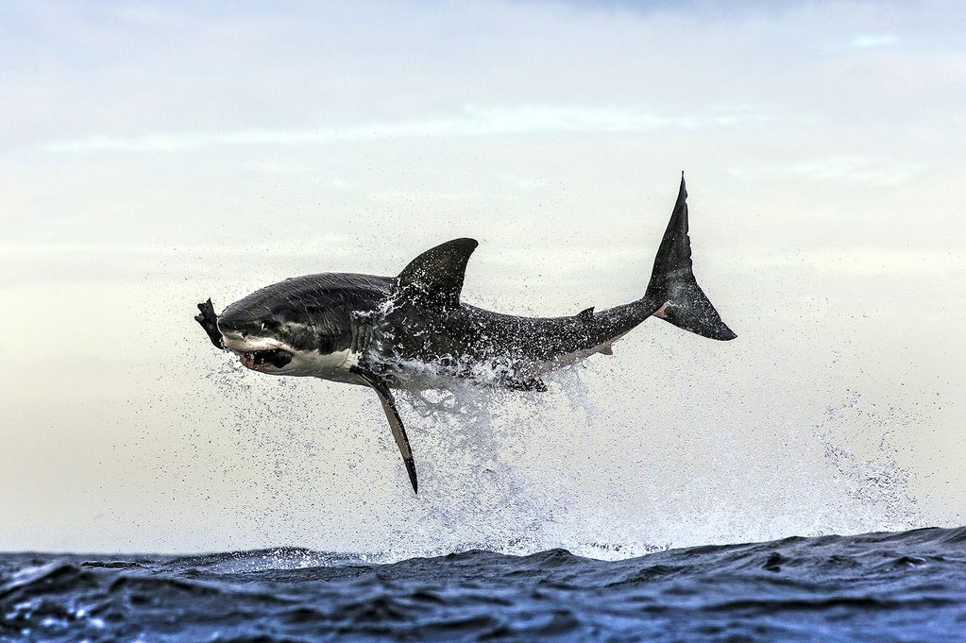

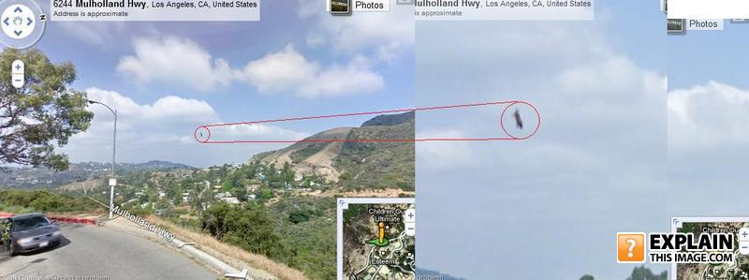
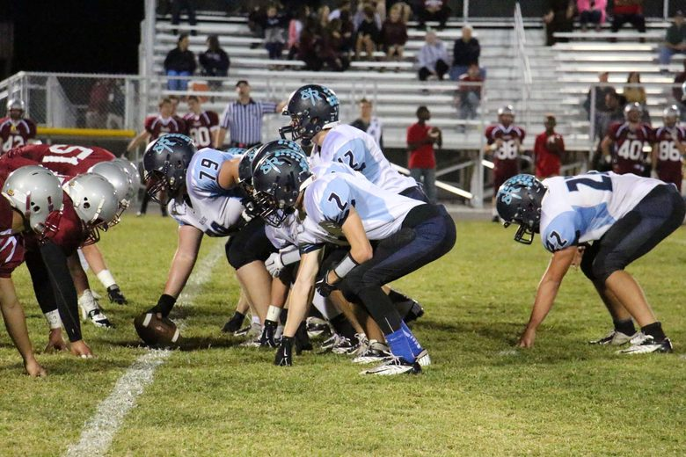




Projectile Motion: eg.
Cristiano Ronaldo Freekicks (vol.5)

Slide 6
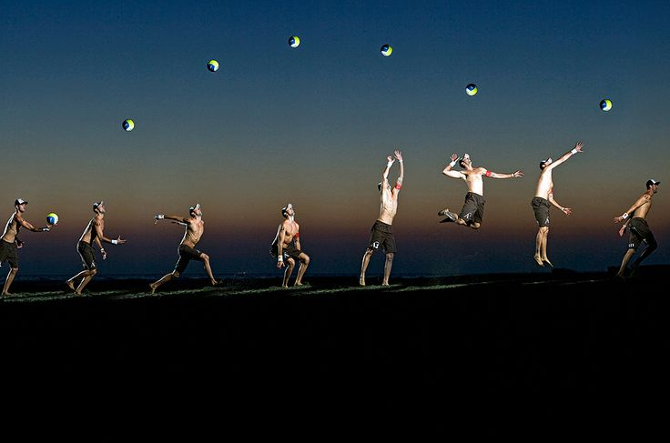

Projectile Motion
"How in the world can object be moving upward if the only force acting upon it is gravity?"
"How would you describe the path of this ball using words like acceleration & gravity?”
remember: a force is not required to keep an object in motion. A force is only required to maintain an acceleration. And in the case of a projectile, that is moving upwards, there is a downwards force and a downwards acceleration; that is, the object is slowing down.

Slide 7
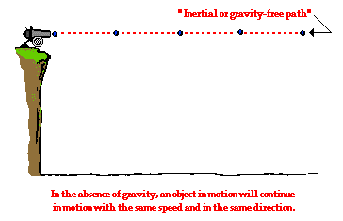
Projectile Motion: with & without g
Draw the ball’s path with 4 one sec. snapshots
Draw the ball’s ideal path
Draw the ball’s path if dropped with g, in 4 one sec. snapshots

Slide 8
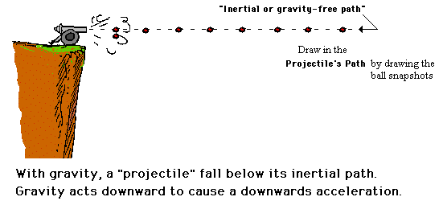
Projectile Motion: with g
Now turn the “gravity-switch” on…
What is the shape of the ball’s trajectory called?

Slide 9
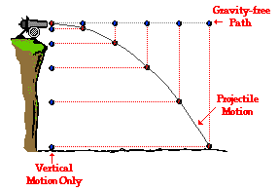
Projectile Motion: with g
Discerning how the parabola is formed…
The vertical motion describes a ball that is ____________; the horizontal motion describes a ball shot without ________________; the projectile motion is the RESULT of the two combined!

Slide 10
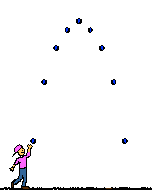
Projectile Motion: components
Which component changes?
Which one stays the same?
Draw in the projectile’s horizontal & vertical components

Slide 11
Projectile Motion: components
Discerning how the parabola is formed…
 | Horizontal Motion | Vertical Motion
Forces (Present? - Yes or No) (If present, what dir'n?) | No | Yes The force of gravity acts downward
Acceleration (Present? - Yes or No) (If present, what dir'n?) | No | Yes "g" is downward at 9.8 m/s/s
Velocity (Constant or Changing?) | Constant | Changing (by 9.8 m/s each second)
The above information can be summarized by the following table:

Slide 12
Projectile Motion: components
Making sense of motion…
Amazing Basketball Experiment!
What TA’s do at Harvard…
Shoot-n-Drop
Care to improve your 3 pointers?
MythBusters Bullet Fired Dropped
Projectile Motion
If the cannon were perfectly level (in the presence of g), which ball, would hit the ground first—and why?

Slide 13
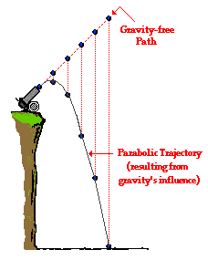
Projectile Motion: with g & angle changes
What happens if you fire upward….downward?…
If the cannon were perfectly level (in the presence of g), which ball, would hit the ground first—and why?

Slide 14

Projectile Motion: applications
Suppose an airplane drops a crate while it is moving with a constant horizontal speed at an elevated height. Assuming that air resistance is negligible, where will the crate land relative to the plane?
A. directly below the plane
B. below the plane and ahead of it
C. below the plane and behind it
WHY?

Slide 15

Projectile Motion: applications
Supposing a snowmobile is equipped with a flare launcher which is capable of launching a sphere vertically (relative to the snowmobile). If the snowmobile is in motion and launches the flare and maintains a constant velocity after the launch, then where will the flare land (neglect air resistance)?
in front of the snowmobile
behind the snowmobile
C. in the snowmobile
WHY?

Slide 16
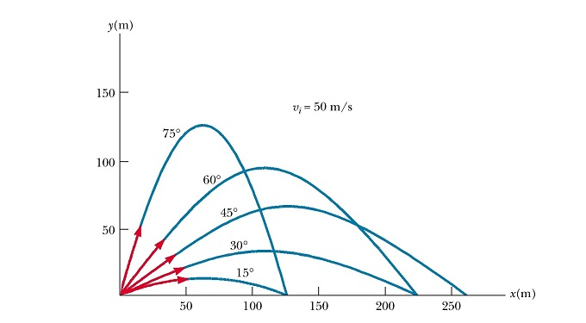
Projectile Motion: altitude & range
45º = max range
90º = max height
Complementary angles = same range
Higher angle = more t for same range
Take a look at the trajectories…
Note observations in your notes to the right:

Slide 17
Projectile Motion: altitude & range
45º = max range
90º = max height
Complementary angles = same range
Higher angle = more t for same range
.
The projectile launched at 45-degree does not win in either category, yet the fact that it is able to place a strong showing in each category contributes to its ability to achieve the greatest range.
More sophisticated arguments for why the 45-degree launch angle yields the greatest range exist; yet since they involve the use of calculus…
The projectile launched at 75º has the greatest v_{y} (vertical v) of all four launch angles; yet its range is limited by the fact that the horizontal v is so small.
The projectile launched at 15-degrees has the greatest v_{x} (horizontal v) of all four launch angles; yet its range is limited by the fact that the hang time is so short.

Slide 18

Projectile Motion: altitude & range applied
What advice about angle and kicking speed would you give to a punter who wants to maximize the distance of a punt? Why?
What advice about angle and speed, would you give a punter that is not trying to maximize distance, but instead wants a long “hang time” to allow his teammates as much time as possible to “get downfield”.
When would these ideas come into play?

Slide 19

Projectile Motion: a cool vid
Projectile Motion & Parabolas - Science of NFL Football
“GO SCIENCE!”

Slide 20
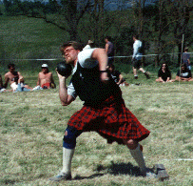
Projectile Motion: altitude & range applied
You are a coach of an experienced shot-putter. You are an educated coach, well aware of the science of ballistics and its application to sports projectiles. You have measured your athlete's projection angles from a video of their competition throws. The projection angles on all the best throws are around 31-33°.
The preceding discussion suggests that the optimum projection angle in is about 45°. Should you increase your athlete's projection angle? Will your athlete throw farther if they project the shot an angle of 45°?
Which element is not being considered in this scenario?

Slide 21




Projectile Motion: velocities
Suppose v_{x} = 40m/s & v_{y}=20m/s; draw in the rest of the components
40 m/s
20 m/s

Slide 22
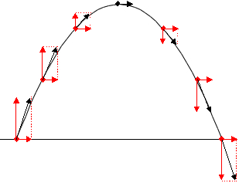
Projectile Motion: velocities
What is the v_{x} at the apex? Why? What is the v_{y} at each position? Why?
40 m/s
20 m/s

Slide 23



Projectile Motion: velocities
Fill in the v_{x} at each position? What is the v_{x} at the apex? What is the a at the apex? Why? How long is he in the air?
40 m/s
Suppose Darth Piggy used the Force to hold redbird’s launch vertical…

Slide 24

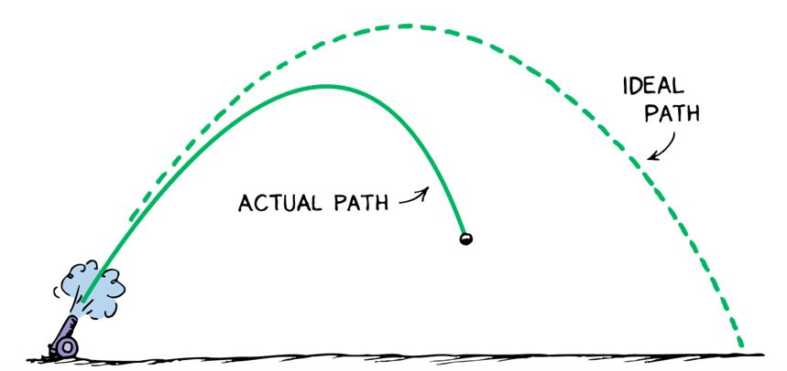
Projectile Motion: air drag
How, then, does an actual path differ from an ideal one?
FYI: a batted baseball travels only 60% as far in air as it would in a vacuum…
https://what-if.xkcd.com/1/

Slide 25
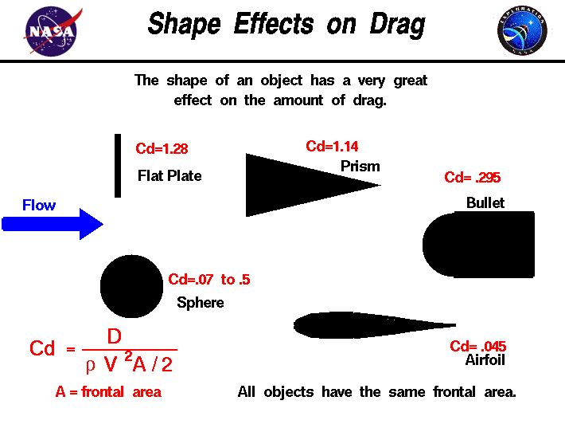

Projectile Motion: air drag
Why is a bullet shaped the way it is?

Slide 26
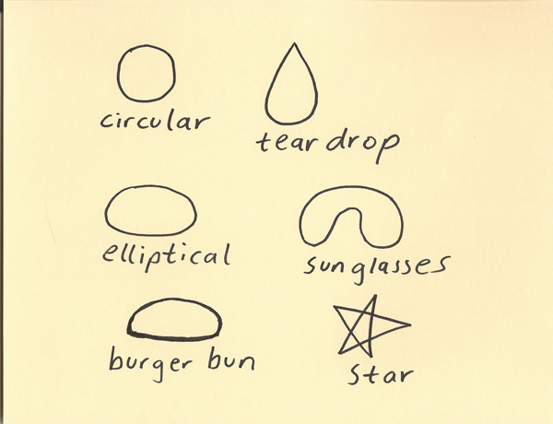
Projectile Motion: air drag
Why is a raindrop shaped the way it is? (What shape are raindrops anyway?!!)
The Shape of Rain Drops

Slide 27

Projectile Motion: air drag
Why is a high performance vehicle shaped the way it is?
2014 Porsche 911 Turbo - Aerodynamics Engineering video

Slide 28
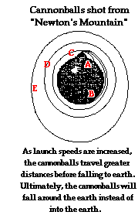

Projectile Motion: satellites
The quote below came from a day when the human launching of a satellite was only dreamed of by a few. It was written by Isaac Newton in 1687. He theorized that celestial bodies in orbit, such as the Moon, are high-speed projectiles, moving fast enough that they never “fall” back to the surface of the body they are orbiting. Some 270 years later, his theory was validated by the launch of the first artificial satellite, Sputnik.
"[T]he greater the velocity with which [a stone] is projected, the farther it goes before it falls to the earth. We may therefore suppose the velocity to be so increased, that it would describe an arc of 1, 2, 5, 10, 100, 1,000 miles before it arrived at earth, till at last, exceeding the limits of the earth, it should pass into space without touching."

Slide 29
Projectile Motion: satellites
There are two elements required for an orbit (falling around an object without falling into it!):
1. v____________: Newton conceived of a hypothetical cannon, able to supply a high initial velocity to an object.
2. g_____________: if there were no such F, the projectile would continue in a straight line out into space, even if fired at only 0.1 m/s.

Slide 30
Projectile Motion: a satellite in the making
If the Earth is curved…what could be theoretically possible?

Slide 31
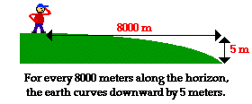
Projectile Motion: a satellite in the making
So what launch speed does a projectile need
in order to orbit the earth (and become a satellite)?
The answer emerges from a basic fact about the curvature of the earth. For every 8000 meters measured along the horizon of the earth, the earth's surface curves downward by approximately 5 meters (that is 16 ft every 5 miles).
~18,000 mph
It so happens that the vertical distance which a horizontally launched projectile would fall in its first second is approximately 5 meters (incidentally calculated how? Calculate it below…)

Slide 32
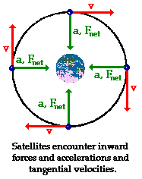
Projectile Motion: a satellite (circular)
Essentially, the tangential velocity and effect of g match the curvature of the Earth…so that the projectile “falls” around it!
For this reason, a projectile launched horizontally with a speed of 8000 m/s will be capable of orbiting the earth in a circular path; this assumes that it is launched above the surface of the earth and encounters negligible atmospheric drag.

Slide 33
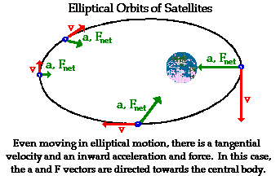
Projectile Motion: a satellite (elliptical)
Essentially, the tangential velocity and effect of g differ to where the Earth’s influence keeps the projectile in orbit, but an “imperfect” one…
…If shot with a speed greater than 8000 m/s, it would orbit the earth in an elliptical path.

Slide 34
Projectile Motion: a satellite (elliptical)
Consider the elliptical orbit… (place the appropriate positional # after each question) After writing it down, explain why as I ask for your answer…
a. When does the satellite move its fastest?
b. It’s slowest?
c. When is the gravitational pull on the satellite at its greatest?
d. It’s least?
4
1
3
2

Slide 35
Projectile Motion: a satellite (elliptical)
Consider the ellipse geometrically?…What is it?
An Ellipse!
Hewitt-Drew-it! PHYSICS 50.Circular/Elliptical Orbit
review

Slide 36
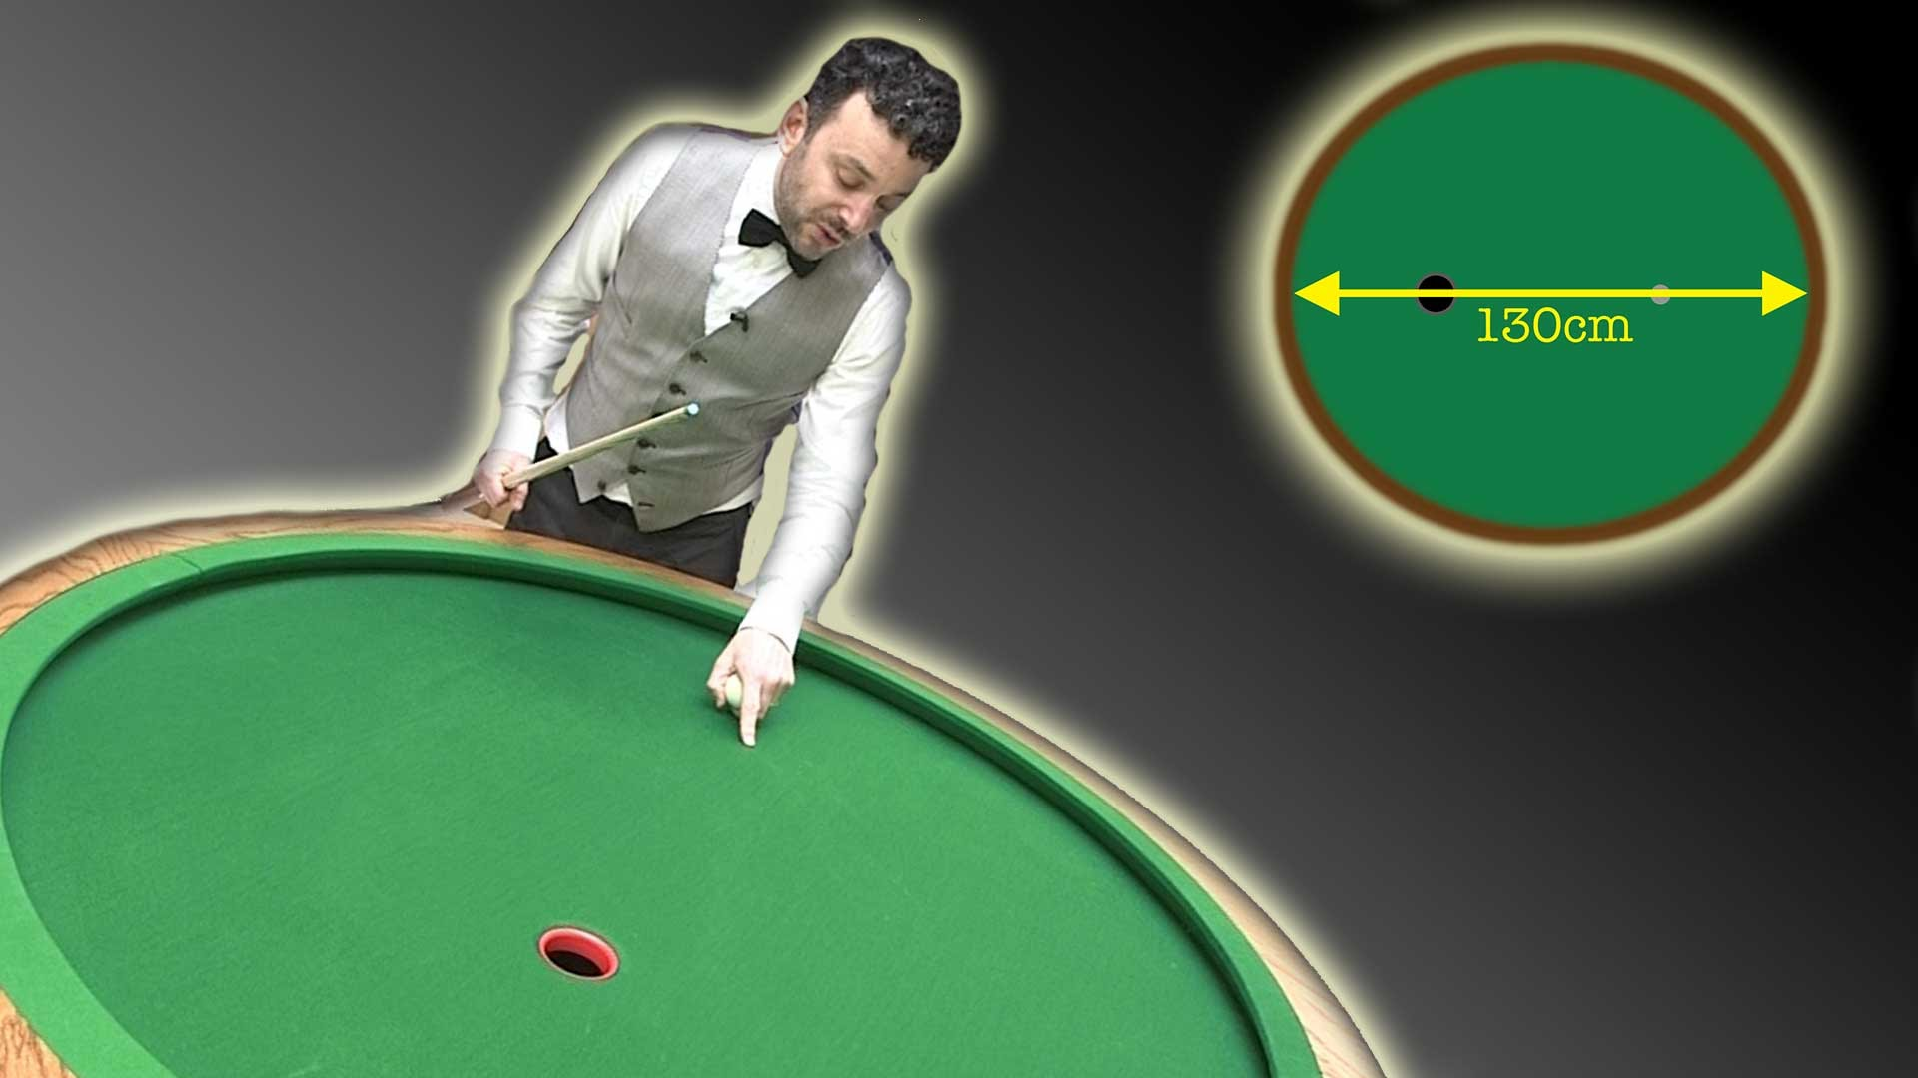
Projectile Motion: a satellite (elliptical)
Elliptical Pool Table - Numberphile

Slide 37

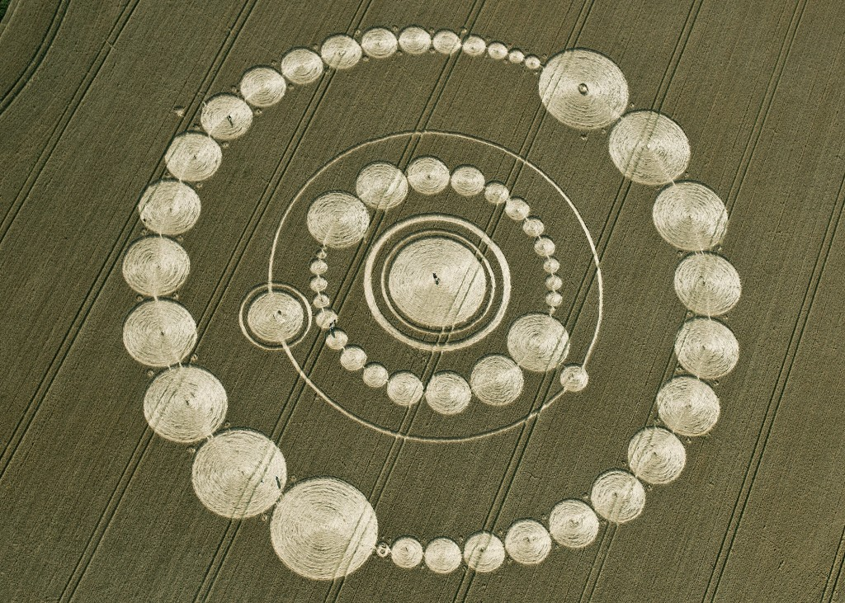
Projectile Motion: a satellite (elliptical)
Nature is filled with circles…why is it that we see far more ellipses than circles?

Slide 38
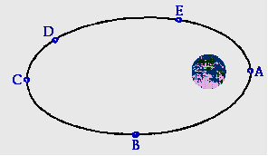
Projectile Motion: a satellite (elliptical)
Consider the elliptical orbit again…answer these questions in your notes…and we will discuss:
Orbit Review: At which point does the satellite have the greatest: (write in the correct letter)
1. speed?
2. v?
3. mass?
4. gravitational attraction to Earth?
5. KE
6. PE
7. total E
8. acceleration?

Slide 39

Projectile Motion: escape speed
Consider the famous dictum…
Is it true?
How might one say this to achieve greater accuracy?

Slide 40
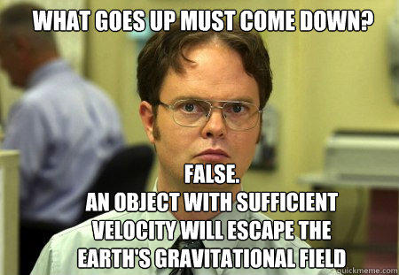
Projectile Motion: escape speed
Well…let Dwight state it simply
If a ball must be shot at 8 km/s in order to become an Earth Satellite, one must be shot at a whopping 11.2 km/s in order to “outrun” gravity and ‘escape’ the Earth…
Use the Universal law of Gravitation to prove this…write how you could in your notes…
Remember: this does not mean that there is no gravitational influence from the Earth---merely that it can be overcome…

Slide 41
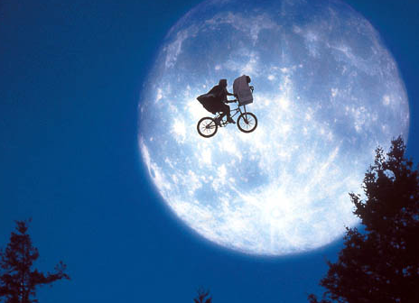
Projectile Motion: escape speed
Let’s review
What happens to the speed of a rocket as it leaves the Earth?
What happens to the F of gravity as the projectile leaves the Earth?
Does the projectile ever literally escape the tug of the Earth’s gravity?
Does it escape the Earth?
Must one travel this fast to get to the moon?
Considering the moon is 250,000 miles away, and a bike traveling at a constant average speed of about 12 mph, it would take approximately 21,000 hours or 875 days or 2.3 years…

Slide 42
Projectile Motion: escape speed
Must one travel this fast to get to the moon?
Why?
One must recognize the difference between ballistic speed and sustained speed
Ballistic speed vs. Sustained speed
brief thrust continuous
11.2 km/s escape v any v > 0
What difference would it make?
The Gravity of the Situation:

