Slide 1
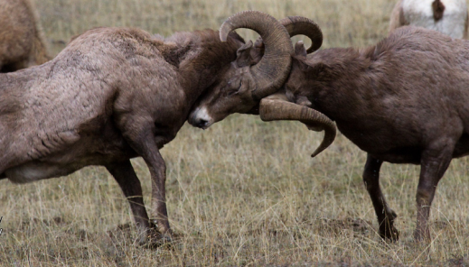
Newton’s 3rd Law of Motion
Physical Science ~ chapter 4 ~ Fall 2010

Slide 2

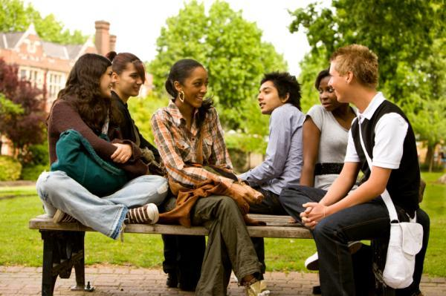
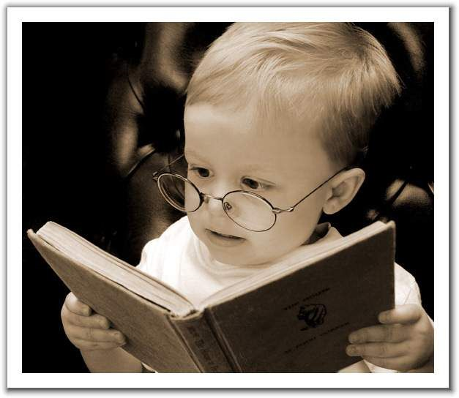
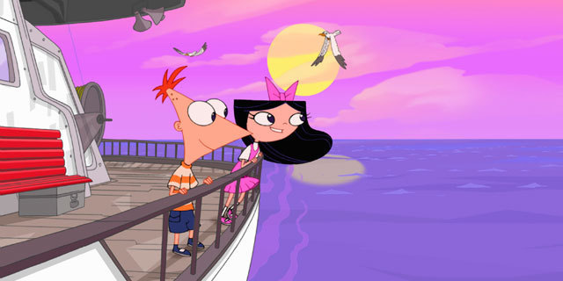
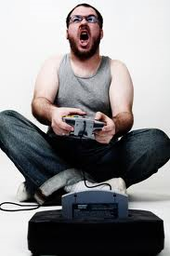
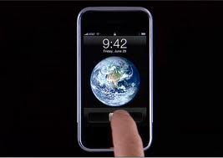
Newton’s 3rd Law of Motion
Interactions are, by definition, not isolated—but are mutual actions
in·ter·ac·tion

Slide 3
Essential Questions:
Interactions produce forces
Newton’s 3rd law
Action/reaction pairs
Nature of act./reax pairs
differing m’s
why not cancel?
Horse-Cart dilemma
What must an interaction possess—by definition? Why?
What are the rules to drawing interactions?
State the law—be sure to include both aspects (equal in what? opposite in what?)
What is the formula for identifying action/reaction pairs?
Which one happens first?
How does the masses of 2 objects affect their a for an equal F?
If they are opposite and equal, why do action/reaction pairs not cancel? Share a real-life example to demonstrate.
If the cart pulls on the horse with an equal & opposite F, how does the cart move when pulled?

Slide 4
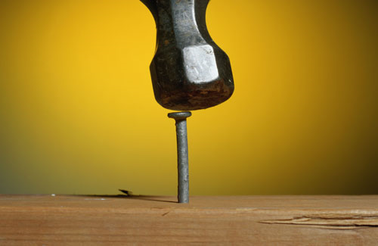
Newton’s 3rd Law of Motion
Interactions produce forces
How to draw Action-Reaction pairs…
Opposite direction (180º)
same magnitude
c) tail to tail
Point? ‘Inter’ implies that it is not an isolated thing…

Slide 5
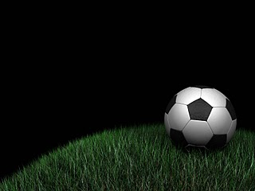
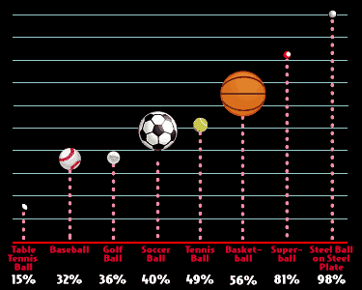
Newton’s 3rd Law of Motion
Interactions produce forces
YouTube - Top 5 Most Embarrassing Moments In Football
Top Soccer Shootout Ever With Scott Sterling (Original)

Slide 6
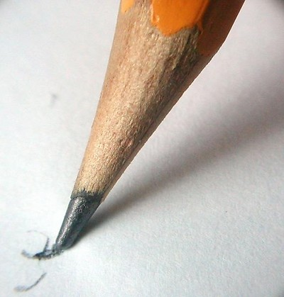
Newton’s 3rd Law of Motion
Interactions produce forces

Slide 7
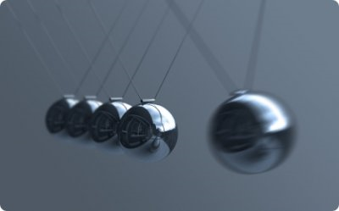
Newton’s 3rd Law of Motion
The Law itself
whenever one object exerts a F on a second object, the second object exerts an equal and opposite F on the first.
Newtons's Cradle for iPhone

Slide 8
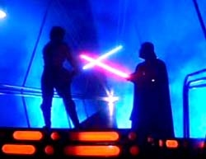
Newton’s 3rd Law of Motion
The Law itself
Who struck first?
Whose lightsaber strikes first?
What do we call it when two actions happen at once?

Slide 9
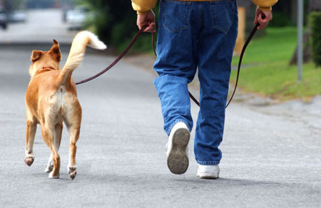
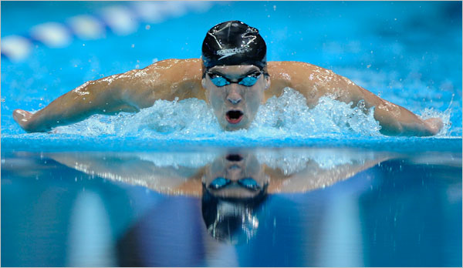
Newton’s 3rd Law of Motion
The Law itself
Action F?
Reaction F?

Slide 10
Newton’s 3rd Law of Motion
The Law itself
What F do both of these (and all other) activities depend on?

Slide 11
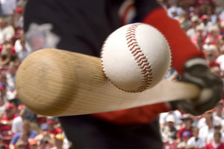
Newton’s 3rd Law of Motion
Identifying Action/Reaction Pairs
Stated?
Object A exerts a F on object B.
Object B exerts a F on object A.

Slide 12
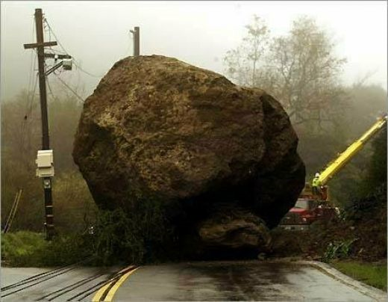
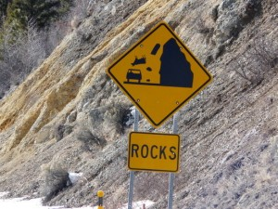
Newton’s 3rd Law of Motion
Identifying Action/Reaction pairs
Stated?
What about as it was falling?

Slide 13
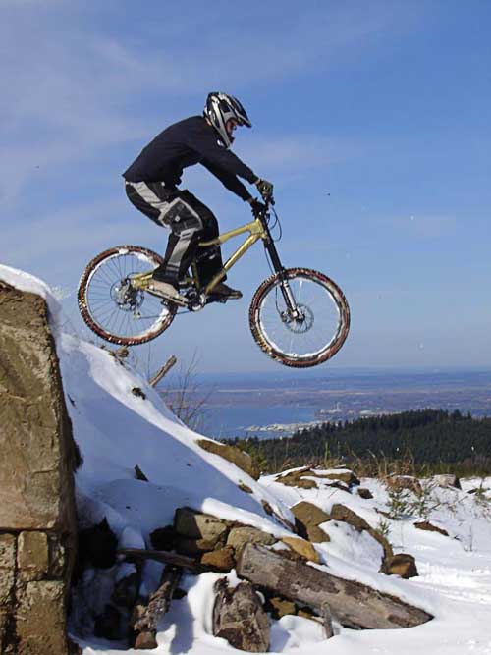
Newton’s 3rd Law of Motion
Action/Reaction with differing masses
State the Action/Reaction pair as the rider is ‘falling’…
Which F is greater? The pull of the rider on the earth or the pull of the earth on the rider?

Slide 14
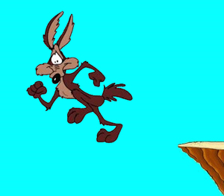
Newton’s 3rd Law of Motion
Action/Reaction with differing masses
Back to the rock…
If this is the case…why then, when falling, does the earth win every time?
F_{action}
F_{action}
The F of the rock pulling up on the earth is ______ and _________to the F of the earth pulling down on the rock.

Slide 15
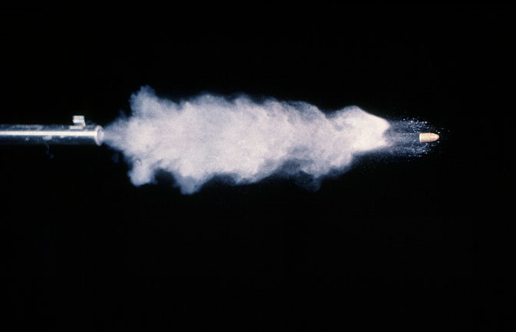
Newton’s 3rd Law of Motion
Identifying Action/Reaction with differing masses
If the Action Reaction Forces are equal, why is it that we can use firearms without injury (from the rifle, that is)?

Slide 16
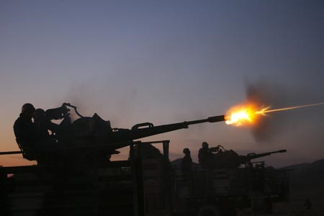
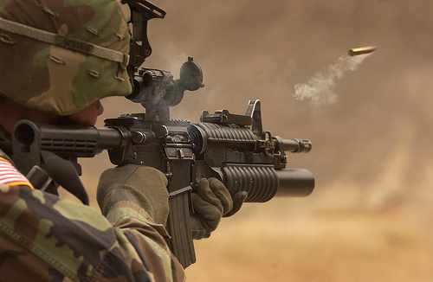
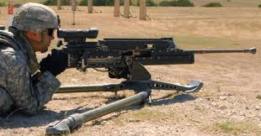
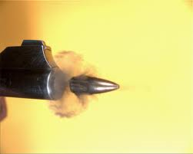
Newton’s 3rd Law of Motion
Action/Reaction with differing masses
Ever wonder why a rifle is larger than a handgun…and an antiaircraft cannon is larger than a 50 cal?

Slide 17
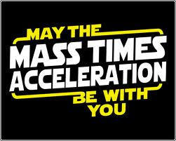

Newton’s 3rd Law of Motion
Action/Reaction with differing masses

Slide 18
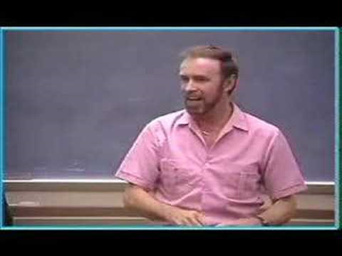
Newton’s 3rd Law of Motion
Action/Reaction with differing masses
If the F is the same on both...then:
Rifle bullet
Mª = = ^{m}A
F
 | conceptual physics action and reaction
What is the reaction F of a rifle-bullet system called?

Slide 19


Newton’s 3rd Law of Motion
Action/Reaction with differing masses
Bullet ballistics through various objects
Time Warp - Sharpshooter
Take note of damage patterns & recoil

Slide 20
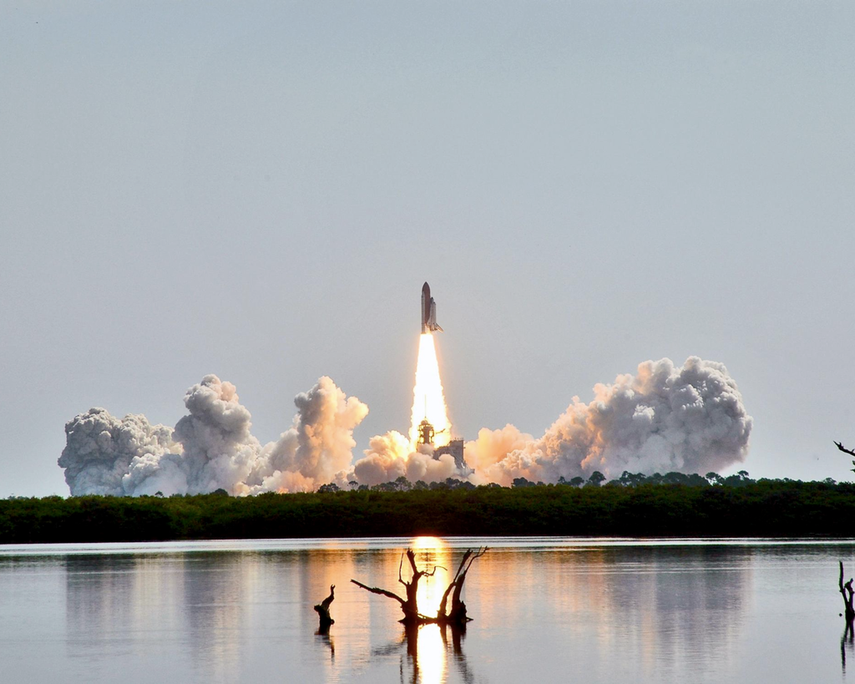
Newton’s 3rd Law of Motion
Action/Reaction pairs inquiry
How is it that rockets launch?
What is the action/reaction pair?

Slide 21
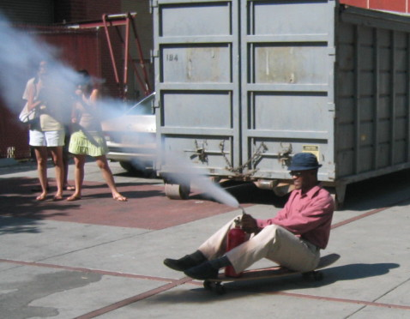
Newton’s 3rd Law of Motion
MIT Physics Demo -- Fire Extinguisher on a Tric...by mittechtv7,552 views

Slide 22

Newton’s 3rd Law of Motion
The nature of Action/Reaction forces
If action/reaction forces are equal in F & opposite in direction…why don’t they cancel?
?

Slide 23
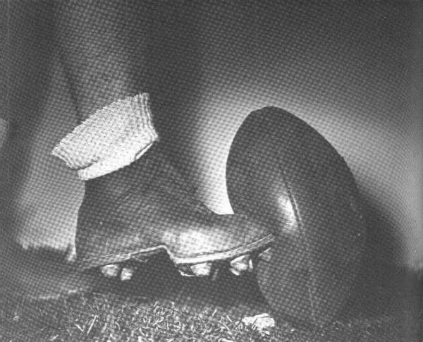
Newton’s 3rd Law of Motion
The nature of Action/Reaction forces
?
Consider a kicker’s job: if the ball provides an equal & opposite F to the kicker…why don’t they cancel
The ball moves, doesn’t it…Why?
How could the ball be kicked so the forces cancel?

Slide 24
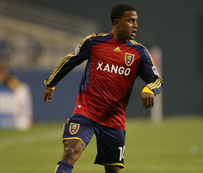
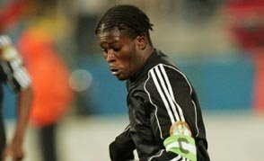
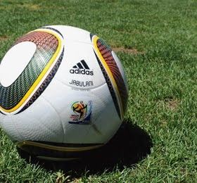
Newton’s 3rd Law of Motion
The nature of Action/Reaction forces

Slide 25
Newton’s 3rd Law of Motion
The nature of Action/Reaction forces
?
Consider a kicker’s job: if the ball provides an equal & opposite F to the kicker…why don’t they cancel
The ball moves, doesn’t it…Why?
The reaction
force acts on your foot, not on the ball.

Slide 26
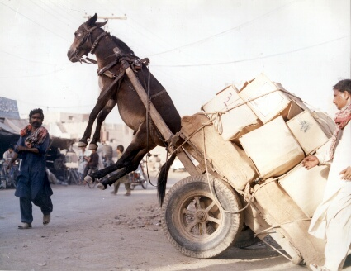
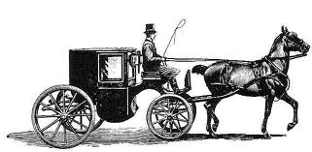
Newton’s 3rd Law of Motion
The nature of Action/Reaction forces
Horse-Cart Dilemma

Slide 27
Newton’s 3rd Law of Motion
The nature of Action/Reaction forces
Horse-Cart Dilemma
Pull of cart on horse
Friction of wheels on ground
Push of ground on horse
Pull of horse on cart
Push of horse on ground
Friction of ground on wheels

Slide 28
Newton’s 3rd Law of Motion
The nature of Action/Reaction forces
Horse-Cart Dilemma
Horse System
Cart System
Pull of cart on horse; P
Friction of wheels on ground; f
Push of ground on horse; F
F_{NET}= P-f
Pull of horse on cart; P
F_{NET}= F-P
How many Forces act in each system?
How would you calculate the F_{NET}?
Push of horse on ground; F
Friction of ground on wheels; f
F_{NET}= F-f
Horse-Cart System

Slide 29
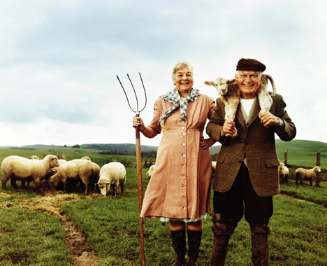
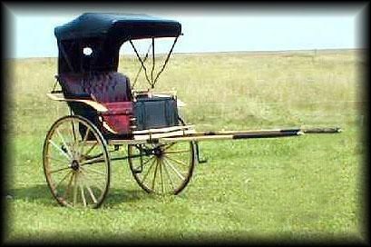

Newton’s 3rd Law of Motion
The nature of Action/Reaction forces
Horse-Cart Dilemma
cart
cart

Slide 30
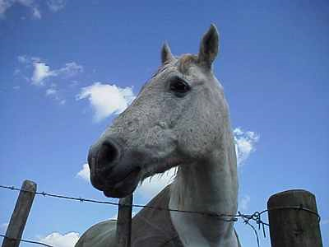
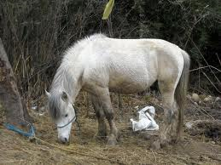
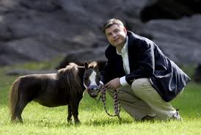
Newton’s 3rd Law of Motion
The nature of Action/Reaction forces
Horse-Cart Dilemma
How does he move forward?
F_{ground} > F_{cart on horse} = a

Slide 31
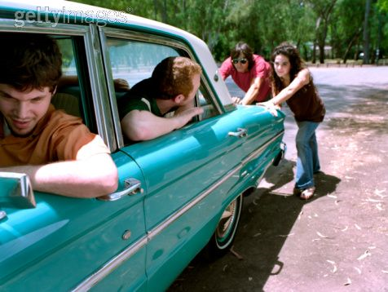
Newton’s 3rd Law of Motion
The nature of Action/Reaction forces
Horse-Cart Dilemma
?
Having trouble seeing how this works?
Consider this: only external Forces will cause acceleration!
F_{feet on ground} > F_{car’s friction} = a

Slide 32
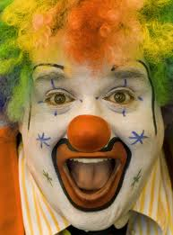
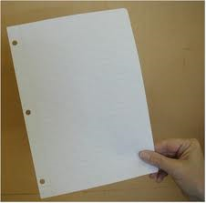
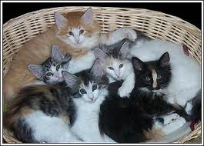
Newton’s 3rd Law of Motion
The nature of Action/Reaction forces
?
How hard can you hit this piece of paper?
Or these… (no not really…I’m not that disturbed)
Or this?

Slide 33
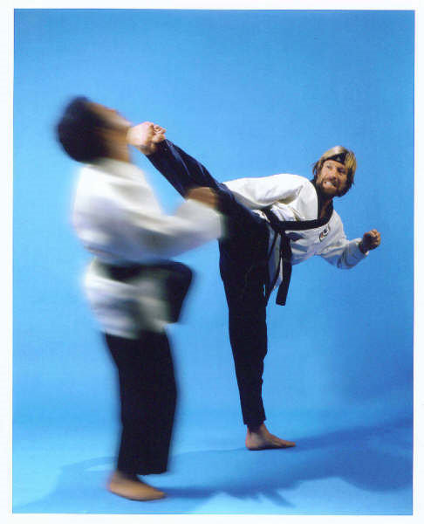

Newton’s 3rd Law of Motion
The nature of Action/Reaction forces
WARNING: only known violation
Chuck Norris can hit objects with a greater force than they can hit back.

Slide 34
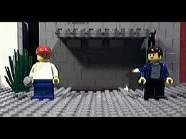
Newton’s Laws of Motion
Review…
The Laws of Sir Isaac Newton

Slide 35
Newton’s 3rd Law of Motion
What is Newton's Third Law about? A. F=MA B. What ever is in motion stays in motion C. Action-Reaction Forces
What happens to the wheels of a car on an icy road? A. The wheels on the car can't grip the road B. The wheels don't move C. The wheels fall off
Which of the following pairs are action-reaction pairs? A. The sun shines and the snow melts B. The ball hits the window and the window breaks C. Doofenshmirtz pushes on the table and the table pushes on Doofenshmirtz. D. swings.

Slide 36
Newton’s 3rd Law of Motion
What do we call the forces that constitute an interaction in Newton's 3rd law? A. Action-Reaction forces B. Force-Interaction forces C. Horse-Cart forces D. Good-Evil Forces
Inanimate objects can exert forces. A. True B. False
What happens when 2 cars with different masses have a head-to-head collision? A. The car with less mass has a greater time of impact. B. They experience the same force of impact. C. The cars just bounce off each other.

Slide 37
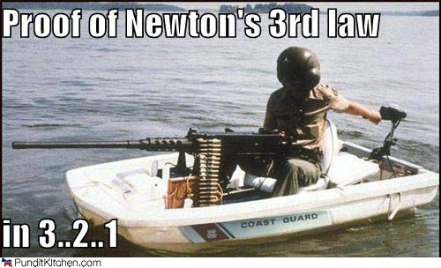
Newton’s 3rd Law of Motion
If two cars with different masses experience the same Force of Impact and the same impulse then what would be different? A. Change of momentum B. Time of impact C. Momentum D. Acceleration
If you push on something, it....? A. pushes back on you. B. doesn't move. C. falls. D. swings.

