Slide 1
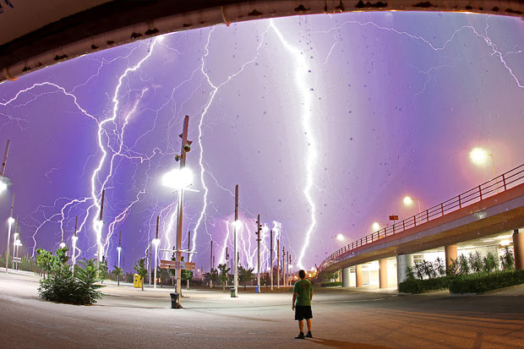
Electricity
Chapter 11
Adapted by mr e from C. Hassen and C.Eckart

Slide 2
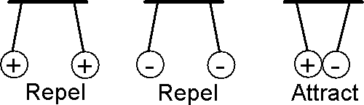
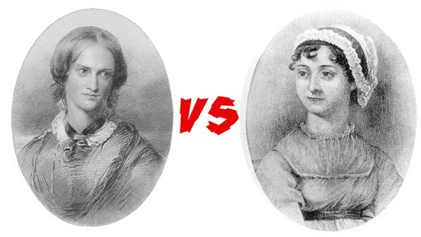

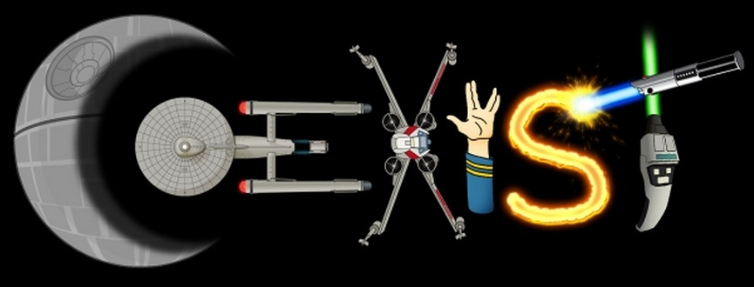

Electric charge is a Basic Characteristic of Matter
Rule 1: Like charges repel another

Slide 3
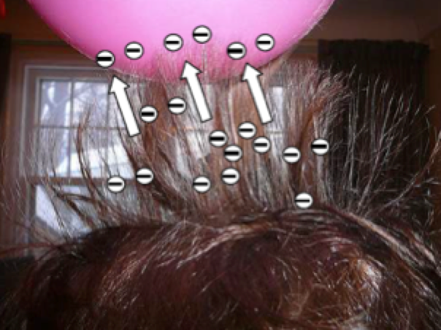

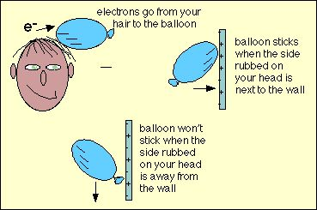
Electric charge is a Basic Characteristic of Matter
Rule 1: Like charges repel another
If you instead rub a balloon with a piece of kitchen plastic wrap, the plastic grabs electrons from the balloon.
The balloon then has an opposite charge to the one rubbed on your hair
What happens when you rub a balloon on your hair?
The rubber balloon has more “grab” on the e- than your hair…and so becomes negatively charged.

Slide 4
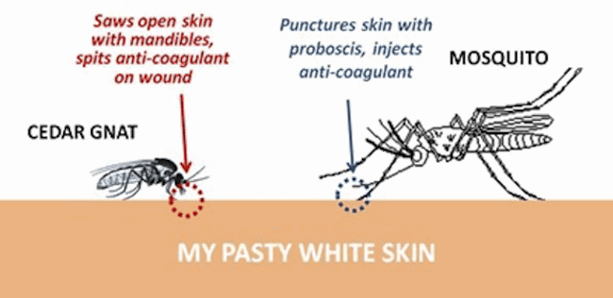
Electric charge is a Basic Characteristic of Matter
To understand electric charge, we look at a preview of atomic parts:
Every atom has a positively charged nucleus surrounded by negatively charged electrons.
The electrons of all atoms are identical Each has the same quantity of negative charge and the same mass.
Protons and neutrons make up the nucleus. Protons are about 1800 times more massive than electrons, but carry an amount of positive charge equal to the negative charge of electrons.
The atomic equivalent of the pain of a mosquito vs. a no see um—about equal despite vast difference in size…

Slide 5
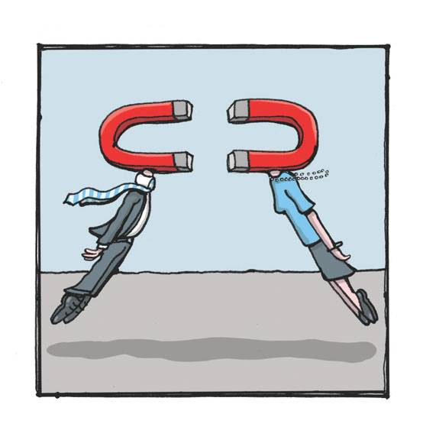


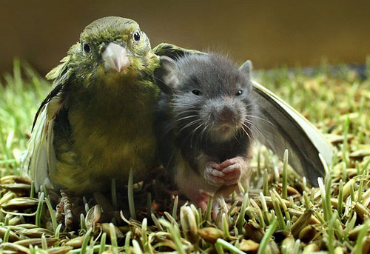
Electric charge is a Basic Characteristic of Matter
When you bring the two oppositely charged balloons together, they attract.
Rule 2: Unlike charges attract one another.

Slide 6
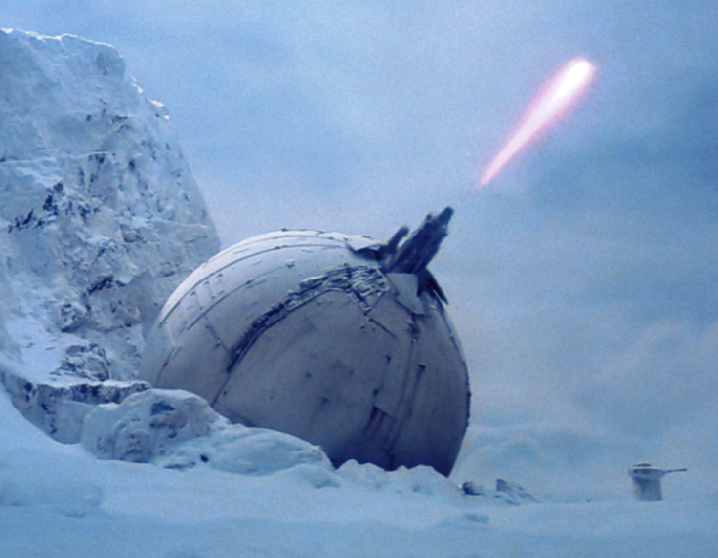
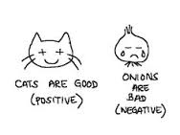
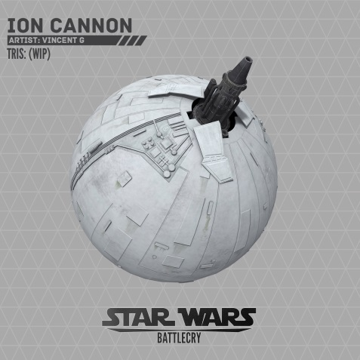
Electric charge is a Basic Characteristic of Matter
An atom in its normal state has the same number of electrons as protons. When an atom loses one or more electrons, it has a positive net charge. When it gains one or more electrons, it has a negative net charge. A charged particle is called an ion. A positive ion (cation) has a net positive charge & is missing e-. A negative ion (anion), with one or more extra e-, has a net negative charge.

Slide 7
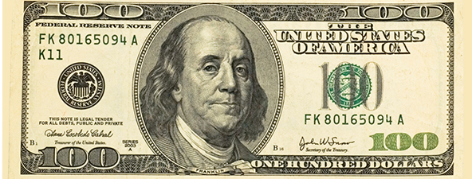
Electric charge is a Basic Characteristic of Matter
It is important to note that when we charge something, no electrons are created or destroyed. They are simply transferred from one material to another.
Charge is conserved. In every event, whether on a large scale or small scale, the principle of conservation of charge has always proved true.
I was an electrical pioneer and first proposed the conservation notion in 1747

Slide 8

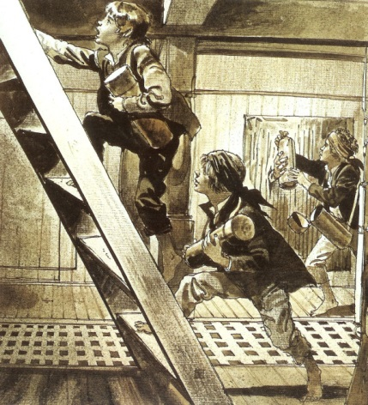
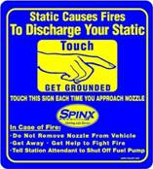
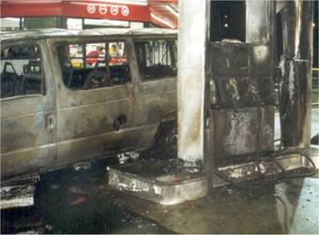
Static Electricity in history
Two contexts seem to warrant some note:
Colonial Ships: boys who came to be called powder monkeys were responsible for carrying powder kegs from the hull to the decks and went barefoot to prevent the sparks that scuffling shoes produced on deck…
Maintain contact with the metal part of the car door while you are getting out of the car.
Rub the seats with a Fabric Softener Sheet.
(Research tested and proved, re-apply approximately every 3/4 weeks).
You could try driving completely naked. Going out in public unclothed is not recommended though, and liable to get you arrested. It's doubtful the police would believe you're trying to prevent static build-up
At the Pump: here some pics and descriptions from a British website dedicated to static precautions.

Slide 9
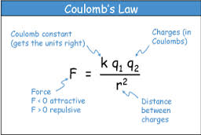
Coulomb’s Law – The force between charged particles
The electrical force has a pattern much like gravitational force.
It depends on the quantity of charge and is inversely proportional to the square of the distance between charged particles
This was discovered by Charles Coulomb in the 18th century and so is called and is called Coulomb’s Law
See any similarities to another formula?…
Which?

Slide 10
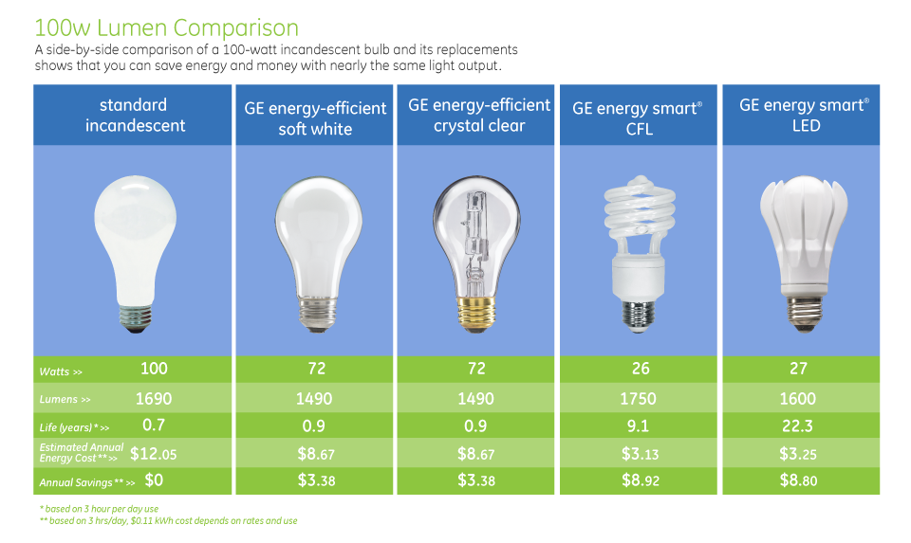
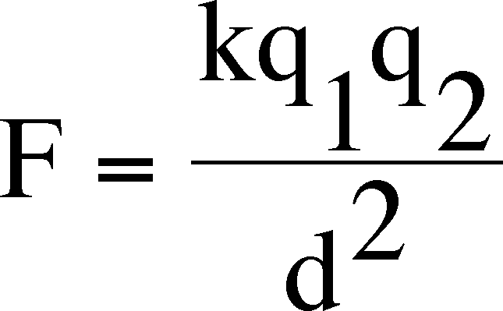
Coulomb’s Law – The force between charged particles
The unit of charge is the coulomb, abbreviated C.
It turns out that a charge of 1C is the charge on 6.25 billion billion electrons.
This might seem like a great number of electrons, but it represents only the amount of charge that passes through a common 100-watt light bulb in little more than a second.

Slide 11
Coulomb’s Law – The force between charged particles
The proportionality constant k in Coulomb’s Law is similar to G in Newton’s law of gravity. Instead of being a very small number like G, k is a very large number:
K = 9,000,000,000 N·m²/C²
In scientific notation, k = 9x10⁹ N·m²/C². The unit N·m²/C² is not important to learn here. It simply converts the right hand side of the equation to the unit of force – the newton.
Why?

Slide 12
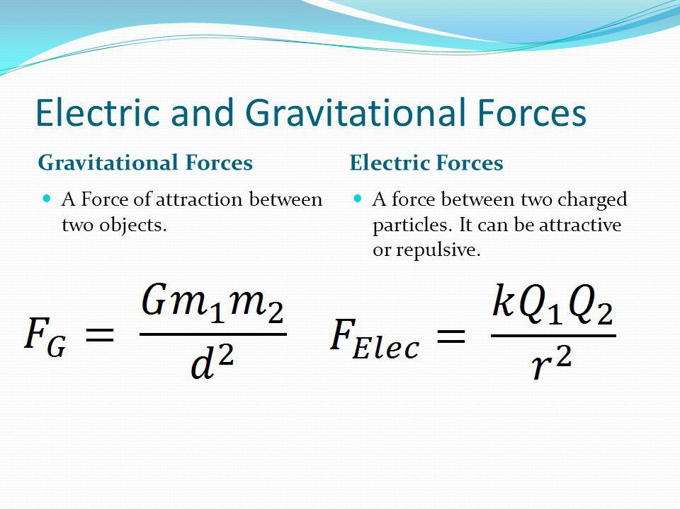
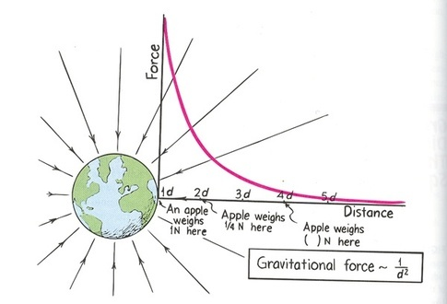
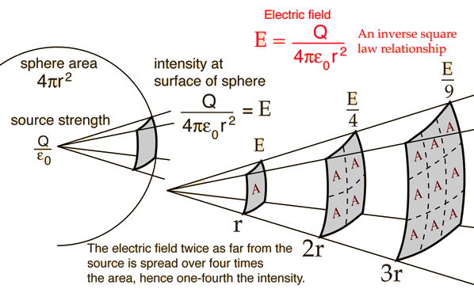
Coulomb’s Law – The force between charged particles

Slide 13
Coulomb’s Law – The force between charged particles
Calculating the Electric Force
1. Two balloons are charged with an identical quantity and type of charge: -6.25 nC. They are held apart at a separation distance of 61.7 cm. Determine the magnitude of the electrical force of repulsion between them.
Given:
Q₁ = -6.25 nC = -6.25 x 10⁻⁹ C
Q₂ = -6.25 nC = -6.25 x 10⁻⁹ C
d = 61.7 cm = 0.617 m
Conversions are required…
Why?
since the units of charge and distance in the Coulomb's constant are Coulombs and meters.

Slide 14
Coulomb’s Law – The force between charged particles
Given:
Q₁ = -6.25 nC = -6.25 x 10⁻⁹ C
Q₂ = -6.25 nC = -6.25 x 10⁻⁹ C
d = 61.7 cm = 0.617 m
F_{elect} = k • Q₁ • Q₂ / d²
F_{elect} = (9.0 x 10⁹ N•m²/C²) • (6.25 x 10⁻⁹ C) • (6.25 x 10⁻⁹ C) / (0.617 m)²
F_{elect} = 9.23 x 10⁻⁷ N

Slide 15
Coulomb’s Law – The force between charged particles
2. Two balloons with charges of +3.37 µC and -8.21 µC attract each other with a force of -0.0626 Newton. Determine the separation distance between the two balloons.
F_{elect} = k • Q₁ • Q₂ / d²
d² • F_{elect} = k • Q₁ • Q₂
d² = k • Q₁ • Q₂ / F_{elect}
d = SQRT(k • Q₁ • Q₂) / F_{elect}
d = SQRT [(9.0 x 10⁹ N•m²/C²) • (-8.21 x 10⁻⁶ C) • (+3.37 x 10⁻⁶ C) / (-0.0626 N)]
d = SQRT [ +3.98 m² ]
d = +1.99 m
Given:
Q₁ = +3.37 µC =
+3.37 x 10⁻⁶ C
Q₂ = -8.21 µC =
-8.21 x 10⁻⁶ C
F_{elect} = -0.0626 N (use a - force value since it is attractive)

Slide 16

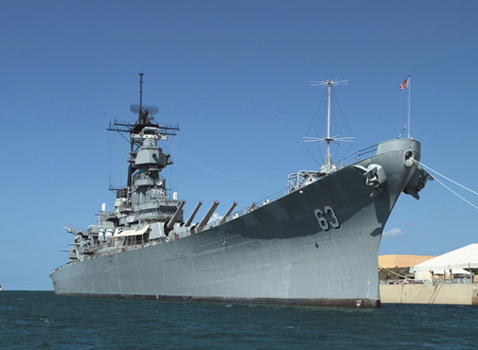
Coulomb’s Law – The force between charged particles
What is important is the large magnitude of k. If, for example, a pair of like-charged particles, each carrying a charge of 1 coulomb, were one meter apart, the force of repulsion between them would be 9 billion newtons. That would be 10x the weight of a battleship.

Slide 17



Coulomb’s Law – The force between charged particles
Such amounts of net charge do not usually exist in our everyday environment. If such charges were common we would see things attracting and repelling quite often.
Like charges repel and leave one another before they can build up. The electrical force between even slightly charged objects greatly overwhelms the gravitational force between them.
What if F_{g} was stronger than F_{electrical}?

Slide 18

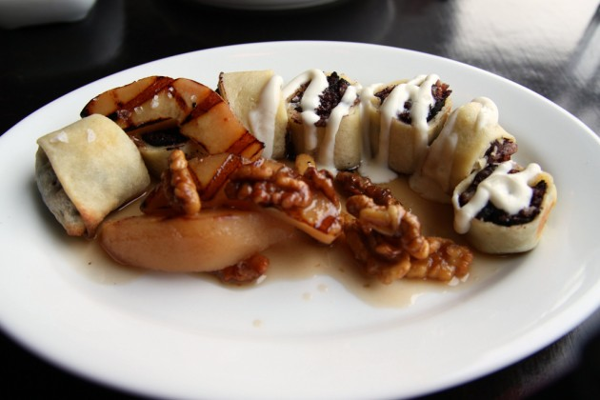
Coulomb’s Law – The force between charged particles
So Newton’s law of gravitation for masses is similar to coulomb’s law for electrically charged bodies.
The most important difference between gravitational and electrical forces is that electrical forces may be either attractive or repulsive, whereas gravitational forces are only attractive. Coulomb’s law underlies the bonding forces between molecules that will be covered in chemistry.
Kind of like crepes…

Slide 19
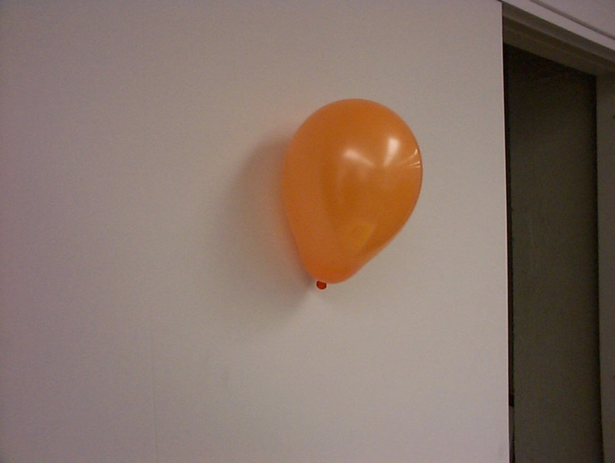
Charge Polarization
We began this chapter by discussing an inflated balloon rubbing on your hair. If you place the balloon against a wall, you will see that it sticks. This is because the negative charge on the balloon pulls the positive part of atoms in the wall closer to it.
The balloon has the effect of inducing an opposite charge in the wall.
Although the atoms of the wall do not move, their centers of charge are moved.

Slide 20

Charge Polarization
Even my self-made childhood friend Ballooney became more negative as I rubbed off on him. I suppose I was destined for evil.

Slide 21
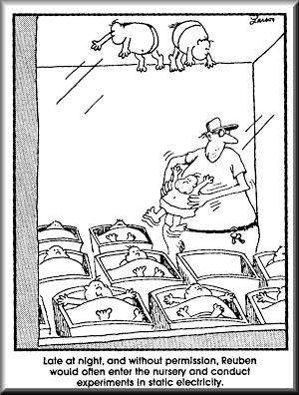
Charge Polarization
The positive part of each atom is attracted toward the balloon, and the negative part is repelled. We say the distorted atoms are electrically polarized.

Slide 22

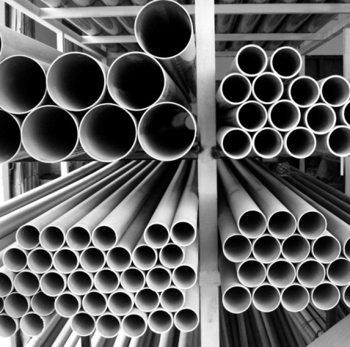
Electric Current – The Flow of Electric Charge
Conduction electrons, however, can freely migrate through a metal. Electrons flow in a way similar to water flow. Just as water current is the flow of H2O molecules, electric current is the flow of electrons.
But there are differences between water flow and electron flow. If you buy a water pipe at a hardware store, the clerk doesn’t sell you the water to go with it.

Slide 23

Electric Current – The Flow of Electric Charge
You provide that yourself. By contrast, when you buy “an electric pipe,” an electric wire, you get the electrons too. Every bit of matter, wires included, contains enormous numbers of electrons that swarm about in random directions.
When they are set in motion in one direction, a net direction, we have an electric current.
Do your wires come with e- ?
If not, I will find you and personally take some back. I wouldn’t suggest taking things from me…hasn’t worked out for others in the past…

Slide 24
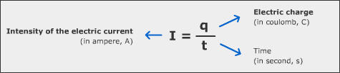
Electric Current – The Flow of Electric Charge
The rate of electrical flow is measured in amperes(A).
An ampere is the rate of flow of one coulomb of charge per second.
In a wire that carries 5 amperes, 5 Coulombs of charge pass any cross section in the wire each second.

Slide 25
Electric Current – The Flow of Electric Charge
1. A 2 mm long cross section of wire is isolated and 20 C of charge is determined to pass through it in 40 s.
I = _____ Ampere
2. A 1 mm long cross section of wire is isolated and 2 C of charge is determined to pass through it in 0.5 s.
I = _____ Ampere
3. The diagram at the right depicts a conducting wire. Two cross-sectional areas are located 50 cm apart. Every 2.0 seconds, 10 C of charge flow through each of these areas. The current in this wire is ____ A.
a. 0.10 b. 0.25 c. 0.50 d. 1.0 e. 5.0

Slide 26
Electric Current – The Flow of Electric Charge
1. A 2 mm long cross section of wire is isolated and 20 C of charge is determined to pass through it in 40 s.
I = 1/2 Ampere
2. A 1 mm long cross section of wire is isolated and 2 C of charge is determined to pass through it in 0.5 s.
I = 4 Amperes
3. The diagram at the right depicts a conducting wire. Two cross-sectional areas are located 50 cm apart. Every 2.0 seconds, 10 C of charge flow through each of these areas. The current in this wire is ____ A.
a. 0.10 b. 0.25 c. 0.50 d. 1.0 e. 5.0

Slide 27
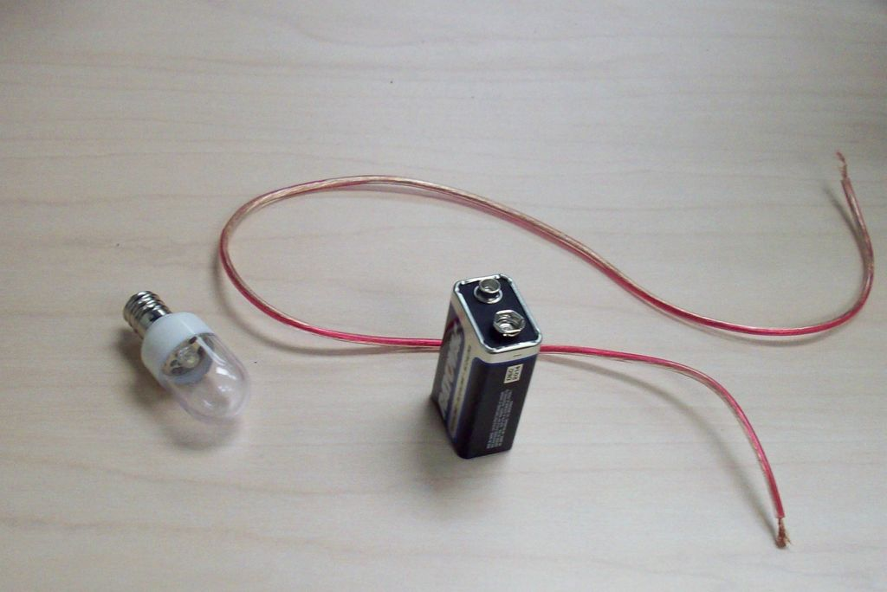
Electric Current – The Electric Circuit
Suppose that you were given a small light bulb, an electrochemical cell and a bare copper wire and were asked to find the four different arrangements of the three items that would result in the formation of an electric circuit that would light the bulb.
What four arrangements would result in the successful lighting of the bulb? And more importantly, what does each of the four arrangements have in common that would lead us into an understanding of the two requirements of an electric circuit?

Slide 28
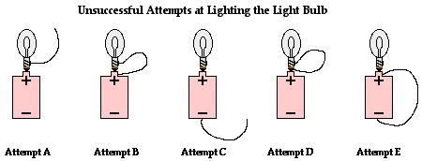
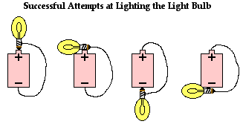
Electric Current – The Electric Circuit
Batteries: A Big Idea That Turned on the World
Suppose that you were given a small light bulb, an electrochemical cell and a bare copper wire and were asked to find the four different arrangements of the three items that would result in the formation of an electric circuit that would light the bulb.
What four arrangements would result in the successful lighting of the bulb? And more importantly, what does each of the four arrangements have in common that would lead us into an understanding of the two requirements of an electric circuit?

Slide 29
Electric Current – The Electric Circuit
Common Misconceptions Regarding Electric Circuits
What Do You Believe? True or False?
To begin the exploration of these misconceptions, take a moment to respond the following five true-false statements.
  a. When an electrochemical cell no longer works, it is out of charge and must be recharged before it can be used again.
b. An electrochemical cell can be a source of charge in a circuit. The charge that flows through the circuit originates in the cell.
c. Charge becomes used up as it flows through a circuit. The amount of charge that exits a light bulb is less than the amount that enters the light bulb.
d. Charge flows through circuits at very high speeds. This explains why the light bulb turns on immediately after the wall switch is flipped.
e. The local electrical utility company supplies millions and millions of electrons to our homes everyday.

Slide 30
Electric Current – The Electric Circuit
Common Misconceptions Regarding Electric Circuits
What Do You Believe? True or False?
To begin the exploration of these misconceptions, take a moment to respond the following five true-false statements.
  a. When an electrochemical cell no longer works, it is out of charge and must be recharged before it can be used again. F
b. An electrochemical cell can be a source of charge in a circuit. The charge that flows through the circuit originates in the cell. F
c. Charge becomes used up as it flows through a circuit. The amount of charge that exits a light bulb is less than the amount that enters the light bulb. F
d. Charge flows through circuits at very high speeds. This explains why the light bulb turns on immediately after the wall switch is flipped. F
e. The local electrical utility company supplies millions and millions of electrons to our homes everyday. F

Slide 31
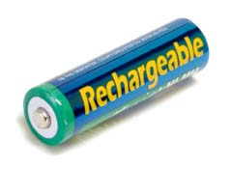
Electric Current – The Electric Circuit
Common Misconceptions Regarding Electric Circuits
False Premise: Batteries are Rechargeable.
  When an electrochemical cell no longer works, it is out of ENERGY (not charge) and must be re-ENERGIZED before it can be used again.
An electrochemical cell supplies the energy needed to move a charge from a low potential location to a high potential location.
The charge that flows through a circuit originates in the wires of the circuit. The charge carriers in wires are simply the electrons possessed by the atoms that make up the wires.
Charge moves abnormally slowly - on average, about 1 meter in an hour - through a circuit. Yet as soon as a switched is turned to ON, charge located everywhere within the circuit begins to move.
The rate at which charge flows is everywhere the same within an electric circuit. The rate at which charge flows into a light bulb is the same as the rate at which charge flows out of a light bulb.
.An electrical appliance such as a light bulb transforms the electrical energy of moving charge into other forms of energy such as light energy and thermal energy. Thus, the amount of electrical energy possessed by a charge as it exits an appliance is less than it possessed when it entered the appliance.

Slide 32
An Electric Current is Produced by Electrical Pressure – voltage.
When water flows in a pipe, there is more pressure on one end than the other. There must be a pressure difference to keep the water flowing.
Also recall from our study of heat in Chapter 10 that heat conduction depends on a temperature difference. Heat flows from zones of high temperature to low temperature. Similarly for electric current.
Electrons flow in a wire only when a difference in electric pressure exists. The name for electrical pressure is voltage.

Slide 33
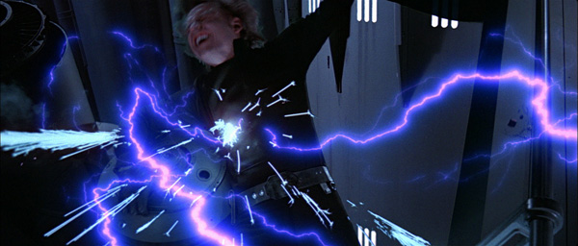
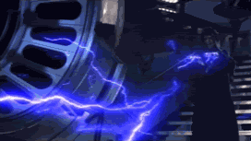
An Electric Current is Produced by Electrical Pressure – voltage.
Electrons flow in a wire only when a difference in electric pressure exists. The name for electrical pressure is voltage.
https://www.youtube.com/watch?v=RLWIBrweSU8
Is it possible that the Sith simply understand e- P differentials (ie. Voltage) and so use e- to create them during their darker moments?

Slide 34

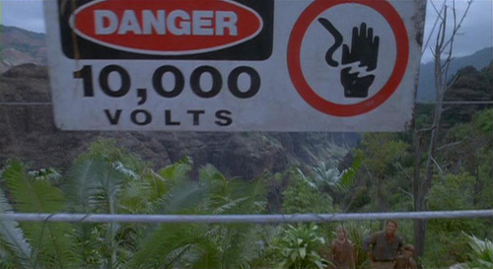

An Electric Current is Produced by Electrical Pressure – voltage.
Reference?

Slide 35
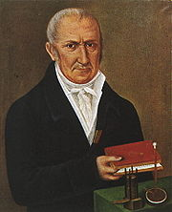
An Electric Current is Produced by Electrical Pressure – voltage.
So what, more specifically, is voltage?
Voltage is directly proportional to electric potential energy. Recall the concept of potential energy discussed in chapter 6. Things have energy due to their position. Likewise with electrons and other charged particles.
Pushing a charged particle toward another charge can increase its electrical potential energy. This potential energy compared with the quantity of charge is what we mean by voltage. While the equation below refers to voltage proper, the formula involving a future concept of resistance is actually easier/more commonly calculated. Hold tight.
Alexander Volta was an eighteenth-century scientist who developed the voltaic pile. This was later developed into a battery. The measure of strength of current [voltage] is named after him
Voltage = potential energy
charge

Slide 36
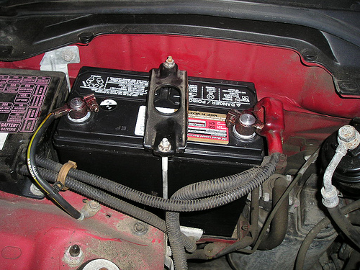
An Electric Current is Produced by Electrical Pressure – voltage.
Current flows in a wire when there is a difference in voltage across the ends of a wire. A steady current needs a pumping device to provide a difference in voltage.
Chemical batteries or generators are “electrical pumps” that do the job nicely.
A common automobile battery provides a voltage of 12 volts. When each of its terminals are attached to ends of a wire, there is a voltage difference of 12 volts across the wire. That means 12 joules of energy are supplied to each coulomb of charge flowing in the wire. The wire is usually part of an electrical circuit.
As current flows through the external circuit (the wire loop outside the battery), V is lost with length & esp. if there are components to drain energy.

Slide 37

An Electric Current is Produced by Electrical Pressure – voltage.
There is often some confusion about charge flowing through a circuit and the voltage across a circuit.
We can see the difference by thinking of a long pipe filled with water. Water flows through the pipe if there is a difference of pressure across or between its ends; it flows from the high pressure to the low pressure end. Only the water flows, not the pressure. Similarly, electrons flow because of a difference in electrical pressure.

Slide 38
An Electric Current is Produced by Electrical Pressure – voltage.
Electrons flow through a circuit because of an applied voltage across the circuit. Voltage does not flow through a circuit – it does not go anywhere, for it is the electrons that flow. Voltage produces current (if there is a complete circuit).

Slide 39
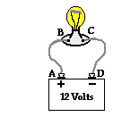
An Electric Current is Produced by Electrical Pressure – voltage.
Concept Practice
The diagram below at the right shows a light bulb connected by wires to the + and - terminals of a car battery. Use the diagram in answering the next four questions.
6. Compared to point D, point A is _____ electric potential.
a. 12 V higher in
b. 12 V lower in
c. exactly the same
d. ... impossible to tell

Slide 40
An Electric Current is Produced by Electrical Pressure – voltage.
Concept Practice
The diagram below at the right shows a light bulb connected by wires to the + and - terminals of a car battery. Use the diagram in answering the next four questions.
6. Compared to point D, point A is _____ electric potential.
a. 12 V higher in
b. 12 V lower in
c. exactly the same
d. ... impossible to tell
The positive terminal of a battery is higher in electric potential than the negative terminal by an amount which is equal to the battery voltage.

Slide 41
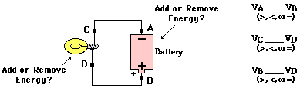
An Electric Current is Produced by Electrical Pressure – voltage.
Fill in the blanks to the right; consider the length from B to D minimal:

Slide 42
An Electric Current is Produced by Electrical Pressure – voltage.
Fill in the blanks to the right; consider the length from B to D minimal:
<
<
=
The electrochemical cell adds energy to the charge to move e- (charge carriers) from the low potential, negative terminal to the high potential, positive terminal. The current, however, moves in the opposite direction (blue arrows). The light bulb removes energy from the charge. Thus, the charge is at lower energy and a lower electric potential when at locations C and A. Since there is no energy-consuming circuit element between locations B and D, these two locations have roughly the same electric potential. The same can be said of locations C and A.

Slide 43
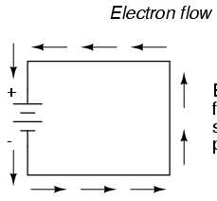
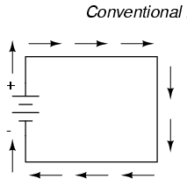
In which direction does electricity flow? +→- or -→+?
It depends on what you define as “electricity”. Do you mean the flow of “electrons” or the flow of “current”? Because, due to an unfortunate quirk of history, the direction of *current* flow is opposite to the direction of *electron* flow. Take a moment and re-read that, because it’s not what you would expect. If electrons are flowing to the right across this screen, then we say that current is flowing to the left.
So, let’s say that the left hand side of this screen is the positive terminal and the right hand side is the negative terminal
+ –
*Electrons* will flow towards the opposite charge, as you say. That’s which direction? Right to left
<—- electrons
But *current* is the opposite direction. Left to right.
—-> current

Slide 44
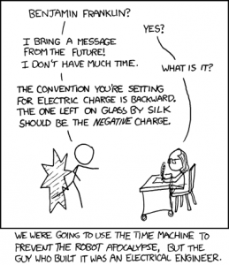
An Electric Current is Produced by Electrical Pressure – voltage.
So *current* does flow from positive to negative, like the drawings show. And electrons do get pulled towards the positive charge, like we said. But we define conventional electric current to be the opposite direction of electron flow.
Why conventional?
<
<
=
History. Benjamin Franklin, while investigating static charge, had to guess what moved where. With too little information (ie. Electrons had not yet been discovered), he guessed wrong. His (very ) important contribution that electricity had polarity was a terrific insight.

Slide 45
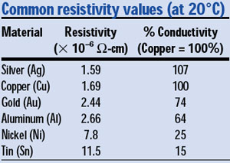
Electrical Resistance
Most important is the kind of material.
Copper has low electrical resistance,
while a strip of rubber has enormous
resistance.
Why?
Relative # of free e-!
Temperature also affects electrical resistance. The greater the jostling of atoms within a conductor (in other words, the higher the temperature), the greater resistance a conductor has. The resistance of some materials reaches zero at very low temperatures. These are superconductors.

Slide 46
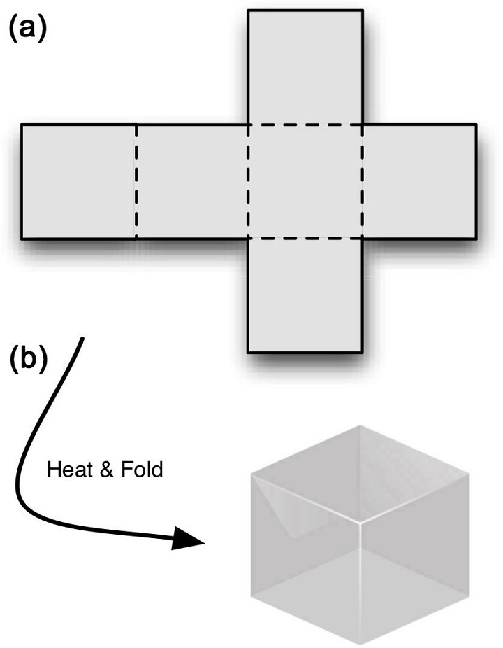
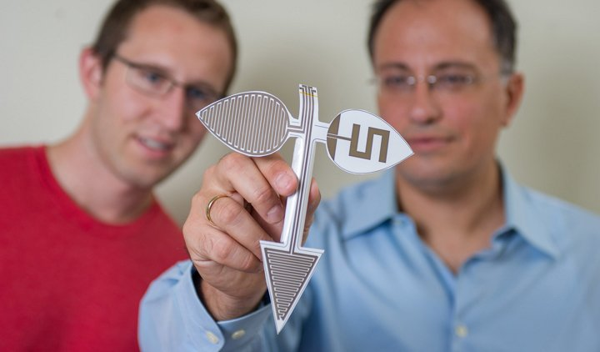
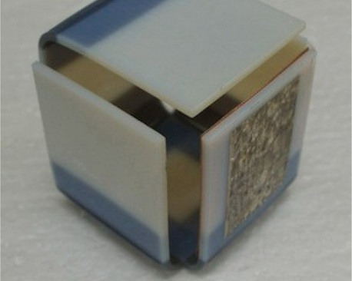
Electrical Resistance
Japanese origami is providing inspiration for a range of bleeding edge 3D printing and design research projects.
The ancient art of paper folding can be traced to the work of Akira Yoshizawa, the artist who created a notation to indicate how to fold origami models. It was called the Yoshizawa-Randlett system, and even now it serves as the basis for origami societies in the UK, the US, and Spain.
Now John Kimionis and Manos Tentzeris of the School of Electrical and Computer Engineering at the Georgia Institute of Technology have created a novel technique that uses origami-esque folding techniques to build 3D printed electronic structures which can be built cheaply and result in complex radio frequency devices and packaging applications.

Slide 47
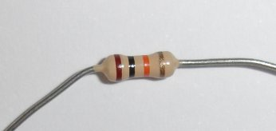
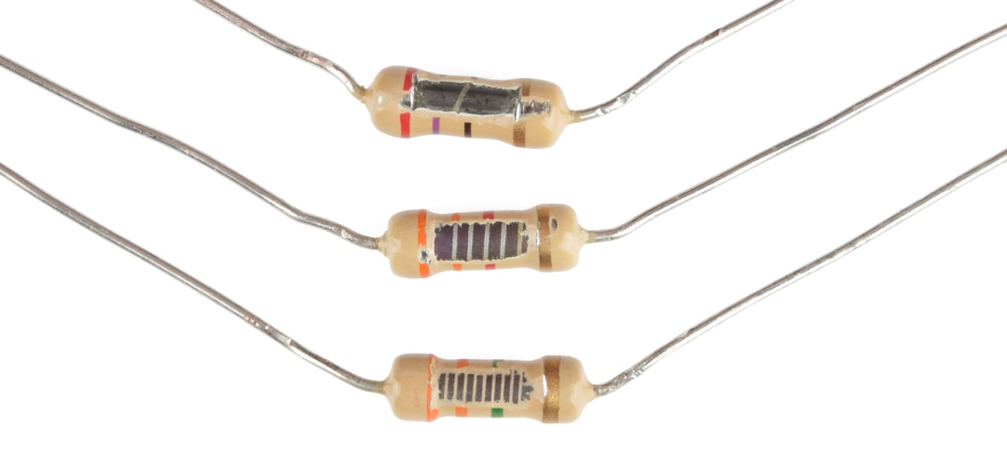
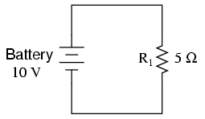
Electrical Resistance
A battery or generator of some kind moves electrons in a circuit. How much current there is depends on the voltage, and also on the electrical resistance on the circuit.
Just as narrow pipes resist water flow more that wide pipes, narrow wires resist electrical current more than wider wires. Length also contributes to resistance. Long wires offer more electrical resistance.

Slide 48
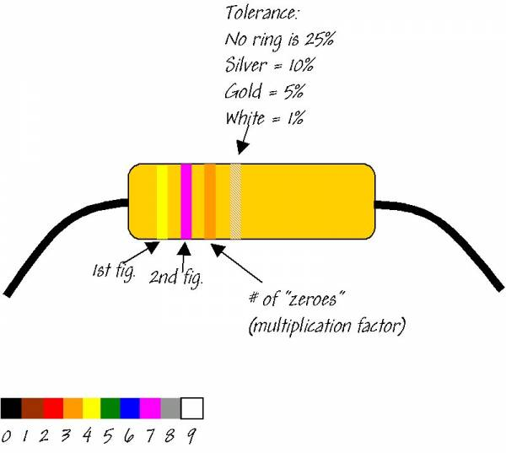
Electrical Resistance
The resistance in this example is:
Yellow = 4
Purple = 7
Orange = 3 "zeros" =000
This makes 47,000 Ohms or 47kOhm

Slide 49

Electrical Resistance
Electrical resistance is measured in units called ohms. The Greek letter Ω is commonly used as the symbol for the ohm.
This unit is named after Georg Simon Ohm, a German physicist, who in 1826 discovered a simple and very important relationship among voltage, current, and resistance.
Ohms = Ω

Slide 50
Ohm’s Law
The relationship between voltage, current, and resistance is Ohm’s law.
Ohm discovered that the amount of current in a circuit is directly proportional to the voltage across the circuit, and inversely proportional to the resistance of the circuit.
Current = voltage/resistance
OR
Amperes = volts/ohms

Slide 51
Ohm’s Law
Ohm’s law tells us that one volt across a circuit with a resistance of 1 ohm produces a current of one ampere.
If there are 12 volts across the same circuit, the current is 12 amperes. For a given circuit of constant resistance, current and voltage are proportional to each other. This means we get twice the current for twice the voltage. The greater the voltage, the greater the current.
Eg. A power saw at the local hardware store boasts of having a 15-Amp motor. Determine its resistance when plugged into a 110-Volt outlet.
Use Ohm’s law: V = I x resistance

Slide 52
Ohm’s Law
Eg. A power saw at the local hardware store boasts of having a 15-Amp motor. Determine its resistance when plugged into a 110-Volt outlet…
Use Ohm’s law: V = I x resistance
110 v = 15 A x resistance
110 v / 15 A = resistance
7.3 Ohms = resistance
v/A = J/C / C/s = JXs/C²
v/A = Ohms (but take the formula for it…)

Slide 53
Ohm’s Law
But if the resistance is doubled for a circuit, the current is reduced to half. The higher the resistance, the lower the current. Ohm’s law makes good sense. The resistance of a typical lamp cord is much less than 1 ohm, and a typical light bulb has a resistance of more than 100 ohms. A toaster has a resistance of 15 to 20 ohms. The current inside these electrical devices is regulated by circuit elements called resistors, whose resistance may be a few ohms or millions of ohms.

Slide 54

What Affects Resistance?

Slide 55


Electric shock
Concept Practice
Resistance = ? ohms
Voltage = 120V
Current = 12A
Formula?
I = V/R
12 A = 120V/ R
12A/R = 120V
R= 120V/12A
R =10 ohms
How much current flows through a lamp with a resistance of 60 ohms when the voltage across the lamp is 12V?
Resistance = 60 ohms
Voltage = 12V
Current = ? A
Formula?
I = V/R
A = 12V/60 ohms
0.2A = 12V/60 ohms
What is the resistance of an electric frying pan that draws a current of 12 A when connected to a 120V circuit?

Slide 56

Electric Shock
Electric Eel >
Which causes electric shock in the human body—current or voltage? The damaging effects of shock result from current through the body. From Ohm’s law, we see current depends on the voltage applied and also on the body’s electrical resistance.
A person’s resistance ranges from about 100 ohms if the body is soaked with salt water to about 500,000 ohms if the skin is very dry.

Slide 57

Electric Shock
Electric Eel >
If you touch the two electrodes of a battery with dry fingers, you make up a circuit with resistance of about 100,000 ohms. You usually cannot feel 12 volts. Even 24 volts just barely tingles.
If your skin is moist, 24 volts can be quite uncomfortable.

Slide 58

Electric Shock
Electric Eel >
To receive a shock, there must be a difference in voltage between one part of your body and another part. Electron flow will pass along the path of least electrical resistance connecting these two points.
The Shocking Truth About Electric Animals!
Do electric eels feel a shock? - Zoo La La (Ep 20) - Earth

Slide 59


Electric shock
Concept Practice
At 100,000 ohms of resistance, how much current will flow through your body if you touch the terminals of a 12V battery? What will it feel like?
Resistance = 100,000 ohms
Voltage = 12V
Current = ? A
Formula?
I = V/R
A = 12V/100,000 ohms
0.00012A = 12V/100,000 ohms
Battery Concerns

Slide 60
Electric shock
Concept Practice
Moisten those very same fingers—now you have 1000 ohms of resistance, how much current will flow through your body if you touch the terminals of a 12V battery? What will it feel like?
Resistance = 1,000 ohms
Voltage = 12V
Current = ? A
Formula?
I = V/R
A = 12V/1000 ohms
0.012A = 12V/1000 ohms

Slide 61


Electric Shock
Suppose you fell from a bridge, and grabbed onto a high voltage power line, stopping your fall. If you touch nothing else of different voltage, you receive no shock. Even if the wire is a few thousand volts and even if you hang by two hands, no significant electron flow will occur between your hands. This is because there is no voltage difference between your hands. However, if you reach over with one hand and grab a wire with a different voltage…

Slide 62



Electric Shock
This restaurant is in Banner Elk, NC…we will pass it when we go skiing in 2 years
Ever wonder why birds can do this?
It is because they are on one wire with the same voltage. Reach over to the neighboring wire and we are having crow for dinner.

Slide 63

Electric Shock
Most electric plugs are wired with three connections. The two flat prongs on a plug are for the current-carrying double wire inside the socket. One part is “live” (energized) and the other is neutral.
The larger round prong connects to a wire in the electrical system that is grounded—connected directly to the ground.
Why longer?

Slide 64
Electric Shock
If the live wire of the plugged-in appliance accidentally comes in contact with the metal surface of the appliance, and you touch the appliance, you could receive a dangerous shock.
This won’t occur when the appliance casing is grounded via the ground wire. Then the voltage of the appliance is the same voltage as the ground—relatively speaking, zero. You can’t get shocked unless there is a voltage difference.

Slide 65

Electric Shock

Slide 66
Electric Shock concept check
Which causes electric shock—current or voltage?
What is the source of e- that produce a shock in your body?
What is the source of the e- in a battery-powered circuit?
Voltage. Electric shock occurs when a current is caused by an applied voltage.
Your body. A voltage applied will move the e- that are already there.
The very components of the circuit—the battery supplies the E to move the e- already present in the wires, etc.

Slide 67


Direct Current and Alternating Current
Electric current may be dc or ac. By dc, we mean direct current. Direct current is current made up of electrons that flow in one direction.
A battery produces direct current in a circuit because the terminals of the battery always have the same opposite signs. Electrons move from the repelling negative terminal toward the attracting positive terminal, always moving through the circuit in the same direction.

Slide 68


Direct Current and Alternating Current
If you are talking about this current, dude, its abbreviation is e.a.c…

Slide 69
Direct Current and Alternating Current
It is interesting to note that the speed of electrons as they drift through a wire is surprisingly slow. This is because electrons continually bump into atoms in the wire. The drift speed of electrons in a typical circuit is much less than 1 cm/s (about 0.1 cm/s). The electric signal, however, travels at nearly the speed of light. That’s the speed at which the electric field in the wire is established.

Slide 70

Even I’m faster than 1 cm/s…

Slide 71
Direct Current and Alternating Current
Alternating current (ac) acts as the name implies. Electrons in the circuit flow initially in one direction and then in the opposite. This is done by switching the sign at the terminals of the power station generator.
The net drift speed of electrons in an ac unit is 0. They vibrate back and forth about relatively fixed positions and travel nowhere. Nearly all commercial ac circuits involve currents that alternate back and forth at a frequency of 60 cycles per second. This is 60 Hertz current (1 Hz = 1 cycle/s)

Slide 72

Direct Current and Alternating Current
AC v/s DC:
1. The amount of energy carried through the alternating current is more and to the longer distances whereas the amount of energy carried by direct current is to shorter distance only, if traveled long it loses energy.
2. Solar cells , fuel cells and batteries produce direct current and the current which comes from power plants is alternating current.
3. AC can be produced using a special type of generator designed to produce alternating current called an alternator. Direct current is generated from a chemical reaction inside of the battery.
4. The frequency of the alternating current is 50 to 60Hz depending on the country and the frequency of the direct current is zero.
5. AC power was discovered by Nikola Tesla and DC power was invented by Thomas Edison in 1800’s.
6. When there is any issue with the alternating current an electrician can rectify it, but if there is any issue with the DC power , then the battery needs to be changed.

Slide 73


Electric Power—the rate of doing work
Moving charges in an electric current can do work.
They can heat a circuit or turn a motor. Recall from chapter 6 how we defined power as the rate of using energy. Power is the energy transformed divided by the elapsed time. Electrical energy may be transformed to mechanical energy, to light, to thermal energy, or to other forms.
In electrical terms, power = current x voltage.

Slide 74

Electric Power—the rate of doing work
When current is in amperes and voltage is in volts, then power is expressed in watts.
So in units form, watts = amperes x volts.
If a lamp rated at 120 watts operates on a 120 volt line, it draws a current of 1 ampere.
Watt = amperes x volts

Slide 75

Electric Power—the rate of doing work concept check
Watt = amperes x volts
P = I x V
What power is needed to operate a clock if it draws a current of 0.05 A from your household circuit
P = I x V
P = 0.05A x 120V
P = 6W
How electricity works.

Slide 76



Electric circuits—series and parallel
Any path along which electrons can flow is a circuit. For a steady current, there must be a complete circuit with no gaps. A gap is usually provided by an electric switch that can be opened or closed. Then there is control to either stop or allow energy flow.
Most circuits contain more that 1 device that receives electric energy in a circuit. It may be several lamps, for example. These devices are commonly connected in one of two ways, series or parallel.

Slide 77

Electric circuits—series and parallel
When connected in series, the devices and wires connecting them form a single pathway for electron flow between the terminals of a battery, generator, or wall socket.
When connected in parallel, the devices and wires connecting them form branches, each providing separate paths for electron flow. Series and parallel connections each have their own characteristics.

Slide 78


Series circuits
A simple series circuit is where four lamps are connected in series with a battery. When switched off, the current exits almost immediately in all four lamps
In a series circuit, if one bulb burns out, what effect does it have on the rest?
They all go out. (Broken circuit)
If additional bulbs are added to a series circuit, what is the effect?
Additional bulbs add resistance which lowers the current and dims the lamps. (same amount of E divided amongst more lamps)
In a series circuit, if one bulb burns out, what effect does it have on the rest?
If additional bulbs are added to a series circuit, what is the effect?

Slide 79


Parallel circuits
Electrical devices connected to the same two points of an electrical circuit are connected and parallel. Electrons leaving the negative battery terminal need to travel through only one lamp filament before returning to the positive terminal of the battery. A break in any one path does not interrupt the flow of charge in any of the paths. Each device operates independently of the others

Slide 80
Let’s Compare Series and Parallel Circuits
Series Circuits
Parallel Circuits
_______ path(s) for current
Current ________________
Voltage ________________
Break in circuit _______________________
Adding resistance in series ______________________
_______ path(s) for current
Current ________________
Voltage ________________
Break in circuit _______________________
Adding resistance in parallel _______________________

Slide 81
Parallel circuits and Overloading
Electricity is usually fed into a home by way of two wires called lines. These lines are very low in resistance and connected to wall outlets in each room—sometimes through two or more circuits. About 110-120 volts are applied across these lines by a transformer in the neighborhood.
Transformer: a device that steps down the higher voltage supplied by the power utility

Slide 82


Parallel circuits and Overloading
Your friendly neighborhood transformers just doing our job
Transformer: a device that steps down the higher voltage supplied by the power utility

Slide 83

Parallel circuits and Overloading
As more devices are connected to a circuit, more pathways for current result. This lowers the combined resistance of the current. Therefore, more current exists in the circuit, which is sometimes a problem. Circuits that carry more than a safe amount of current are said to be overloaded.
Why? ΔV = I • R;
As R goes down (more circuits)…current (I) must meet the constant voltage supplied
Every load connected in a separate path receives the full circuit voltage. If a third 60-watt bulb is added to the circuit, it also glows at its intended brightness since it also receives its full 120 volts from the source.
One special concern in parallel circuits is that the amperage from the source increases each time another load is added to the circuit in parallel. Therefore, it is very easy to keep adding loads or plugging them in parallel and thereby overload a circuit by requiring more current to flow than the circuit can safely handle.

Slide 84


Parallel circuits and Overloading

Slide 85

Parallel circuits and Overloading
To prevent overloading in circuits, fuses are connected in series along the supply line. In this way the entire line current muss pass through the fuse. Some fuses are constructed with a wire ribbon that heats up and melts at a given current. Before a blown fuse is replaced, the cause of overloading should be determined and remedied. Often, insulation that separates the wires in a circuit wears away and allows the wire to touch each other. This is called a short circuit.
The danger here is that there is little resistance to the high V and so large amounts of heat can result…

Slide 86


Parallel circuits and Overloading
In modern buildings, fuses have been largely replaced by circuit breakers, which use magnets or bimetallic strips to open a switch when the current is too much. Utility companies use circuit breakers to protect their lines all the way back to the generators.

Slide 87
Let’s Compare Series and Parallel Circuits
Series Circuits
Parallel Circuits
1 path(s) for current
Current is the same at every point
Voltage drops at each resistor
Break in circuit stops all current
Adding resistance in series decreases total current (dimmer light bulbs)
multiple path(s) for current
Current can be different in each branch
Voltage same across each resistance
Break in circuit does not affect other bulbs
Adding branches in parallel increases total current
(by decreasing R)

Slide 88
Summary of formulae & units
Quantity | Symbol | Equation(s) | Standard Metric Unit | Other Units
Potential Difference (a.k.a. voltage) | ΔV | ΔV = ΔPE / Q ΔV = I • R | Volt (V) | J / C
Current | I | I = Q / t I = ΔV / R | Amperes (A) | Amp or C / s or V / Ω
Power | P | P = ΔPE / t (more to come) | Watt (W) | J / s
Resistance | R | R = ρ • L / A R = ΔV / I | Ohm (Ω) | V / A
Energy | E or ΔPE | ΔPE = ΔV • Q ΔPE = P • t | Joule (J) | V • C or W • s
(Note the unit symbol C represents the unit Coulombs.)

