Slide 1
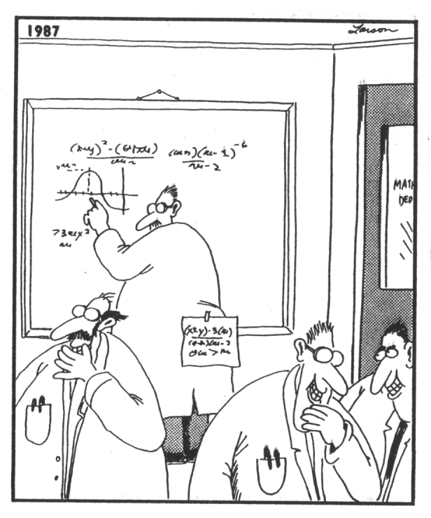

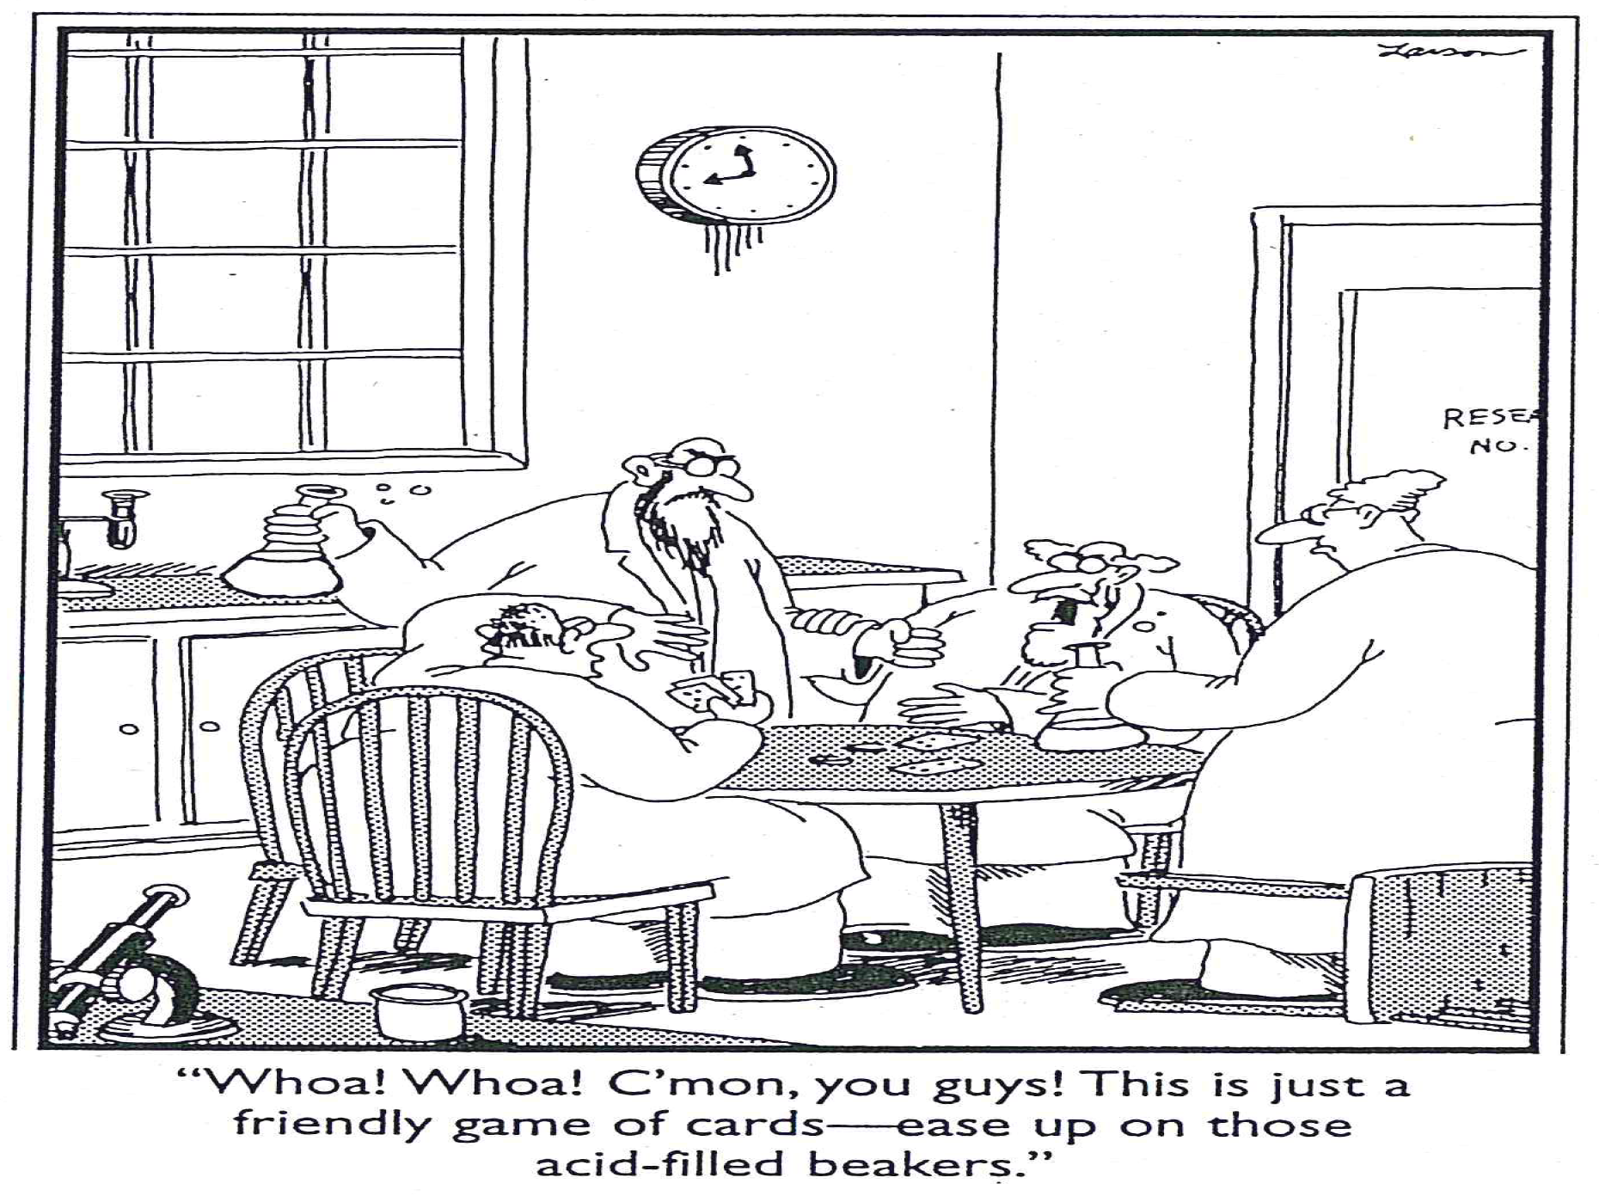


mr e physical science SRCS fall 2014

Slide 2
Essential Questions:
Ultimate Things: Does what we believe matter?
History of Science
The Scientific Method
Ways of doing Science
Religion & Science
Does one’s view of God influence one’s cosmology? Which worldview is responsible for the scientific revolution? What 3 things Christianity teaches about God and nature distinguishes this view from other religions?
How does science happen? What is the nature of Scientific Revolutions? Tie this to the Secular view of Galileo, the Church and science.
Why is physics considered to be the most fundamental of the sciences?
How could one sum up man’s pursuit in natural philosophy? Share an example of man’s quest for simplification . How is this an expression of elegance?
State 6 basic steps of the Scientific Method. Is this the only means to acquire knowledge? Why must a problem to be addressed by this method be scientific? Discuss inherent limitations, then, to a naturalistic worldview.
Contrast pure science with applied science. Trace how people’s personalities play into their preference between the two. How can Christians bring these into balance in the marketplace?
According to our author these have differing spheres of influence. What are they? What caveat does mr e add to set these two into proper perspective? Are any scientific facts/theories/laws above question?

Slide 3
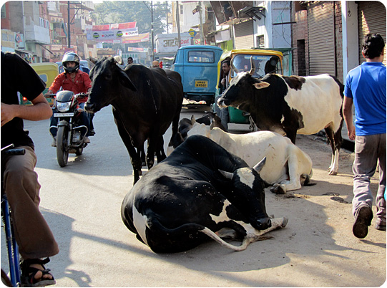

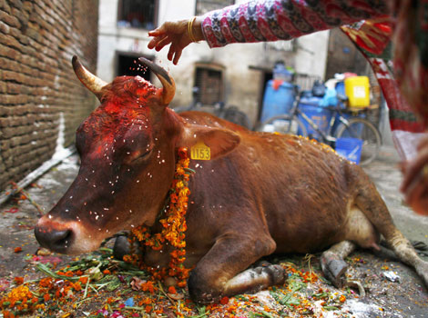

Contra pantheism
Points to laws/covenant purposes
Contra hinduism; this encourages what? Sound familiar?
Europe embraced Christianity
Christianity spawned & nurtured modern science
God the Creator is orderly & rational
Nature is real & distinct from God
Nature is fallen/in need of Redemption/Restoration

Slide 4
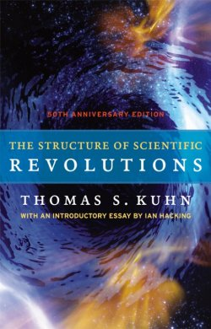

Central to Kuhn’s analysis is the idea that our understanding of the universe has evolved in a series of discontinuities in which an intellectual framework (or paradigm) is built up, only to be brought crashing down in a crisis in which it becomes clear that theory is incapable of describing nature…then scientists are forced to abandon certain theories (a “crisis”) and find one that can explain current observations (which promotes scientific revolutions…)
Typical characteristics:
1. Revolutionary theory often faces resistance
2. Proposals are almost exclusively done by younger (20’s & 30’s)
3. Often radical (“sci-fi”)
4. Always creative (the art of science)
Understanding widens & simplifies (“elegance”) as we/society shifts perspectives…
The Church was not “ignorant”, it actually embraced the popular belief of the day…it simply resisted the paradigm shift as it entered into crisis and needed more evidence & time to endorse the Copernican revolution…

Slide 5
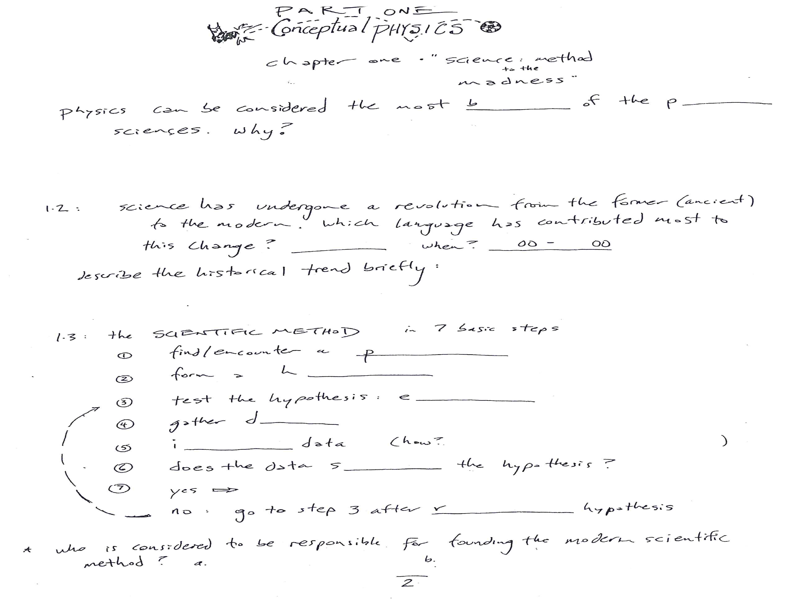
hysical
asic
It deals with fundamental laws which govern the universe (all other scientific disciplines)
mathematics
15
16
Science moved from the deductive and untested to the experimental and technological (heavily philosophical/rational → heavily application/lab-driven)

Slide 6
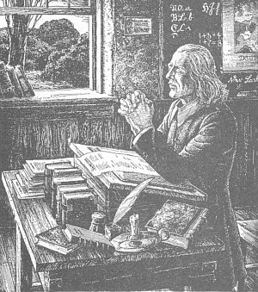
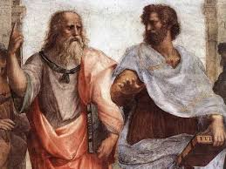
A brief guided tour of the history of science…
Do you know what the subject now called “science” would have been labelled in my day?
The whole of the pursuit of philosophy, in fact, can be boiled down to the idea of simplification.
Though I and my mentor sought to uncover a universal philosophy, my “natural philosophy” was centered on the essence of things existing in themselves, whereas Plato taught the “forms” of things as being outside the actual objects…

Slide 7
Look again at the inside cover of your book…
http://en.wikipedia.org/wiki/List_of_Christian_thinkers_in_science

Slide 8

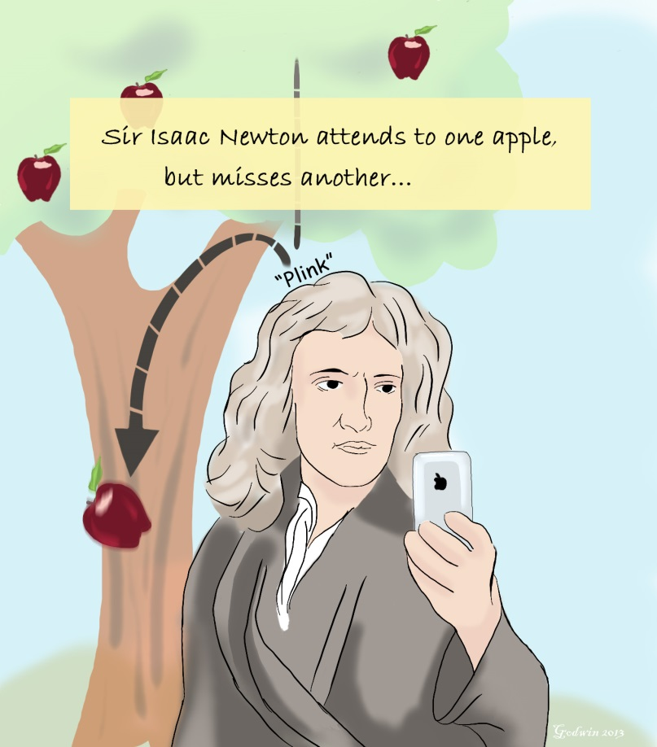


Slide 9
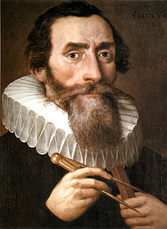
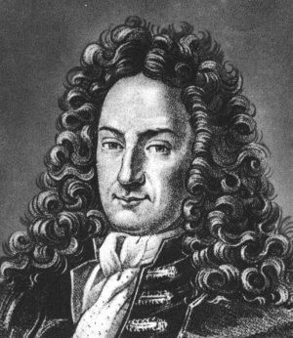
Gottfried Leibniz (1646–1716): He was a philosopher who developed the philosophical theory of the Pre-established harmony; he is also most noted for his optimism, e.g., his conclusion that our Universe is, in a restricted sense, the best possible one that God could have created. He also made major contributions to mathematics, physics, and technology.
Kepler was convinced "that the geometrical things have provided the Creator with the model for decorating the whole world". In his work, Harmony of the World, he attempted to explain the proportions of the natural world—particularly the astronomical and astrological aspects—in terms of music and geometric laws.

Slide 10
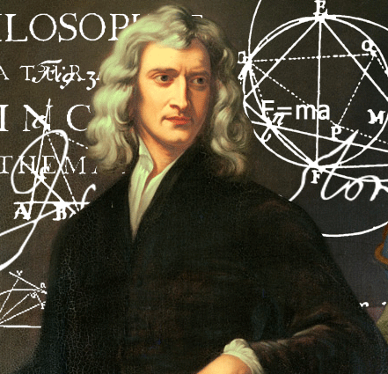
The Enlightenment philosophes subjected religion to an unprecedented rational scrutiny, many of them rejecting Christianity for deism and a few even turning to atheism.
Given this chain of events, it was natural for many to assume that Newton could not have been very religious; after all, he was the Enlightenment's exemplar of reason. But it turns out that Newton thought about religion a great deal, and his private manuscripts on theology are voluminous, totaling four million words.
Newton accepted many of the conventional religious beliefs of the English Puritan culture in which he was raised: "Newton trusted the Bible and often took it literally, especially prophetic texts from Daniel and Revelation. He believed in predestination, the bodily resurrection of Jesus, the future resurrection of the faithful, and the millennial kingdom ruled by Christ."

Slide 11
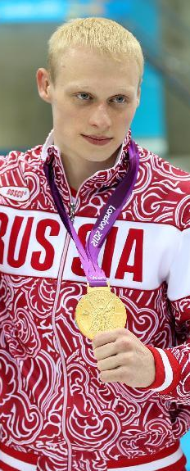


Slide 12

roblem
ypothesis
xperimentation
ata
nterpret
upport
eform
any ideas?

Slide 13
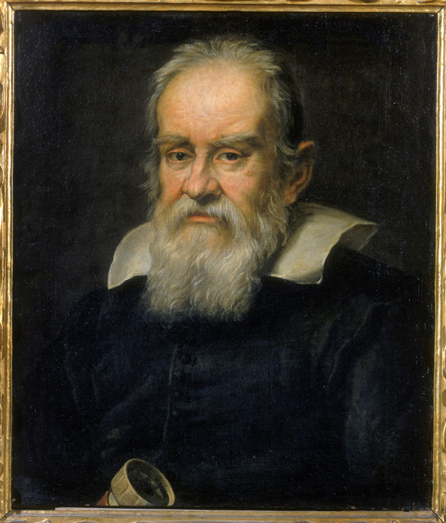
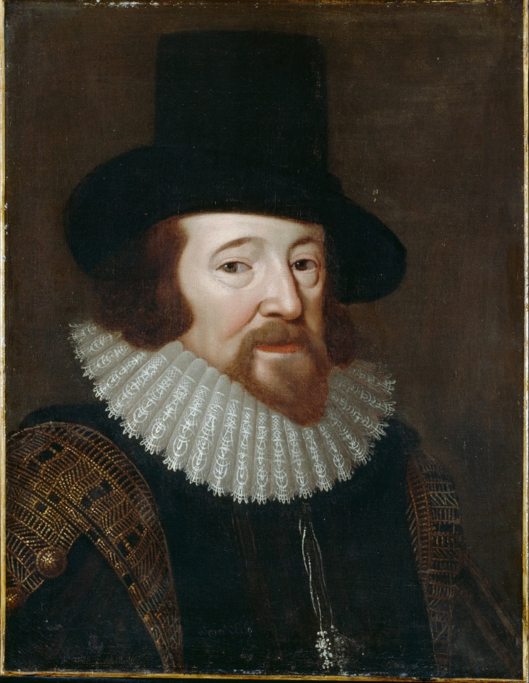
Ask me about war, my trial, and the Pope…
Ask me about knights, the Baconian Method, and pneumonia…
Knighted in 1603, the Baconian Method was the moniker for the scientific method, and he contracted pneumonia while studying the effects of freezing on the preservation of meat.
Galileo Galilei (1564-1642)
Italian physicist, mathematician, engineer, astronomer, and philosopher; played a major role in the scientific revolution.
Francis Bacon (1561-1626)
English philosopher, statesman, scientist, jurist, orator, essayist, and author

Slide 14
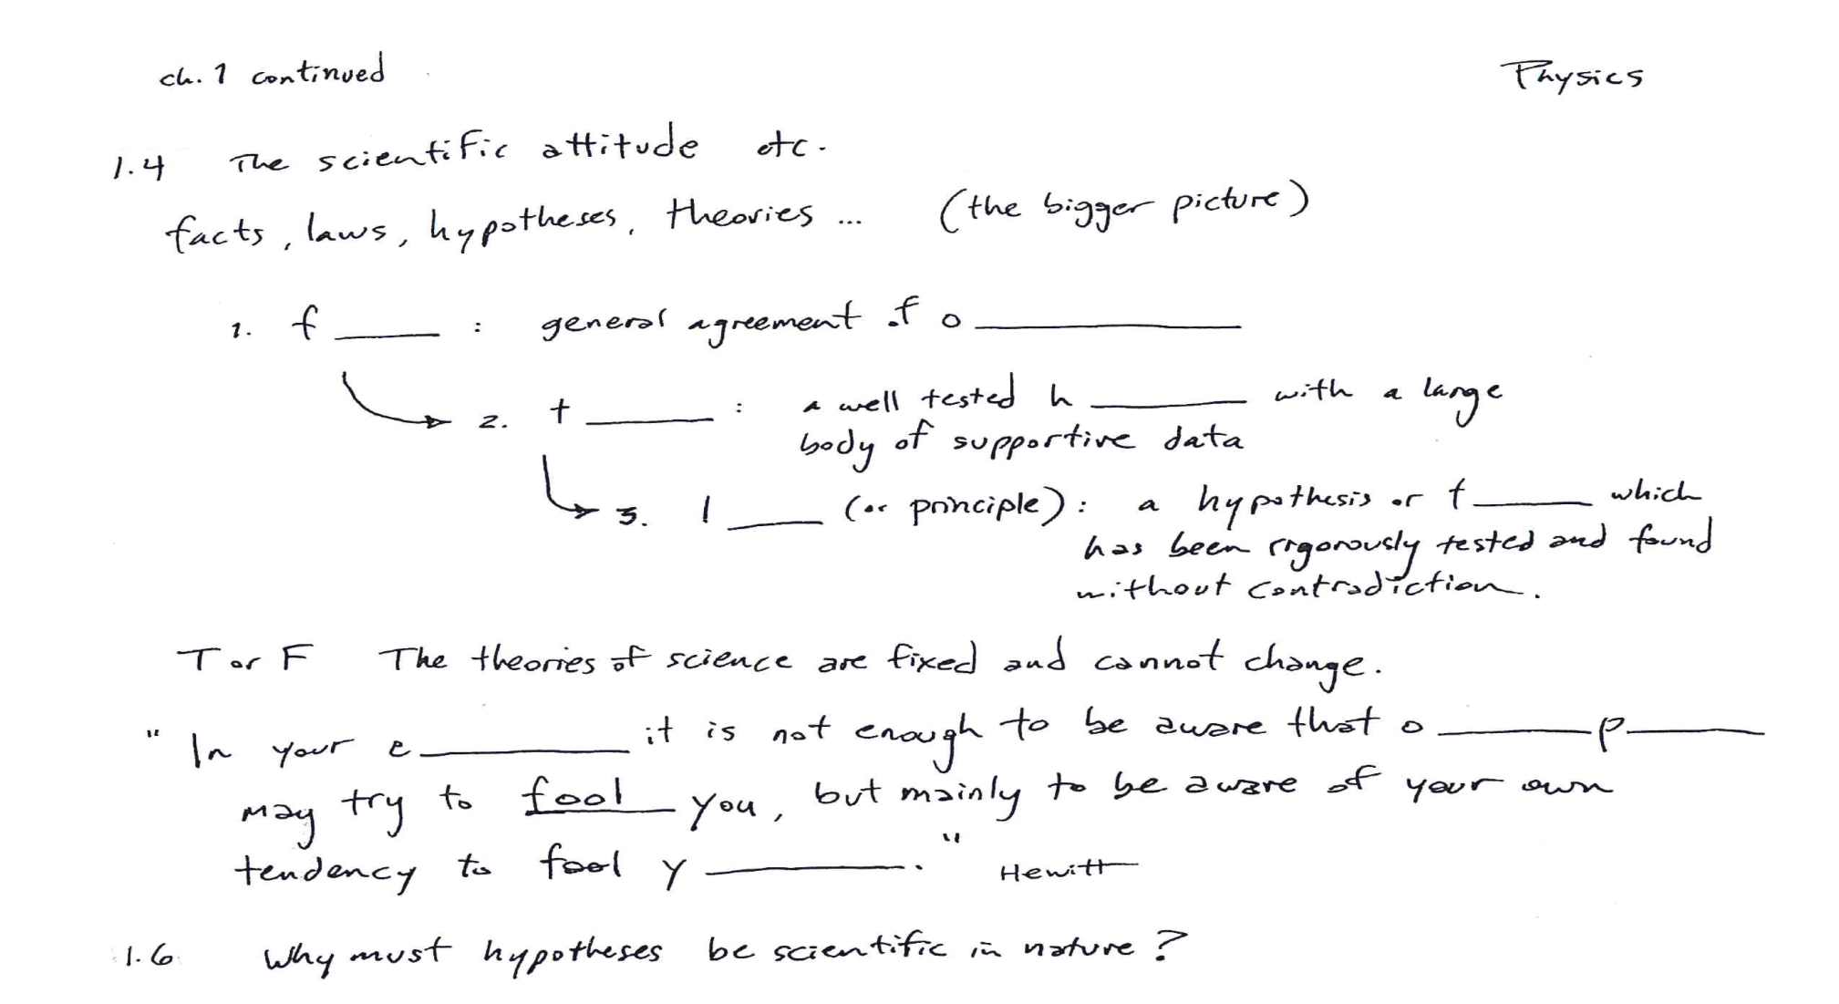
acts
bservation
Group of ypotheses
heory
aw
heory
ducation
ther eople
ourself
If a particular problem or set of problems is unscientific, then it is no longer testable and the very method of experimentation is rendered impossible

Slide 15

(pure)
pplies
inds
iscovers acts
ractical ools
echniques
rocedures
iscovers elationships
akes heories
Pure science
esponsibility
aintaining alance ature
FiST Chat 153: Pure Vs Applied Science on Vimeo

Slide 16
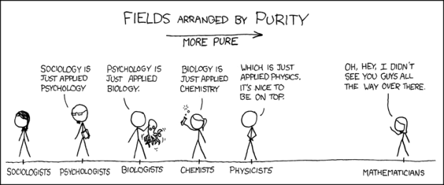


(pure)

Slide 17
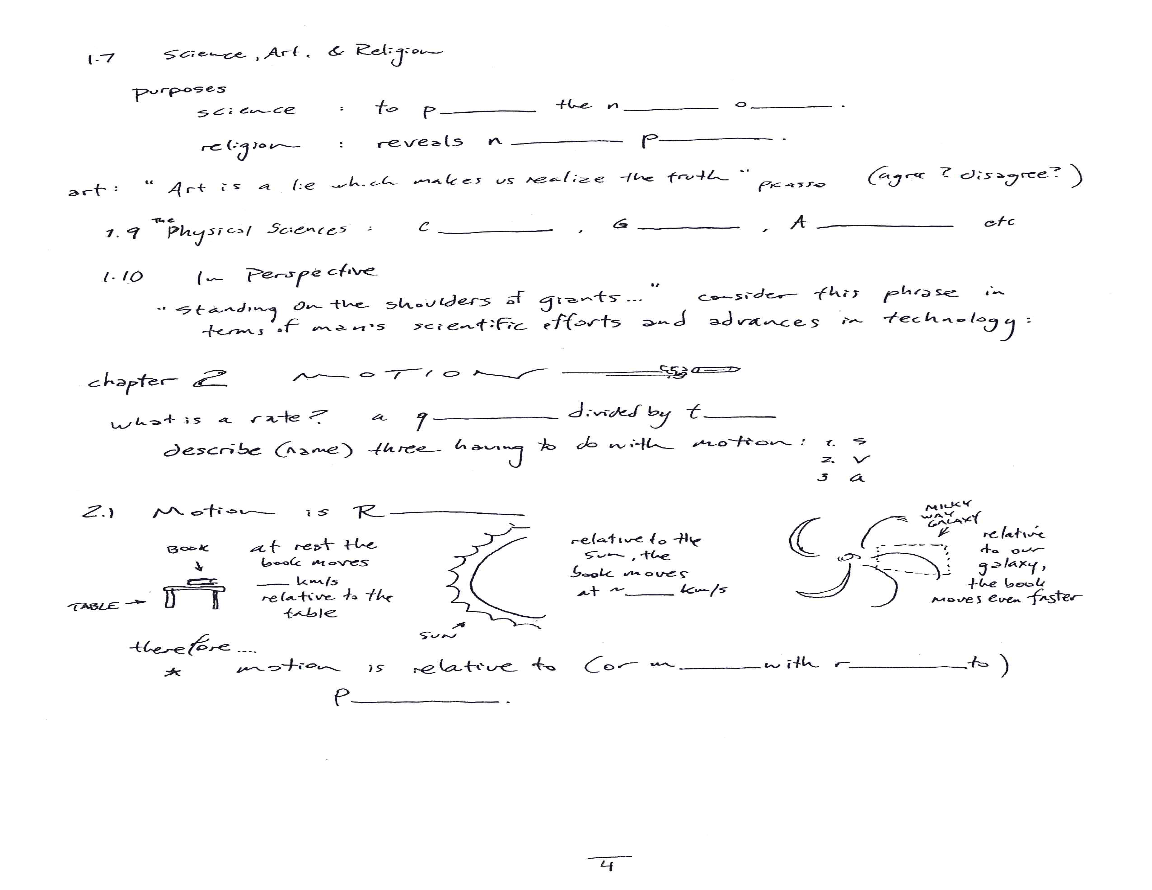
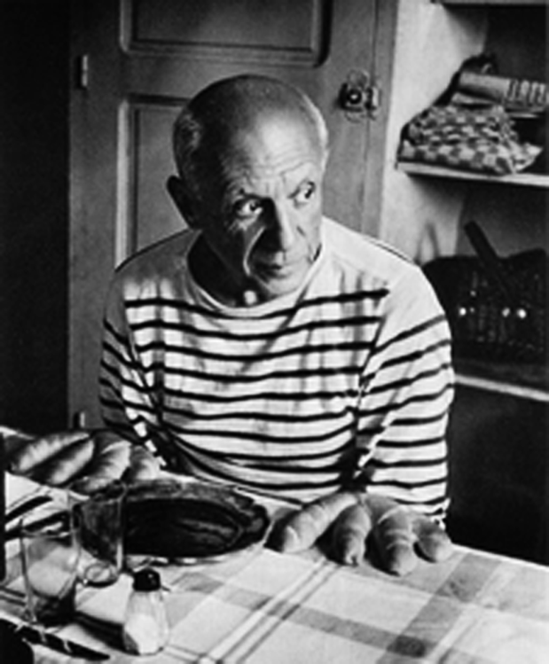


robe atural rder
ature’s urpose
chemistry eology stronomy

Slide 18


Newton's First Law - TeacherTube
conceptual physics the old tablecloth trick - YouTube
BMW S1000 RR. Dinner for RR. - YouTube

Slide 19

uantity ime
elative
oves espect
osition
How fast are you moving right now? - Tucker Hiatt - YouTube

