Slide 1

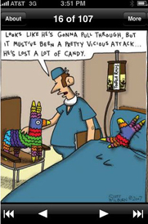
Ever wonder what we are made of?
Chapter 4: Tissues: (but don’t start crying) A&P fall 2014 mr. e SRCS

Slide 2
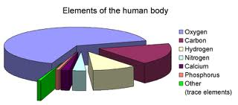
Chapter 4: Tissues: (but don’t start crying) A&P fall 2014 mr. e SRCS

Slide 3
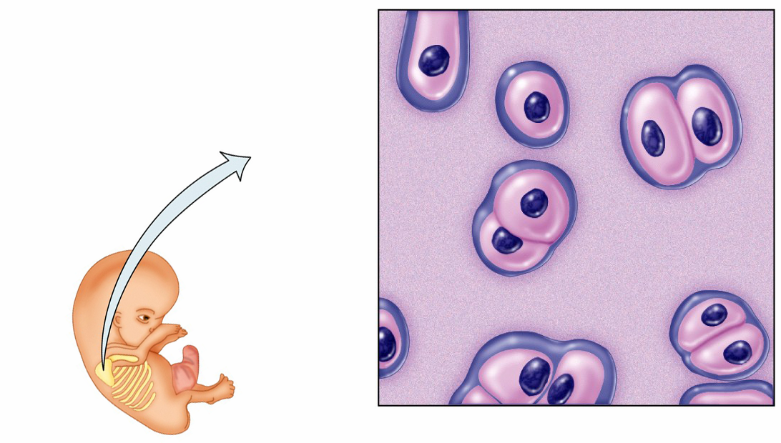
Tissues
Tissues are a group of cells with a common embryonic origin that function together to carry out specialized activities.
  They include various types,
  ranging from hard (bone)
  to semisolid (fat) to
  liquid (blood).

Slide 4
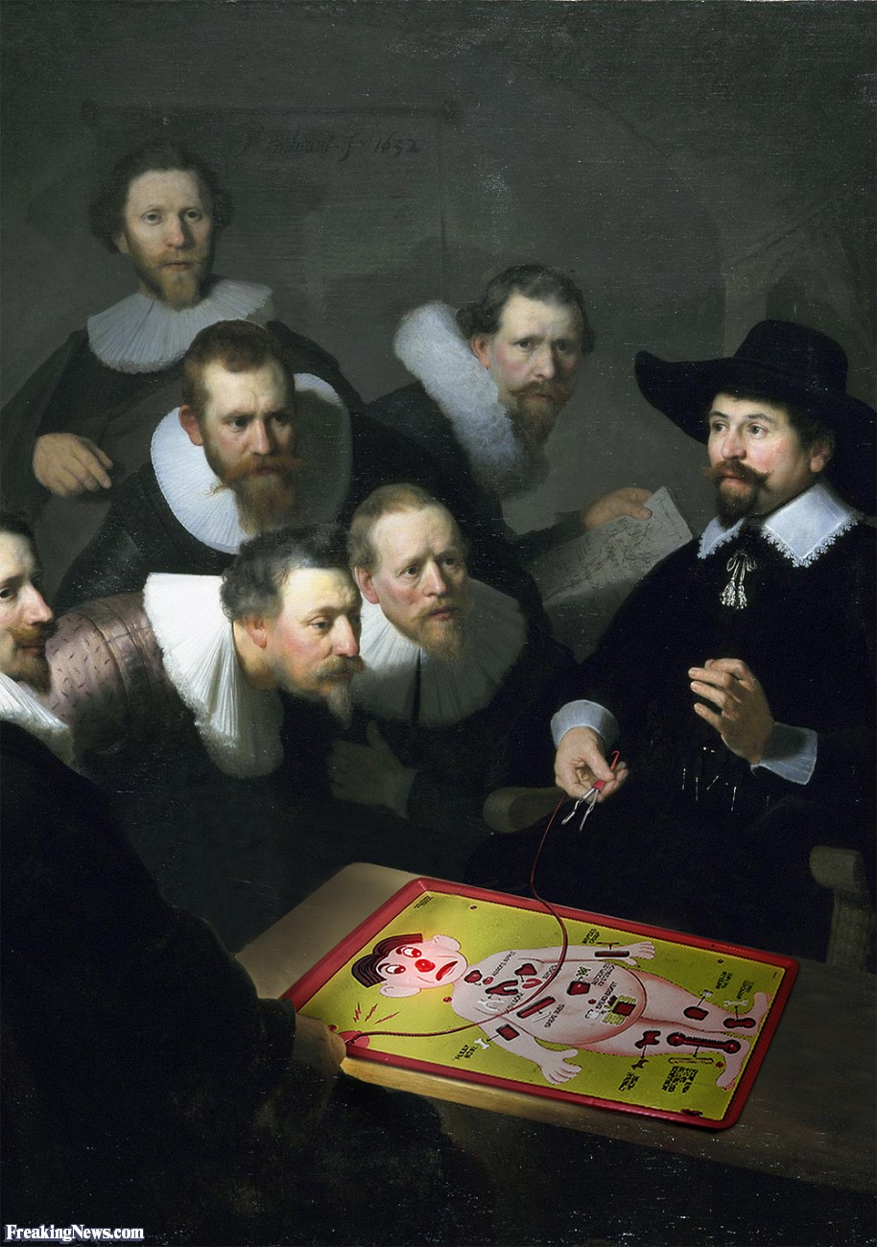
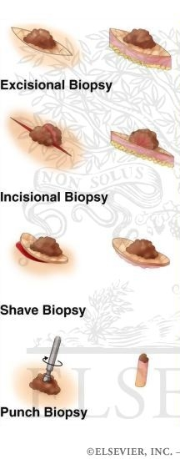
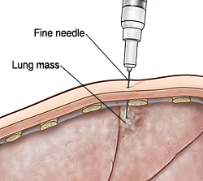
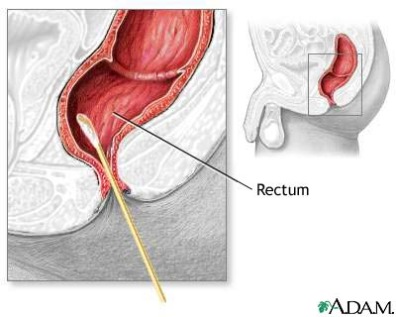
Clinical Connection
Biopsy
Bio-(“life”) –opsy (“to view”)
The removal of a section of tissue for microscopic observation…
Various biopsies…

Slide 5
Tissues
Histology is the study of the microscopic anatomy of cells and tissues – it is a branch of pathology.
  Of the 10 trillion cells in our body, no single cell type can said to be “typical”.
  A trained histologist can recognize over 200 distinct human cell types under the microscope and is able to distinguish a cell from pancreatic tissue as opposed to a cell from the skin.
  Each cell type has features particular to its function.
Notes:
From Lab 4

Slide 6
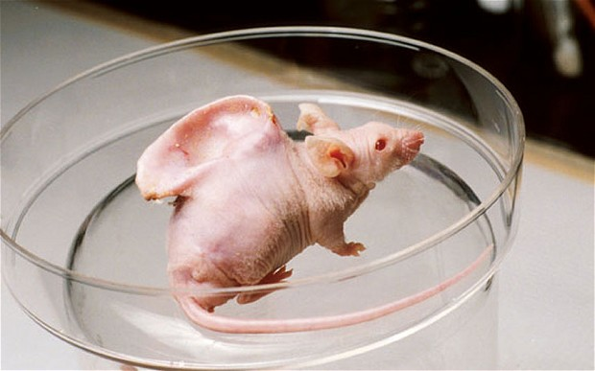
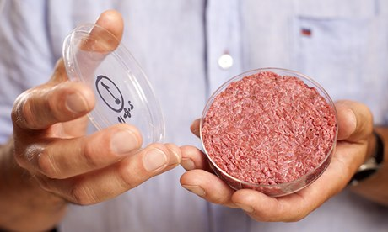
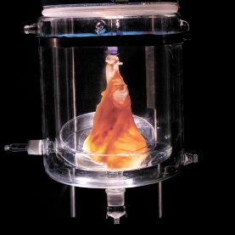
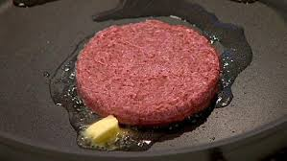
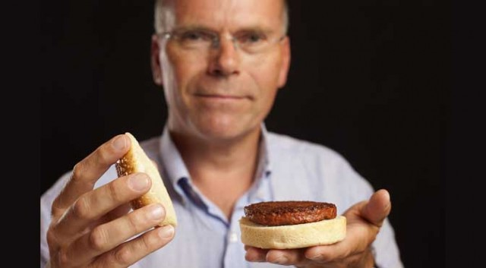
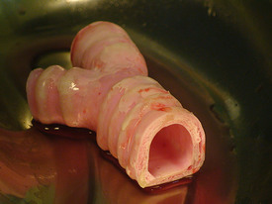
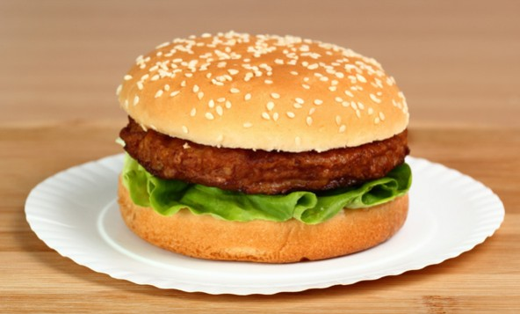
Clinical Connection
Tissue Engineering
A building material (e.g., extracellular matrix, biodegradable polymer), is shaped as needed, seeded with living cells and bathed with growth factors. When the cells multiply, they fill up the scaffold and grow into three-dimensional tissue. Once implanted in the body, the cells recreate their intended tissue functions. Blood vessels attach themselves to the new tissue, the scaffold dissolves, and the newly-grown tissue eventually blends in with its surroundings.
Possibilities...

Slide 7
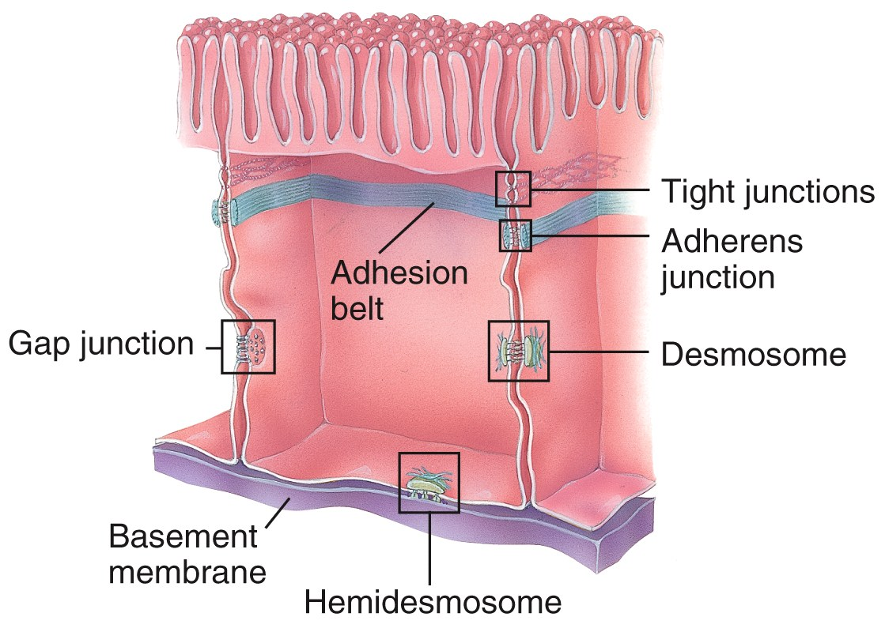
Intercellular Junctions
Tissues are formed by grouping cells together using a variety of Intercellular Junctions .
  Intercellular Junctions connect adjacent cells mechanically at the cell membranes or through cytoskeletal elements within and between cells.
You will be responsible to match each junction with a keyword and pic
Notes:
From Lab 4

Slide 8
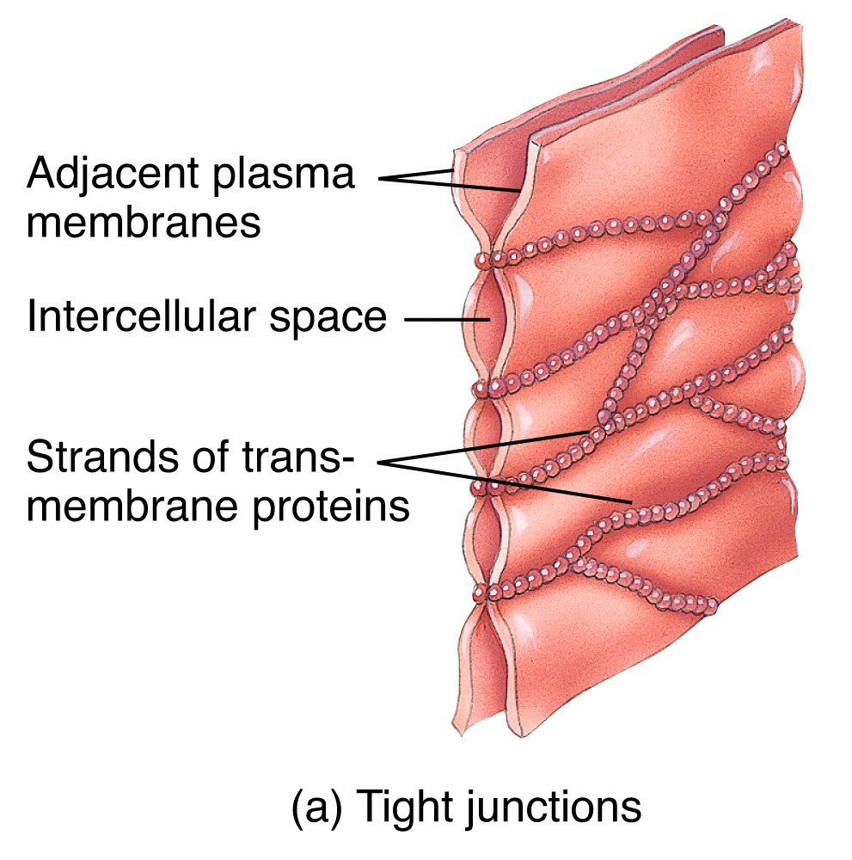
Intercellular Junctions
Tight Junctions are found where a leakproof seal is needed between cells.
  They keep materials from leaking out of organs like the stomach and bladder.

Slide 9
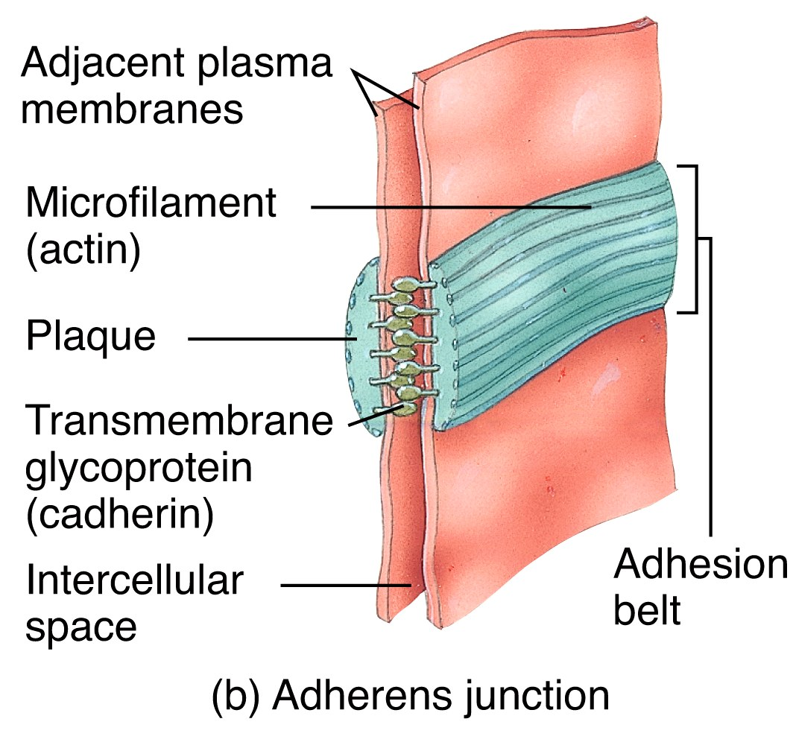
Intercellular Junctions
Adherens Junctions make an adhesion belt (like the belt on your pants) that keeps tissues from separating as they stretch and contract.

Slide 10
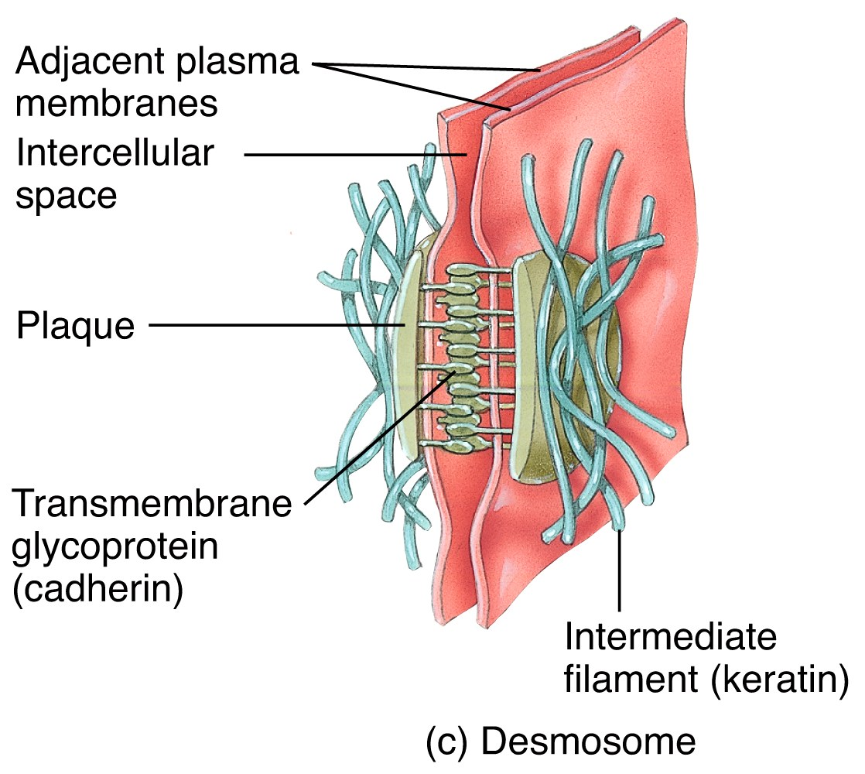
Intercellular Junctions
Desmosomes act as “spot welds”. They also use cadherin glycoprotein (plus intermediate filaments) to hook into the cytoplasm.

Slide 11
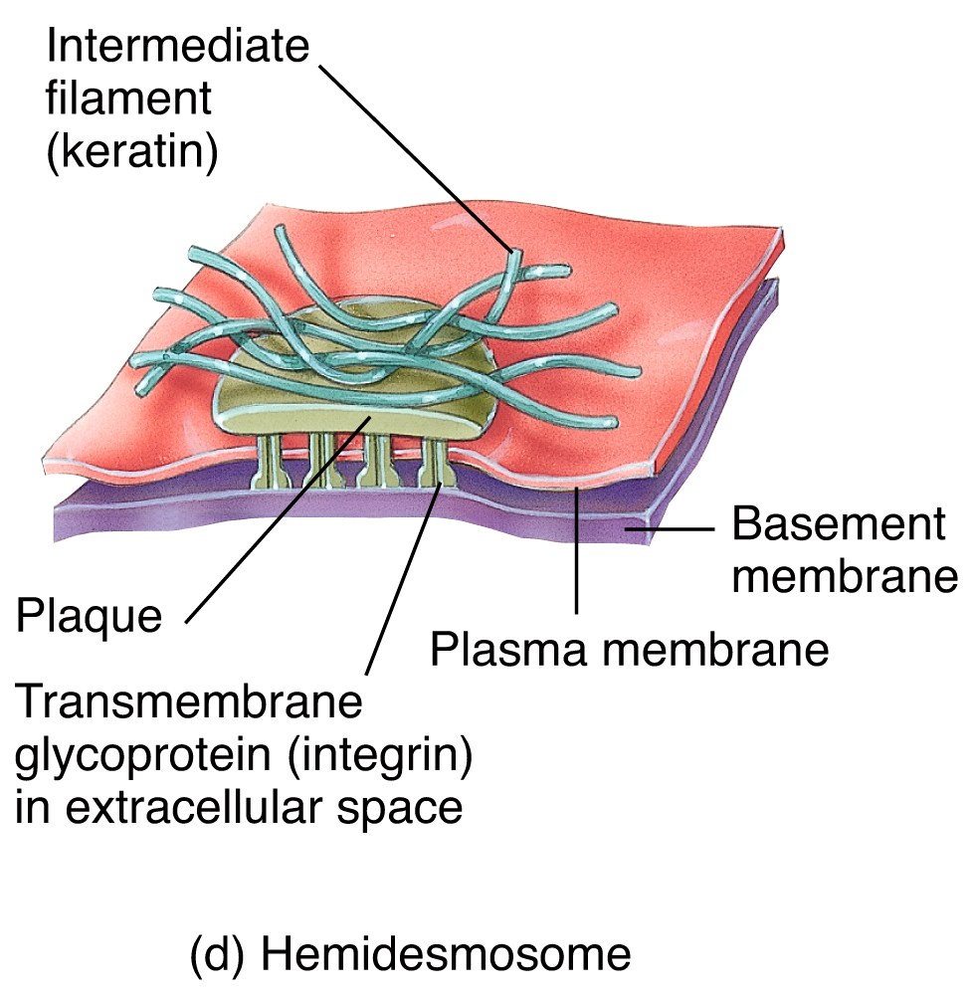
Intercellular Junctions
Hemidesmosomes are half-welds that join cells to the basement membrane.

Slide 12
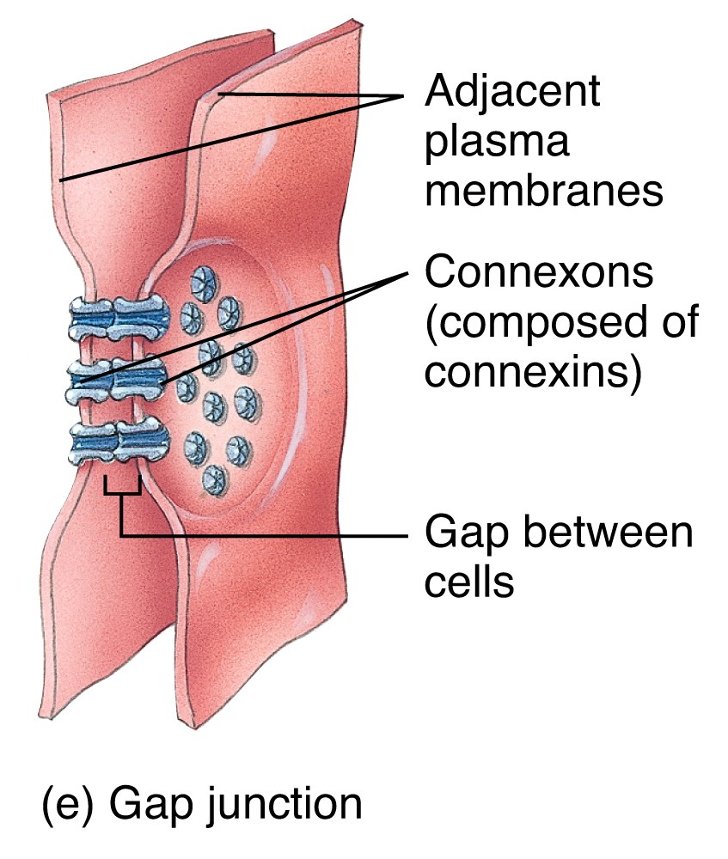
Intercellular Junctions
Gap Junctions are pores (connexons) that allow small substances like ions to pass between cells. If one of the cells gets sick or dies, these seal like a hatch to prevent damage to other cells.

Slide 13
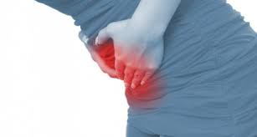
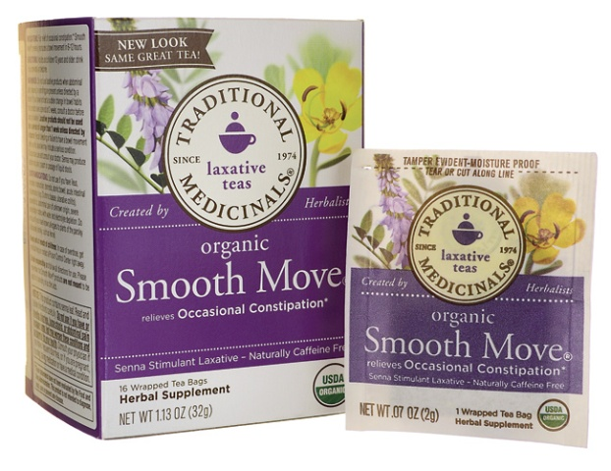

Clinical Connection
Adhesions
Adhesions are fibrous bands that form between tissues and organs, often as a result of injury during surgery. They may be thought of as internal scar tissue that connect tissues not normally connected. Abdominal are the most common and can lead to the obstruction of the bowels.
Btw: this is not my mother
Personal story…

Slide 14
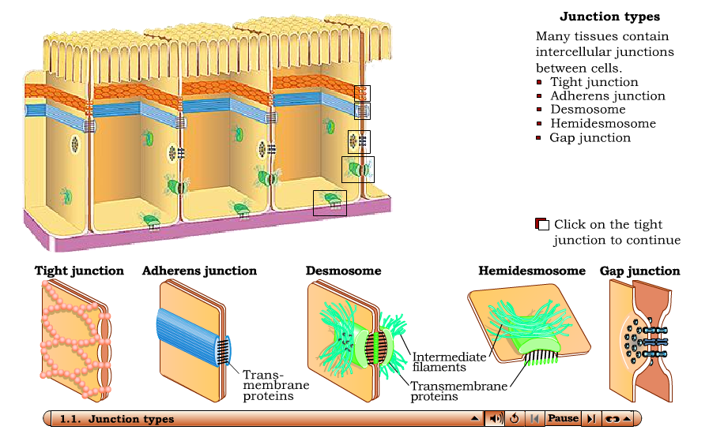
Intracellular Junctions
Interactions Animation
Intracellular Junctions
You must be connected to the internet to run this animation

Slide 15
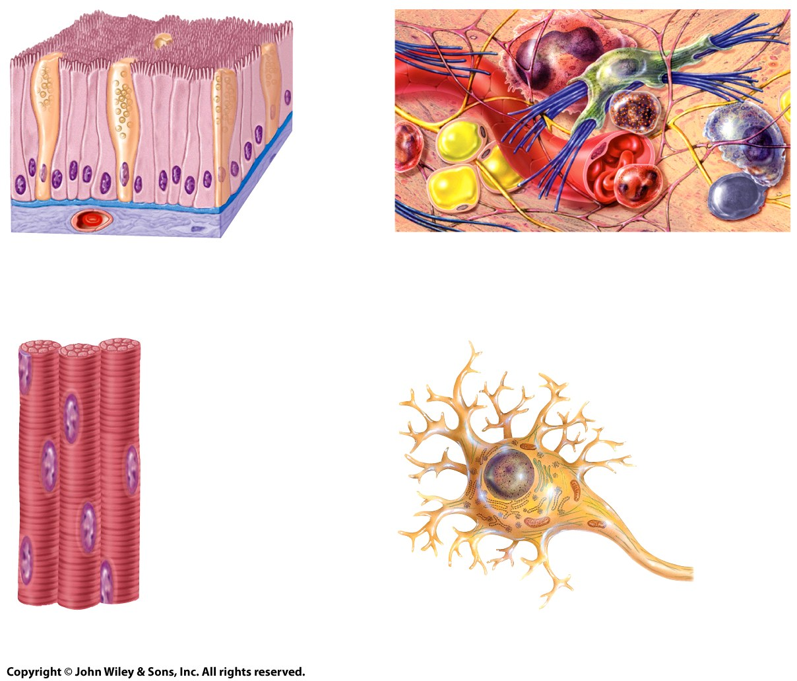
The 4 Basic Tissues
Of all the cells in the body, they combine to make only 4 basic tissue types:
  Epithelial tissues
  Connective tissues
  Muscular tissues
  Nervous tissues
Tissues, Part 1: Crash Course A&P #2

Slide 16
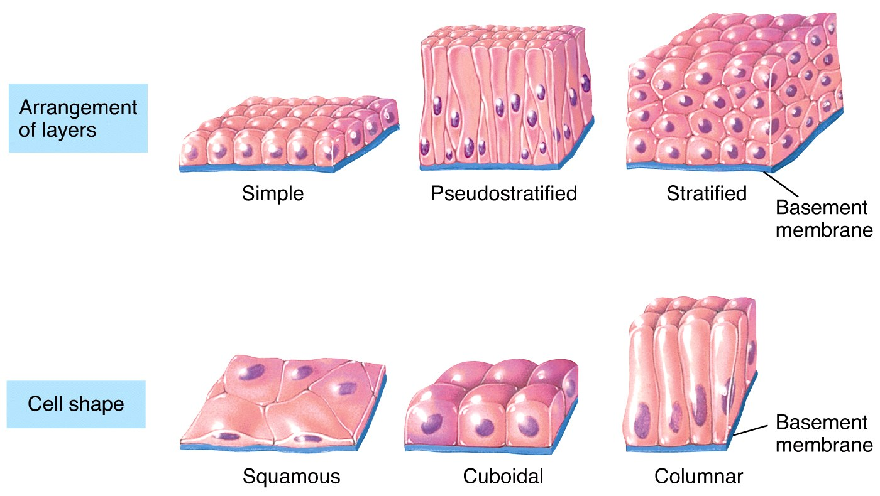
The 4 Basic Tissues
Epithelial tissues cover body surfaces and form glands and line hollow organs, body cavities, and ducts.

Slide 17
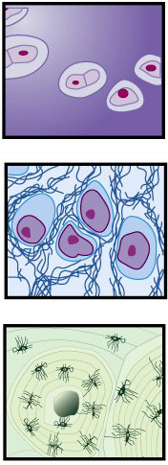
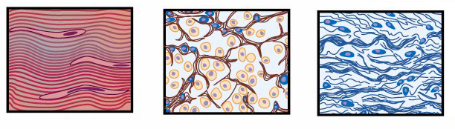
The 4 Basic Tissues
Connective tissues (C.T.) protect, support, and bind organs.
  Fat is a type of C.T. that stores energy.
  Red blood cells, white blood cells, and
  platelets are all C.T.

Slide 18
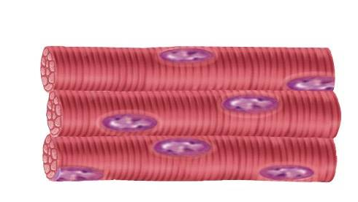
The 4 Basic Tissues
Muscular tissues generate the physical force needed to make body structures move. They also generate heat used by the body. (Skeletal (mov’t/heat); Cardiac (heart; mov’t); Smooth (involuntary organs; mov’t)
Nervous tissues detect changes in the body and respond by generating nerve impulses.
Also called “striated” b/c of its appearance

Slide 19
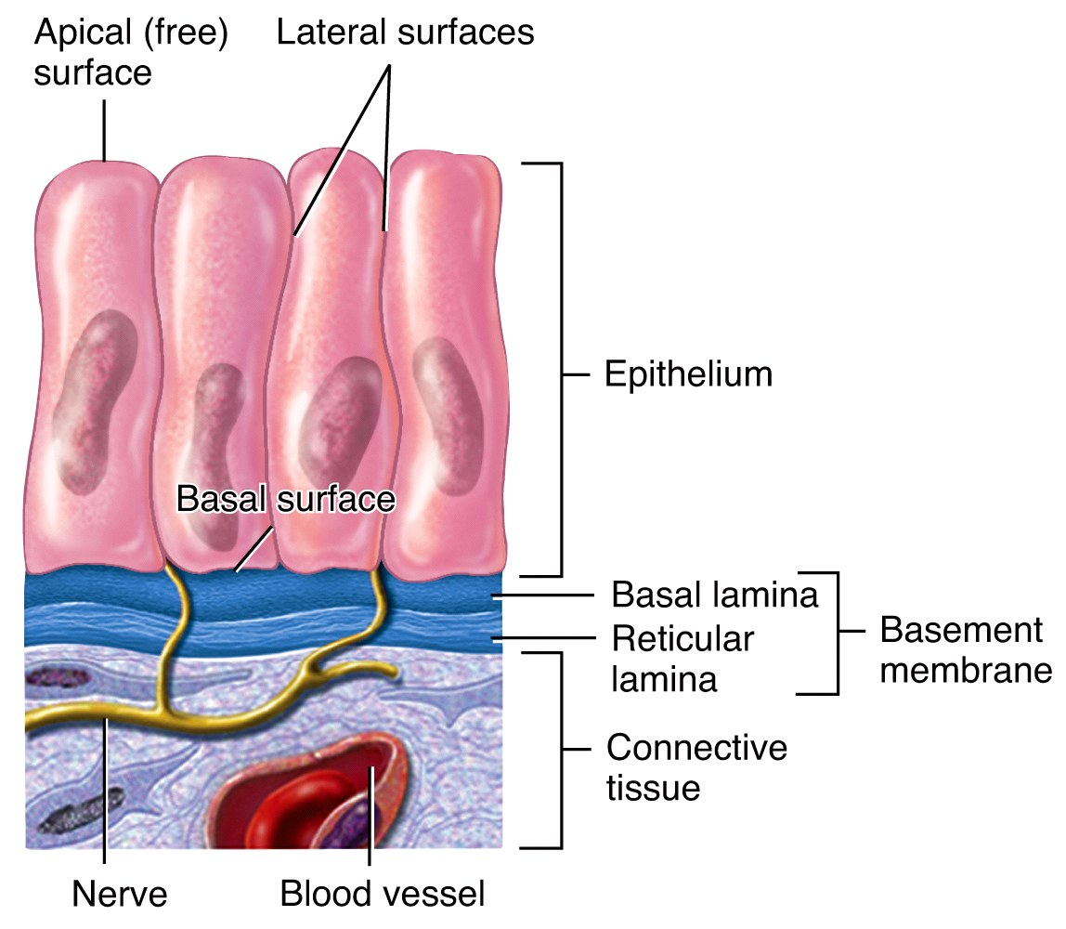
1. Epithelium
Epithelium is used to line surfaces and form protective barriers. Epithelium is also good at secreting things like mucous, hormones, and
other substances .
All epithelia have a
  free apical surface
  and an attached
  basal surface.
Notes:
04_02

Slide 20


Clinical Connection
Diabetic Retinopathy
The basement membranes of capillaries in the eyes and kidneys harden and thicken, causing inefficient function…and can result in blindness or kidney failure.
If untreated…

Slide 21
Epithelium
Epithelia are named according to the shape of their cells, and the thickness or arrangement of their layers (of cells).

Slide 22
Epithelium

Slide 23
Epithelium
First word: Named according to arrangement
One layer. All cells in contact with basement membrane | Appears to have layers, but in reality all cells go from the apex to the base | Two or more layers. Only basal layer in contact with basement membrane

Slide 24
Epithelium
Second word: Named according to shape
Flat, wide “paving stone” cells | Cells as tall as they are wide | Cells taller than they are wide

Slide 25
Epithelium
Naming epithelia
  Three different cell shapes x three different cell arrangements = nine possibilities. Two of these are not used. Add transitional (cells that change shape), and we’re back up to eight possible combinations.
  If different shapes are present in layers of cells, the epithelium is always named by the shape of cells in the apical (outermost) layer.
  Add “ciliated” or “nonciliated” before the shape if it has or could, but doesn’t have them…

Slide 26
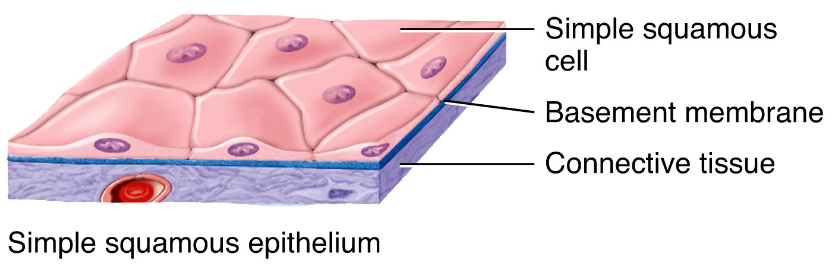
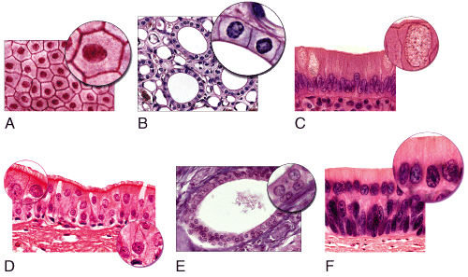
Epithelium
Simple Squamous Epithelium is composed of a single layer of flat cells found:
  In the air sacs of lungs
  In the lining of blood
  vessels, the heart, and lymphatic vessels
  In all capillaries, including those of the kidney
  As the major part of a
  serous membrane
simple squamous | pseudostratified squamous | stratified squamous
simple cuboidal | pseudostratified cuboidal | stratified cuboidal
simple columnar | pseudostratified columnar | stratified columnar
transitional
Notes:
04_table_01a

Slide 27
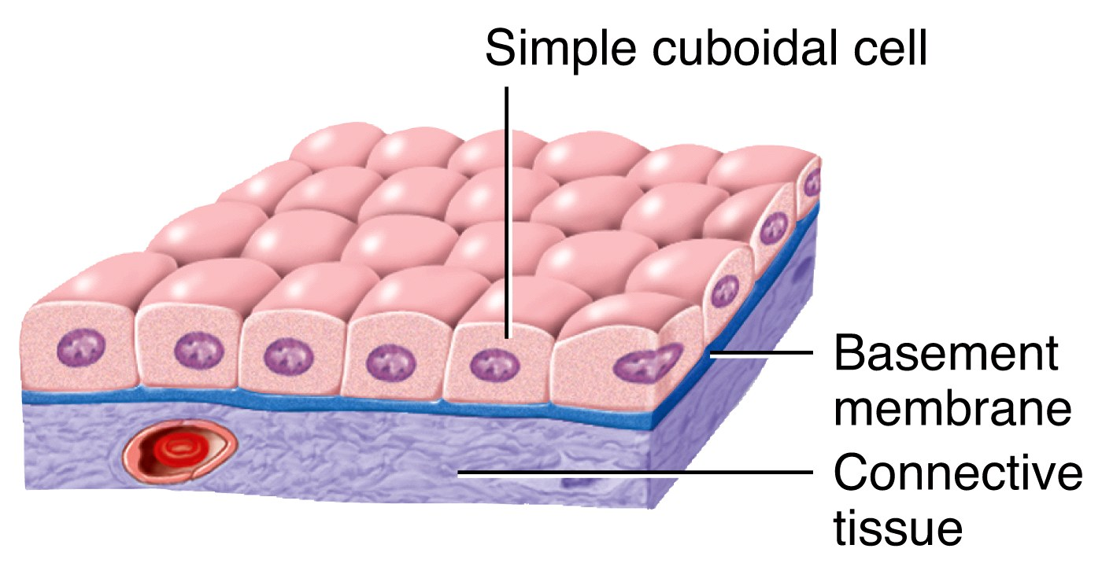
Epithelium
Simple Cuboidal Epithelium is composed of a single layer of cube shaped cells.
  It is often found lining
  the tubules of the
  kidneys and many
  other glands.
simple squamous | pseudostratified squamous | stratified squamous
simple cuboidal | pseudostratified cuboidal | stratified cuboidal
simple columnar | pseudostratified columnar | stratified columnar
transitional
Notes:
04_table_01a

Slide 28
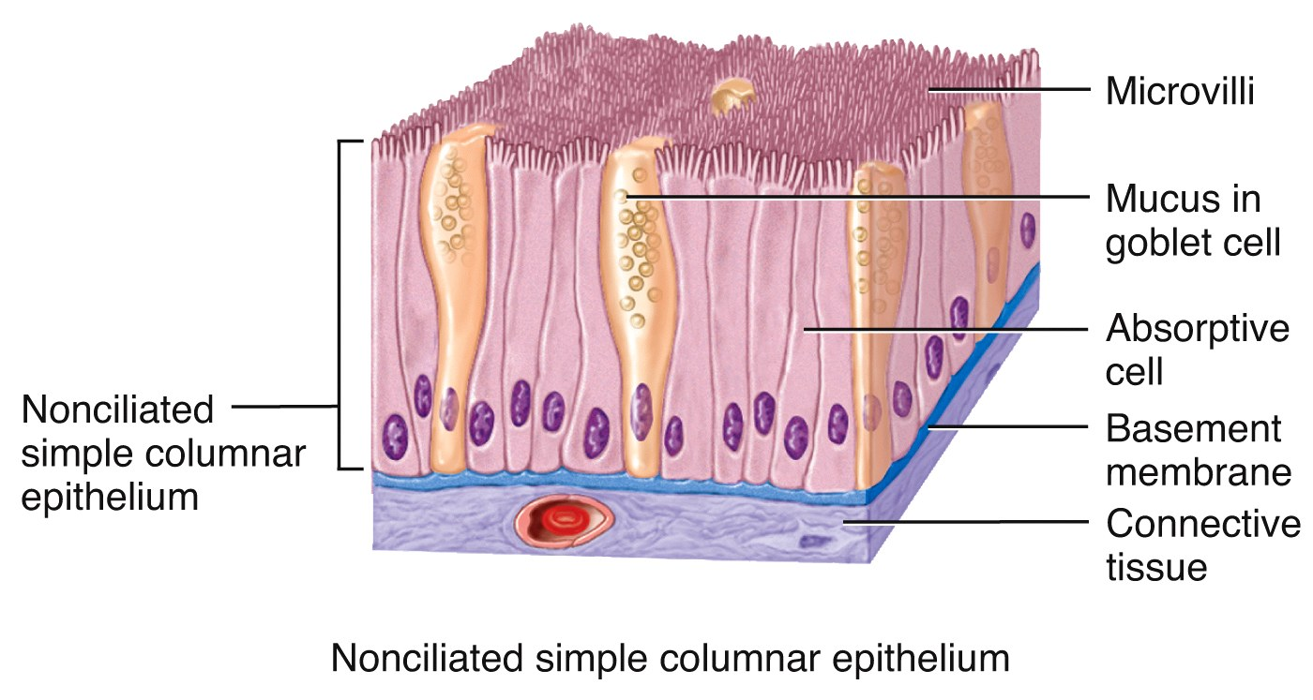
Epithelium
Simple Columnar Epithelium forms a single layer of column-like cells, ± cilia, ± microvilli, ± mucous (goblet cells).
  Goblet cells are simple
  columnar cells that
  have differentiated to
  acquire the ability to
  secrete mucous.
simple squamous | pseudostratified squamous | stratified squamous
simple cuboidal | pseudostratified cuboidal | stratified cuboidal
simple columnar | pseudostratified columnar | stratified columnar
transitional
Notes:
04_table_01bc

Slide 29
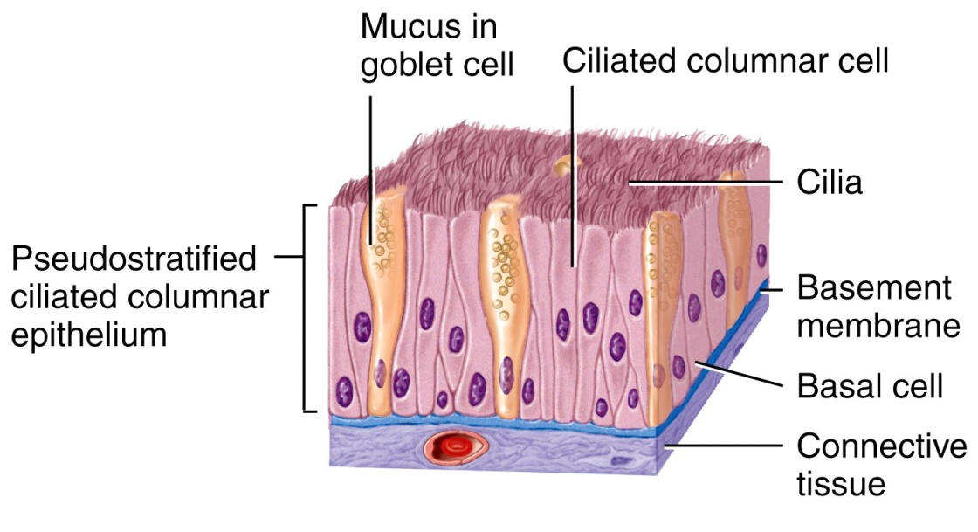
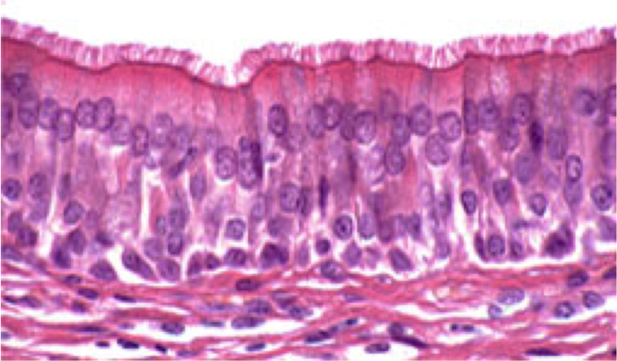
Epithelium
Pseudostratified Columnar Epithelium appears to have layers, due to nuclei which are at various depths. In reality, all cells are attached to the basement
membrane in a single
layer, but some do not
extend to the apical surface.
  Ciliated tissue has
  goblet cells that
  secrete mucous.
simple squamous | pseudostratified squamous | stratified squamous
simple cuboidal | pseudostratified cuboidal | stratified cuboidal
simple columnar | pseudostratified columnar | stratified columnar
transitional
Notes:
04_table_01de

Slide 30
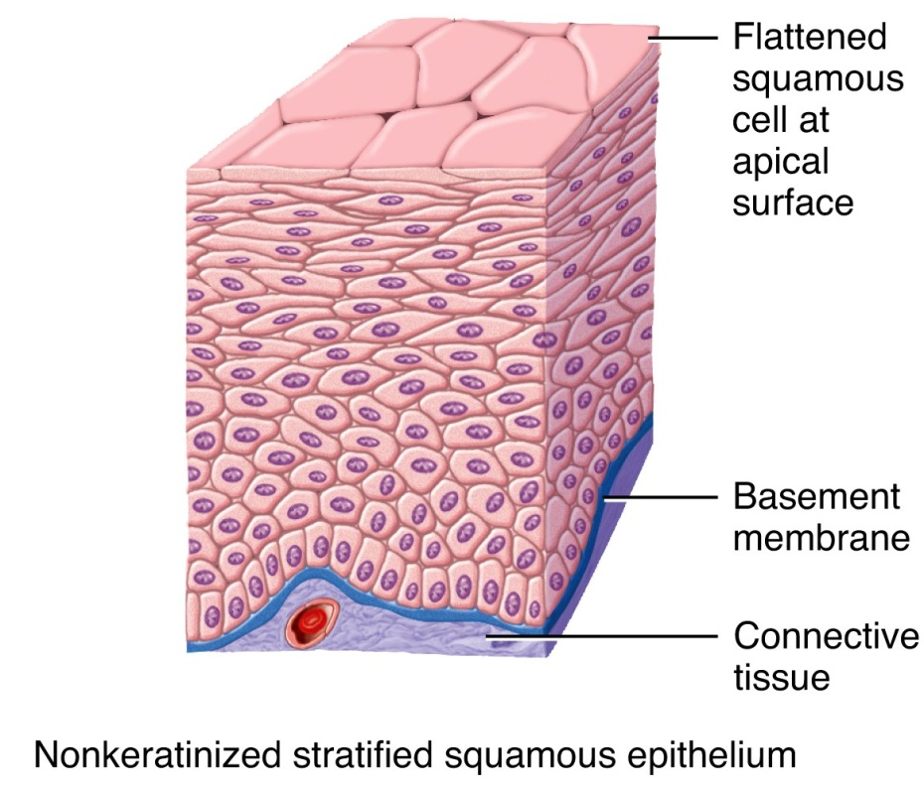
Epithelium
Stratified Squamous Epithelium has an apical surface that is made up of squamous (flat) cells.
  The other layers have different
  shapes, but the name is based
  on the apical layer.
  The many layers are ideal for
  protection against
  strong friction
  forces.
simple squamous | pseudostratified squamous | stratified squamous
simple cuboidal | pseudostratified cuboidal | stratified cuboidal
simple columnar | pseudostratified columnar | stratified columnar
transitional
Notes:
04_table_01fg

Slide 31
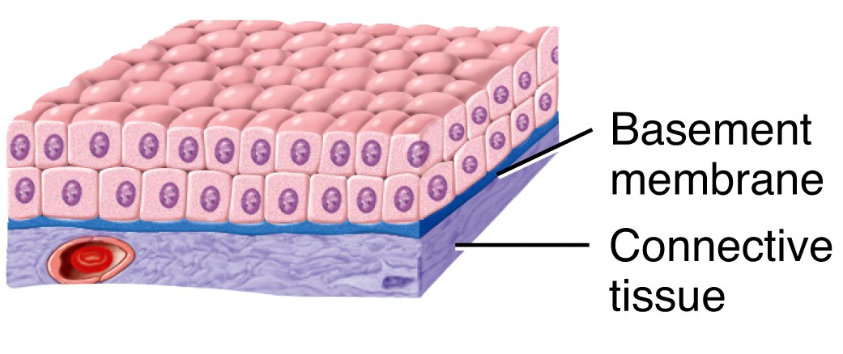
Epithelium
Stratified Cuboidal Epithelium has an apical surface made up of two or more layers of cube-shaped cells.
  Locations include the sweat
    glands and part of the
    ♂ urethra
Stratified Columnar Epithelium is very rare, and for
our purposes, hardly
worth mentioning.
simple squamous | pseudostratified squamous | stratified squamous
simple cuboidal | pseudostratified cuboidal | stratified cuboidal
simple columnar | pseudostratified columnar | stratified columnar
transitional
Notes:
04_table_01fg

Slide 32
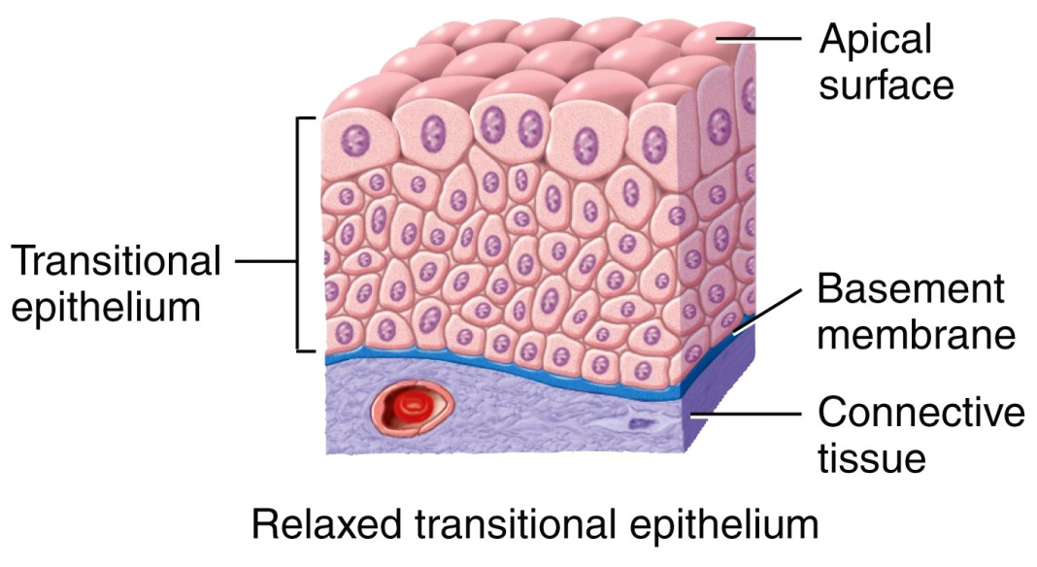
Epithelium
The cells of Transitional Epithelium change shape depending on the state of stretch in the tissue.
  The apical “dome cells” of
  the top layer (seen here in
  relaxation) are an
  identifiable feature and
  signify an empty bladder .
  In a full bladder, the
  cells are flattened.
simple squamous | pseudostratified squamous | stratified squamous
simple cuboidal | pseudostratified cuboidal | stratified cuboidal
simple columnar | pseudostratified columnar | stratified columnar
transitional
Notes:
04_table_01hi

Slide 33
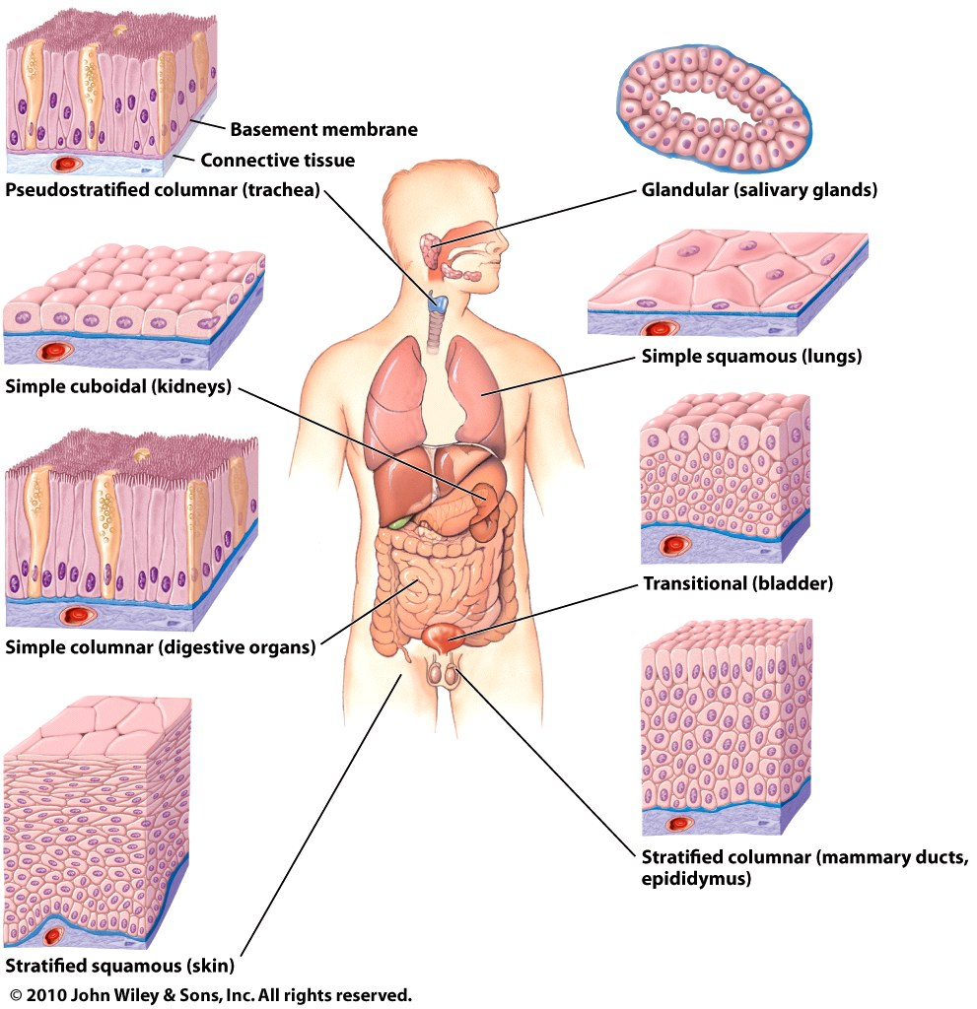
Epithelium
Although epithelia are found throughout the body, certain ones are
associated with specific
body locations.
  Stratified squamous
  epithelium is a
  prominent feature
  of the outer layers
  of the skin.
Why?

Slide 34
Epithelium
  Simple squamous makes up epithelial membranes and lines the blood vessels.
  Simple Columnar is common in the digestive tract.
  Pseudostratified ciliated
  columnar is characteristic
  of the upper respiratory tract.
  Transitional is found in
  the bladder.
  Cuboidal lines ducts and
  sweat glands.
Tissues, Part 2 - Epithelial Tissue:
Why?
Why?
Why?
Why?

Slide 35
2. Connective Tissue
Connective Tissues are the most abundant and widely distributed tissues in the body – they are also the most heterogeneous of the tissue groups.
  They perform numerous functions:
    Bind tissues together
    Support and strengthen tissue
    Protect and insulate internal organs
    Compartmentalize and transport
    Energy reserves and immune responses
Tissues, Part 3 - Connective Tissues:

Slide 36
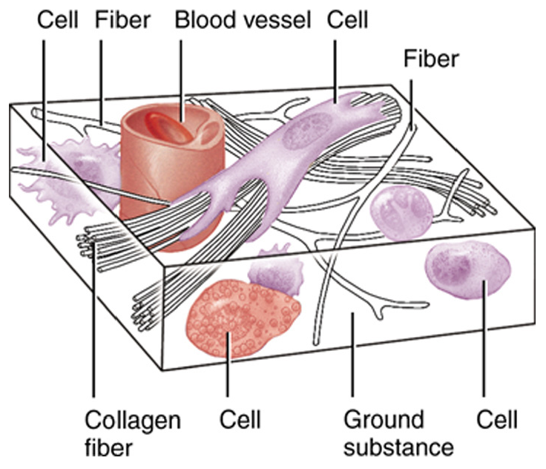
Connective Tissues
Collagen is the main protein of C.T. and the most abundant protein in the body, making up about 25% of total protein content.
Connective tissue is usually
highly vascular and supplied
with many nerves.
  The exception is cartilage and
  tendon - both have little or no
  blood supply and no nerves.
What consequences does this have when injured?

Slide 37
Connective Tissues
Although they are a varied group, all C.T. share a common “theme”:
  Sparse cells
  Surrounded by an extracellular matrix
    The extracellular matrix is a non-cellular material located between and around the cells.
      It consists of protein fibers and ground substance (the ground substance may be fluid, semifluid, gelatinous, or calcified.)
Therefore CT has 3 main parts: cells, fibers, & ground substance

Slide 38
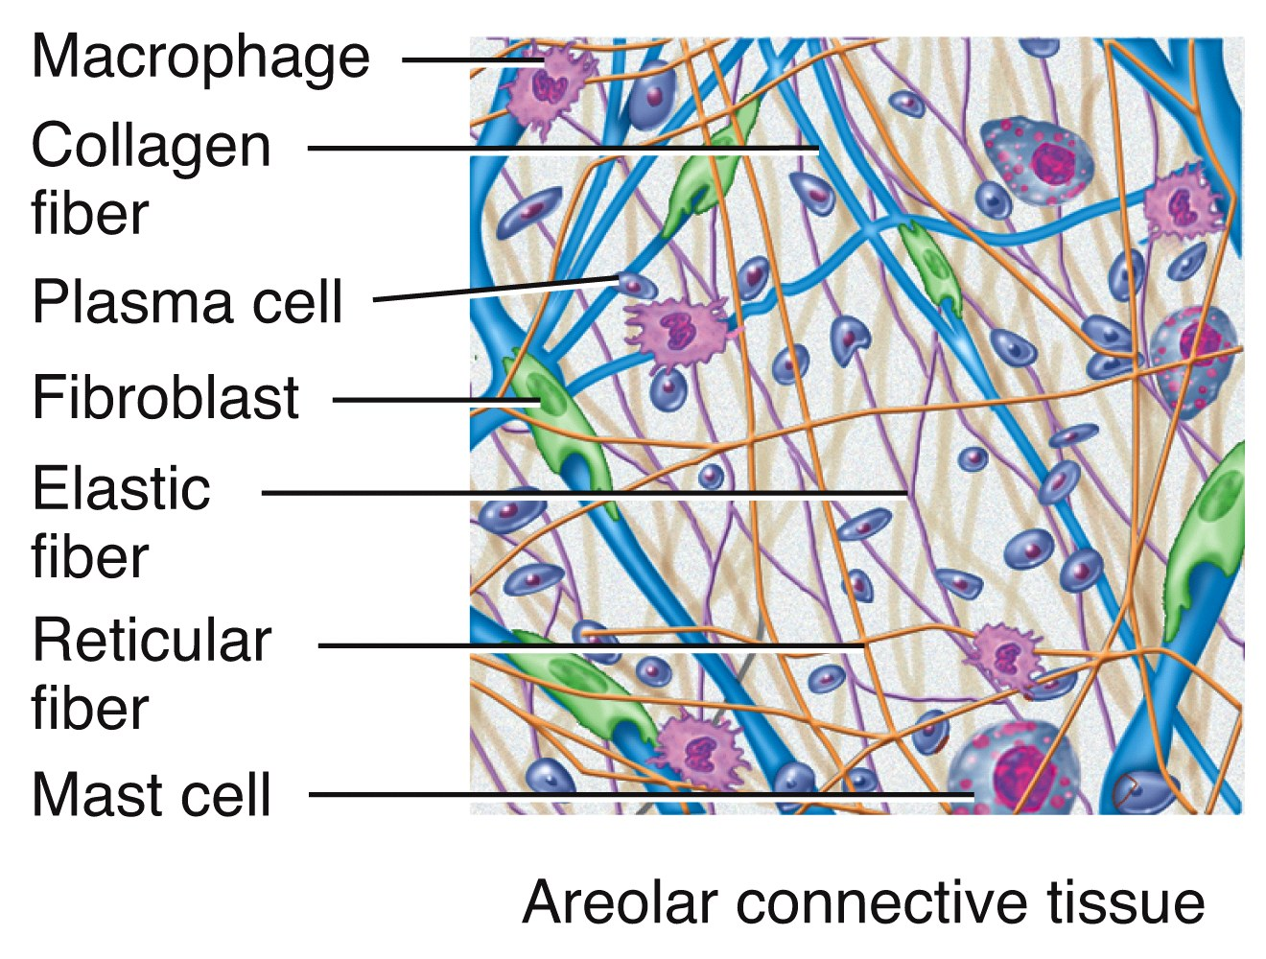
Cells Of Connective Tissues
Common C.T. cells
  Fibroblasts are the most numerous cell of connective tissues. These cells secrete protein fibers (collagen, elastin, & reticular
  fibers) and a
  “ground substance”
  which varies from
  one C.T. to another.

Slide 39
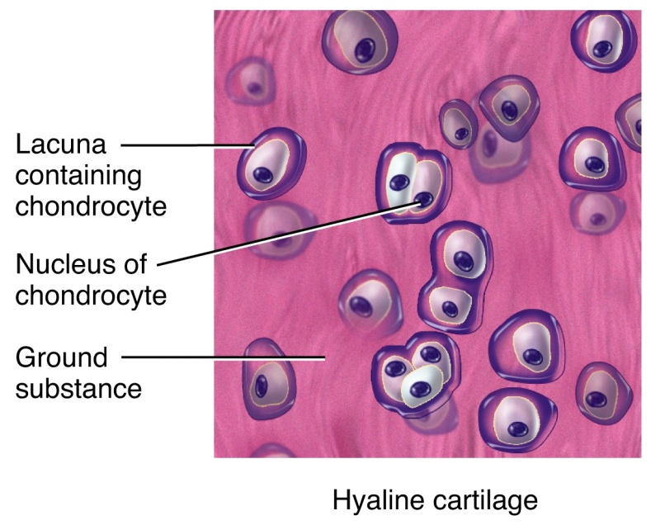
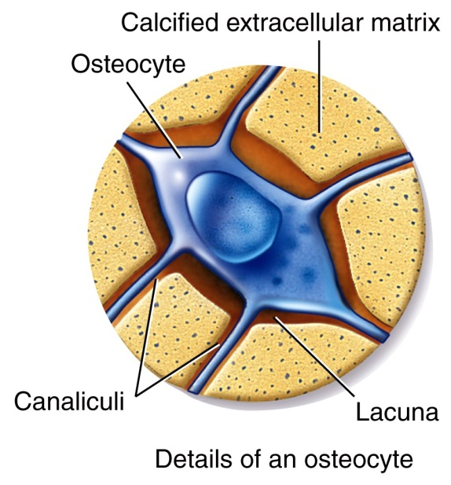
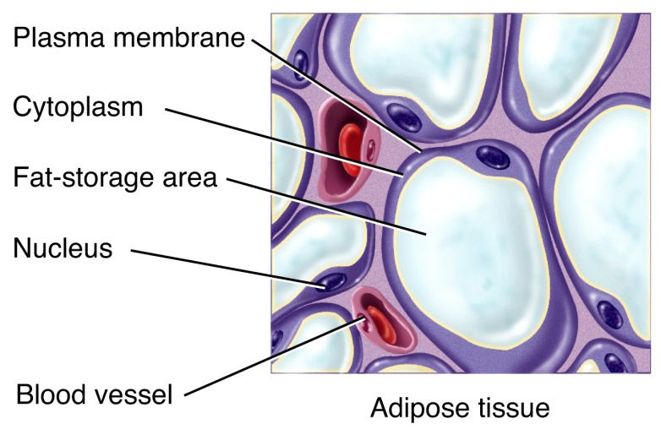
Cells of Connective Tissues
Of the other common C.T. cells:
  Chondrocytes make the various cartilaginous C.T.
  Adipocytes store triglycerides (fats).
  Osteocytes make bone.
  Blood: White blood cells (leucocytes), Red blood cells (erythrocytes), and platelets (thrombocytes)

Slide 40
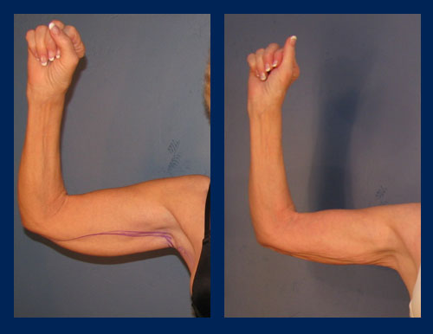
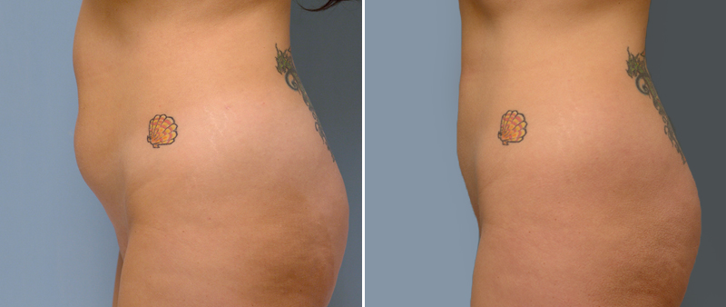
Clinical Connection
Liposuction
Liposuction is a surgical technique that improves the body's contour by removing excess fat from deposits located between the skin and muscle. Liposuction uses a small stainless steel tube, called a cannula (from the Latin word for reed, tube, cane), connected to a powerful suction pump and inserted into the fat through small incisions in the skin. Fat removal is accomplished as it creates tiny tunnels through the fatty layers. After surgery, these tiny tunnels collapse and thus result in an improved body contour.
Sounds easy but there can be complications…

Slide 41
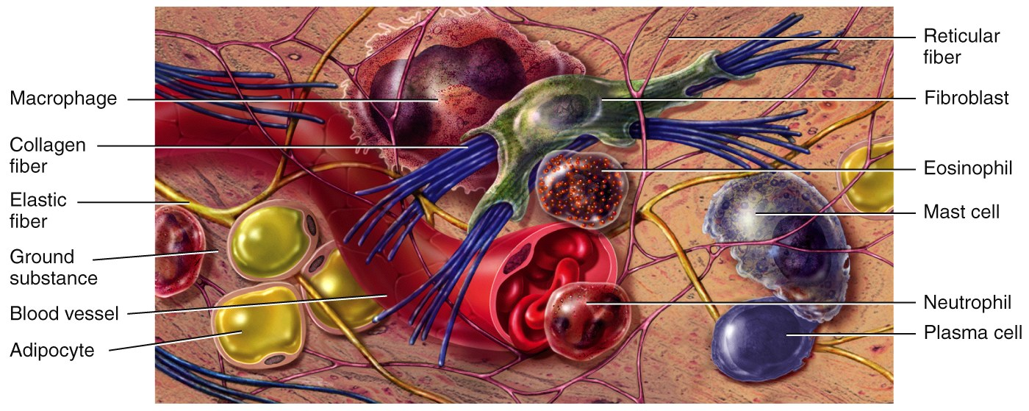
Connective Tissues
This graphic represents a collage of different C.T. elements (cells and fibers) and not a specific C.T.

Slide 42
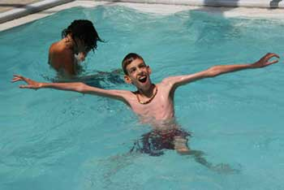
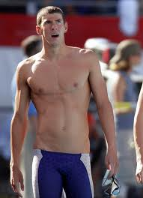

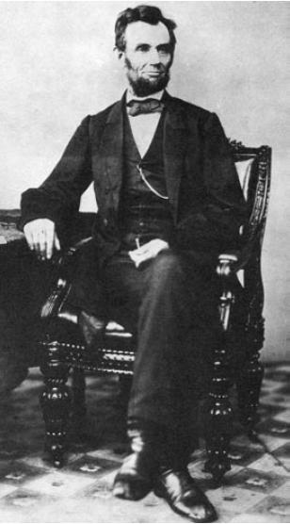

Clinical Connection
Marfan Syndrome
Marfan syndrome is a genetic disorder that affects the connective tissue that holds together all of the body's cells, organs and tissue and plays an important role in helping the body grow and develop properly. Problems with vision, long limbs, fingers, and aortic thinness oft results.
Former Baylor star Isaiah Austin
Is it possible?
http://espn.go.com/nba/draft2014/story/_/id/11119553/former-baylor-star-isaiah-austin-career-ending-medical-condition

Slide 43
Connective Tissue Classification
Embryonic connective tissue
  Mesenchyme
  Mucous connective tissue
Mature connective tissue
  Loose connective tissue
  Dense connective tissue
  Cartilage
  Bone
  Liquid
Do not worry your overstuffed and glorious little heads about this…must save some stuff for undergrad…

Slide 44


FYI: Embryonic Connective Tissues
There are 2 Embryonic Connective Tissues:
  Mesenchyme gives rise to all other connective tissues.
  Mucous C.T. (Wharton's Jelly) is a gelatinous substance within the umbilical cord and is a rich source of stem cells.
You need to know what these are…

Slide 45

Mature Connective Tissues
Loose Connective Tissues
  Areolar Connective Tissue is the most widely distributed in the body. It contains several types of cells and all three fiber types.
    It is used to attach skin and underlying tissues, and as a packing between glands, muscles, and nerves.
  Adipose
  Reticular

Slide 46


Mature Connective Tissues
MD: Mnemonic Device
(association…)
Loose Connective Tissues
  Loose areolar
  Adipose tissue is located in the subcutaneous layer deep to the skin and around organs and joints.
    It reduces heat loss and serves as padding and as an energy source.
  Reticular

Slide 47



Mature Connective Tissues
Loose Connective Tissues
  Loose areolar
  Adipose
  Reticular connective tissue is a network of interlacing reticular fibers and cells.
    It forms a scaffolding used by cells of lymphoid tissues such as the
    spleen and
    lymph nodes.
Means “marked like a net”

Slide 48


Mature Connective Tissues
Dense Connective Tissues
  Dense Irregular Connective Tissue consists predominantly of fibroblasts and collagen fibers randomly arranged. (like a sweater knitted by a beginner or a wardrobe recommended by this guy…)
    It provides strength when forces are pulling from many different directions.
  Dense regular
  Elastic

Slide 49

Mature Connective Tissues
Dense Connective Tissues
  Dense Irregular
  Dense regular Connective Tissue comprise tendons, ligaments, and other strong attachments where the need for strength along one axis is mandatory (a muscle pulling on a bone). (hey—like this guy’s belt!)
  Elastic

Slide 50

Mature Connective Tissues
Dense Connective Tissues
  Dense Irregular
  Dense regular
  Elastic Connective Tissue consists predominantly of fibroblasts and freely branching elastic fibers.
    It allows stretching of certain tissues like the elastic arteries and this man’s sense of fashion)

Slide 51

Mature Connective Tissues
Why?
Cartilage is a tissue with poor blood supply that grows slowly. When injured or inflamed, repair is slow.
  Hyaline cartilage is the most abundant type of cartilage; it covers the ends of long bones and parts of the ribs, nose, trachea, bronchi, and larynx.
    It provides a smooth surface for joint movement.
  Fibrocartilage
  Elastic cartilage

Slide 52

Mature Connective Tissues
Cartilage
  Hyaline cartilage
  Fibrocartilage, with its thick bundles of collagen fibers, is a very strong, tough cartilage.
    Fibrocartilage discs in the intervertebral spaces and the knee joints support the huge loads up and down the long axis
    of the body.
  Elastic cartilage
Why?

Slide 53

Mature Connective Tissues
Cartilage
  Hyaline cartilage
  Fibrocartilage
  Elastic cartilage consists of chondrocytes located in a threadlike network of elastic fibers.
    It makes up the malleable part of the external ear and the
    epiglottis.
Why?

Slide 54

Mature Connective Tissues
Bone is a connective tissue with a calcified intracellular matrix. In the right circumstances, the chondrocytes of cartilage are capable of turning into the osteocytes that make up bone tissue.
  We will study bone in detail in Chapter 6.

Slide 55

Mature Connective Tissues
Blood and lymph are atypical liquid connective tissues that we will study in Chapters 19 and 22. As we have seen, blood has many cells. It also has fibers (such as fibrin that makes blood clot).
What are the three? What is the extracellular matrix of blood called?

Slide 56

Summary of Mature Connective Tissues
duh.
Tissues, Part 4 - Types of Connective

Slide 57
Muscle and Nerve Tissues
Muscles and nerve tissues are the last of the 4 basic tissue types. Neurons and muscle fibers are considered excitable cells because they exhibit electrical excitability, the ability to respond to certain stimuli by producing electrical signals such as action potentials.
  Action potentials can propagate (travel) along the plasma membrane of a neuron or muscle fiber due to the presence of specific voltage-gated ion channels.
Each will be studied in depth in upcoming chapters.

Slide 58


Muscle and Nerve Tissues
Briefly explain the interdependence of these two tissue types…

Slide 59

Epithelial Membranes
Combining two tissues creates an organ. However, most of the organs and all of the organs systems studied this year contain all 4 basic types of tissues.
  Epithelial membranes are the simplest organs in the body, constructed of only epithelium and a little bit of connective tissue.
Notes:
Synovial membranes are not simple organs because they contain only connective tissue elements

Slide 60
Epithelial Membranes
Epithelial membranes (3)= epithelium + connective tissue
  Mucous membranes: line “interior” body surfaces open to the outside (GI tract, repro & resp tracts)
  Serous membranes: membranes that line internal surfaces
  Cutaneous membrane = skin
    Skin is not a simple organ. We will study the integument as our first organ system in the next chapter.
Synovial membranes enclose certain joints and are made of connective tissue only.
Epithelial glands are another example of simple organs
  Glands that secrete their contents directly into the blood are called endocrine glands.
  Glands that secrete their contents into a lumen or duct are called exocrine glands.
We are skipping the details of glandular types—and saving it for ch 18…
Notes:
Synovial membranes are not simple organs because they contain only connective tissue elements

Slide 61
Tissue Repair
A convenient way to refer to certain cells when discussing an organ’s tissues is whether it is the Parenchyma or Stroma.
  The parenchymal cells of an organ consist of that tissue which conducts the specific function of the organ. Cells of the stroma are everything else—connective tissue, blood vessels, nerves.
For example: The parenchyma of the heart is cardiac muscle cells. The nerves, intrinsic blood vessels, and connective tissue of the heart comprise the stroma.
Notes:
From Lab 4

Slide 62
FYI: Tissue Repair
Parenchyma is interesting because organ-specific function usually centers on parenchymal cells (“how’s your heart working?”), histological and physiological descriptions of the tissues of an organ often emphasize parenchyma.
Unfortunately, stroma is commonly ignored as just boring background tissue. No organ, however, can function without the mechanical and nutritional support provided by the stroma. (esp. viewed as note wothy by DO’s)
Notes:
From Lab 4

Slide 63
FYI: Tissue Repair
When tissue damage is extensive, return to homeostasis depends on active repair of both parenchymal cells and stroma.
  Fibroblasts divide rapidly.
  New collagen fibers are manufactured.
  New blood capillaries supply materials for healing.
All of these processes create an actively growing connective tissue called granulation tissue.

Slide 64

AGING…

Slide 65
Aging and Tissues
Tissue heals faster in young adults.
Surgery of a fetus normally leaves no scars.
Young tissues have a better nutritional state, blood supply, and higher metabolic rate.
Extracellular components also change with age.
Changes in the body’s use of glucose, collagen, and elastic fibers contribute to the aging process.

Slide 66

The end…
literally.
Chapter 4: Tissues: (but don’t start crying) A&P fall 2014 mr. e SRCS

