Slide 1
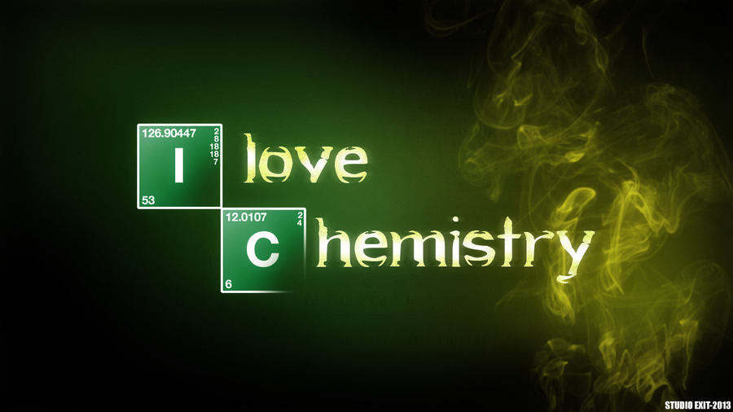
Intro to chem
Physical science
Spring 2016
mr e

Slide 2
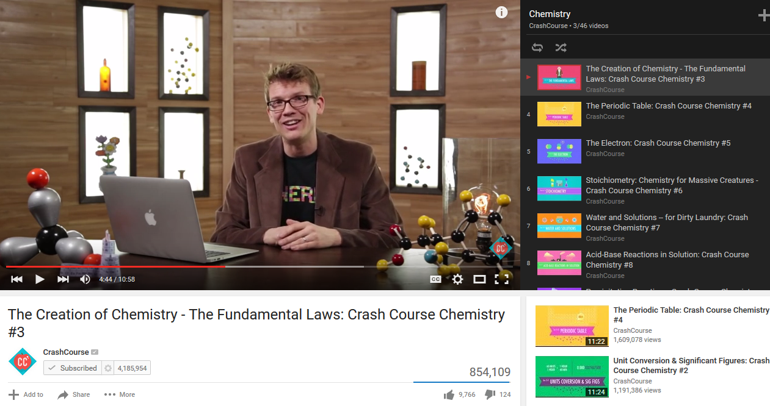
ntro to
The Creation of Chemistry - The Fundamental Laws: Crash Course Chemistry #3
What is Chem?
In a word? “Chemistry is the study of matter and the changes it undergoes…”

Slide 3

ntro to
Cast Fe dish painted with alkyd polymers and metallic pigments
Stainless steel (alloy of 10 metals)
What is Chem?
Polysaccharides grown by N-based organic fertilizers
Silicate window pane (melted sand)
Gaseous hydrocarbons laced with a mercaptan (S-based)
Solid cellulose and dye with mineral oil residue
Stainless steel alloy filled with high T H₂O
Alloy device filled with sodium laureth sulfates
Caffeinated beans…
Painted veneer with melamine topcoat and cellulose fiberboard
Wood veneer with melamine topcoat and cellulose fiberboard
Man-made quartz (SiO₂)
Bleached cotton treated with Teflon
Polymeric thermoplasic
comprised of practical, stylish, & affordable

Slide 4
ntro to
Why Study Chem?
10.
9.
8.
7.
6.
5.
4.
3.
2.
1.

Slide 5
ntro to
Unit Outline
Setting up the Lab
A. How did we get the periodic table?
1. Negative space
2. Mendeleev & Moseley
B. What does “Periodic” mean anyway?
II. Prepping the Reactants: making sense of the Periodic Table
Basic atomic structure
Places e- like to be, Things e- like to do
Chemspeak
D. Family Resemblances: Cracking the album open
E. e- dot notation
III. Cooking: Applying the Periodic Chart
Chemical bonding
Chemical formulae & equations
Maintaining the Balance
Reaction types
Using equations to Predict Products

Slide 6
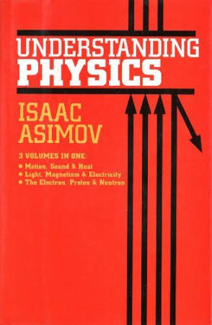

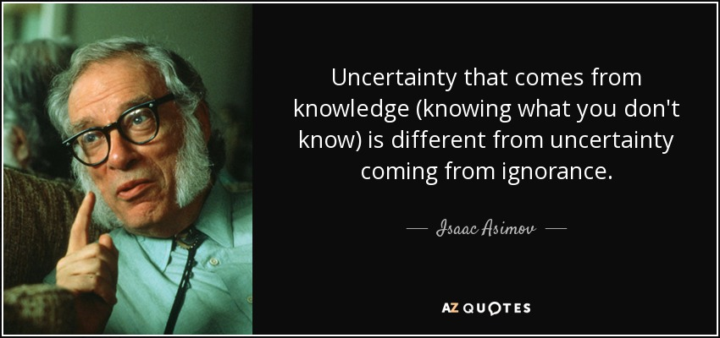
ntro to

Slide 7

ntro to
Unit Outline
Setting up the Lab
A. How did we get the periodic table?
1. The importance of Negative space
When has knowing what you don’t know revolutionized what man has been searching for?

Slide 8
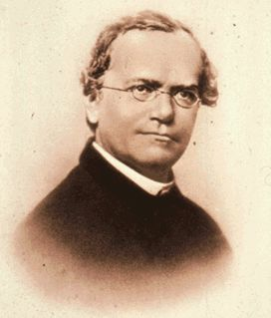
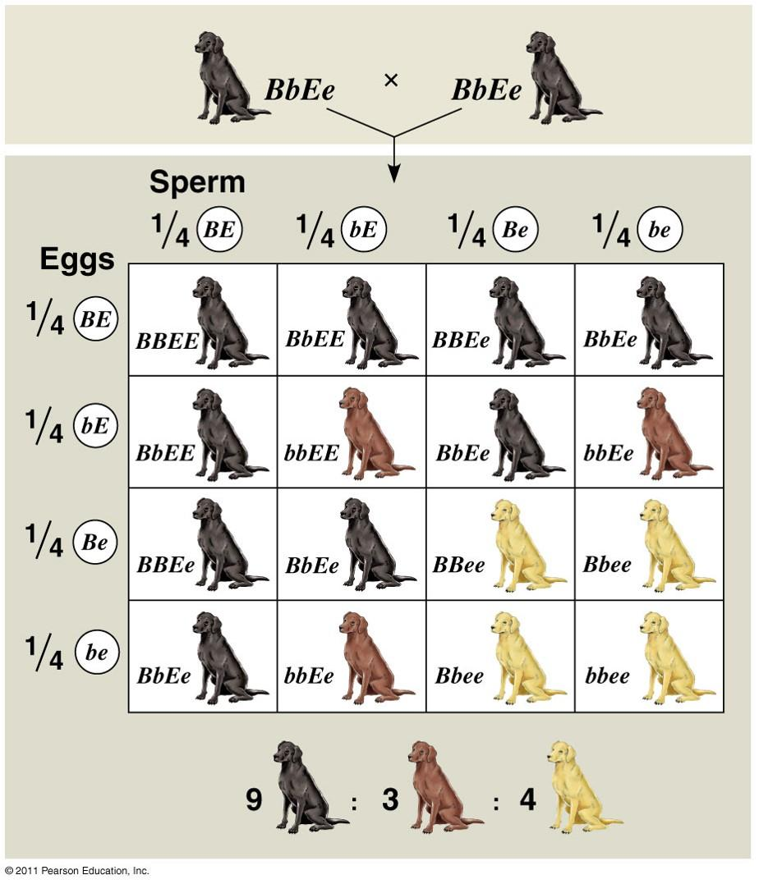
ntro to
Unit Outline
Setting up the Lab
A. How did we get the periodic table?
1. The importance of Negative space
When has knowing what you don’t know revolutionized what man has been searching for?
Consider the genetic notion of carriers…
Gregor Mendel
1822-1884

Slide 9
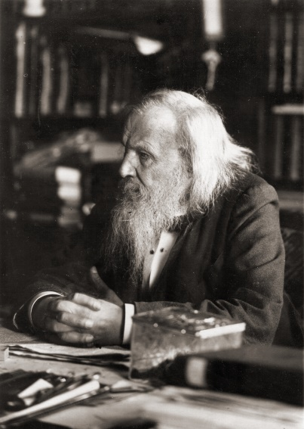
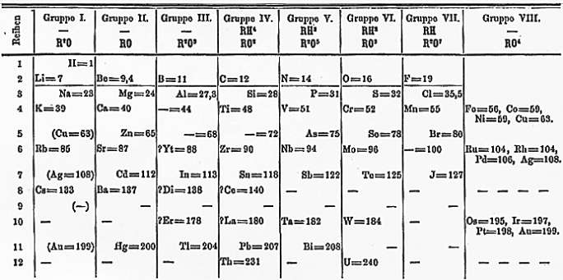
ntro to
Unit Outline
Setting up the Lab
A. How did we get the periodic table?
1. The importance of negative space
2. Mendeleev & Mosely
When has knowing what you don’t know revolutionized what man has been searching for?
Consider the chemical notion of gaps in the periodic chart…
The Periodic Table: Crash Course Chemistry #4
The genius of Mendeleev's periodic table - Lou Serico

Slide 10
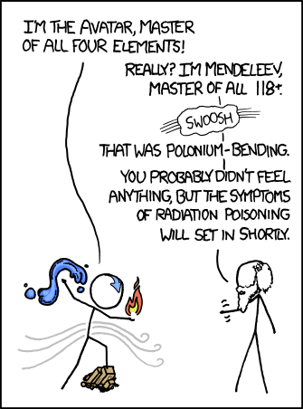
ntro to
Unit Outline
Setting up the Lab
A. How did we get the periodic table?
1. The importance of Negative space

Slide 11
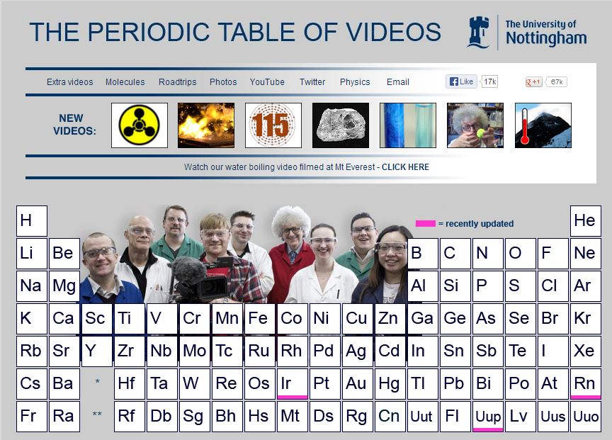
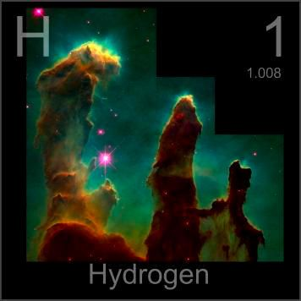

ntro to
Hydrogen

Slide 12
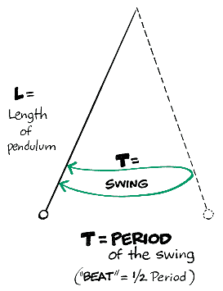
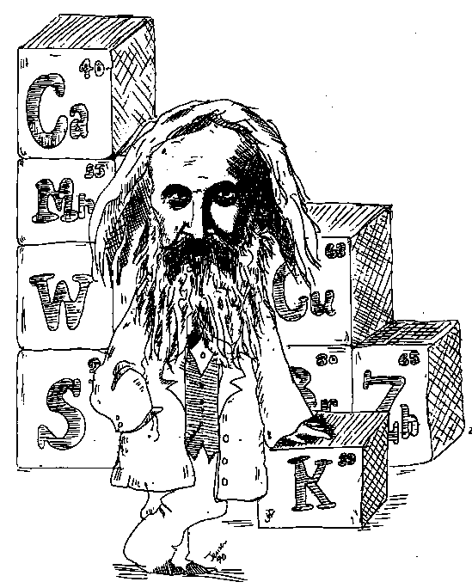
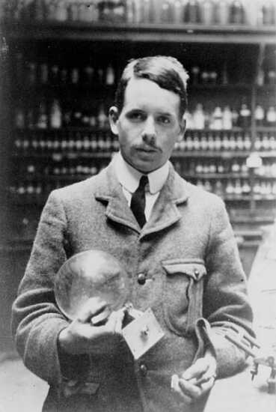
ntro to
Unit Outline
Setting up the Lab
A. How did we get the periodic chart?
B. What does “Periodic” mean anyway?
Arranging these elements according to atomic masses and properties, Mendeleev became the “Father of the modern Periodic Table.”
Eventually, what was termed the ‘periodic law’ changed from Mendeleev’s means…
Why couldn’t I have thought of this?
Moseley’s means…
"The properties of the elements are a periodic function of their atomic masses"
"The properties of the elements are a periodic function of their atomic NUMBERS"
to

Slide 13
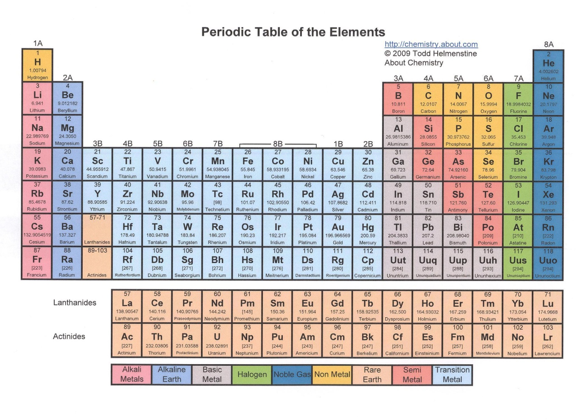
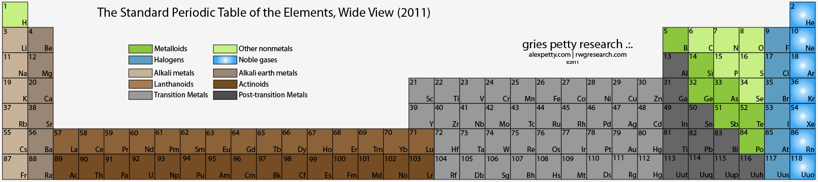
ntro to
Unit Outline
Setting up the Lab
A. How did we get the periodic chart?
B. What does “Periodic” mean anyway?

Slide 14
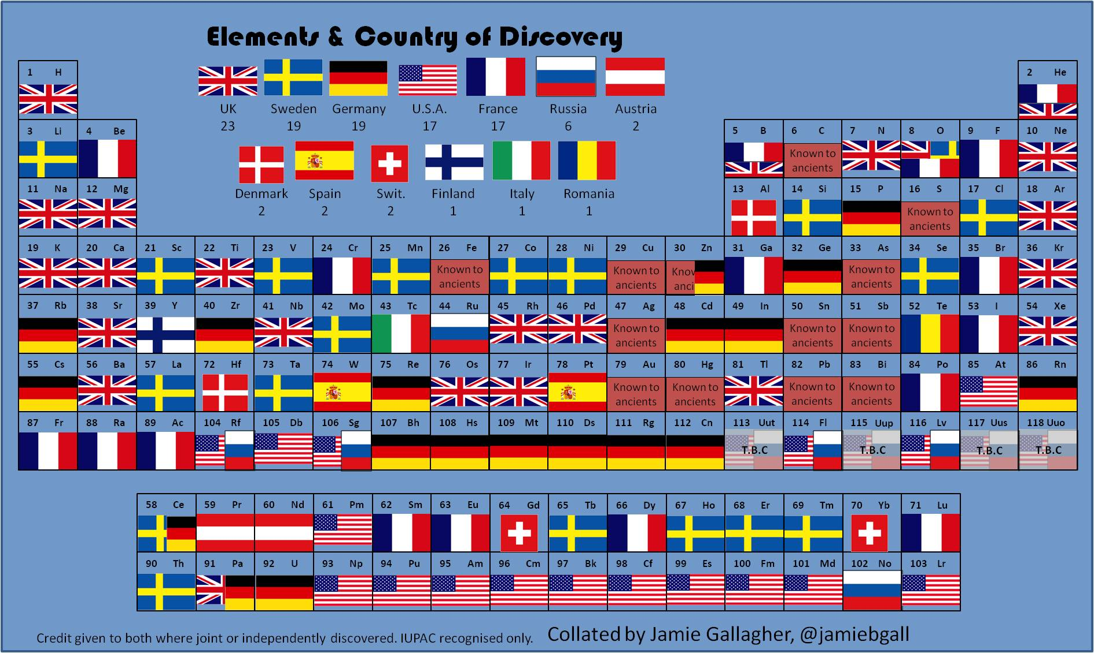
ntro to
Unit Outline
Setting up the Lab
A. How did we get the periodic chart?
B. What does “Periodic” mean anyway?

Slide 15
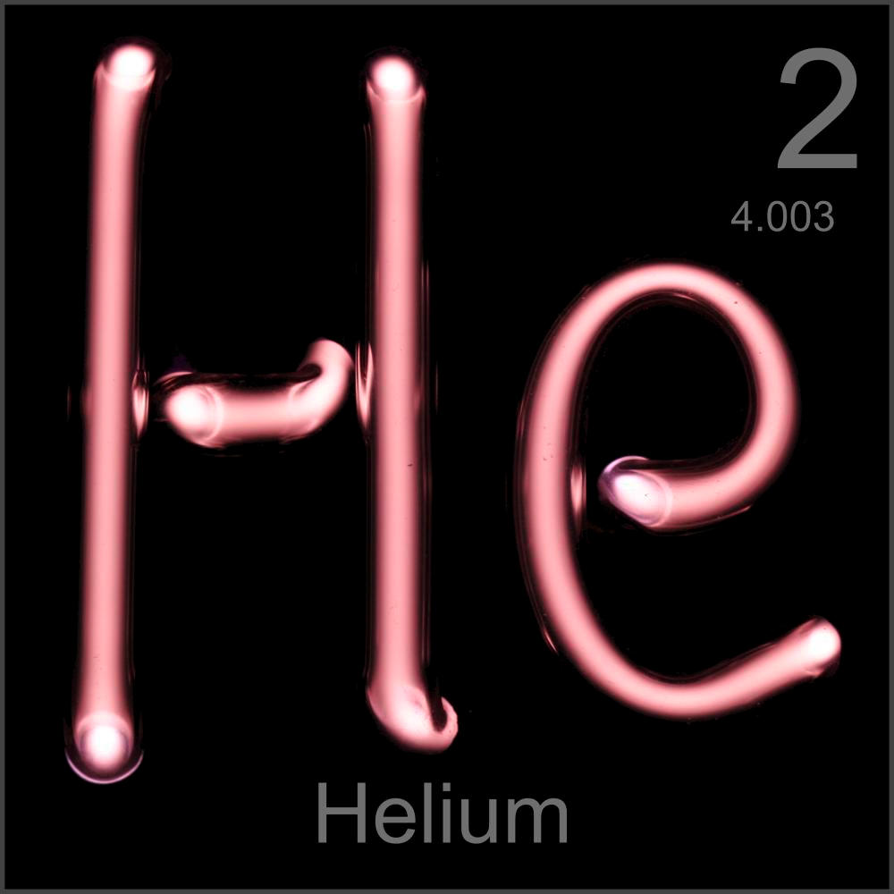
ntro to
Helium

Slide 16
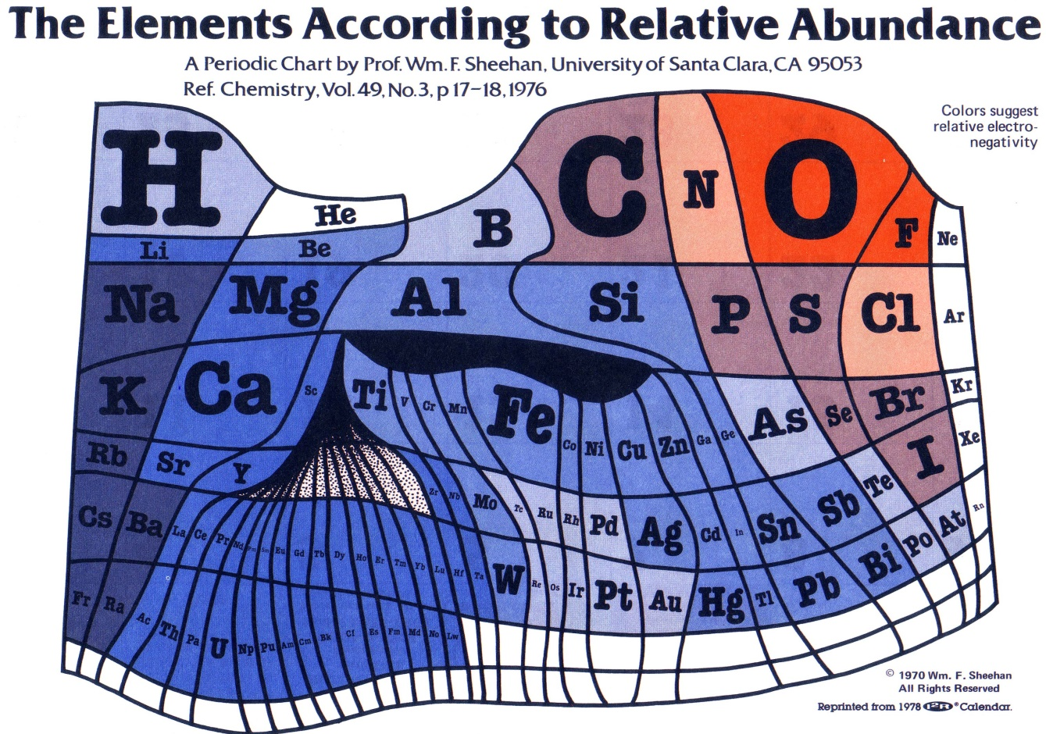
ntro to
Unit Outline
Setting up the Lab
A. How did we get the periodic chart?
B. What does “Periodic” mean anyway?

Slide 17
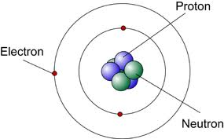
ntro to
Discovered 2nd; positive charge (+1); responsible for atomic IDENTITY
Unit Outline
Setting up the Lab
II. Prepping the Reactants: making sense of the Periodic Table
Basic atomic structure
Discovered 1st; negative charge (-1); responsible for atomic CHARGE
What’s in an atom?
Atoms are made of protons, neutrons, and electrons.
1. Nucleus contains nucleons) nº and p+
a. Neutrons are neutrally charged (nº)
b. Protons are positively charged (p+)
c. Both are similar and size and mass
2. Electrons move in clouds outside of the nucleus
a. Electrons have a negative charge
b. Electrons are very small in comparison to protons and neutrons (so small that mass is unaccounted for)
nucleons
Play to 6:35
Discovered last; neutral charge; responsible for nuclear MASS
The Nucleus: Crash Course Chemistry #1
Play to 4:35
The Electron: Crash Course Chemistry #5

Slide 18
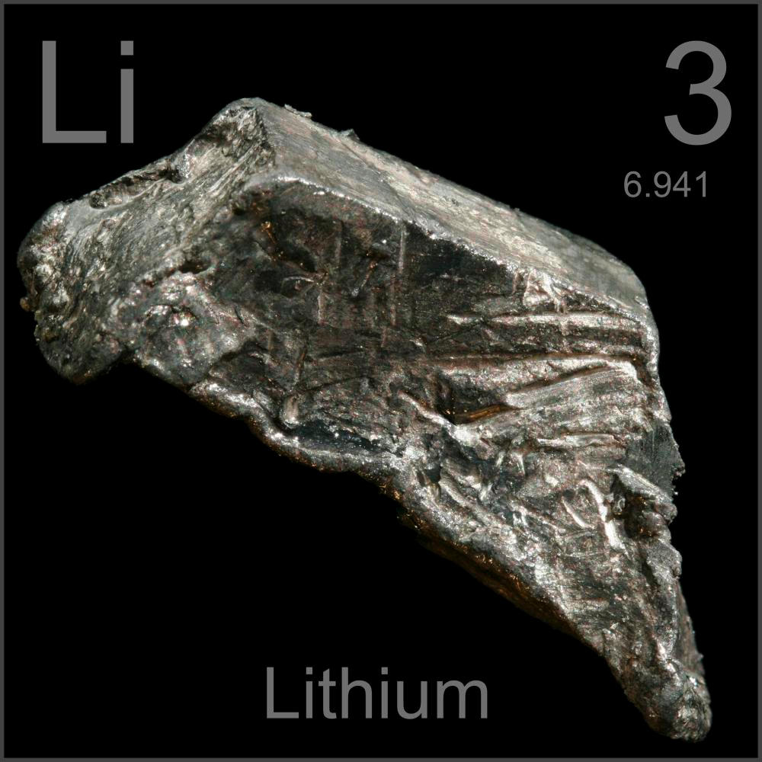
ntro to
Lithium

Slide 19
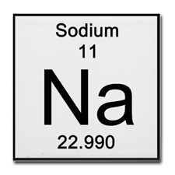
ntro to
Unit Outline
Setting up the Lab
II. Prepping the Reactants: making sense of the Periodic Table
Basic atomic structure
Play from 6:35
The Nucleus: Crash Course Chemistry #1
General Rules for Chemical symbols:
1. The first letter of a chemical symbol is always capitalized.
2. When a second letter is used, it is lowercase.
Elemental name
atomic number
Chemical symbol
atomic mass

Slide 20
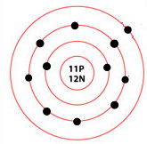
ntro to
Unit Outline
Setting up the Lab
II. Prepping the Reactants: making sense of the Periodic Table
Basic atomic structure
Let’s see how this relates to its Periodic box…
This is a Sodium atom
How many p⁺? nº?
atomic number
Describes
# of p⁺
# of e- in a stable atom
How many e-?
If atomic masses are whole #’s. why is this a decimal?
atomic mass
AS A WHOLE #, describes:
# of p⁺+ # of nº
They are: Weighted average of relative amounts of Isotopes of element

Slide 21
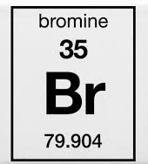
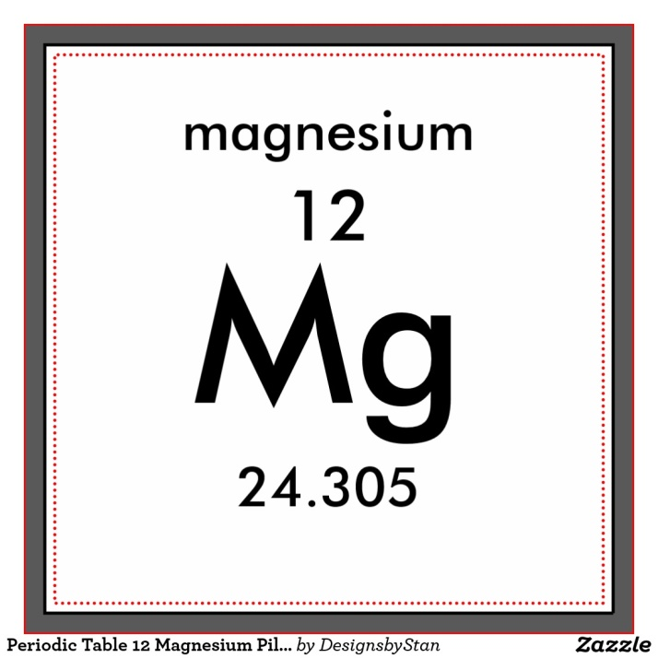
ntro to
Unit Outline
Setting up the Lab
II. Prepping the Reactants: making sense of the Periodic Table
Basic atomic structure
Let’s see how this works…
How many p⁺? nº?
How many p⁺? nº?
How many e-?
How many e-?

Slide 22


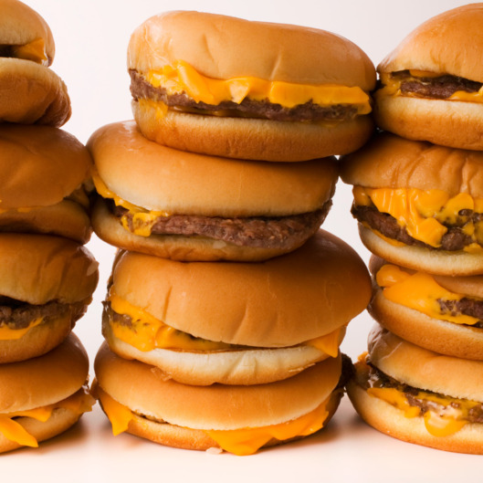
ntro to
Suppose that my Seth and I go to McDonalds and order three cheeseburgers...
Unit Outline
Setting up the Lab
II. Prepping the Reactants: making sense of the Periodic Table
Basic atomic structure
Places e- like to be, Things e- like to do
Suppose that these represent e-
When we get to the table I find that Seth has two and I have one... What options do we have?

Slide 23
ntro to
Unit Outline
Setting up the Lab
II. Prepping the Reactants: making sense of the Periodic Table
Basic atomic structure
Places e- like to be, Things e- like to do
I could “gain” a burger…
we could share
I could “lose” my burger…

Slide 24
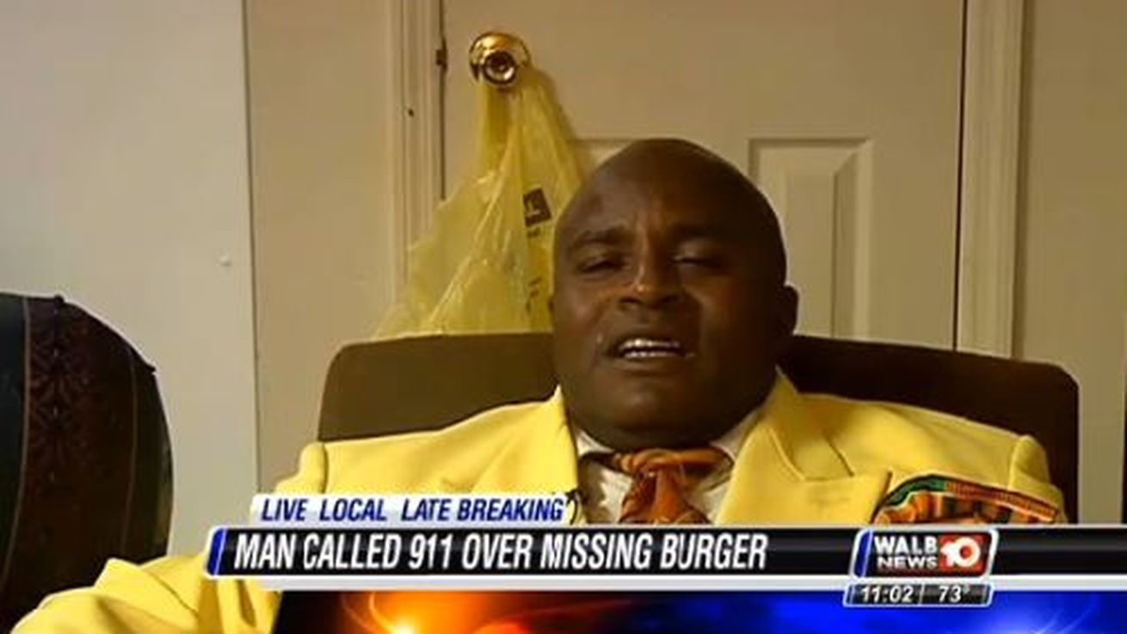
ntro to
Unit Outline
Setting up the Lab
II. Prepping the Reactants: making sense of the Periodic Table
Basic atomic structure
Places e- like to be, Things e- like to do
We end up doing the inevitable with the “extra burger”…which is to make sure each is “satisfied”
(at least we did not do what this dude did)

Slide 25
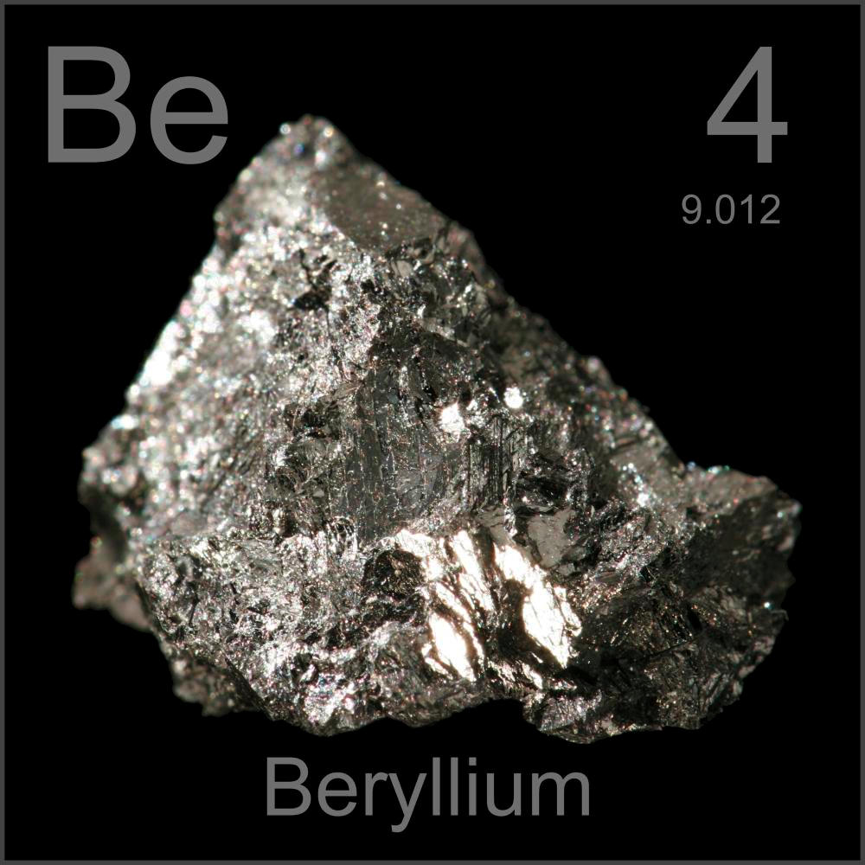
ntro to
Beryllium

Slide 26
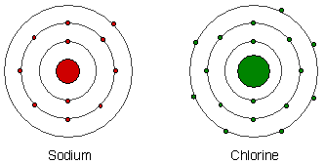
ntro to
Unit Outline
Setting up the Lab
II. Prepping the Reactants: making sense of the Periodic Table
Basic atomic structure
Places e- like to be, Things e- like to do
This is a Sodium atom
This is a Chlorine atom
Valence e-
PEL’s
For now… The Octet Rule: an atom is “satisfied” once it has 8e- in its outer shell

Slide 27
ntro to
Unit Outline
Setting up the Lab
II. Prepping the Reactants: making sense of the Periodic Table
Basic atomic structure
Places e- like to be, Things e- like to do
This is a Sodium atom
This is a Chlorine atom
In the presence of Cl atoms, what possible options does Na have?
In the presence of Cl atoms, what does Na actally do?

Slide 28
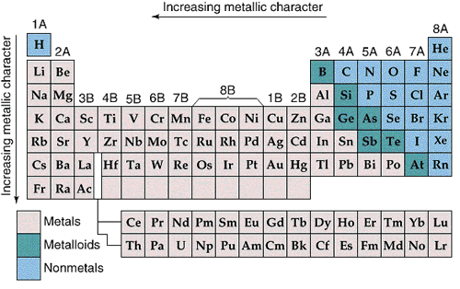
ntro to
Unit Outline
Places e- like to be, Things e- like to do
This is a Sodium atom
1
2
3
4
5
6
7
This is a Chlorine atom
Notice any correlations between the chart and the atoms?

Slide 29
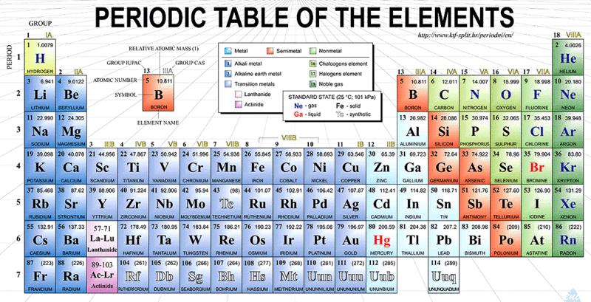
ntro to
What are Period & Groups?
Unit Outline
Places e- like to be, Things e- like to do
With whom do the alkali like to bond? How? Why?
With whom do the alkaline earth metals like to bond? How? Why?
With whom do groups 3A-6A like to bond? Why?

Slide 30
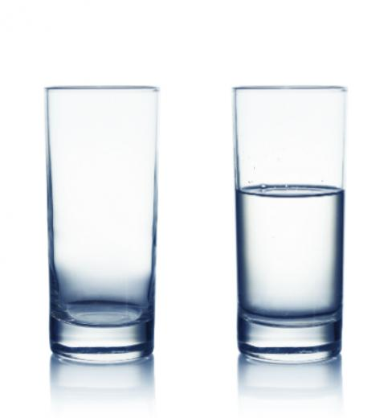
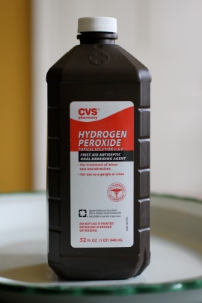
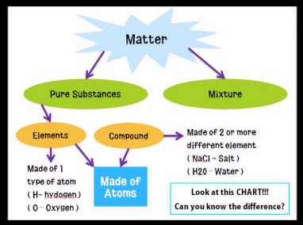
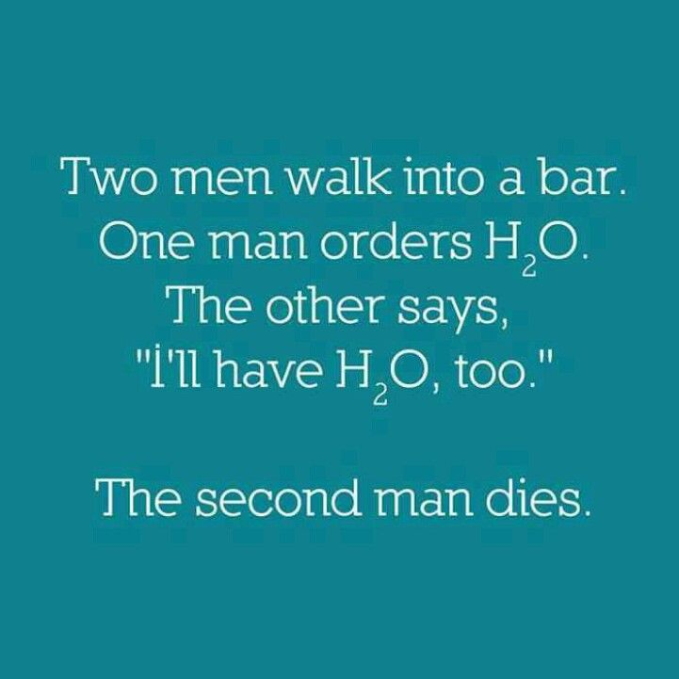
ntro to
Unit Outline
Setting up the Lab
II. Prepping the Reactants: making sense of the Periodic Table
Chemspeak
Anything that takes up space and has mass… (V&M)
They Might Be Giants - Meet the Elements
A compound can be broken down by chemical means…elements cannot—why?
These elements are combined in fixed proportions (important?)

Slide 31
ntro to
Unit Outline
Setting up the Lab
II. Prepping the Reactants: making sense of the Periodic Table
D. Family Resemblances: Cracking the album open
FAMILIES/GROUPS
1. Tend to share a resemblance to one another (if not visual—then chemical)
2. Reactivity increases or decreases (eg. )
3. Share = # of valence e-
PERIODS
1. Tend to radically differ from one another
2. Each period adds another new E level (PEL)
Alkali metals in water
Metallic, tend to give up e-
Nonmetallic, tend to gain e-
Unreactive, tend to be satisfied with own e-

Slide 32
ntro to
Unit Outline
Places e- like to be, Things e- like to do
A Tour of the Periodic Table

Slide 33
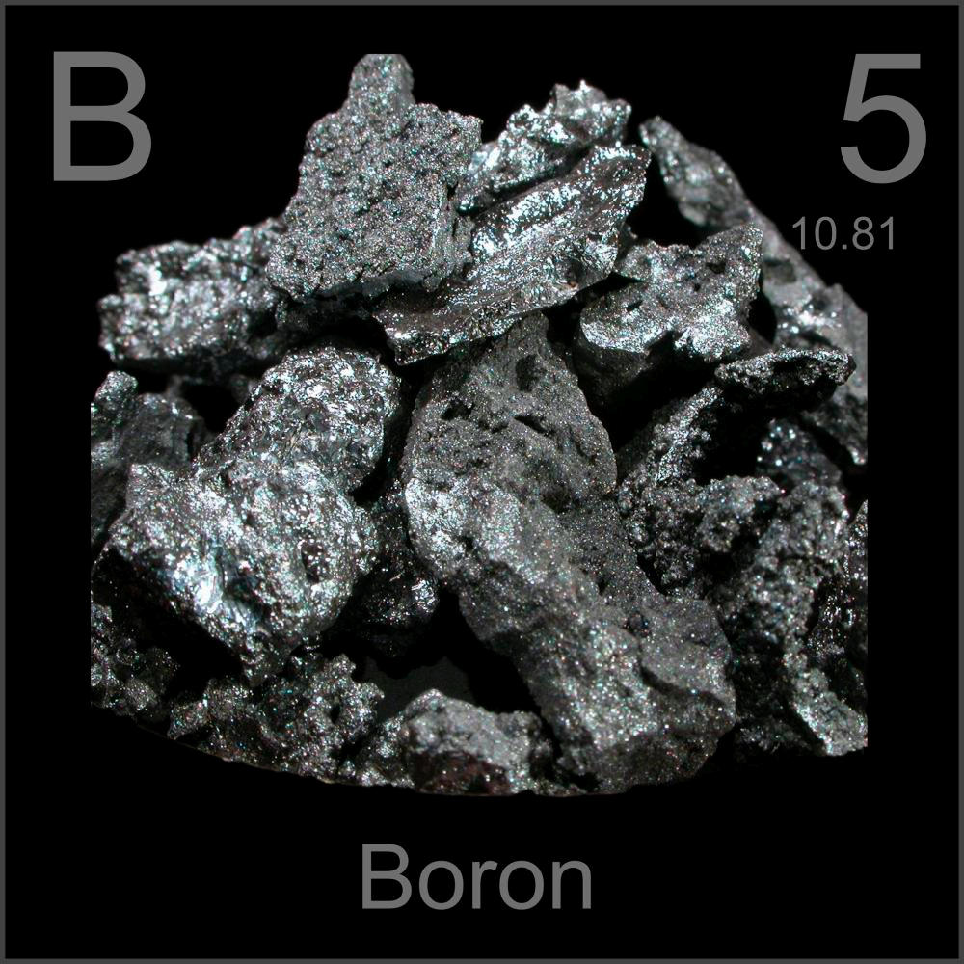
ntro to
Boron

Slide 34
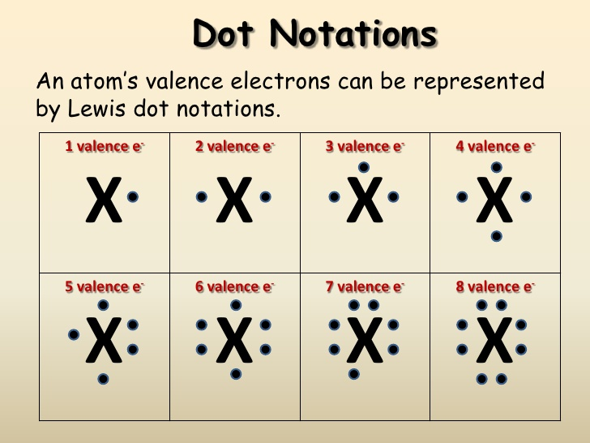
ntro to
Unit Outline
Setting up the Lab
II. Prepping the Reactants: making sense of the Periodic Table
E. e- dot notation
3
7
2
1
6
5
4
8

Slide 35
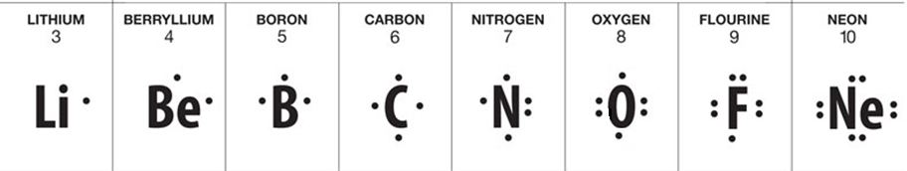
ntro to
Unit Outline
Setting up the Lab
II. Prepping the Reactants: making sense of the Periodic Table
E. e- dot notation
3
7
2
1
6
5
4
8
.

Slide 36
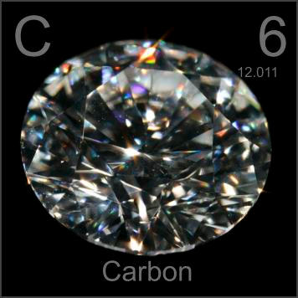
ntro to
Carbon

Slide 37
ntro to
Unit Outline
Places e- like to be, Things e- like to do
Physical and Chemical Changes
Physical changes occur when matter changes its property but not its chemical nature (identity).
Physical property changes could include a change in: texture, shape, size, volume, mass, weight, and density.
Physical changes are typically reversible
Chemical changes are changes matter undergoes when it becomes new or different matter by breaking bonds and rearranging atoms.
To identify a chemical change look for signs such as color change, bubbling and fizzing (gas), heat & light production (E), and smoke.
Chemical changes are not reversible.

Slide 38
ntro to
Unit Outline
Places e- like to be, Things e- like to do
Chewing up a bite of hamburger: a. Teeth chewing sandwich; b. saliva digesting
You take a shower and your wet hair begins to dry.
Silver nitrate and sodium chloride mix to form a grey-violet precipitate.
Trimming a plant because it has grown too high.
Mashing up potatoes to make mashed potatoes; melting butter into the fluffy mix.
Sodium polyacrylate and water mix in a bowl to form a gel. When the water evaporates, the sodium polyacrylate remains in the bowl.
Hydrogen peroxide is poured on some liver the liver begins to break down.

Slide 39
ntro to
Unit Outline
Places e- like to be, Things e- like to do
8. You leave your bicycle out in the rain and it rusts.
9. A sugar cube dissolves in tea.
10. Pure potassium is normally stored in oil. When the oil is removed, a flame is produced because the potassium can now react with water vapor in the air.
11. Sand is mixed with water.
12. Scientists break up water (called hydrolysis) up by separating it into O₂ and H₂
13. You are cleaning your bathroom and you accidentally mix bleach and ammonia, which produces a toxic gas, which makes you pass out.
14. Burning coal for a barbecue.

Slide 40
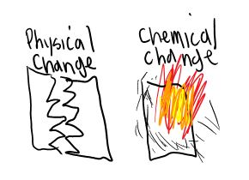
Physical & Chemical Changes Inquiry
Video links for each station

Slide 42
Stations 1-6
Single Displacement Mg and HCl - YouTube
Station 1: Mg and HCl
Station 2: Heating Sucrose
Station 3 : Silver nitrate and Hydrochloric acid
Station 4 : Potassium iodide and lead nitrate
Station 5 : Copper(II) chloride and Aluminum foil
Station 6 : H₂SO4 and antacid
Dehydration of Sugar By Heat - YouTube
HCL + Silver Nitrate - YouTube
reaction of LEAD NITRATE & POTASSIUM IODIDE solutions - YouTube
Potassium iodide and lead nitrate - YouTube
Copper (ii) chloride solution and aluminium foil. - YouTube
Neutralization Reaction of an Antacid - YouTube

Slide 43
ntro to
Unit Outline
Setting up the Lab
II. Prepping the Reactants: making sense of the Periodic Table
III. Cooking: Applying the Periodic Chart
Chemical bonding
Chemical formulae & equations
Maintaining the Balance
Reaction types
Using equations to Predict Products

Slide 44

ntro to
How much a particular atom likes its e- determines what it will yield to or take from another atom. This determines the type of bond that forms between them—and, ultimately , the characteristics of the result
Unit Outline
III. Cooking: Applying the Periodic Chart
Chemical bonding
Remember these two? What type of bond forms between them?
Look first at…
This is a Sodium atom
This is a Chlorine atom
The movement of the singular valence e- from Na forms which type of ion? Additional e- to Cl forms the other called a _________.
This bond is typical between a metal and a nonmetal…

Slide 45
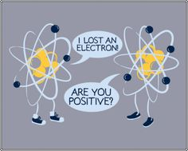
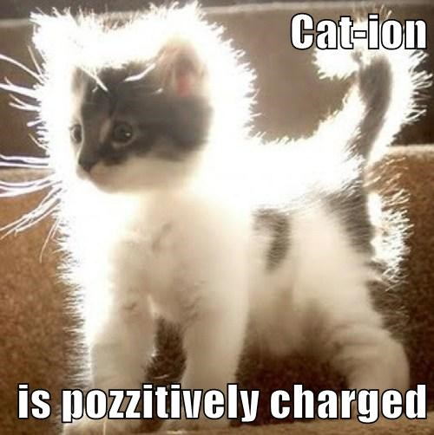
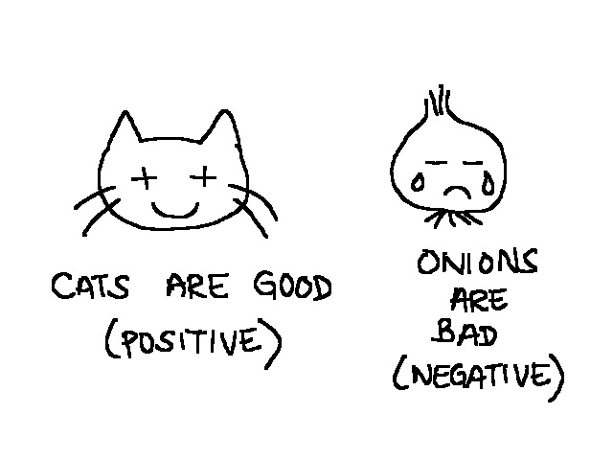
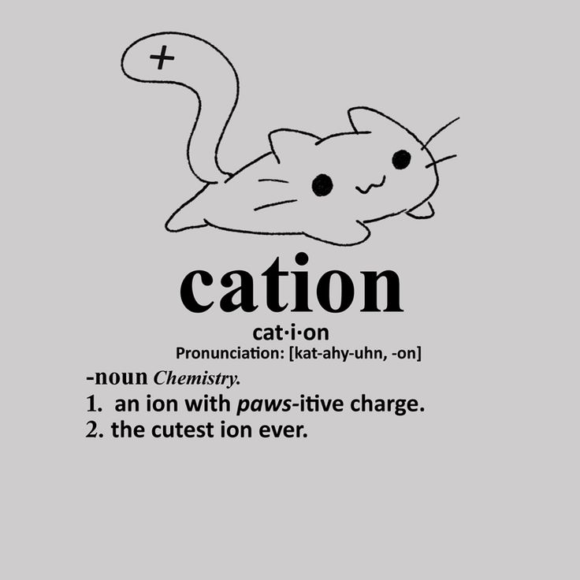
ntro to
Unit Outline
III. Cooking: Applying the Periodic Chart
Chemical bonding
Ionic bonds are formed by the attraction b/w cations (+) and anions (-)

Slide 46
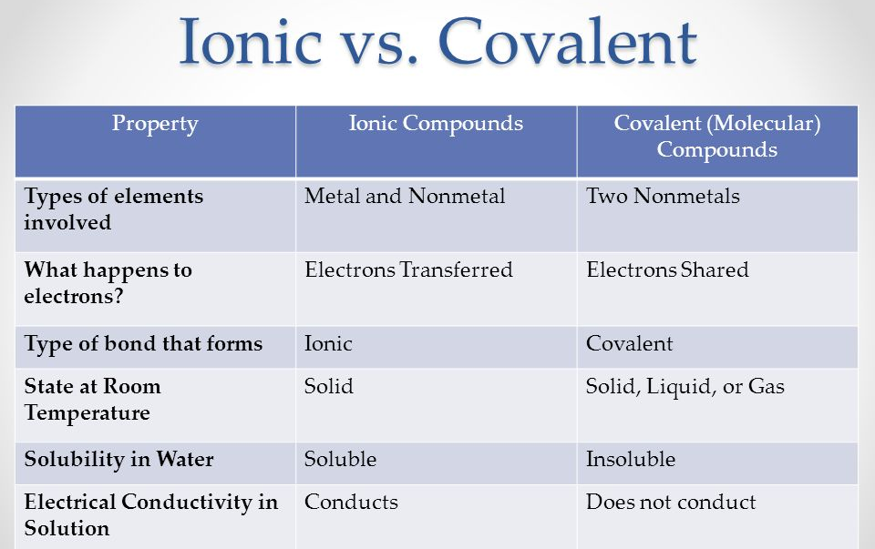
ntro to
Unit Outline
III. Cooking: Applying the Periodic Chart
Chemical bonding

Slide 47
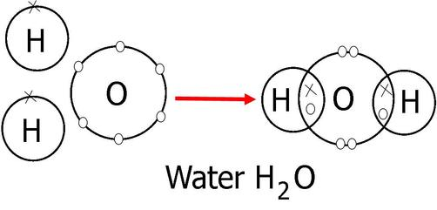
ntro to
Unit Outline
III. Cooking: Applying the Periodic Chart
Chemical bonding: Covalent
This bond is typical between a two nonmetals…
Here’s the math on what happens:
O brings 6e- needs 8e-
H brings 1e- needs 2e-
H brings 1e- needs 2e-
8e- 12e-
Need 12e-
Bring 8e-
SHARE: 4e- (2 bonds b/c 2e- = 1 bond)
How many valence e- does O need?
How many does each H need? How can they solve it?
Here’s the math on the PEL’s & what they can theoretically hold: 2n²; n=E level

Slide 48
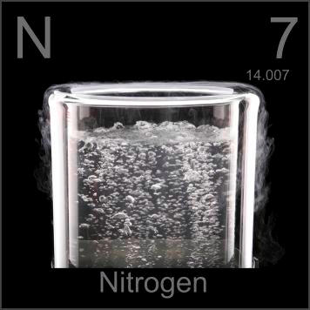
ntro to
Nitrogen Triiodide
Slow Motion Contact Explosive - Nitrogen Triiodide
Nitrogen

Slide 49

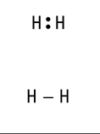
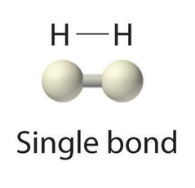
ntro to
Unit Outline
III. Cooking: Applying the Periodic Chart
Chemical bonding: Covalent
Here’s the math on what happens:
H brings 1e- needs 2e-
H brings 1e- needs 2e-
2e- 4e-
Need 4e-
Bring 2e-
SHARE: 2e- (1 bond b/c 2e- = 1 bond)

Slide 50
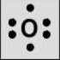


ntro to
Unit Outline
III. Cooking: Applying the Periodic Chart
Chemical bonding: Covalent
Here’s the math on what happens:
O brings 6e- needs 8e-
O brings 6e- needs 8e-
12e- 16e-
Need 16e-
Bring 12e-
SHARE: 4e- (2 bonds b/c 2e- = 1 bond)
+

Slide 51


ntro to
Unit Outline
III. Cooking: Applying the Periodic Chart
Chemical bonding: Covalent
Here’s the math on what happens:
O brings 6e- needs 8e-
O brings 6e- needs 8e-
C brings 4e- needs 8e-
16e- 24e-
Need 24e-
Bring 16e-
SHARE: 8e- (4 bonds b/c 2e- = 1 bond)
When confused about which atom(s) to use as the central atom, C is very typically a central atom b/c it is the basis of organic life forms

Slide 52
ntro to
Unit Outline
III. Cooking: Applying the Periodic Chart
Chemical bonding: Covalent
Here’s the math on what happens:
N brings e- needs e-
N brings e- needs e-
e- e-
Need e-
Bring e-
SHARE: e-
Try your hand at drawing a typical nitrogen molecule (N₂)
Here are the steps:
Draw the dot structures of the atoms involved
Find out how e- are shared (e- needed minus e- brought)
Draw molecule with the shared e- between them such that all will end up with 8e-

Slide 53
ntro to
Unit Outline
III. Cooking: Applying the Periodic Chart
Chemical bonding: Covalent
a nitrogen molecule (N₂) is made up of very strong bonds…

Slide 54

ntro to
Oxygen

Slide 55


ntro to
Unit Outline
III. Cooking: Applying the Periodic Chart
Chemical bonding
Chemical formulae & equations
Chemists use chemical symbols to represent elements and chemical formulas to represent compounds
A chemical formula tells us the number of atoms of each element in a compound.
It contains the symbols of the atoms of the elements present in the compound, as well as how many there are for each element in the form of subscripts.
Does it matter the order?
If one looks at it from a humanities perspective:
A chemical symbol is to a letter
A chemical formula is to a word
A chemical equation is to a sentence.

Slide 56

ntro to
Unit Outline
III. Cooking: Applying the Periodic Chart
Chemical bonding
Chemical formulae & equations
What is a chemical equation?
Numbers used to obey the law (more about this later)
Substance(s) put together to react in some way
Substance(s) produced by the reaction

Slide 57
ntro to
Unit Outline
III. Cooking: Applying the Periodic Chart
Chemical bonding
Chemical formulae & equations
How do I know this is a chemical reaction?
hydrogen and oxygen make water
Combustion of hydrogen and oxygen
Look at the nature of the reactants…
Look at the nature of the product

Slide 58



ntro to
Unit Outline
III. Cooking: Applying the Periodic Chart
Chemical bonding
Chemical formulae & equations
How do I know this is a chemical reaction?
How to make Table Salt!
Neutralization of Sodium Hydroxide by Hydrochloric Acid
Look at the nature of the reactants…
Look at the nature of the products

Slide 59


ntro to
Unit Outline
III. Cooking: Applying the Periodic Chart
Chemical bonding
Chemical formulae & equations
Maintaining the Balance
How do I know this is a chemical reaction that could possibly occur?
Remember me?
Near the time when Mozart was composing his final works, I discovered this: (it doesn’t fit on this paltry slide)

Slide 60

ntro to
Unit Outline
III. Cooking: Applying the Periodic Chart
"We may lay it down as an incontestible axiom, that, in all the operations of art and nature, nothing is created; an equal quantity of matter exists both before and after the experiment; the quality and quantity of the elements remain precisely the same; and nothing takes place beyond changes and modifications in the combination of these elements."
In other words… in any physical change or chemical reaction, mass is conserved. In a word: “Mass is neither created nor destroyed.” What is this Law called?

Slide 61
ntro to
Unit Outline
III. Cooking: Applying the Periodic Chart
Chemical bonding
Chemical formulae & equations
Maintaining the Balance
How do I know this is a chemical reaction that could possibly occur?
Therefore, what goes in must come out…Can this occur as stated?
BTW….here we introduce the idea of DIATOMIC molecules…

Slide 62
ntro to
These are less tricky than they sound…we will get to know them a bit using a table I will hand out
Unit Outline
III. Cooking: Applying the Periodic Chart
C. Maintaining the Balance
When balancing equations, there are several things you should bear in mind:
Start from left to right.
Change coefficients (not subscripts!)..remember, we can alter the amounts…but we may not fool with the identity of the substances themselves! Progress from 1 to 2 and so on (low to high).
You cannot place a coefficient in the middle of a formula.
Treat polyatoms as one unit (“married as it were”).
Double-check yourself, making sure all the coefficients are in the lowest possible ratio.
Watch for tricky ones [like diatomics or H₂O which can also be written H(OH)]; I usually save O for last…
Have loads of fun!

Slide 63

ntro to
DIATOMIC molecules result when these 7 elements find themselves unattached to anything else and, in a chemical equivalent of Noah’s Ark, bind to another atom of the same kind forming a “2-atomed” molecule of that substance.

Slide 64

ntro to

Slide 65

ntro to
Fluorine

Slide 66

ntro to
Neon

Slide 67
ntro to
Unit Outline
III. Cooking: Applying the Periodic Chart
C. Maintaining the Balance
Balance these equations:
Zn + HCl ---> ZnCl₂ + H₂
KClO₃ ---> KCl + O₂
S₈ + F₂ ---> SF₆
Fe + O₂ ---> Fe₂O₃
C₂H₆ + O₂ ---> CO₂ + H₂O
Practice…
Practice…
Practice…
Use handouts here…

Slide 68
ntro to
Unit Outline III. Cooking: Applying the Periodic Chart
Chemical bonding
Chemical formulae & equations
Maintaining the Balance
Reaction types

Slide 69
ntro to
Unit Outline III. Cooking: Applying the Periodic Chart
Chemical bonding
Chemical formulae & equations
Maintaining the Balance
Reaction types
The vast number of chemical reactions can be classified in five major reaction types:
(1) synthesis/combination reaction
(2) decomposition reaction
(3) single displacement reactions
(4) double displacement reactions
(5) Combustion reaction

Slide 70


ntro to
Five major reaction types:

Slide 71

ntro to
Five major reaction types:

Slide 72

ntro to
Five major reaction types:

Slide 73

ntro to
Five major reaction types:

Slide 74

ntro to
Five major reaction types:

Slide 75

ntro to
Five major reaction types:

Slide 76
ntro to
Pick a former balancing worksheet and do this…
Five major reaction types: Which reaction types are these?
Classify these equations according to rxn type:
Zn + HCl ---> ZnCl₂ + H₂
KClO₃ ---> KCl + O₂
S₈ + F₂ ---> SF₆
Fe + O₂ ---> Fe₂O₃
C₂H₆ + O₂ ---> CO₂ + H₂O
Single displacement
Decomposition
Synthesis/combination
Synthesis/combination
Combustion

Slide 77

ntro to
Five major reaction types:
5 Types of Chemical Reactions Lab
Watch the lab and pause between reactions to fill out data. Link to data table below
http://www.livebinders.com/media/get/NTI2MDI4Ng==

Slide 78
ntro to
Unit Outline
III. Cooking: Applying the Periodic Chart
Chemical bonding
Chemical formulae & equations
Maintaining the Balance
Reaction types
Using equations to Predict Products

Slide 79
ntro to
Unit Outline
III. Cooking: Applying the Periodic Chart
E. Using equations to Predict Products

Slide 80
ntro to
Predicting Reaction Products: Balance the equations and predict the products for the following reactions:
1) ____ Na + ____ FeBr3 →
Single displacement
2) ____ NaOH + ____ H2SO4 →
Double displacement
3) ____ C2H4O2+ ____ O2 →
combustion
4) ____ NH3+ ____ H2O →
Synthesis
5) ____ PbSO4+ ____ AgNO3 →
Double displacement
6) ____ KMnO4+ ____ ZnCl2 →
Double displacement
7) ____MnO2+ ____ Sn(OH)4 →
Double displacement
8) ____ O2+ ____ C5H12O2 →
Combustion
9) ____ H2O2 →
Decomposition
3Na + 1FeBr₃ → 3 NaBr + 1 Fe
2NaOH + 1H₂SO₄ →1 Na₂SO₄ + 2 H₂O
1C₂H₄O₂+ 2O₂ → 2 CO₂+ 2 H₂O
1NH₃+ 1H₂O → 1 NH₄OH
1PbSO₄+ 2AgNO₃ →1Ag₂SO₄+1Pb(NO3)₂
2KMnO₄+ 1ZnCl₂ → 2 KCl + 1 Zn(MnO₄)
1MnO₂+ 1Sn(OH)₄ → 1 Mn(OH)4+ 1 SnO
7O₂+ 1C₅H₁₂O₂ → 5 CO2+ 6 H2O
2H₂O₂ → 2 H₂O + 1 O₂

Slide 81
ntro to
Unit Outline
Setting up the Lab
A. How did we get the periodic table?
1. Negative space
2. Mendeleev & Moseley
B. What does “Periodic” mean anyway?
II. Prepping the Reactants: making sense of the Periodic Table
Basic atomic structure
Places e- like to be, Things e- like to do
Chemspeak
D. Family Resemblances: Cracking the album open
E. e- dot notation
III. Cooking: Applying the Periodic Chart
Chemical bonding
Chemical formulae & equations
Maintaining the Balance
Reaction types
Using equations to Predict Products

