Slide 1
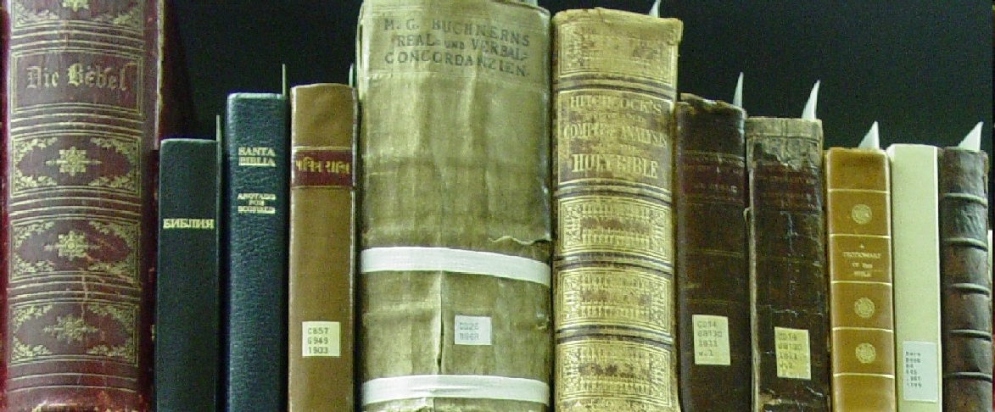
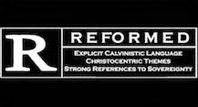
Systematic Theology
Soteriology
Part ii
Acts, Epistles, & Systematics
SRCS ~ Bible 10
mr. e ~ winter 2009

Slide 2
Soteriology: part 2
2. Lecture &Discussion
3. Reading & Questions (Frame ch 15-17; or Berkhof ch )
4. Vocab (Each unit; matching)
sanctification
assurance (of Salv.)
eternal security
perseverance of the Saints
Determinism
reprobation
infused righteousness
imputation/double imp.
justification
forensic
adoption

Slide 3
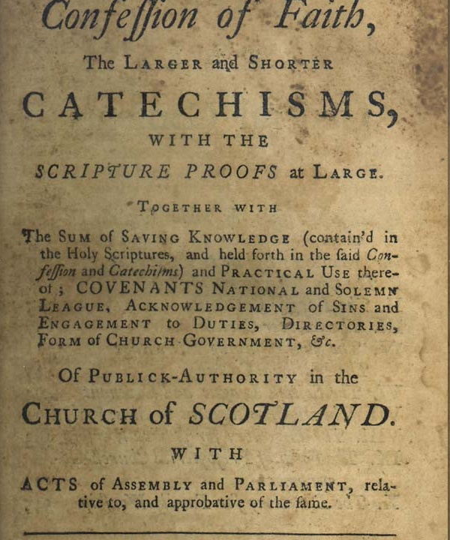
Introduction: Systematic Theology
5. Catechism (WSC Q33 – Q38)
6. Bible memory (look at the green boxes in the presentation)
28 And we know that for those who love God all things work together for good,[h] for those who are called according to his purpose. 29 For those whom he foreknew he also predestined to be conformed to the image of his Son, in order that he might be the firstborn among many brothers. 30 And those whom he predestined he also called, and those whom he called he also justified, and those whom he justified he also glorified. Romans 8:28-30
7. Doctrine/WCF (ch 9-20\)

Slide 4
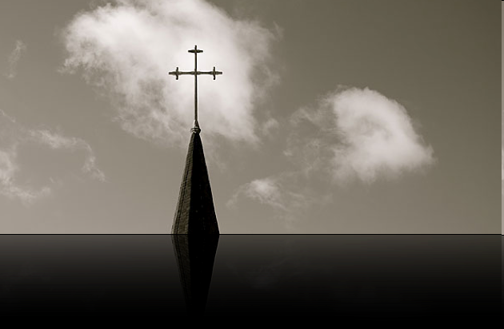
Systematic Theology: Soteriology
What is this called?
Soteriology
Part V: The Doctrine of the Application of Redemption (Salvation) 17. Common Grace What are the undeserved blessings that God gives to all people, both believers and unbelievers? 18. Election When and why did God choose us? Are some not chosen? 19. The Gospel Call What is the Gospel message? How does it become effective?

Slide 5
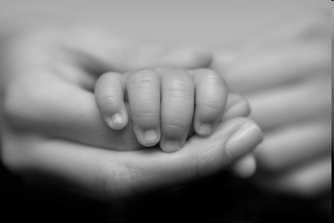
Systematic Theology: Soteriology
Part V (con’t): The Doctrine of the Application of Redemption (Salvation) 20 Regeneration What does it mean to be born again? 21. Conversion (Faith and Repentance) What is true repentance? What is saving faith? Can people accept Jesus as Saviour and not as Lord? 22. Justification and Adoption How and when do we gain right legal standing before God? What are the benefits of being a member of God's family?

Slide 6
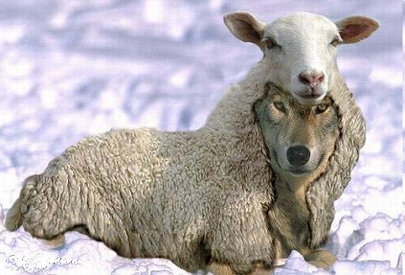
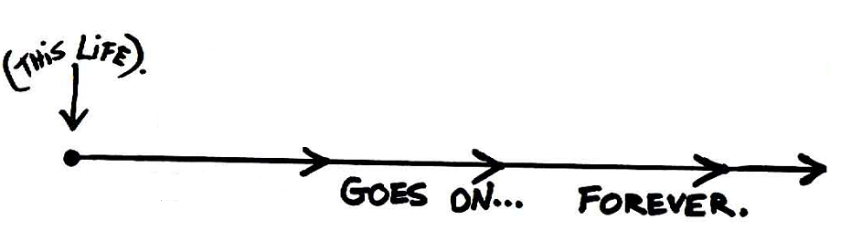
Introduction: Systematic Theology
Part V (con’t): The Doctrine of the Application of Redemption 23. Sanctification (Growth in Likeness to Christ) How do we grow in Christian maturity? What are the blessings of Christian growth? 24. The Perseverance of the Saints (Remaining a Christian) Can true Christians lose their salvation? How can we know if we are truly born again?
25. Glorification (Receiving a resurrection body)
When will we receive resurrection bodies? What will they be like?

Slide 7
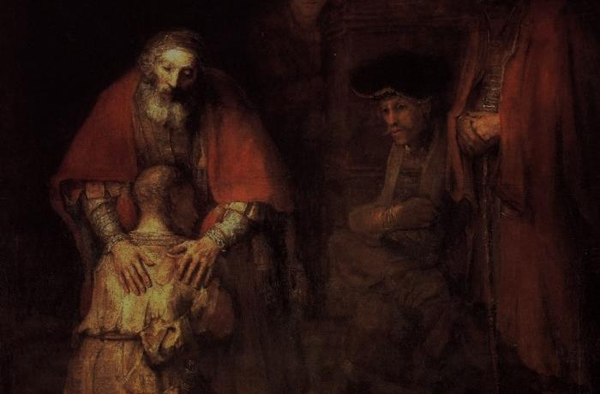
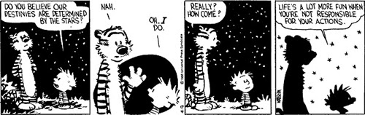
Systematic Theology: Soteriology 2
VII. Justification
Intro to Justification, Adoption, & Sanctification…
The state of fallen human beings
Guilty
orphans
dead in sin
The needs of fallen human beings
New legal status
New family
New life
Justification, Adoption & and Sanctification addresses these needs.

Slide 8
Systematic Theology: Soteriology 2
VII. Justification
Intro
Place in History
Protestant? (What’s in a name?)
Reformation’s crux
Context of misunderstanding
English word (eg. Romans 1:17; justificare)
Catholic understanding & development (Latin Vulgate)
Luther’s epiphany (Greek NT)
Defined
Explained
Before we start, we have to lay some groundwork…

Slide 9
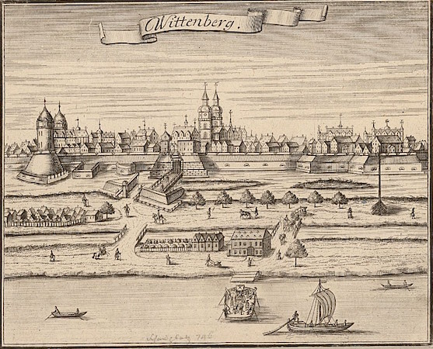
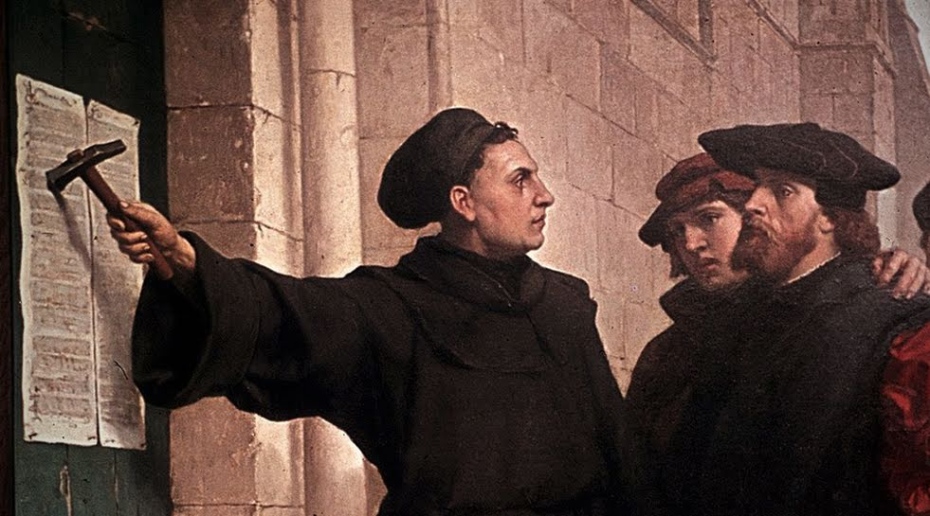
Systematic Theology: Soteriology 2
VII. Justification
Intro
Place in History
Protestant? (What’s in a name?)
Many of you are “Protestants”…what does that mean?

Slide 10
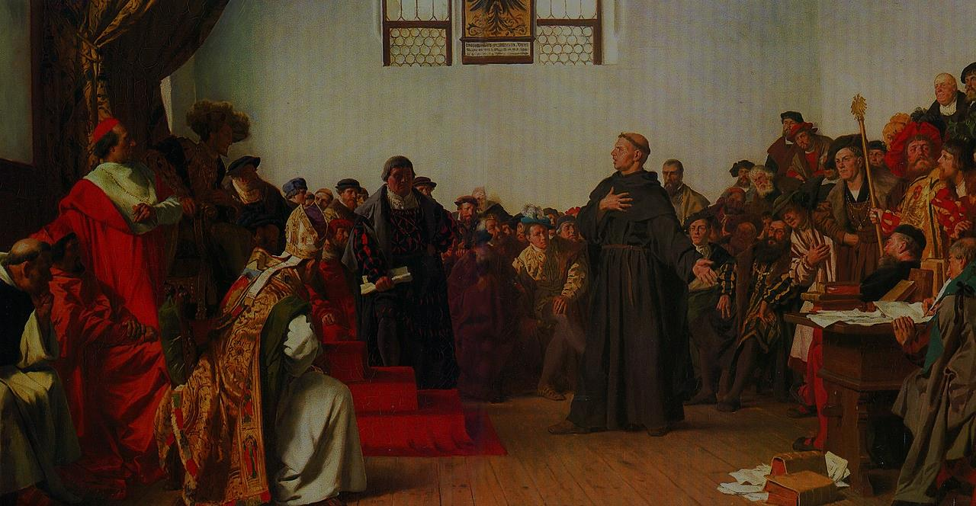

Systematic Theology: Soteriology 2
VII. Justification
Intro
Place in History
Protestant? (What’s in a name?)
Reformation’s crux
We are faced with a host of people who are defined as Protestants but who have evidently forgotten altogether what it is they are protesting.
Contrary to some of these contemporary assessments of the importance of the doctrine of justification by faith alone, we recall a different perspective by the sixteenth-century magisterial Reformers. Luther made his famous comment that the doctrine of justification by faith alone is the article upon which the church stands or falls. John Calvin added a different metaphor, saying that justification is the hinge upon which everything turns. In the twentieth century, J.I. Packer used a metaphor indicating that justification by faith alone is the “Atlas upon whose shoulder every other doctrine stands.”
Justified by Faith Alone, New from R.C. Sproul
Luther at the Diet of Worms
Anton von Werner, 1877

Slide 11
Systematic Theology: Soteriology 2
VII. Justification
Intro
Place in History
Protestant? (What’s in a name?)
Reformation’s crux
Context of misunderstanding
English word (eg. Romans 1:17) from latin justificare)
17 For in it the righteousness of God is revealed from faith for faith,[e] as it is written, “The righteous [just] shall live by faith.”

Slide 12
Systematic Theology: Soteriology 2
VII. Justification
Intro
Place in History
Protestant? (What’s in a name?)
Reformation’s crux
Context of misunderstanding
English word (eg. Romans 1:17; justificare)
Catholic understanding & development (Latin Vulgate)
Catholic term “justificare” – justus (righteous) ficare (to make)
Roman legal term (forensic term)
Catholic interp: “to be made righteous”
Overlaps Justification & sanctification
Justification (Roman view) is when God, through the sacraments, makes unrighteous people righteous. Sanctification makes one righteous enough to be accepted (Justified) by God.

Slide 13
Systematic Theology: Soteriology 2
VII. Justification
Intro
Place in History
Protestant?
Reformation’s crux
Context of misunderstanding
English word (eg. Romans 1:17; justificare)
Catholic understanding & development (Latin Vulgate)
Luther’s epiphany (Greek NT)
Luther felt great anxiety over the possibility that the gospel “good news” kept him wondering whether he had enough good works to stand before God’s throne on Judgement day.
Greek term “dikaiosuné” – (to regard/count as/declare righteous)
Luther had an awakening
Biblical interp: “to declare righteous”
Distinguishes Justification & sanctification
The Reformed Protestant position is that works are not required and that faith alone is sufficient to justify the believer. Justification is based on Christ alone, received by faith alone, and given by grace alone..

Slide 14
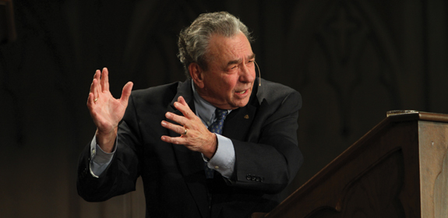
Systematic Theology: Soteriology 2
VII. Justification
The fundamental issue is this: is the basis by which I am justified a righteousness that is my own? Or is it a righteousness that is, as Luther said, “an alien righteousness,” a righteousness that is extra nos, apart from us—the righteousness of another, namely, the righteousness of Christ?
From the sixteenth century to the present, Rome has always taught that justification is based upon faith, on Christ, and on grace. The difference, however, is that Rome continues to deny that justification is based on Christ alone, received by faith alone, and given by grace alone.
The difference between these two positions is the difference between salvation and its opposite. There is no greater issue facing a person who is alienated from a righteous God.
When Luther discovered this, he declared, “I was born again of the Holy Ghost, and the doors of paradise swung open and I walked through!”

Slide 15
Systematic Theology: Soteriology 2
An instantaneous legal act of God in which he (1) thinks of our sins as forgiven and (2) declares us to be righteous in his sight.
VII. Justification
Intro
Place in History
Protestant? (What’s in a name?)
Reformation’s crux
Context of misunderstanding
English word (eg. Romans 1:17; justificare)
Catholic understanding & development (Latin Vulgate)
Luther’s epiphany (Greek NT)
Defined

Slide 16
Systematic Theology: Soteriology 2
An instantaneous legal act of God in which he (1) thinks of our sins as forgiven and (2) declares us to be righteous in his sight.
VII. Justification
Intro
Place in History
Protestant? (What’s in a name?)
Reformation’s crux
Context of misunderstanding
English word (eg. Romans 1:17; justificare)
Catholic understanding & development (Latin Vulgate)
Luther’s epiphany (Greek NT)
Defined
Explained

Slide 17
Systematic Theology: Soteriology 2
An instantaneous legal act of God in which he (1) thinks of our sins as forgiven and (2) declares us to be righteous in his sight.
VII. Justification
C. Explained
Note the two parts:
1. forgiveness
2. imputation of Christ’s righteousness
Justification does not renew us from within (sanctification) but rather provides us with a new legal position—righteous in Christ.
Do you recall the obediences of Christ we distinguished?
His passive obedience (death & suffering) brings us forgiveness while His active obedience (perfect life) is the basis for God’s declaring us positively righteous.

Slide 18
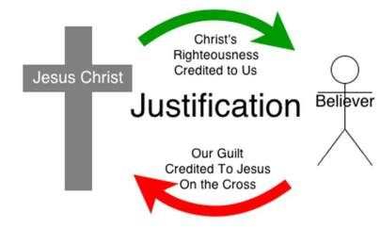
Systematic Theology: Soteriology 2
An instantaneous legal act of God in which he (1) thinks of our sins as forgiven and (2) declares us to be righteous in his sight.
VII. Justification
C. Explained
Note the two parts:
1. forgiveness
2. imputation of Christ’s righteousness
Justification involves a double transfer--one negative and one positive: our sins are imputed to Christ who bore them on the cross and Christ's righteousness is imputed to believers whereby they are seen by God as cloaked in the righteousness of Christ.
This is called “double imputation” …sometimes called “The Great Exchange”
Justification and Imputed Righteousness

Slide 19



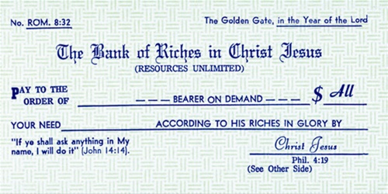
Systematic Theology: Soteriology 2
An instantaneous legal act of God in which he (1) thinks of our sins as forgiven and (2) declares us to be righteous in his sight.
VII. Justification
Here’s another way to look at it:
Sin has plunged us into deep debt
God has forgiven that debt
Christ has taken you far beyond zero…

Slide 20
Systematic Theology: Soteriology 2
An instantaneous legal act of God in which he (1) thinks of our sins as forgiven and (2) declares us to be righteous in his sight.
VII. Justification
Intro
Place in History
Protestant? (What’s in a name?)
Reformation’s crux
Context of misunderstanding
English word (eg. Romans 1:17; justificare)
Catholic understanding & development (Latin Vulgate)
Luther’s epiphany (Greek NT)
Defined
Explained
A Roman/Protestant disagreement

Slide 21
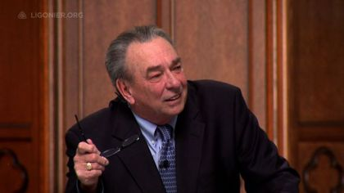
Systematic Theology: Soteriology 2
VII. Justification
Roman view vs. Protestant view
Without His life of sinless obedience, Jesus’ atonement would have had no value at all. We need to see the crucial significance of this truth; we need to see that not only did Jesus die for us, He lived for us.
Roman Catholics call this concept a legal fiction, and they recoil from it because they believe it casts a shadow on the integrity of God by positing that God declares to be just people who are not just.
Without His life of sinless obedience, Jesus’ atonement would have had no value at all. We need to see the crucial significance of this truth; we need to see that not only did Jesus die for us, He lived for us.

Slide 22
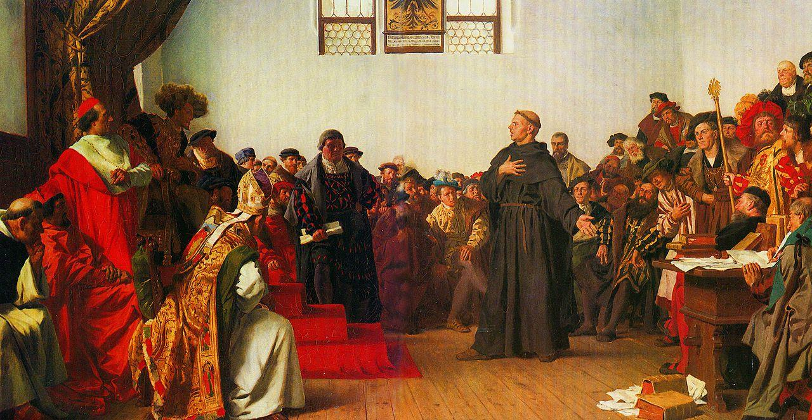
Systematic Theology: Soteriology 2
Do you have anything to say for yourself about the doctrine of justification?
VII. Justification
D. A Roman/Protestant disagreement
Man is simultaneously both just and sinner.
You said,”Simul Justus et pecator.” Explain.
I. too, would say so if Christ’s imputation was fiction…and the Gospel would be a lie--but it is real precisely because He lived in perfect obedience and that obedience is counted mine because God regards Christ ‘s righteousness as my own.
The Roman Catholic view may be said to understand justification as based not on
imputed righteousness but on infused righteousness—that is, righteousness that God
actually puts into us and that changes us internally and in terms of our actual moral
character. Then he gives us varying measures of justification according to the measure
of righteousness that has been infused or placed within us.
This, then is a legal fiction! How can you accuse God of declaring a sinner is just when he is not just!

Slide 23
Systematic Theology: Soteriology 2
VII. Justification
D. A Roman/Protestant disagreement
In Protestantism, we speak of this as the doctrine of justification by faith alone, for according to the New Testament, the only means by which the righteousness and the merit of Christ can come into our accounts and be applied to us is by faith. We can’t earn it. We can’t deserve it. We can’t merit it. We can only trust in it and cling to it. RC Sproul
According to Rome (Council of Trent dogma vs. reformers), this infused grace is given at baptism and the person is in a state of grace conditionally. For this justifying grace to be efficacious, the person must assent to and cooperate with that grace. This grace can be changed—or even ultimately lost—hence Rome’s categories of sin: mortal & venial and the restorative sacrament of penance.
The Catholic Church teaches that people cannot be certain that they are in this “state of grace”, that justification varies from individual to individual, and that the grace of justification is partially based on our merits as well. The reason that, in Reformed theology, our salvation is sure is that it is entirely based on God’s work and character—a Promise of Himself that He has carved into the very hands of His Son.

Slide 24
Systematic Theology: Soteriology 2
An instantaneous legal act of God in which he (1) thinks of our sins as forgiven and (2) declares us to be righteous in his sight.
VII. Justification
Intro
Place in History
Protestant? (What’s in a name?)
Reformation’s crux
Context of misunderstanding
English word (eg. Romans 1:17; justificare)
Catholic understanding & development (Latin Vulgate)
Luther’s epiphany (Greek NT)
Defined
Explained
A Roman/Protestant disagreement
Justification, Faith, & Works

Slide 25
Systematic Theology: Soteriology 2
Justification is by faith apart from works…
VII. Justification
Justification, Faith, & Works
23 for all have sinned and fall short of the glory of God, 24 and are justified by his grace as a gift, through the redemption that is in Christ Jesus, 25 whom God put forward as a propitiation by his blood, to be received by faith. This was to show God's righteousness, because in his divine forbearance he had passed over former sins. Romans 3:23,24
A faith without works is not saving faith—so works are evidence of a true, saving faith. Justification bears, not a mere profession—but faith in action, a grateful response to God’s salvation
14 What good is it, my brothers, if someone says he has faith but does not have works? Can that faith save him? …
…26 For as the body apart from the spirit is dead, so also faith apart from works is dead. James 2 :17, 26

Slide 26
Systematic Theology: Soteriology 2
An instantaneous legal act of God in which he (1) thinks of our sins as forgiven and (2) declares us to be righteous in his sight.
VII. Justification
Intro
Place in History
Protestant? (What’s in a name?)
Reformation’s crux
Context of misunderstanding
English word (eg. Romans 1:17; justificare)
Catholic understanding & development (Latin Vulgate)
Luther’s epiphany (Greek NT)
Defined
Explained
A Roman/Protestant disagreement
Justification, Faith, & Works
Consequences for the believer
First, this doctrine enables us to offer genuine hope to unbelievers who know they could never make themselves righteous before God
Second, this doctrine gives us confidence that God will never make us pay the penalty for sins that have been forgiven on Christ’s merits.
There is therefore now no condemnation for those who are in Christ Jesus. Romans 8:1

Slide 27
Systematic Theology: Soteriology 2
VIII. Adoption
Defined
Explained
Relation to other doctrines
Privileges

Slide 28
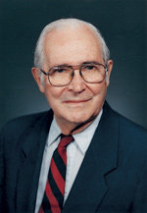
Systematic Theology: Soteriology 2
VIII. Adoption
Defined
An act of God whereby he makes us members of his family—admitted to all the promises and privileges as heirs.
What need did Justification address? Adoption now addresses our familial need. John Gerstner puts it this way:
“The first problem we have with being adopted into God's family is that we are born into another family, and we are not up for adoption. As a matter of fact, our father is very much opposed to our adoption and does everything he possibly can to keep us where we were born and see to it that nobody takes us from him.”
42 Jesus said to them, “If God were your Father, you would love me, for I came from God and I am here. I came not of my own accord, but he sent me. 43 Why do you not understand what I say? It is because you cannot bear to hear my word. 44 You are of your father the devil, and your will is to do your father's desires. He was a murderer from the beginning, and does not stand in the truth, because there is no truth in him. When he lies, he speaks out of his own character, for he is a liar and the father of lies. John 8 42-44

Slide 29
Systematic Theology: Soteriology 2
An act of God whereby he makes us members of his family—admitted to all the promises and privileges as heirs.
VIII. Adoption
Defined
Explained
We are born under sin –by nature children of the devil.
The Bible teaches that there is a sense in which God is the Father of all men due to the fact that He made us and, therefore, we depend upon Him for everything. But the Bible does not teach the universal Fatherhood of God in the matter of salvation.
11 He came to his own,[b] and his own people[c] did not receive him. 12 But to all who did receive him, who believed in his name, he gave the right to become children of God, 13 who were born, not of blood nor of the will of the flesh nor of the will of man, but of God. John 1:11-13

Slide 30
Systematic Theology: Soteriology 2
An act of God whereby he makes us members of his family—admitted to all the promises and privileges as heirs.
VIII. Adoption
Defined
Explained
We are born under sin –by nature children of the devil.
Adoption is a separate act of God.
A separate act
Monergistic
11 He came to his own,[b] and his own people[c] did not receive him. 12 But to all who did receive him, who believed in his name, he gave the right to become children of God, 13 who were born, not of blood nor of the will of the flesh nor of the will of man, but of God. John 1:11-13
One pressing practical reason for treating the doctrine of adoption as a separate act of God is to counter the wide-spread, but unbiblical notion of the universal Fatherhood of God.

Slide 31
Systematic Theology: Soteriology 2
An act of God whereby he makes us members of his family—admitted to all the promises and privileges as heirs.
VIII. Adoption
Defined
Explained
We are born under sin –by nature children of the devil.
Adoption is a separate act of God.
A separate act
Monergistic…which makes adoption…
Adoption is an act of God’s grace—we are not entitled to sonship/daughterhood on our own.
Adoption as a child of God, like every element of our redemption, is not something we earn, it is not something that God is forced to do. The status of sonship is a loving and merciful gift from our heavenly Father.
11 He came to his own,[b] and his own people[c] did not receive him. 12 But to all who did receive him, who believed in his name, he gave the right to become children of God, 13 who were born, not of blood nor of the will of the flesh nor of the will of man, but of God. John 1:11-13

Slide 32
Systematic Theology: Soteriology 2
An act of God whereby he makes us members of his family—admitted to all the promises and privileges as heirs.
VIII. Adoption
Defined
Explained
4. Adoption is present & future (“now & not yet”).
5. Jesus is the Son of God (unique Sonship).
Adoption is demonstrated by good works (like saving faith & justification)
Adoption relates us to God & one another.
3 Blessed be the God and Father of our Lord Jesus Christ! According to his great mercy, he has caused us to be born again to a living hope through the resurrection of Jesus Christ from the dead, 4 to an inheritance that is imperishable, undefiled, and unfading, kept in heaven for you, I Peter1:3,4
“…adoption, belonging to God’s family, is the height of our privilege as God’s people and the beginning of our heavenly reward.” Frame. SBL 210
Despite our sonship with the Father never being equalized with Jesus’ sonship, nevertheless, we share in the blessings that the Father gives to Him. Frame. SBL 210

Slide 33
Systematic Theology: Soteriology 2
An act of God whereby he makes us members of his family—admitted to all the promises and privileges as heirs.
VIII. Adoption
Defined
Explained
Relation to other Doctrines
Regeneration
Faith
Justification
Regeneration emphasizes our new birth and Spiritual life from God; Adoption centers on our privileges due to God bringing us into a family in which we had no inherent right to belong.
While Justification is often a focal point and gives us a new legal standing, adoption is the apex of our relationship to God because it carries us past justification and describes the beginning and endpoint of salvation—and even the process between….
Adoption, like justification, is a gift received through faith—itself a gift from God.

Slide 34
Systematic Theology: Soteriology 2
An act of God whereby he makes us members of his family—admitted to all the promises and privileges as heirs.
VIII. Adoption
Defined
Explained
Relation to other Doctrines
Privileges of Adoption
Inheritance (slaves to sons & daughters)
Promise of maturity (eg. child→ adult: increased freedom and responsibility)
Freedom & confidence in prayer
Discipline that legitimizes our Sonship/Daughterhood
New vertical relationship with God (loving Father--giver of good things)
New horizontal relationship with fellow family members
Forward-looking vision
5 Do not rebuke an older man but encourage him as you would a father, younger men as brothers, 2 older women as mothers, younger women as sisters, in all purity.
I Timothy 5: 1,2
11 If you then, who are evil, know how to give good gifts to your children, how much more will your Father who is in heaven give good things to those who ask him!
Matthew 7: 11
31 What then shall we say to these things? If God is for us, who can be[i] against us? 32 He who did not spare his own Son but gave him up for us all, how will he not also with him graciously give us all things? Romans 8: 31,32
5 And have you forgotten the exhortation that addresses you as sons? “My son, do not regard lightly the discipline of the Lord, nor be weary when reproved by him. 6 For the Lord disciplines the one he loves, and chastises every son whom he receives.” Hebrews 12: 5,6
6 And because you are sons, God has sent the Spirit of his Son into our hearts, crying, “Abba! Father!” 7 So you are no longer a slave, but a son, and if a son, then an heir through God. Galatians 4: 6,7

Slide 35
Systematic Theology: Soteriology 2
God’s grace to us before time
REVIEW: Regeneration(presupposed)
Gospel Call Regeneration Justification Adoption Sanctification
God summons us to Him
God makes us alive in Him; “new birth”
God forgives us & declares us righteous
God brings us into His family as sons & daughters
God conforms us to His image—He makes us righteous

Slide 36
Systematic Theology: Soteriology 2
Justification Sanctification
Addresses legal standing
Work
Relation to time
Agent
Result
Addresses internal condition
Once for all time (punctual)—though the effects echo to glory
Continuous throughout life (progressive)
God (monergistic); God & man cooperates (synergistic)
God (monergistic)
Perfect in this life; made full in glory; equal to all Christians
Not perfected in this life; perfected in glory; greater in some than others

Slide 37

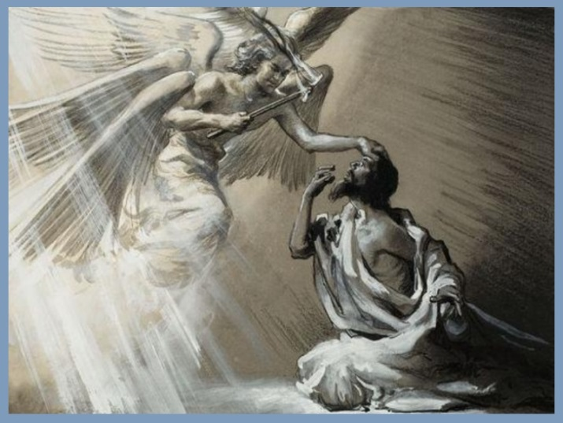
Systematic Theology: Soteriology 2
A progressive work of God and man that makes us more and more free from sin and more like Christ in our actual lives.
VIII. Sanctification
Defined
Keep this in mind… 1. God is Holy.
Ever consider the Holiness of God?
2. We are fallen.
“Holiness provokes hatred. The greater the holiness, the greater the human hostility toward it. It seems insane. No man was ever more loving than Jesus Christ. Yet even His love made people angry. His love was a perfect love, a transcendent and holy love, but His very love brought trauma to people. This kind of love is so majestic we can't stand it.”
― R.C. Sproul, The Holiness of God
“The tongue is a restless evil, full of deadly poison. This was the realization of Isaiah. He recognized that he was not alone in his dilemma. He understood that the whole nation was infected with dirty mouths: "I live among a people of unclean lips." in the flash of the moment Isaiah had a new radical understanding of sin. He saw that it was pervasive, in him and in everyone else.”
― R.C. Sproul, The Holiness of God
Animated Explanation of God's Holiness
What distances us from God, namely God’s holiness, now joins us to Him in intimate fellowship as He, through Sanctification, makes us holy

Slide 38
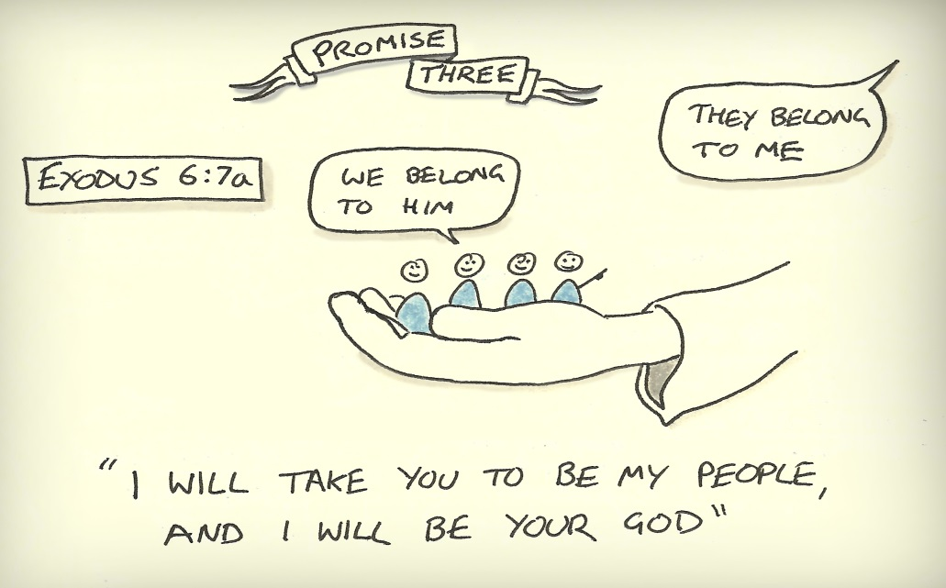
Systematic Theology: Soteriology 2
A progressive work of God and man that makes us more and more free from sin and more like Christ in our actual lives.
VIII. Sanctification
Defined
Explained
To sanctify is to make holy (to set apart).
While in Justification God declares us righteous, in sanctification, God makes us righteous.
Sanctification is a working out of the Scriptural theme of God setting apart His covenant people.
In sanctification, God’s sovereignty and our responsibility meet.
(both fact & command)
Sanctification is both definitive & progressive.
Describes the sainthood of all believers.
2 To the church of God that is in Corinth, to those sanctified in Christ Jesus, called to be saints together with all those who in every place call upon the name of our Lord Jesus Christ, both their Lord and ours
Romans 1: 2

Slide 39
Systematic Theology: Soteriology 2
A progressive work of God and man that makes us more and more free from sin and more like Christ in our actual lives.
VIII. Sanctification
Defined
Explained
A word on definitive & progressive sanctification
A “Once for all” event simultaneous with effectual calling & regeneration in which God transfers us from the sphere of sin to the sphere of God’s holiness. It is a movement from being under God’s condemnation to being welcomed by His smile. It reorients our minds, wills, & affections.
A continuing work of God in which he calls us to cooperate and workout the new life given in regeneration—all on the basis of union with Christ.
11 So you also must consider yourselves dead to sin and alive to God in Christ Jesus. 12 Let not sin therefore reign in your mortal body, to make you obey its passions. 13 Do not present your members to sin as instruments for unrighteousness, but present yourselves to God as those who have been brought from death to life, and your members to God as instruments for righteousness. 14 For sin will have no dominion over you, since you are not under law but under grace. Romans 6: 11-14

Slide 40
Systematic Theology: Soteriology 2
VIII. Sanctification
Defined
Explained
Living out the definitive Sanctification in the progressive…
Q: does definitive Sanctification mean that Christians are sinless—that is that we don’t sin?
“It’s dangerous to assume that because a person is drawn to holiness in his study that he is thereby a holy man. There is irony here. I am sure that the reason I have a deep hunger to learn of the holiness of God is precisely because I am not holy. I am a profane man—a man who spends more time out of the temple than in it. But I have had just enough of a taste of the majesty of God to want more. I know what it means to be a forgiven man and what it means to be sent on a mission. My soul cries for more. My soul needs more.”
― R.C. Sproul, The Holiness of God
“To be conformed to Jesus, we must first begin to think as Jesus did. We need the "mind of Christ." We need to value the things He values and despise the things He despises. We need to have the same priorities He has. We need to consider weighty the things He considers weighty.”
R.C. Sproul, The Holiness of God

Slide 41
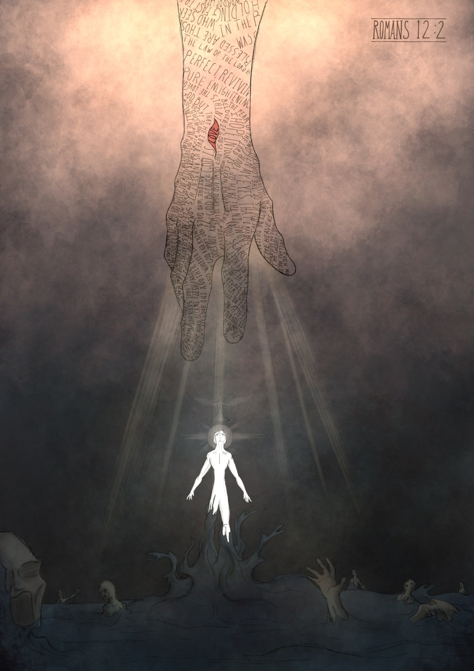
Systematic Theology: Soteriology 2
VIII. Sanctification
Defined
Explained
Living out the definitive Sanctification in the progressive…
If Justification frees us from the
PENALTY
of sin,
Sanctification is freeing us from the POWER
of sin.
A: Not at all! Scripture says we would be deceiving ourselves (I Jn 1:8). It means that, in Christ, our bondage to sin has been broken and now we can say “no” to Satan’s Temptation.
2 Do not be conformed to this world,[c] but be transformed by the renewal of your mind, that by testing you may discern what is the will of God, what is good and acceptable and perfect.[d] Romans 12:2

Slide 42
Systematic Theology: Soteriology 2
VIII. Sanctification
Defined
Explained
Living out the definitive Sanctification in the progressive…
Q: Does definitive Sanctification mean that Christians should “let go & let God?”
A: Not really. I’m not sure what that is intended to mean. God is in control without my permission and we are consistently called to righteous action in Scripture. Progressive Sanctification does not permit passivity.
Q: does progressive Sanctification mean that it is my work?
A: It is God working through us—God does it…through human effort. Here in lies the paradox:
work out your own salvation with fear and trembling, 13 for it is God who works in you, both to will and to work for his good pleasure. Philippians 2: 12b-13

Slide 43
Systematic Theology: Soteriology 2
VIII. Sanctification
Defined
Explained
Living out the definitive Sanctification in the progressive…
Q: What is affected in Sanctification?
A: Our whole person…
“fear of the Lord is the beginning of…”
We are renewed in our:
1. Intellects (our minds change)
2. Emotions (our passions change)
3. Wills (our decision –making changes)
4. Spirits (we ourselves change)
5. Bodies (the use and care of our physical bodies)
“abstain from the passions of the flesh…”
“delight in the law of the Lord…”
“to be holy in body and spirit…”

Slide 44
Systematic Theology: Soteriology 2
VIII. Sanctification
D. Roman clarification
The following is one of the Canons from the council of Trent (late 16th c); affirmed in 20th c.
Canon 9: “If anyone says that the sinner is justified by faith alone, meaning that nothing else is required to cooperate in order to obtain the grace of justification, and that it is not in any way necessary that he be prepared and disposed by the action of his own will, let him be anathema.”
“However, to the man who does not work but trusts God who justifies the wicked, his faith is credited as righteousness. David says the same thing when he speaks of the blessedness of the man to whom God credits righteousness apart from works:
“Blessed are they whose transgressions are forgiven, whose sins are covered. Blessed is the man whose sin the Lord will never count against him.” Romans 4:5-8
In other words, the Roman view sees a necessary overlap between sanctification & justification. From the sixteenth century to the present, Rome has always taught that justification is based upon faith, on Christ, and on grace. The difference, however, is that Rome continues to deny that justification is based on Christ alone, received by faith alone, and given by grace alone.

Slide 45
Systematic Theology: Soteriology 2
VIII. Sanctification
E. Assurance of Salvation
If this is how we are saved, how do I know I am saved?
Scripture speaks of God’s intent for us to be sure…
6 But let him ask in faith, with no doubting, for the one who doubts is like a wave of the sea that is driven and tossed by the wind. James 1:6
13 I write these things to you who believe in the name of the Son of God that you may know that you have eternal life.
I John 5:13
Scripture also couches doubt in negative terms…
This does not mean that all doubts are by nature sinful—merely to doubt in the face of God’s clear special revelation…
…when in situations where it would be wrong to claim knowledge (eg. answering some student questions) it is actually godly to admit ignorance. (Frame SBL 216)

Slide 46
Systematic Theology: Soteriology 2
VIII. Sanctification
E. Assurance of Salvation
If this is how we are saved, how do I know I am saved? This corresponds to 3 realities:
“This certainty is not a bare conjectural and probable persuasion, grounded upon a fallible hope; but an infallible assurance of faith, founded upon the divine truth of the promises of salvation, the inward evidence of those graces unto which these promises are made, the testimony of the Spirit of adoption witnessing with our spirits that we are the children of God: which Spirit is the earnest of our inheritance, whereby we are sealed to the day of redemption.” WCF 18.2
How so? The answer to this question is the basis for assurance & the reason salvation, ultimately, cannot be lost
“Trusting God’s promise of salvation in our JUSTIFICATION”
“Trusting God’s testimony that we are God’s children through the Spirit in our ADOPTION”
“Seeing God’s grace evident in our SANCTIFICATION”

Slide 47
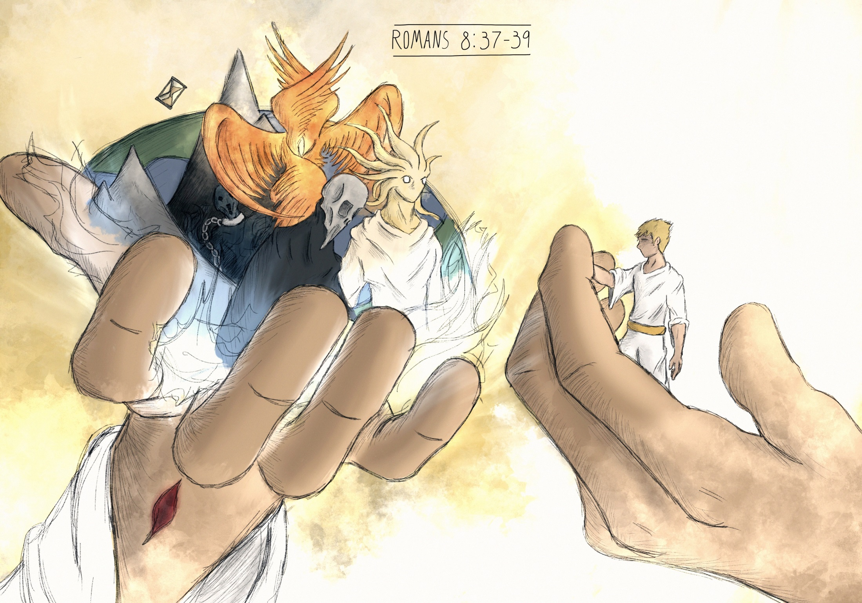
38 For I am sure that neither death nor life, nor angels nor rulers, nor things present nor things to come, nor powers, 39 nor height nor depth, nor anything else in all creation, will be able to separate us from the love of God in Christ Jesus our Lord.
In this Paul points to our next doctrine and connects it to God’s love—the basis of our security

Slide 48
Systematic Theology: Soteriology 2
God’s grace to us before time
REVIEW: Regeneration(presupposed)
Gospel Call Regeneration Justification Adoption Sanctification
God summons us to Him in space & time
God makes us alive in Him; “new birth”
God forgives us & declares us righteous
God brings us into His family as sons & daughters
God conforms us to His image—He makes us righteous

Slide 49
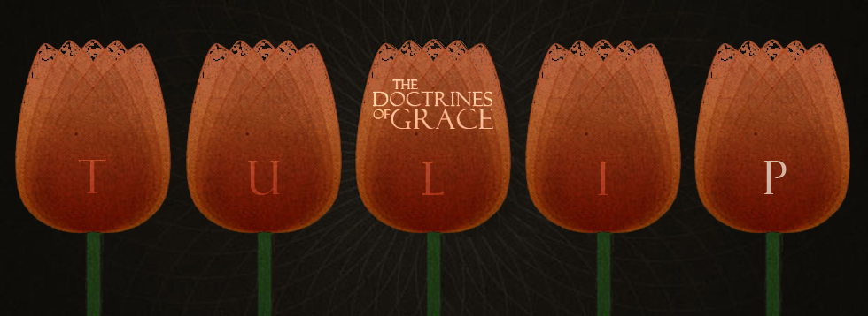
Systematic Theology: Soteriology 2
IX. Perseverance of the Saints
Defined
New life given by God continues to the end (to eternity)
(Our vocab definition): The doctrine that all those who are truly "born again" will be kept by God's power and will persevere as Christians until the end of their lives, and that only those who persevere until the end have been truly "born again."
6 And I am sure of this, that he who began a good work in you will bring it to completion at the day of Jesus Christ. Philippians 1:6
Many Reformed theologians agree that the word “Perseverance” might be misleading…any idea why?
This rendering of TULI”P” seems to preserve 2 ideas:
1. What we call the “divine initiative” of God—that is that our Salvation is wholly incepted (begun) by God (starting with which stage in us?)
2. The Promised completion of our Salvation: “What God begins—He finishes.” (Philippians 1:6)
IX. Preservation of the Saints

Slide 50
Systematic Theology: Soteriology 2
IX. Preservation of the Saints
B. Explained
1. Those who are truly regenerate—in union with Christ, cannot lose their salvation (often called “eternal security”)
Listen to John Piper’s 5 theses on eternal security and write them in your notes (include a verse reference for each)
New life given by God continues to the end (to eternity)
http://www.desiringgod.org/labs/five-truths-about-eternal-security

Slide 51
Systematic Theology: Soteriology 2
IX. Preservation of the Saints
B. Explained
2. Five Theses of Eternal Security
a. We are justified by grace alone through faith alone apart from works (Rom. 3:28)
b. Those who are justified will certainly be glorified (Rom 8:30)
c. But no one will be glorified/finally saved who does not continue in faith (I Cor. 15; 1,2)
d. God will keep His children from finally falling away (I Cor. 1:8,9)
e. God keeps his children by means of His children (Hebrews 3:13)
3. Can those who are saved lose their salvation?
New life given by God continues to the end (to eternity)

Slide 52
Systematic Theology: Soteriology 2
IX. Preservation of the Saints
3. Can those who are saved lose their salvation?
New life given by God continues to the end (to eternity)
For all practical purposes, these were people who outwardly demonstrated seemed to confess all necessary to belong to a church fellowship but, in the end, showed their true colors—that they were never saved in the first place. Consider that even Jesus warned of those who profess Him outwardly but remain unchanged on the inside.
¹⁹ They went out from us, but they were not of us; for if they had been of us, they would have continued with us. But they went out, that it might become plain that they all are not of us. I John 2:19
⁶ And he said to them, “Well did Isaiah prophesy of you hypocrites, as it is written, “‘This people honors me with their lips, but their heart is far from me”
Mark 7:6

Slide 53
Systematic Theology: Soteriology 2
IX. Preservation of the Saints
3. Can those who are saved lose their salvation?
New life given by God continues to the end (to eternity)
²¹ “Not everyone who says to me, ‘Lord, Lord,’ will enter the kingdom of heaven, but the one who does the will of my Father who is in heaven. ²² On that day many will say to me, ‘Lord, Lord, did we not prophesy in your name, and cast out demons in your name, and do many mighty works in your name?’ ²³ And then will I declare to them, ‘I never knew you; depart from me, you workers of lawlessness.’
Matthew 7:21-23
And elsewhere Jesus says…
This is not to say that Christians do not engage in serious sin—consider King David or the Peter while a disciple…
³¹ “Simon, Simon, behold, Satan demanded to have you,^{[d]} that he might sift you like wheat, ³² but I have prayed for you that your faith may not fail. And when you have turned again, strengthen your brothers.” Luke 22:31

Slide 54
Systematic Theology: Soteriology 2
IX. Preservation of the Saints
3. Can those who are saved lose their salvation?
New life given by God continues to the end (to eternity)
Christians can have serious falls—even severe church discipline (with the hope of repentance & restoration), but, in the end, if they are regenerate, God will see them restored.
In the end, two possibilities exist:
Either they never made a true profession
If they did leave for a time, they will come back.
How should we treat people like this?
We are to judge them with Christian charity—God knows their condition but we don’t for sure and so we seek the peace and purity of the church with forbearance and the hope that repentance will occur.
It is good to note that the whole purpose of election is to bring His people safely to be with Him.
Who are we to thing we can thwart that—particularly as Salvation comes to us through the work of the Holy Spirit.

Slide 55
Systematic Theology: Soteriology 2
IX. Preservation of the Saints
4. The work of the Spirit
a. Not only does God initiate Salvation—He also brings it to completion, seeing that God’s children make it through by working in us to preserve us.
b. The Spirit specifically:
1) seals us
2) the Father’s earnest for us
New life given by God continues to the end (to eternity)
A seal was placed on official documents as a signature marking ownership & authority. In this work, the Holy Spirit puts God’s claim on us as Hiss own, but also promises us a claim on Him!
Derived from the commercial language of the day, this term is somewhat related to the concept of “earnest money”—that is a down payment that the Father will make good on what He started.
¹³ In him you also, when you heard ^{e}the word of truth, the gospel of your salvation, and believed in him, ^{f}were sealed with the ^{g}promised Holy Spirit, ¹⁴ who is ^{h}the guarantee⁴ of our ^{i}inheritance until ^{j}we acquire ^{k}possession of it,⁵ ^{l}to the praise of his glory. Ephesians 1:13,14

Slide 56
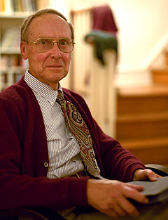
Systematic Theology: Soteriology 2
IX. Preservation of the Saints
4. The work of the Spirit
New life given by God continues to the end (to eternity)
“Here is the incredible mystery that Paul celebrates in Ephesians. God not only defeats our rebellion to claim us again as His; He draws us even closer to Himself than His creation could make us. We are brought closer than [we were in] (sic.) Adam, for we are united to Jesus Christ, God’s own Son. We who were far off in sin are brought near, nearer than the cherubim beside the throne, as near as God’s Son, our Savior.”

Slide 57
Systematic Theology: Soteriology 2
IX. Preservation of the Saints
5. The work of the Son
a. We have a tendency to think that Christ came to Earth, lived a perfect life in His active obedience and suffered a redeeming death in His passive obedience, but forget that His work is not done.
b. The Son entered into heaven as our Great High Priest and , as such, intercedes daily before the Father on our behalf.
New life given by God continues to the end (to eternity)
Back to Peter & Judas;
1. Both betrayed Jesus
2. Both crimes were severe
3. Both were predicted (Jesus)
Difference?
One was saved and the other not…
Look at Christ’s words…
“What you are about to do, do quickly” (then dismissed)
“Satan is about to sift you…but, Simon, I have prayed for you so that when you turn…”

Slide 58

Systematic Theology: Soteriology 2
X. Glorification
Defined of all believers.
The final step in the application of redemption. It will happen when Christ returns and raises from the dead the bodies of all believers for all time who have died, and reunites them with their souls, and changes the bodies of all believers who remain alive, thereby giving all believers at the same time perfect resurrection bodies like His own.

Slide 59
Systematic Theology: Soteriology 2
X. Glorification
Defined
Explained
When Christ redeemed us, He redeemed us as whole persons (body & soul).
There is both a present sense and future sense.
The final step in the application of redemption whereby God gives all believers at the same time perfect resurrection bodies like His own.
¹⁷ Now the Lord^{[d]} is the Spirit, and where the Spirit of the Lord is, there is freedom. ¹⁸ And we all, with unveiled face, beholding the glory of the Lord,^{[e]} are being transformed into the same image from one degree of glory to another. For this comes from the Lord who is the Spirit. I Corinthians 3:17,18
Through the Gospel, we presently partake in the glory (to a certain extent) that will eventually be revealed in the future aspect

Slide 60
Systematic Theology: Soteriology 2
X. Glorification
Defined
Explained
When Christ redeemed us, He redeemed us as whole persons (body & soul).
There is both a present sense and future sense.
The final step in the application of redemption whereby God gives all believers at the same time perfect resurrection bodies like His own.
Through the Gospel, we presently partake in the glory (to a certain extent) that will eventually be revealed in the future aspect
²⁵ For he must reign until he has put all his enemies under his feet. ²⁶ The last enemy to be destroyed is death.
I Corinthians 15:25,26

Slide 61
Systematic Theology: Soteriology 2
X. Glorification
Defined
Explained
When Christ redeemed us, He redeemed us as whole persons (body & soul).
There is both a present sense and future sense.
The resurrection body will be imperishable, incorruptible, and we will experience realization of our Justification.
Glorification is the culmination of the Imago Dei—a consummation of human nature in God’s image.
The final step in the application of redemption whereby God gives all believers at the same time perfect resurrection bodies like His own.
Consider a “Continuum of Righteousness” with Hitler, Jesus, and the Apostle Paul just before and just after Glorification…

