Slide 1

Systematic Theology
ChristologY
Part 2
The Work of Jesus
Acts, Epistles, & Systematics
SRCS ~ Bible 10
mr. e ~ summer 2013

Slide 2
Christology: part 2
2. Lecture &Discussion
3. Reading & Questions (Frame ch 11; or Berkhof ch xvi-xvii)
4. Vocab (Each unit; matching)
passive obedience
penal substitution
propitiation
ransom to Satan theory
reconciliation
redemption
sacrifice
unlimited atonement
vicarious atonement
Ascension
exaltation of Christ
humiliation of Christ
incorruptible
Consequent absolute necessity view
active obedience
atonement
blood of Christ
example theory
general redemption
governmental theory
impute
limited atonement
moral influence theory
Particular redemption
raised in glory
raised in power
Resurrection
Session
spiritual body
states of Jesus Christ
Intercession
King
Priest
prophet

Slide 3
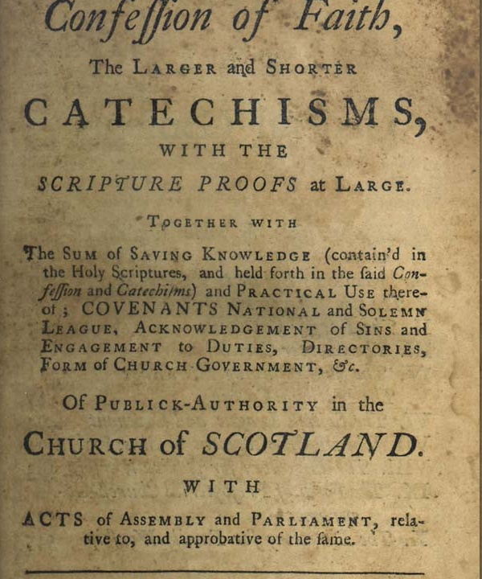
Christology
5. Catechism (PART 2: WSC Q23-Q28
6. Bible memory (look at the green boxes in the presentation)
Romans 3:23-25a: 23 for all have sinned and fall short of the glory of God, 24 and are justified by his grace as a gift, through the redemption that is in Christ Jesus, 25 whom God put forward as a propitiation by his blood, to be received by faith. This was to show God's righteousness…
7. Doctrine/WCF (ch 8)

Slide 4
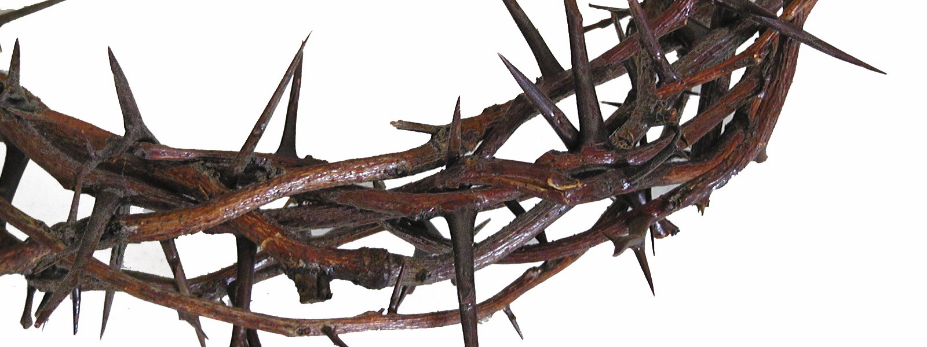
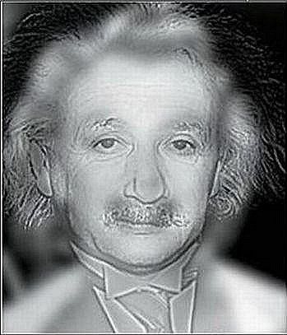

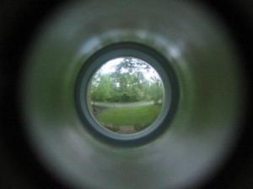
Christology
How would you describe what Christ did?
Jesus Christ: His Work
Is that all?
Why, first & foremost, did He do this?
If you are a normal person - you suppose to see Einstein here, but if you are myopic, then you will see Marilyn Monroe.

Slide 5
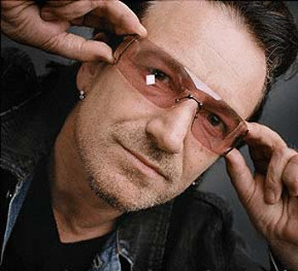
Christology
Jesus Christ: His Work
Here's an interview with Bono from a couple of years ago, which is, against all odds, quite interesting. They get into a talk about grace and Christ, and Bono hits us with his theory of atonement.
At the center of all religions is the idea of Karma. You know, what you put out comes back to you: an eye for an eye, a tooth for a tooth, or in physics; in physical laws every action is met by an equal or an opposite one. It's clear to me that Karma is at the very heart of the universe. I'm absolutely sure of it. And yet, along comes this idea called Grace to upend all that "as you reap, so you will sow" stuff. Grace defies reason and logic. Love interrupts, if you like, the consequences of your actions....

Slide 6
Christology
Jesus Christ: His Work
God says: Look, you cretins, there are certain results to the way we are, to selfishness, and there's a mortality as part of your very sinful nature, and, let's face it, you're not living a very good life, are you? There are consequences to actions. The point of the death of Christ is that Christ took on the sins of the world, so that what we put out did not come back to us, and that our sinful nature does not reap the obvious death. That's the point. It should keep us humbled . It's not our own good works that get us through the gates of heaven....
When I look at the Cross of Christ, what I see up there is all my {sin} and everybody else's. So I ask myself a question a lot of people have asked: Who is this man?

Slide 7
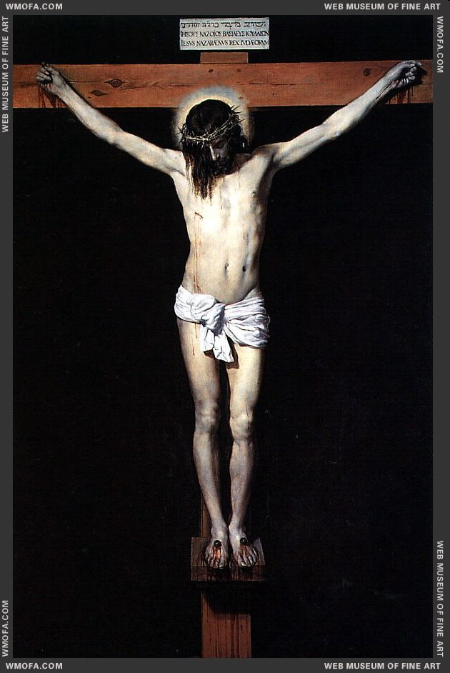
Christology
Part IV: The Doctrine of Christ
One
14. The Person of Christ
How is Jesus fully God and fully man, yet one person?
Two
15. The Atonement
Was it necessary for Christ to die? What really happened in the atonement? Did Christ descend into hell?
16. Resurrection and Ascension
What was Christ's resurrection body like? What is its significance for us? What happened to Christ when he ascended into heaven?
17. Offices of Christ

Slide 8
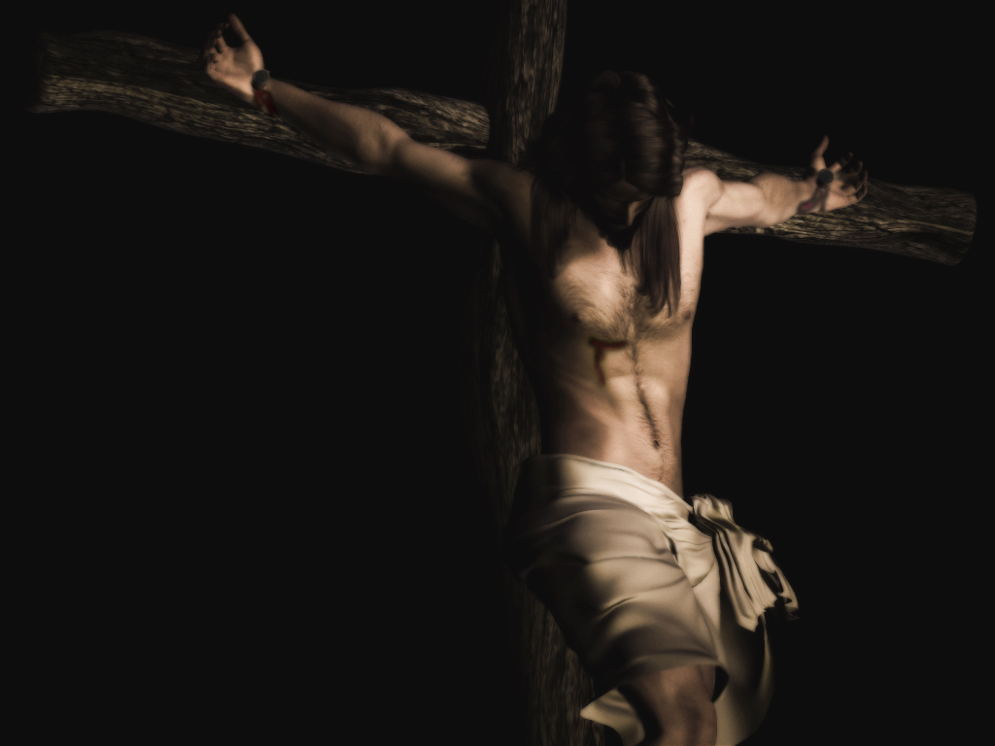
Christology
II. The Work of Christ
    Atonement of Christ
    Resurrection
    Ascension
    Offices
Tidbits O’ Import
States of Christ
Evidence
Ascension
Nature
Why necessary?
Cause
Doctrinal Significance
Atonement
Resurrection
of Christ
Nature
Ethical significance
Offices
Distinguishing the obediences…
Further words on His death
Triumvirate work of Christ
A word about the Apostle’s Creed
Extent

Slide 9
Christology
II. The Atonement
Was it necessary for Christ to die? What really happened in the atonement? Did Christ descend into hell?

Slide 10
Christology
II. The Work of Christ
    Atonement of Christ
Ascension
Cause
Atonement
Resurrection
of Christ
Offices

Slide 11

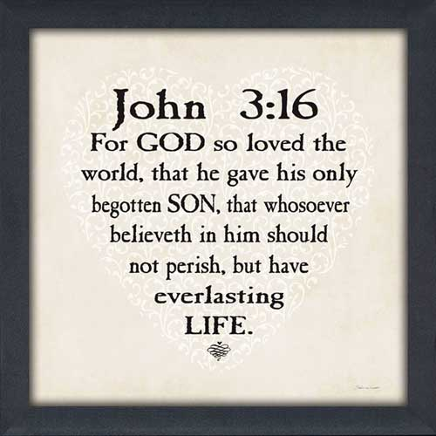
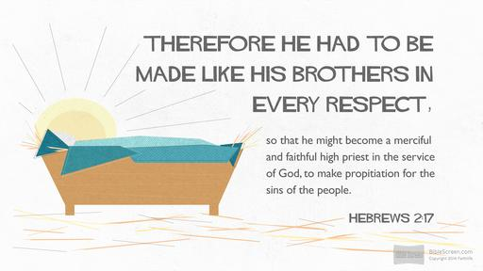
Christology
Notice the extended scope
A. The Atonement
1. What caused the atonement?
We may define the atonement as follows: “The atonement is the work Christ did in his life and death to earn our salvation.”
&
Love
Justice

Slide 12
Christology
II. The Work of Christ
    Atonement of Christ
Ascension
Why necessary?
Cause
Atonement
Resurrection
of Christ
Offices

Slide 13

Christology
While we are waiting for the answer…what do you think?
A. The Atonement
2. Was the atonement necessary?
From one perspective, we may ask the question, “Did God have to save anyone at all?”
No
From another perspective, we see in Scripture that God, when He purposed to save anyone, made atonement necessary.
& Yes
This is sometimes called the “consequent absolute
necessity” view of the atonement.

Slide 14
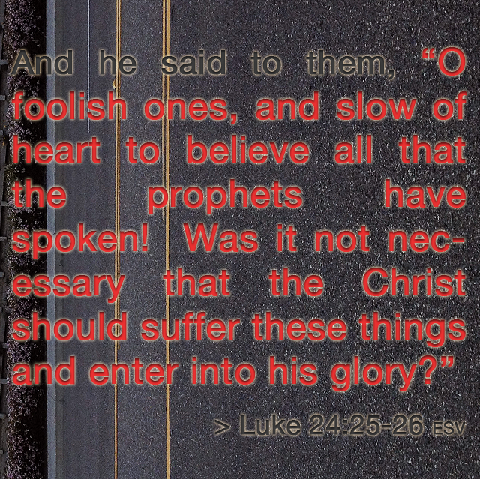

Christology
Yes
A. The Atonement
2. Was the atonement necessary?
It is impossible to do a cursory reading of Hebrews without a sense that Christ had to come and die in our place—
God’s own character compelled the Son to voluntarily offer himself to satisfy the Father’s justice.
Justice
Love

Slide 15
Christology
II. The Work of Christ
    Atonement of Christ
Ascension
Why necessary?
Cause
Atonement
Resurrection
of Christ
Nature
Offices

Slide 16
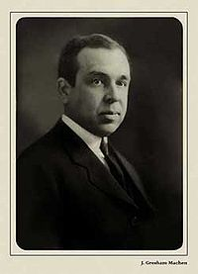
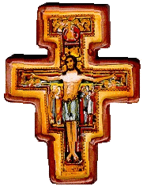

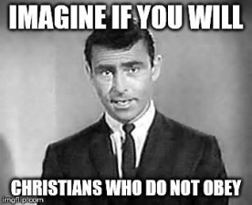
Christology
We will consider the two aspects…
A. The Atonement
3. Was the Nature of the atonement?
We may define the atonement as follows: “The atonement is the work Christ did in his life and death to earn our salvation.”
Obedience in Life
Referred to as “passive obedience”
Referred to as “active obedience”
Obedience in Death
While the terms “active’ & “passive” carry imprecision (christ actively went to die; and his obedience continued beyond his earthly life) nevertheless, the distinction between active and passive obedience is still useful because it helps us appreciate the two aspects of Christ’s work for us. R.L. Reymond prefers the terms preceptive (for active)and penal (for passive), in his article “Obedience of Christ,” EDT p. 785.

Slide 17
Christology
We will consider the two aspects…
A. The Atonement
3. Was the Nature of the atonement?
We may define the atonement as follows: “The atonement is the work Christ did in his life and death to earn our salvation.”
Obedience in Life
Obedience in Death

Slide 18
Christology
II. The Work of Christ
    Atonement of Christ
Ascension
Why necessary?
Cause
Atonement
Resurrection
of Christ
Nature
Offices
Distinguishing the obediences…

Slide 19
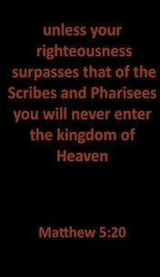
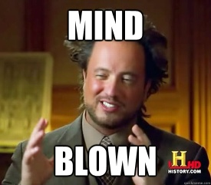
Christology
“Active Obedience”
A. The Atonement
4. Distinguishing the obediences…
If Christ had only earned forgiveness of sins for us, then we would not merit heaven.
He had to “fulfill all
righteousness” for our sake; that is, for the sake of the people whom he was
representing as their head. Unless he had done this for us, we would have no record of obedience by which we would merit God’s favor and merit eternal life with him.
Obedience in Life
if Jesus had needed only sinlessness and not also a life of perfect obedience, he could have died for us when he was a young child rather than when he was thirty-three years old…

Slide 20
Christology
“Passive Obedience”
A. The Atonement
4. Distinguishing the obediences…
If Christ had only earned forgiveness of sins for us, then we would not merit heaven.
He suffered His Whole life.
The Pain of the Cross
  Physical pain & death
  Pain of bearing sin
  Abandonment
Temptation, opposition, death of Laz & dad,
Obedience in Death
Climax of the agony of His suffering
“My soul is very sorrowful, even to death” (Matt. 26:38)

Slide 21
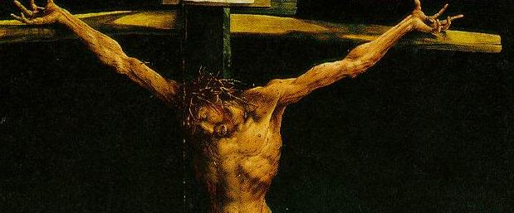
Christology
“Passive Obedience”
A. The Atonement
4. Distinguishing the obediences…
  Physical pain & death
Obedience in Death
“We do not need to hold that Jesus suffered more physical pain than any human being has ever suffered, for the Bible nowhere makes such a claim. But we still must not forget that death by crucifixion was one of the most horrible forms of execution ever devised by man.” WG, 496
The Crucifixion of Jesus a Medical look-

Slide 22
Christology
“Passive Obedience”
A. The Atonement
4. Distinguishing the obediences…
  b. Pain of bearing sin
“21 For our sake he made him to be sin who knew no sin, so that in him we might become the righteousness of God.”
(2 Cor. 5:21)
More awful than the pain of physical suffering that Jesus endured was the psychological pain of bearing the guilt for our sin.
The passage from 2 Corinthians quoted above, together with the verses from Isaiah, indicate that it was God the Father who put our sins on Christ. How could that be? In the same way in which Adam’s sins were imputed to us,10 so God imputed our sins to Christ; that is, he thought of them as belonging to Christ and, since God is the ultimate judge and definer of what really is in the universe, when God thought of our sins as belonging to Christ then in fact they actually did belong to Christ. This does not mean that God thought that Christ had himself committed the sins, or that Christ himself actually had a sinful nature, but rather that the guilt for our sins (that is, the liability to punishment) was thought of by God as belonging to Christ rather than to us. WG, 497
Obedience in Death

Slide 23
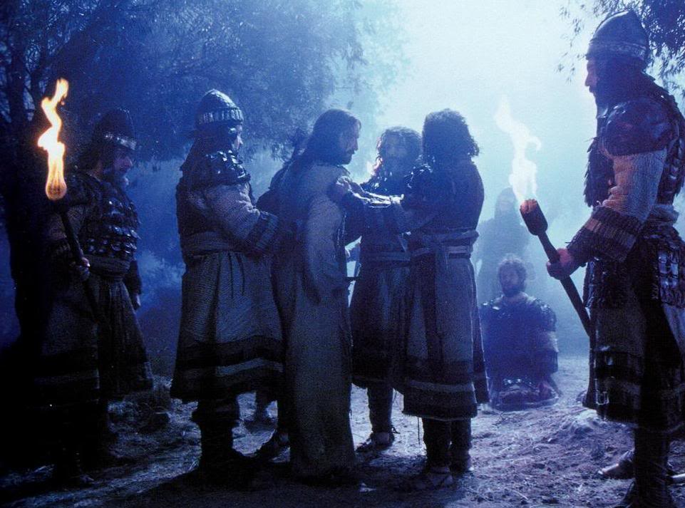
Christology
“Passive Obedience”
A. The Atonement
4. Distinguishing the obediences…
  c. Abandonment
“My soul is very sorrowful, even to death; remain here, and watch” (Mark 14:34)…
“having loved his own who were in the world, he loved them to the end” (John 13:1). He had done nothing but love them; in return, they all abandoned him.
When Jesus cried out “Eli, Eli, lama sabach-thani?” that is, “My God, my God, why have you forsaken me?” (Matt. 27:46), he showed that he was finally cut off from the sweet fellowship with his heavenly Father that had been the unfailing source of his inward strength and the element of greatest joy in a
life filled with sorrow
Yet as soon as Jesus was arrested, “all the disciples forsook him and fled”
(Matt. 26:56).
Obedience in Death
As Jesus bore our sins on the cross, he was abandoned by his heavenly Father, who is “of purer eyes than to behold evil” (Hab. 1:13). He faced the weight of the guilt of millions of sins alone. WG, 480

Slide 24
Christology
II. The Work of Christ
    Atonement of Christ
Ascension
Why necessary?
Cause
Atonement
Resurrection
of Christ
Nature
Offices
Distinguishing the obediences…
Further words on His death

Slide 25
Christology
The everlasting nature of unbelievers’ punishment points to the inability to satisfy God’s wrath
A. The Atonement
5. Further notes on His death…
  The Penalty Was Inflicted By God the Father
  Not Eternal Suffering but Complete Payment
  The Meaning of the Blood of Christ
“…and The LORD has laid on him the iniquity of us all” (Isa. 53:6b).
Jesus was able to bear all the wrath of God against sin and bear it to the end. Isaiah predicted that God “shall see the fruit of the travail of his soul and be satisfied” (Isa. 53:11).
By the blood of Christ our consciences are cleansed (Heb. 9:14), we gain bold access to God in worship and prayer (Heb. 10:19), we are progressively cleansed from remaining sin (1 John 1:7; cf. Rev. 1:5b), we are able to conquer the accuser of the brethren (Rev. 12:10–11), and we are rescued out of a sinful way of life (1 Peter 1:18–19).
Scripture’s emphasis on the blood of Christ also shows the clear connection between Christ’s death and the many sacrifices in the Old Testament that involved the pouring out of the life blood of the sacrificial animal.

Slide 26
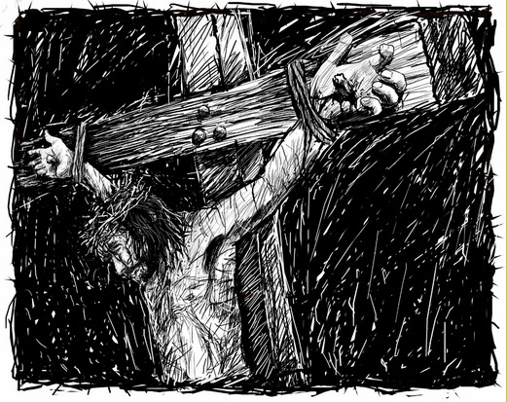
Christology
A. The Atonement
5. Further notes on His death…
  the Atonement: The view of the Atonement we have been discussing is called the “Penal Substitution” view
  Christ died on the cross as a substitute for sinners. God imputed the guilt of our sins to Christ, and He, in our place, bore the punishment that we deserve. This was a full payment for sins, which satisfied both the wrath and the righteousness of God, so that He could forgive sinners without compromising His own holy standard.
http://www.fullofeyes.com/project/close-by-an-animation/

Slide 27
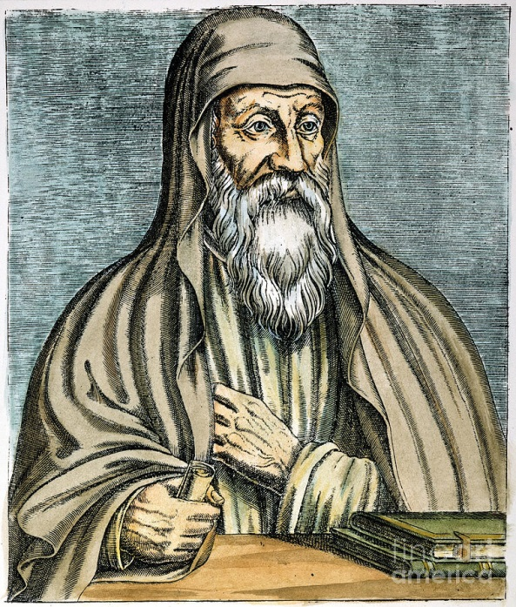
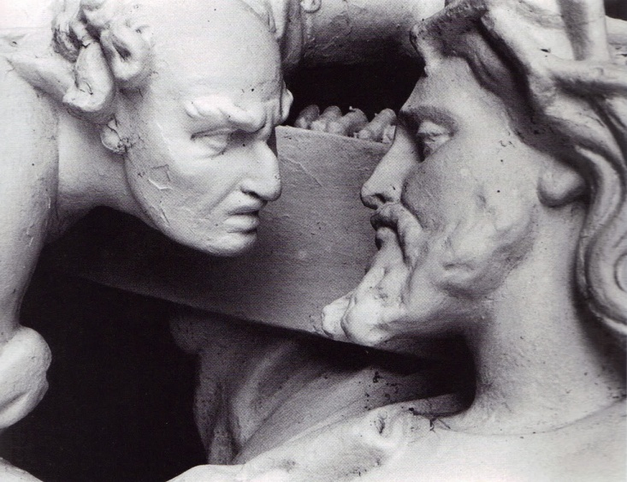
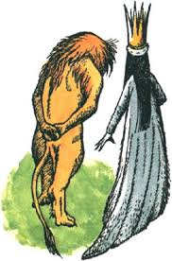
Christology
A. The Atonement
5. Further notes on His death…
ORIGEN
(c. A.D. 185—254), a theologian from Alexandria
  d. Wrong views on the Atonement
Problems?
  No Scriptural support.
  Sets Satan on par—or above God in terms of being/authority
  Neglects Father’s requirement of and transaction for payment of sin.
Ransom to Satan Theory

Slide 28
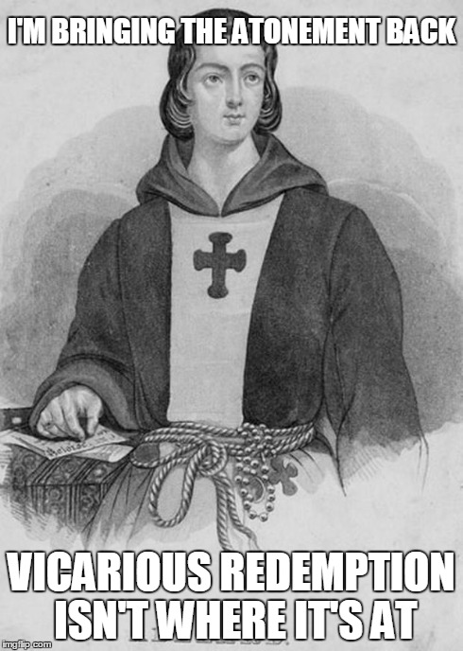
Christology
A. The Atonement
5. Further notes on His death…
  d. Wrong views on the Atonement
Problems?
  Contradicts every passage speaking of Christ dying for our sins (the propitiation of our sins specifically!)
  No real way of dealing with guilt
  Theological equivalent of “That’s nice.”
Peter Abelard
(1079–1142), a French theologian
Moral Influence Theory ( merely teaches us how much God loves us)

Slide 29

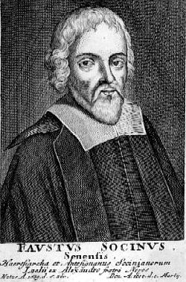
Christology
A. The Atonement
5. Further notes on His death…
Example Theory (merely teaches us how to live)
  d. Wrong views on the Atonement
Problems?
  While Christ is our example, it does not follow that it is a complete explanation of the atonement
  Does not take into account every passage speaking of Christ dying for our sins as actual payment
  Argues that man can save himself.
Faustus Socinus
(1539–1604), an Italian theologian who settled in Poland in 1578

Slide 30
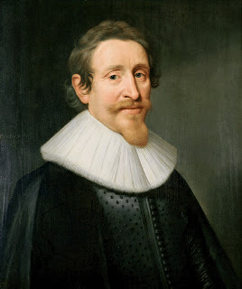
Christology
A. The Atonement
5. Further notes on His death…
  d. Wrong views on the Atonement
Hugo Grotius (1583—
1645) was a Dutch jurist who is famous for his work on international law.
Governmental Theory
Problems?
  Actual earning of forgiveness separated from the cross (merely proves who is the Cosmic Lawgiver)
  We cannot trust in Christ’s work to forgive our sins
  Fails to recognize God’s immutability---and (ironically) absolute justice.
Christ did not exactly pay the penalty for the actual sins of any people, but simply suffered to show that God’s laws were broken and there must be some penalty paid.

Slide 31
Christology
II. The Work of Christ
    Atonement of Christ
Ascension
Why necessary?
Cause
Atonement
Resurrection
of Christ
Nature
Offices
Distinguishing the obediences…
Further words on His death
A word about the Apostle’s Creed

Slide 32
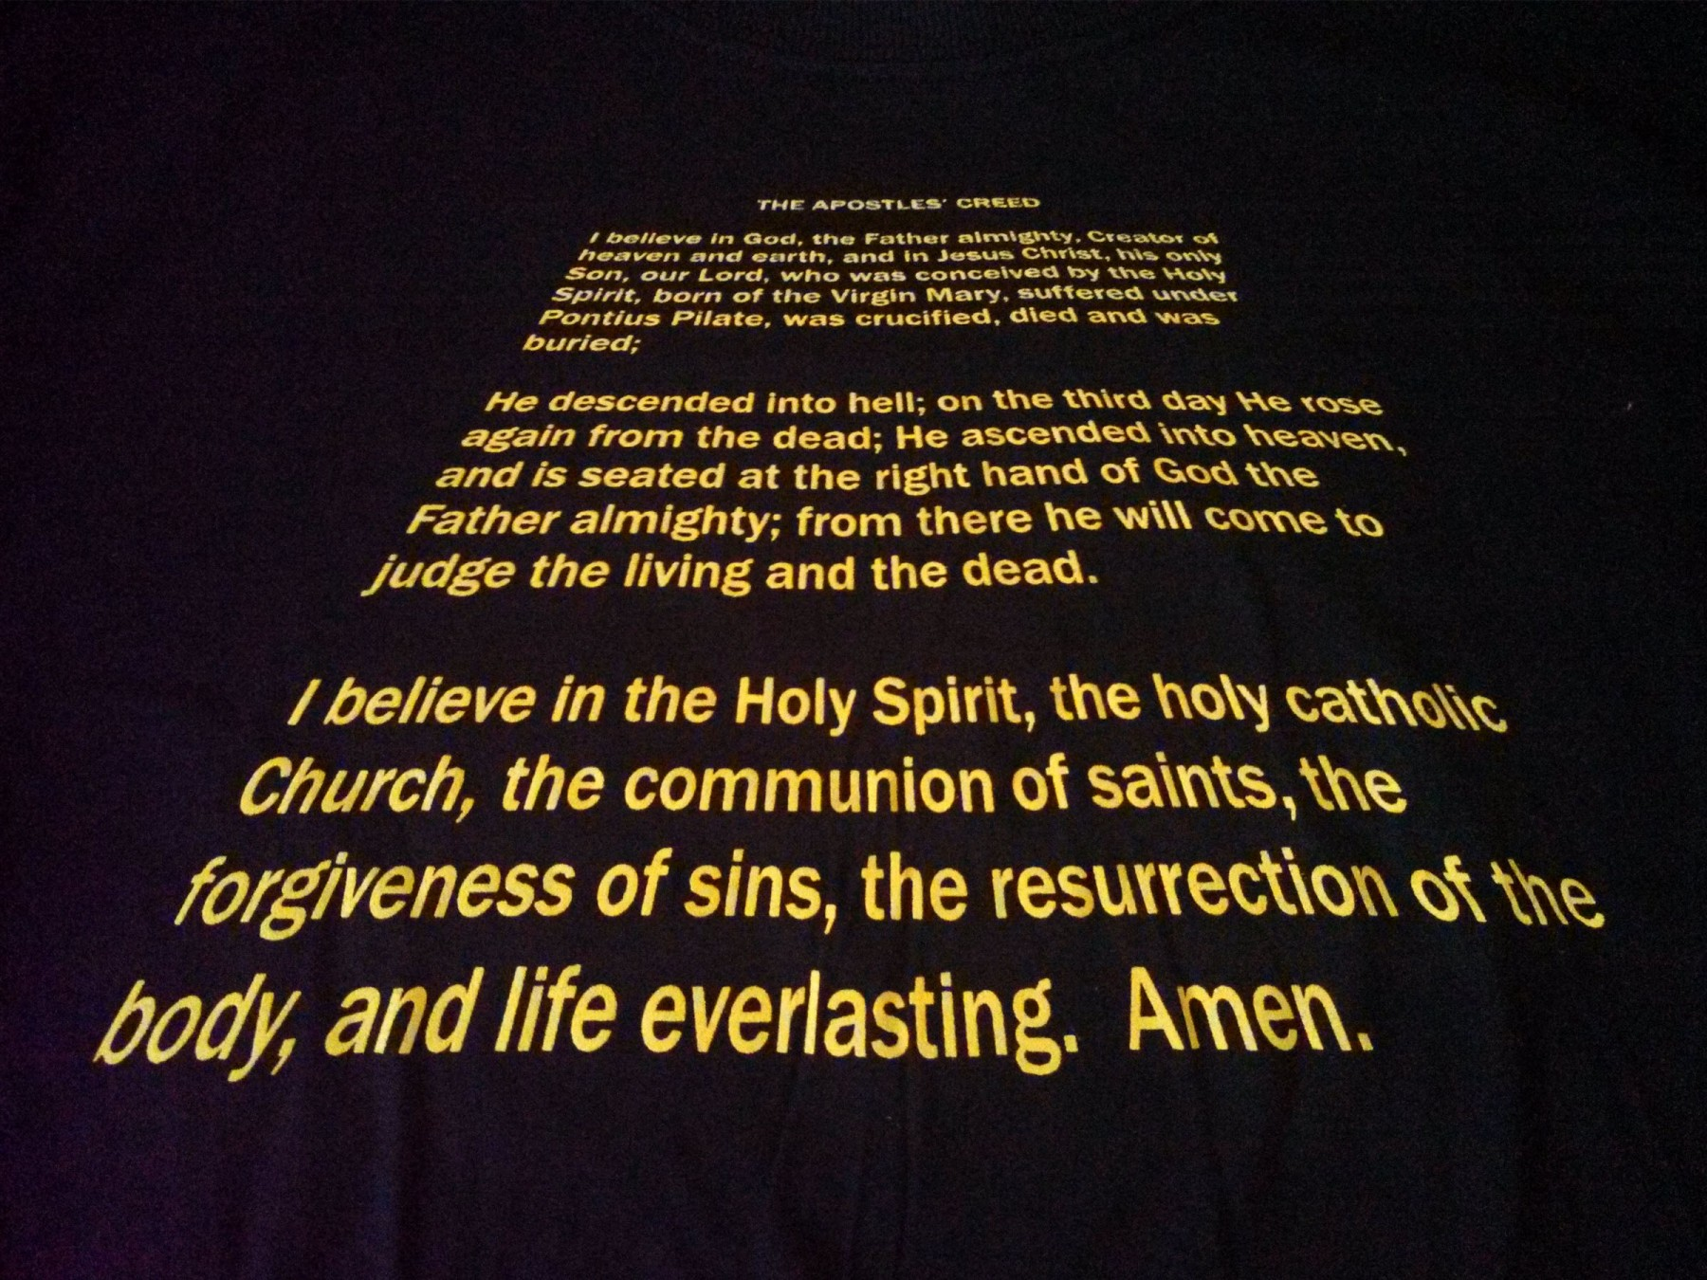
Christology
A. The Atonement
6. A comment on the Apostle’s creed…
Read aloud… anything seem weird?

Slide 33
Christology
Pros: It has been around for so long….
Cons:
  It has no claim to being “apostolic” and no support (in the sense of a “descent into hell”) from the first six centuries of the church.
  It was not in the earliest versions of the Creed ; only included in it later because of an apparent misunderstanding about its meaning.
  Unlike every other phrase in the Creed, it represents not some major doctrine on which all Christians agree, but rather a statement about which most Christians seem to disagree.
  “It is at best confusing and in most cases misleading for modern Christians. My own judgment is that there would be all gain and no loss if it were dropped from the Creed once for all. Concerning the doctrinal question of whether Christ did descend into hell after he died, the answer from several passages of Scripture seems clearly to be no.” WG, 517
A. The Atonement
6. A comment on the Apostle’s creed…

Slide 34
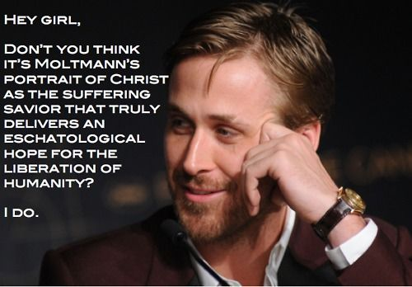
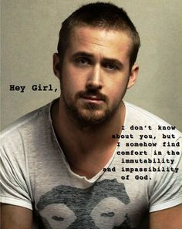
Christology
A. The Atonement
A Gosling moment…first a warm up…
Protestant Jürgen Moltmann sees the cross as indispensable to our healing- both as earthly creatures who experience pain and need a Brother, and as spiritual creatures who are sinful and need a Savior.

Slide 35
Christology
II. The Work of Christ
    Atonement of Christ
Ascension
Why necessary?
Cause
Atonement
Resurrection
of Christ
Nature
Offices
Distinguishing the obediences…
Further words on His death
A word about the Apostle’s Creed
Extent

Slide 36
Christology
A. The Atonement
7. Extent of the Atonement…
The “extent” question may be put this way:
For whom did Christ die?
Which of these statements is true?
1. Christ died for some of the sins of all men.
2. Christ died for all the sins of some men.
3. Christ died for all the sins of all men.
an incomplete atonement
A limited atonement
A universal atonement

Slide 37
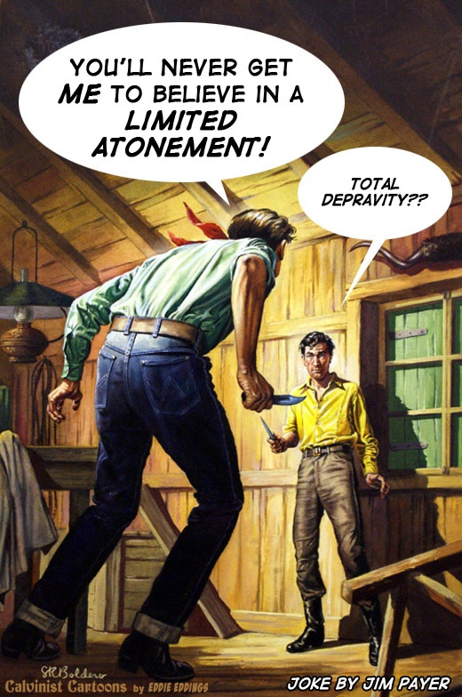
Christology
A. The Atonement
7. Extent of the Atonement…
Unfortunately, the “extent” question can become a point of disagreement between believers

Slide 38
Christology
A. The Atonement
7. Extent of the Atonement…
“Limited Atonement”
The “extent” question may be put this way:
When Christ died on the cross, did he pay for the sins of the entire human race or only for the sins of those who he knew would ultimately be saved?
“Unlimited Atonement”
Reformed response:
  1. if Christ’s death actually paid for the sins of every person who ever lived, then there is no penalty left for anyone to pay, and it necessarily follows that all people will be saved, without exception
  2. God could not condemn to eternal punishment anyone whose sins are already paid for: that would be demanding double payment, and it would therefore be unjust.
Non-Reformed view:
  1. the gospel offer in Scripture is repeatedly made to all people, and to be genuine, the payment for sins must have already been made and must be actually available for all people.
  2. if the people whose sins Christ paid for are limited, then the free offer of the gospel also is limited, and the offer of the gospel cannot be made to all mankind without exception.

Slide 39
Christology
A. The Atonement
7. Extent of the Atonement…
When Christ died on the cross, for whose sins did He pay?
Further Reformed response:
we do not know who will come to trust in Christ (only God knows) and the free offer of the gospel is to be made to everybody without exception.
We know that everyone who repents and believes in Christ will be saved, so all are called to repentance (cf.Acts 17:30). The fact that God foreknew who would be saved, and that he accepted Christ’s death as payment for their sins only, does not inhibit the free offer of the gospel, for who will respond to it is hidden in the secret counsels of God. That we do not know who will respond no more constitutes a reason for not offering the gospel to all than not knowing the extent of the harvest prevents the farmer from sowing seed in his fields.
God’s purposes in redemption are agreed upon within the Trinity and they are certainly accomplished. Those whom God planned to save are the same people for whom Christ also came to die, and to those same people the Holy Spirit will certainly apply the benefits of Christ’s redemptive work, even awakening their faith (John 1:12; Phil. 1:29; cf. Eph. 2:2) and calling them to trust in him. What God the Father purposed, God the Son and the Holy Spirit agreed to and surely carried out.

Slide 40
Christology
A. The Atonement
7. Extent of the Atonement…
The “extent” question may be put this way:
When Christ died on the cross, did he pay for the sins of the entire human race or only for the sins of those who he knew would ultimately be saved?
Reformed response:
  The outward call can genuinely be made to all.
  Not all are called inwardly (saved).
  The atonement is limited in its extent; (Christ died for the Church)
  The atonement is complete in its effect.
“the bread of God is that which comes down from heaven, and gives life to the world”
(John 6:33).
“I am the good shepherd. The good shepherd lays down his life for the sheep” (John 10:11)
“Husbands, love your wives, as Christ loved the
church and gave himself up for her” (Eph. 5:25).
Read…Ephesians 1: 3-14
In regards to those outwardly claiming Christ, Read Jesus’ difficult words about the goats in Matthew 25:31-46

Slide 41

Christology
A. The Atonement
7. Extent of the Atonement…
A word on the notion of “limiting”…
Reformed people argue that it is the “Unlimited” view that truly limits the power of the atonement because in that view the atonement does not actually guarantee salvation for God’s people but only makes salvation possible for all people. In other words, if the atonement is not limited with respect to the number of people to which it applies, then it must be limited with respect to what it actually accomplishes.

Slide 42
Christology
A. The Atonement
7. Extent of the Atonement…
A word on the interpretation of “world” passages…
The passages that speak about Christ dying “for” the whole world are best
understood to refer to the free offer of the gospel that is made to all people.
  When Jesus says, “The bread which I shall give for the life of the world is my flesh” (John 6:51)—He is extending the offer of this Bread to all…
Or
  When John says that Christ “is the propitiation for our sins, and not for ours only but also for the sins of the whole world” (1 John 2:2), he may simply be understood to mean that Christ is the atoning sacrifice that the gospel now makes available for the sins of everyone in the world.

Slide 43
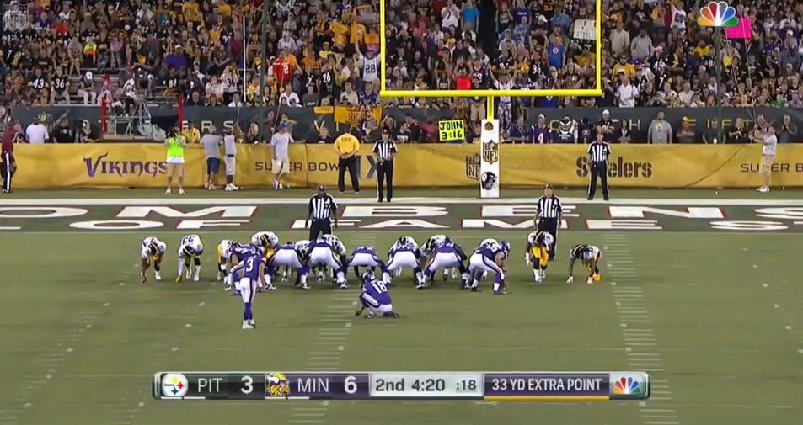
Christology
A. The Atonement
7. Extent of the Atonement…
And (especially) You have heard it said…
  ¹⁶ For God so loved the world that he gave
  his one and only Son, that whoever believes
  in him shall not perish but have eternal life.
  (John 3:16),
  No word for "whoever" exists in the Greek text.
  A literal interpretation of the Greek is "all the believers," not "whoever believes" (the same is true in John 3:15). This verse would read more accurately as: "God so loved the world that He gave His only begotten son, that all the believers in Him should not perish.“
  In other words, the Greek text makes it clear that Jesus did not come to save just anyone, but that he came to save a definite, specific group of people identified as believers.
  John is stating how God showed His love to the world—and saved----some.

Slide 44

Christology
A. The Atonement
7. Extent of the Atonement…
FINALLY, a word of caution…
When people debate this issue, they often take it way beyond the scope of the atonement—that is, those for whom Christ paid for on the cross.
When a non-Reformed person hears someone describe Particular Redemption saying “Christ died for His people”, he or she means that “Christ died to actually pay the penalty for all the sins of his people only.” In that sense it is true. But when non-Reformed people hear the sentence “Christ died for his people only,” they often hear in it, “Christ died so that he could make the gospel available only to a chosen few,” and they are troubled over what they see as a real threat to the free offer of the gospel to every person. Reformed people who hold to particular redemption should recognize the potential for misunderstanding that arises with the sentence
When a non-Reformed person says, “Christ died for all people,” is true if it means, “Christ died to make salvation available to all people” or if it means, “Christ died to bring the free offer of the gospel to all people.”

Slide 45
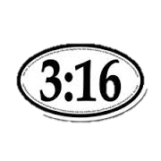
Christology
The Atonement
7. Extent of the Atonement…
What if a non-believer saw this sticker…and guessed
that the 3:16 referred to a chapter and verse of the Bible,
how would he or she know which book?
What if the reader went to Genesis 3:16 (the first of the books), which reads:
"To the woman he [God] said, 'I will greatly multiply your pain in childbearing; in pain you shall bring forth children, yet your desire shall be for your husband, and he will rule over you'"? That probably won't convert an unbeliever.
Or what if the reader went instead to the last book, to Revelation 3:16, which reads: "So, because you are lukewarm, and neither cold nor not, I will spew you out of my mouth"? That not might not help, either.
If you are choosing to bring attention to this verse….include the book!

Slide 46
Christology
A. The Atonement
7. Extent of the Atonement…
The “extent” question may be put this way:
For whom did Christ die?
Which of these statements is true?
1. Christ died for some of the sins of all men.
2. Christ died for all the sins of some men.
3. Christ died for all the sins of all men.
an incomplete atonement
A limited atonement
A universal atonement

Slide 47
Christology
A. The Atonement
7. Extent of the Atonement…
The “extent” question may be put this way:
For whom did Christ die?
Which of these statements is true?
1. Christ died for some of the sins of all men.
2. Christ died for all the sins of some men.
3. Christ died for all the sins of all men.
From John Piper:
“The third statement is what the Arminians would say. Christ died for all the sins of all men. But then why are not all saved? They answer, because some do not believe. But is this unbelief not one of the sins for which Christ died? If they say yes, then why is it not covered by the blood of Jesus and all unbelievers saved? If they say no (unbelief is not a sin that Christ has died for) then they must say that men can be saved without having all their sins atoned for by Jesus, or they must join us in affirming statement number two: Christ died for all the sins of some men. That is, he died for the unbelief of the elect so that God’s punitive wrath is appeased toward them and his grace is free to draw them irresistibly out of darkness into his marvelous light.”

Slide 48
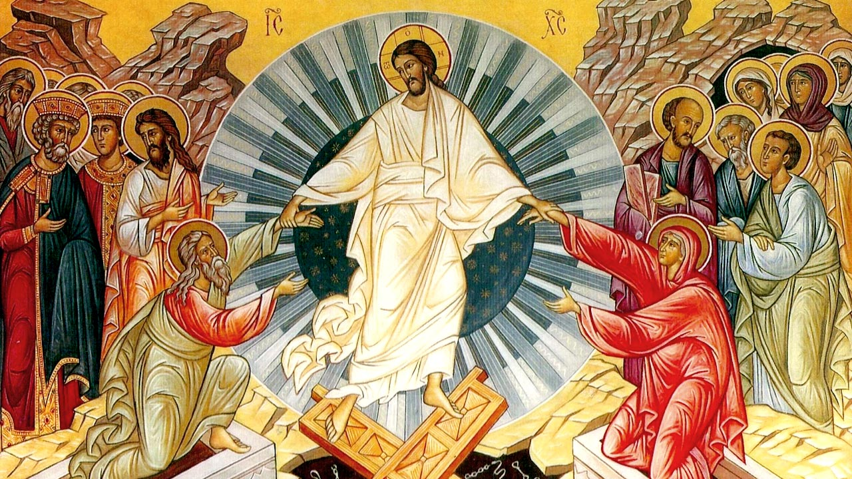
Christology
Resurrection and Ascension
What was Christ's resurrection body like? What is its significance for us? What happened to Christ when he ascended into heaven?

Slide 49
Christology
II. The Work of Christ
    Atonement of Christ
    Resurrection
Evidence
Ascension
Why necessary?
Cause
Atonement
Resurrection
of Christ
Nature
Offices
Distinguishing the obediences…
Further words on His death
A word about the Apostle’s Creed
Extent

Slide 50
Christology
B. The Resurrection
1. Evidence of the Resurrection…
The Evidence is overwhelming. Consider the fourfold testimony:
1. Gospels
2. Acts of the Apostles
3. Epistles
4. Non-Biblical History
(see Matt. 28:1–20; Mark 16:1–8; Luke 24:1–53; John 20:1–21:25)
“With great power the apostles continued to testify to the resurrection of the Lord Jesus. And God's grace was so powerfully at work in them all.” Acts 4:33
In turning to one of Paul’s greatest chapters, we see him viewing himself as the last witness of Christ’s resurrection (I Cor. 15:8); The statements of I Corinthians 15:1-8 not only confirm Christ’s resurrection, but also authenticate Paul’s apostleship (I Cor. 9:1).
Professor Thomas Arnold, appointed to the chair of modern history at Oxford, was well acquainted with the value of evidence in determining historical facts. This great scholar said: "I have been used for many years to study the histories of other times, and to examine and weigh the evidence of those who have written about them, and I know of no one fact in the history of mankind which is proved by better and fuller evidence of every sort, to the understanding of a fair inquirer, than the great sign which God hath given us that Christ died and rose again from the dead." Brooke Foss Westcott, an English scholar, said: "raking all the evidence together, it is not too much to say that there is no historic incident better or more variously supported than the resurrection of Christ.

Slide 51
Christology
II. The Work of Christ
    Atonement of Christ
    Resurrection
Evidence
Ascension
Nature
Why necessary?
Cause
Atonement
Resurrection
of Christ
Nature
Offices
Distinguishing the obediences…
Further words on His death
A word about the Apostle’s Creed
Extent

Slide 52
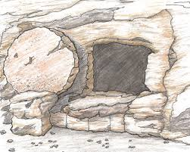
Christology
B. The Resurrection
2. Nature of the Resurrection…
Consider these ideas:
1. A physical body—but different
2. A Similar appearance most likely
He was recognized and touched after death; when he rose from the dead Jesus was the “first fruits”2 (1 Cor. 15:20, 23) of a new kind of human life—not the resurrected body of Lazarus, but a life in which his body was made perfect, no longer subject to weakness, aging, or death, but able to live eternally.
If the slowness of recognition was not due to God’s withholding, perhaps any difference in appearance was simply the difference between a man who had lived a life of suffering, hardship, and grief, and one whose body was restored to its full youthful appearance of perfect health: though Jesus’ body was still a physical body, it was raised as a transformed body, never able again to suffer, be weak or ill, or die.
By the way, the 2 Biblical texts that mention that Jesus appeared in a room when the doors had been shut or locked (John 20:19, 26) may or may not mean that he passed through a door or wall—the door may have been miraculously opened and shut (locked).

Slide 53
Christology
II. The Work of Christ
    Atonement of Christ
    Resurrection
Evidence
Ascension
Nature
Why necessary?
Cause
Doctrinal Significance
Atonement
Resurrection
of Christ
Nature
Offices
Distinguishing the obediences…
Further words on His death
A word about the Apostle’s Creed
Extent

Slide 54
Christology
B. The Resurrection
2. Doctrinal Significance of the Resurrection…
The Resurrection of Christ:
1. Insures our Regeneration
2. Insures our Justification
3. Assures us we will receive Perfect Resurrection Bodies as well
Peter says that “we have been born again to a living hope through the resurrection of Jesus Christ from the dead” (1 Peter 1:3*). *look up rest!
Paul says that Jesus “was put to death for our trespasses and raised for our justification” (Rom. 4:25).
There Paul says that Christ is the “first fruits of those who have fallen asleep” (1 Cor. 15:20). In calling Christ the “first fruits” (Gk. ἀπαρχή, G569), Paul uses a metaphor from agriculture to indicate that we will be like Christ. Just as the “first fruits” or the first taste of the ripening crop show what the rest of the harvest will be like for that crop, so Christ as the “first fruits” shows what our resurrection bodies will be like when, in God’s final “harvest,” he raises us from the dead and brings us into his presence.

Slide 55
Christology
II. The Work of Christ
    Atonement of Christ
    Resurrection
Evidence
Ascension
Nature
Why necessary?
Cause
Doctrinal Significance
Atonement
Resurrection
of Christ
Nature
Ethical significance
Offices
Distinguishing the obediences…
Further words on His death
A word about the Apostle’s Creed
Extent

Slide 56
Christology
B. The Resurrection
3. Ethical Significance of the Resurrection…
After a long discussion of the resurrection, Paul concludes by encouraging his readers, “Therefore my beloved brethren, be steadfast, immovable, always abounding in the work of the Lord, knowing that in the Lord your labor is not in vain”
(1 Cor. 15:58).
The Resurrection of Christ:
1. Foundation to continue the Lord’s work
2. Fixes our Hope on a Heavenly Reward
3. Obligation and ability to have power over sin
“17 And if Christ has not been raised, your faith is futile and you are still in your sins. 18 Then those also who have fallen asleep in Christ have perished. 19 If in Christ we have hope[b] in this life only, we are of all people most to be pitied.”
(1 Cor. 15:17–19 cf. v. 32).
When Paul says we are to consider ourselves “dead to sin and alive to God in Christ Jesus” by virtue of the resurrection of Christ and his resurrection power within us (Rom. 6:11), he then goes on immediately to say, “Let not sin therefore reign in your mortal bodies....Do not yield your members to sin” (Rom. 6:12–13). The fact that we have this new resurrection power over the domination of sin in our lives is used by Paul as a reason to exhort us not to sin any more.

Slide 57
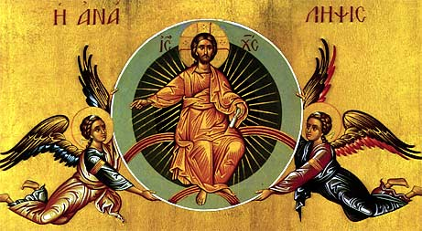
Christology
C. The Ascension
What happened to Christ when he ascended into heaven?

Slide 58
Christology
II. The Work of Christ
    Atonement of Christ
    Resurrection
    Ascension
Tidbits O’ Import
Evidence
Ascension
Nature
Why necessary?
Cause
Doctrinal Significance
Atonement
Resurrection
of Christ
Nature
Ethical significance
Offices
Distinguishing the obediences…
Further words on His death
A word about the Apostle’s Creed
Extent

Slide 59
Christology
C. The Ascension
1. Tidbits of Import…
“Men of Galilee, why do you stand looking into heaven?
This Jesus, who was taken up from you into heaven, will come in the same way as you saw him go into heaven.” (Acts 1:9–11)
Regarding Christ’s Ascension:
1. Christ Ascended to a Place
2. Christ Received Glory and Honor That Had Not Been His when Incarnate
Man.
3. Christ Was Seated at God’s Right Hand (Christ’s Session).
Before Jesus died, he prayed, “⁵ And now, Father, glorify me in your own presence with the glory that I had with you before the world existed.” (John 17:5).
When Christ ascended back into heaven he received the fulfillment of that promise: “When he had made purification for sins, he sat down at the right hand of the Majesty on high” (Heb. 1:3). This welcoming into the presence of God and sitting at God’s right hand is a dramatic indication of the completion of Christ’s work of redemption.

Slide 60
Christology
C. The Ascension
1. Tidbits of Import…
Regarding Christ’s Ascension:
4. It Has Doctrinal Implications for Our Lives
  a. Since we are united with Christ in every aspect of his work of redemption, Christ’s going up into heaven foreshadows our future ascension into heaven with him.
  b. Jesus’ ascension gives us assurance that our final home will be in heaven with him.
  c. Because of our union with Christ in his ascension, we are able to share now (in part) in Christ’s authority over the universe, and we will later share in it more fully.
Jesus promises, “He who conquers and who keeps my works until the end, I will give him power over the nations, and he shall rule them with a rod of iron, as when earthen pots are broken in pieces, even as I myself have received power from my Father” (Rev. 2:26–27). These are amazing promises of our future sharing in Christ’s sitting at the right hand of God, promises that we will not fully understand until the age to come.

Slide 61
Christology
II. The Work of Christ
    Atonement of Christ
    Resurrection
    Ascension
Tidbits O’ Import
States of Christ
Evidence
Ascension
Nature
Why necessary?
Cause
Doctrinal Significance
Atonement
Resurrection
of Christ
Nature
Ethical significance
Offices
Distinguishing the obediences…
Further words on His death
A word about the Apostle’s Creed
Extent

Slide 62
Christology
C. The Ascension
2. States of Christ
“In talking about the life, death, and resurrection of Christ, theologians have sometimes talked about the “states of Jesus Christ.” By this they mean the different
relationships Jesus had to God’s law for mankind, to the possession of authority, and to receiving honor for himself.
What do the “states of Christ” mean:
1. There are 2 traditional states
a. Humiliation
  b. Exaltation
Within the humiliation of Christ are included his incarnation, suffering, death, and
burial. Sometimes a fifth aspect (descent into hell) is included, but as explained
above, the position taken in this book is that that concept is not supported in Scripture.
In the exaltation of Christ, there are also four aspects: his resurrection, ascension into heaven, session at the right hand of God, and return in glory and power.

Slide 63
Christology
II. The Work of Christ
    Atonement of Christ
    Resurrection
    Ascension
    Offices
Tidbits O’ Import
States of Christ
Evidence
Ascension
Nature
Why necessary?
Cause
Doctrinal Significance
Atonement
Resurrection
of Christ
Nature
Ethical significance
Offices
Distinguishing the obediences…
Further words on His death
Triumvirate work of Christ
A word about the Apostle’s Creed
Extent

Slide 64
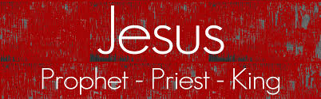
Christology
The Offices
John Calvin (1509–64) was the first major theologian to apply these three categories to the work of Christ (see his Institutes of the Christian Religion Book 2, Chapter 15). The categories have been adopted by many subsequent theologians as a helpful way of understanding various aspects of Christ’s work.
The Old
Testament prophets looked forward to Christ in what they wrote, and the New Testament apostles looked back to Christ and interpreted his life for the benefit of the church.
God raised him up and “made him sit at his
right hand in the heavenly places, far above all rule and authority and power and dominion and above every name that is named, not only in this age but also in that which is to come; and he has put all things under his feet and has made him the head
over all things for the church” (Eph. 1:20–22; Matt. 28:18; 1 Cor. 15:25)
Jesus Offered a Perfect Sacrifice for Sin and Continually Brings Us Near to God through prayer.

Slide 65
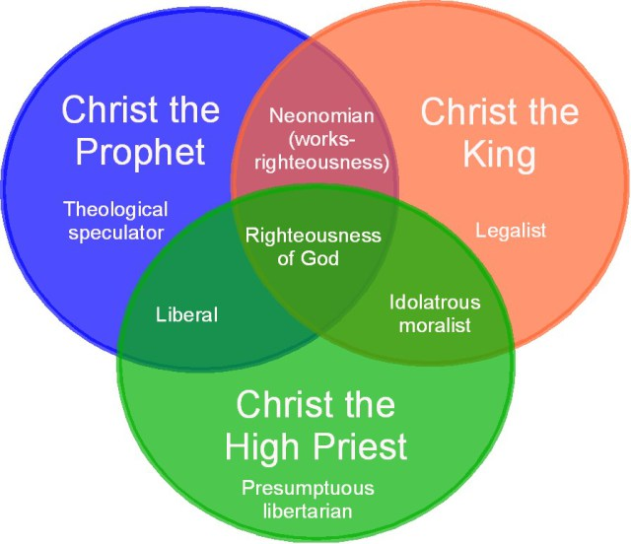
Christology
Our Roles…
Here is an interesting view of what may occur if we neglect to apply all of Christ’s offices to our daily lives…but, rather focus on one or two.
Keep in mind this is someone’s opinion—and a rather negative view of an individual’s trajectory.
The roles of prophet, priest, and king has parallels in the experience that God originally intended for man: these were compromised at the fall, but later re-established in the lives of God’s people. We are intended to be prophets proclaiming God’s truth, priests worshipping God in all we do, and godly leaders extending His authority globally—looking to Christ, the only fulfillment of these roles.

Slide 66
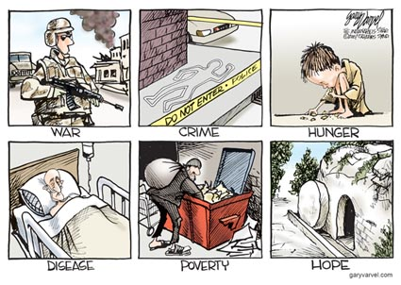
Christology

