Slide 1
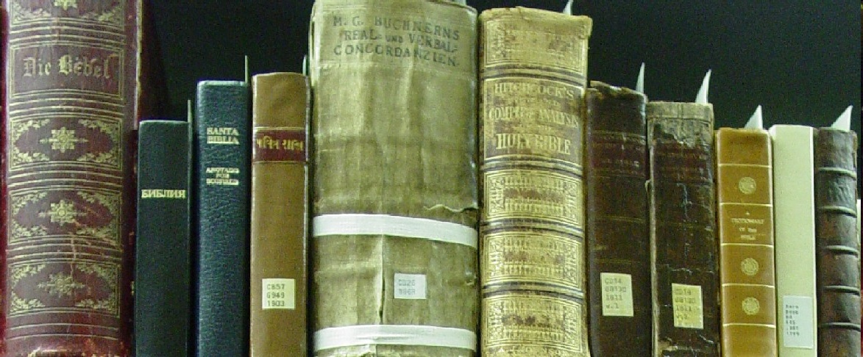
Systematic Theology
ChristologY
Part 1
The person of Jesus
Acts, Epistles, & Systematics
SRCS ~ Bible 10
mr. e ~ spring 2015

Slide 2
Christology: part 1
2. Lecture &Discussion
3. Reading & Questions (Frame ch 10; or Berkhof ch xiv-xv )
4. Vocab (Each unit; matching)
Apollinarianism
Arianism
Chalcedonian definition
impassibility
docetism
Eutychianism (monophysitism)
mediator
Lord
Ebionism
monothelite view
Nestorianism
Son of God
Son of Man
virgin birth
God
hypostatic union
impeccability
incarnation
kenosis theory
Logos
will

Slide 3
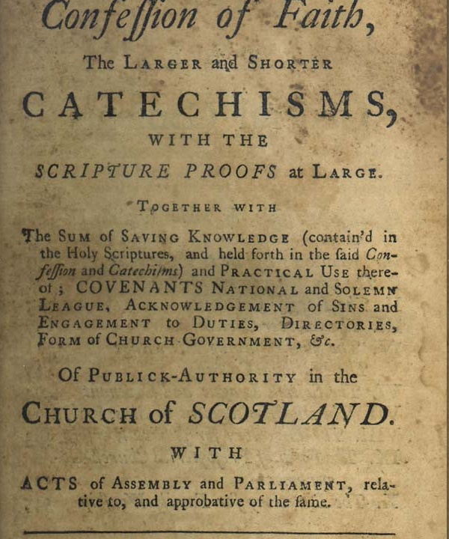
Christology
5. Catechism (PART 1: WSC Q21-Q22
6. Bible memory (look at the green boxes in the presentation)
John 1:14: And the Word became flesh and dwelt among us, full of grace and truth; we have beheld his glory, glory as of the only Son from the Father.
7. Doctrine/WCF (ch 8)

Slide 4

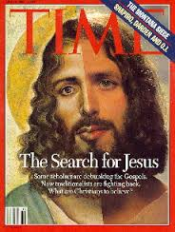
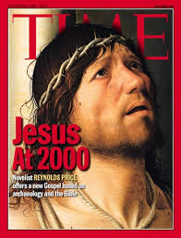
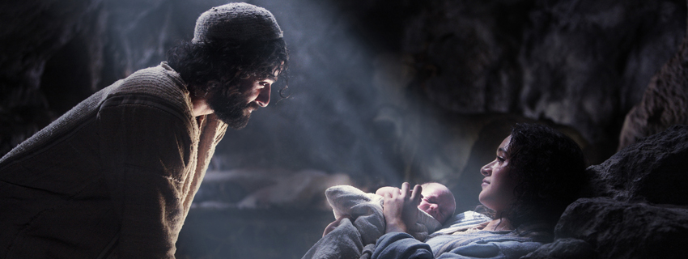
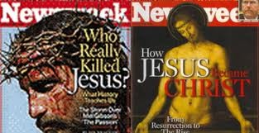
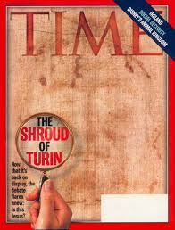
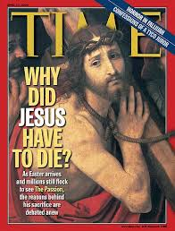
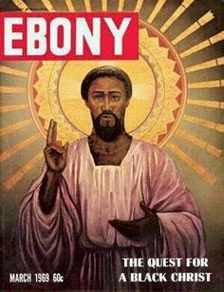
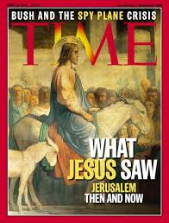
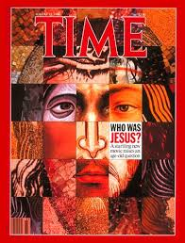
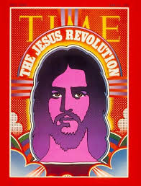
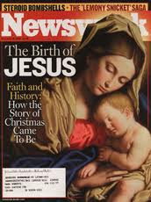
Christology
How would you describe Him—ontologically?
Jesus Christ

Slide 5
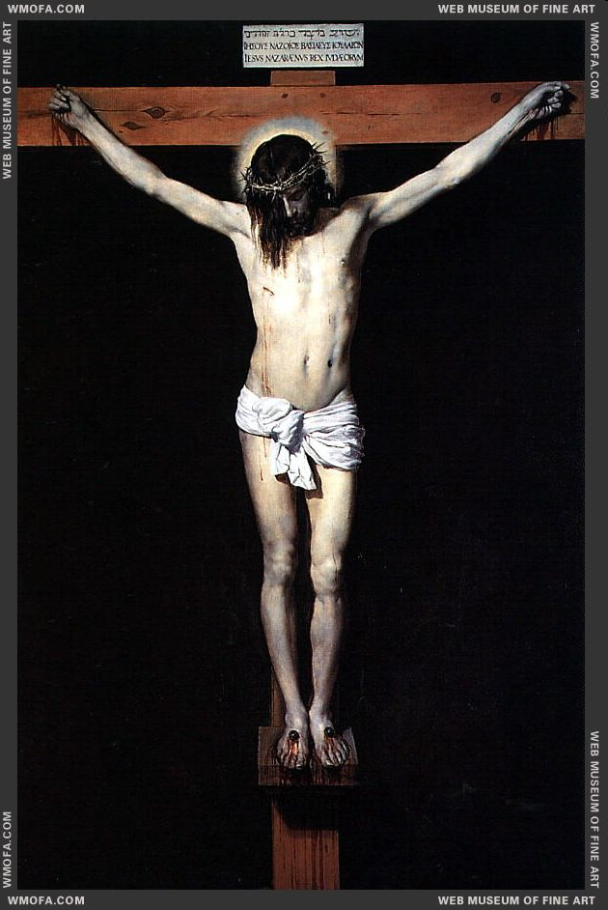
Christology
Part IV: The Doctrine of Christ
One 14. The Person of Christ How is Jesus fully God and fully man, yet one person?
Two 15. The Atonement Was it necessary for Christ to die? What really happened in the atonement? Did Christ descend into hell? 16. Resurrection and Ascension What was Christ's resurrection body like? What is its significance for us? What happened to Christ when he ascended into heaven?

Slide 6
Christology
The Person of Christ
How is Jesus fully God and fully man, yet one person?

Slide 7
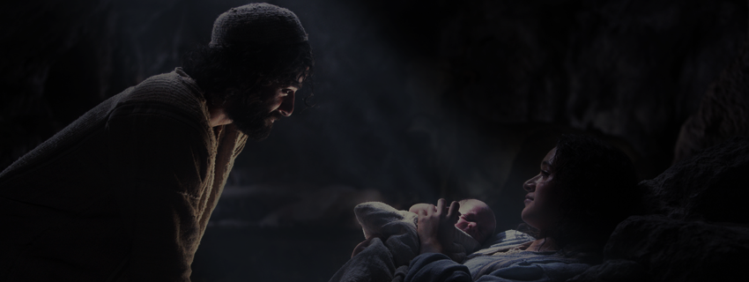
Christology
We may summarize the biblical teaching about the person of Christ as follows:
Jesus Christ was fully God and fully man in one person, and will be so forever.
I. The Person of Christ
We will begin the humanity of Christ → deity of Christ → attempt to show their unity in the one person of Jesus Christ .

Slide 8
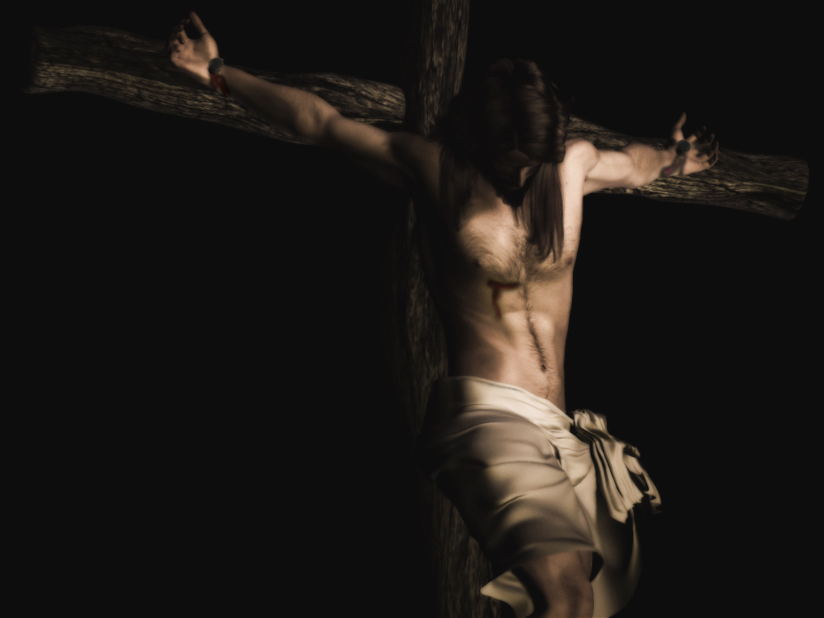
Christology
The Person of Christ
Humanity of Christ
Deity of Christ
Incarnation
Direct Claims
Human Limitations & weaknesses
Virgin birth
Evidence
Kenosis theory
Humanity
Deity
of Christ
Sinlessness
Incarnation
“Could Jesus have sinned?”
Why necessary?
Why necessary?
Perpetuity

Slide 9
Christology
The Person of Christ
Humanity of Christ
Virgin birth
Humanity
Deity
of Christ

Slide 10

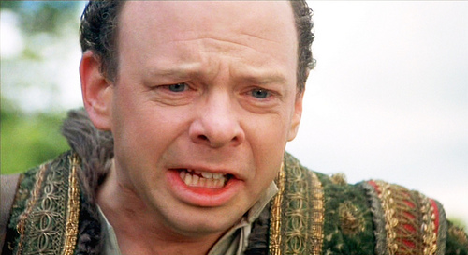
Christology
Virgin birth
The Person of Christ
Humanity of Christ

Slide 11
Christology
Virgin birth
The Person of Christ
Humanity of Christ
Just as God had promised that the “seed” of the woman (Gen. 3:15) would ultimately destroy the serpent, so God had to fulfill it.
The doctrinal importance of the virgin birth is seen in at least three areas.
It shows that salvation ultimately must come from the Lord.
2. The virgin birth made possible the uniting of full deity and full humanity in one person.
3. The virgin birth also makes possible Christ’s true humanity without inherited sin.
Consider two ways God could have sent Jesus into the world:
1. made human in Heaven, sent as adult
2. Conceived by 2 human parents and made Divine/perfected
See potential diametric problems?
Jesus did not descend from Adam in exactly the same way in which every other human being has descended from Adam. And this helps us to understand why the legal guilt and moral corruption that belongs to all other human beings did not belong to Christ..
“18 Now the birth of Jesus Christ took place in this way. When his mother Mary had been betrothed to Joseph, before they came together she was found to be with child from the Holy Spirit. ” Matt. 1:18

Slide 12
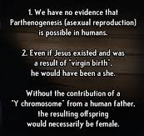
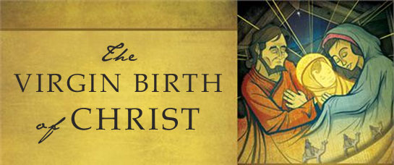
Christology
Virgin birth
The Person of Christ
Humanity of Christ
Isn’t that the point?
If God can make an 23 pairs of X chromosomes….is it too difficult for Him to make 45 x’s & 1 Y?
Detractors & Skeptics….

Slide 13
Christology
The Person of Christ
Humanity of Christ
Human Limitations & weaknesses
Virgin birth
Humanity
Deity
of Christ

Slide 14

Christology
The Person of Christ
Humanity of Christ
Human Limitations & weaknesses
Eg.
Jesus had a human body
2. Jesus had a human mind
3. Jesus had emotions
4. People near Jesus saw Him as a man
Hungry, thirsty, tired
Increased in wisdom
Troubled soul, marveled, angered
“Where did this man get this wisdom and these mighty works? Is not this the carpenter’s son? Is not his mother called Mary? And are not his brothers James and Joseph and Simon and Judas? And are not all his sisters with us? Where then did this man get all this?” And they took offense at him.... And he did not do many mighty works there, because of their unbelief. (Matt. 13:53–
58)

Slide 15
Christology
The Person of Christ
Humanity of Christ
Human Limitations & weaknesses
Virgin birth
Humanity
Deity
of Christ
Sinlessness

Slide 16
Christology
Sinlessness
The Person of Christ
Humanity of Christ
Jesus was human…yet sinless
“¹⁵ For we do not have a high priest who is unable to sympathize with our weaknesses, but one who in every respect has been tempted as we are—yet without sin. Hebrews 4:15
The statements about Jesus’ sinlessness are quite explicit in John’s gospel: “I am the light of the world” (John 8:12).
“I always do what is pleasing to him” (John 8:29; the present tense gives the sense of
continual activity, “I am always doing what is pleasing to him”). At the end of his life,
Jesus could say, “I have kept my Father’s commandments and abide in his love”
(John 15:10).
It is significant that when Jesus was put on trial before Pilate, in spite of
the accusations of the Jews, Pilate could only conclude, “I find no crime in him”
(John 18:38).

Slide 17
Christology
Sinlessness
The Person of Christ
Humanity of Christ
Jesus was human…yet sinless
Also…consider the temptation of Christ compared to Adam & Eve:
ADAM & EVE CHRIST
garden wilderness
surrounded by food fasted for 40 days
fellowship w/ God & each other alone (no human relationship)
healthy near physical death
relied on Father’s directive relied on Father’s directive
The Ultimate Example of “Do harder things”
--rather than choosing instant gratification (on the spot bread; immediate route to power; force Father’s rescue in a notable spectacle) Jesus chose lifelong obedience and suffering at the hands of unjust Sinners.

Slide 18
Christology
The Person of Christ
Humanity of Christ
What we can say with surety:
1. Christ never sinned
2. Jesus was tempted by real temptations. (Heb 4:15)
3. God cannot be tempted by evil
(Js 1:13)
Human Limitations & weaknesses
Virgin birth
Humanity
Deity
of Christ
Sinlessness
“Could Jesus have sinned?”

Slide 19
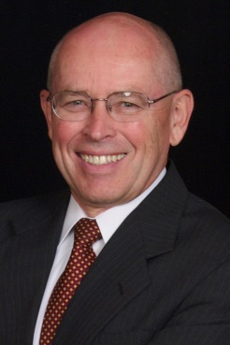
Christology
Do you sense the difficulty here?
The Person of Christ
Humanity of Christ
What we can say with surety b/c of Scripture:
1. Christ never sinned
2. Jesus was tempted by real temptations. (Heb 4:15)
3. God cannot be tempted by evil (Js 1:13)
“Although those statements are not contradictory, they are, nonetheless, difficult to understand in connection with each other, and although we can make some progress in understanding how they fit together, in this life, at least, we have to admit that there can be no final understanding on our part. Here the situation is somewhat similar. We do not have an actual contradiction. Scripture does not tell us that “Jesus was tempted” and that “Jesus was
not tempted” (a contradiction if “Jesus” and “tempted” are used exactly in the same sense in both sentences). The Bible tells us that “Jesus was tempted” and “Jesus was fully man” and “Jesus was fully God” and “God cannot be tempted.” This combination of teachings from Scripture leaves open the possibility that as we understand the way in which Jesus’ human nature and divine nature work together, we might understand more of the way in which he could be tempted in one sense and yet, in another sense, not be tempted…At this point, then, we pass beyond the clear affirmations of Scripture and attempt to suggest a solution to the problem of whether Christ could have sinned.”

Slide 20
Christology
The Person of Christ
Humanity of Christ
What we can reasonably surmise:
1. If Christ’s human nature was independent of His Divine nature, it would be like Adam’s before the fall; posse peccare (able to sin)
2. Jesus’ human nature never existed apart from His divine nature.
3. Though Jesus experienced things in his humanity that divinity does not (hunger, etc.), it seems that sinning would be a moral act involving the whole person—that is, both natures at once.
4. God, then, would be sinning, and cease to be God.
5. Conclusion: it seems that the union of His two natures prevented Christ from sinning.
Are the temptations, then, real?
In this discussion I am largely following the conclusions of Geerhardus Vos,
Biblical Theology (Grand Rapids: Eerdmans, 1948), pp. 339–42.

Slide 21

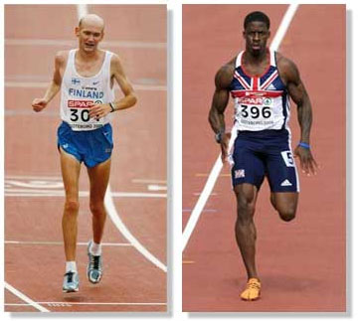

Christology
The Person of Christ
Humanity of Christ
Are the temptations, then, real?
Consider these ideas:
“only he who successfully resists a temptation to the end most fully feels the force of that temptation…Christ’s temptations were most real because He did not give into them” W. Grudem
Does the marathoner experience the reality of training for a sprint & vice versa?

Slide 22
Christology
The Person of Christ
Humanity of Christ
Human Limitations & weaknesses
Virgin birth
Humanity
Deity
of Christ
Sinlessness
“Could Jesus have sinned?”
Why necessary?

Slide 23

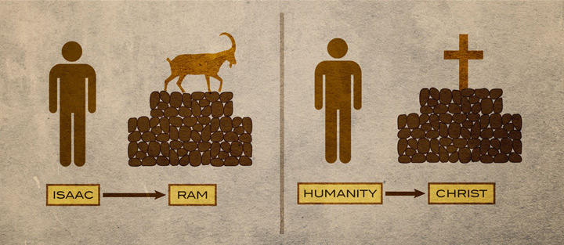
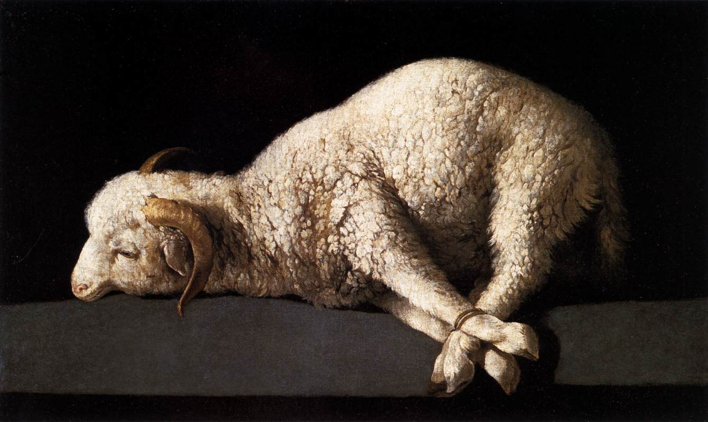
Christology
Christ succeeded where Adam failed
The Person of Christ
Humanity of Christ
He had to be made like us…
Why was Christ’s full humanity necessary?
1. For representative obedience (Rom. 5:18–19)
2. To be a substitute sacrifice
3. To be a Mediator (b/w God & man) (1 Tim. 2:5)
4. To Fulfill God’s Original purpose to rule Creation.
5. To be our Example & Pattern in life & death
6. To be the pattern for our redeemed bodies
7. To sympathize as High Priest
“There is but one mediator b/w God & man”
Given all authority under Heaven (Mt 28:18)
This is what we have to look forward to…
Having experienced what we face…
We follow in His steps and trust in the Father’s will…no matter what…

Slide 24
Christology
The Person of Christ
Humanity of Christ
Human Limitations & weaknesses
Virgin birth
Humanity
Deity
of Christ
Sinlessness
“Could Jesus have sinned?”
Why necessary?
Perpetuity

Slide 25
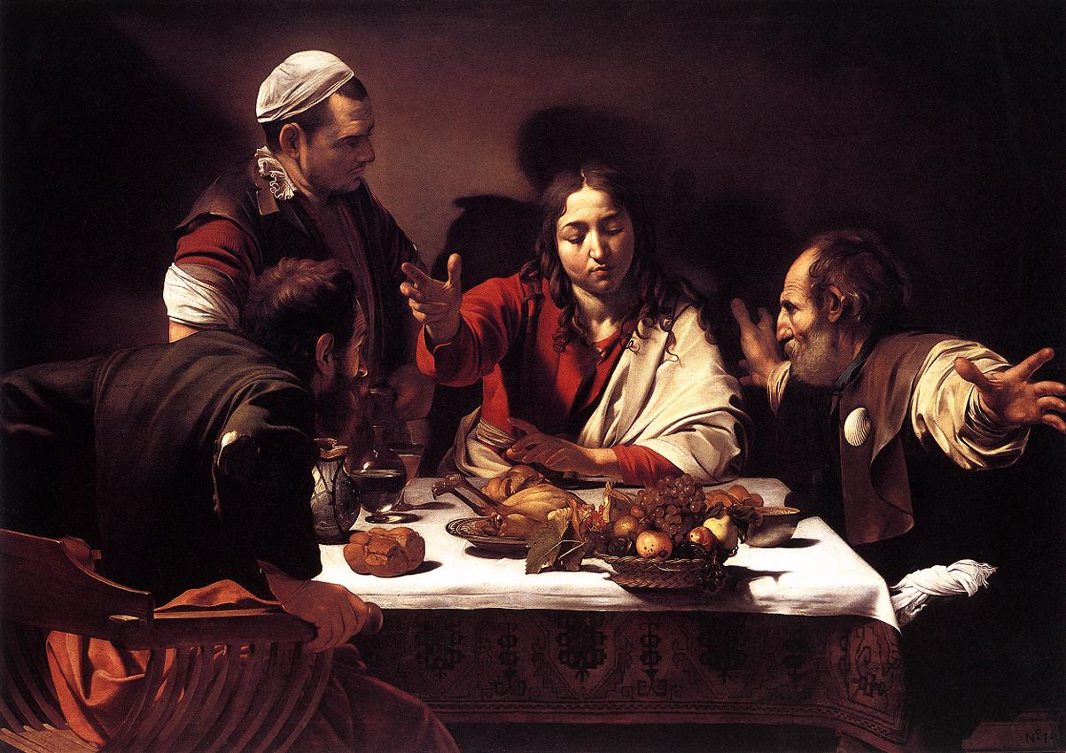
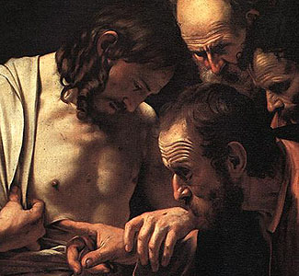
Christology
The Person of Christ
Humanity of Christ
Jesus will be a man forever…
How do we know this?
“This Jesus, who was
taken up from you into heaven, will come in the same way as you saw him go into heaven” (Acts 1:11)
Detail of The Incredulity of Saint Thomas by Caravaggio (1601)
Supper at Emmaus, Caravaggio depicts the moment the disciples recognize Jesus. (1601)

Slide 26
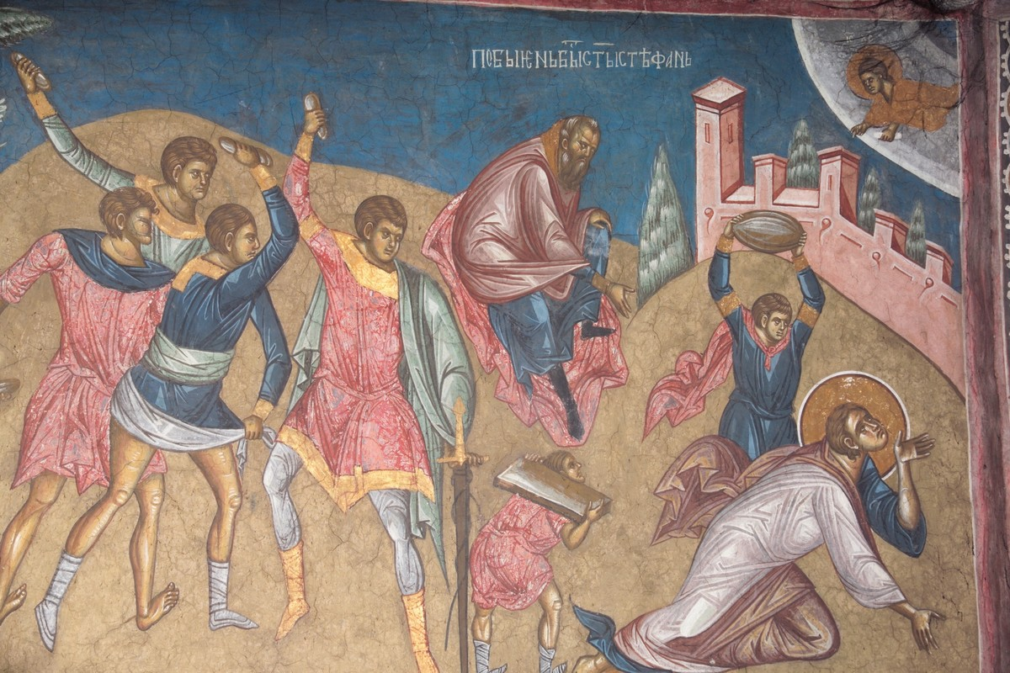
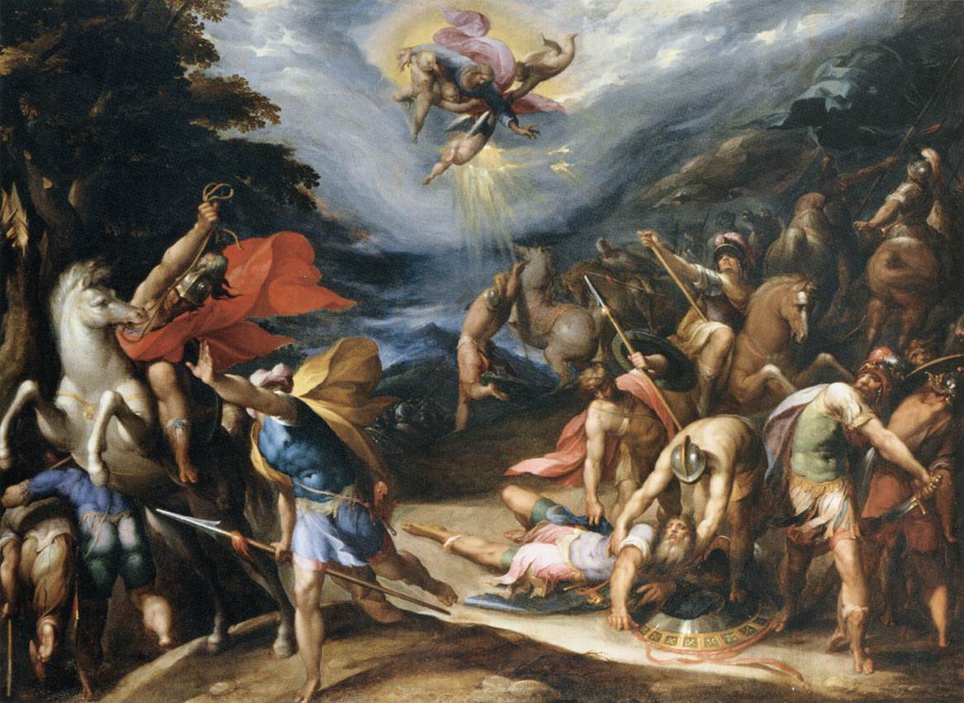
Christology
The Person of Christ
Humanity of Christ
Jesus will be a man forever…
How do we know this?
Jesus appears to John in Revelation as one like the son of man—and he promises to drink wine with the disciples and invites us to the wedding feast of the Lamb…
Saul when on the road to Damascus saw Christ
Stoning of Stephen; Stephen saw Christ “the Son of Man standing at the right hand of God.

Slide 27
Christology
The Person of Christ
Humanity of Christ
Deity of Christ
Direct Claims
Human Limitations & weaknesses
Virgin birth
Evidence
Kenosis theory
Humanity
Deity
of Christ
Sinlessness
Incarnation
“Could Jesus have sinned?”
Why necessary?
Why necessary?
Perpetuity

Slide 28
Christology
The Person of Christ
Humanity of Christ
Deity of Christ
Direct Claims
Human Limitations & weaknesses
Virgin birth
Humanity
Deity
of Christ
Sinlessness
“Could Jesus have sinned?”
Why necessary?
Perpetuity

Slide 29

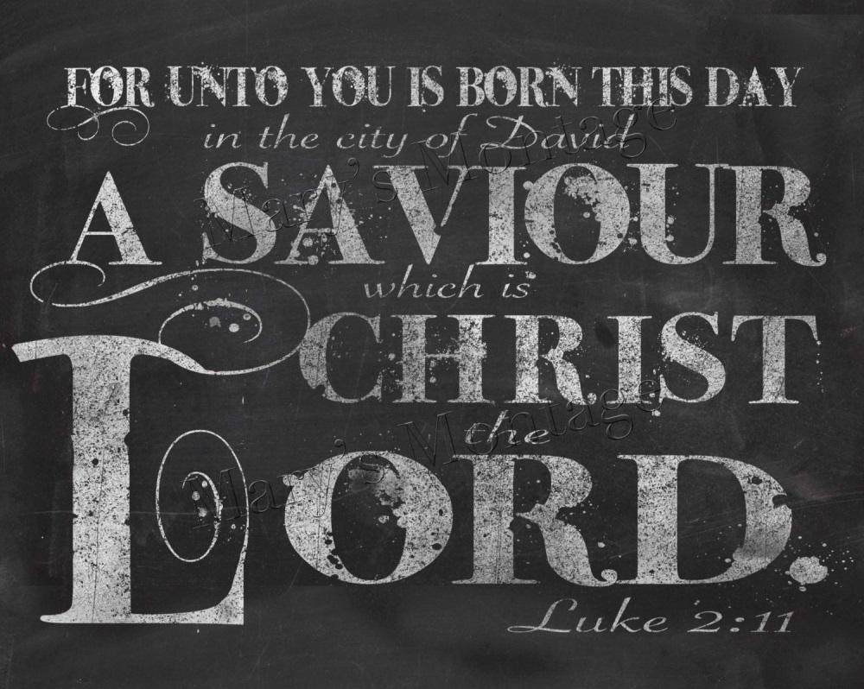
Christology
Direct Claims
The Person of Christ
Humanity of Christ
Deity of Christ
1. Called Theos in Scripture…
2. Called Kurios in Scripture…(green box verse!)

Slide 30
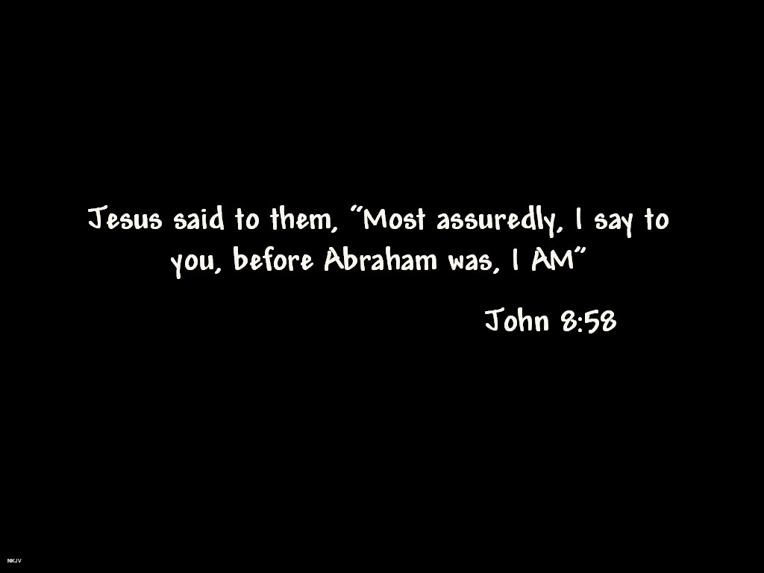
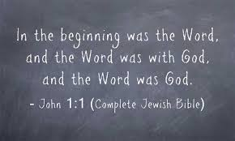
Christology
Other Direct Claims
The Person of Christ
Humanity of Christ
Deity of Christ
3. Startling claim to Pharisees…
4. John’s intro in his Gospel…& our green-box verse

Slide 31
Christology
The Person of Christ
Humanity of Christ
Deity of Christ
Direct Claims
Human Limitations & weaknesses
Virgin birth
Evidence
Humanity
Deity
of Christ
Sinlessness
“Could Jesus have sinned?”
Why necessary?
Perpetuity

Slide 32
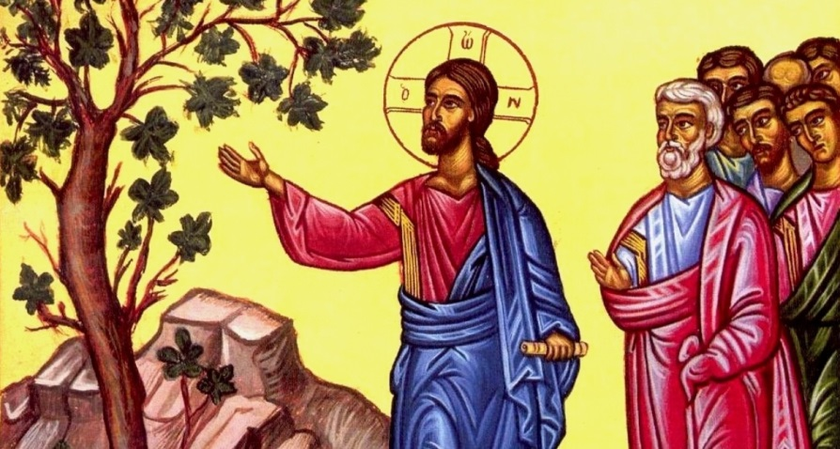
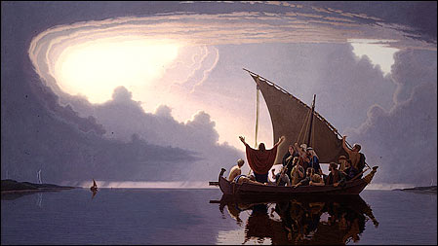
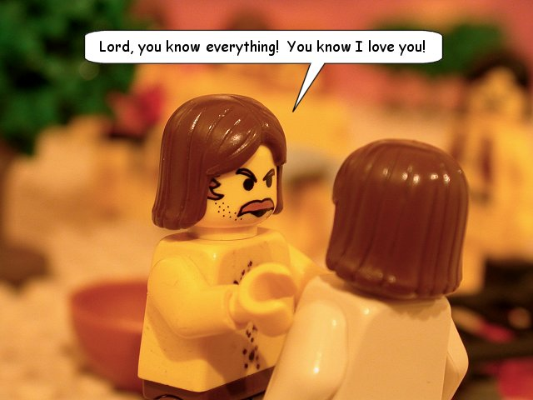
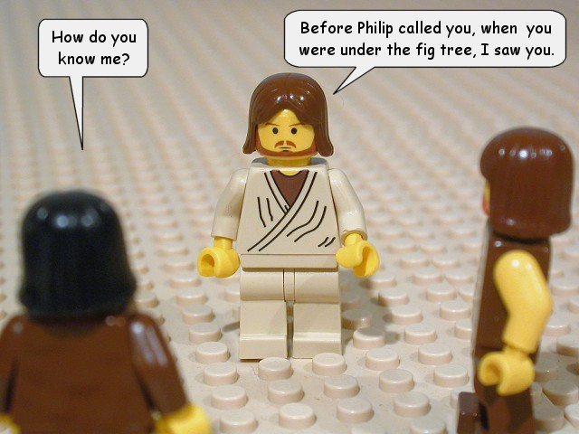
Christology
Evidence: Jesus possessed attributes of the deity…
The Person of Christ
Humanity of Christ
Deity of Christ
1. Manifested omnipotence…
2. Omniscience…

Slide 33


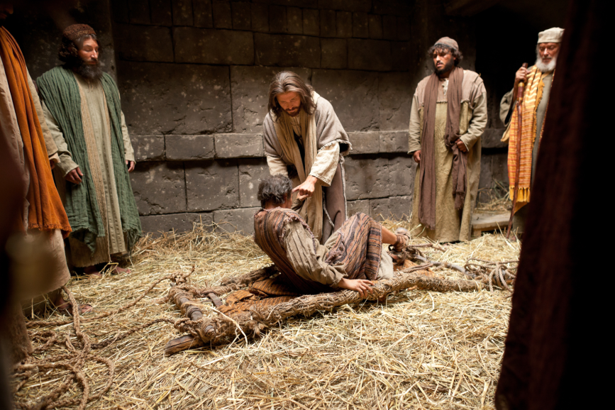

Christology
Evidence: Jesus possessed attributes of the deity…
The Person of Christ
Humanity of Christ
Deity of Christ
3. Promised omnipresence… & a green box verse..
4. Sovereignty… forgives sin, heals sick, & raises dead

Slide 34


Christology
Evidence: Jesus possessed attributes of the deity…
The Person of Christ
Humanity of Christ
Deity of Christ
5. Worthy of worship…& green-box verse

Slide 35
Christology
The Person of Christ
Humanity of Christ
Deity of Christ
Direct Claims
Human Limitations & weaknesses
Virgin birth
Evidence
Kenosis theory
Humanity
Deity
of Christ
Sinlessness
“Could Jesus have sinned?”
Why necessary?
Perpetuity

Slide 36
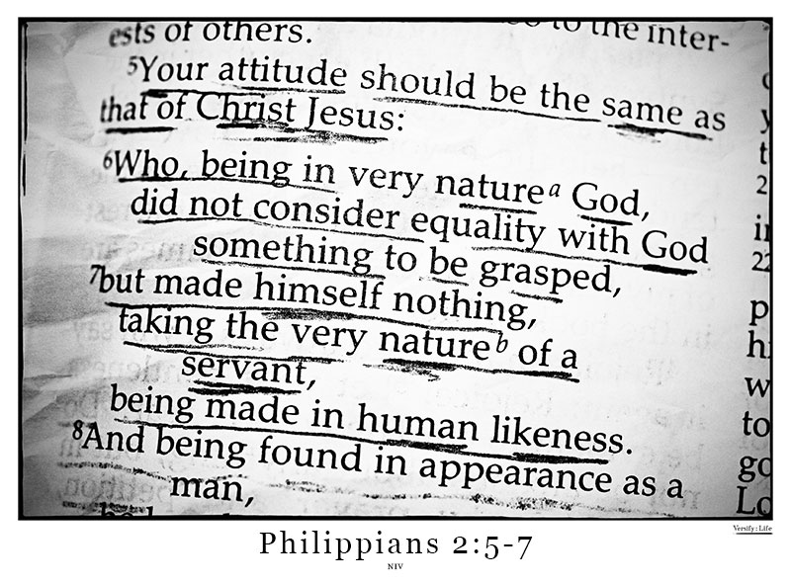
Christology
Kenosis theory
The Person of Christ
Humanity of Christ
Deity of Christ
How should we understand this passage?
The word κενόσις is taken from the Greek verb κενόω, which generally means “to empty,” and is translated “emptied himself“ in Phil. 2:7.
A green-box passage! (though in the NIV!)

Slide 37
Christology
Kenosis theory
The Person of Christ
Humanity of Christ
Deity of Christ
"Who, although He existed in the form of God, did not regard equality with God a thing to be grasped, but emptied Himself, taking the form of a bond-servant, and being made in the likeness of men." (Phil. 2:6-7 NASB)
“According to the theory Christ “emptied himself“ of some of his
divine attributes, such as omniscience, omnipresence, and omnipotence, while he was
on earth as a man. This was viewed as a voluntary self-limitation on Christ’s part,
which he carried out in order to fulfill his work of redemption” WG
Beginning with this text, several theologians in Germany (1860–1880) and England (1890–1910) advocated a view of the incarnation that had not been advocated before in the history of the church.
The aim was to solve supposed paradoxes between Christ having a divine nature and a human nature. For example, how could an all knowing God become a baby, how could God be tempted, or how could Jesus (being God) not know the time of His return?

Slide 38
Christology
Kenosis theory
The Person of Christ
Humanity of Christ
Deity of Christ
"Who, although He existed in the form of God, did not regard equality with God a thing to be grasped, but emptied Himself, taking the form of a bond-servant, and being made in the likeness of men." (Phil. 2:6-7 NASB)
“According to the theory Christ “emptied himself“ of some of his
divine attributes, such as omniscience, omnipresence, and omnipotence, while he was
on earth as a man. This was viewed as a voluntary self-limitation on Christ’s part,
which he carried out in order to fulfill his work of redemption” WG
Do you see problems with this theory?
1. Phil 2 :6-7 does not specifically teach this.
The rest of the NT does not confirm kenotic theory.
The passage does say how He emptied Himself:
a. By taking the form of a servant
By being made in human likeness
The context for the passage is for us to imitate Christ—an impossible task if we are to “set aside certain aspects of deity” that we do not remotely possess.
The obvious danger of stripping Christ of His deity.

Slide 39
Christology
Kenosis theory
The Person of Christ
Humanity of Christ
Deity of Christ
"Who, although He existed in the form of God, did not regard equality with God a thing to be grasped, but emptied Himself, taking the form of a bond-servant, and being made in the likeness of men." (Phil. 2:6-7 NASB)
“It is important to realize that the major force persuading people to accept kenotic theory was not that they had discovered a better understanding of Philippians 2:7 … but rather the increasing discomfort people were feeling with the formulations of the doctrine of Christ in historic, classical orthodoxy. It just seemed too incredible for modern rational and “scientific” people to believe that Jesus Christ could be truly human and fully, absolutely God at the same
time” WG, 477
How should we understand this passage then?
“Therefore, the best understanding of this passage is that it talks about Jesus giving
up the status and privilege that was his in heaven: he “did not count equality with God
a thing to be grasped, but “emptied himself “
or “humbled himself “ for our sake, and came to live as a man. Jesus speaks elsewhere
of the “glory” he had with the Father “before the world was made” (John 17:5), a glory that he had given up and was going to receive again when he returned to heaven” WG, 476

Slide 40
Christology
The Person of Christ
Humanity of Christ
Deity of Christ
Direct Claims
Human Limitations & weaknesses
Virgin birth
Evidence
Kenosis theory
Humanity
Deity
of Christ
Sinlessness
Incarnation
“Could Jesus have sinned?”
Why necessary?
11 For unto you is born this day in the city of David a Savior, who is Christ the Lord. 12 And this will be a sign for you: you will find a baby wrapped in swaddling cloths and lying in a manger.” luke 2:11,12
Perpetuity

Slide 41
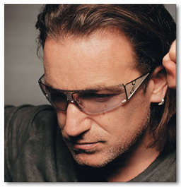

Christology
The Person of Christ
Humanity of Christ
Deity of Christ
Incarnation: tenable in our “modern” age?
"I remember coming back from a very long tour.... On Christmas Eve I went to St. Patrick’s Cathedral. ...It had dawned on me before, but it really sank in: the Christmas story. The idea that God, if there is a force of Love and Logic in the universe, that it would seek to explain itself is amazing enough. That it would seek to explain itself and describe itself by becoming a child born in straw poverty... a child, I just thought: “Wow!” Just the poetry. Unknowable love, unknowable power, describes itself as the most vulnerable…(con’t)

Slide 42
Christology
The Person of Christ
Humanity of Christ
Deity of Christ
"There it was. I was sitting there, and ...tears came down my face, and I saw the genius of this, utter genius of picking a particular point in time and deciding to turn on this. Because that’s exactly what we were talking about earlier: love needs to find form, intimacy needs to be whispered. To me, it makes sense. It’s actually logical. It’s pure logic. Essence has to manifest itself. It’s inevitable. Love has to become an action or something concrete. It would have to happen. There must be an incarnation. Love must be made flesh." Bono interview with Mishka Assayas, 2008

Slide 43
Christology
The Person of Christ
Humanity of Christ
Deity of Christ

Slide 44
Christology
The Person of Christ
Humanity of Christ
Deity of Christ
Direct Claims
Human Limitations & weaknesses
Virgin birth
Evidence
Kenosis theory
Humanity
Deity
of Christ
Sinlessness
Incarnation
“Could Jesus have sinned?”
Why necessary?
Why necessary?
Perpetuity

Slide 45
Christology
The Person of Christ
Humanity of Christ
Deity of Christ
Why is His Deity necessary?
Here it is appropriate to recognize that it is crucially important to insist
on the full deity of Christ :
(1) only someone who is infinite God could bear the full penalty for all
the sins of all those who would believe in him—any finite creature would have been incapable of bearing that penalty;
(2) salvation is from the Lord (Jonah 2:9 NASB), and
the whole message of Scripture is designed to show that no human being, no creature, could ever save man—only God himself could; and
(3) only someone who was truly and fully God could be the one mediator between God and man (1 Tim. 2:5), both to bring us back to God and also to reveal God most fully to us (John 14:9).

Slide 46
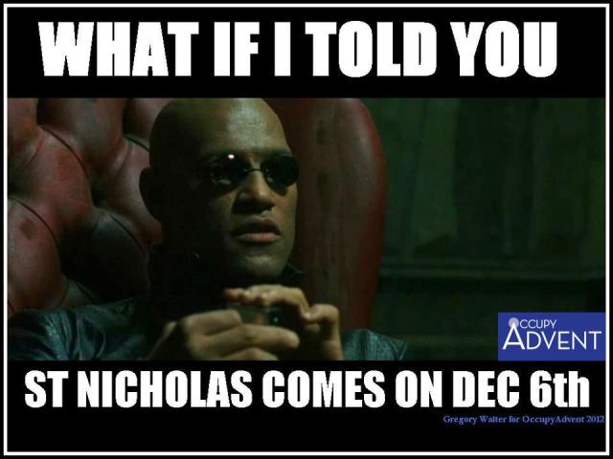

Christology
The Person of Christ
Humanity of Christ
Deity of Christ
Incarnation
A Word on Heretics and councils…
Heretics come from inside.
It’s like this—
The motive is to find genuine understanding…
Only those with deep religious convictions would care enough to “die” on these hills…
In the end, they seem to value their positions over and against the authority of the Church—and so seek support elsewhere.

Slide 47
Christology
The Person of Christ
Humanity of Christ
Deity of Christ
Incarnation
A Word on Heretics and councils…
Heretics are extremely smart.
“I was told by my confessor years ago (before going to seminary) that I should learn all the heresies and avoid them. He went on to explain that all of the arch-heretics were brilliant men and it actually took very intelligent men to create a new heresy. I added that I wasn’t smart enough to come up with a new one myself, so I’d be fine just learning the classical ones and avoiding them.”
Fr. John Winfrey @ http://byzantinefrontier.com/the-heresy-of-apollinarianism/
Although I would find myself in agreement, for the most part, with key orthodox bishops in the past, those deemed heretics regularly engaged the likes of St Athanasius, St. Anselm, St. Augustine, Martin Luther…etc.—a feat I would be loathe to assume

Slide 48
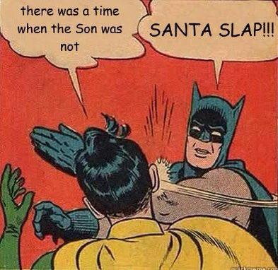
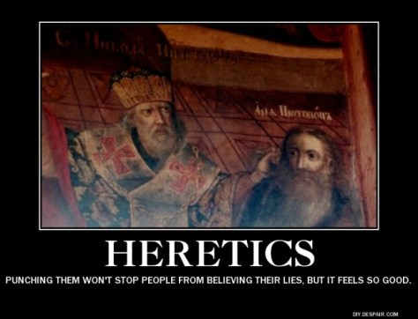
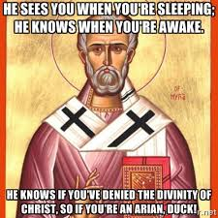
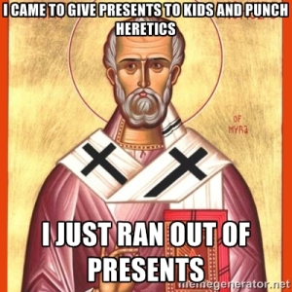
Christology
The Person of Christ
Humanity of Christ
Deity of Christ
Incarnation
A Word on Heretics and councils…
Bishops are extremely human.
Once you get away from the consumerist, red-pajama-wearing Santa Claus myth, you can explore the historical St. Nicholas, who was born in the third century A.D., suffered persecution as a Christian in the Roman Empire, became Bishop of Myra (on the Mediterranean coast of what is now Turkey), and was renowned for his generosity and protection of children.
St. Nicholas is popular in Catholic Memes that play on a story from the Council of Nicea, where Bishop Nicholas allegedly punched Arius during a heated argument about the divinity of Jesus Christ.
According to Dr. Timothy Milinovich, Assistant Professor of Theology and Pastoral Ministry at Dominican University,
“To be fair to the guy, bishops punching bishops/priests at Councils was extremely common. To this day, the Code of Canon Law strictly forbids anyone to “punch” a bishop or “pull his beard.” And, if that directive seems so specific that you think it must be based on things that actually happened, you would be correct. I normally tell students when we start covering the councils, “If at any point these dry theological debates seem unappetizing, just imagine a bunch of bishops punching each other and pulling each others beards while shouting theological slogans.” It helps.

Slide 49
Christology
The Person of Christ
Humanity of Christ
Deity of Christ
Incarnation
Heresies on the Person of Jesus Christ overview…
Heresies Regarding Christ’s Deity (There are more..but they are deviations that stem from or are a literal repackaging from these main ones)
• Heresies which deny the genuineness of Christ’s deity: Ebionism (2)
• Heresies which deny the completeness of Christ’s deity: Arianism (3)
Heresies Regarding Christ’s Humanity
• Heresies which deny the genuineness of Christ’s humanity: Docetism (1)
• Heresies which deny the completeness of Christ’s humanity: Apollinarianism (4)
Heresies which divide Christ’s person: Nestorianism (5)
Heresies which confuse Christ’s natures: Eutychianism (6)

Slide 50


Christology
The Person of Christ
Humanity of Christ
Deity of Christ
Incarnation
Heresies on the Person of Jesus Christ overview…
A. Docetism *Product of an early Gnostic philosophy; 1st century
*From the Greek word dokeo, "to seem, to appear" *Distinctive Teaching: Christ merely seemed human, a phantom or appearance of some kind, His physical appearance was not real.
Eg.
Why would this be their natural conclusion?

Slide 51
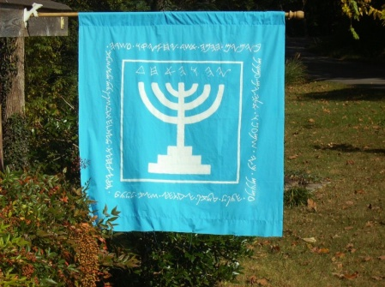
Christology
The Person of Christ
Humanity of Christ
Deity of Christ
Incarnation
Heresies on the Person of Jesus Christ overview…
B. Ebionism (2nd century) *Denial of Deity of Christ
*An early heresy stemming from some Jewish Christian circles (Ebionite was the Hebrew word for “poor”; these may have been poor Jewish Christians)
*(Too) Strongly monotheistic, they denied that Jesus was God, rejected the virgin birth, and believed Jesus was born naturally. He was human but possessed of unusual gifts. They believed God’s power descended on him in a special way at his baptism.

Slide 52
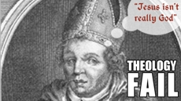
Christology
The Person of Christ
Humanity of Christ
Deity of Christ
Incarnation
Heresies on the Person of Jesus Christ overview…
C. Arianism (early 4th century; modern Jehovah's Witnesses) *Denial of Deity of Christ; Christ the highest created being
*Named after Arius of Alexandria, a presbyter whose views were condemned by Athanasius at the Council of Nicea in AD 325.
*Saw God as absolutely unique and transcendent (inflexible monotheism). They believed God alone possesses attributes of deity; to share these with anyone would be to render God less than divine. Everything besides God is created and temporal. The Word was a created being, though the first and highest created being. He was a demigod, an intermediate being, not God; JW’s embrace this
*Condemned by Council of Nicea, 325

Slide 53
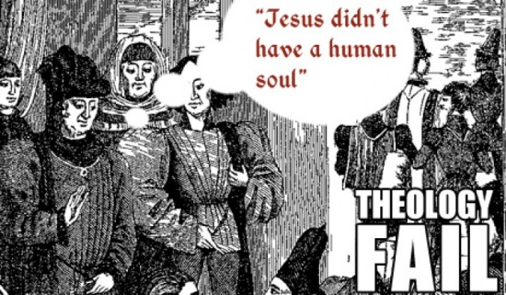
Christology
The Person of Christ
Humanity of Christ
Deity of Christ
Incarnation
Heresies on the Person of Jesus Christ overview…
D. Apollinarianism (4th century) *Jesus was fully divine but not fully human (He had a body but it was not at all like ours)
*The views of Apollinarius, a close friend and associate of Athanasius, the leading champion of orthodox Christology (the one who defeated Arius at the Council of Nicea).
*He saw Jesus as a compound unity: some of Jesus was human, the rest was divine. Jesus was physically human, but psychologically divine (the divine Word took the place of his human soul).
*Condemned by Council of Constantinople, 381 on basis of “exchange of gifts”—if Christ has no genuine human soul, then He could not become what we are and so save our souls.

Slide 54

Christology
The Person of Christ
Humanity of Christ
Deity of Christ
Incarnation
Heresies on the Person of Jesus Christ overview…
E. Nestorianism (5th century) *Great emphasis on the fact of Jesus' physical body
*A reaction to Apollinarius
*Named after Nestorius, the patriarch of Constantinople in 428. Nestorius had trouble with the idea that the divine and human natures were united in one person in Christ (he felt this obscured them both). He preferred to see them as a conjunction, operating in stages of Christ’s life, or distinctly side-by-side. This tended to divide the natures of Christ, and render him somewhat schizophrenic.
*Condemned by Council of Ephesus, 431

Slide 55
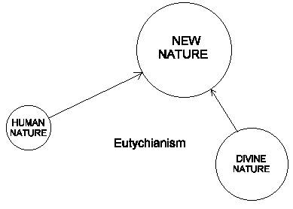
Christology
The Person of Christ
Humanity of Christ
Deity of Christ
Incarnation
Heresies on the Person of Jesus Christ overview…
F. Eutychianism (5th century)
*The heresy was named after Eutyches of Constantinople (who tried to replace the historical doctrine and tp the scales of power to Alexandria from Constantinople as 2nd behind Rome).
*It assumes that Christ can have only one nature, which is a mixture of divine nature and human natures, such that the human becomes divine and the divine human. This confuses both Christ’s true humanity and his true deity.
*Condemned by the Council of Chalcedon in 451.

Slide 56



Christology
The Person of Christ
Humanity of Christ
Deity of Christ
Incarnation
Heresies on the Person of Jesus Christ overview…
F. Eutychianism (5th century)
the theological equivalent of combining 2 natures into one…

Slide 57
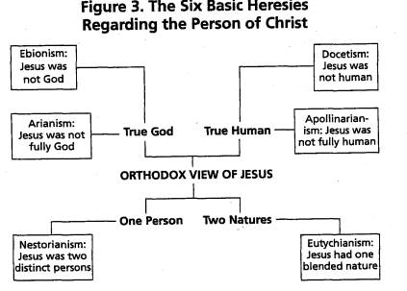
Christology
The Person of Christ
Humanity of Christ
Deity of Christ
Incarnation
How did the Church respond to all this?

Slide 58
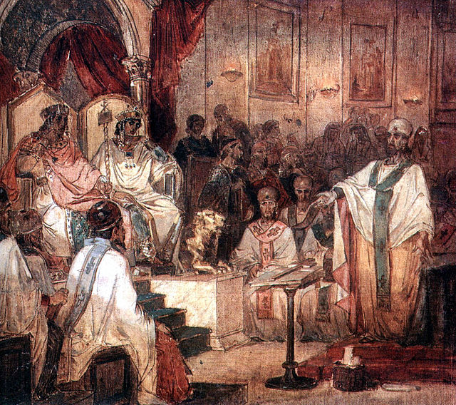
Christology
The Person of Christ
Humanity of Christ
Deity of Christ
Incarnation
The Solution to the Controversy: The Chalcedonian Definition of A.D. 451.
a large church council was convened in the city of Chalcedon near Constantinople (modern Istanbul), from October 8 to November 1, A.D. 451. The resulting statement, called the Chalcedonian Definition, guarded against Apollinarianism, Nestorianism, and Eutychianism.
"Fourth ecumenical council of chalcedon - 1876" by Vasily Surikov - Wikipaintings. Licensed under Public Domain via Wikimedia Commons -

Slide 59
Christology
The Person of Christ
Humanity of Christ
Deity of Christ
Incarnation
The Chalcedonian Definition of A.D. 451
“We, then, following the holy Fathers, all with one consent, teach men to confess one and the same Son, our Lord Jesus Christ, the same perfect in Godhead and also perfect in manhood; truly God and truly man, of a reasonable [rational] soul and body; consubstantial [co-essential] with the Father according to the Godhead, and consubstantial with us according to the Manhood; in all things like unto us, without sin; begotten before all ages of the Father according to the Godhead, and in these latter days, for us and for our salvation, born of the Virgin Mary, the Mother of God, according to the Manhood; one and the same Christ, Son, Lord, Only begotten, to be acknowledged in two natures, inconfusedly, unchangeably, indivisibly, inseparably; the distinction of natures being by no means taken away by the unity, but rather the property of each nature being preserved, and concurring in one Person and one Subsistence, not parted or divided into two persons, but one and the same Son, and only begotten, God the Word, the Lord Jesus Christ; as the prophets from the beginning [have declared] concerning him, and the Lord Jesus Christ himself has taught us, and the Creed of the holy Fathers has handed down to us.” [emphasis mine]

Slide 60
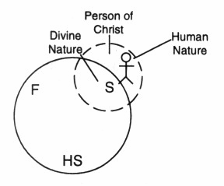
Christology
The Person of Christ
Humanity of Christ
Deity of Christ
Incarnation
The Chalcedonian Definition of A.D. 451
Which Four words are central to the point of the Chalcedonian creed when speaking of Christ's two natures?
A. “Inconfusedly”; without Mixing
Maintains that Jesus always possessed both the divine from eternity and the human from the moment of his conception (2 natures); the error this view corrects is called monophysitism (one nature, presumably mixed)
B. “Unchangeably”; without Change
Maintains that neither the divine nature nor the human nature was essentially changed in any way by the union of the two natures in the person of the Son of God.
C. “Indivisibly”; without Division
Maintains that each of Christ’s natures is full and complete without being divided into parts, such that the Son of God did not therefore assume a partial human nature such as a human body without a true human soul, mind, heart and will. It has in view the perfect completeness of each nature.
D. “Inseparably” without Separation
Maintains that, while the divine did not become human nor the human become divine, there was by unity of person an inner connection between them which was constant and which continues in Jesus Christ.

Slide 61
Christology
The Person of Christ
Humanity of Christ
Deity of Christ
Incarnation
A word on how to understand two natures within the person of Jesus Christ
If someone asks whether Jesus, when he was asleep in the boat, was also “continually carrying along all things by his word of power” (Heb. 1:3, author’s translation), and whether all things in the universe were being held together by him at that time (see Col. 1:17), the answer must be yes, for those activities have always been and will always be the particular responsibility of the second person of the Trinity, the eternal Son of God.
Those who find the doctrine of the incarnation “inconceivable” have sometimes asked whether Jesus, when he was a baby in the manger at Bethlehem, was also “upholding the universe.” To this question the answer must also be yes: Jesus was not just potentially God or someone in whom God uniquely worked, but was truly and fully God with all the attributes of God. He was “a Savior, who is Christ the Lord” (Luke2:11). Those who reject this as impossible simply have a different definition of what is “possible” than God has, as revealed in Scripture.39 To say that we cannot understand this is appropriate humility. But to say that it is not possible seems more like intellectual arrogance. WG, 484

Slide 62
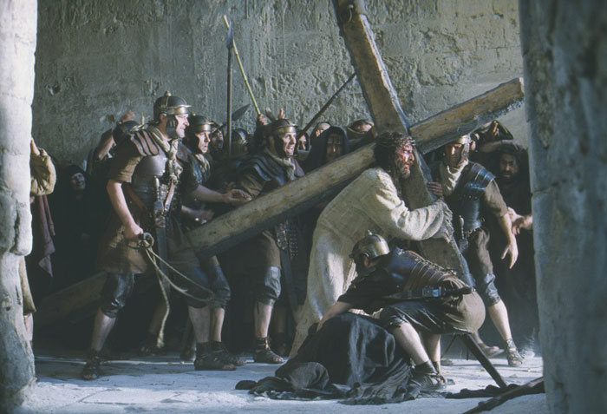

Christology
The Person of Christ
Humanity of Christ
Deity of Christ
Incarnation
A word on how to understand two natures within the person of Jesus Christ
Also…
Jesus died….His human body separated from His Human soul and His soul passed into the presence of God the Father in heaven. Yet His divine nature somehow tasted something of death without experiencing any cessation of activity and so did not die—yet he experienced death as a whole person

Slide 63



Christology
The Person of Christ
Humanity of Christ
Deity of Christ
Incarnation
A word on how to understand two natures within the person of Jesus Christ
Also…
Jesus was tempted: His human nature was tempted as we are, yet His divine nature was not (& could not be)

Slide 64

Christology
The Person of Christ
Humanity of Christ
Deity of Christ
Incarnation
A word on how to understand two natures within the person of Jesus Christ
Also…
Jesus had two distinct wills. These relate to His two natures. To deny His human will is to deny His human nature and have an “unsympathetic priest” (contra Hebrews); to deny His Divine will is to deny His Divine nature and sacrifice a mere man accomplishing nothing (contra Hebrews). Adapted from WG, 485,6

