Slide 1
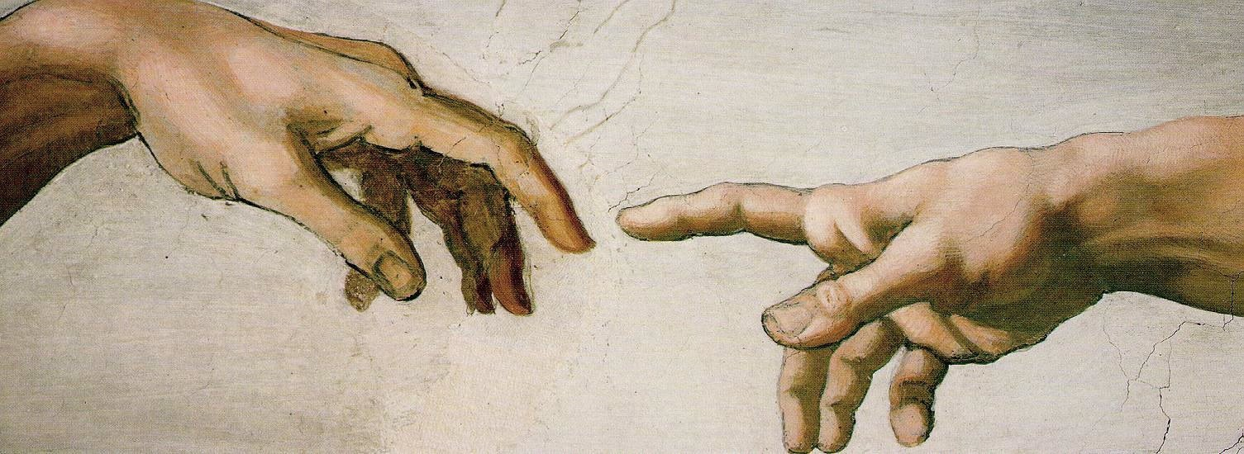
we were created 2.0
(biological perspective: What can we say about reality when it comes to Christianity and Evolutionary theory?)
life science- 10.19.15

Slide 2


we were created

Slide 3
we were created
no. 1
God is eternally uncaused and exists before all He created.
The notion that there is anything at all demands an eternal being…
“Before the mountains were born or you brought forth the whole world, from everlasting to everlasting you are God.” Ps 90:2

Slide 4
we were created
no. 2
God is triune and has chosen to reveal Himself through His creative work & infallible Word.
“¹⁹ For what can be known about God is plain to them, because God has shown it to them. ²⁰ For his invisible attributes, namely, his eternal power and divine nature, have been clearly perceived, ever since the creation of the world, in the things that have been made. So they are without excuse.” Romans 1:19,20

Slide 5
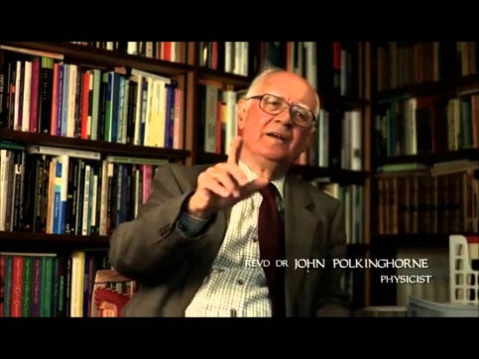
we were created
John Polkinghorne: People who tell you, for example, that science tells all you need to know about the world, or what science tells you is all wrong, or science tells us there is no God, those people aren't telling you scientific things. They are saying metaphysical things, and they have to defend their positions for metaphysical reasons.
no. 3
All models that describe the origin of life/mankind and the universe are, by default, expressions of faith.
“11 Now faith is the assurance of things hoped for, the conviction of things not seen. …. ³ By faith we understand that the universe was created by the word of God, so that what is seen was not made out of things that are visible.”
Hebrews 11:1,3

Slide 6
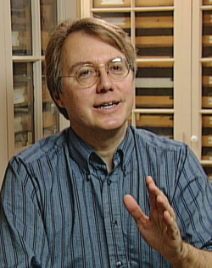
we were created
no. 3
Andy Knoll, Harvard paleontologist and author of Life on a Young Planet: The First Three Billion Years of Life, was interviewed on May 3, 2004 as part of a PBS NOVA program. He is described as a person who has "exhaustively investigated" the origin of life. Here are excerpts from an interview:
NOVA: In a nutshell, what is the process? How does life form?
Knoll: The short answer is we don't really know how life originated on this planet. There have been a variety of experiments that tell us some possible roads, but we remain in substantial ignorance.
NOVA: So at this point we're seeing the origins of life through a glass darkly?
Knoll: If we try to summarize by just saying what, at the end of the day, do we know about the deep history of life on Earth, about its origin, about its formative stages that gave rise to the biology we see around us today, I think we have to admit that we're looking through a glass darkly here. . . .
. . . We don't know how life started on this planet. We don't know exactly when it started, we don't know under what circumstances.
It's a mystery that we're going to chip at from several different directions. . . .
NOVA: Will we ever solve the problem?
Knoll: I don't know. I imagine my grandchildren will still be sitting around saying that it's a great mystery, but that they will understand that mystery at a level that would be incomprehensible to us today.

Slide 7
we were created
Ch 1: science text spends time proving Life cannot arise from non-life.
Ch. 2: same text teaches life arose from nonlife “somewhere, somehow”
no. 4
All evolutionists must, at some point, contradict themselves theologically, philosophically, and/or scientifically.
Eg. Assumed
https://www.youtube.com/watch?v=V5EPymcWp-g
Eg. Where did life come from?
Eg. If evolution is scientific, why is it closed to rigorous questioning? (cf. film: EXPELLED: no intelligence allowed)
“¹² Now we have received not the spirit of the world, but the Spirit who is from God, that we might understand the things freely given us by God…. ^{.14} The natural person does not accept the things of the Spirit of God, for they are folly to him, and he is not able to understand them because they are spiritually discerned.” I Corinthians 1:12,14

Slide 8
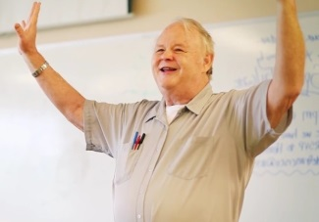
we were created
Evolution’s popularity as a theory does not come from its ability to present compelling evidence, but simply because it provides an alternative to theism and theism’s moral consequences (Systematic Theology, Frame, p. 203).
no. 5
Evolutionary theory, though always itself evolving, will, in some form, remain.
^{“22} Claiming to be wise, they became fools, ²³ and exchanged the glory of the immortal God for images resembling mortal man and birds and animals and creeping things…
…²⁵ because they exchanged the truth about God for a lie and worshiped and served the creature rather than the Creator, who is blessed forever! Amen.”
Romans 1:22, 23, 25

Slide 9
we were created
no. 6
The most vocal and popular evolutionary models, assume atheism.*
Material naturalism
Nonliving matter → cellular life ^{natural selection} > all living things
^{“22} Claiming to be wise, they became fools, ²³ and exchanged the glory of the immortal God for images resembling mortal man and birds and animals and creeping things…
…²⁵ because they exchanged the truth about God for a lie and worshiped and served the creature rather than the Creator, who is blessed forever! Amen.”
*Notre Dame philosopher and Christian thinker, Alvin Plantinga has formulated arguments for theistic evolution…

Slide 10


we were created
Energy: What happens if you don’t attend to your room?
no. 7
Entropy: biological information is maintained (in a perfect world) through ordinary generation and (at best) lost/fatal, in mutations.
Information: Consider the game “whisper down the lane”…

Slide 11
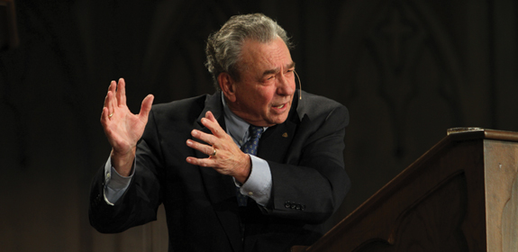
we were created
no. 8
The Genesis account, as Hebrew poetry, was not intended to precisely address the scope of scientific questions on origins.
“When you say you have a view, it’s one thing to say, “I think that this is the way it is.” It’s another thing to take a stand where you say: “Here I stand. I’m going to die on this mountain.” I could be wrong in my understanding of Genesis. It’s a very difficult to deal with the literary genre in the opening verses of the beginning chapters of Genesis. I think there has to be some room for some
flexibility on it.” R.C. Sproul

Slide 12
we were created
no. 9
The Big Bang as an event does not necessitate evolutionary mechanisms for life.
(where you believe the singularity came from might!)
“³ And God said, “Let there be… Genesis 2:3a

Slide 13
we were created
no. 10
Man was created in God’s image by a special act of God. We hold a unique place in the created order.
“⁷ then the Lord God formed the man of dust from the ground and breathed into his nostrils the breath of life, and the man became a living creature..” Genesis 2:7

Slide 14
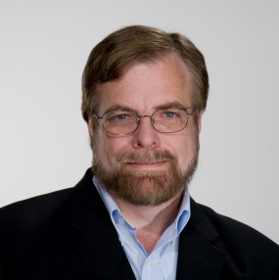
we were created
no. 11
Man has inherent dignity given to no other in the same way.
“We are clay images-a powerful lesson in humility, but we are also images of God-creatures of wondrous value and dignity.”
Richard Pratt, Designed for Dignity, pg. 13

Slide 15
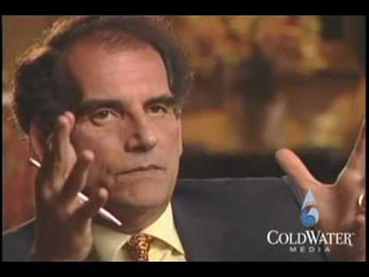
we were created
no. 12
It is difficult to find 2 things in a room filled with evolutionary experts:
1. Something on which all can agree. 2. Something known.
David Berlinski: Before you can ask is Darwinian Theory correct or not, you have to ask the preliminary question, is it clear enough so that it could be correct. That's a very different question. One of my prevailing doctrines about Darwinian Theory is: man that thing is just a mess. It's like looking into a room full of smoke. Nothing in the theory is precisely, clearly, carefully defined and delineated. It lacks all of the rigor one expects from Mathematical Physics. And Mathematical Physics lacks all of the rigor one expects from Mathematics. So we're talking about a gradual decent down the level of intelligibility, until we reach Evolutionary Biology. We don't even know what a species is, for heaven sakes!

Slide 16
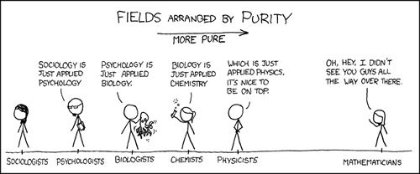
we were created
Elegance: streamlined simplicity with overarching explanatory power
Darwinism
Opposites attract…
Is marriage between 1 man & 1 woman best?
Breeding is good for the species…
You are attracted because of chemical reactions in your brain…
1+1=2
If 1 man is attracted to one woman…
relativism
pluralism
determinism

Slide 17
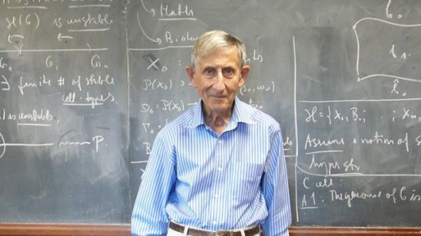
we were created
no. 13
We must firmly grasp the dividing line between life (eg. the cell) and nonlife (eg. chemicals).
Freeman J. Dyson, physicist and mathematician, A Many-Colored Glass: Reflections on the Place of Life in the Universe (Charlottesville, VA: University of Virginia Press, 2010), 104:
The origin of life is the deepest mystery in the whole of science. Many books and learned papers have been written about it, but it remains a mystery. There is an enormous gap between the simplest living cell and the most complicated naturally occurring mixture of nonliving chemicals. We have no idea when and how and where this gap was crossed. We only know that it was crossed somehow, either on Earth or on Mars or in some other place from which the ancestors of life on Earth might have come.

Slide 18
we were created
no. 14
The PCA sanctions a variety of views—all of which believe what Scripture teaches clearly about God, man, and the Fall.
These were taken from the PCA historical site @ http://www.pcahistory.org/creation/report.html#d1; further explanations, strengths and weaknesses, and proponents of these theories are included.

Slide 19
we were created: PCA positions
1. Calendar-Day Interpretation
The Bible teaches that God created of nothing all things in six days, by which Moses meant six calendar days. The view is often called the literal view, the traditional view, or the twenty-four-hour view.
The ‘six days’ are understood in the same sense as “in that day” of Isaiah 11:10-11—that is, as periods of indefinite length and not necessarily of 24 hours duration.
2. Day-Age Interpretation
The scheme of the creation week itself is a poetic figure and that the several pictures of creation history are set within the six work-day frames not chronologically but topically. God’s supernatural creative words or fiats are real and historical, but the exact timing is left unspecified.
3. Framework Interpretation

Slide 20
we were created: PCA positions
The “days” are God’s work-days, which are analogous, and not necessarily identical, to our work days, structured for the purpose of setting a pattern for our own rhythm of rest and work.
4. Analogical Days Interpretation
5+ other less dominant beliefs
These theories seek to address Modern biological theories and include “gap theory”-dividing Genesis 1&2 and 6 “instructional days” from periods of time in which God worked.

