Slide 1
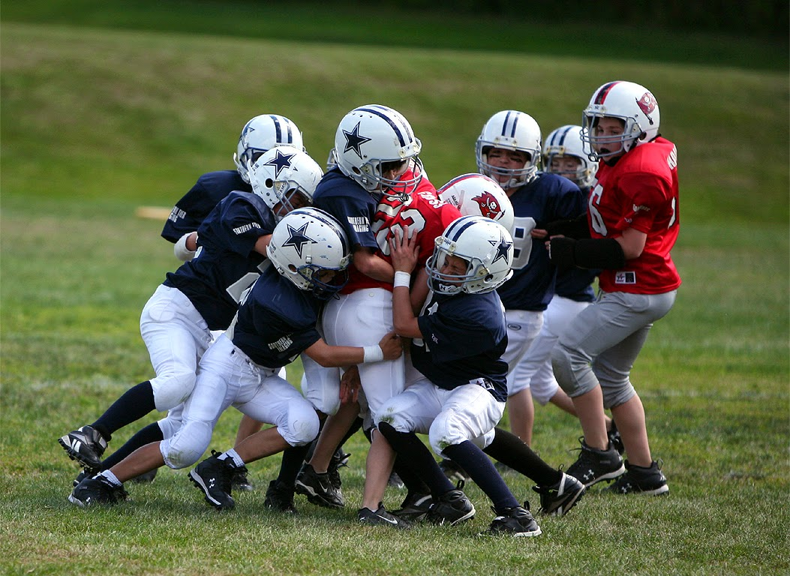
Ch 3: Newton’s Second Law
I can do this…I’m bigger!
I can do this…I’m faster!
I cannot do this alone for I have neither the mass nor velocity!
mr e~SRCS~fall 2015

Slide 2
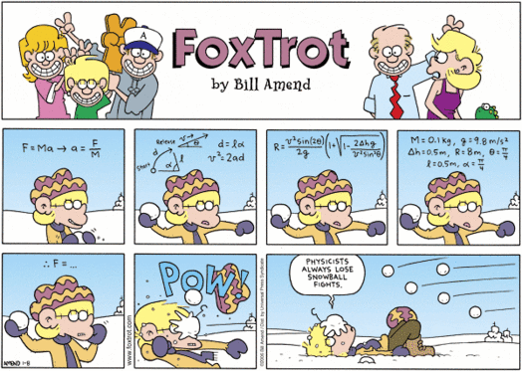
Ch 3: Newton’s Second Law

Slide 3
This lecture will help you understand:
Review Aristotle’s Ideas of Motion
Galileo’s Concept of acceleration
Relating F & a
Mass vs. weight
Relating mass & a
Newton’s Second Law of Motion
Friction: resisting motion
Free Fall
Why Objects Fall at the same rate
Air R & a

Slide 4
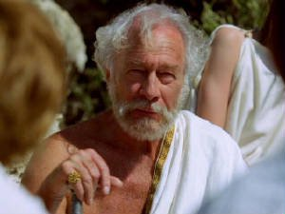
Review: Aristotle’s Ideas of Motion
3.1 Aristotle’s classification of motion
Natural motion
  Any object not in its proper place will strive to get there by virtue of its essence (nature).
Violent motion (AKA “unnatural” motion)
  Imposed; produced by external pushes or pulls on objects.
“For the natural motion of heavy objects falling to earth, the speed of fall was proportional to the weight, and inversely proportional to the density of the medium through which they fall.”

Slide 5
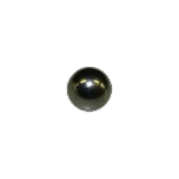
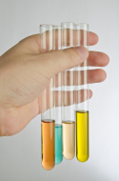
Review: Aristotle’s Ideas of Motion
“In other words, the heavier an object is, the faster it will fall; the thicker a medium is, the slower it will fall….”
Suppose I drop a bearing into each liquid and measure the time it takes to reach the bottom. In what order will they be from quickest to slowest?
Corn oil (high D)
Alcohol (lowest D)
Corn syrup (highest D)
Windex (low D)

Slide 6
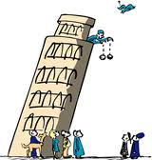
Galileo’s Concept of acceleration
What I'd like you to remember is that here Galileo defined the distinction between Ancient science and Modern Science.
What, in essence, is this distinction?
Legend has it that Galileo performed this particular experiment from the leaning tower of Pisa.
Galileo goes on to give a detailed analysis of falling bodies. He realizes that for extremely light objects, such as feathers, the air resistance becomes the dominant effect, whereas it makes only a tiny difference in the experiment to the left.

Slide 7
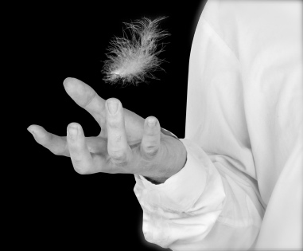
Galileo’s Concept of acceleration
Having established experimentally that heavy objects fall at practically the same rate, Galileo went on to consider the central question about speed of fall barely touched on by Aristotle---how does the speed vary during the fall?
Why is this a difficult question to answer?
How does a light object fall? Do all objects act the same as, say, a feather? Most objects in everyday experience tend to fall how?

Slide 8

Galileo’s acceleration hypothesis
Having established that a falling body continues to pick up speed, or accelerate, as it falls, Galileo suggested the simplest possible hypothesis (paraphrasing the discussion on TNS page 161):
This is an appealingly simple hypothesis, but not so easy for Galileo to check by experiment---how could he measure the speed of a falling stone twice during the fall and make the comparison?
A falling body accelerates uniformly: it picks up equal amounts of speed in equal time intervals, so that, if it falls from rest, it is moving twice as fast after two seconds as it was moving after one second, and moving three times as fast after three seconds as it was after one second.

Slide 9
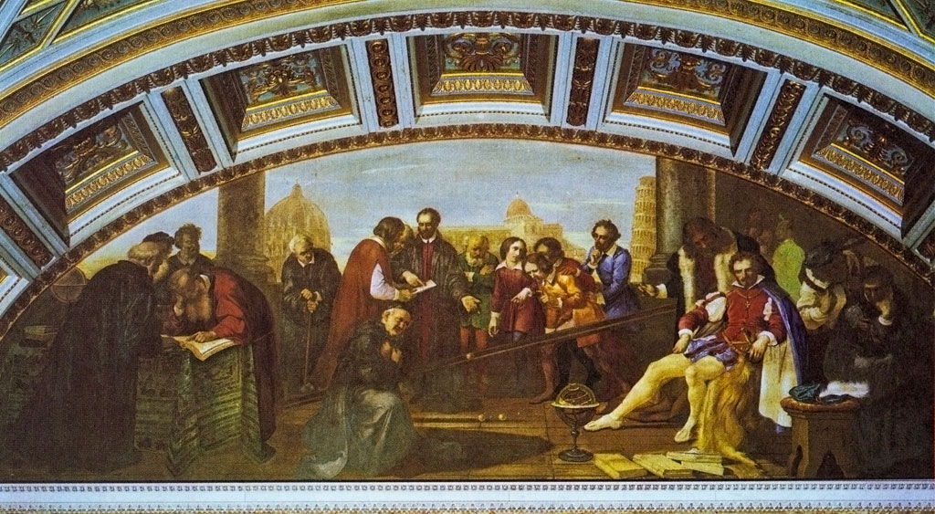
Galileo’s means of slowing it down
The trick is to slow down the motion somehow so that speeds can be measured, without at the same time altering the character of the motion…
Galileo's idea for slowing down the motion was to have a ball roll down a ramp rather than to fall vertically.
Galileo then suggests we imagine the second ramp steeper and steeper---and we see that if it's steep enough, we can think of the ball as just falling!

Slide 10
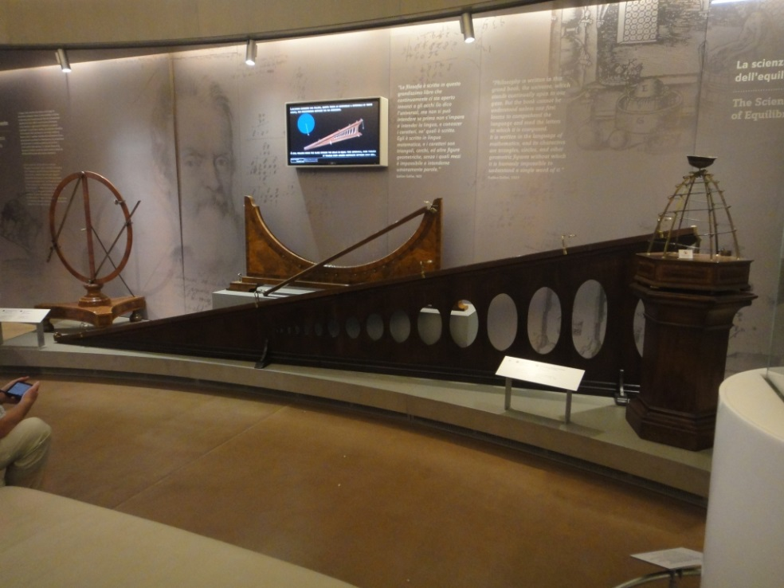
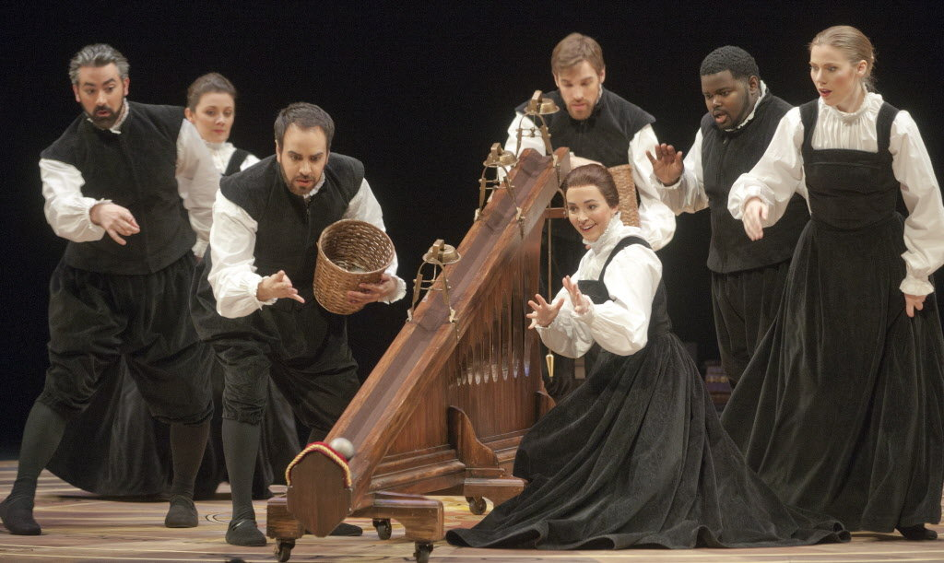
Galileo’s means of slowing it down
We are now ready to consider Galileo's experiment in which he tested his hypothesis about the way falling bodies gain speed. We quote the account from Two New Sciences, page 178:
A piece of wooden moulding or scantling, about 12 cubits long, half a cubit wide, and three finger-breadths thick, was taken; on its edge was cut a channel a little more than one finger in breadth; having made this groove very straight, smooth, and polished, and having lined it with parchment, also as smooth and polished as possible, we rolled along it a hard, smooth, and very round bronze ball.
Having placed this board in a sloping position, by raising one end some one or two cubits above the other, we rolled the ball, as I was just saying, along the channel, noting, in a manner presently to be described, the time required to make the descent.

Slide 11
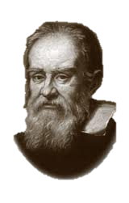
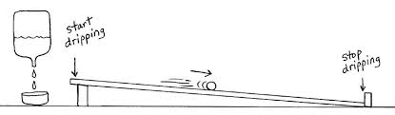
Galileo’s Ideas of Motion
Galileo used a “water clock” which operated on the principle of mass comparisons as long as the dripping was consistent.
Why “slow things down?”—
The only timepiece I had in my day was a water-clock, and so to time with any degree of accuracy, I needed more time….
We repeated this experiment more than once in order to measure the time with an accuracy such that the deviation between two observations never exceeded one-tenth of a pulse-beat. Having performed this operation and having assured ourselves of its reliability, we now rolled the ball only one-quarter the length of the channel; and having measured the time of its descent, we found it precisely one-half of the former.
Next we tried other distances, compared the time for the whole length with that for the half, or with that for two-thirds, or three-fourths, or indeed for any fraction; in such experiments, repeated a full hundred times, we always found that the spaces traversed were to each other as the squares of the times, and this was true for all inclinations of the plane, i.e., of the channel, along which we rolled the ball. We also observed that the times of descent, for various inclinations of the plane, bore to one another precisely that ratio which, as we shall see later, the Author had predicted and demonstrated for them.

Slide 12
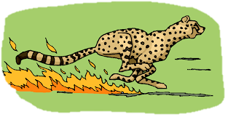
Acceleration
What, in common terms, is acceleration?
Did you say “speeding up?” You are mostly right!
What is the formula for speed?
What does “up”, in that phrase, imply?
Change…which inevitably demands what?
v = d/t
Hint: God, because He is not bound by this, does not change.

Slide 13
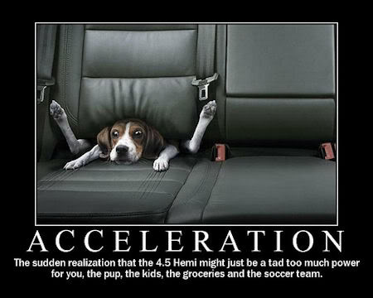
Acceleration
What, in common terms, is acceleration?
Put them together and we have acceleration!
v = d/t & t
a = d/t/t or a = v/t
a is a rate of a rate!
Units?
a = m/s/s
or m/s x 1/s= m/s²

Slide 14
Direction of the Acceleration Vector
Acceleration is a vector quantity so it will always have a direction associated with it. The direction of the acceleration vector depends on two factors:
• whether the object is speeding up or slowing down
• whether the object is moving in the positive (+) or negative (–) direction
This RULE OF THUMB can be applied to determine whether the sign of the acceleration of an object is positive or negative, right or left, up or down, etc. Consider the two data tables on the next slide....
The general RULES OF THUMB is:
Direction: use a number line as a general rule: ← negative –0-- positive → & up is + while down is – (look at the sign)
Acceleration: If an object is slowing down, then its acceleration is in the opposite direction of its motion.

Slide 15
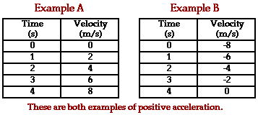
Direction of the Acceleration Vector
In Example A, the object is moving in which direction (look at the sign)? Is its velocity positive or negative?
Is it speeding up or slowing down?
Is its acceleration positive or negative?
In Example B, the object is moving in which direction? Is its velocity positive or negative?
Is it speeding up or slowing down?
Is its acceleration positive or negative?
Easy way to calculate? Multiply v x slowing (-) or speeding (+)

Slide 16
Direction of the Acceleration Vector
In Example A, the object is moving in the positive direction (i.e., has a positive velocity) and is speeding up. When an object is speeding up, the acceleration is in the same direction as the velocity. Thus, this object has a positive acceleration.
In Example B, the object is moving in the negative direction (i.e., has a negative velocity) and is slowing down. When an object is slowing down, the acceleration is in the opposite direction as the velocity. Thus, this object also has a positive acceleration.

Slide 17
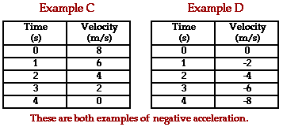
Direction of the Acceleration Vector
In Example C, the object is moving in which direction ? Is its velocity positive or negative?
Is it speeding up or slowing down?
Is its acceleration positive or negative?
In Example D, the object is moving in which direction? Is its velocity positive or negative?
Is it speeding up or slowing down?
Is its acceleration positive or negative?
Do we have another word for “slowing down”? It is not the same as “negative acceleration”. Why?

Slide 18
Direction of the Acceleration Vector
In Example C, the object is moving in the positive direction (i.e., has a positive velocity) and is slowing down. When an object is slowing down, the acceleration is in the opposite direction as the velocity. Thus, this object has a negative acceleration.
In Example D, the object is moving in the negative direction (i.e., has a negative velocity) and is speeding up. When an object is speeding up, the acceleration is in the same direction as the velocity. Thus, this object also has a negative acceleration.

Slide 19
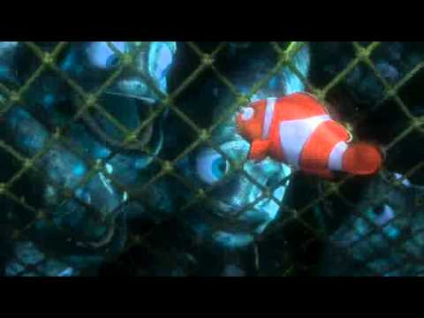
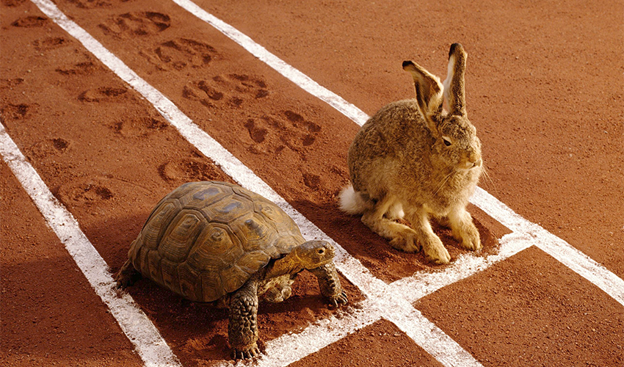
3.2 F causes a
Remember these vocab terms:
Sum of all F acting on a system!
Net F
acceleration
How fast v changes…

Slide 20
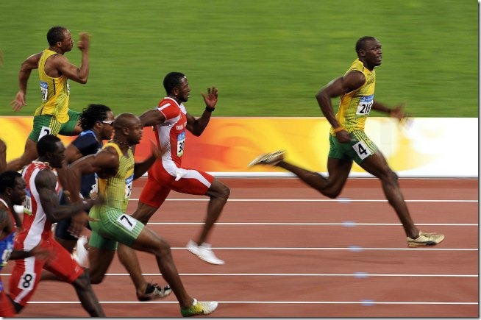
3.2 F causes a
How are these related?
Acceleration ~
Net F
In other words…
…the greater the Force…the greater the acceleration…and…the lesser the F…
http://speedendurance.com/2014/08/25/world-class-sprinters-attack-ground-to-maximize-impact-forces-speed/
What makes Bolt so fast??

Slide 21

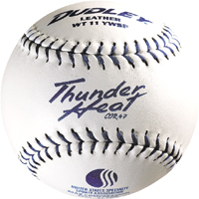
3.3 Mass is a measure of INERTIA
Acceleration ~
Net F
Suppose… you are playing that silly game where friends hurl large and unsoft objects at each other ….and you had to step up to the firing squad wall—yet you were given a choice as to which ball would be hurled at you:
…no hesitation…yes? Why?…
Suppose that there are two seemingly identical bricks at rest on the physics lecture table. Yet one brick consists of mortar and the other brick consists of Styrofoam. Without lifting the bricks, how could you tell which brick was the Styrofoam brick?

Slide 22
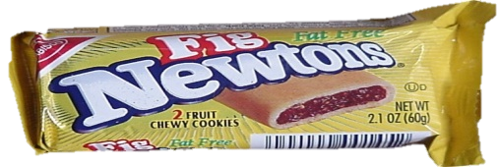
Mass: Things to keep in mind
Force
  Mass: amount of matter in an object; measurement of inertia
  2. Inertia is the “laziness” an object shows whenever you try to change its state of motion.
  3. Kilogram (kg)-base unit of mass
Mass is not volume
  1. Volume is measure of space
  2. Liter (L)-base unit of volume
Mass is not weight
  1. Weight is the force due to gravity that acts on an objects mass
  Newton (N)-base unit of weight
  One Kilogram Weighs 9.8 Newtons
  (9.8N=the amount of force gravity exhibits upon one kg)
  1 kg = 9.8 N;
  1 kg = 2.2 lbs. ; 4.45 N = 1lb.

Slide 23
3.4 Mass resists a
Acceleration ~ 1/ mass
That is, ACCELERATION is directly proportional to the inverse of mass…therefore:
ACCLELERATION is inversely proportional to mass.
(Inversely proportional means that as one factor increases, the other factor decreases.)
This is why more massive objects are more difficult to accelerate.
Consider…
Notes:
The key word in this law is continues: An object continues to do whatever it happens to be doing unless a force is exerted upon it.
If it is at rest, it continues in a state of rest.
If an object is moving, it continues to move without turning or changing its speed.

Slide 24
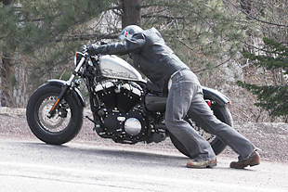

applications of Newton's 2nd law of motion:
Which would you rather push home after running out of gas?

Slide 25
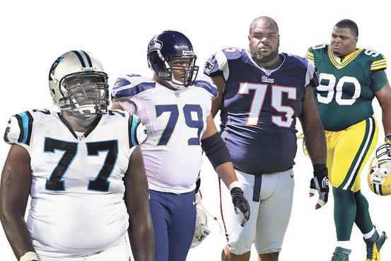
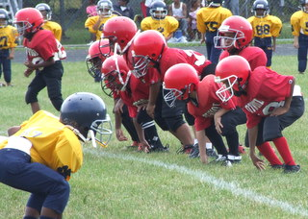
applications of Newton's 2nd law of motion:
Who would you rather face on the front line?

Slide 26
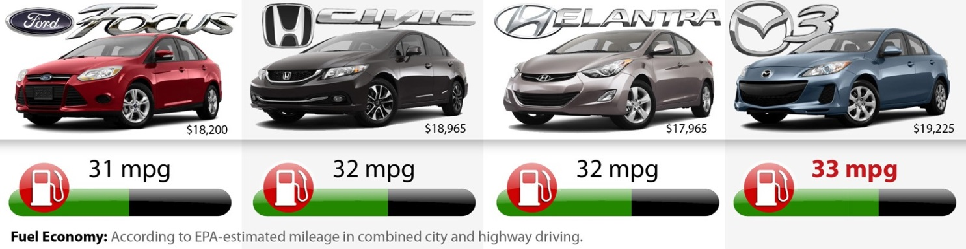
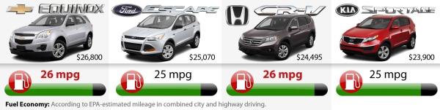
applications of Newton's 2nd law of motion:
Why is there a difference?

Slide 27
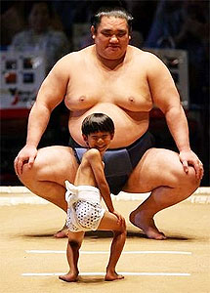
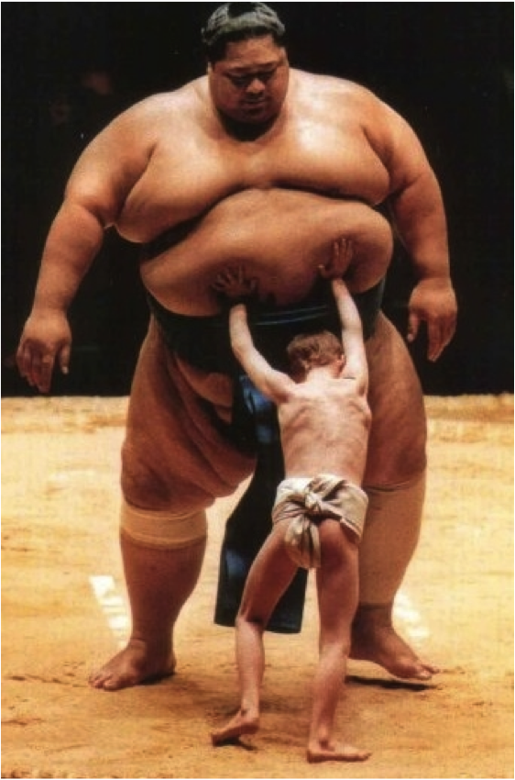
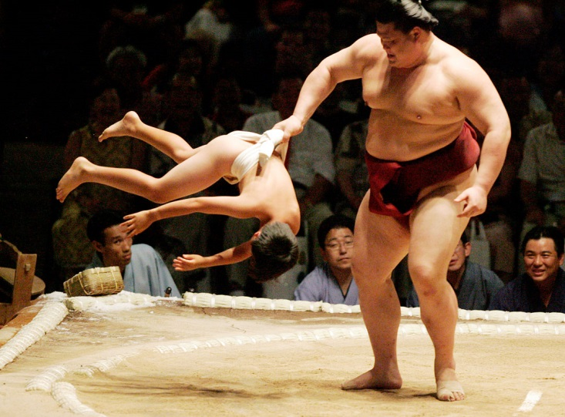
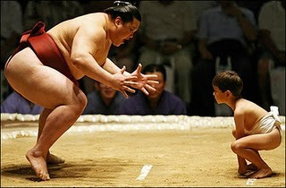
applications of Newton's 2nd law of motion:
Who would win?

Slide 28
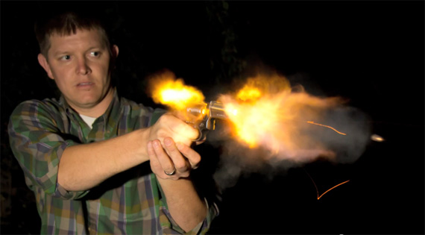
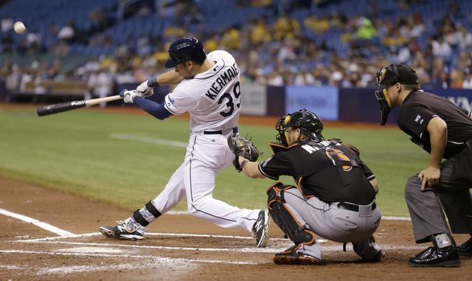
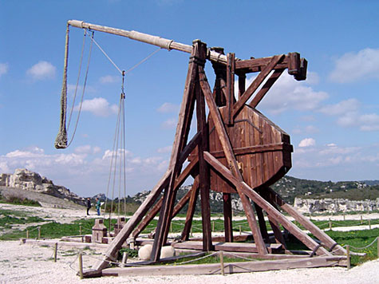
applications of Newton's 2nd law of motion:
Why are projectiles smaller than the devices that launch/fire them?

Slide 29
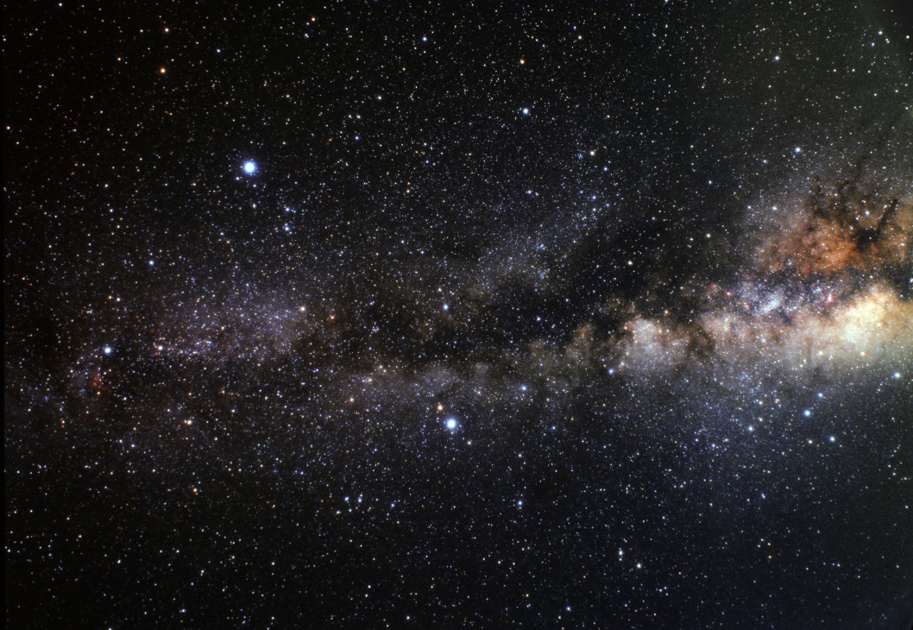
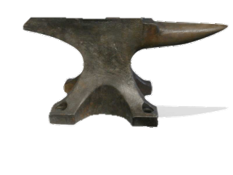
applications of Newton's 2nd law of motion:
Would this be possible? Why? Could a little child hold an anvil in space? Throw it?

Slide 30
3.5 Newton's 2nd law: linking F, m, & a
Newton's second law of motion can be formally stated as follows:
In terms of an equation, the net force is equated to the product of the mass times the acceleration.
F_{net} = m a
The acceleration of an object as produced by a net force is directly proportional to the magnitude of the net force, in the same direction as the net force, and inversely proportional to the mass of the object.
How derived?

Slide 31
3.5 Newton's 2nd law: linking F, m, & a
Newton's second law of motion can be formally stated as follows:
a ~ F & a ~ 1/mass…
a ~ F/mass therefore, you can manipulate it 2 ways!
Try it…
Which is the standard?
The acceleration of an object as produced by a net force is directly proportional to the magnitude of the net force, in the same direction as the net force, and inversely proportional to the mass of the object.

Slide 32
3.5 Newton's 2nd law: linking F, m, & a
So that you can figure out any one of these by simply memorizing one formula and manipulating it algebraically!
Units? Sub metric units into the formula!
F = ma
1 Newton = 1 kg. * m/s²

Slide 33
3.5 Newton's 2nd law: linking F, m, & a
Check Your Understanding
1. What acceleration will result when a 12-N net force is applied to a 3-kg object? A 6-kg object?
2. A net force of 16 N causes a mass to accelerate at the rate of 5 m/s2. Determine the mass.
Formula? F=ma
12N = 3kg x a
12N/3kg = a
4N/kg?? = a
Units?
1N=1kg x m/s2
so…
4 kgxm/s² /kg = 4 m/s²
Givens: F=12N
m=3kg
a=?m/s²
Formula? F=ma
16N = m x 5m/s²
16N/5m/s² = m
3.2kgxm/s²/m/s² =m
3.2 kg=m
Givens: F=16N
m=?kg
a=5m/s²

Slide 34
3.5 Newton's 2nd law: linking F, m, & a
Check Your Understanding
3. An object is accelerating at 2 m/s². If the net force is tripled and the mass of the object is doubled, what is the new acceleration?
4. An object is accelerating at 2 m/s². If the net force is tripled and the mass of the object is halved, what is the new acceleration?
A volunteer willing to come to the board?...
What to do?...The Lampinen method…
Formula? F=ma → a=F/m
2m/s² = ?N/? kg
2m/s² = 4N/2kg
Now factor in your “givens” to find a_{after}
a_{after}= 3x4N/2x2kg = 12N/4kg = 3 m/s²
Givens: F= tripled (3F)
m= doubled (2m)
a_{before}=2 m/s²
a_{after}=?m/s²

Slide 35
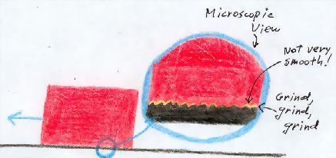
3.6 Friction: the Bane of Forces in Forces in the Real World
•Why do objects which encounter air resistance ultimately reach a terminal velocity (a point of no more acceleration)?
•In situations in which there is air resistance, why do massive objects fall faster than less massive objects?
Friction: a few rules
1. It ALWAYS acts in a direction opposite to motion.
2. It depends upon the kinds of materials passing by one another
3. It depends on how the objects are pressed together.
Types: a. solid to solid (eg. notebook on table, crate on floor)
b. solid to fluid (liquid: boat against water) (air: ball falling—also known as _____ _______ .

Slide 36
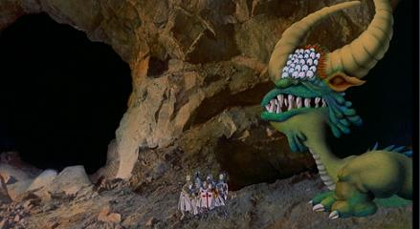
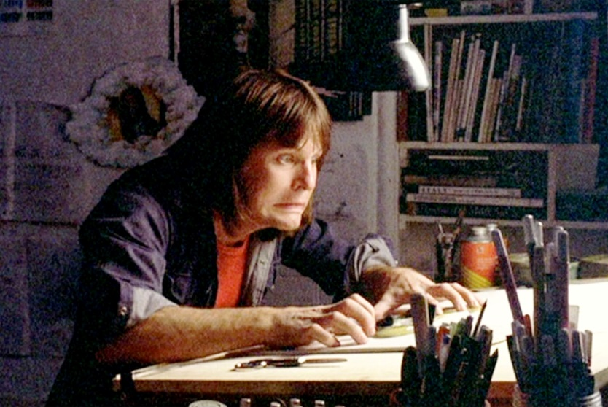
3.6 Friction: the Bane of Forces in Forces in the Real World
But friction is not all bad. In fact, it has a lot to do with life as we know it here on Earth. Without it, we wouldn't be able to walk, sit in a chair, climb stairs, or use a mouse to surf the web. Everything would just keep slipping and falling all over the place. (Or could it?…considering that friction produces heat…without it, could life exi
(at this point imagine me freezing in place as I type these notes)

Slide 37
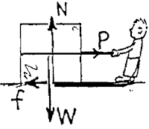
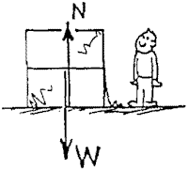
3.6 Friction: the Bane of Applied Forces in the Real World
A crate filled with bananas rests on a horizontal floor. Only gravity and the support force of the floor act on it, as shown by the vectors for weight W and normal force N. F_{net}=?
A slight pull P is exerted on the crate, not enough to move it.
The net force on the crate is?
How do you know?
A force of friction f now acts, which must be equal to what?

Slide 38
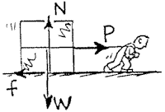
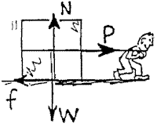
3.6 Friction: the Bane of Applied Forces in the Real World
The pull on the crate is increased until the crate begins to move. It is pulled with pull P so that it moves with constant velocity across the floor.
Pull P is further increased and is now greater than friction f.
The net force on the crate is?
How do you know?
A force of friction f now acts, which must be (less than; equal to; greater than) what?

Slide 39
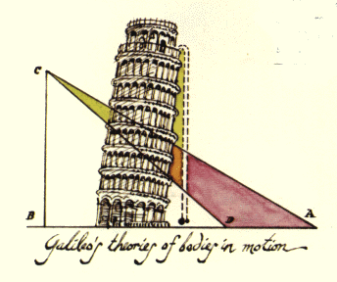
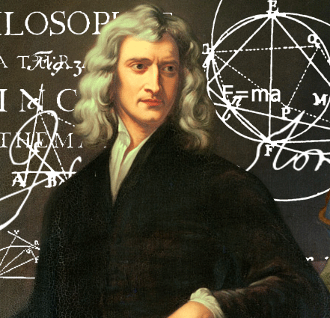
3.7 Objects in Free Fall Have Equal Acceleration
  A. Galileo observed that objects that did not experience much surface friction or air resistance accelerated equally….(Remember how ch. 3 notes began…the incline plane from level to 90º)
  Newton explained why (2nd law)…
              →

Slide 40
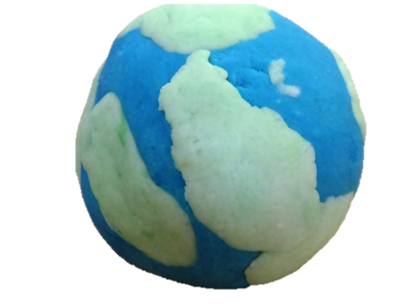
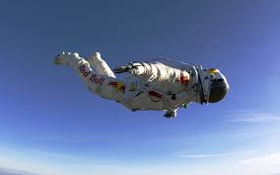
3.8 Why objects in Free Fall Have Equal Acceleration
What, exactly, is “free fall?”
(falling situations where air resistance [friction] is neglected and only the F_{gravity} is considered)
In Free Fall , the greater F of the larger object is offset by its greater ‘laziness’ (greater inertia)…as the lesser force experienced by the smaller object is offset by the lesser ‘laziness’ of the smaller object.
Allow me to say it another way…
The earth likes larger objects more…(Fg…or weight) …but the objects size makes it harder to get going…(inertia); the earth cares less about smaller objects…F_{g.}...but they move more willingly…(less inertia).

Slide 41
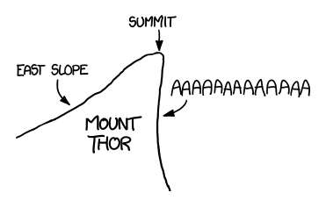
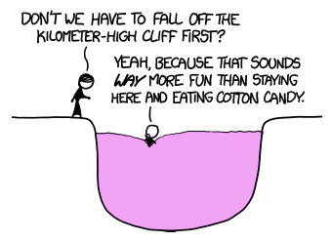
3.8 Why objects in Free Fall Have Equal Acceleration
Free Fall
What place on Earth would allow you to freefall the longest by jumping off it?
                —Dhash Shrivathsa
The largest purely vertical drop on Earth is the face of Canada's Mount Thor, which is shaped like this:
To make things a little less gruesome, let's suppose there's a pit at the bottom of the cliff, filled with something fluffy—like cotton candy—to safely break your fall.

Slide 42
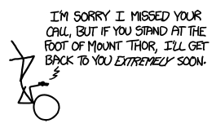
3.8 Why objects in Free Fall Have Equal Acceleration
Free Fall
What place on Earth would allow you to freefall the longest by jumping off it? —Dhash Shrivathsa
A human falling with arms and legs outstretched has a terminal velocity in the neighborhood of 55 meters per second. It takes a few hundred meters to get up to speed, so it would take you a little over 26 seconds to fall the full distance.
What can you do in 26 seconds?
For starters, it's enough time to get all the way through the original Super Mario World 1-1,[1] assuming you have perfect timing and take the shortcut through the pipe.
It's also long enough to miss a phone call. Sprint's ring cycle—the time the phone rings before going to voicemail—is 23 seconds.[2]
.
If someone called your phone, and it started ringing the moment you jumped, it would go to voicemail three seconds before you reached the bottom

Slide 43
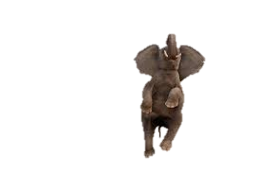



3.8 Why objects in Free Fall Have Equal Acceleration
(Keep the proportional nature of a in mind…)
Let’s use a formula to guide our thinking…
F =
a
F
m
m

Slide 44
3.8 Why objects in Free Fall Have Equal Acceleration
We can insert numerical values for any object…Suppose a rabbit’s mass is 1 kg and we decide to toss it into free-fall: (hint- 1kg of anything = 10N)
If a = F/m = weight/m = ______N/_______kg =
__________m/s2 = g
Try it with a different object...with a different mass…
Again, let’s use a formula to guide our thinking…
Hewitt-Drew-it! PHYSICS 12.Free Fall

Slide 45

3.9 The effect of R_{air} on Acceleration
The Scoop on Forces while Falling in air…
First: FreeFall: F_{net} = weight (weight is only downward F!)
But… In Air: F_{net} = weight – air drag
This means: 1. Air drag reduces F_{net}.
2. Less F_{net} means less acceleration.
3. Therefore…as an object falls faster, its acceleration decreases!
Is it possible that an object’s acceleration can = zero?
How?
“If that’s the case…then that’s really groovy…”

Slide 46


3.9 The effect of R_{air} on Acceleration
If air drag equals weight…then an object’s F_{net} also equals zero…and wah-lah: no acceleration!!
Does this mean that the object comes to a stop in midair?
Like in other cartoons, characters violate laws of physics. The Road Runner has the ability to enter painted caves, which the Coyote cannot. Sometimes the Coyote is allowed to hang in midair until he realizes that he is about to plummet into a chasm. The coyote can overtake rocks which fell before him, and end up being squashed by them.

Slide 47


3.9 The effect of R_{air} on
Acceleration
In his book Chuck Amuck, Chuck Jones explains some of the rules the artists followed in making the Coyote-Road Runner series:
  The Road Runner cannot harm the Coyote except by going "Beep-beep!"
  No outside force can harm the Coyote - only his own ineptitude or the failure of the Acme products.
  The Coyote could stop any time -
  No dialogue ever, except "Beep - beep!"
  The Road Runner must stay on the road - otherwise, logically, he would not be called Road Runner.
  All action must be confined to the natural environment of the two characters - the southwest American desert.
  All materials, tools, weapons, or mechanical conveniences must be obtained from the Acme Corporation.
  Whenever possible, make gravity the Coyote's greatest enemy.
  The Coyote is always more humiliated than harmed by his failures.

Slide 48

3.9 The effect of R_{air} on Acceleration
If air drag equals weight…then an object’s F_{net} also equals zero…and wah-lah: no acceleration!!
In Summary…If an object reaches a point in its fall where the air resistance equals its weight, then it no longer accelerates and reaches a point called terminal velocity.
To gain a sense of this, consider these two scenarios:
  1. Suppose Wile. E Coyote runs foolishly beyond a cliff face and hangs for a moment in midair… In which situation does he reach terminal velocity first—falling alone or falling with a refrigerator strapped to his back?
(Underline what you think) Why?
  2. Suppose a parachutist jumps out of a plane and wishes to reach terminal velocity first, should he pull the ripcord (undo the parachute) or should he fall packed (do not take self-preservation into account)? Why?

Slide 49

3.10 How fast…how far?
If air drag equals weight…then an object’s F_{net} also equals zero…and wah-lah: no acceleration!!
Free-falling objects are in a state of acceleration.
Specifically, they are accelerating at a rate of 10 m/s/s. This is to say that the velocity of a free-falling object is changing by 10 m/s every second.
If dropped from a position of rest, the object will be traveling 10 m/s at the end of the first second, 20 m/s at the end of the second second, 30 m/s at the end of the third second, etc.
There is a formula for this…and it depends on the length of time that it falls…
v_{f} = gt

Slide 50
3.10 How fast…how far?
If air drag equals weight…then an object’s F_{net} also equals zero…and wah-lah: no acceleration!!
v_{f} = gt
g is the acceleration of gravity (approximately 10 m/s/s on Earth; its exact value is 9.8 m/s/s).
Examples
t = 6 s
v_{f} = (10 m/s²) * (6 s) = 60 m/s
t = 8 s
v_{f} = (10 m/s²) * (8 s) = 80 m/s

Slide 51
3.10 How fast…how far?
If air drag equals weight…then an object’s F_{net} also equals zero…and wah-lah: no acceleration!!
v_{f} = gt
t= 0s; v = ________ m/s²
t=1s; v = ________ m/s²
t=2s; v = ________ m/s²
t=3s; v = ________ m/s²
t=4s; v = ________ m/s²
t=5s; v = ________ m/s²
Fill these values in:

Slide 52
3.10 How fast…how far?
If air drag equals weight…then an object’s F_{net} also equals zero…and wah-lah: no acceleration!!
The distance which a free-falling object has fallen from a position of rest is also dependent upon the time of fall. The distance fallen after a time of t seconds is given by the formula below:
Examples
t = 1 s
d = (0.5) * (10 m/s²) * (1 s)² = 5 m
t = 5 s
d = (0.5) * (10 m/s²) * (5 s)² = 125 m
d = ½ gt²

Slide 53
3.10 How fast…how far?
If air drag equals weight…then an object’s F_{net} also equals zero…and wah-lah: no acceleration!!
d = ½ gt²
t= 0s; d = ________ m
t=1s; d = ________ m
t=2s; d = ________ m
t=3s; d = ________ m
t=4s; d = ________ m
t=5s; d = ________ m
Fill these values in:

Slide 54


3.10 How fast…how far?
d = ½ gt²
Try these on for size:
1. Neglecting air resistance, if I toss a text out a second floor window (assume height is 3 meters per story), how long until it strikes the ground?
2. Suppose it takes 3.7 seconds for a penny in free fall to strike the ground below, how far (approximately) am I standing above the ground?
3. Neglecting gravity, suppose I throw the very same text in #1 out a 3 story window, how long does it take until it hits the ground?

