Slide 1
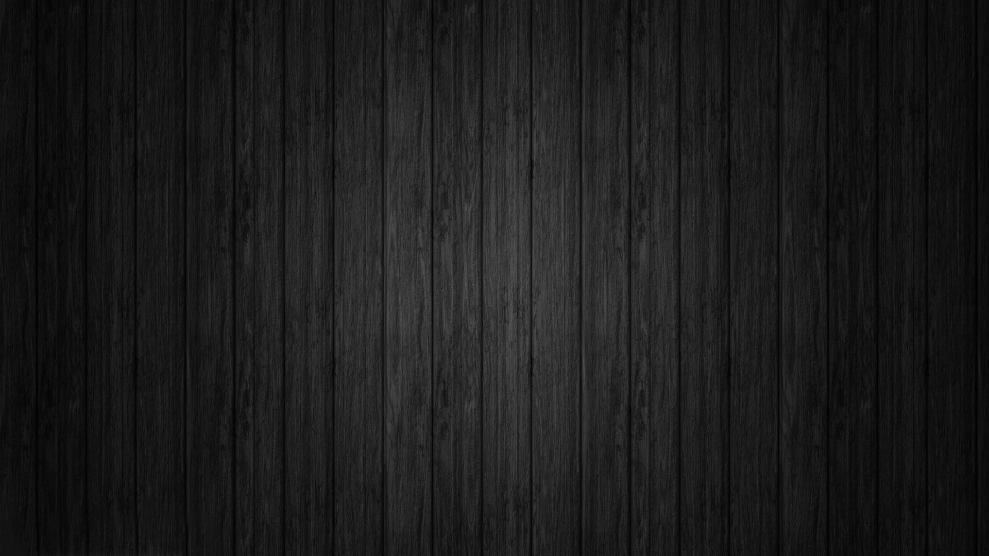
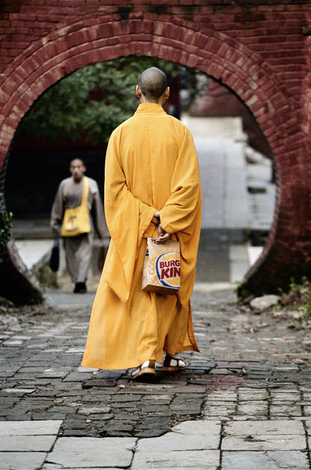
Chapter 11: Muscular System A&P fall 2014 mr. e SRCS

Slide 2
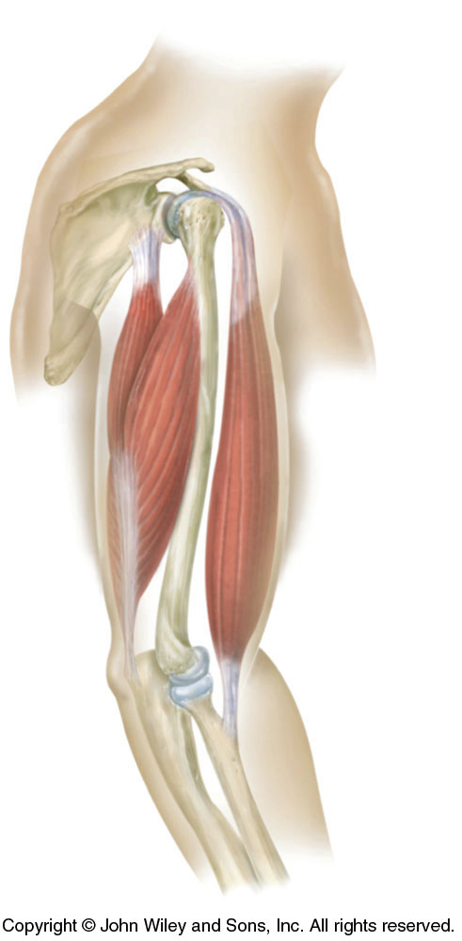
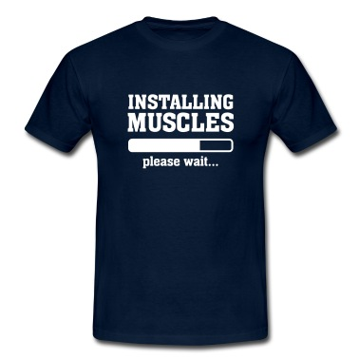
Naming the muscles of the
Muscular
System
Lecture slides prepared by Curtis DeFriez, Weber State University

Slide 3
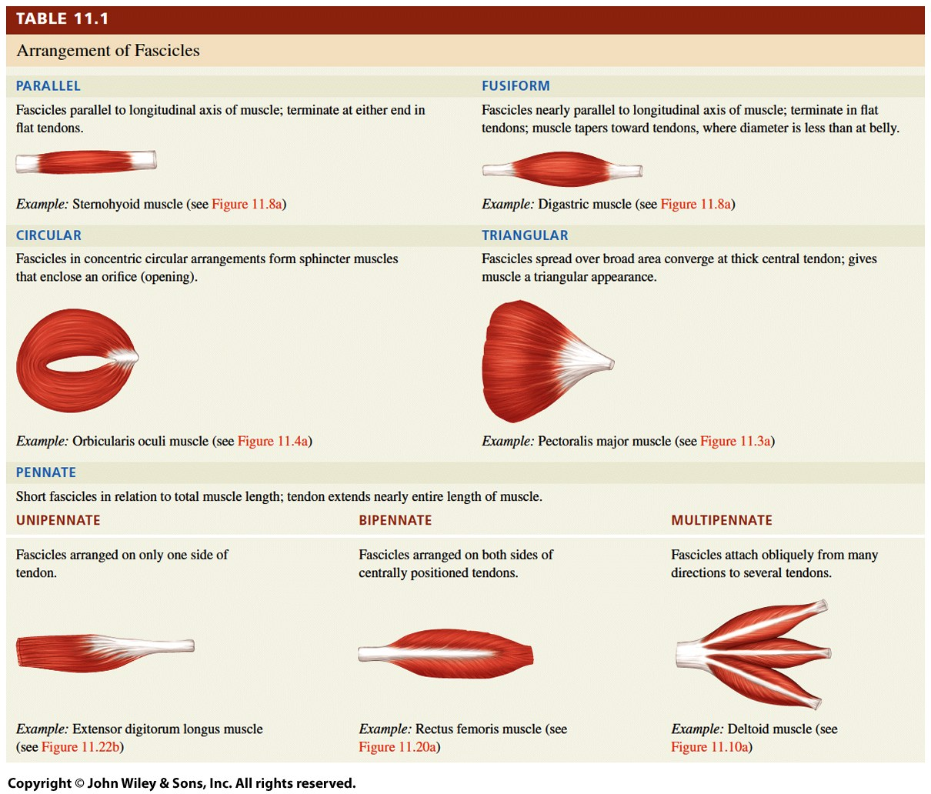

Slide 4
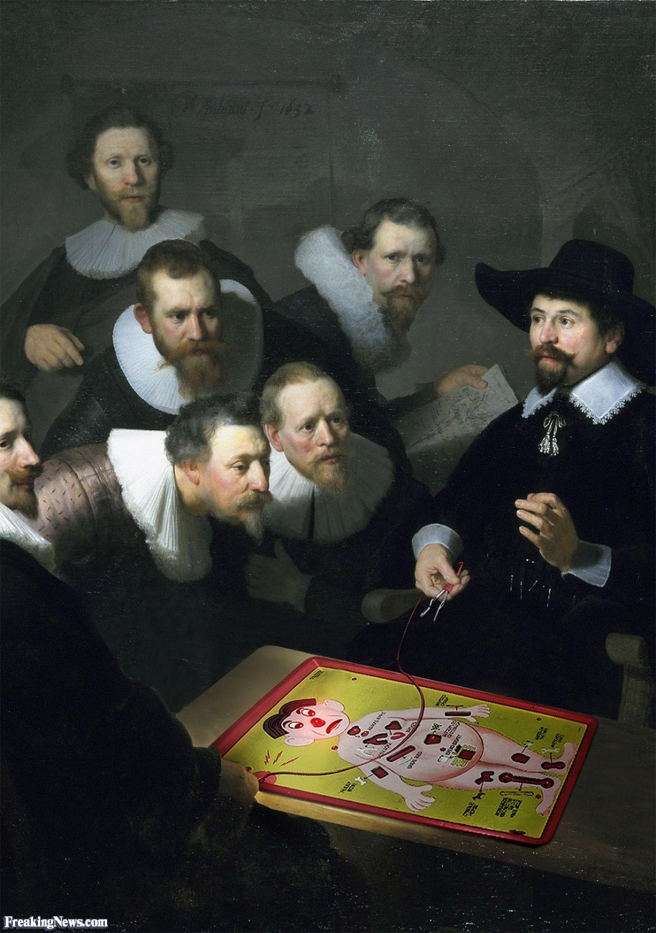
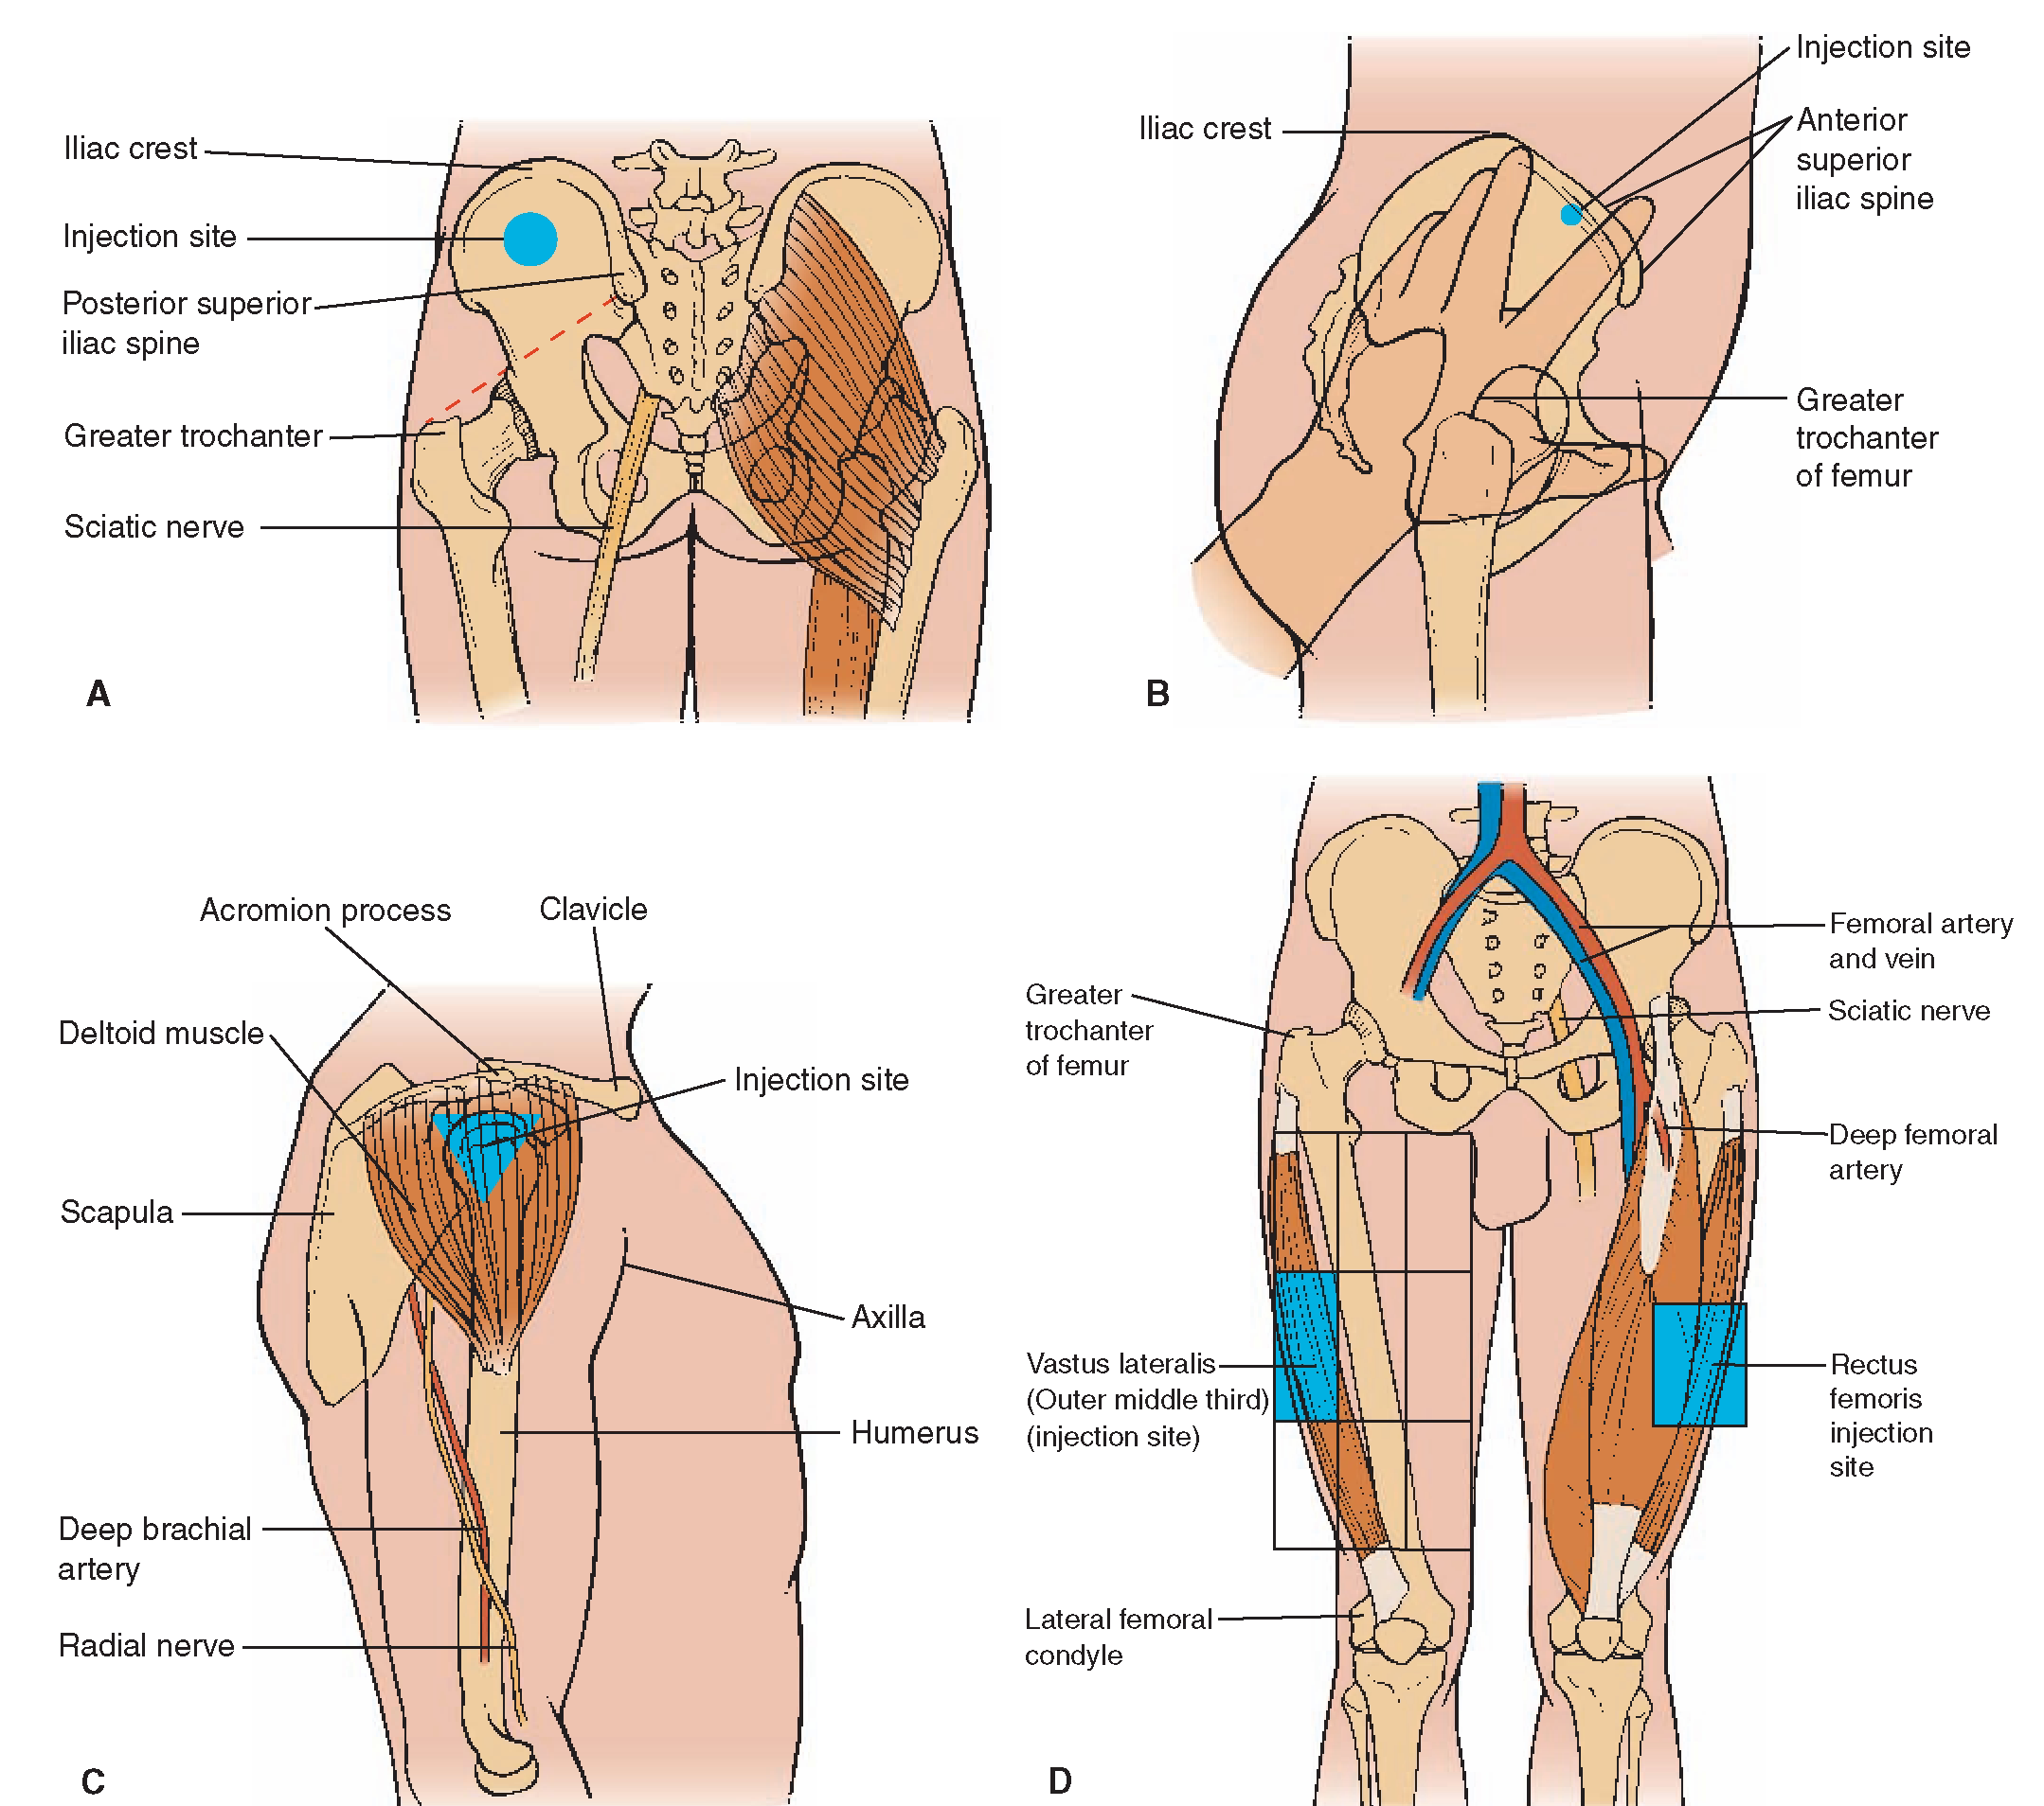
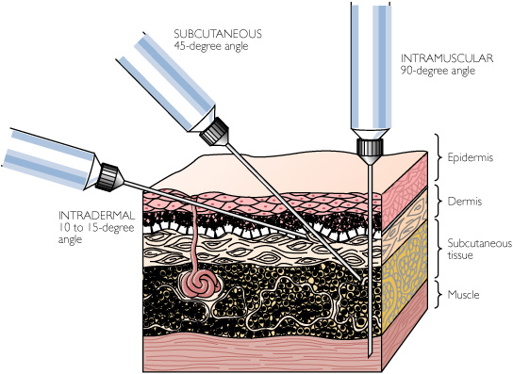
Clinical Connection
Intramuscular Injections
An intramuscular (IM) injection penetrates the skin and the subQ to enter the muscle itself. Common sites for IM injections:
the gluteus medius muscle of the buttock,
lateral side of the thigh in the mid portion of the vast us laterals muscle,
the deltoid muscle of the shoulder.
IM injections have a faster speed of delivery than oral medications but are slower than intravenous infusions.
To avoid injury, IM injections are given deep within the muscle, away from major nerves and blood vessels.

Slide 5
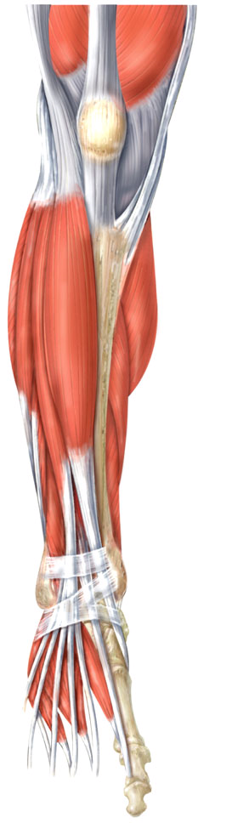
Naming Muscles
Location
tibialis anterior
What is this name teaching?
Tibialis anterior

Slide 6
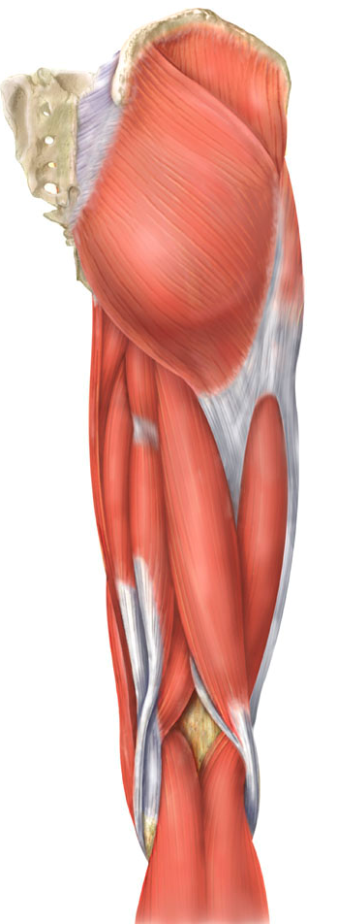
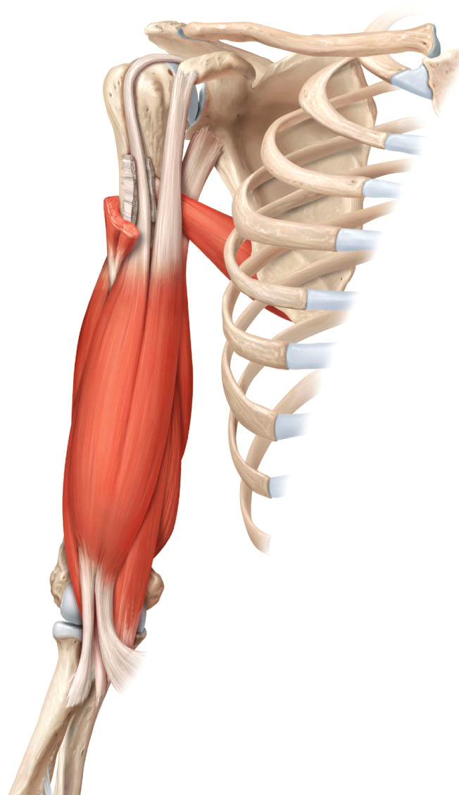
Naming Muscles
What is this name teaching?
Size
gluteus maximus
Number of Attachments
biceps; triceps
What are these names teaching?

Slide 7
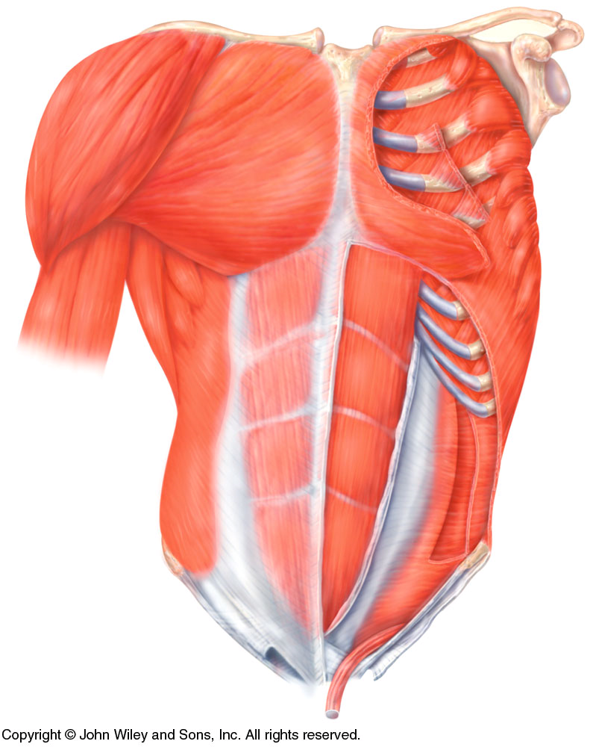
Naming Muscles
What is this name teaching?
Location/Direction of Fibers
transversus abdominus

Slide 8
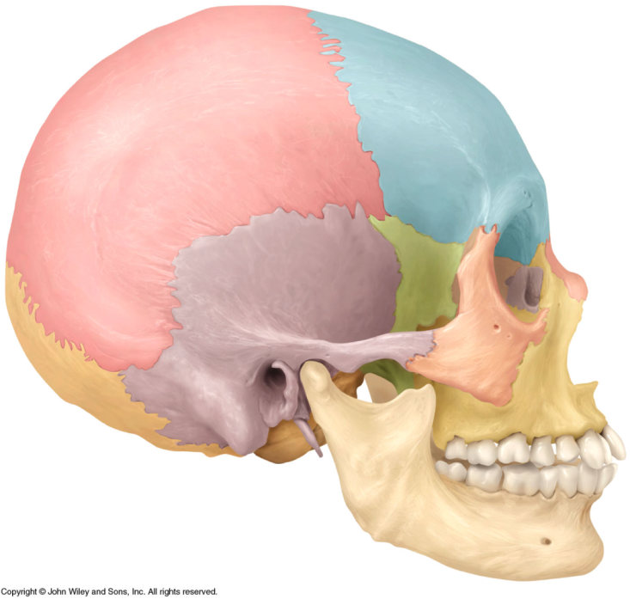
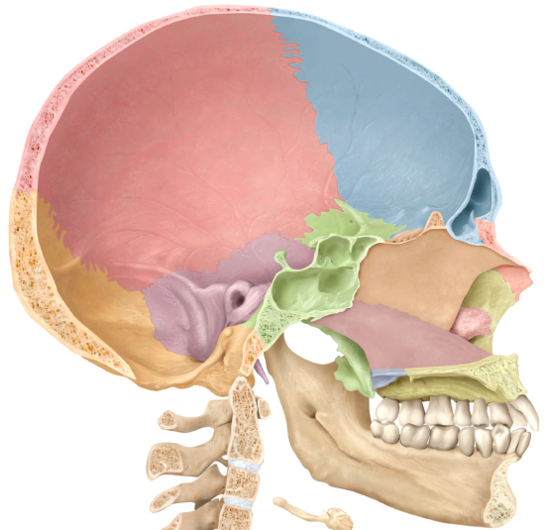
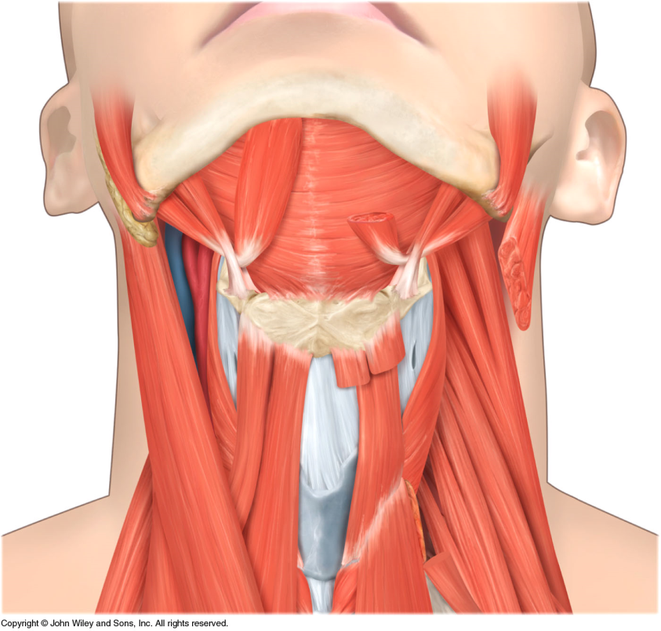
Naming Muscles
What is this name teaching?
Hyoid
bone
Styloid process
Attachments
(origin & insertion)
stylohyoid; sternocleidomastoid

Slide 9
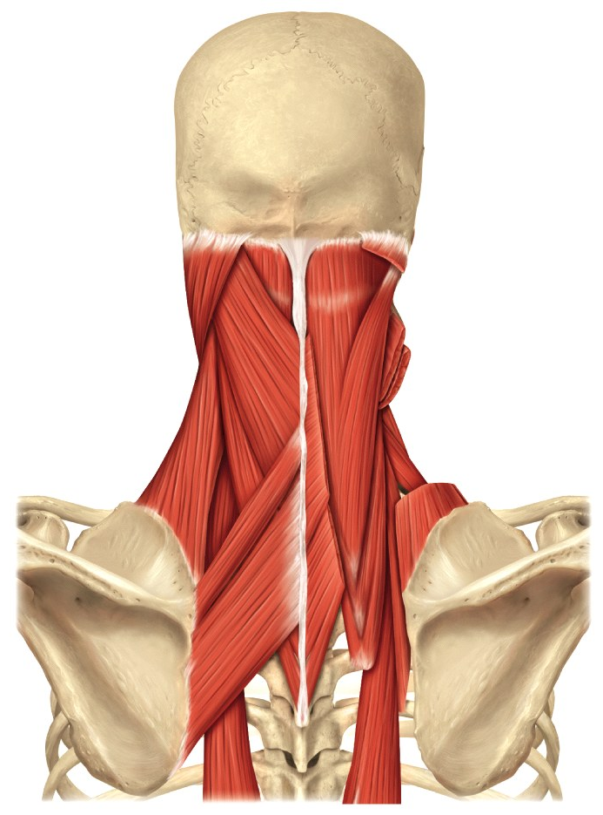
Naming Muscles
Muscle action
levator scapulae
adductor magnus
tensor tympani
Levator scapulae
What is this name teaching?

Slide 10
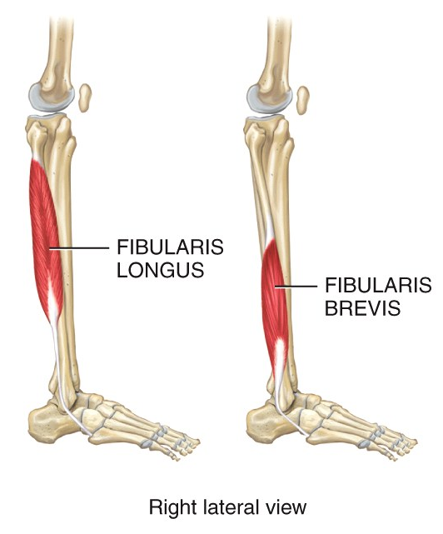
Naming Muscles
Combination of above & shape
Fibularis longus
What is this name combining?
Notes:
A concentric contraction is a type of muscle contraction in which the muscles shorten while generating force.

Slide 11
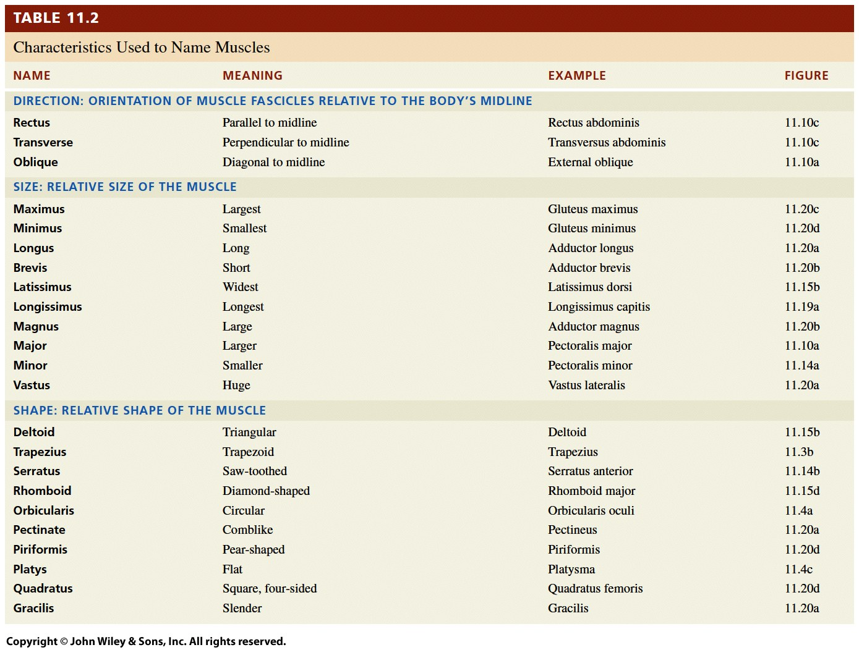

Slide 12
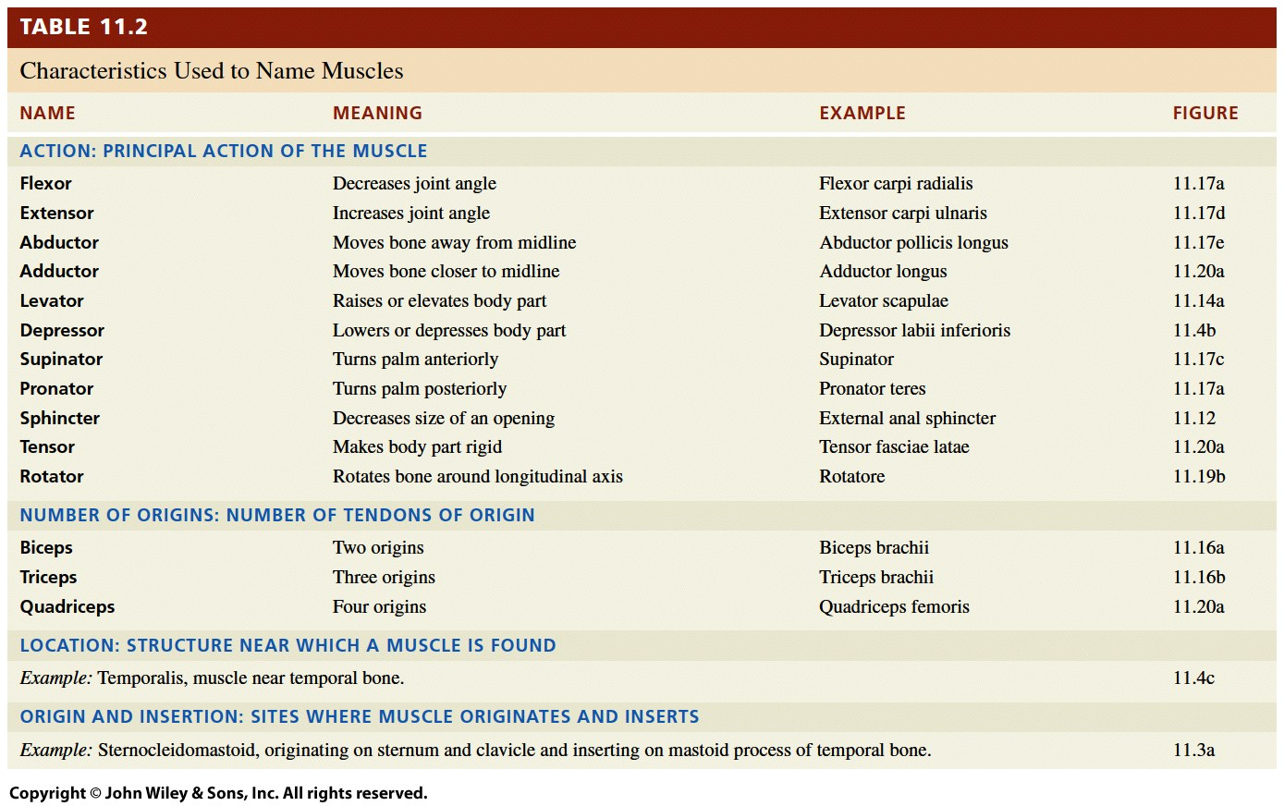

Slide 13
Clinical Connection
Intramuscular Injections
An intramuscular (IM) injection penetrates the skin and the subQ to enter the muscle itself. Common sites for IM injections:
the gluteus medius muscle of the buttock,
lateral side of the thigh in the mid portion of the vast us laterals muscle,
the deltoid muscle of the shoulder.
IM injections have a faster speed of delivery than oral medications but are slower than intravenous infusions.
To avoid injury, IM injections are given deep within the muscle, away from major nerves and blood vessels.

Slide 14
Origins and Insertions
Muscles produce movement by exerting force on
tendons which in turn pull on bones and other
supporting structures like the skin.
In order to produce movement around a joint, one bone must be stationary while another bone moves.
The attachment of a muscle's tendon to the stationary, usually proximal bone, is called the origin.
Notes:
There are approximately 639 skeletal muscles in the human body. The exact number is difficult to define because different sources group muscles differently

Slide 15
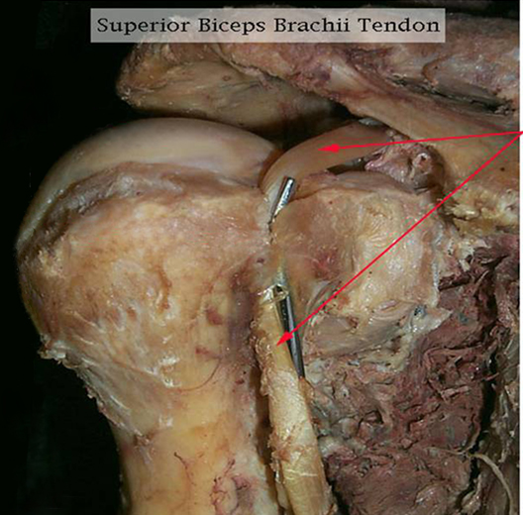
FYI: Origins and Insertions
Origin of the long head of the biceps
Notes:
The field of kinesiology

Slide 16
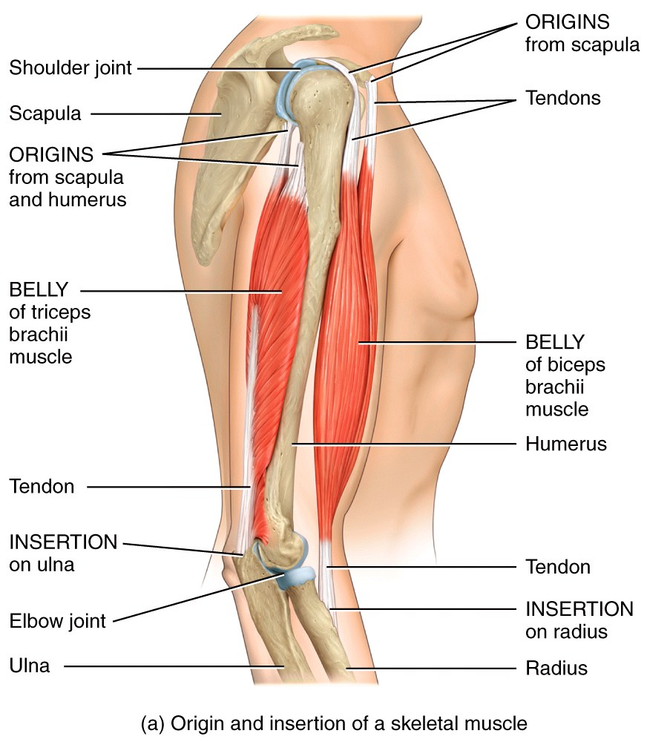
Origins and Insertions
Biceps: Origin: Scapula Insertion: Radius Action: pronate and flex the arm
Triceps:
Origin:
Scapula near shoulder joint
Upper lateral and posterior sites
of humerus
Posterior surface of humerus
Insertion: Back of olecranon process of ulna
Action: Straighten (extend) the arm
Notes:
The field of kinesiology

Slide 17
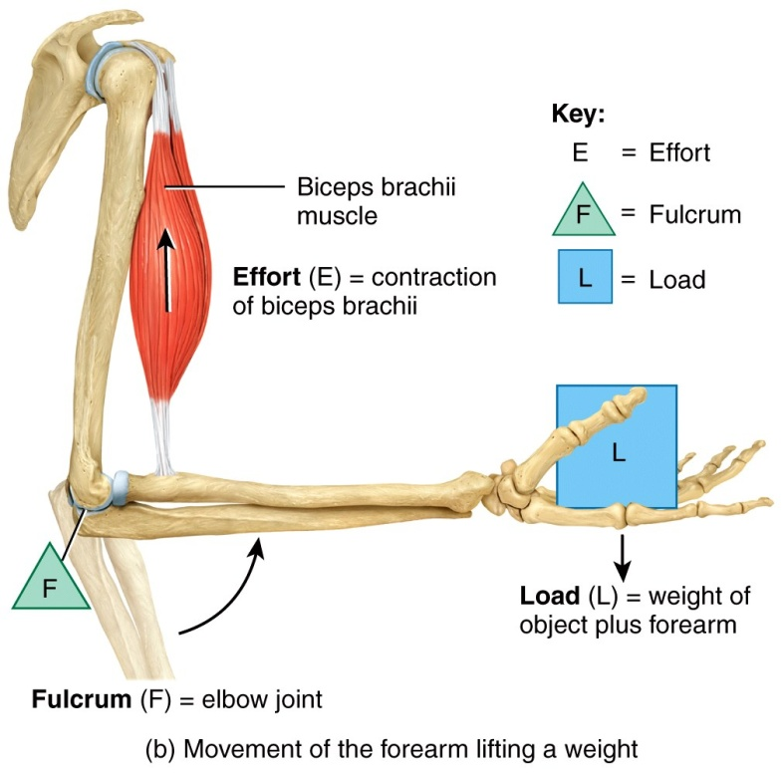
Musculoskeletal Levers
Motion will occur in a muscle when the ______ supplied exceeds the _______.
Muscles, tendons, bones, and joints can form three different types of levers in the body.
When producing movement, bones act as levers, and joints function as the fixed point
of movement called the fulcrum.
In a lever, the point of movement
(fulcrum) is acted on by two
different forces: Effort and load.
Notes:
A lever is a simple machine that magnifies speed of movement or force. The levers are mainly the long bones of the body and the axes are the joints where the bones meet.

Slide 18
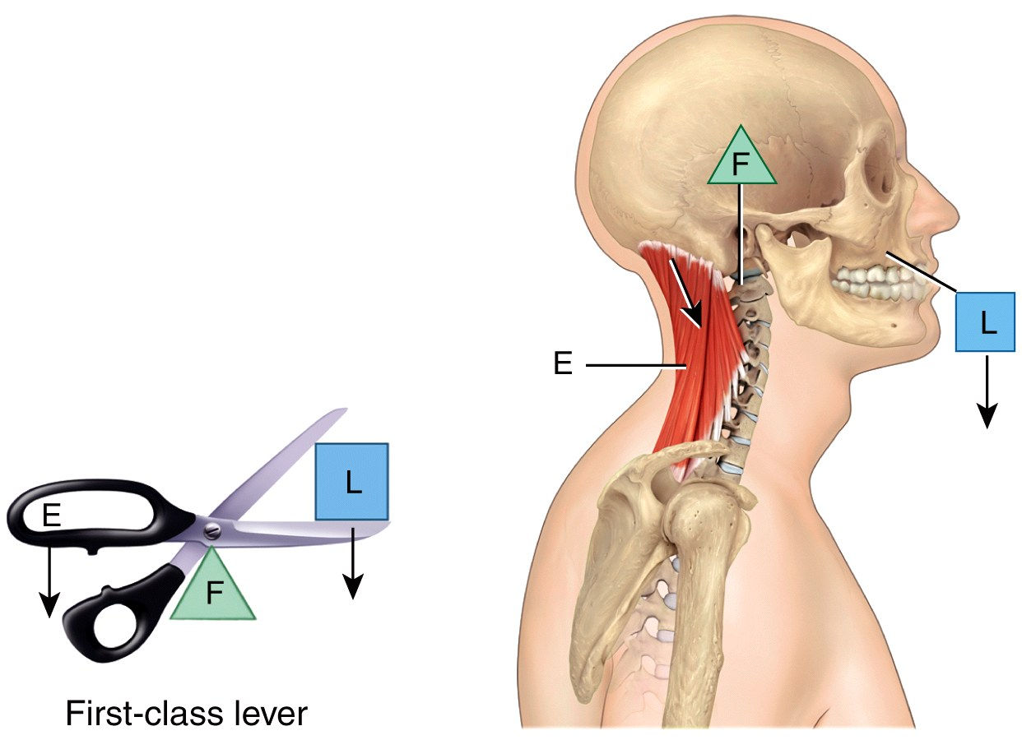
Musculoskeletal Levers
The middle reveals the class
There are few first-class levers
in the body
Remember the mnemonic device: FLorida Education?
Notes:
A first-class lever can produce either a mechanical advantage or mechanical disadvantage depending on whether the effort or the load is closer to the fulcrum. If the effort is farther from the fulcrum than the load (adult), a heavy load can be moved, but not very far or fast. If the effort is closer to the fulcrum than the load, only a lighter load can be moved, but it moves far and fast. There are few first-class levers in the body.

Slide 19
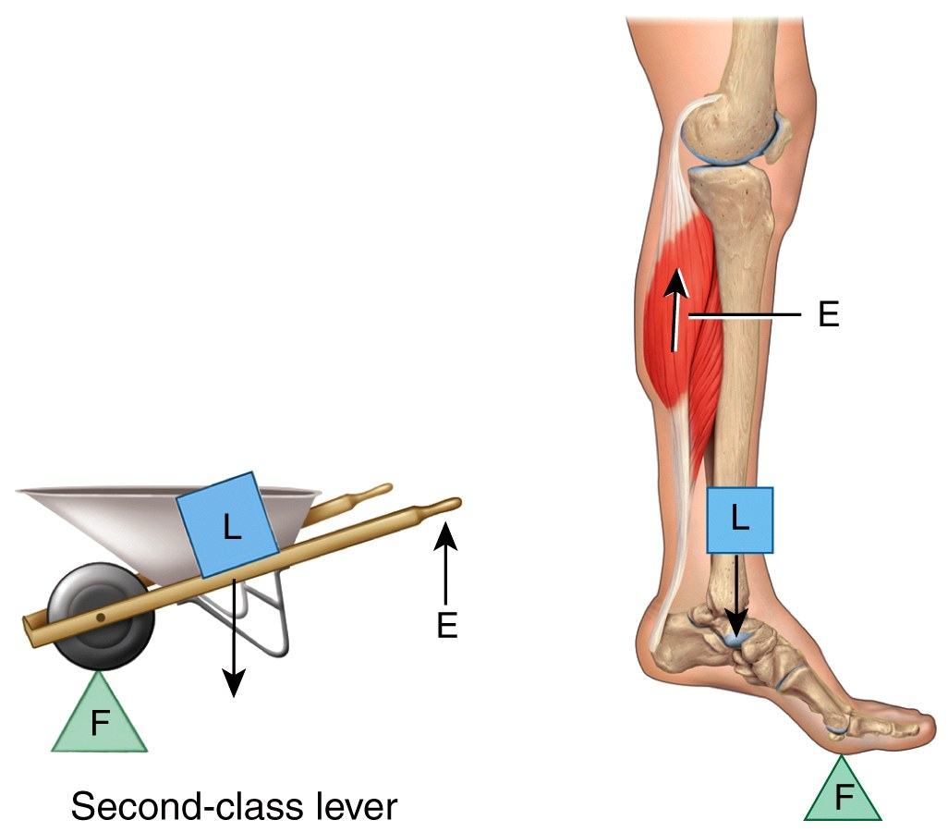
Musculoskeletal Levers
Second class levers always provide a distinct mechanical advantage in producing force.
pry bar
wheelbarrow
Notes:
Second-class levers operate like a wheelbarrow. They always produce a mechanical advantage because the load is always closer to the fulcrum than the effort. This arrangement sacrifices speed and range of motion for force; this type of lever produces the most force. This class of lever is uncommon in the human body.

Slide 20
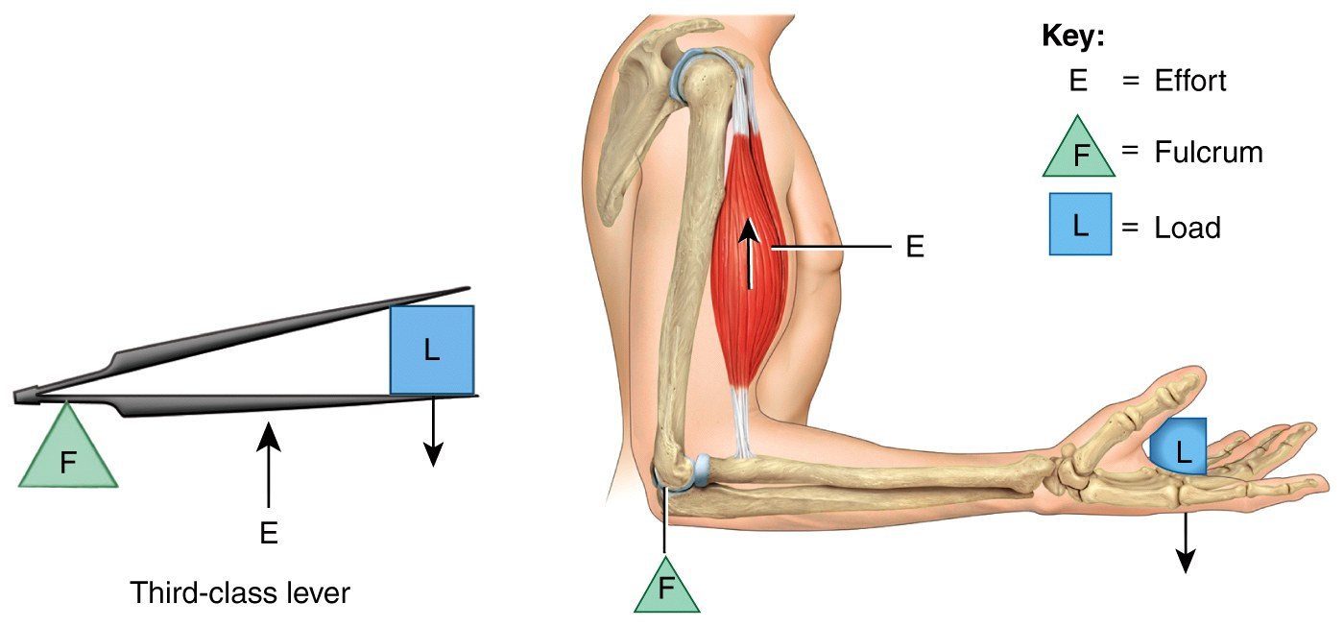
Musculoskeletal Levers
Third-class levers are the most common and favor speed and range of motion over maximum force.
Notes:
These levers operate like a pair of forceps and are the most common levers in the body. Third-class levers always produce a mechanical disadvantage because the effort is always closer to the fulcrum than the load. In the body, this arrangement favors speed and range of motion over force. .

Slide 21
Coordination Among Muscles
Movements are often the result of several skeletal muscles acting as a group.
Most skeletal muscles are arranged in opposing (antagonistic) pairs at joints.
Within opposing pairs, the prime mover or agonist (“the leader”) is the muscle primarily responsible for causing the desired movement.

Slide 22
Coordination Among Muscles
The antagonist stretches and yields to the effects of the prime mover.
In flexing the forearm at
the elbow, the brachialis
is the prime mover or
agonists, and the triceps
brachii is the antagonist.

Slide 23
Coordination Among Muscles
Synergists are muscles used to prevent unwanted movements at intermediate joints, or otherwise aid the movement of the prime mover.
The biceps acts synergistically with the brachialis.
Fixator muscles are a type of synergist muscle that are used to steady the proximal joints/origin of a prime mover.
Shoulder stabilizers for the forearm flexors

Slide 24
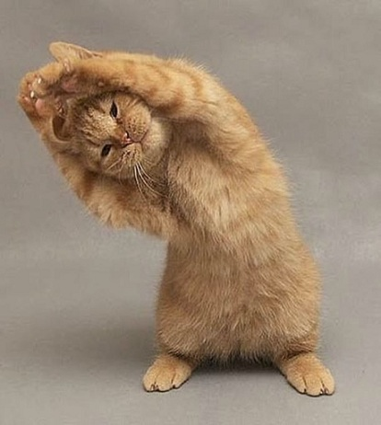
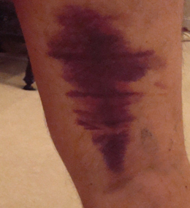
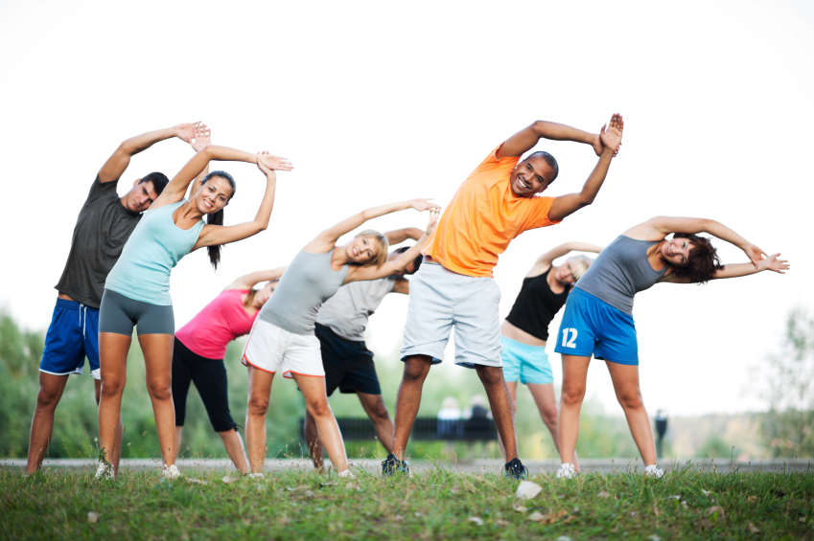
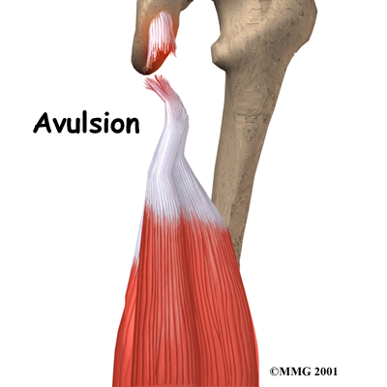
Clinical Connection
Benefits of Stretching
The overall goal of stretching is to achieve normal range of motion of joints and mobility of soft tissues surrounding the joints.
Improved physical performance (a flexible joint is able to move through a greater range of motion)
Decreased risk of injury (stretching decreases resistance in various soft tissues)
Reduced muscle soreness
Improved posture (stretching can help realign soft tissues to improve and maintain good posture)
Stretching is good…
but don’t abuse it or this might happen

Slide 25
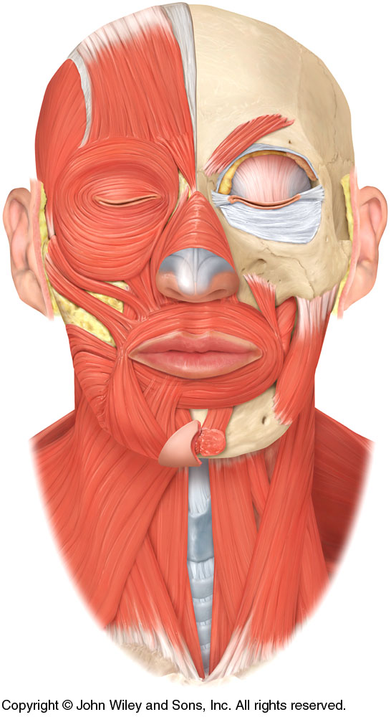
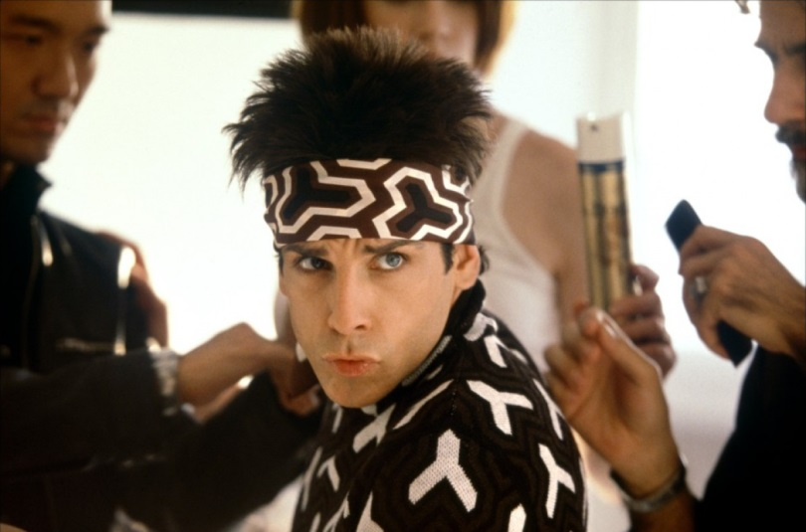
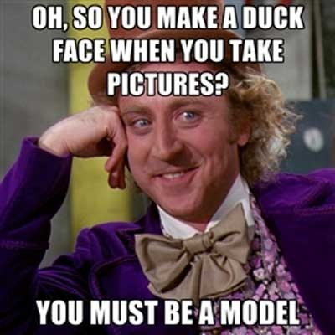
Major Skeletal Muscles
The cranial & facial muscles move skin rather than bones around a joint.
Orbicularis oris
Action: Closes and
protrudes lips for expression &
osculation
Origin: Surrounding the
opening of the mouth
Insertion: The skin at the
corner of the mouth
Orbicularis oris

Slide 26
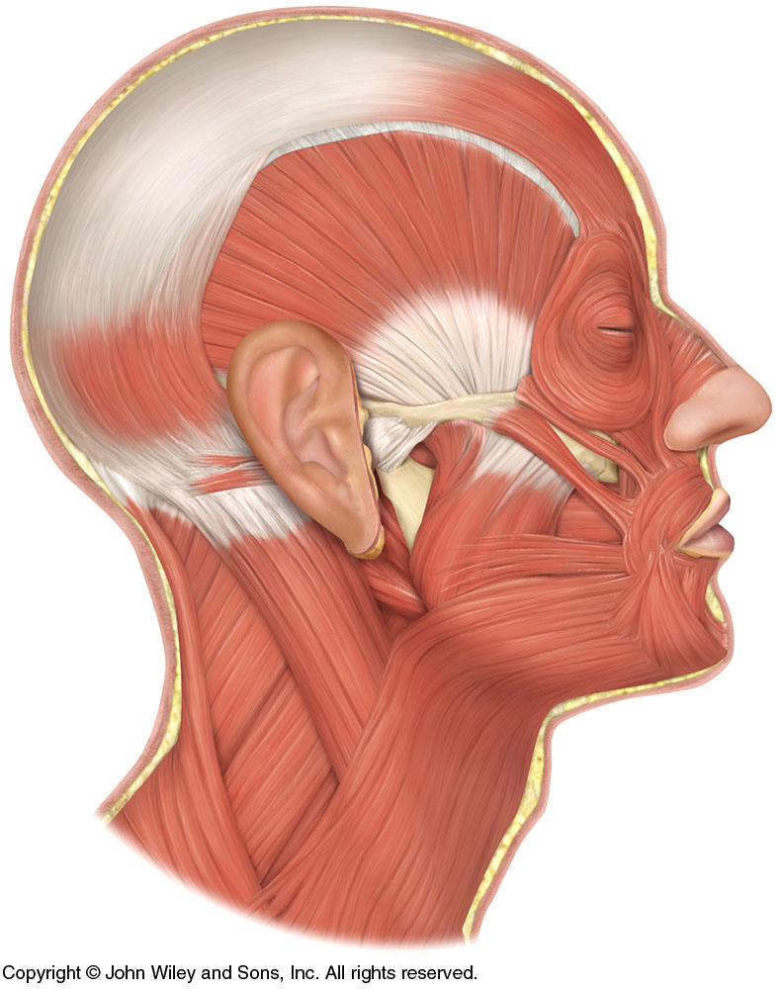
Major Skeletal Muscles
Muscles that move the mandible (lower jaw)
Also called muscles of mastication
Masseter
Origin: Maxilla and zygomatic arch
Insertion: Mandible
Action: Closes the mouth
Masseter

Slide 27
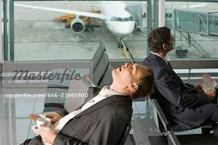
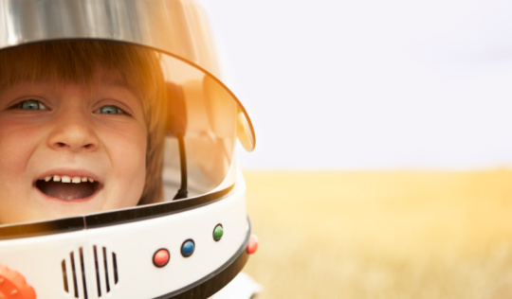
Clinical Connection
Gravity and the Mandible
Three of the four muscles of mastication close the mandible and only the lateral pterygoid opens the mouth. The force of gravity on the mandible offsets this imbalance. When the masseter, temporalis and medial pterygoid muscles relax, the mandible drops.
In contrast, astronauts in zero gravity must work hard to open their mouths.
This is why when we fall asleep in chairs, many persons’ mouths open.

Slide 28
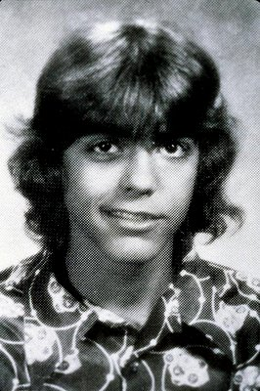
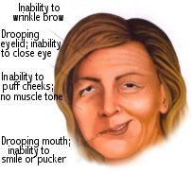
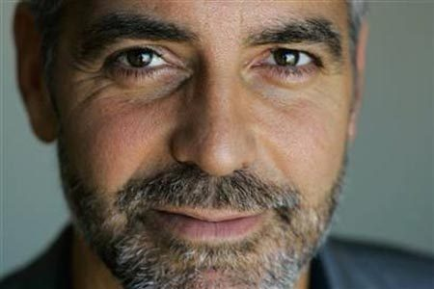
Clinical Connection
Bell’s Palsy
Also known as facial paralysis, it is a unilateral paralysis of the muscles of facial expression, due to damage or disease of the facial (VII) nerve. 80% of patients recover completely within a few weeks to a few months. For others, paralysis is permanent. The symptoms of Bell’s palsy mimic those of a stroke.
As if you were made of wax that is melting…

Slide 29
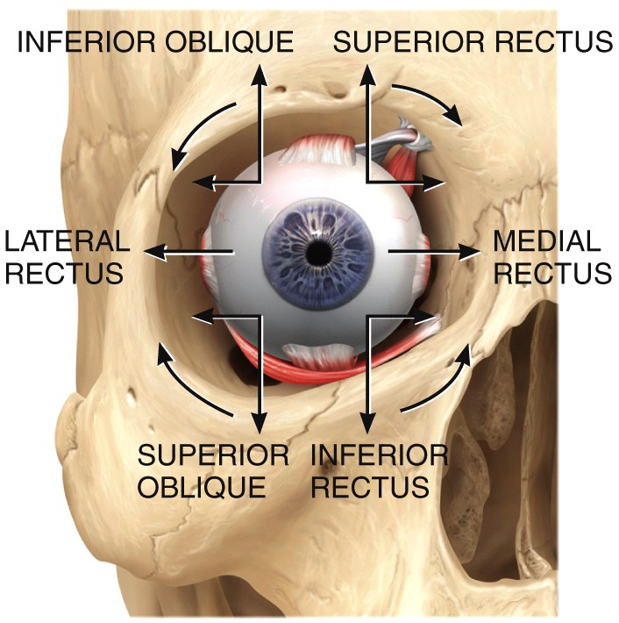
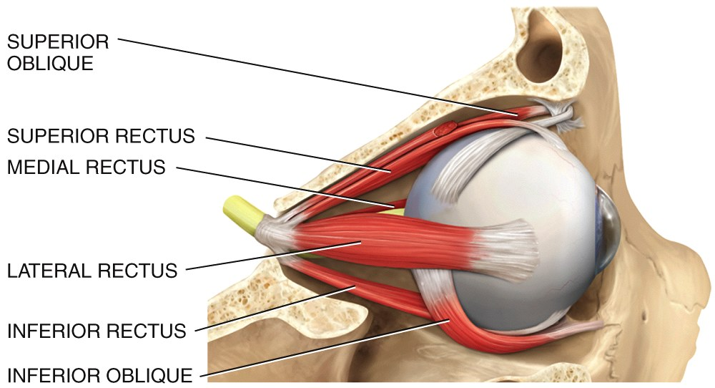
Major Skeletal Muscles
The Extraocular muscles
3 pair give each eye very
precise movement
Origin: Back of the orbit
Insertion: Different parts
of the eyeball
Action: Precise and rapid
movement of the eyes

Slide 30
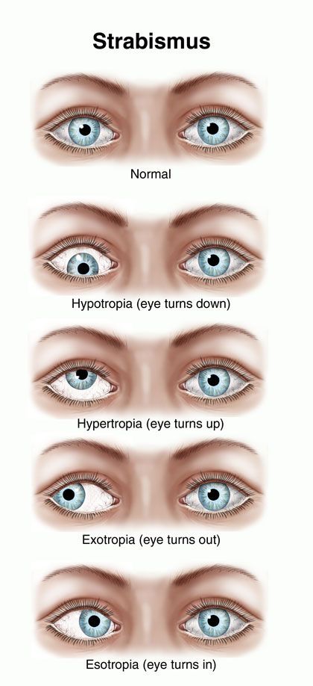
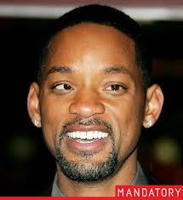
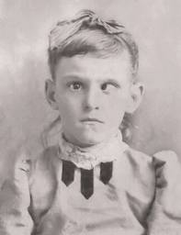
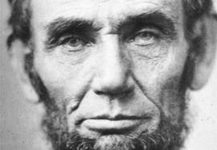
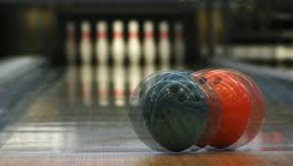
Clinical Connection
Strabismus
Strabismus : a condition in which the two eyeballs are not properly aligned. Can be hereditary or due to birth injuries, poor attachments of the muscles, problems with the brain’s control center, or localized disease.
More common than you might think

Slide 31
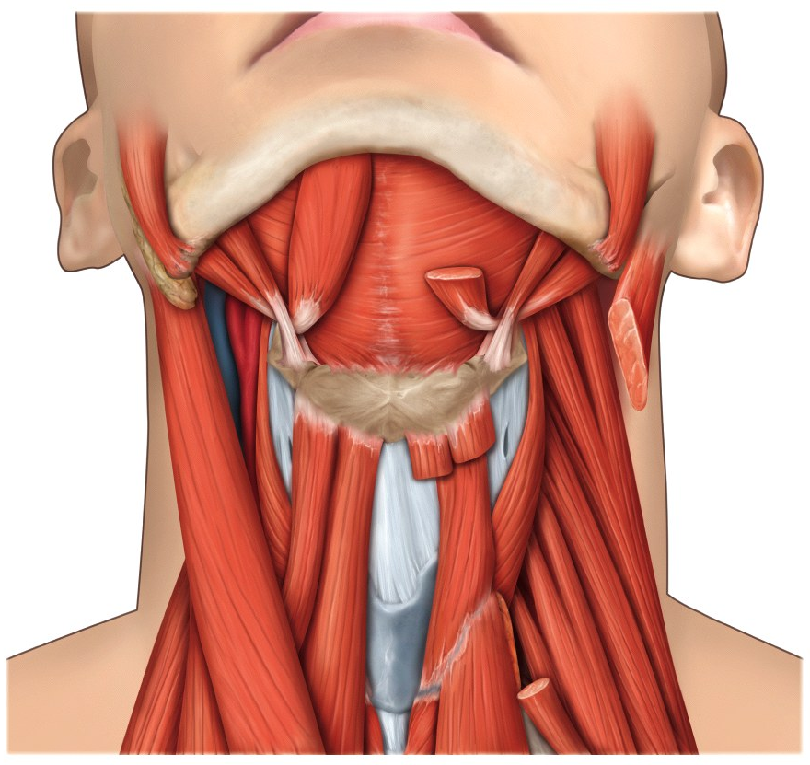
Major Skeletal Muscles
Muscles that move the head
Sternocleidomastoid (commonly abbreviated as SCM)
Origin: Clavicle and sternum
Insertion: Mastoid
process of temporal bone
Action: Flex and
rotate the head
Sternocleidomastoid

Slide 32
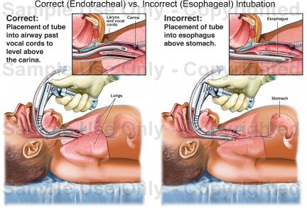
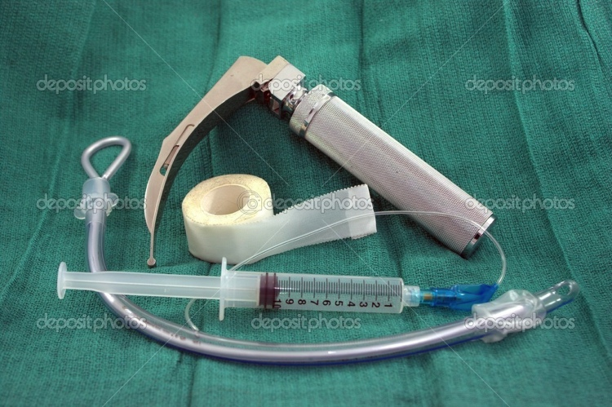
Clinical Connection
Intubation during Anesthesia
During surgery when general anesthesia is administrated, every muscle involved with respiration is then paralyzed. This paralysis causes the tongue to fall posteriorly, which may obstruct the airway to the lungs. To avoid this, the mandible is either manually thrust forward and held in place, or a tube is inserted from the lips through the laryngopharynx into the trachea (endotracheal intubation).

Slide 33
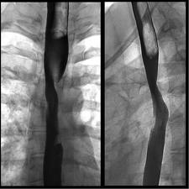
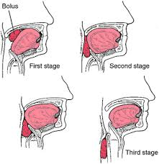
Clinical Connection
Dysphagia
Dysphagia is a clinical term for difficulty in swallowing. Some individuals are unable to swallow while other have difficulty swallowing liquids, foods, or saliva. Causes include nervous system disorders that weaken or damage muscles of deglutition (stroke, Parkinson disease, cerebral palsy)

Slide 34

Epicranial aponeurosis
Know the Bold-faced muscles…
OCCIPITOFRONTALIS
(FRONTAL BELLY)
Frontal bone
CORRUGATOR SUPERCILII
TEMPORALIS
Levator palpebrae superioris
ORBICULARIS OCULI
Lacrimal gland
Zygomatic bone
LEVATOR LABII SUPERIORIS
Nasalis
Nasal cartilage
ZYGOMATICUS MINOR
Maxilla
ZYGOMATICUS MAJOR
LEVATOR ANGULI ORIS
RISORIUS
BUCCINATOR
MASSETER
PLATYSMA
ORBICULARIS ORIS
Mandible
DEPRESSOR ANGULI ORIS
MENTALIS
DEPRESSOR LABII INFERIORIS
Omohyoid
Sternohyoid
Thyroid cartilage (Adam’s apple)
Sternocleidomastoid
Sternothyroid
(a) Anterior superficial view
(b) Anterior deep view

Slide 35

Epicranial aponeurosis
OCCIPITOFRONTALIS (FRONTAL BELLY)
TEMPORALIS
ORBICULARIS OCULI
ZYGOMATICUS MINOR
NASALIS
OCCIPITOFRONTALIS
(OCCIPITAL BELLY)
LEVATOR LABII SUPERIORIS
Zygomatic arch
ZYGOMATICUS MAJOR
Posterior auricular
LEVATOR ANGULI ORIS
Mandible
BUCCINATOR
MASSETER
ORBICULARIS ORIS
Splenius capitis
RISORIUS
Sternocleidomastoid
DEPRESSOR LABII INFERIORIS
Splenius cervicis
Trapezius
MENTALIS
Levator scapulae
DEPRESSOR ANGULI ORIS
Middle scalene
PLATYSMA
(c) Right lateral superficial view

Slide 36

Major Skeletal Muscles
Some of the more common muscles that originate on the trunk include:
Describe each action of each muscle you can see…
Pectoralis major and minor
Anterior abdominal muscle group
Latissimus dorsi
Biceps brachii
Diaphragm
Trapezius
Deltoid

Slide 37


Major Skeletal Muscles
Muscles that move the pectoral girdle (shoulder)
Pectoralis major
Origin: Clavicle and sternum
Insertion: Proximal humerus
Action: Adducts and draws arm at across chest at shoulder joint
Pectoralis minor
Origin: Ribs 3–5
Insertion: Coracoid process of the scapula
Action: Internally rotates the shoulder

Slide 38
Major Skeletal Muscles
Muscles that move the pectoral girdle (shoulder)
Deltoid Muscle
Origin: Lateral clavicle and upper scapula
Insertion: Deltoid tuberosity
on the shaft of the humerus
Action: Abducts, flexes, and
medially rotates the upper arm
at the shoulder joint
Deltoid
Notes:
In human anatomy, the deltoid muscle is the muscle forming the rounded contour of the shoulder. Anatomically, it appears to be made up of three distinct sets of fibers though electromyography suggests that it consists of at least seven groups that can be independently coordinated by the central nervous system.

Slide 39

Major Skeletal Muscles
Muscles that move the pectoral girdle (shoulder)
Trapezius
Origin: Occipital bone and
cervical spine
Insertion: Clavicle, scapula and
lower thoracic vertebrae
Action: Supports the arm and
moves the scapula up, down,
in, and out
Trapezius
Notes:
The Trapezius arises from the external occipital protuberance and the medial third of the superior nuchal line of the occipital bone (both in the back of the head), from the ligamentum nuchae, the spinous process of the seventh cervical (both in the back of the neck), and the spinous processes of all the thoracic vertebrae, and from the corresponding portion of the supraspinal ligament (both in the upper back).
From this origin:
the superior fibers proceed downward and laterally. They are inserted into the posterior border of the lateral third of the clavicle.
the inferior fibers proceed upward and lateralward. They converge near the scapula and end in an aponeurosis, which glides over the smooth triangular surface on the medial end of the spine, to be inserted into a tubercle at the apex of this smooth triangular surface.
the middle fibers proceed horizontally. They are inserted into the medial margin of the acromion, and into the superior lip of the posterior border of the spine of the scapula.

Slide 40

Major Skeletal Muscles
Muscles that move the pectoral girdle (shoulder)
Latissimus dorsi
Origin: Thoracic and lumbar
vertebrae and the iliac bone
Insertion: Mid-humerus
Action: Drives arm inferiorly
and posteriorly (the
swimmer’s muscle)
Latissimus dorsi
Notes:
The latissimus dorsi is responsible for extension, adduction, transverse extension also known as horizontal abduction, flexion from an extended position, and internal rotation of the shoulder joint. It also has a synergistic role in extension and lateral flexion of the lumbar spine.

Slide 41




Clinical Connection
Back Injury
Four factors that contribute to back injury: amount of force, repetition, posture, and stress applied to the back.
Poor physical condition, poor posture, lack of exercise, and excessive body weight contribute to the number and severity of sprains and strains in your back.

Slide 42

Major Skeletal Muscles
Anterior abdominal wall
Rectus abdominis
Origin: Pubic bone
Insertion: Ribs and sternum
External oblique
Origin: Ribs 5–12
Insertion: Iliac crest and
linea alba
Actions: Flexes vertebral column
and compresses abdomen; aids Defecation

Slide 43

Clavicle
Deltoid
Scapula
Pectoralis major
Biceps brachii
Tendinous intersections
Latissimus dorsi
Serratus anterior
Serratus anterior
EXTERNAL OBLIQUE (cut)
RECTUS ABDOMINIS (covered by anterior layer of rectus sheath)
RECTUS ABDOMINIS
TRANSVERSUS ABDOMINIS
Linea alba
Aponeurosis of internal
oblique (cut)
EXTERNAL OBLIQUE
Aponeurosis of external oblique
INTERNAL OBLIQUE
Inguinal ligament
Anterior superior iliac spine
Inguinal ligament
Aponeurosis of external
oblique (cut)
Superficial inguinal ring
Cremaster muscle
around spermatic cord
Pubic tubercle of pubis
(a) Anterior superficial view
(b) Anterior deep view

Slide 44

DEEP
TRANSVERSUS ABDOMINIS
Aponeurosis of
external oblique
Aponeurosis of
internal oblique
INTERNAL OBLIQUE
Aponeurosis of transversus abdominis
EXTERNAL OBLIQUE
Posterior layer of
rectus sheath
Linea alba
Skin
Subcutaneous layer
View
RECTUS ABDOMINIS
Transverse
plane
Anterior layer of rectus sheath
SUPERFICIAL
(c) Superior view of transverse section of anterior abdominal wall superior to umbilicus (navel)

Slide 45

Trapezius
Sternocleidomastoid
Deltoid
Clavicle
Pectoralis major
Biceps brachii
Serratus anterior
EXTERNAL OBLIQUE
Tendinous intersections
RECTUS ABDOMINIS
Linea alba
Aponeurosis of external
oblique
Inguinal
ligament
(d) Anterior view

Slide 46



Clinical Connection
Groin Pull
A rupture or tear of one or more of the five major muscles of the inner thigh. Groin pulls are usually caused by sprinting or twisting, or kicking a solid object.
Symptoms: sharp pain in the inguinal region, swelling, bruising, or inability to contract the muscles.

Slide 47

Levator scapulae (cut)
First thoracic vertebra
RHOMBOID MINOR
Acromion of scapula
Acromion of scapula
Clavicle
1
2
Spine of scapula
Spine of scapula
3
SUPRASPINATUS
4
DELTOID
5
Humerus
Scapula
6
TERES MINOR
TERES MAJOR
7
INFRASPINATUS
CORACOBRACHIALIS
RHOMBOID MAJOR
Humerus
TERES MAJOR
LATISSIMUS DORSI
Long head of triceps brachii
Spinous process of first lumbar vertebra
Thoracolumbar fascia
Iliac crest
(b) Posterior view
(c) Posterior view

Slide 48




Clinical Connection
Inguinal Hernia
A hernia is a protrusion of an organ through a structure that normally contains it, which creates a lump that can be seen or felt through the skin’s surface. The inguinal region is a weak aria in the abdominal wall. It is often the site of an inguinal hernia a rupture or separation if the inguinal area of the abdominal wall resulting in the protrusion of a part of the small intestine
This is more common in man than in woman

Slide 49


Clinical Connection
Injury of Levator Ani and Urinary Stress Incontinence
During childbirth, the levator ani muscle supports the head of the fetus, and the muscle may be injured during a difficult childbirth or traumatized during an episiotomy (a cut made with surgical scissors to prevent or direct tearing of the perineum during the birth of a baby). The consequence of such injuries may be urinary stress incontinence, that is, the leakage or urine whenever intra-abdominal pressure is increased. One way to treat it is to strengthen and tighten the muscles that support the pelvic viscera.

Slide 50

Major Skeletal Muscles
The main muscle of inspiration is the diaphragm.
Origin: Inferior 6 ribs
(anteriorly) and lumbar
vertebrae (posteriorly)
Insertion: Central tendon
Diaphragm
Central
tendon

Slide 51
Major Skeletal Muscles
Some of the more common muscles of the extremities include:
Triceps brachii
Brachioradialis
Thenar muscles
Hypothenar muscles
Gluteus maximus
Biceps femoris
Quadriceps group: Rectus femoris, along with the vastus lateralis, vastus intermedius, and vastus medialis
Tibialis anterior
Gastrocnemius
Soleus

Slide 52

Major Skeletal Muscles
Muscles that move the Radius and Ulna
Biceps brachii
Origin: Scapula
Insertion: Radius
Action: Flexes and
supinates forearm at
elbow joint and flexes
arm at shoulder joint
Brachialis
Origin: Distal anterior surface of humerus
Insertion: Ulna
Action: Flexor of forearm at elbow

Slide 53
Major Skeletal Muscles
Muscles that move the Radius and Ulna
Triceps brachii
Origin: Scapula and posterior surface of humerus
Insertion: Olecranon
process of ulna
Action: Extends
forearm at elbow
joint and arm
at shoulder joint
Notes:
The triceps brachii crosses two joints

Slide 54




Clinical Connection
Rotator Cuff Injury
This is a strain or tear in the rotator cuff muscles and is common among baseball pitchers, volleyball players, racquet sports players, and swimmers due to shoulder movements that involve vigorous circumduction. It also occurs as a result of wear and tear, aging, trauma, poor posture, improper lifting, and repetitive motions.
Impingement syndrome- one of the most common causes of shoulder pain and dysfunction in athletes.

Slide 55

Major Skeletal Muscles
Muscles that move the Radius and Ulna
Brachioradialis
Origin: Humerus
Insertion: Distal radius
Action: Supinates the forearm
at the radioulnar joint

Slide 56


Clinical Connection
Golfer’s Elbow
This is a condition that can be caused by strain of the flexor muscles, especially the flexor carpi radialis, as a result of repetitive movements such as swinging a golf club.

Slide 57



Clinical Connection
Carpal Tunnel Syndrome
Carpel Tunnel – is a narrow passageway formed anteriorly by the flexor retinaculum and posteriorly by the carpal bones.
Structures within the carpal tunnel, especially the median nerves, are vulnerable to compression this leads to carpal tunnel syndrome. Compression of the median nerve leads to sensory changes over the lateral side of the hand and muscle weakness in the thenar emincece.

Slide 58

Major Skeletal Muscles
Muscles that move the wrist, hand, thumb,
and finger
Thenar: lateral aspect of palm
Hypothenar: medial aspect of palm
Action: Oppose thumb
against other 4 fingers
Thenar
Hypothenar

Slide 59

Major Skeletal Muscles
Muscles that move the femur
Gluteus maximus
Origin: Iliac crest, sacrum, and coccyx
Insertion: Femur
Action: Extends and laterally rotates thigh at hip joint
Gluteus maximus

Slide 60

Major Skeletal Muscles
Muscles that move the femur, tibia, and fibula
Quadricep group (Rectus femoris, vastus lateralis, vastus intermedius, and vastus medialis)
Origin: Iliac spine and proximal femur
Insertion: Patella and proximal tibia
Action: Flexes thigh at high joint and extends leg at knee joint

Slide 61

Major Skeletal Muscles
Muscles that move the femur, tibia, and fibula
Hamstring group: (Biceps femoris,
Semitendinosus, and Semimembranosus)
Origin: Ischial tuberosity
Insertion: Proximal tibia and fibula

Slide 62






Clinical Connection
Pulled Hamstrings and Charley Horse
Pulled Hamstring- A strain or partial tear of the proximal hamstring muscle.
Charley Horse- cramp or stiffness of muscles due to tearing of the muscle, followed by bleeding into the area.
Both are common in sports.

Slide 63

Major Skeletal Muscles
Muscles that move the femur, tibia, and fibula
Tibialis anterior
Origin: Tibia
Insertion: First cuneiform
and first metatarsal
Action: Dorsiflexes and
inverts the foot

Slide 64


Clinical Connection
Shin Splint Syndrome
Pain or soreness along the tibia, specifically the medial, distal two-thirds. It may be caused by tendinitis of the anterior compartment muscles, especially the tibialis anterior muscle, inflammation of the periosteum around the tibia, or stress fractures of the tibia.

Slide 65

Major Skeletal Muscles
Muscles that plantar flex the foot at the ankle joint (standing on “tip toes”)
Gastrocnemius and soleus muscles
function as one – often called the
gastrocsoleus muscle
Origin: Femur, capsule of
knee, and head of fibula
Insertion: Calcaneus by way
of calcaneal (Achilles) tendon

Slide 66



Clinical Connection
Plantar Fasciitis
Planter fasciitis or painful heel syndrome is an inflammatory reaction due to chronic irritation of the plantar aponeurosis (fascia) at its origin on the calcaneus (heel bone).

Slide 67



Clinical Connection
Disorders: Homostatic Imbalances
Running injuries: Although minor injuries, some can become quite serious. Among runners this is the most commonly found in the ankle, knee, Achilles tendon, hip, groin, foot, and back.
Compartment syndrome: External or internal pressure constricts the structures within a compartment, resulting in damaged blood vessels and subsequent reduction of blood supply to the compartments. Treatment for this is fasciotomy which is a surgical procedure in which the fascia muscle is cut to relieve pressure.

Slide 68

Twelfth rib
Quadratus lumborum
Psoas minor
Iliac crest
ILIACUS
PSOAS MAJOR
Anterior superior iliac spine
Femoral triangle
Sacrum
TENSOR FASCIAE LATAE
SARTORIUS
Inguinal ligament
QUADRICEPS FEMORIS:
Pubic tubercle
RECTUS FEMORIS (cut)
PECTINEUS
VASTUS LATERALIS
ADDUCTOR LONGUS
VASTUS INTERMEDIUS
GRACILIS
VASTUS MEDIALIS
RECTUS FEMORIS (cut)
ADDUCTOR MAGNUS
Iliotibial tract
Section of fascia lata (cut)
Tendon of quadriceps femoris
Patella
Patellar ligament
(a) Anterior superficial view (the femoral triangle is indicated by a dashed line)

Slide 69

Gluteus medius (cut)
Iliac crest
Gluteus minimus
Piriformis
Sacrum
Superior gemellus
Gluteus maximus (cut)
Greater trochanter
Obturator internus
Inferior gemellus
Quadratus femoris
Coccyx
Gluteus maximus (cut)
Sacrotuberous ligament
Femur
Ischial tuberosity
ADDUCTOR MAGNUS
ADDUCTOR MINIMIS
Sciatic nerve
GRACILIS
HAMSTRINGS:
SEMITENDINOSUS
BICEPS FEMORIS
SEMIMEMBRANOSUS
SARTORIUS
Iliotibial tract
VASTUS LATERALIS
Femur in floor of popliteal fossa
Sartorius
Tendon of biceps femoris
Gracilis
Plantaris
Semitendinosus
Gastrocnemius
(d) Posterior superficial view of thigh and deep view of gluteal region

Slide 70







Clinical Connection
Medical Terminology
Muscle Strain- Tearing of fibers in a skeletal muscle or its tendon that attaches the muscle to the bone.
Paralysis- Loss of muscle function through injury, disease, or damage to the never supply.
Repetitive strain or motion injuries- conditions resulting from overuse of equipment, poor posture, poor body mechanics, or activity that requires repeated movements.
Rhabdomyosarcoma- A tumor of skeletal muscle.
Torticollis- A contraction or shortening of the sternocleidomastoid muscle that causes the head to tilt toward the affected side and the chin to rotate to the opposite side.
Tic- twitching made involuntarily by muscles that are usually under conscious control.
Strain

Slide 71

Occipitofrontalis (frontal belly)
Epicranial aponeurosis
Nasalis
Temporalis
Orbicularis oris
Orbicularis oculi
Transverse Abdominis
Masseter
Depressor anguli oris
Sternocleidomastoid
Platysma
Trapezius
Sternohyoid
Deltoid
Serratus anterior
Pectoralis major
Rectus abdominis
Triceps brachii
Brachioradialis
Biceps brachii
External oblique
Brachialis
Tensor fasciae latae
Pronator teres
Internal oblique
Iliacus
Brachioradialis
Flexor carpi radialis
Psoas major
Palmaris longus
Pectineus
Thenar muscles
Adductor longus
Flexor carpi ulnaris
Hypothenar muscles
Sartorius
Flexor digitorum superficialis
Gracilis
Vastus lateralis
Iliotibial tract
Rectus femoris
Patellar ligament
Vastus medialis
Tibialis anterior
Tendon of quadriceps femoris
Fibularis longus
Patella
Tibia
Gastrocnemius
Soleus
(a) Anterior view

Slide 72

Epicranial aponeurosis
Occipitofrontalis (occipital belly)
Sternocleidomastoid
Infraspinatus
Trapezius
Teres minor
Deltoid
Teres major
Triceps brachii
Anconeus
Latissimus dorsi
Brachioradialis
Extensor carpi radialis brevis
Extensor carpi radialis longus
Extensor digitorum
External oblique
Extensor carpi ulnaris
Flexor carpi ulnaris
Abductor pollicis longus
Gluteus medius
Extensor pollicis brevis
Gluteus maximus
Gracilis
Adductor magnus
Plantaris
Semitendinosus
Gastrocnemius
Biceps femoris
Iliotibial tract
Semimembranosus
Popliteal fossa
Calcaneal
(Achilles) tendon
Sartorius
(b) Posterior view
Soleus

Slide 73

Muscle Practicum
Chapter 11
word bank
Epicranial aponeurosis
Platysma
Temporalis
Trapezius
Rectus femoris
Deltoid
Soleus
Rectus abdominis
Pectoralis major
Triceps brachii
Brachialis
Gluteus medius
Thenar muscles
Occipitofrontalis
(frontal belly)
Tibialis anterior
Serratus anterior
Sartorius
Orbicularis oculi
Gracilis
Masseter
Vastus medialis
Gastrocnemius
Occipitofrontalis (occipital belly)
Internal Oblique
Brachioradialis
External oblique
Calcaneal (Achilles) tendon
Infraspinatus
Latissimus dorsi
Gluteus maximus
Biceps brachii
Sternocleidomastoid
Semitendinosus
Hypothenar muscles
Biceps femoris
Semimembranosus
Teres major
Nasalis
Vastus lateralis
Orbicularis oris
Transverse Abdominis

