Slide 1
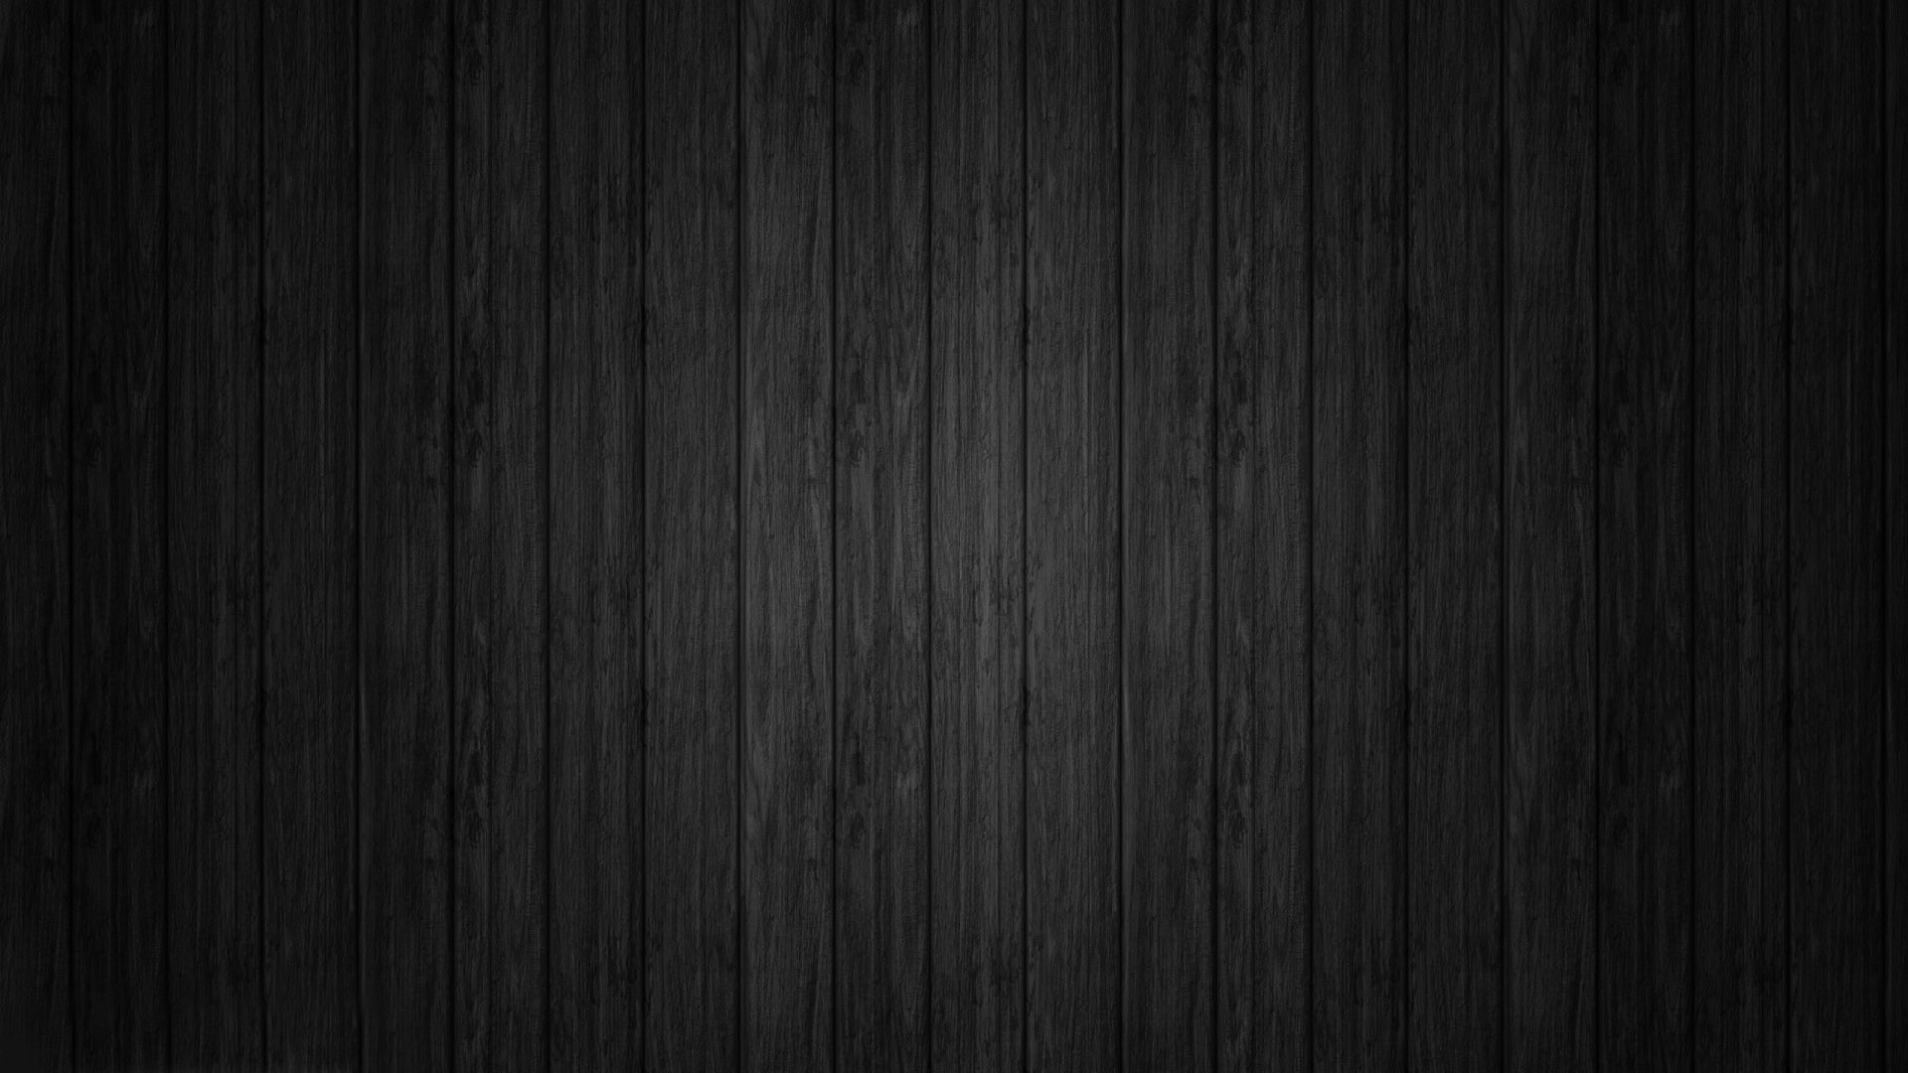
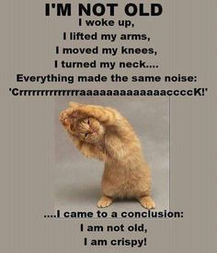
Chapter 9: Joints A&P winter 2014 mr. e SRCS

Slide 2
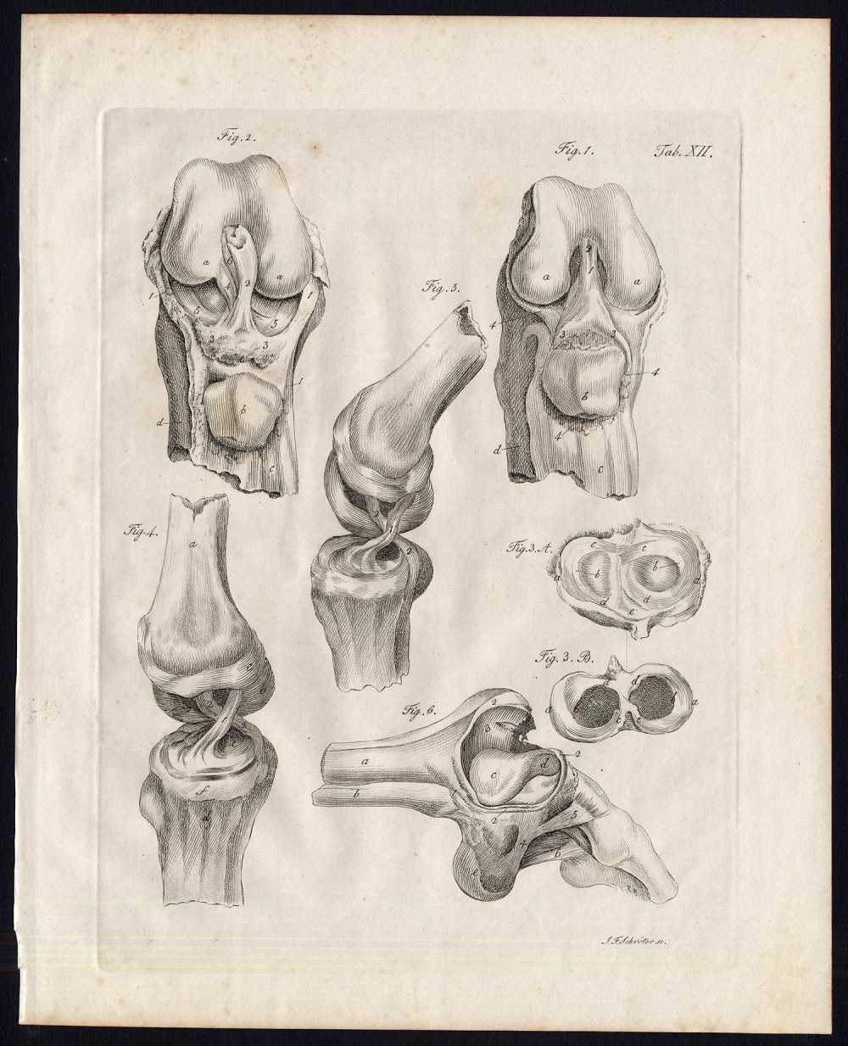
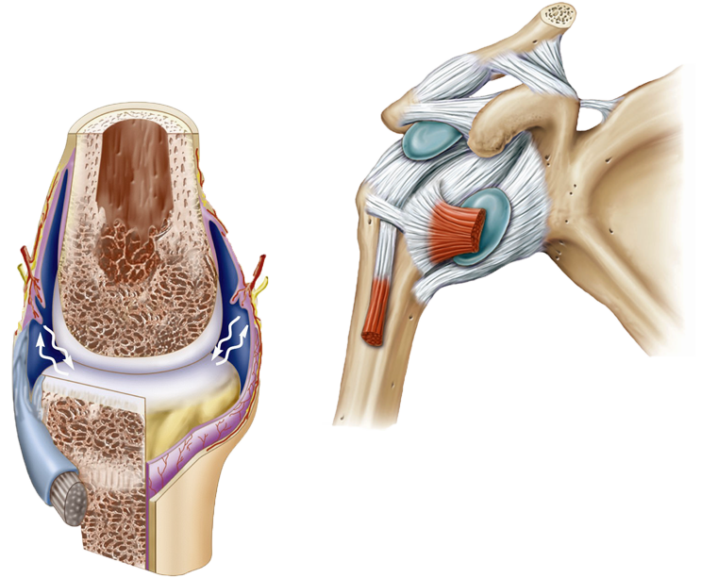
Chapter 9 Joints
Modified Lecture slides prepared by Curtis DeFriez, Weber State University

Slide 3
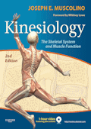
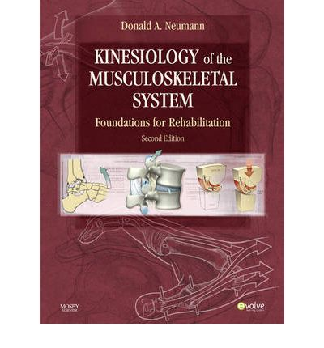
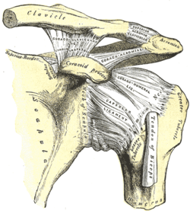
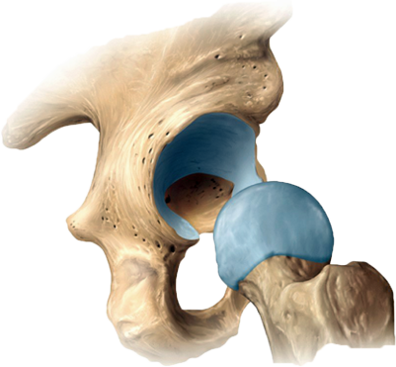
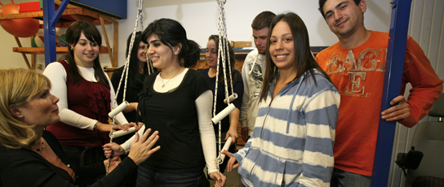
Joints in medicine
Those who study joints and their affect on the human body:
Arthrology/Arthrologists: study joints proper
Kinesiology/kinesiologists: study the motion of the human body

Slide 4
Joint Classification
Joints (articulation) have both structural and functional classifications:
The criteria for classifying joints structurally are anatomical: The presence or absence of a space between the articulating bones and the type of C.T. that binds the bones together.
Functional classification relates to the degree of movement they permit.

Slide 5
Joint Classification
Structural classification subcategories include:
Fibrous joints (bones held together by dense collagen fibers)
Cartilaginous joints (bones held together by cartilage)
Synovial joints (bones held together by ligaments)
Functional classification subcategories include:
Synarthrosis (an immovable joint)
Amphiarthrosis (a slightly movable joint)
Diarthrosis (a freely movable joint)

Slide 6
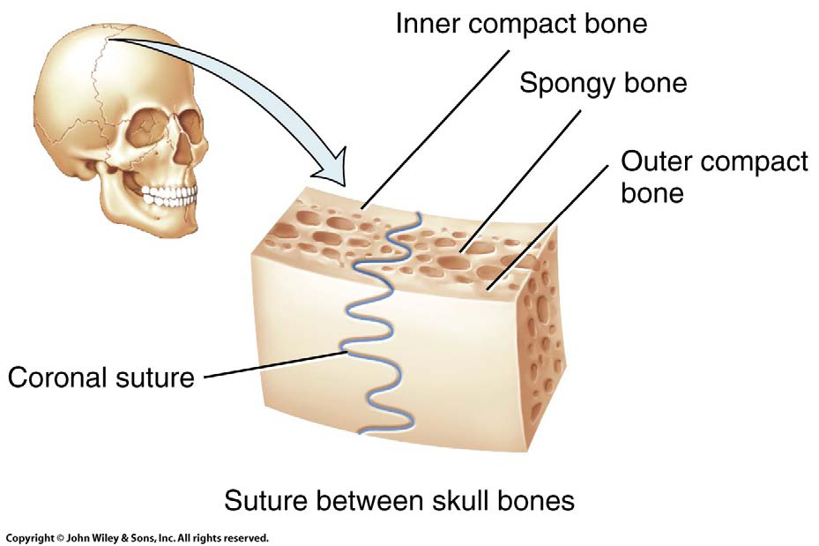
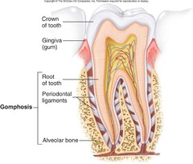
Classification by Structure
Fibrous joints lack cartilage and a synovial cavity.
The bones are held closely together by dense irregular connective tissue.
Sutural joints
in the skull
Syndesmoses:
joints w greater distance & dense irregular CT b/w articulating bones; eg. teeth joints (gomphoses)
Interosseus membrane: Ct b/w bones of forearm & lower leg
Notes:
To teach more detail, fibrous joints can be further divided into suture joints, syndesmoses, and gomphoses.
Sutures occur only between bones of the skull
Syndesmosis permit slight movement, such as the interosseous membrane between the tibia and fibula
Gomphoses occur between the teeth and the periodontal ligament

Slide 7
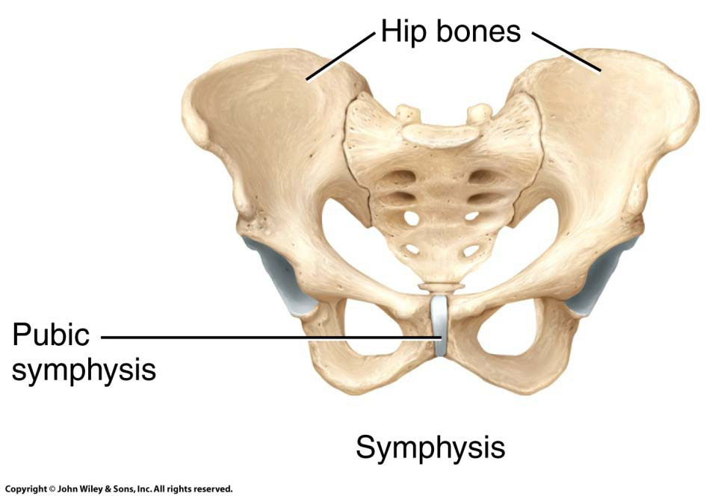
Classification by Structure
Specify joint types…based on mov’t
Cartilaginous joints consist of a bar of cartilage between two bones (2 types: synchondrosis; symphysis)
They lack a synovial cavity and provide little or no movement.
Synchondrosis: epiphyseal plate
Symphysis: Pubic symphysis and
the intervertebral disks
of the spine
Symph-yses only occur in axial skeleton
Notes:
To teach more detail there are two kinds of cartilaginous joints
Synchondroses are made of hyaline cartilage, like the epiphyseal growth plates
Symphyses are have hyaline cartilage sandwiching a disc of fibrocartilage; like the pubic symphysis and the intervertebral discs

Slide 8
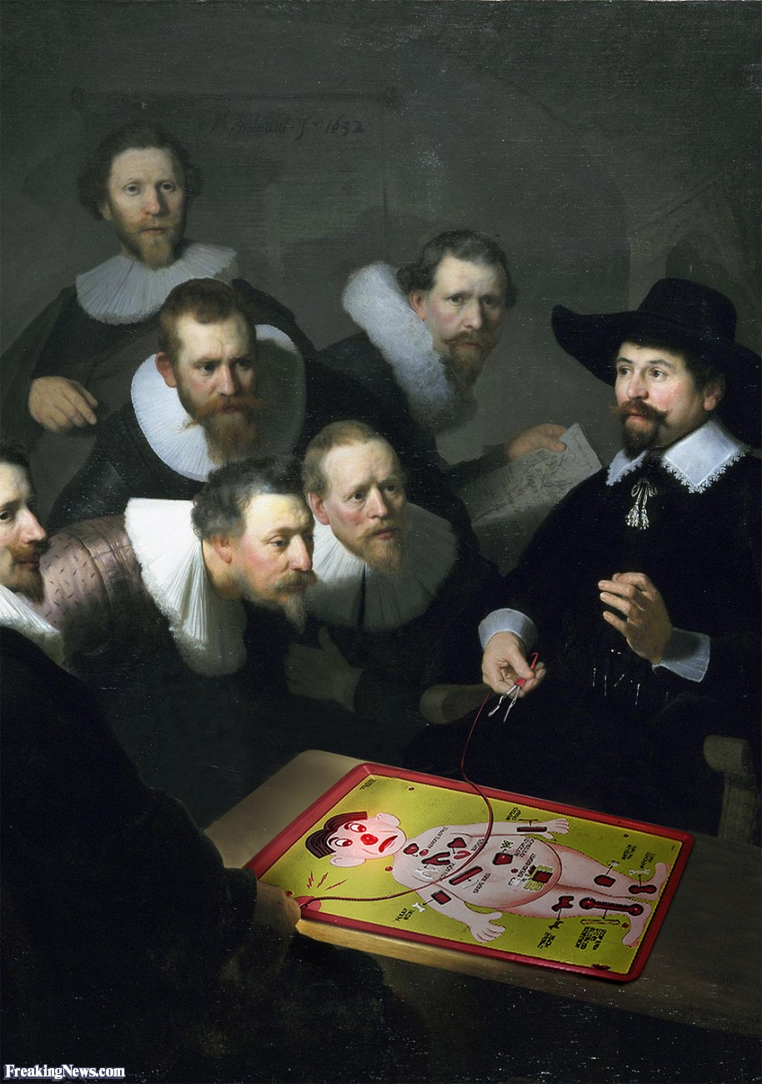
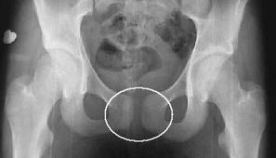
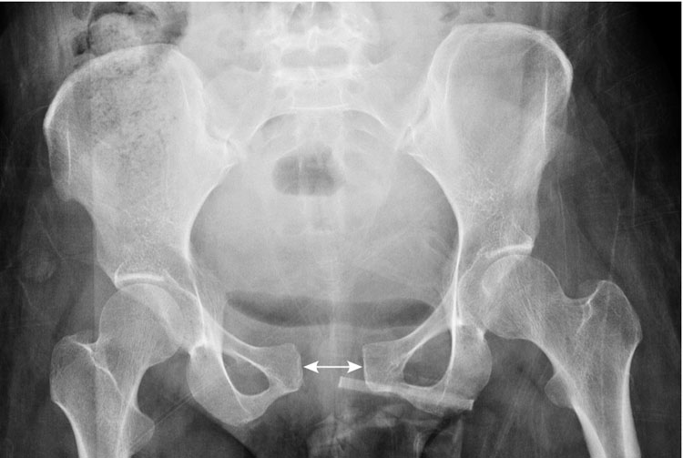
Clinical Connection
How little movement of the Pubic Symphysis is no small thing
During pregnancy, the hormone relaxin will increase the flexibility of the pubic symphysis and of ligaments of the pelvic bones that will allow expansion of the pelvic outlet during delivery of the baby.
“Remember that lovely hormone relaxin that makes every joint, ligament and connective tissue loosy goosy in preparation for labour and delivery? Well…sometimes that relaxin goes a bit overboard and starts to go gung-ho on the pelvis…”
http://coreexpectations.com/symphysis-pubis-dysfunction-say-what/

Slide 9
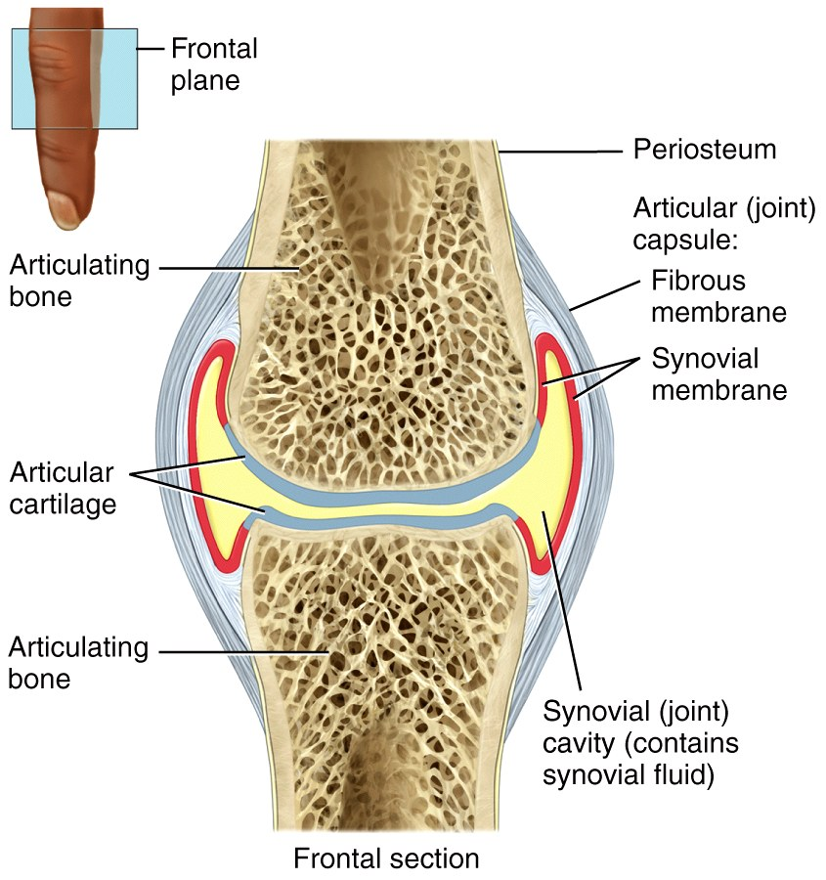
Classification by Structure
Synovial joints are more complex than the other two: Ligaments hold bones together to form a synovial cavity and a freely moveable joint.
A two layered capsule
encloses the synovial cavity:
An outer fibrous capsule
An inner synovial
membrane
Specify joint type…based on mov’t
Know all parts

Slide 10
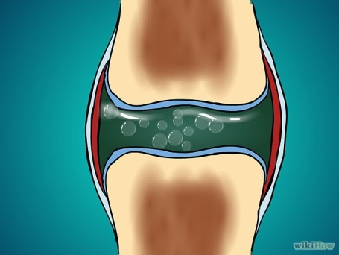
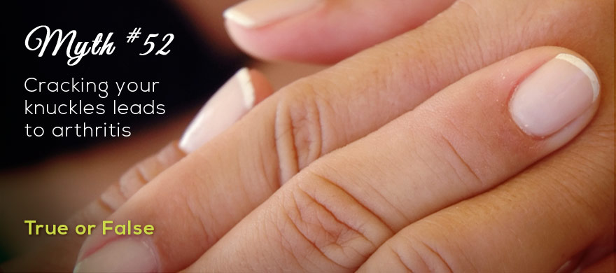
Clinical Connection
Cracking knuckles/joints
When the synovial cavity expands, the pressure of the synovial fluid decreases, creating a partial vacuum. The suction draws carbon dioxide and oxygen out of the blood vessels in the synovial membrane, forming bubbles in the fluid (think “insolubility” from chem). When the bubbles are forced out of solution, as when the fingers are hyperflexed, the cracking or popping sound is heard as the gases are driven out of solution.
A study was done in which they compared knuckle crackers vs. non-crackers and found the crackers didn’t have increased rates of arthritis in old age. They did find however, that those who did habitually crack their knuckles were more likely to have hand swelling and decreased grip strength and they suggest that habitual knuckle cracking should be avoided.
Why Do Joints Pop And Crack? - YouTube

Slide 11
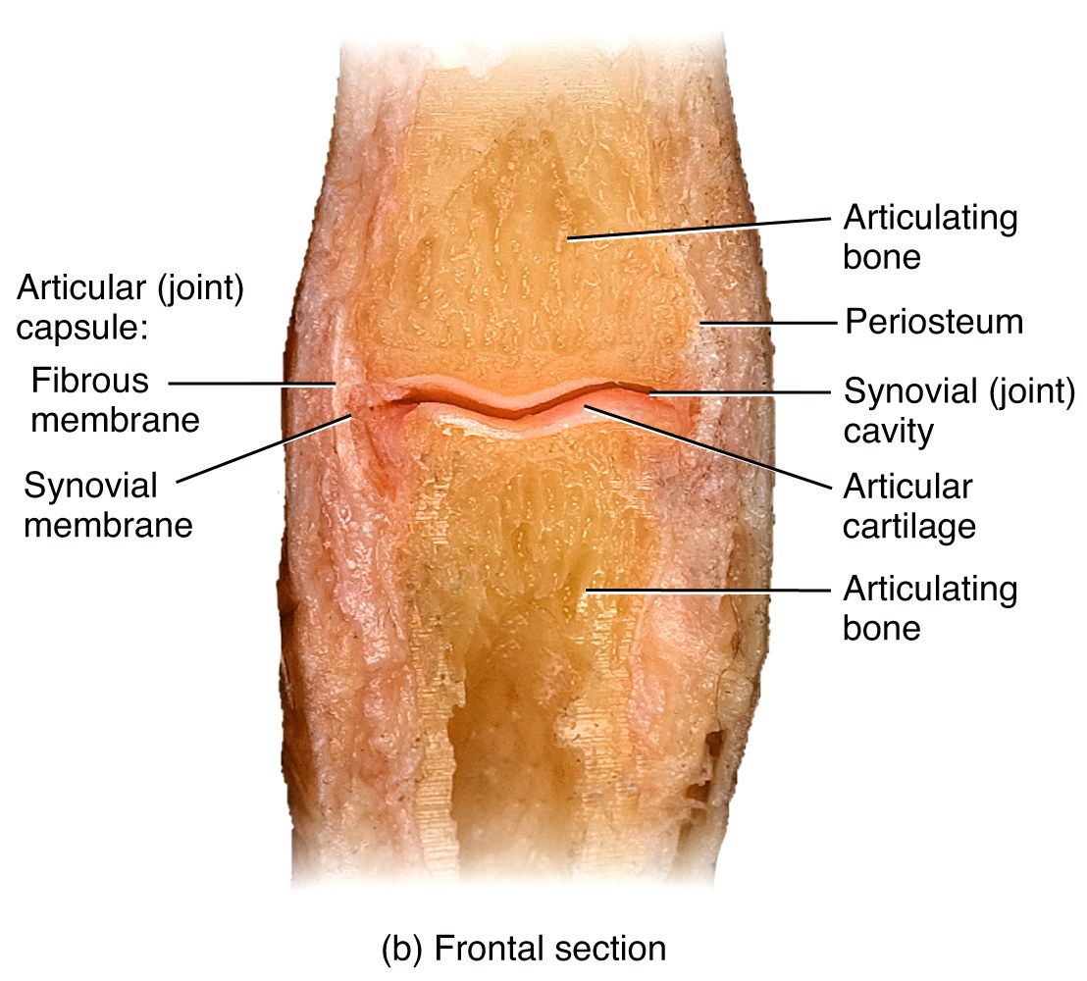
Classification by Structure
The synovial membrane secretes synovial fluid which functions to reduce friction by lubricating the joint and absorbing shocks. It also supplies oxygen and nutrients to the cartilage, while removing carbon
dioxide and metabolic wastes.
The major
joints of the
arms, hips, and legs

Slide 12
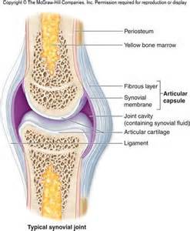
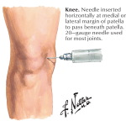
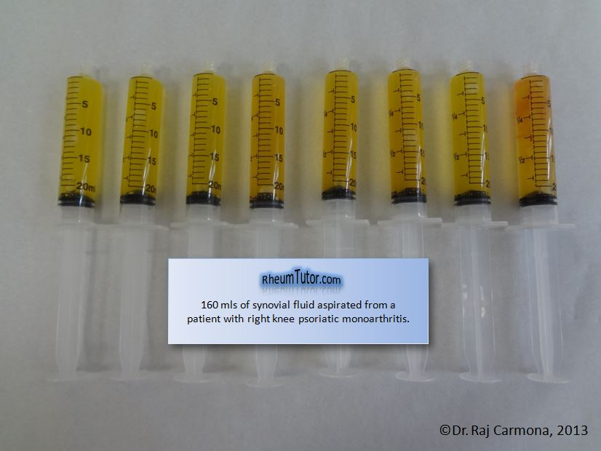
Clinical Connection
Aspiration of Synovial Fluid
Various injuries or diseases may cause buildup of synovial fluid in a joint cavity, causing pain and decreased mobility. To decrease pressure and pain a needle is inserted into the cavity and it withdraws fluid, which is then used for diagnostic purposes.

Slide 13
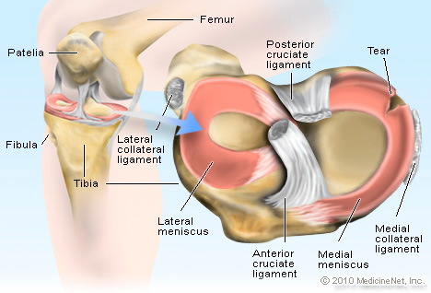
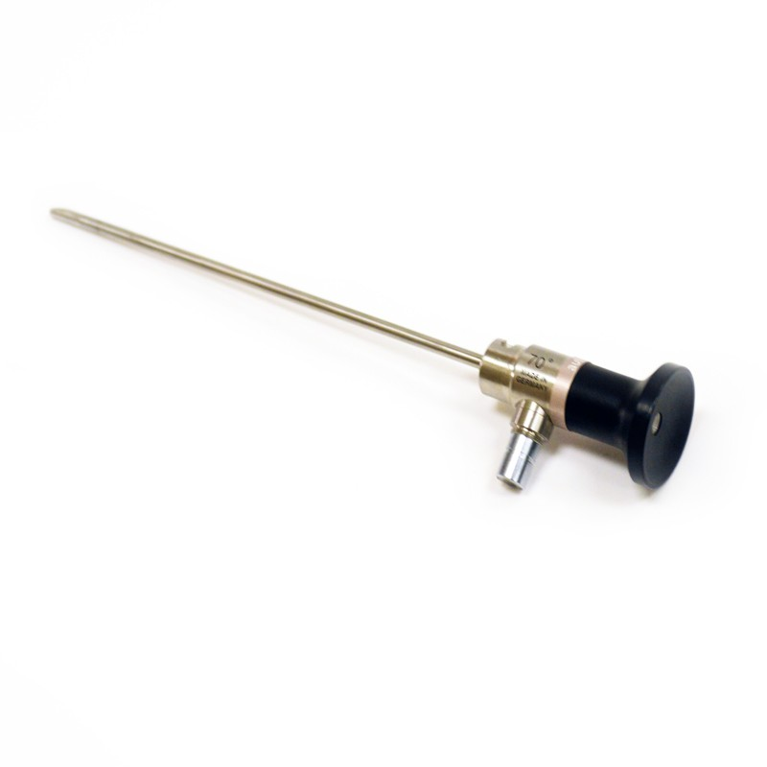
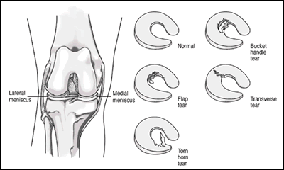
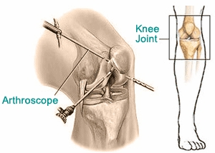
Clinical Connection
Torn Cartilage & Arthroscopy
The tearing of the menisci in the knee is common among athletes. The damaged cartilage may begin to wear and cause arthritis in the future if not surgically treated. An arthroscopy is a minimally invasive procedure that involves examination of the interior of the joint with an arthroscope (lighted, pencil-thin fiber optic camera) in order to inspect/treat the nature of the damage and progression of disease.

Slide 14
Classification by Function
Synarthroses are immoveable joints, like the fibrous joints of the skull.
Amphiarthroses are slightly movable joints like the cartilaginous pubic symphysis.
Diarthroses are freely moveable joints like the big “ball and socket” synovial joints of the shoulder and hip.

Slide 15
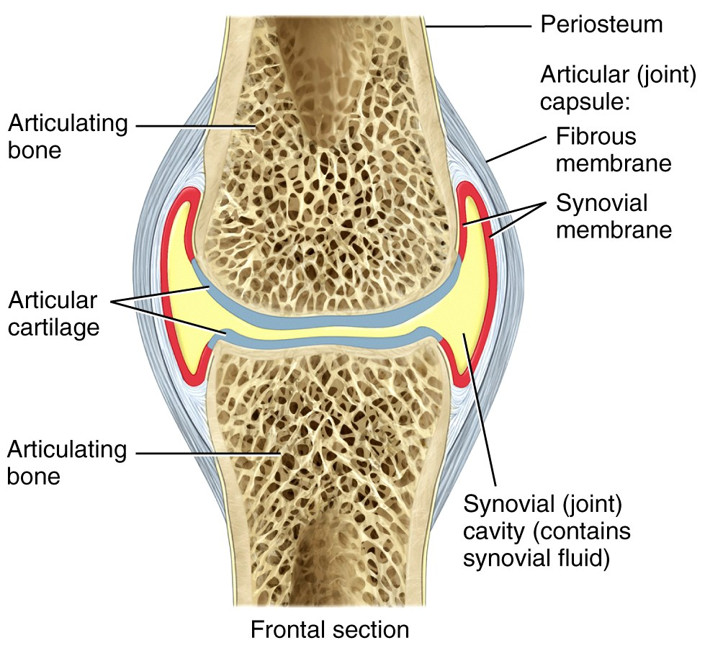
Synovial Joints
Because the synovial joint is the most complex, we will look at it now in more detail, including the accessory structures.
Synovial joints are
surrounded by
accessory structures
like the joint capsule,
ligaments, and
sometimes bursae.

Slide 16
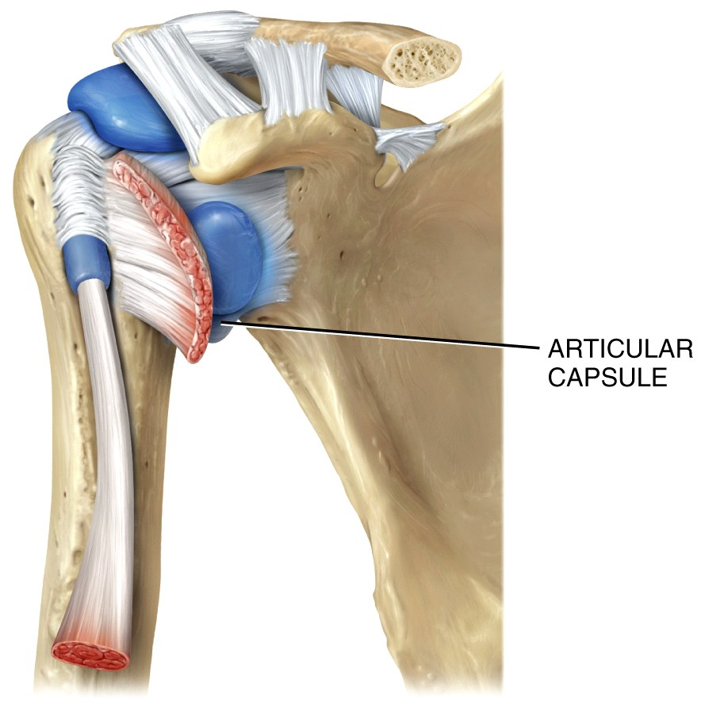
Synovial Joints
Accessory structures
Joint capsules are composed of dense irregular C.T., lined by a synovial membrane.
They encompass the
joint cavity and the
synovial fluid
within it.

Slide 17
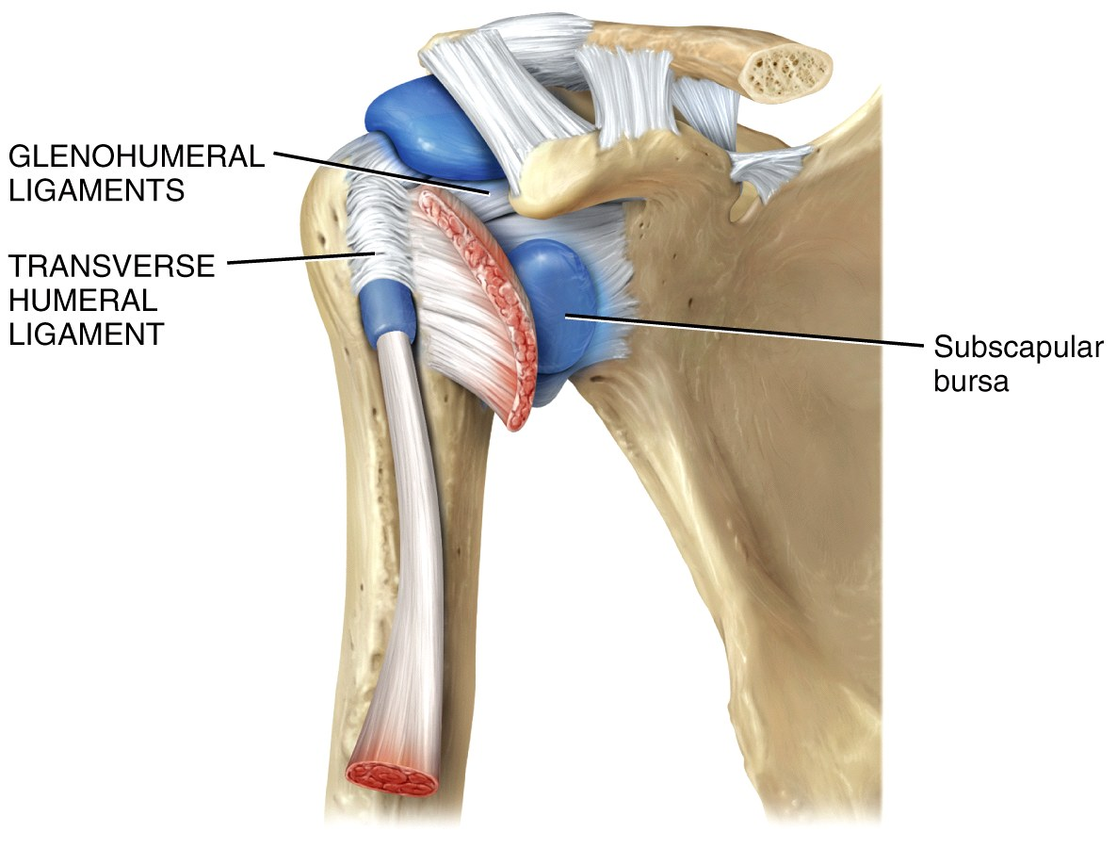
Synovial Joints
Accessory structures
Ligaments are bands of dense regular C.T. (like tendons) that join one bone to another bone.
Bursae (and tendon sheaths)
are fluid-filled structures
strategically placed to
minimize friction in
some joints.

Slide 18
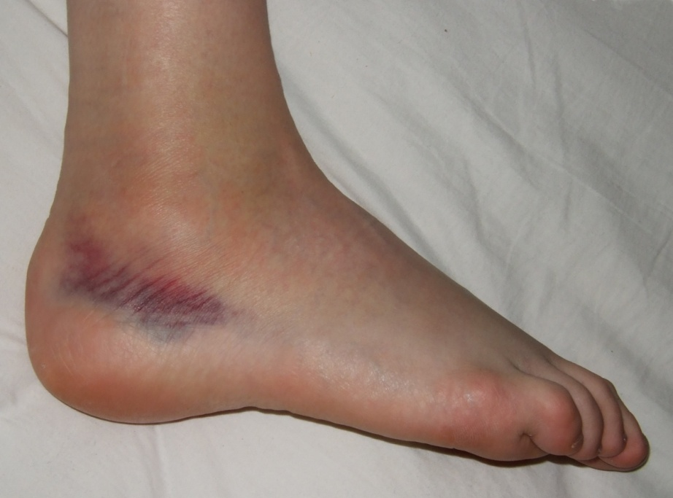
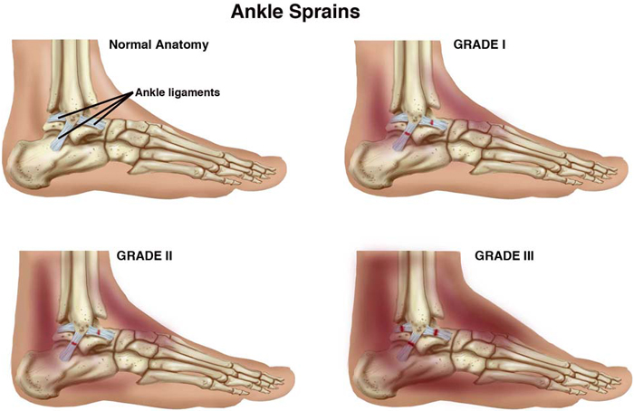
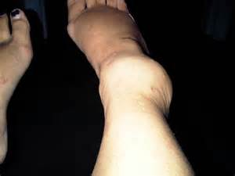
Clinical Connection
Sprain
The forcible wrenching or twisting of a joint that stretches or tears ligaments but does not dislocate bones. Occurs when ligaments are stressed beyond normal capacity. Considerable swelling occurs as result of damaged cells and hemorrhage of blood cells.
Sprains occur most commonly in ankles and wrists.
High ankle sprain

Slide 19
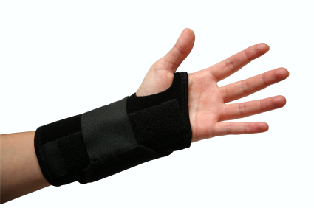
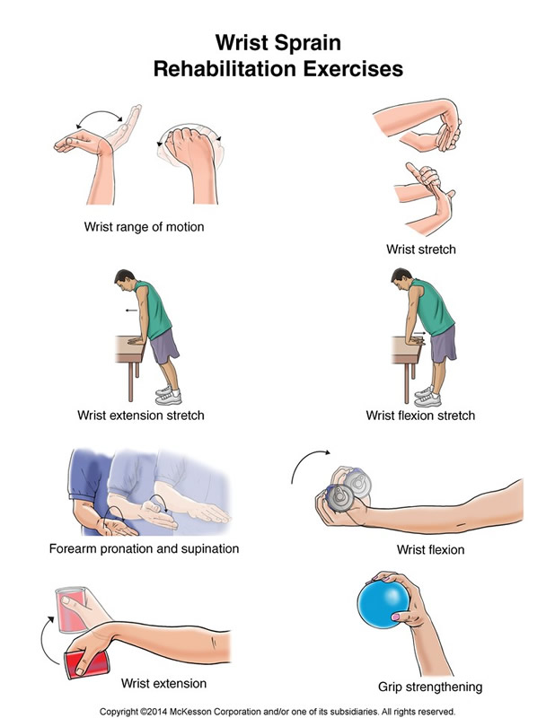
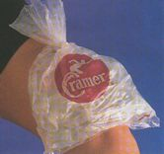
Clinical Connection
How to Treat Sprains
P – Protection: stop the activity and use padding, protection, braces, splints
R – Rest: to avoid further damage, avoid exercise or anything that causes swelling or pain.
I – Ice: as soon as possible. This slows blood flow to the area and reduces swelling and pain. On for 20 min, off for 40 min, repeat.
C – Compression by wrap or bandage, helps reduce swelling
E – Elevation: elevate the area above the level of the heart

Slide 20
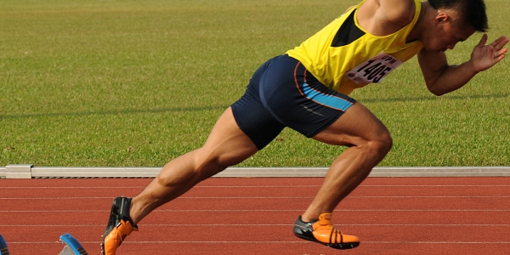
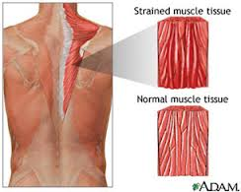
Clinical Connection
Strain
A stretched or partially torn muscle or muscle and tendon. It often occurs when a muscle contracts suddenly and powerfully—such as the leg muscles of sprinters when they spring from the blocks

Slide 21
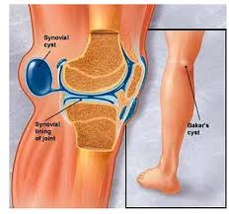
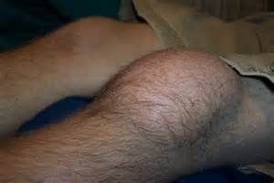
Clinical Connection
Bursitis
An acute or chronic inflammation of a bursa. Usually caused by irritation from repeated, excessive exertion of a joint. May also be caused by trauma or infection (like syphilis or tuberculosis or arthritis). Symptoms include pain, swelling, tenderness, and limited movement. Treatment includes anti-inflammatory agents or steroid injections

Slide 22
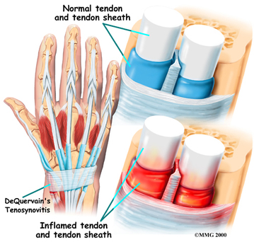
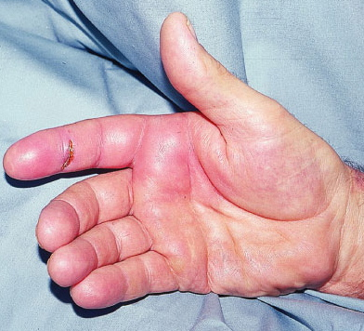
Clinical Connection
Tenosynovitis
Inflammation of the tendons, tendon sheaths, and synovial membranes around certain joints. The tendons of the wrists, shoulders, elbows, finger joints, ankles, and feet are most often affected. Occurs most often after trauma, strain, excessive exercise, or a repetitive movement (ie haircutting, typing, carpentry).

Slide 23
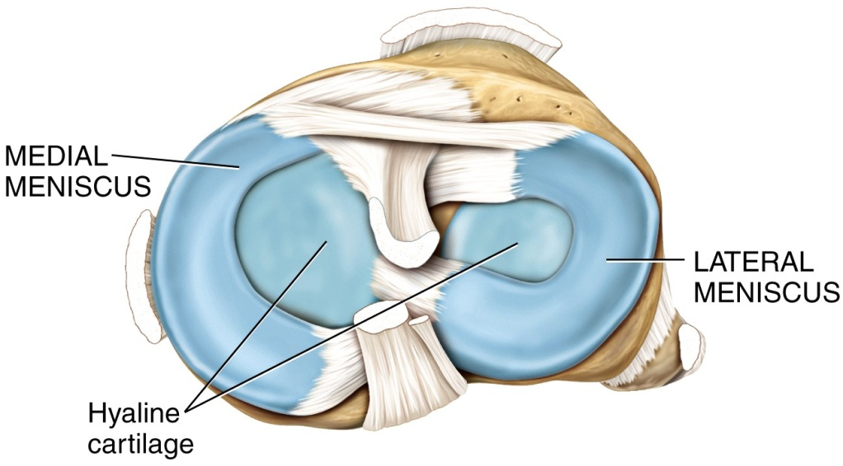
Synovial Joints
Accessory structures
In some joints where hyaline cartilage predominates, pads of dense fibrocartilage called menisci are also found between the articular surfaces.
These “articular discs” provide superior strength and allow bones of different
shapes to fit together
more tightly.

Slide 24
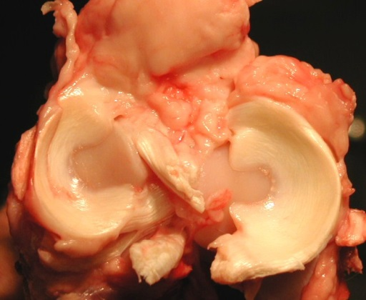
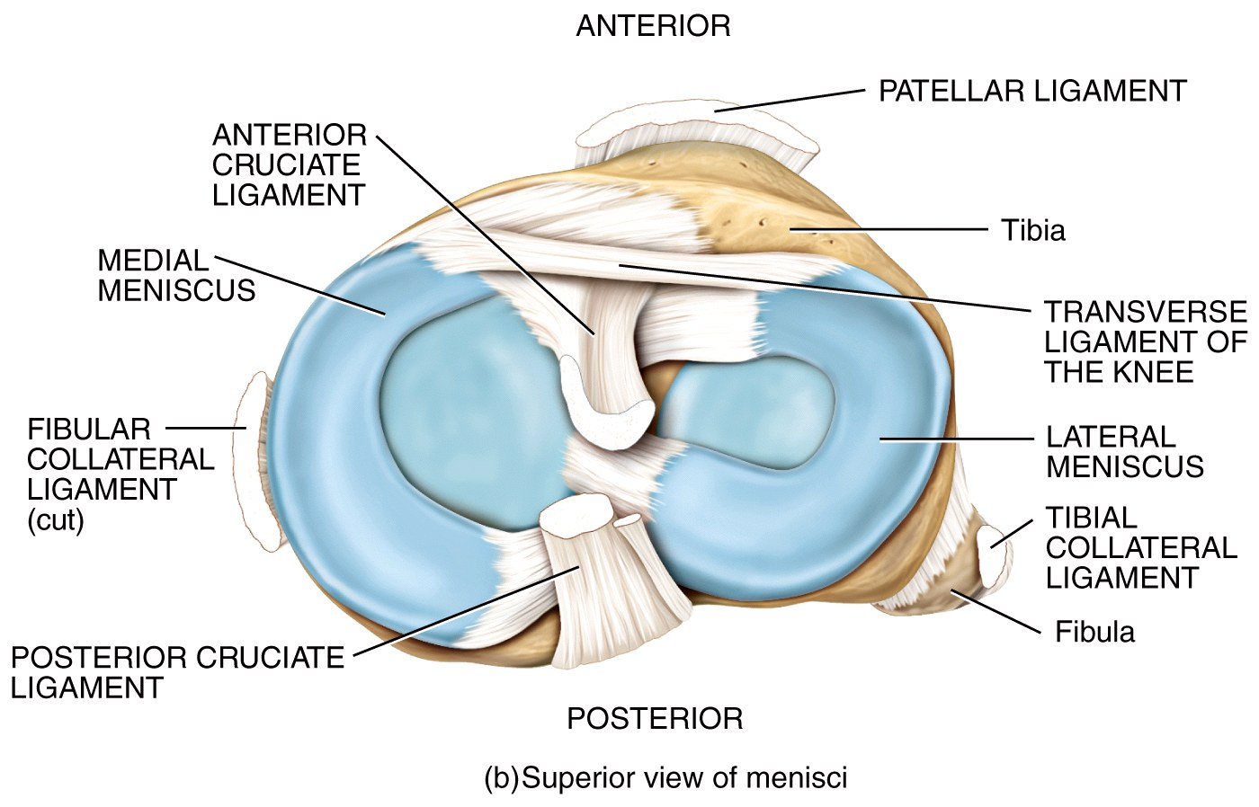
Synovial Joints
Accessory structures
Notice that ligaments can blend with other C.T. to become part of a joint capsule, or they can run inside or outside the joint.
The ACL (ligament)
lies inside the knee
joint, whereas the
patellar ligament
is outside the joint.

Slide 25
Synovial Joints
Accessory structures
Nerve and Blood Supply
Arterial branches from several different arteries merge around a joint before penetrating the articular capsule.
Nerve endings respond to the degree of movement and stretch, and convey information about pain from the joint to the spinal cord and brain.

Slide 26
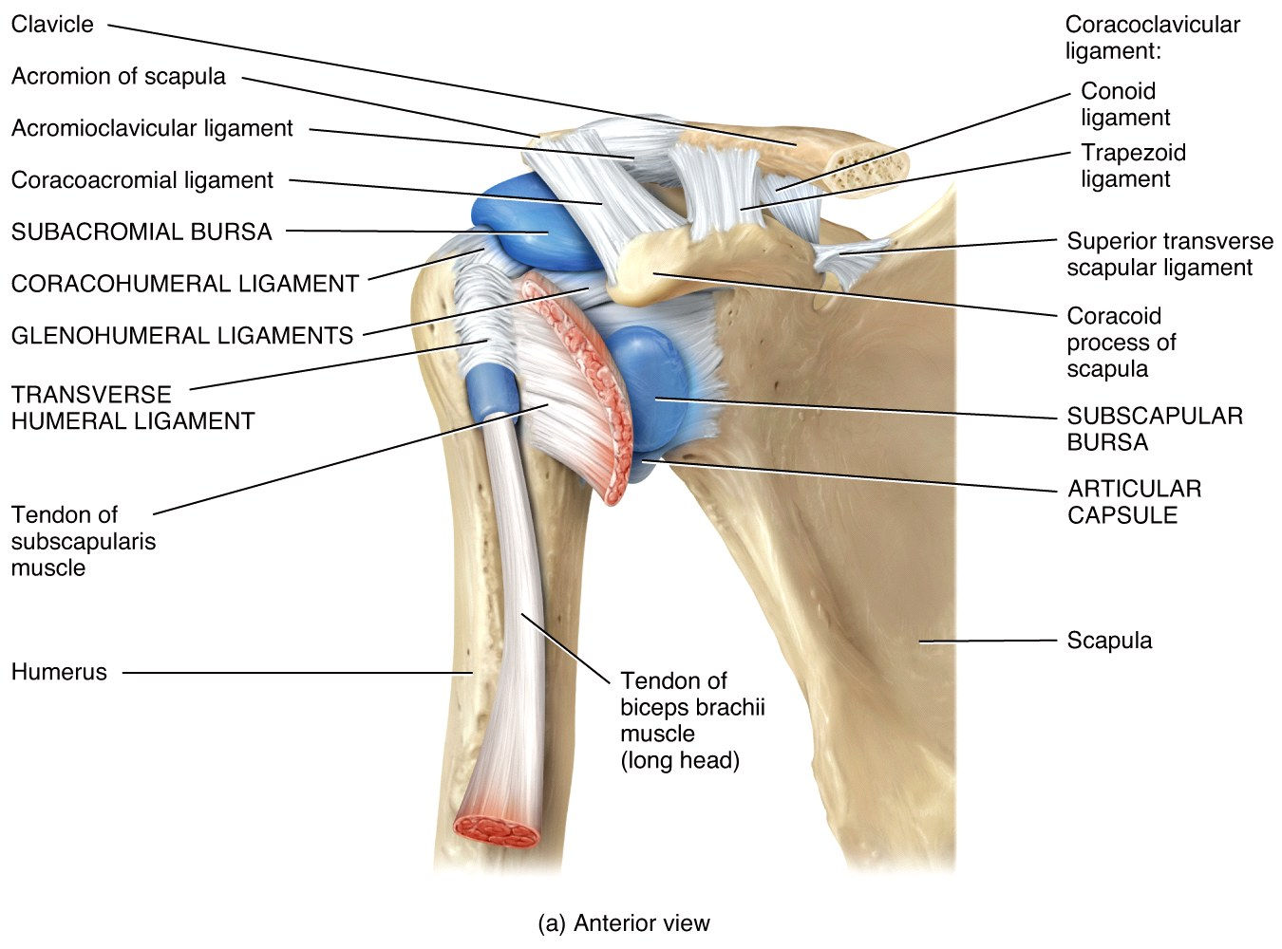
Synovial Joints
Accessory structures of the right shoulder joint, anterior view

Slide 27
Types of Synovial Joints
There are 6 types of synovial joints based on the shapes of the articulating bone surfaces.
Not all synovial joints have all (or any) accessory structures like ligaments and bursae – some of them are quite simple.

Slide 28
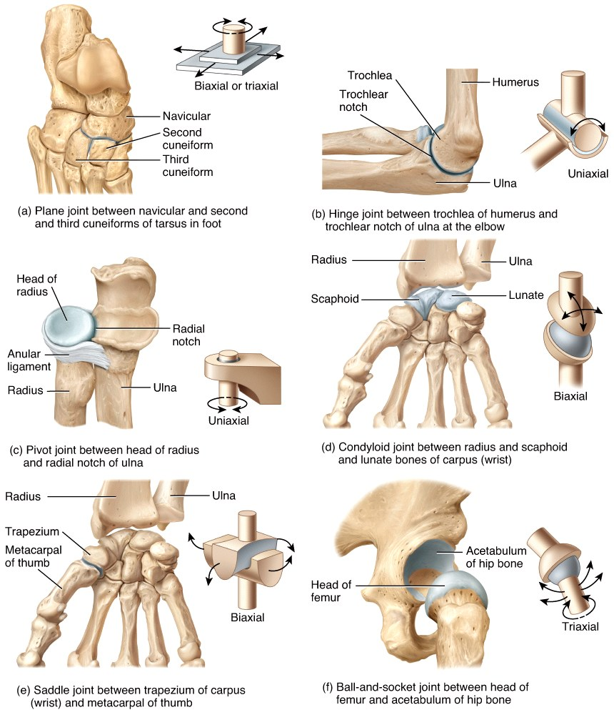
Types of Synovial Joints (intro…details ahead)

Slide 29
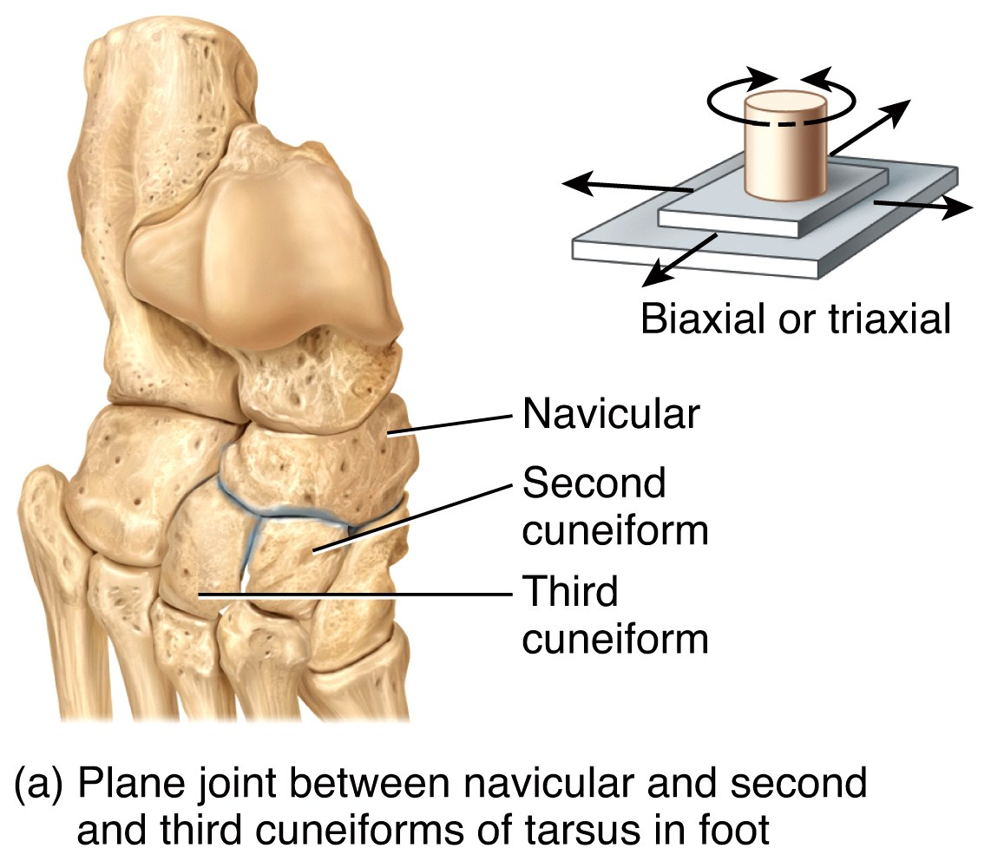
Types of Synovial Joints
In a planar joint, the articulating surface is flat or slightly curved, permitting back
and forth and side-to-side
movements.

Slide 30
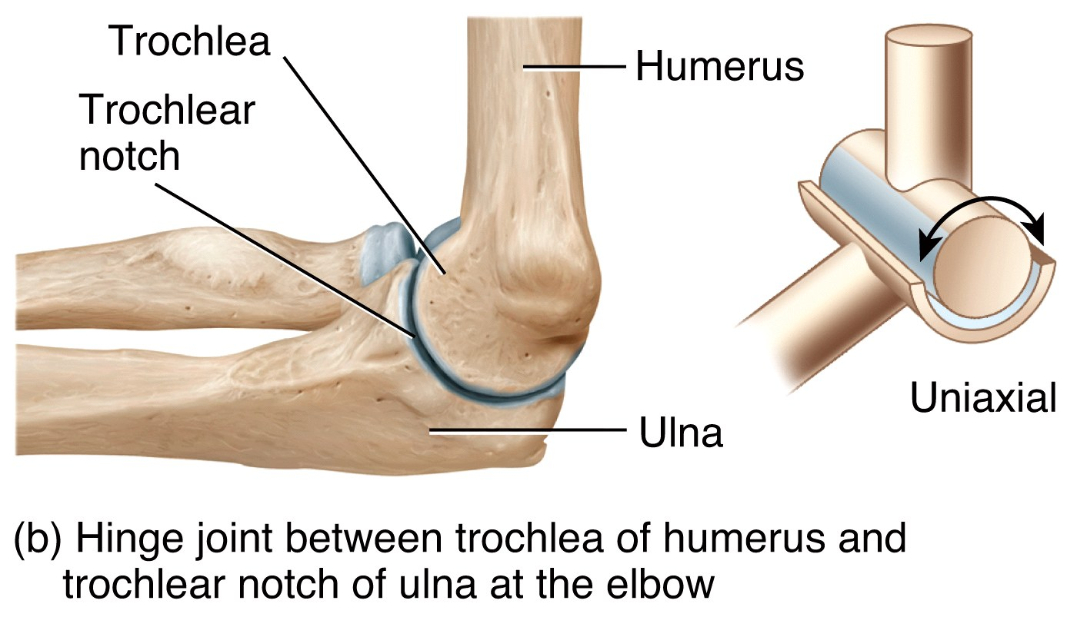
Types of Synovial Joints
In a hinge joint, the convex surface of one bone fits into the concave surface of another, producing an opening and closing action like a hinge.

Slide 31
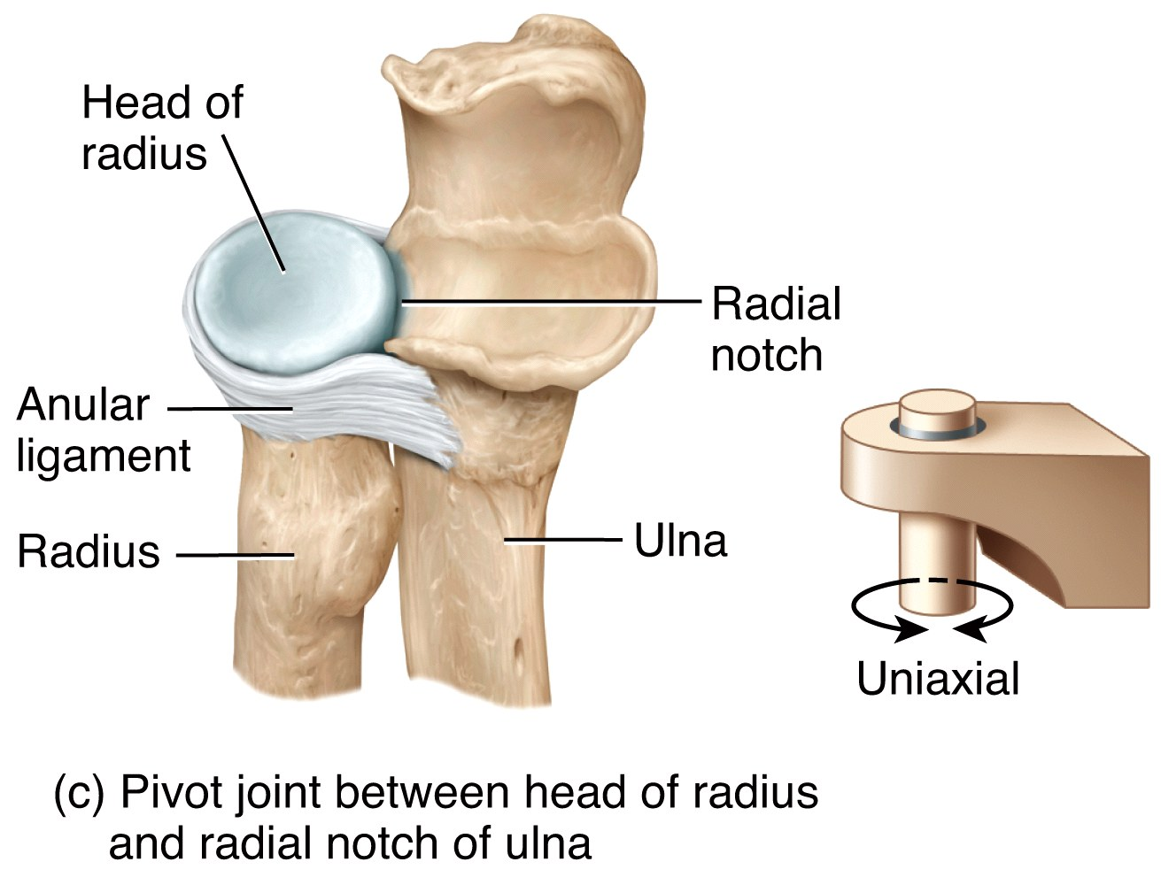
Types of Synovial Joints
In a pivot joint, the rounded surface of one bone articulates with a ring structure formed by another bone and a ligament (allowing
rotation around its
longitudinal axis).

Slide 32
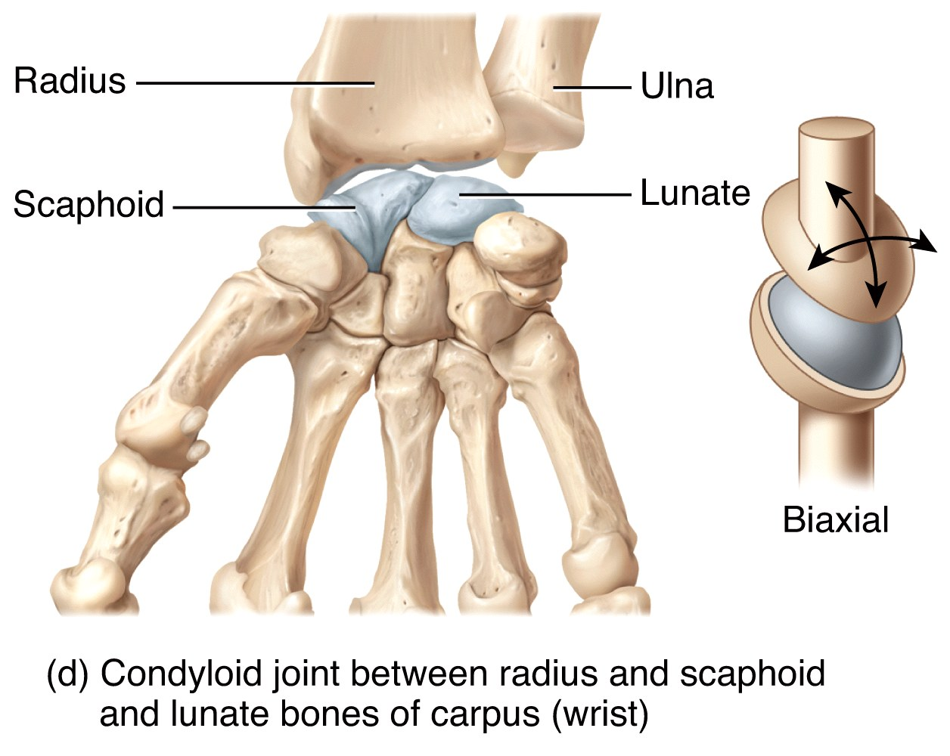
Types of Synovial Joints
In a condyloid joint, the convex oval-shaped projection of one bone fits into the oval-shaped depression of another bone (allowing
movement around
two axes).

Slide 33

Types of Synovial Joints
In a saddle joint, the articular surface of one bone is saddle-shaped. This is really a modified condyloid joint, but the range of motion is
expanded to include
movement around
all 3 axes.

Slide 34

Types of Synovial Joints
In a ball-and-socket joint, the ball surface of one bone fits into a cuplike depression of another bone. These joints allows the most movement of any joint.
The shoulder joint is a
ball-and-socket synovial
joint – it has the most
range of motion of any
joint in the body.

Slide 35
Joint Movements
Range of motion (ROM) refers to the range, measured in degrees of a circle, through which the bones of a joint can be moved. Some of the factors that contribute to keeping the articular surfaces in contact (and affect ROM) include:
Structure or shape of the articulating bones
The shape of the articulating bones determines how closely they fit together.
The strength and tension of the muscles and joint ligaments varies to restrict or permit certain positions.

Slide 36
Joint Movements
ROM is also affected by:
3. Hormones
Relaxin increases the flexibility of the pubic symphysis and loosens the ligaments between the sacrum and hip bone toward the end of pregnancy.
4. Disuse
Movement may be restricted if a joint has not been used for an extended period.

Slide 37
Joint Movements
Joint movements are grouped into four main categories:
Gliding – relatively flat bone surfaces move back-and-forth and from side-to-side with respect to one another.
Angular movements – there is an increase or a decrease in the angle between articulating bones.
Rotation – a bone revolves around its own longitudinal axis.
Special movements

Slide 38

Joint Movements
Gliding movements are simple back-and-forth and side-to-side movements.
They are limited in range since there is no significant alteration of the angle
between the bones.
Typical of the
intercarpal joints

Slide 39
Joint Movements: defined
Angular movements increase or decrease the angle between articulating bones.
Flexion is a decrease in the angle.
Extension is an increase in the angle.
Hyperextension is a continuation of extension beyond the normal extension.
Abduction is movement away from the midline.
Adduction is movement towards the midline.
Circumduction is movement of a body part in a circle.

Slide 40


Joint Movements: examples
Flexion and Extension at the elbow joint
Hyperextension at the shoulder joint

Slide 41


Joint Movements
Circumduction of the shoulder & hip
Any circumduction is actually a combo of which 4 movements?
Abduction and Adduction at the shoulder joint

Slide 42


Joint Movements
How about these? Why?
Think….
Which mov’t is this?

Slide 43

Joint Movements
Rotation involves a bone revolving around its own longitudinal axis:
Turning the head from side to side as when you shake your head “no”

Slide 44
Joint Movements
Special movements
Elevation is an upward movement of a body part.
Closing the mouth
Depression is a downward movement of a body part.
Opening the mouth
Protraction is movement of a body part anteriorly, while retraction is movement back to normal.
Thrusting the mandible outward

Slide 45


Joint Movements
Elevation and depression of the temporal mandibular joint (TMJ)
Protraction and retraction of the temporal mandibular joint (TMJ)

Slide 46
Joint Movements
Special movements
Inversion is movement of the foot medially.
Eversion is moving the foot laterally.
Dorsiflexion is bending of the foot at the ankle in an upward direction. ("door-stop" motion)
Plantar flexion is bending the foot at the ankle in a downward direction. (planting foot; toe lift)
At the ankle

Slide 47


Joint Movements
Inversion and Eversion of the foot at the ankle
Dorsiflexion and Plantar flexion of the foot at the ankle

Slide 48




Joint Movements
Special movements
Supination is movement of the forearm so that the palm is turned upward. (as if holding a bowl of soup)
Pronation is movement of the forearm so that
the palm is turned downward.
Opposition is movement of our magnificent opposable thumb across the palm to touch the tips of the fingers on the same hand.

Slide 49


Joint Movements
Opposition of the thumb and fingers at the carpometacarpal joint
Supination and Pronation of the forearm and hand at the radioulnar joint

Slide 50


Joint Movements
Gait- the motion your foot goes through when it is in contact with the ground Pronate- (aka over-pronate) the inward rolling of your ankles/feet toward each other Supinate- (aka under-pronate) the outward rolling of your ankles/feet away from each other Neutral- the ability of your ankles/feet to stay straight without pronating throughout your gait cycle

Slide 51


Joint Movements
We’ll apply this to a lab exercise in which we will assess our feet, shoes, and gait... then “order” the best shoes for our feet!
here are some tips you can use to diagnose your gait.
Grab your current running shoe, we are going to analyze the wear pattern on the bottom. The picture [below, LEFT] shows where we are going to be looking on our shoes to determine if we pronate, supinate, or have neutral gait.
The reason I point out to not look at your outside heel is because EVERYBODY has wear right there.
In general, most people are heel strikers and when you strike on your heel, you land on the outside, not centered like most would believe. Time and time again I have had people tell me they supinate because they saw wear on the outside heel. When I break it to them that everybody wears right there and the real spot to look is on the forefoot, they tend to not believe me at first, but then I show them what I mean.

Slide 52

Joint Movements

Slide 53

Selected Joints of the Body
Some important, representative joints of the body include:
The temporomandibular joint
The shoulder joint
The elbow joint
The hip joint
The knee joint

Slide 54

Selected Joints of the Body
The temporomandibular joint is a combined hinge and planar joint formed by
the mandible and the
temporal bone - it is the
only movable joint
between the skull bones.

Slide 55

Clinical Connection
Dislocated Mandible
Anterior displacement- most common, occurs when the condylar processes of the mandible pass anterior to the articular tubercles
Posterior displacement- occurs when there is a direct blow to the chin
Superior displacement- caused by direct blow to a partially opened mouth
4. Lateral displacement- associated with mandibular fractures.
A dislocation is the displacement of a bone; a dislocated mandible can occur in several ways.

Slide 56

Selected Joints of the Body
The shoulder joint is a ball-and-socket joint formed by the head of the humerus and the scapula.

Slide 57


Clinical Connection
Dislocated Shoulder
This is most commonly dislocated in adults. The head of the humerus becomes displaced inferiorly, where the articular capsule is least protected. Treated with rest, ice, manipulation, or surgery.
How to Treat a Shoulder Dislocation When You Can't Get to .
Popping Mikes shoulder back in place

Slide 58




Clinical Connection
Rotator Cuff Injury
A strain or tear in the rotator cuff muscles. Also occurs as a result of wear and tear, age, trauma, poor posture, improper lifting, repetitive motions. Most often there is a tearing of the supraspinatus muscle tendon of the rotator cuff.
The muscles of the rotator cuff are responsible for keeping the head of the humerus in the glenoid cavity

Slide 59


Clinical Connection
Separated Shoulder
Refers to an injury not to the shoulder joint, but to the acromioclavicular joint. Usually result of forceful trauma to the joint (shoulder hitting the ground in a fall).

Slide 60


Clinical Connection
Torn Glenoid Labrum
This occurs when the fibrocatilaginous labrum may tear away from the glenoid cavitity, causing the joint to catch or feel like it’s slipping out of place, may become dislocated.

Slide 61

Selected Joints of the Body
The elbow joint is a hinge joint formed by the humerus, the ulna, and the radius.
Elbow Relocation

Slide 62


Clinical Connection
Tennis Elbow
Refers to pain at or near the lateral epicondyle of the humerus. The extensor muscles strain or sprain. This is usually caused by an improperly executed backhand swing.

Slide 63


Clinical Connection
Little-League Elbow
Inflammation of the medial epicondyle. Typically develops as a result of a heavy pitching schedule or excessive curve-balls. Elbow may enlarge, fragment, or separate.

Slide 64



Clinical Connection
Dislocation of the Radial Head
Most common upper limb dislocation in kids. The head of the radius slides past or ruptures the radial anular ligament (ligament that forms a collar around the head of the radius at the proximal radioulnar joint). Commonly occurs when swinging children around with outstretched arms.
Pulled Elbow In Children, Nursemaid's Elbow - Everything You Need To Know

Slide 65


Selected Joints of the Body
The hip joint is a ball-and-socket joint formed by the femur and the os coxae.

Slide 66


Selected Joints of the Body
The knee joint is a modified hinge joint. It is the largest and most complex joint of the body. (MADE UP OF 3 JOINTS; lateral, medial, patellar)

Slide 67

Selected Joints of the Body
The knee joint

Slide 68

Selected Joints of the Body
The knee joint

Slide 69


Clinical Connection
Autologous Chondrocyte Implantation
An alternative, partial, or total knee replacement that occur when there is damage to articular cartilage in the knee joint (usually trauma-not arthritis), especially involving the femur. In the procedure, healthy chondrocytes are taken from the area of the femoral condyle that is not weight-bearing and sent to a laboratory to be cultured for 4-5 weeks in order to generate 5-10 million cells. Then the implantation takes place. Dead cartilage is removed from the damaged area, then the chondrocytes are injected under the periosteum where they will grow and mature over time.

Slide 70

Selected Joints of the Body
The knee joint

Slide 71


Clinical Connection
Swollen Knee
May occur immediately or hours after an injury. Initial swelling is due to escape of blood from damaged blood vessels. Delayed swelling is due to excessive production of synovial fluid, a condition referred to as “water on the knee.”

Slide 72


Clinical Connection
“Unhappy Triad”
Strengthens medial side;
Applied to a knee injury that involves damage to the three components of the knee at the same time: the tibial collateral ligament, the medial meniscus, and the anterior cruciate ligament.
Compensates for irregular shapes & circulates synovial fluid
Prevents knee hyperextension; Stretched or torn in 70% of knee injuries

Slide 73


Clinical Connection
Dislocated Knee
Refers to the displacement of the tibia relative to the femur. Most common type is dislocation anteriorly, which results in hyperextension of the knee. If no surgery is required, treatment involves P.R.I.C.E.
The wider pelvis of females and the greater angle this creates between the femur and the tibia puts females at a greater risk than males for damage to the ACL .

Slide 74



Which special movement?
5.
6.
7.
8.
9.
10.
11.
12.
13.
14.
15.
16.

Slide 75
Aging and Arthroplasty
The effect of aging on joints varies considerably from person to person. By age 80, almost everyone develops some type of degeneration in the knees, elbows, hips, and shoulders.
Osteoarthritis is at least partially age-related.
Aging results in thinning of the articular cartilage and decreased production of synovial fluid in joints.
Ligaments shorten and lose elasticity.

Slide 76

Aging and Arthroplasty
Joint arthroplasty is the surgical implantation of an artificial joint. The most commonly replaced are the hips, knees, and shoulders.
Partial hip replacements
involve only the femur, while
total hip replacements involve
both the acetabulum and head
of the femur.

Slide 77


Aging and Arthroplasty

Slide 78


Aging and Arthroplasty
Prep for an artificial knee
Potential complications of arthroplasty include infection, blood clots and nerve injury.
Components of an artificial knee

Slide 79



Clinical Connection
Rheumatism & Arthritis
Rheumatism is a painful disorder of the supporting structures of the body (bones, ligaments, tendons, muscles) that is not caused by infection or injury.
Arthritis is a form of rheumatism in which joints are painful, stiff, and swollen. 45 million people in the US have it.

Slide 80


Clinical Connection
Osteoarthritis
Articular cartilage degenerates and new bone forms in the subchondral areas and at the margins of joints. Bone ends slowly become exposed and spurs of new osseous tissue are deposit on them in the body’s attempt to protect against friction. These spurs decrease joint movement.
A degenerative joint disorder in which joint cartilage is gradually lost. Results from a combination of aging, obesity, irritation of the joints, muscle weakness, wear, and abrasion. Most common type of arthritis.

Slide 81


Clinical Connection
Rheumatoid Arthritis
An autoimmune disease in which the immune system of the body attacks its own tissues—in this case it attacks its own cartilage and joint linings. Characterized by inflammation of the joint, causing swelling, pain, and loss of function.

Slide 82


Clinical Connection
Gouty Arthritis
Sodium urate crystals are deposited in the soft tissues of the joints. The crystals irritate and erode the cartilage—leading to inflammation, swelling, and pain. If untreated, the joint becomes unmovable.

Slide 83


Clinical Connection
Lyme Disease
Caused by the bite of tick that contains Borreli burgdorferi (bacteria). A rash then forms. May result in joint stiffness, fever, chills, headache, nausea, and low back pain. Usually afflicts the larger joints.

Slide 84


Clinical Connection
Ankylosing Spondylitis
An inflammatory disease that affects joints between vertebrae and between the sacrum and hip bone. Typically sets in between the age of 20-40. Results in pain and stiffness of the hips and lower back that spread upward. Can lead to loss of movement at a joint and hunchback.

