Slide 1
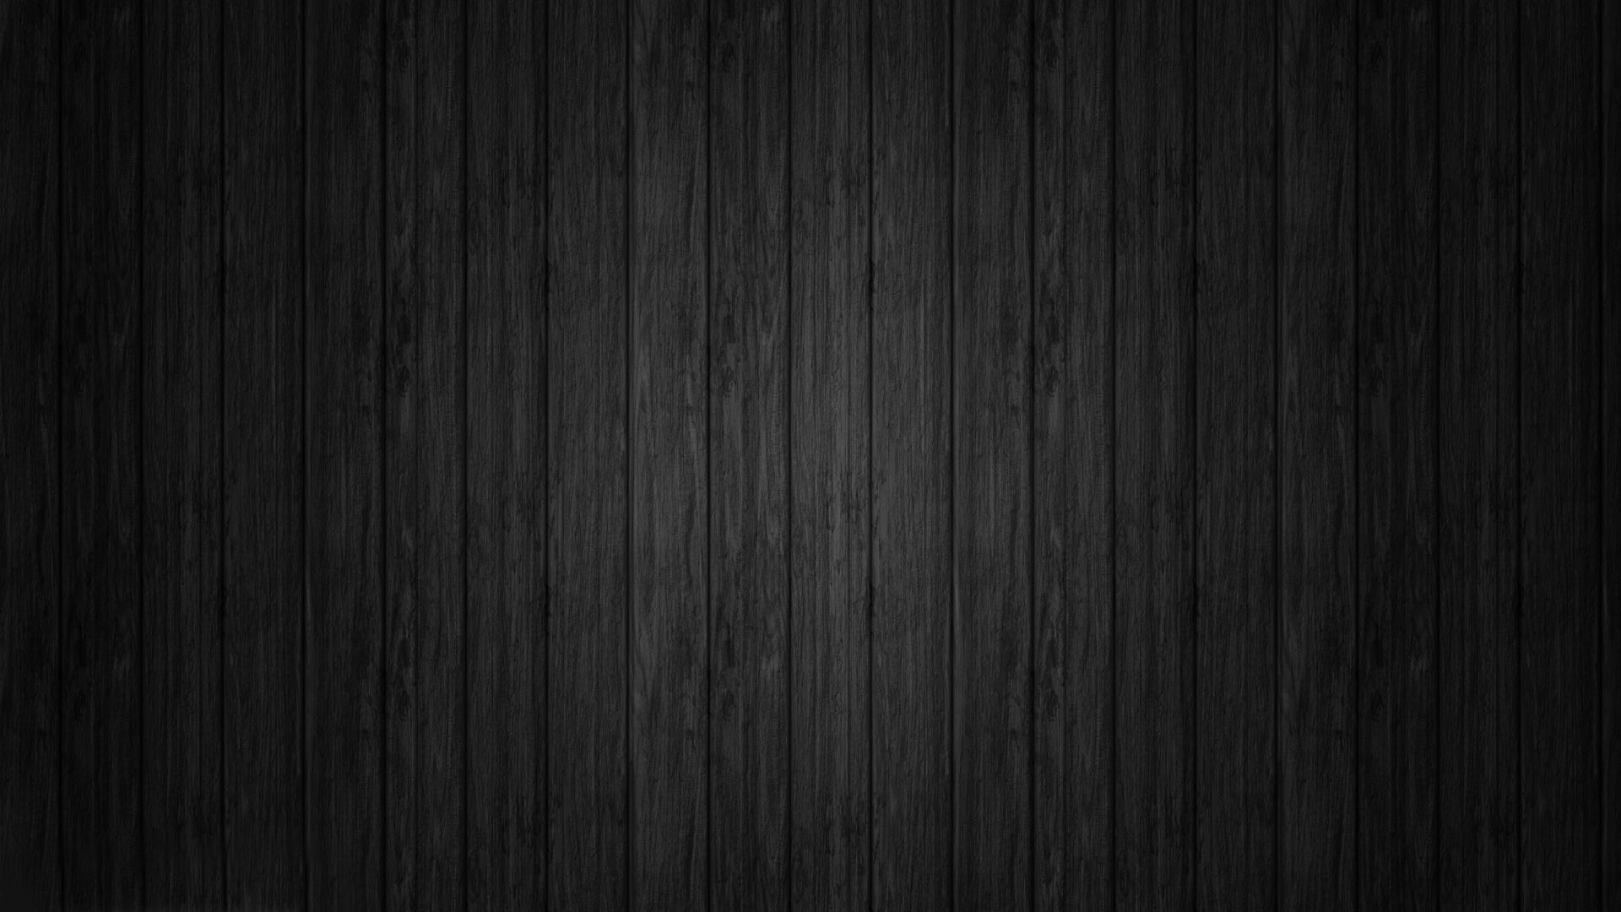
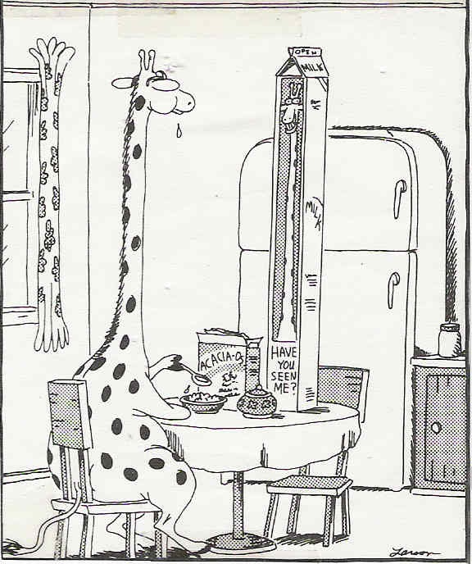
Chapter 7&8: The Skeletal System A&P fall 2014 mr. e SRCS

Slide 2
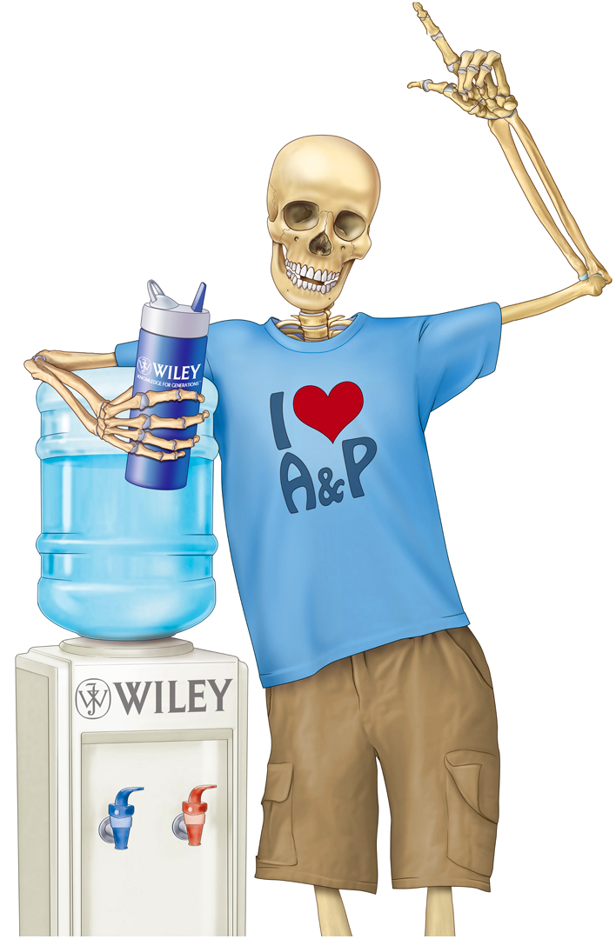
Chapter 7
The Axial
Skeleton
Lecture slides prepared by Curtis DeFriez, Weber State University

Slide 3
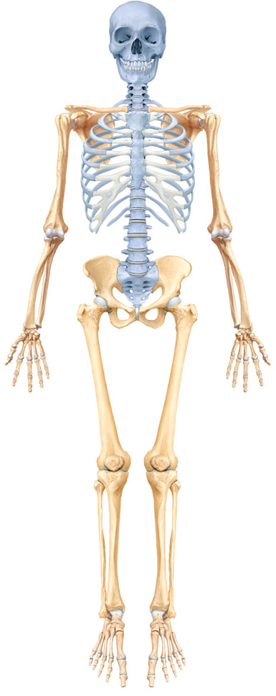
Divisions of the Skeletal System
The human skeleton consists of 206 named bones grouped into two principal divisions:
Axial skeleton
Appendicular skeleton
In this graphic, the axial skeleton is
highlighted in blue, while the appendicular skeleton constitutes the remainder.

Slide 4
Divisions of the Skeletal System
The axial skeleton consists of the bones that lie around the longitudinal axis of the human body:
Skull bones, auditory ossicles (ear bones), hyoid bone, ribs, sternum (breastbone), and bones of the vertebral column
The appendicular skeleton consists of the bones of the upper and lower limbs (extremities) and the bones forming the girdles that connect the limbs to the axial skeleton.

Slide 5
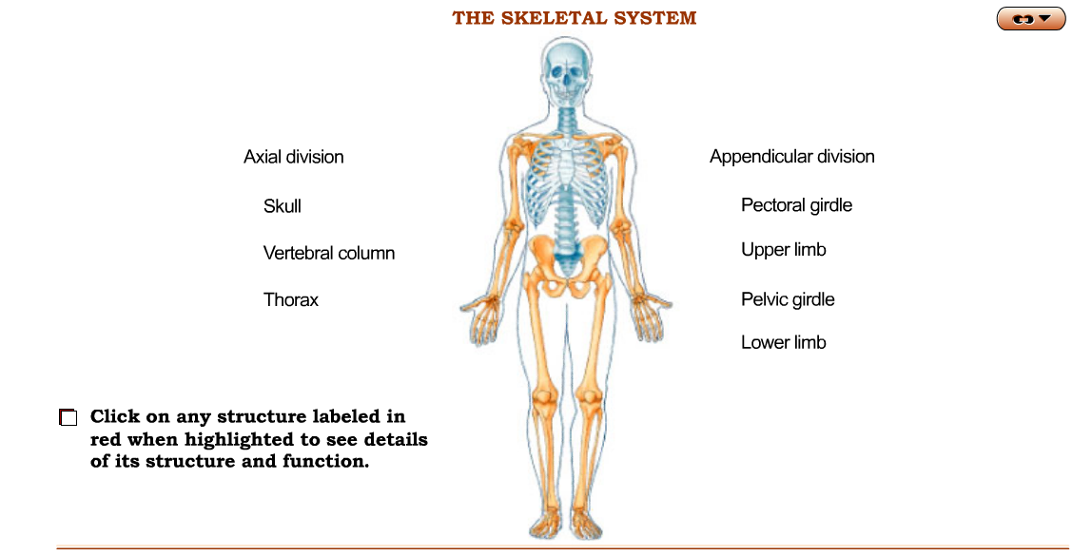
Divisions of the Skeletal System Interactions Animation
The Skeletal System
You must be connected to the internet to run this animation

Slide 6
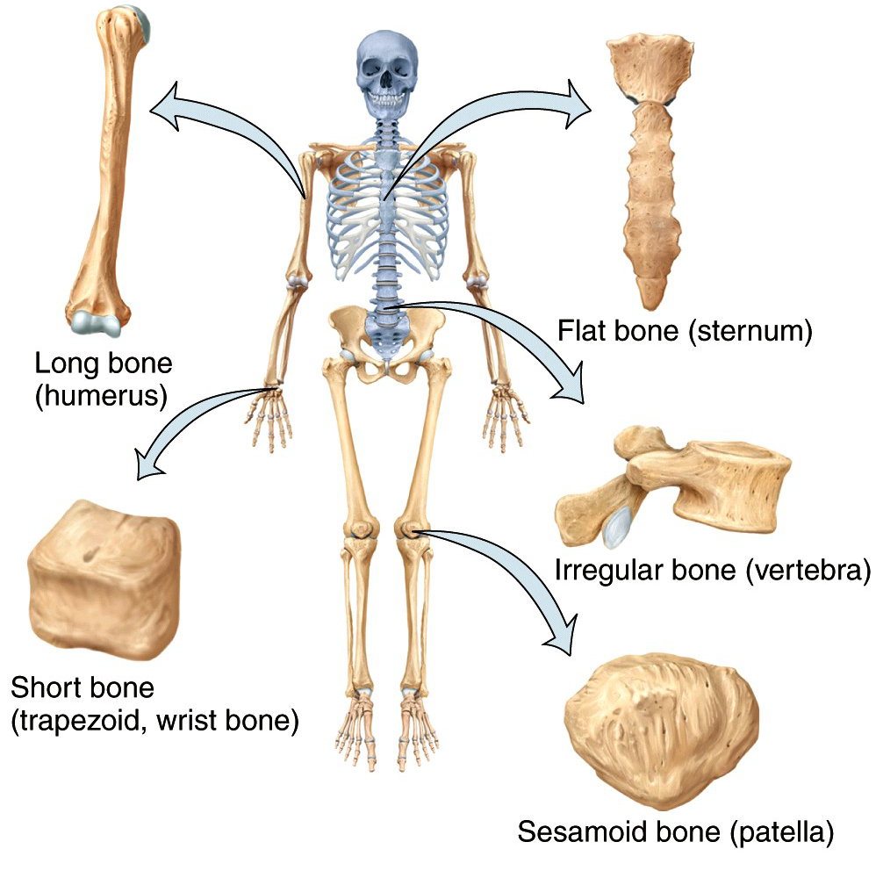
Types of Bones
Each of the 206 named bones of the axial and appendicular skeleton can
be placed in one of 6
broad classifications
based on their
embryological origins
and their anatomical
characteristics.

Slide 7
Types of Bones
Long bones are greater in length than in width and are often slightly curved for the purpose of weight bearing.
Examples include the femur, tibia, fibula, humerus, ulna, radius, metacarpals, metatarsals, and phalanges.
Short bones (cube-shaped) include the carpals & tarsals.
Flat bones are thin and composed of two nearly parallel plates of compact bone enclosing a layer of spongy bone.
They include the cranial bones, ribs, sternum, scapulae, and clavicles.

Slide 8
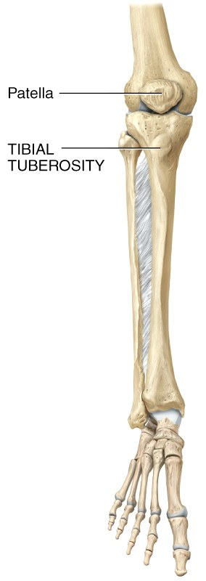
Types of Bones
Irregular bones include complex shapes like the vertebrae and some facial bones.
Sesamoid bones vary in number and
protect tendons from excessive wear:
The best example is the patella.
Sesamoid bones can develop fractures
due to friction, tension, and stress.

Slide 9
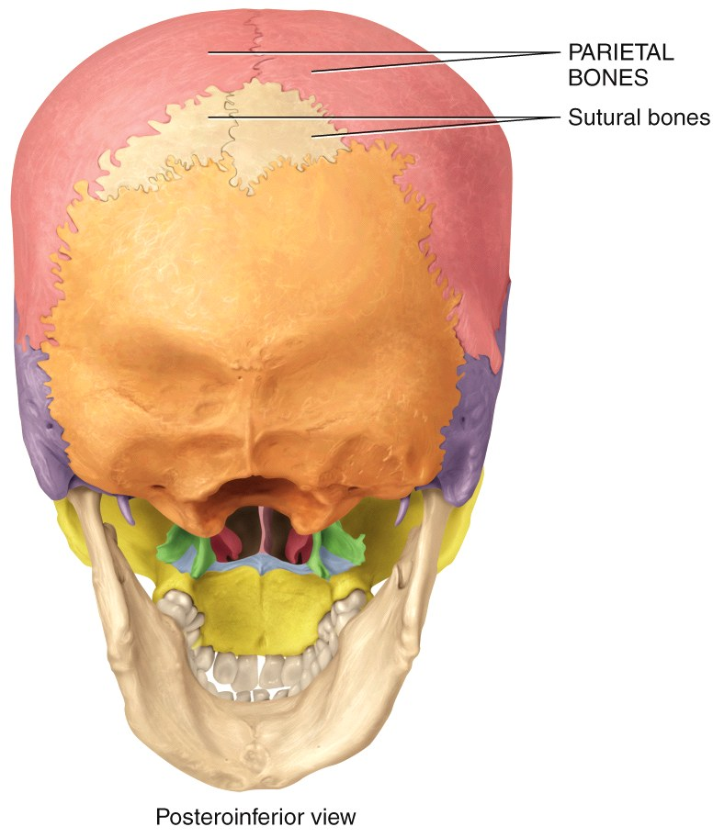
Types of Bones
Sutural bones, also known as Wormian bones, are small extra bone plates located
within the sutures of
cranial bones.
These are found as
isolated examples, and
although unusual, they
are not rare.

Slide 10
Bone Markings
Bones have characteristic surface markings - structural features adapted for specific functions.
There are two major types of surface markings:
Depressions and openings (foramena)
Allow the passage of blood vessels and nerves
Form joints
Processes
Projections or outgrowths that form joints
Serve as attachment points for ligaments and tendons

Slide 11
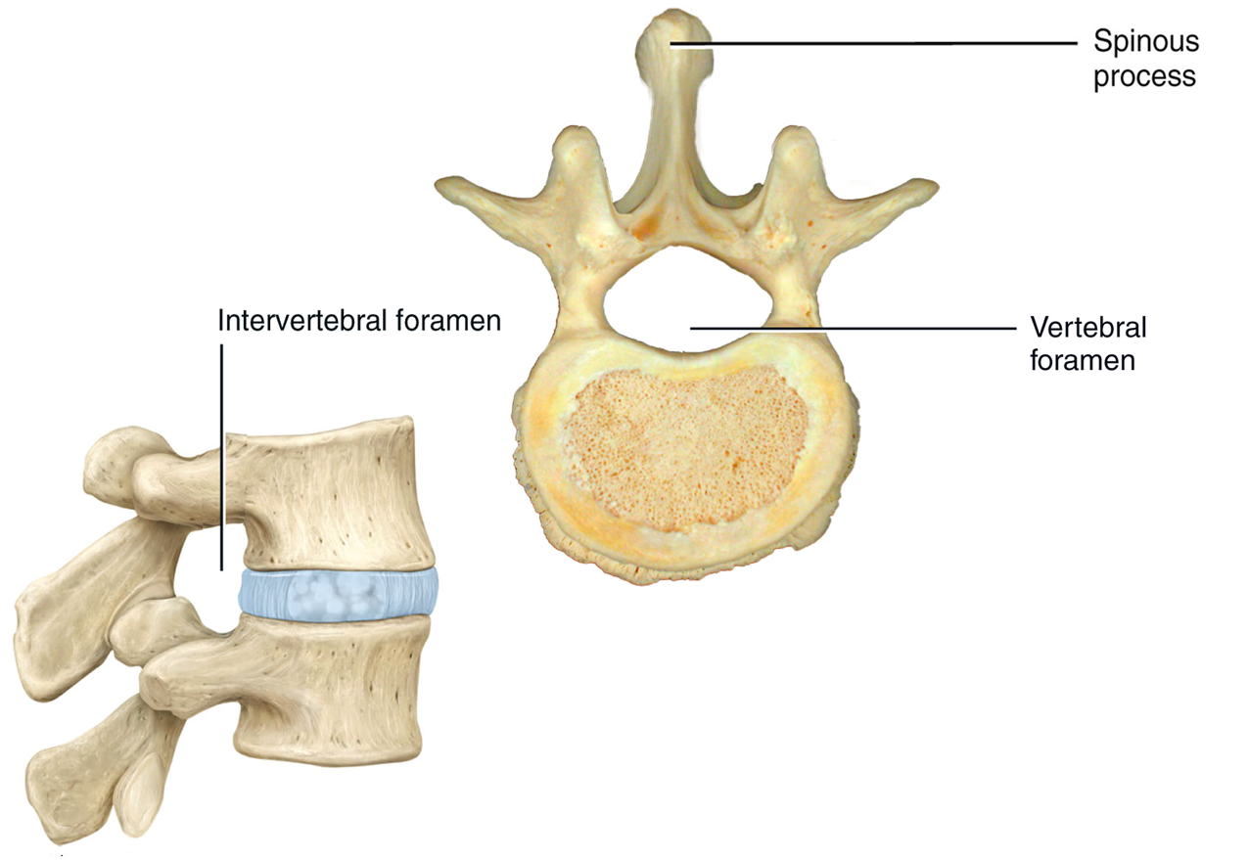
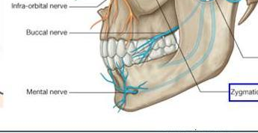
Bone Markings
While a process is any projection of bone (large or small), a spinous process is a slender projection from a vertebrae.
A foramen is an opening in bone through which blood vessels and/or
nerves pass.
A facet is a smooth, flat or slightly convex or concave
articular surface
Mental foramen
Vertebral facet
Notes:
The condyles of the humerus are the Trochlea and the Capitulum.

Slide 12
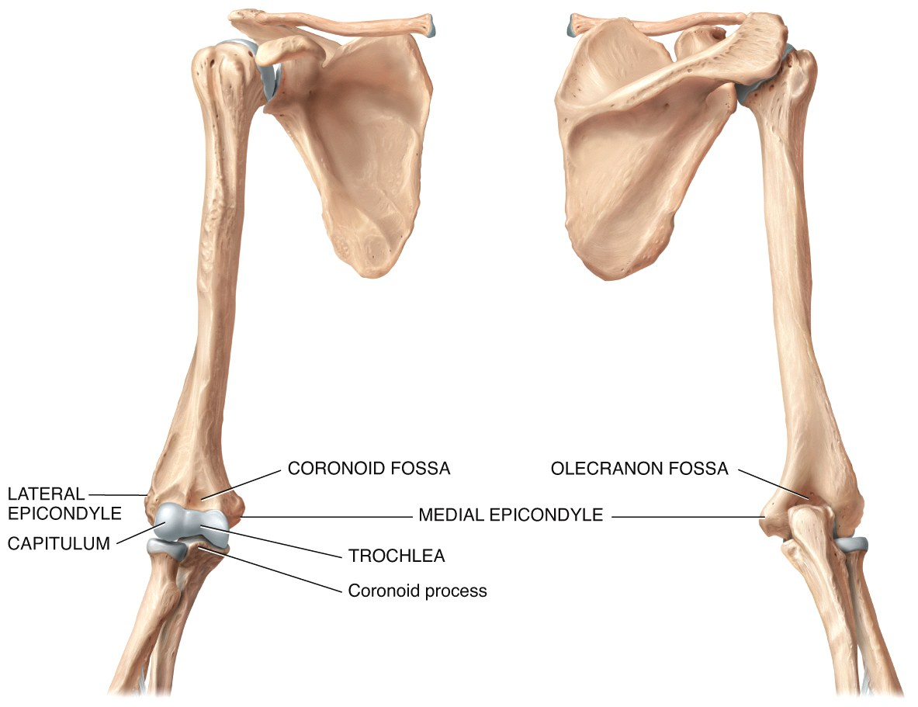
Bone Markings
If a bony process is large, round, and articular, it might be called a condyle. The condyles of the humerus are the Trochlea and
the Capitulum.
An epicondyle is a
bony protuberance
above a condyle.
A fossa is a shallow
depression in bone.

Slide 13
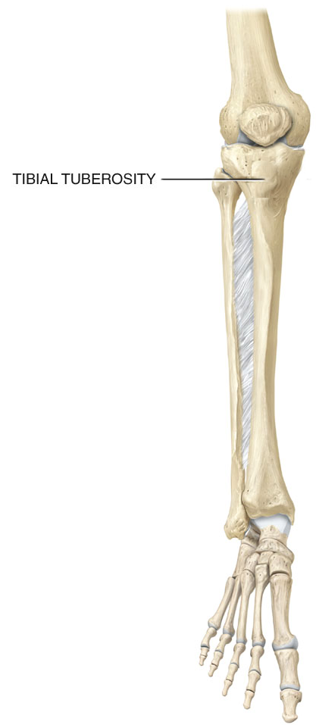
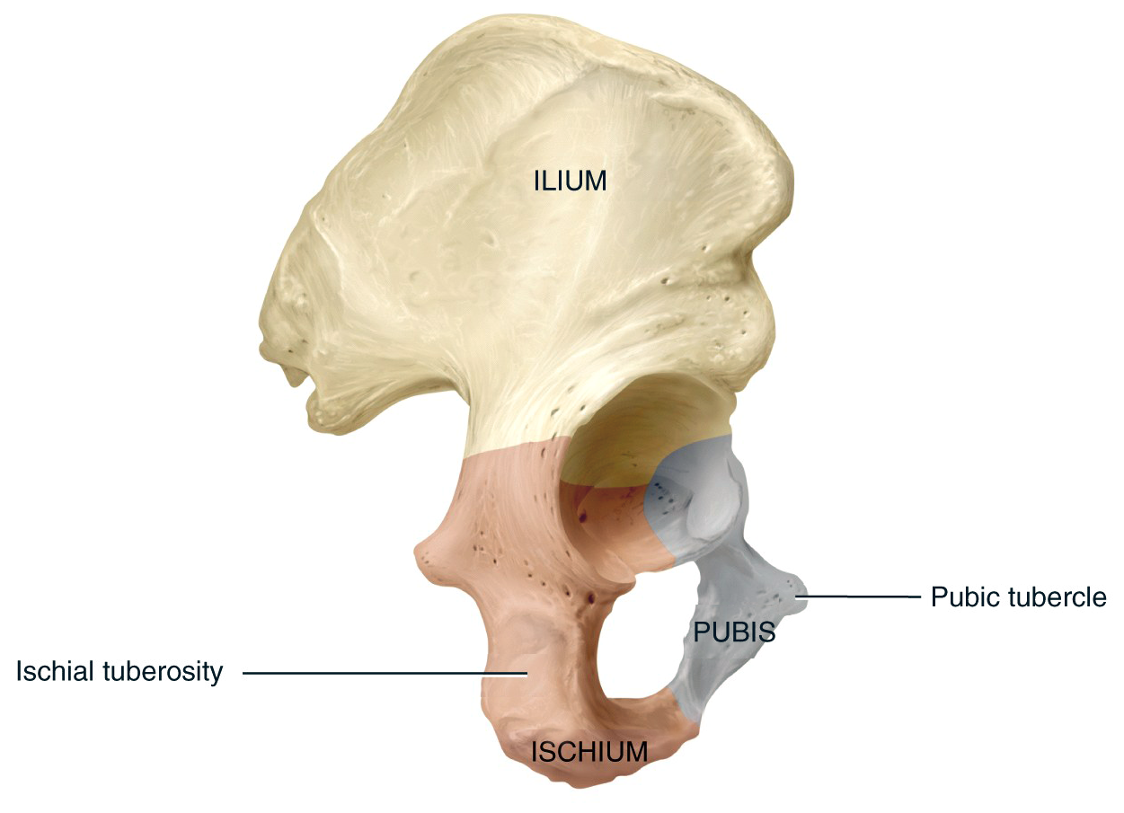
Bone Markings
A tubercle is a small rounded projection.
A tuberosity is a large bony prominence
that is not articular.

Slide 14
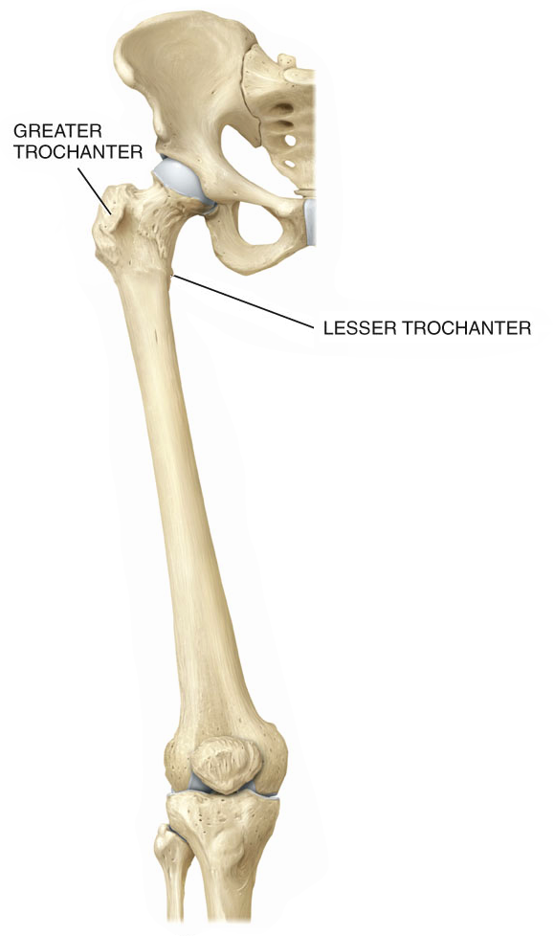
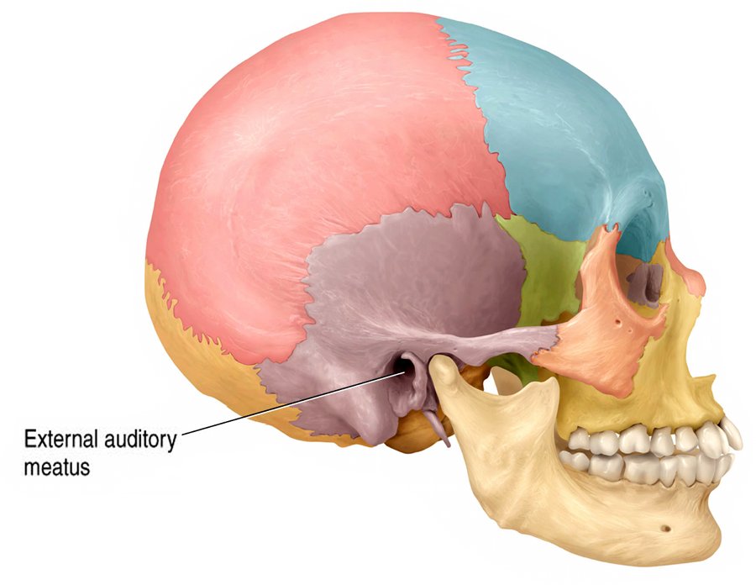
Bone Markings
A meatus is a tube-like canal. The external auditory
meatus is a good example.
The trochanters are two very
large bony projections on the femur.

Slide 15
Bones of the Axial Skeleton
There are 80 bones in the central (axial)
skeleton, comprising:
Skull
Vertebral column (including the
sacrum)
Ribs
Sternum

Slide 16
Bones of the Skull
The skull protects and supports the brain and special sense organs.
Besides forming the large cranial cavity, the skull also forms several smaller cavities.
Nasal cavity
Orbits (eye sockets)
Paranasal sinuses
Small cavities which house organs involved in hearing and equilibrium

Slide 17
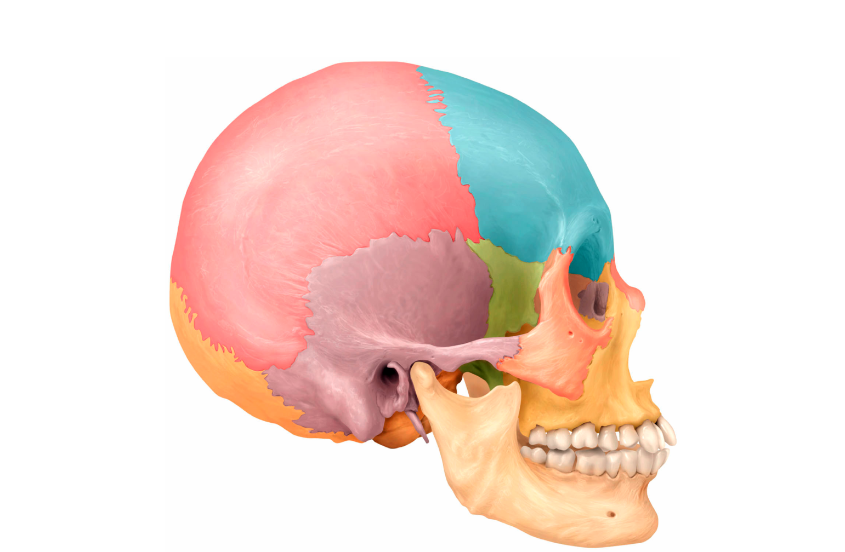
Bones of the Skull
The bones of the skull are grouped into two categories:
Cranial bones
Facial bones
Cranial bones
Facial bones

Slide 18
Bones of the Skull
8 Cranial Bones
(Bones of the Braincase)
Frontal bone (1)
Parietal bone (2)
Temporal bone (2)
Occipital bone (1)
Sphenoid bone (1)
Ethmoid bone (1)
14 Facial Bones
Mandible (1)
Maxilla (2)
Zygomatic bone (2)
Nasal bones (2)
Lacrimal bones (2)
Palatine bones (2)
Inf. Nasal conchae (2)
Vomer (1)

Slide 19
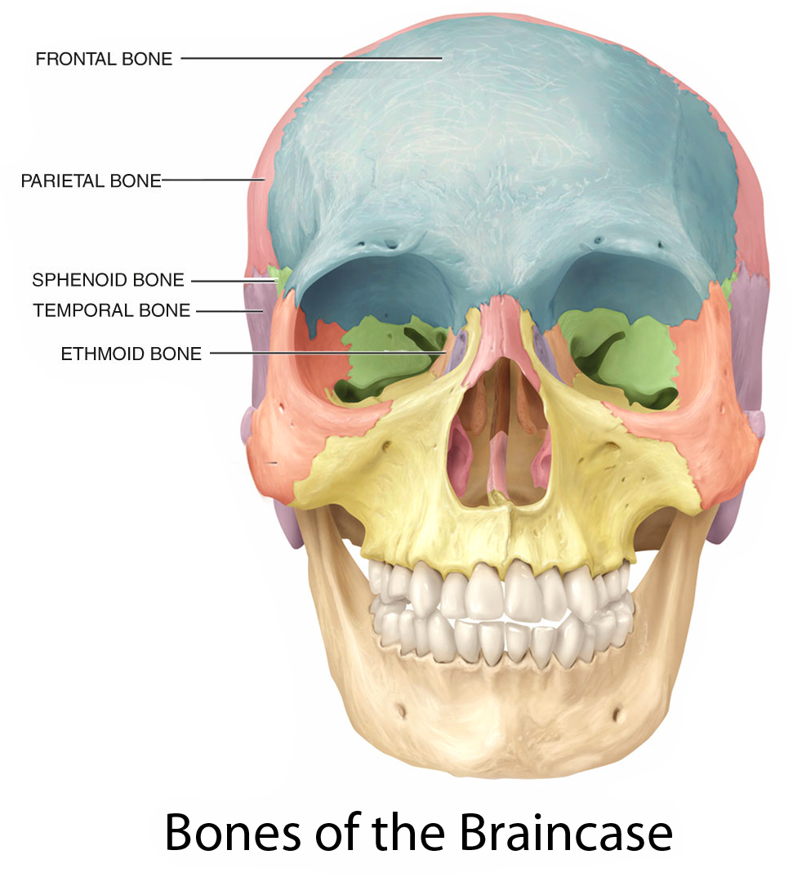
Bones of the Skull
The braincase (neurocranium) has 8 bones: Single frontal, occipital (not shown on this graphic), ethmoid, and sphenoid bones, and paired temporal and parietal bones.

Slide 20
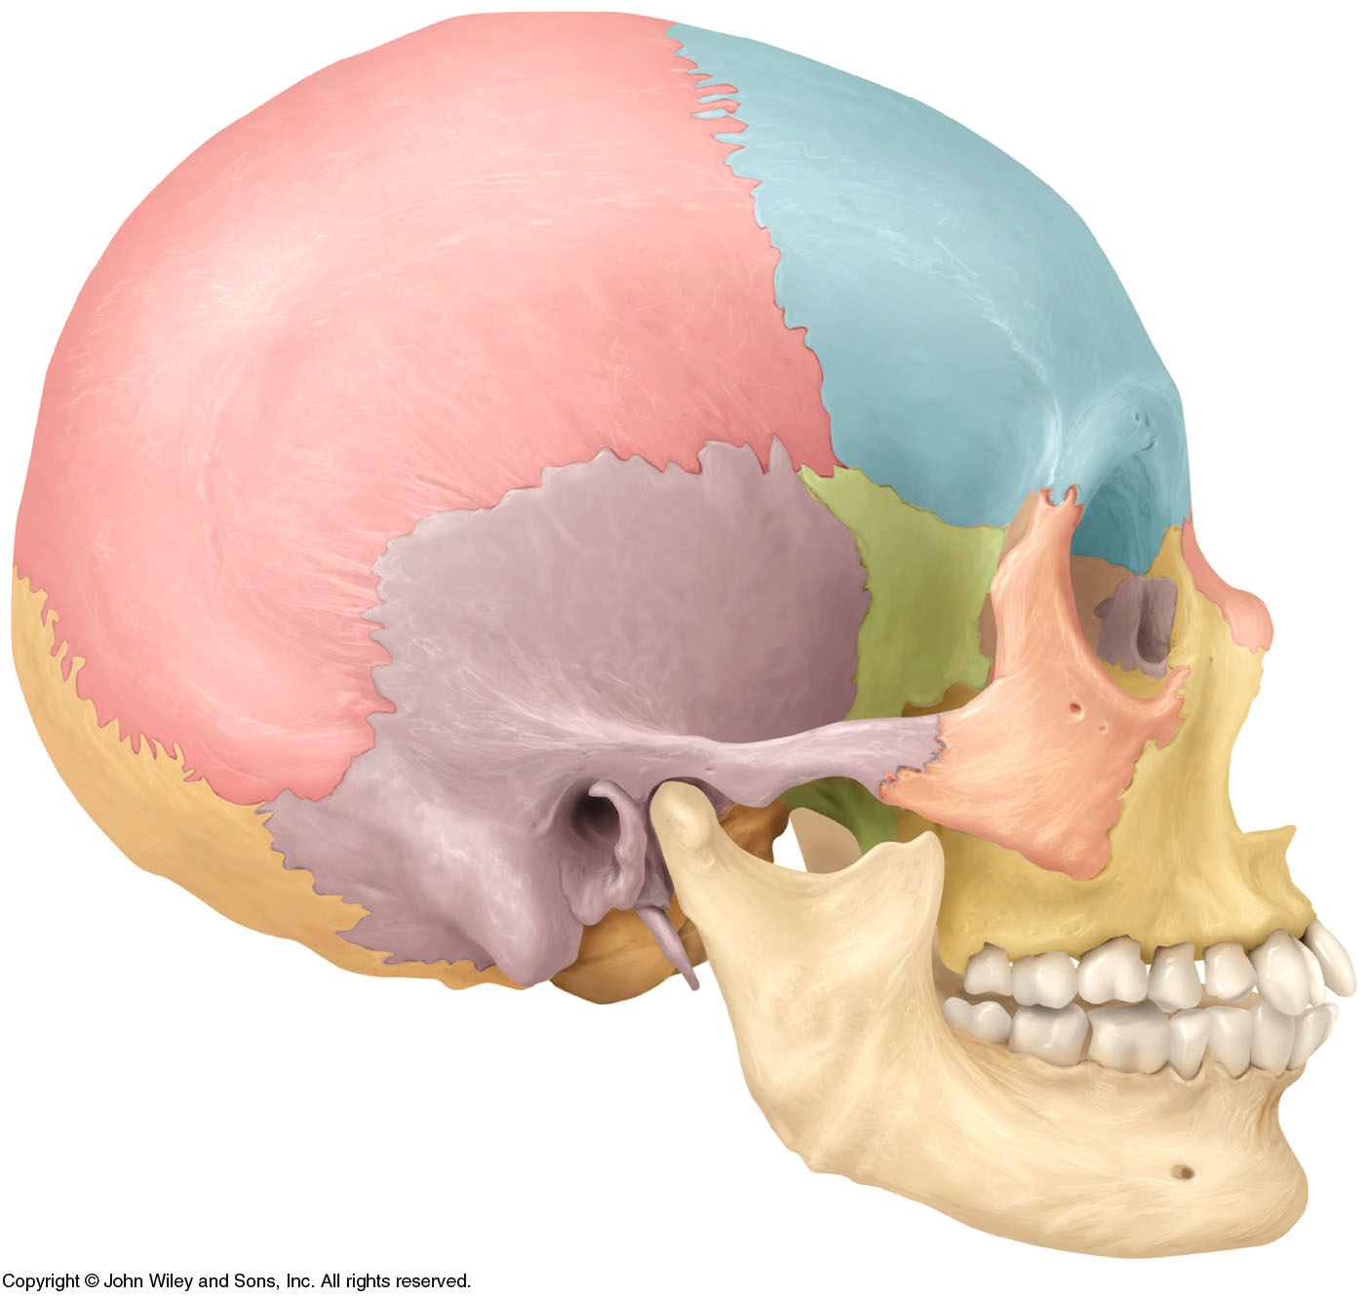
Bones of the Skull
Frontal bone
Parietal bone
Sphenoid bone
Ethmoid bone
Temporal bone
Occipital bone
Styloid process
Notes:
There are 8 bones in the cranium and 14 bones in the face = 22 bones in the skull

Slide 21
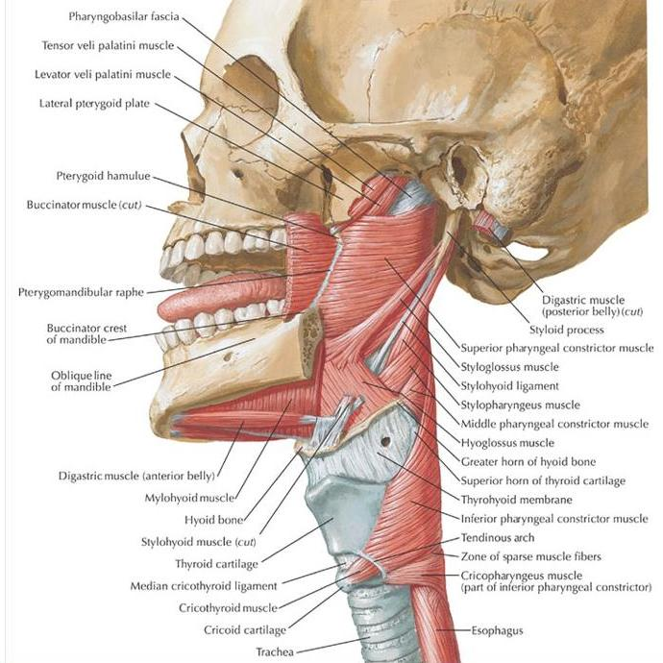
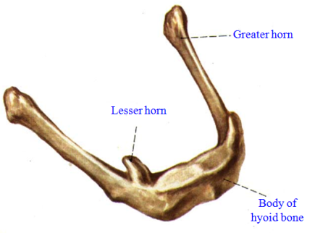
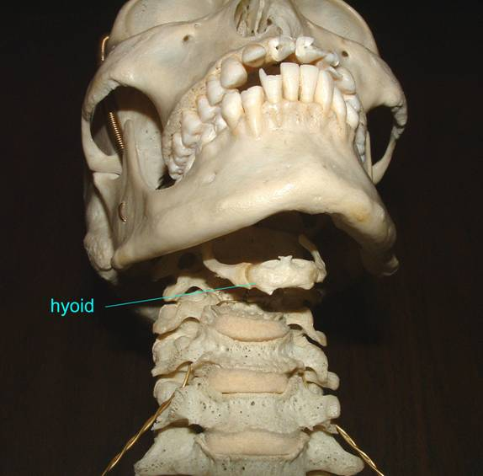
An oddball….hyoid bone
Temporal bone
Styloid process
Facts:
Does not articulate w/ any other bone. (Suspended from styloid process)
Supports tongue & neck muscles
Oft examined when manual strangulation is suspected. Why?
Notes:
There are 8 bones in the cranium and 14 bones in the face = 22 bones in the skull

Slide 22
Bones of the Skull
A suture is a “seam” – an immovable joint between bones of the skull.
Sagittal Suture
Coronal Suture
Squamous Suture
Lambdoidal Suture

Slide 23
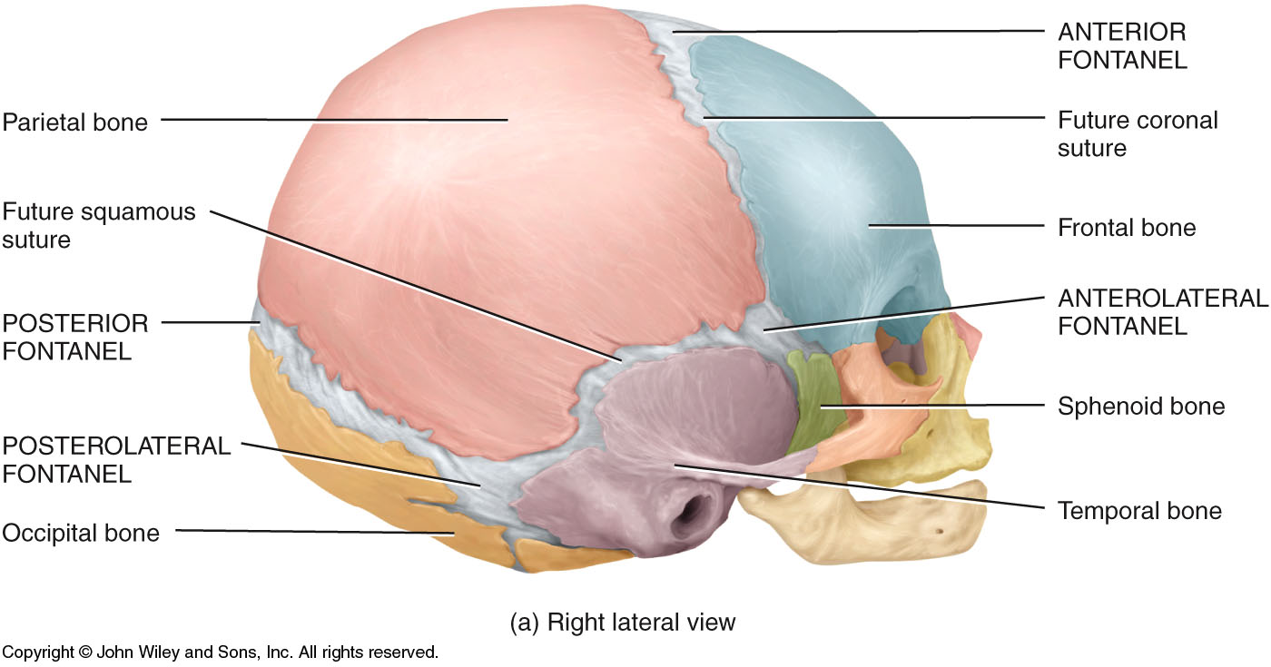
Bones of the Skull
These aid childbirth and rapid brain-growth during infancy…
Fontanels (“little fountains”) are soft, mesenchyme-filled spaces between cranial bones in babies. They will become suture joints in adults.

Slide 24
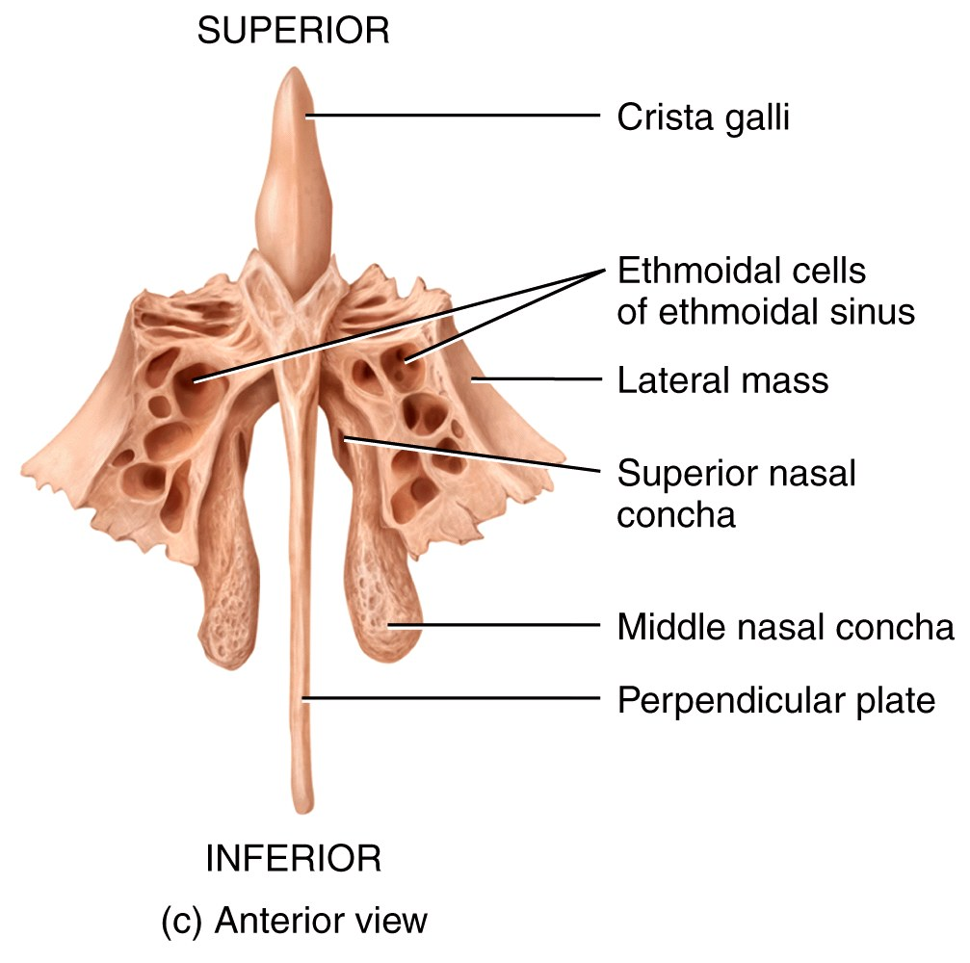
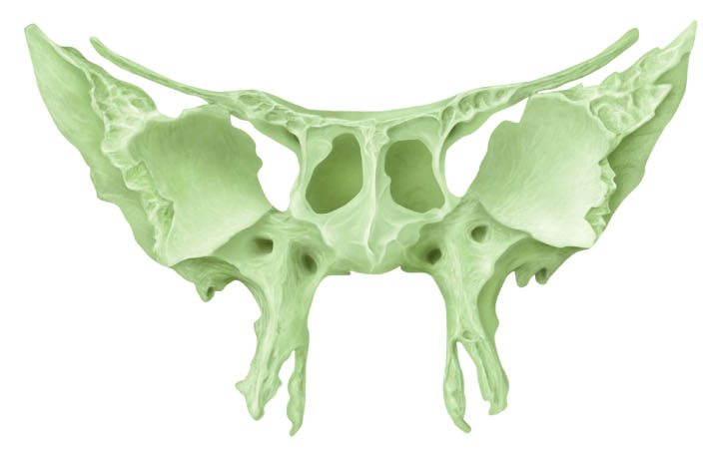
Bones of the Skull
The paranasal sinuses are prominent features of the frontal bone, ethmoid bone, sphenoid bone, and maxillary bones.
Greater and lesser wings of the Sphenoid
bone
Sphenoid sinus
Ethmoid bone (top) showing the “air cells” that make up the Ethmoid sinuses. Sphenoid bone (right)

Slide 25
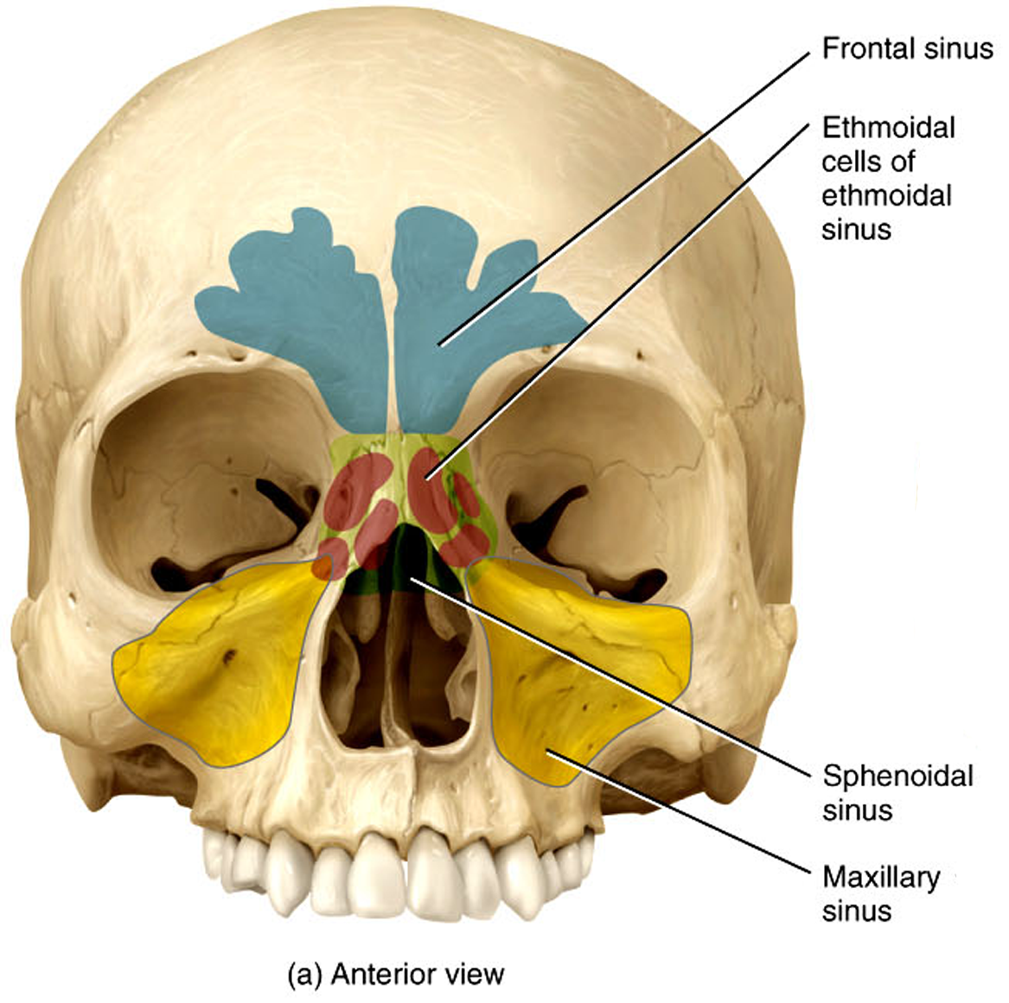
Bones of the Skull: Sinuses
With the exception of the ethmoid sinuses, the other paranasal sinuses are paired.
They are lined with mucus
membranes that humidify
and warm the air.
Reduce weight in the skull
Help to resonate the
sound of our voice

Slide 26
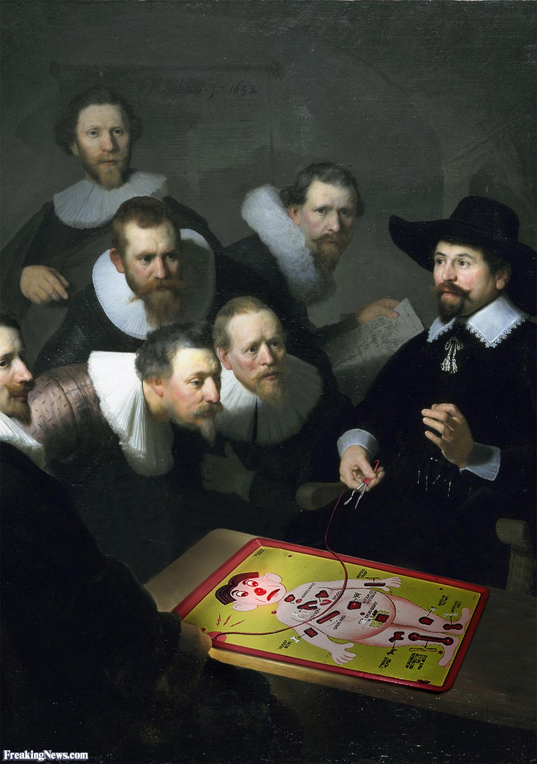
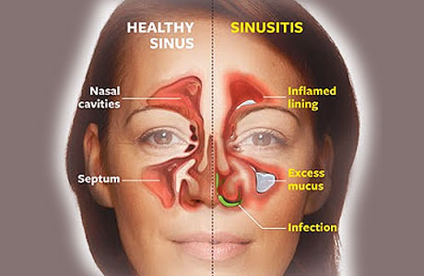

Clinical Connection
Sinusitis
Sinusitis is an inflammation, or swelling, of the tissue lining the sinuses. Normally, sinuses are filled with air, but when sinuses become blocked and filled with fluid, germs (bacteria, viruses, and fungi) can grow and cause an infection.
Conditions that can cause sinus blockage include the common cold, allergies, nasal polyps (small growths in the lining of the nose), or a deviated septum (a shift in the cartilage of the nasal cavity).
About 37 million Americans suffer from at least one episode of sinusitis each year.

Slide 27
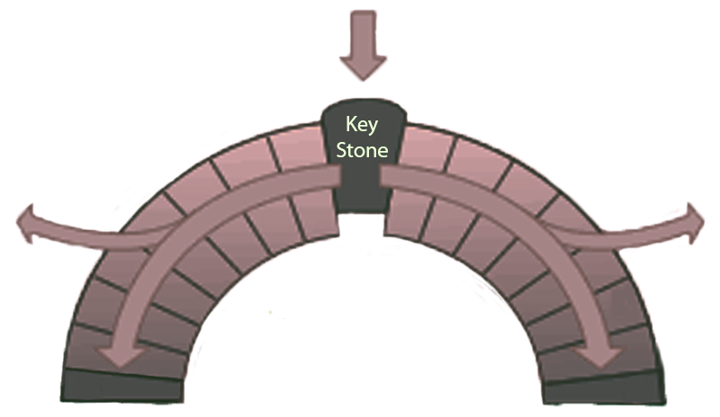
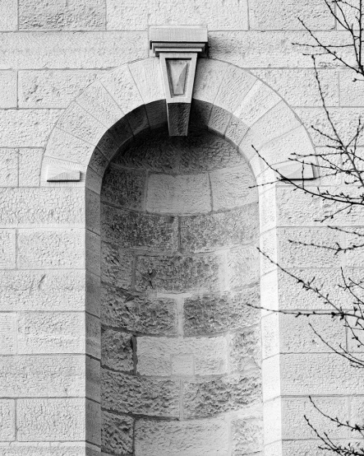
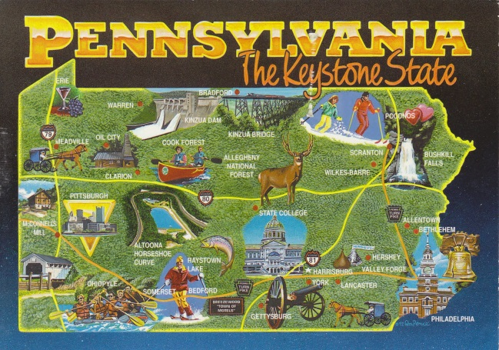
Bones of the Skull
Of the 8 cranial bones that fit together to form the braincase, the sphenoid bone is the “keystone”.
Like the keystone of a roman arch, the sphenoid is the
“center brick” that balances the outward thrust of
the other bones.
Furthermore, it
touches every
other cranial bone…
Representation of a Roman Arch

Slide 28
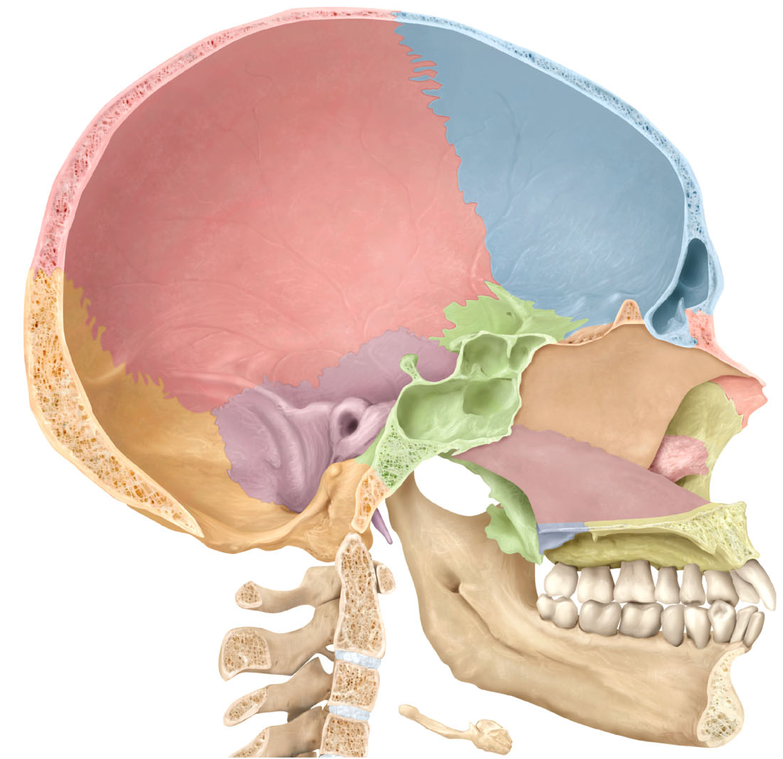
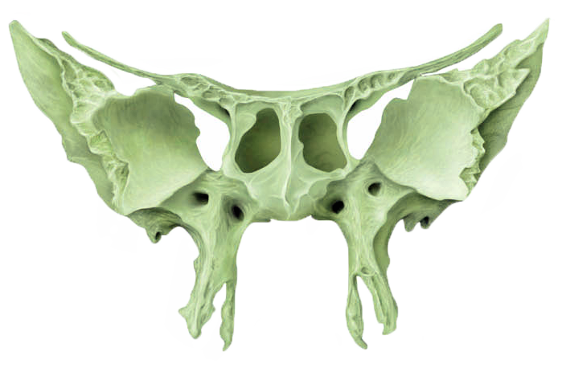
Bones of the Skull
The Sphenoid bone
The rest of the braincase bones are dependent for support on the sphenoid bone (with its greater and lesser wings).

Slide 29

Bones of the Skull
14 Facial Bones:
Mandible (1)
Maxilla (2)
Vomer (1)
Nasal bones (2)
Zygomatic bones (2)
Lacrimal bones (2)
Palatine bones (2)
Inf. Nasal conchae (2)
Nasal bones
Zygomatic bone
Maxilla
Mandible

Slide 30
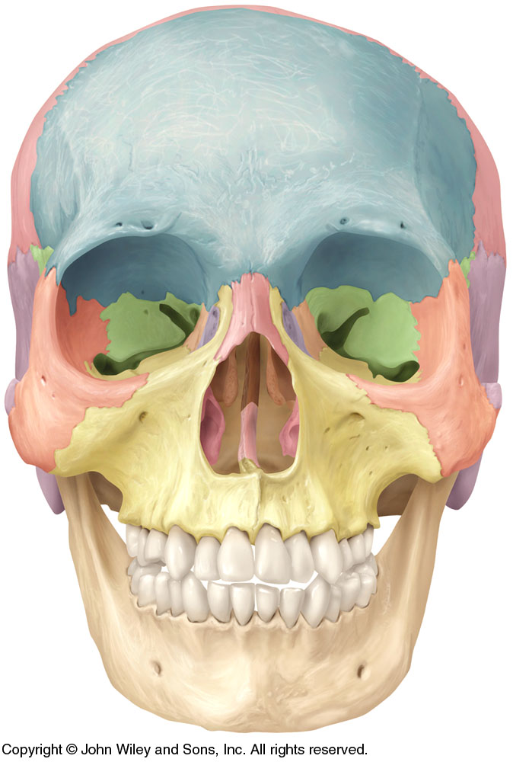
Bones of the Skull
Perpendicular plate of the ethmoid bone
Nasal bones
Lacrimal bone
Zygomatic bone
Middle nasal concha
Inferior nasal concha
Vomer
Maxilla (fused)
Mandible
Notes:
There are 8 bones in the cranium and 14 bones in the face = 22 bones in the skull

Slide 31
Bones of the Skull
Nasal bones
Inferior nasal concha
Vomer
Maxilla
Palatine bone
Mandible

Slide 32
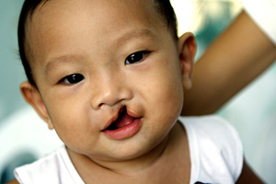
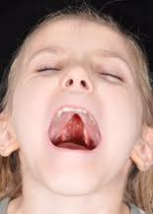
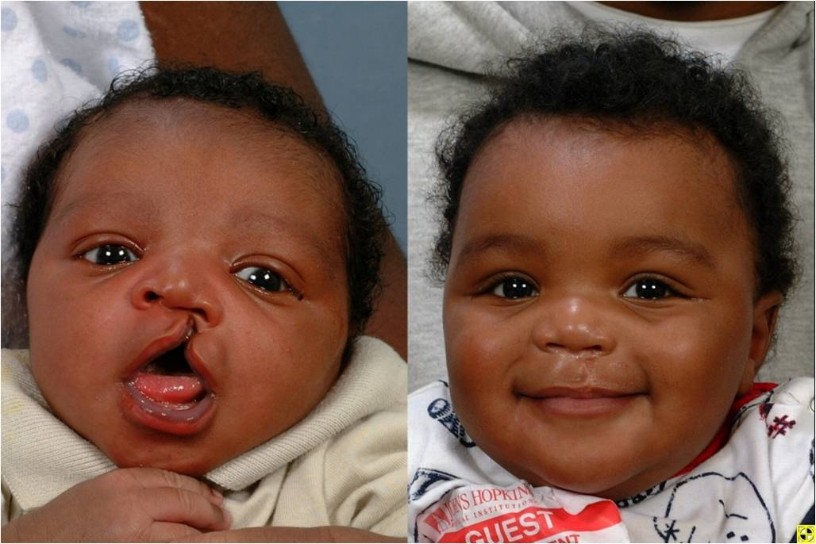
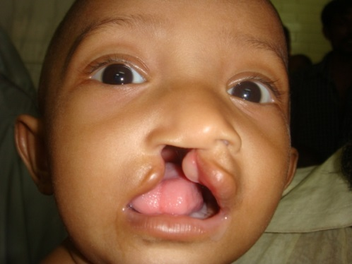
Clinical Connection
Palatine Abnormalities
Cleft lip and cleft palate are birth defects that occur when a baby’s lip or mouth do not form properly during pregnancy. Together, these birth defects commonly are called “orofacial clefts”. These birth defects happen early during pregnancy. A baby can have a cleft lip (improper fusion of the lip), a cleft palate (improper fusion of the palate) , or both a cleft lip and cleft palate.
Lips fuse b/w the 4th & 7th weeks of pregnancy; palates fuse between the 6th & 9th

Slide 33
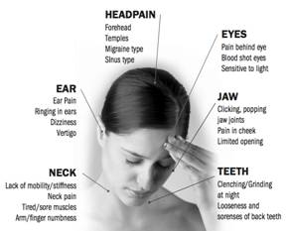
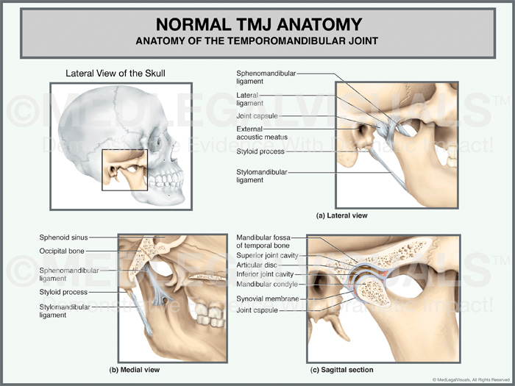
Clinical Connection
TMJ
The temporomandibular (tem-puh-roe-mun-DIB-u-lur) joint (TMJ) acts like a sliding hinge, connecting your jawbone to your skull. TMJ disorders can cause pain in your jaw joint, in the muscles that control jaw movement and even painful side-effects extending from this oft-used joint.
(TMJ) Anatomy and Disc Displacement Animation - YouTube
About 20% to 30% of the adult population are affected to some degree.Usually people affected by TMD are between 20 and 40 years of age, and it is more common in females than males.

Slide 34
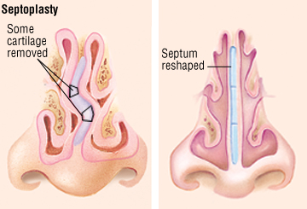
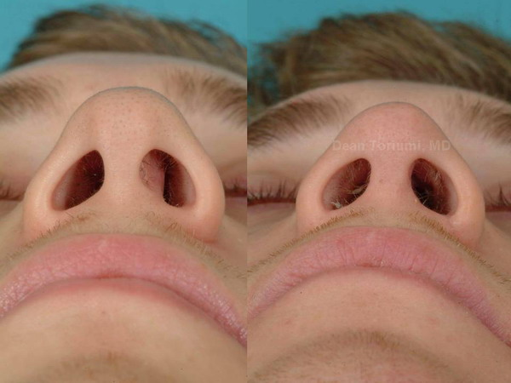
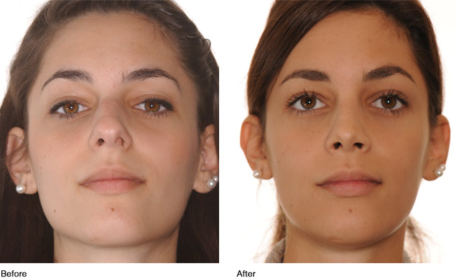
Clinical Connection
Deviated Septum
A deviated septum occurs when the thin wall (nasal septum) between your nostrils is displaced to one side. In many people, the nasal septum is displaced — or deviated — making one nasal passage smaller.
When a deviated septum is severe, it can block one side of your nose and reduce airflow, causing difficulty breathing. The additional exposure of a deviated septum to the drying effect of airflow through the nose may sometimes contribute to crusting or bleeding in certain individuals.
Some displacement is common, affecting 80% of people, most unknowingly…most cases result from impact trauma/

Slide 35
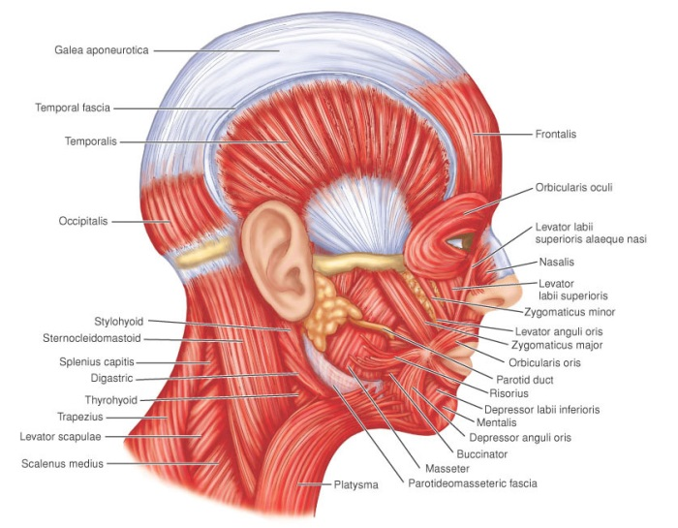
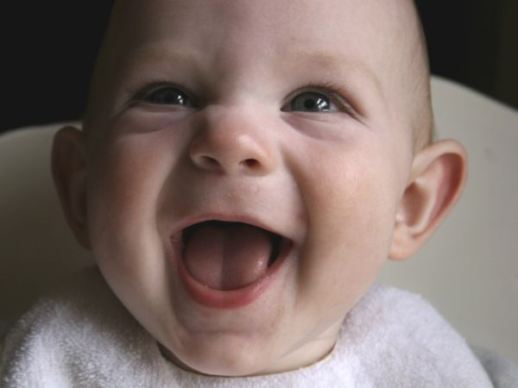
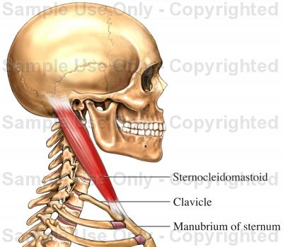
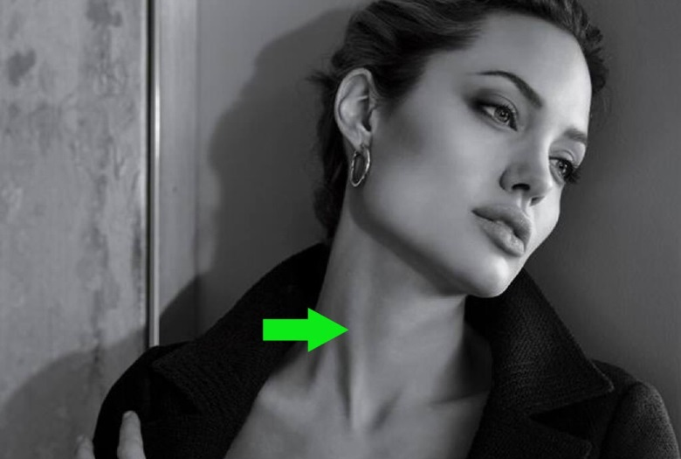
Bones of the Skull
Besides protecting the brain, the skull provides a framework for:
Attachment of muscles that move various parts of the head
Attachment for muscles that produce facial expressions
The facial bones form the framework of the face and provide support for the entrances to the digestive and respiratory systems.

Slide 36
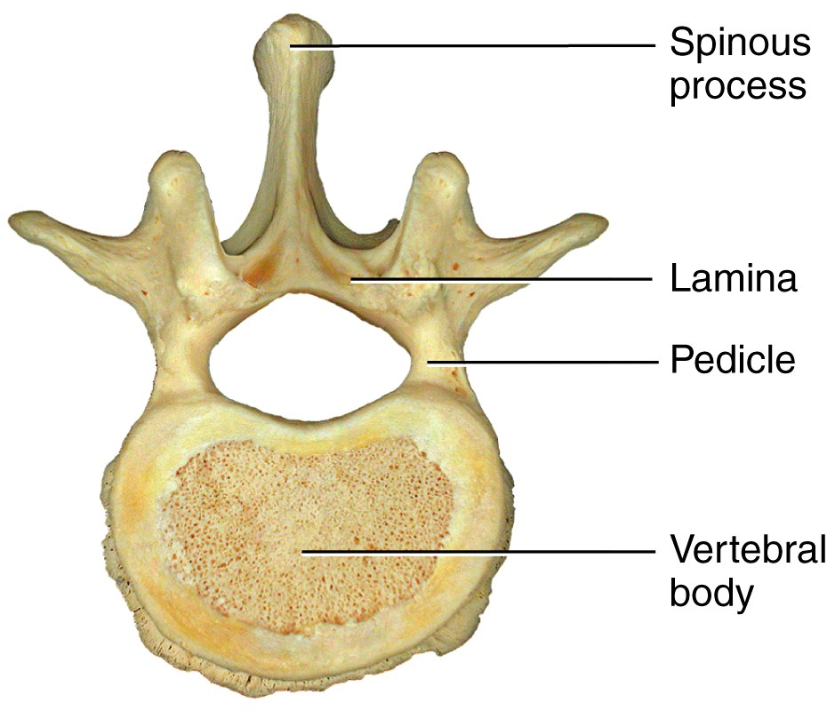
The Vertebral Column
The spine is composed of a series of bones called vertebrae.
Vertebrae typically consist of:
A body (weight bearing)
A pedicle and lamina
forming the vertebral arch
(surrounds the spinal cord)
Several processes (points
of attachment for muscles)

Slide 37
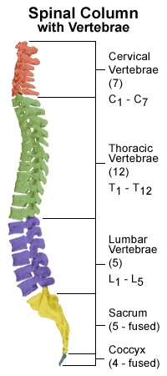
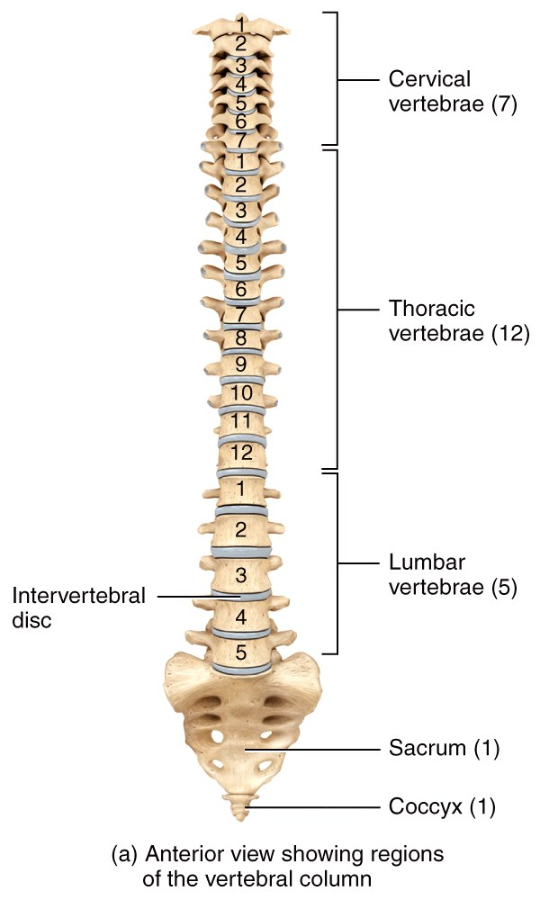
The Vertebral Column
There are 7 cervical vertebrae in the neck region labeled C₁-C_{7 .}
There are 12 thoracic vertebrae that articulate with the ribs (T₁-T₁₂).
There are 5 lumbar vertebrae that support the lower back labeled L₁-L₅
The sacrum and coccyx are single bones that result from the fusion of several vertebrae.

Slide 38
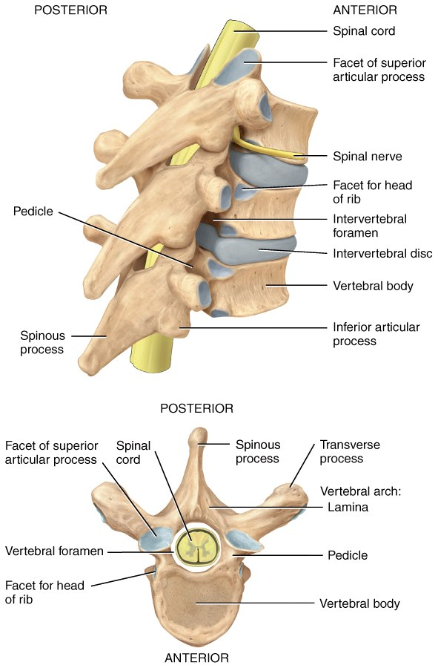
The Vertebral Column
From the cervical region to the sacrum, each vertebra has a large central hole, or vertebral foramen in which the spinal cord can travel.
At each segmental level, on both the right and left sides, an intervertebral foremen is formed for the exiting spinal nerves.

Slide 39

The Vertebral Column
A tough fibrocartilage intervertebral disc is found between the bodies of adjacent vertebrae.
It functions to absorb vertical shock and form joints which are strong
yet still permit
movement
of the spine.

Slide 40

The Vertebral Column
When viewed from the front, a normal adult vertebral column appears straight.
When viewed from the side,
it has four slight bends which
constitute the normal spinal
curvatures.

Slide 41



Vertebral Column
Relative to the front of the body, the cervical and lumbar curves are convex (anterior),
The thoracic and sacral curves are concave (posterior).

Slide 42

Clinical Connection
Spinal Abnormalities
Scoliosis: lateral bending (look for uneven shoulders)
Kyphosis: exaggeration of the thoracic curve
Lordosis: exaggeration of the lumbar curve

Slide 43

The Vertebral Column
Why?
Why?
Why?
Why?

Slide 44

The Vertebral Column
The cervical vertebrae comprise the bony spine in the neck:
C₁ is called the Atlas because it holds up the head the way the Titan of Greek mythology supported the world.
C₂ is called the Axis because it provides a pivot, allowing the head to turn on the neck.
Without these first two specialized cervical vertebra, the head/neck range of motion would be very limited.

Slide 45

The Vertebral Column
Below the neck, each of the 12 pairs of thoracic vertebrae articulate with a rib to
form the posterior part
of the thoracic cage.

Slide 46

The Vertebral Column
Because the lumbar vertebrae (5) bear greater loads, they are much stouter than their more superior cousins (the cervical and thoracic vertebrae).

Slide 47

Clinical Connection
Disc Abnormalities
Bulging disc: Annulus fibrosus (outer layer) of the disk bulge into the spinal canal. Thinning Disk
Herniated disc: Nucleus pulposus (inner portion) of the disk is forced through a weakened part of the annulus fibrosus
Thinning: Narrowed intervertebral disc
Disk Degeneration with Osteophyte Formation:
bony projections develop along the edges of disc

Slide 48

The Vertebral Column
2 theories: “temple”-seat of procreation; last to rot;
The sacrum is a single triangular body formed from a fusion of 5 separate vertebrae in-utero (during fetal development).
What’s in a name? It comes from the mid 18th century: from Latin os sacrum, translation of Greek hieron osteon ‘sacred bone’ (from the belief that the soul resides in it).

Slide 49


Clinical Connection
Spina bifida
Spina bifida (Latin: "split spine") is a developmental congenital disorder caused by the incomplete closing of the embryonic neural tube. Some vertebrae overlying the spinal cord are not fully formed and remain unfused and open. If the opening is large enough, this allows a portion of the spinal cord to protrude through the opening in the bones. There may or may not be a fluid-filled sac surrounding the spinal cord.
Play media
Ultrasound view of the fetal spine at 21 weeks of pregnancy. In the longitudinal scan a lumbar myelomeningocele is seen.

Slide 50
The Vertebral Column
The coccyx, commonly referred to as the tailbone, is the final segment of the bony spine.
It is also an in-utero fusion of 3–5 separate vertebrae.

Slide 51




The Vertebral Column
Injuries to the coccyx
A fall onto the tailbone in the seated position, usually against a hard surface, is the most common cause of coccyx injuries.
A direct blow to the tailbone, childbirth, repetitive straining
How do I know how badly it is injured?

Slide 52


The Vertebral Column
Injuries to the coccyx
A fall onto the tailbone in the seated position…

Slide 53

The Vertebral Column
Injuries to the coccyx
How do wrestlers fall and “powerbomb” without injury?
Batista Bombs - WWE Top 10
Power Bomb! Combining Professional Wrestling and Stage ... paragraphs 3-6

Slide 54
The Thorax
The thoracic cage is the final part of the axial skeleton.
In addition to the thoracic vertebrae, it is formed from:
The sternum
The ribs and costal cartilages
Its functions are to
enclose and protect the organs in the thoracic and abdominal cavities
Provide support for the bones of the upper limbs
Play a role in breathing

Slide 55

The Thorax
The sternum or “breastbone” is located anteriorly in the center of the thoracic wall.
Consists of the manubrium, body, xiphoid process

Slide 56


The Thorax
The 12 pairs of ribs give structural support to the sides of the thoracic cavity.
The costal (having to do with the ribs) cartilages are bars of hyaline cartilage connecting the sternum to the ribs.
Contribute to the elasticity of the thoracic cage

Slide 57

The Thorax
The upper 7 rib pairs are called true ribs because they attach “directly” to the
sternum (with just a
small piece of costal
cartilage).
With which part of the vertebra do ribs articulate?

Slide 58

The Thorax
The bottom 5 pairs of ribs (and this number can vary from one individual to another) are called
false ribs.
They attach indirectly to the
sternum with an elongated piece
of costal cartilage…
… or not at all (ribs 11 and 12
are called floating ribs.)

Slide 59



The Thorax

Slide 60



The Thorax

Slide 61

The Thorax
Why are true ribs called such?
Why are false ribs called such?
Why are floating ribs called such?

Slide 62





The Thorax
Romo suffers fractured tranverse process…

Slide 63




The Thorax
Cam Newton Suffers Fractured Rib

Slide 64




The Thorax
mr e Suffers Fractured Ribs

Slide 65
Chapter 8
The Appendicular
Skeleton
Lecture slides prepared by Curtis DeFriez, Weber State University

Slide 66

The Appendicular Skeleton
The 126 bones of the appendicular skeleton are primarily concerned with movement.
As “appendages” to the central skeleton,
these bones include those of the upper and lower limbs (including the girdles that attach them to the axial skeleton).

Slide 67
The Upper Limb
Based on the position of its major joints and component bones, the upper limb is divided into the shoulder, arm, forearm, and hand:
The shoulder is the area of upper limb attachment to the trunk.
The arm is the part of the upper limb between the shoulder and the elbow joint.
The forearm is between the elbow and the wrist.
The hand is distal to the wrist.

Slide 68

The Shoulder Girdle
The bones of the shoulder (pectoral) girdle include the scapula and the clavicle.
The shoulder joint also incorporates the upper part of the humerus.
A limb’s girdle refers to the bones that attach said limb to the axial skeleton.

Slide 69

The Shoulder Girdle

Slide 70
The Shoulder Girdle
The triangular shaped scapula is also called the shoulder blade.
Spine - a large process on the posterior of the scapula
Acromion - the flattened lateral portion of the spine
Coracoid process - a protruding projection on the anterior surface just inferior to the lateral aspect of the clavicle
Glenoid cavity - shallow concavity that articulates with the head of the humerus

Slide 71

The Shoulder Girdle
Right scapula (shoulder blade), posterior and lateral view

Slide 72

The Shoulder Girdle
The clavicle is “S” shaped:
The medial end articulates with the manubrium of the sternum forming the sternoclavicular joint.
The lateral end articulates with the acromion forming the acromioclavicular joint.

Slide 73




Clinical Connection
Broken collar bone
A broken collarbone is a common injury, particularly in children and young adults. Your collarbone connects the upper part of your breastbone to your shoulder blade. Common causes of a broken collarbone include falls, sports injuries and trauma from traffic accidents. Infants can sometimes experience a broken collarbone during the birth process

Slide 74

The Arm
The only bone in the arm is the humerus. The proximal end of the humerus has two necks:
The anatomical neck lies proximal (by head).
The surgical neck lies distal (below tubercles)
and matches the epiphyseal line of the
humerus.

Slide 75
The Forearm
The two bones of the forearm are the radius and ulna:
The radius is lateral (in anatomic position) and widens distally.
The more medial ulna widens proximally into the Olecranon process, a large prominence we feel as the tip of the elbow.

Slide 76

The Forearm
Functions: 1. joins bones of forearm 2. attachment site for deeper tendons/muscles of forearm

Slide 77




The Forearm
Common name?
Review each bone…

Slide 78
The Hand
The hand is composed of the wrist, the palm, and the fingers.
The wrist, or carpus, is made up of 8 carpal bones arranged in two rows.
The palm of the hand has 5 metacarpal bones .

Slide 79

The Hand
Each finger, with the exception of the thumb or 1st digit, is composed of 3 phalanges:
proximal phalanx
middle phalanx
distal phalanx
The thumb has two phalangeal bones.

Slide 80

The Hand
Associate roman numeral with finger…
(pnemonic device: how do you count with your hand?…go European here…

Slide 81


The Lower Limb
The lower limb is directly anchored to the axial skeleton by a sacroiliac joint which links the pelvic bone to the sacrum.
Based on the position of its major joints and component bones, the lower limb is divided into the gluteal region (the major bones forming the hip girdle), thigh, leg, and foot.
Note: the pelvis includes the sacrum….the girdle does not
The gluteal region is between the iliac crest and hip joint.
The thigh is between the hip and the knee joint.
The leg is between the knee and the ankle.
The foot is distal to the ankle.

Slide 82

The Pelvic Girdle
In the gluteal region, the pelvic girdle is made up of two os coxae, or hip bones.
Each coxal (hip) bone consists of 3 bones that fuse together:
Ileum
Ischium
Pubis

Slide 83
The Pelvic Girdle
On the right and left sides, the os coxae are joined posteriorly to the sacrum, and anteriorly to one another at the pubic symphysis (made of fibrocartilage).
The free part of the lower
limb below the
hip joint is
composed of 30
different bones.
Notes:
Point out that the lower limb bones are larger and stronger than the upper limb bones due to the need to support the weight of the body

Slide 84



Clinical Connection
Hip pointer
A hip pointer is a contusion, or bruise, of the iliac crest, the bone along the brim of the pelvis, and its surrounding structures.

Slide 85

The Pelvic Girdle
The ilium is the largest of the three hip bones - it forms the superior lateral prominence of the pelvis (iliac crest):
Consists of a superior ala and inferior body which forms the acetabulum
(the socket for the head
of the femur)
Notes:
A “hip pointer” is a bruise to this part of the bone

Slide 86


Clinical Connection
Bone grafting
Bone grafting is a surgical procedure that replaces missing bone in order to repair bone fractures that are extremely complex, pose a significant health risk to the patient, or fail to heal properly.
Bone generally has the ability to regenerate completely but requires a very small fracture space or some sort of scaffold to do so. Bone grafts may be autologous (bone harvested from the patient’s own body, often from the iliac crest), allograft (cadaveric bone usually obtained from a bone bank), or synthetic (often made of hydroxyapatite or other naturally occurring and biocompatible substances) with similar mechanical properties to bone. Most bone grafts are expected to be reabsorbed and replaced as the natural bone heals over a few months’ time.

Slide 87

The Pelvic Girdle
The ischium constitutes the inferior and posterior part of the hip bone.
Its most prominent feature is the ischial tuberosity - the part that meets
the chair when
you are sitting.
(this is what people are complaining about when you sit on them and they say you have a bony butt!)

Slide 88

The Pelvic Girdle
The pubis is the anterior and inferior part of the hip bone.
It has superior and
inferior rami and
a body.

Slide 89


The Pelvic Girdle
The pelvic brim is a line from the sacral promontory to the upper part of the pubic symphysis.
The false pelvis lies above this line. It contains no pelvic organs except the urinary bladder (when full) and the uterus during pregnancy.
The true pelvis is the bony pelvis inferior to the pelvic brim. It has an inlet, an outlet and a cavity.

Slide 90

The Pelvic Girdle
The pelvic axis
is the path of
childbirth
during the first
and second
stages of labor.

Slide 91

The Male/Female Pelvis
Compared to the female pelvis, the male pelvis:
Is larger, heavier, and more narrow
Has a smaller
inlet and outlet
Has a pubic arch
angle of < 70º
Male Pelvis

Slide 92

The Male/Female Pelvis
Compared to the male pelvis, the female pelvis:
Is rounder, has a flared iliac crest, and a wider pelvic
opening to assist childbirth. It also has a pubic arch angle of > 90º and
a more moveable
pubic symphysis.
Has a more flexible
coccyx
Female Pelvis

Slide 93


Male/Female Pelvis: quick comparison
Male vs Female Pelvis - YouTube
To review…
Pelvic inlet | M; narrow heart shaped F;wide oval and rounded
Pelvic outlet | M;smaller F;larger
Pubic arch | M;narrow <70 degrees F;wide >80, almost 90 degrees
Obturator foramen | M;round F;oval
Acetabulum | M;Larger F;smaller
Overall structure | M: taller; stout F: wider; lighter
Coccyx | M;curved F;straighter

Slide 94

The Thigh
The femur is the longest, heaviest, and strongest bone in the entire body.*
Proximally, the head articulates with the acetabulum of the hip bone forming the hip (coxal) joint.
The neck (distal to head) is a common site of fracture.
Distally, the medial and lateral femoral condyles articulate with the tibia to form the knee joint.
The femur also articulates with patella.
Know these parts of the femur…

Slide 95

FYI: The Thigh
The greater and lesser trochanters are projections where large muscles attach.
The gluteal tuberosity
and linea aspera are
attachment sites for the
large hip muscles.

Slide 96

The Thigh
The femur has sites for attachment of the knee muscles at the medial and lateral epicondyles (above the femoral condyles).

Slide 97

The Thigh
Recall what this is?
The patella (knee cap) is the only named sesamoid bone in the body.
A thick articular cartilage lines the posterior surface.
Functions:
Increase leverage of quads
Maintain position of tendon when knee is bent
Protect knee joint

Slide 98

The Patella
At the distal femur, the patella forms the patellofemoral joint where it functions to
increase the leverage of the
quadriceps muscles.
Runner’s knee
(patellofemoral stress
syndrome) is a common
sports injury which includes a variety of leg, knee, or foot disorders.

Slide 99


The Tibiofemoral Joint: the knee
The knee is the largest and most complex joint in the body.
Tendons connect the knee bones to the leg muscles that move the knee joint. Ligaments join the knee bones and provide stability to the knee:
The anterior cruciate ligament prevents the femur from sliding backward on the tibia (or the tibia sliding forward )
The posterior cruciate ligament prevents the femur from sliding forward on the tibia (or the tibia from sliding backward )
The medial and lateral collateral ligaments prevent the femur from sliding side to side.
Two C-shaped pieces of cartilage called the medial and lateral menisci act as shock absorbers between the femur and tibia.
Numerous bursae, or fluid-filled sacs, help the knee move smoothly.

Slide 100

The Leg
Of the two bones in the leg, the tibia (always medial) is the larger and bears all the weight.
The lateral and medial condyles at the proximal end articulate with the femur.
It articulates distally with the talus of the ankle and the fibula.

Slide 101
The Leg
The fibula is the smaller, laterally placed bone of the leg:
It is non-weight bearing.
The head forms the proximal tibiofibular joint.
At the distal end, the lateral malleolus articulates with the tibia and the talus at the ankle.

Slide 102




The Leg
Much like the forearm bones, the tibia and fibula are joined by an interosseous membrane.
The distal end of the leg bones
form the medial and lateral malleoli
of the ankle.

Slide 103

The Foot
The tibia and fibula articulate with the talus bone of the ankle to form the ankle “mortise” (ankle joint).
This is the only bone of the foot to articulate with the tibia & fibula!

Slide 104
The Foot
There are many similarities between the hand of the upper limb and the foot of the lower limb:
The ankle, or tarsus, is made up of 7 tarsal bones arranged to form the ankle mortise, heel, and arches.
The largest and strongest
tarsal bone, the
calcaneus, forms
the heel.

Slide 105

The Foot
Like the palm of the hand, the sole of the foot has 5 bones – in this case called metatarsals.
The metatarsals also participate in forming
the arches of
the foot.

Slide 106




Clinical Connection
Fractured Metatarsals
A fracture of the metatarsals is a common injury amongst ballet dancers. Particularly when doing “en pointe”, dancers losing balance from their toes catch themselves on their metatarsals…and (well, you know).
Another means is through trauma-dropping heavy objects onto foot…

Slide 107
The Lower Limb
The longitudinal and transverse foot arches support the weight of the body while providing spring and leverage to the foot when walking. Flatfeet occur when the arches decrease or “fall”.

Slide 108






Clinical Connection
Flatfoot & Clawfoot
You have flatfeet when the arch on the inside of your feet is flattened, allowing the entire sole of your foot to touch the floor when you stand up.
A common and usually painless condition, flatfeet may occur when the arches don't develop during childhood. In other cases, flatfeet may develop after an injury or from the simple wear-and-tear stresses of age.
Severity differs by degrees and orthotics & braces often help—with surgery being a final alternative.
Clawfoot is when the longitudinal arch is elevated.

Slide 109


Clinical Connection
bunions
A hallux abducto valgus deformity, commonly called a bunion, is a deformity characterized by medial deviation of the great toe, often erroneously described as an enlargement of bone or tissue around the joint at the head of the big toe.
Causes are debated: ill-fitting shoes?…genetics…? Combo?
Bunion Surgery Explained Pain Hallux Abducto Valgus
New Bunion Surgery

Slide 110

The Foot
Each toe with the exception of the hallux (big toe) is composed of 3 phalanges:
proximal phalanx
middle phalanx
distal phalanx

