Slide 1
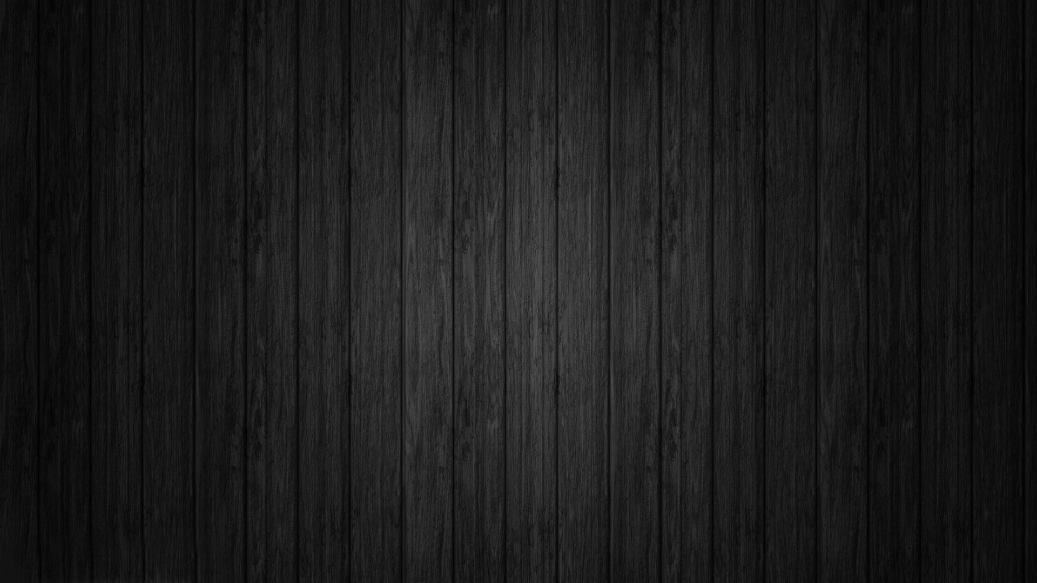
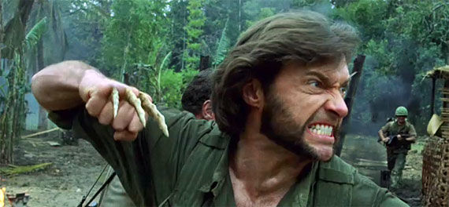
Chapter 6: Bone Tissue A&P fall 2014 mr. e SRCS
Bone Tissue: Origin

Slide 2
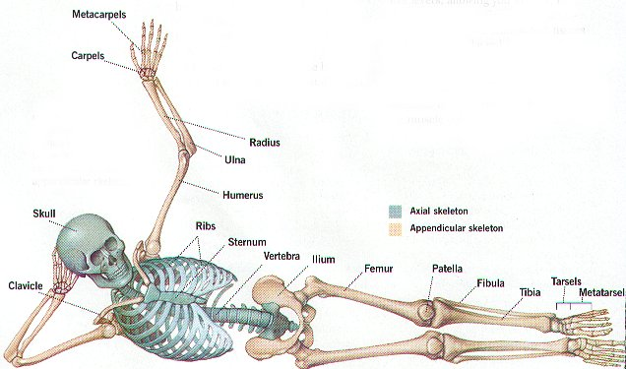
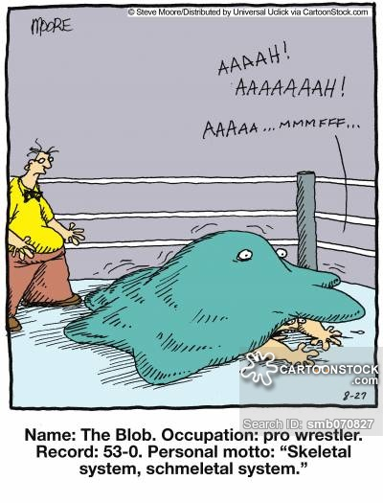
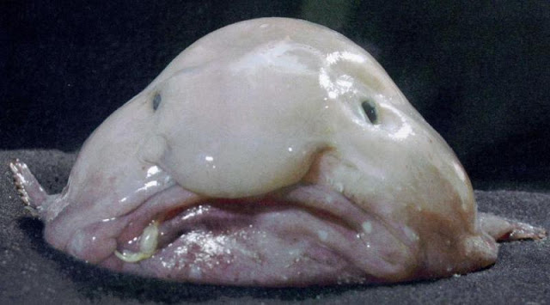
Introduction
The skeletal system has 6 important functions:
  Provide support by acting as a structural framework and a point of attachment for tendons and ligaments

Slide 3
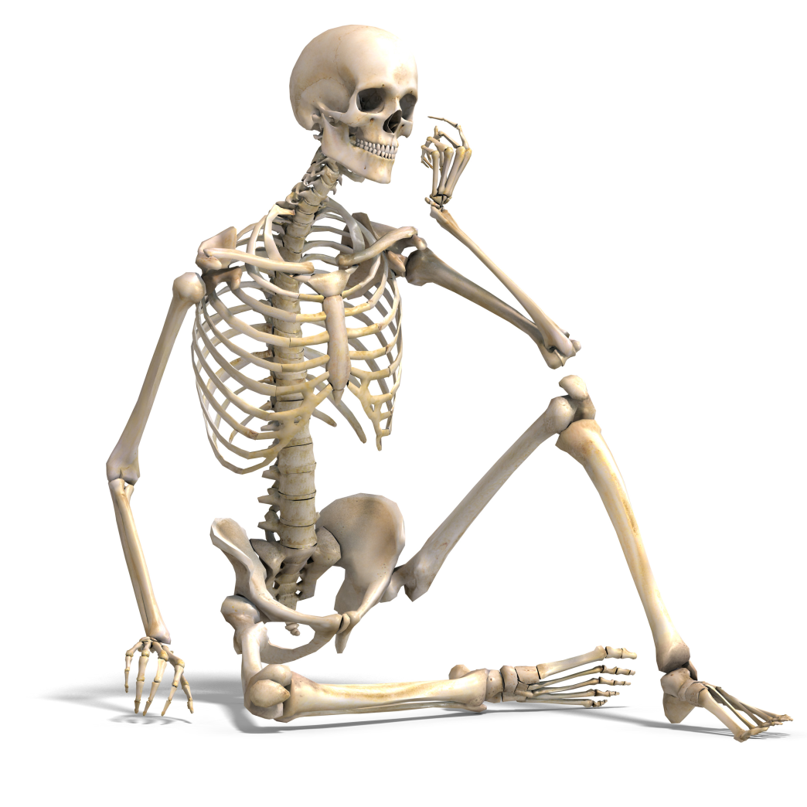
Introduction
The skeletal system has 6 important functions:
  Protect the internal organs
Which areas protects Which organs?

Slide 4
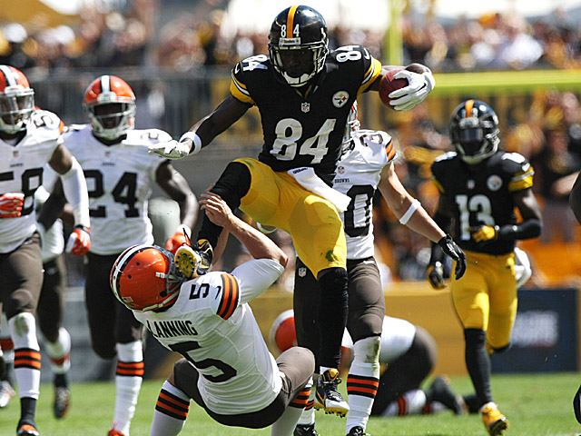
Introduction
The skeletal system has 6 important functions:
  Assist body movements (in conjunction with muscles)

Slide 5
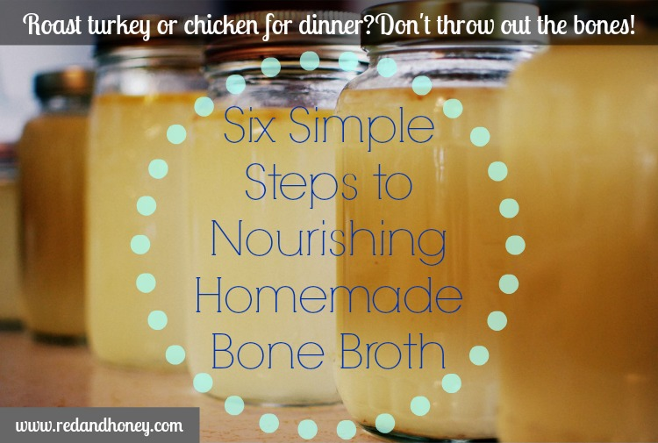
Introduction
The skeletal system has 6 important functions:
  Store and release salts of calcium and phosphorus (mineral homeostasis)

Slide 6
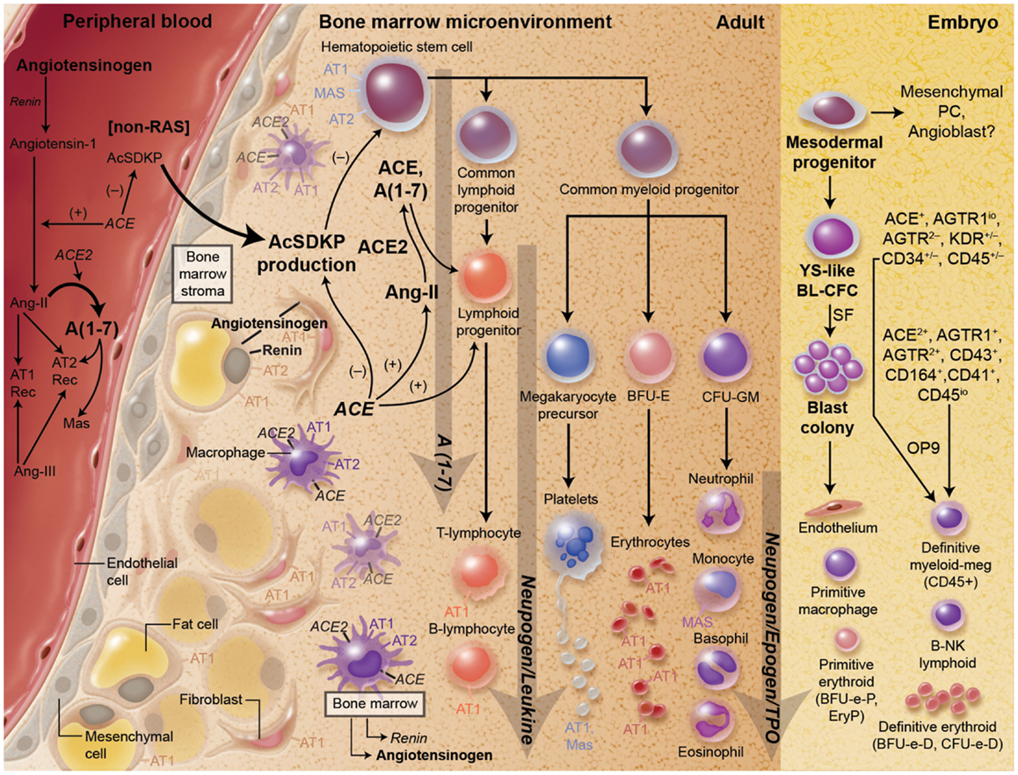
Introduction
The skeletal system has 6 important functions:
  Participate in blood cell production (hematopoiesis)

Slide 7
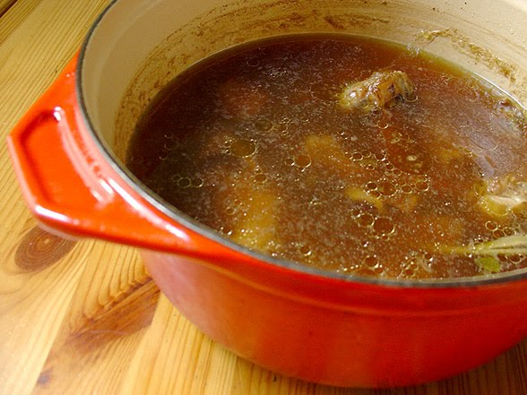
Introduction
The skeletal system has 6 important functions:
  Store triglycerides in adipose cells of yellow marrow

Slide 8
Introduction
The skeletal system has 6 important functions:
  Provide support by acting as a structural framework and a point of attachment for tendons and ligaments
  Protect the internal organs (brain, chest, etc.)
  Assist body movements (in conjunction with muscles)
  Store and release salts of calcium and phosphorus
  Participate in blood cell production (hematopoiesis)
  Store triglycerides in adipose cells of yellow marrow

Slide 9
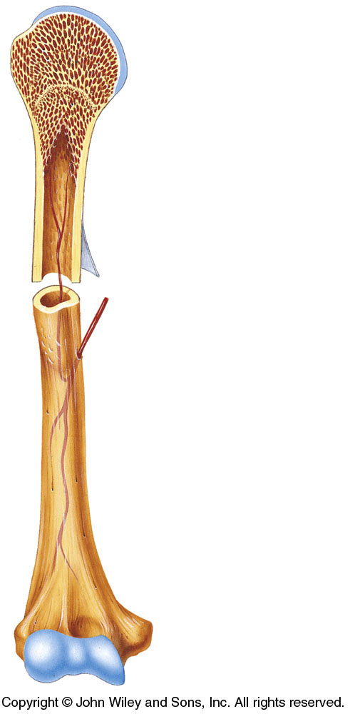
Tissues of the Skeletal System
Bone is a dynamic tissue – it is always remodeling (building up and breaking down).
  The two major tissues are bone
  (osseous tissue) and cartilage.

Slide 10
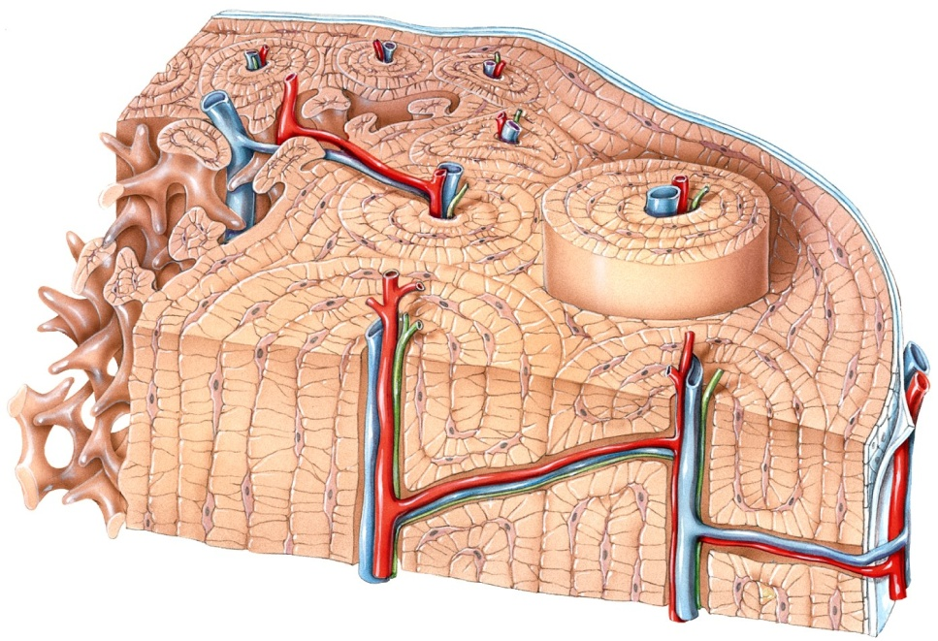
Tissues of the Skeletal System
Bone is a highly vascularized C.T. with a hard, mineralized extracellular matrix. It is found in the body in two different arrangements:
  Compact bone – most of the bone in this graphic is compact bone.
  Spongy bone is seen as
  the less organized tissue
  along the left margin
  (with the spicules).

Slide 11

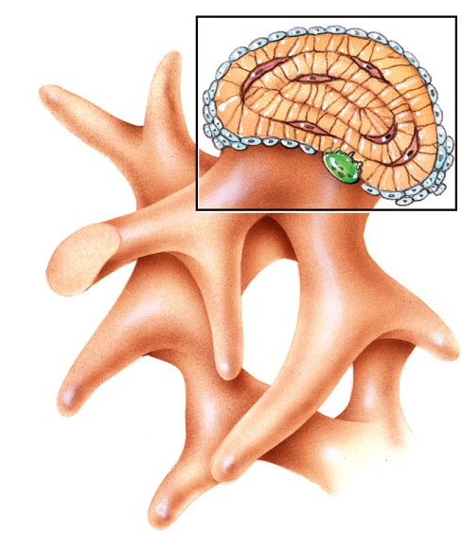
Tissues of the Skeletal System
Compact bone is good at providing
protection and support.
  It forms the shaft of long bones,
  and the external layer of all bones.
Spongy bone is lightweight and
provides tissue support .
  It forms much of the ends
  and the internal cavity of long bones.
Compact bone
Spongy bone

Slide 12
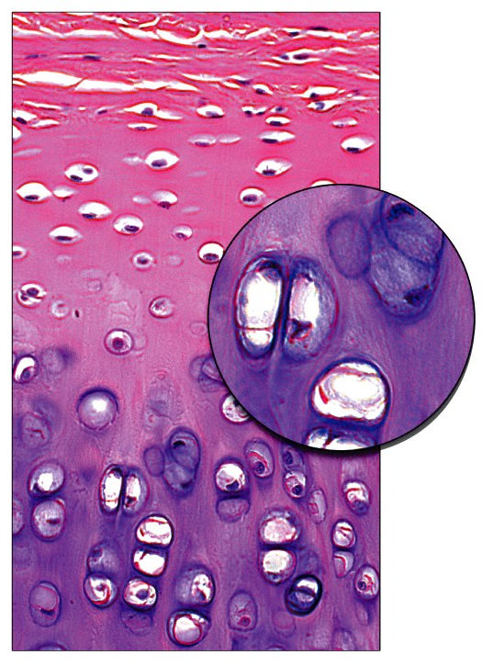
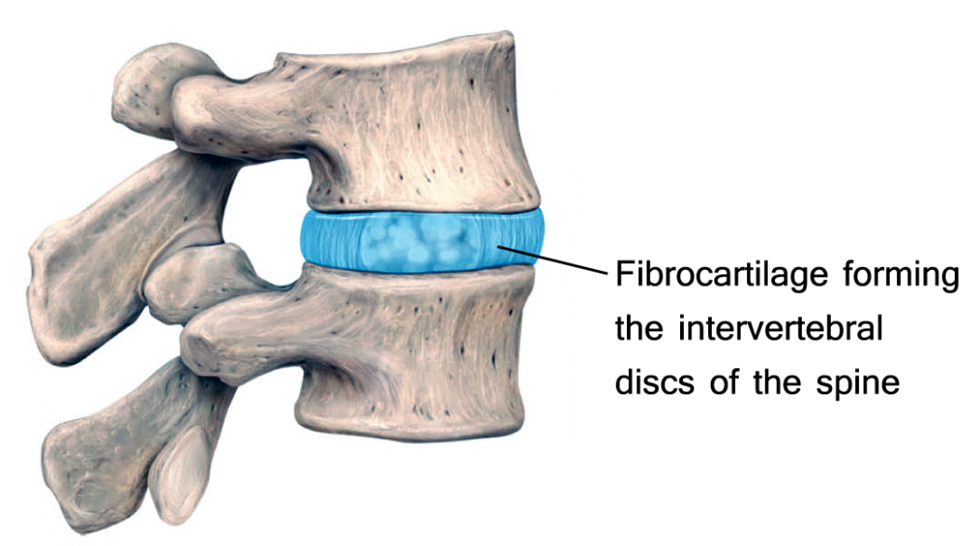
Tissues of the Skeletal System
Cartilage is a poorly vascularized C.T. with a matrix composed of chondroitin sulfate and various fibers.
  Fiber types distinguish hyaline
  cartilage from fibrocartilage or
  elastic cartilage.
What consequences does this present when injury occurs in these tissues?
Hyaline cartilage

Slide 13
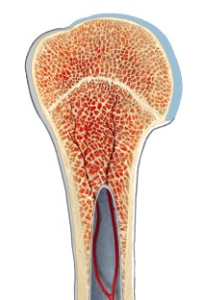
Tissues of the Skeletal System
Articular cartilage is the thin layer of hyaline cartilage covering the epiphysis of long bones.
  Articular cartilage is found where the bone forms an
  articular (joint) surface -
  where one bone
  moves against another
  bone.
Hyaline cartilage is the articular cartilage of this long bone

Slide 14
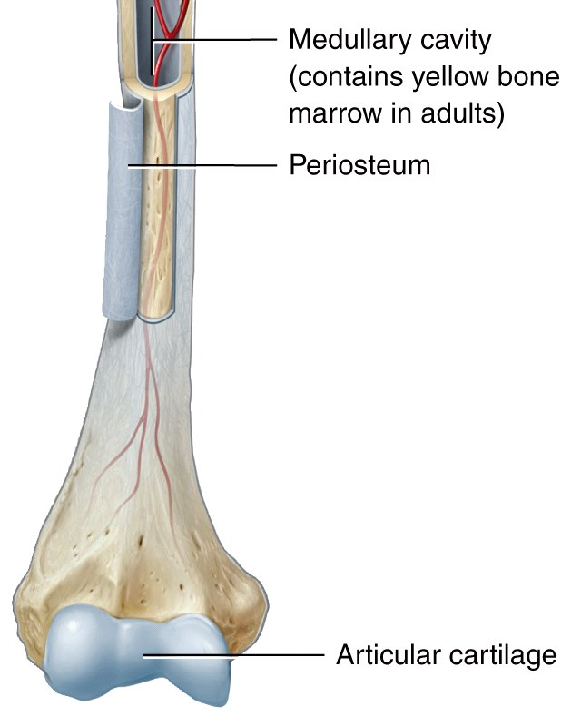
Tissues of the Skeletal System
The periosteum is a tough sheath of dense, irregular connective tissue on the outside of the bone.
  It contains osteoblasts that
  help the bone grow in thickness,
  but not in length.
  It also assists with fracture repair
  and serves as an attachment point
  for tendons and ligaments.
Notes:
The periosteum is only found on areas where there is no articular cartilage

Slide 15
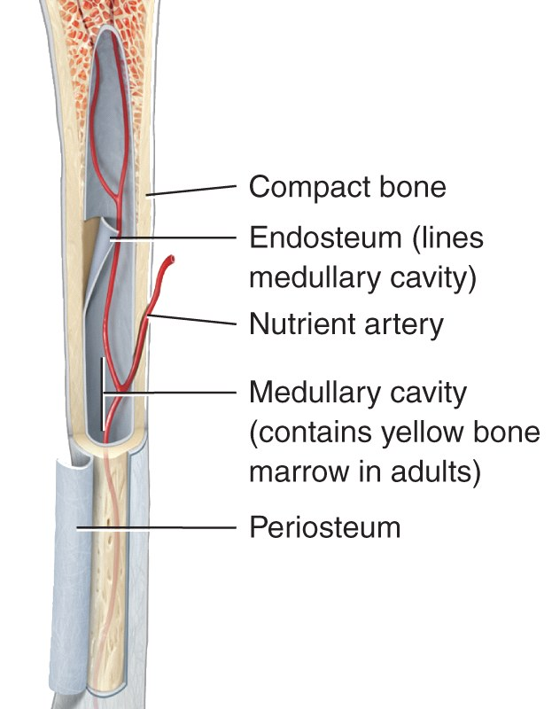
Structure of Bone
The medullary cavity is a space within the diaphysis of long bones that contains fatty
yellow bone marrow in adults.
The endosteum is a membrane that
lines the medullary cavity .
  The endosteum is composed of
  osteoclasts, osteoblasts, and
  connective tissue.
Osteoblasts and Osteoclasts

Slide 16
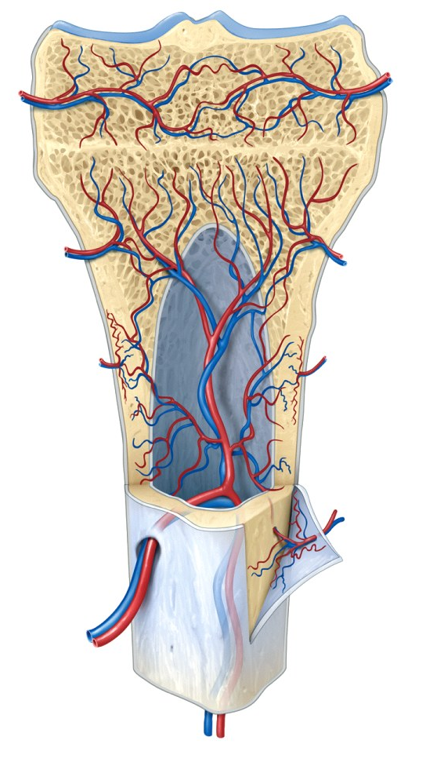
Tissues of the Skeletal System
The perichondrium is a dense irregular connective tissue membrane that surrounds cartilage.
  Chondrocytes are cells that
  form cartilage.
  As we will soon see, many of
  the major bones are formed
  from cartilage (the remainder
  do not go through a
  cartilaginous stage.)
Perichondrium
Periosteum

Slide 17
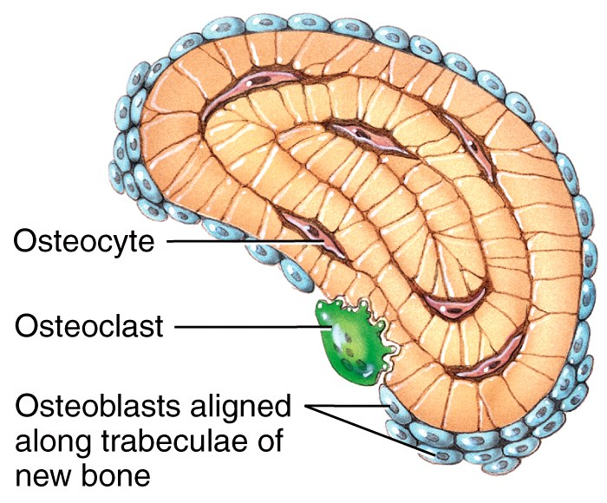
Tissues of the Skeletal System
Osteoblasts are bone building cells: They synthesize and secrete collagen fibers and other organic components.
Osteocytes are mature bone cells; main cells (maintenance).
Osteoclasts are large bone-breakdown cells (resorption)
  concentrated locations:
    Osteoblasts: in periosteum
    Osteoclasts: in endosteum
Any ideas why this is the case?

Slide 18
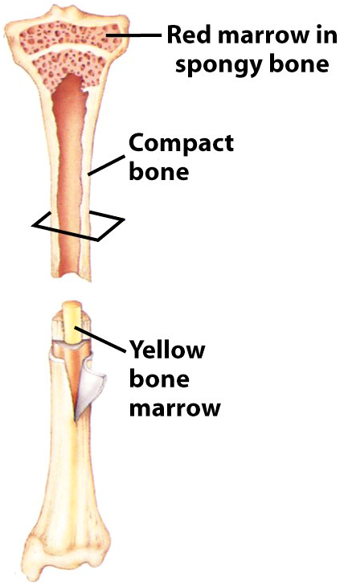
Tissues of the Skeletal System
Besides bone and cartilage, the skeletal system contains other important tissues:
  Epithelium (endothelium) form
  the capillary walls
  Nerves (the periosteum is
  especially tender)
  Red marrow – hematopoiesis
  Yellow marrow – fat storage
why is this important?

Slide 19
Chemical Constituents of Bone
Bone is 25% water, 25% organic proteins, 50% mineral salts (hydroxyapatite crystals).

Slide 20
Chemical Constituents of Bone
Bone is 25% water, 25% organic proteins, 50% mineral salts (hydroxyapatite crystals).
  Organic constituents
    Collagen fibers provide flexibility and tensile strength.
  Inorganic hydroxyapatite crystals (mineral salts)
    Calcium Phosphate (Ca₃PO₄)₂
    Calcium Carbonate (CaCO₃ – marble)
    Other trace elements: magnesium, fluoride, sulfate
Compressive strength

Slide 21
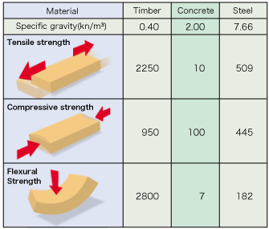
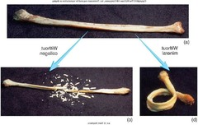
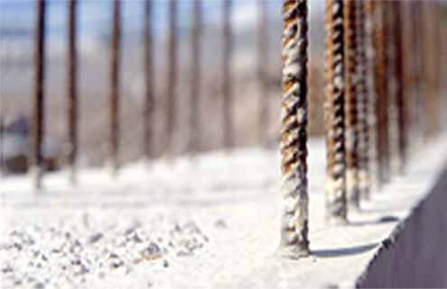
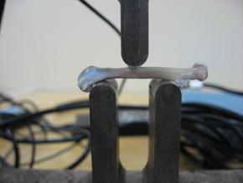
Chemical Constituents of Bone
Bone is 25% water, 25% organic proteins, 50% mineral

Slide 22
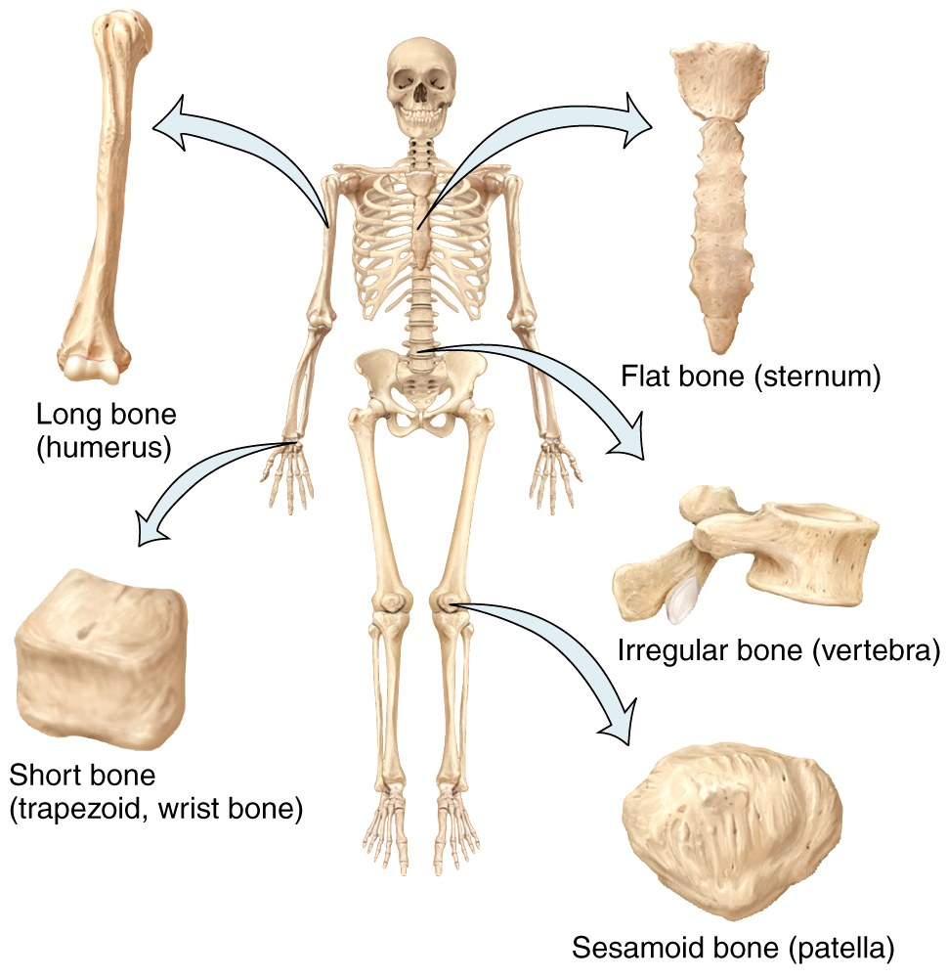
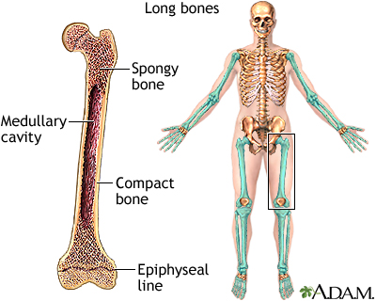
Bone Types in the Body
typical bone types
Notes:
Discuss only a typical long bone at this point. Later, other bone types will be discussed.

Slide 23
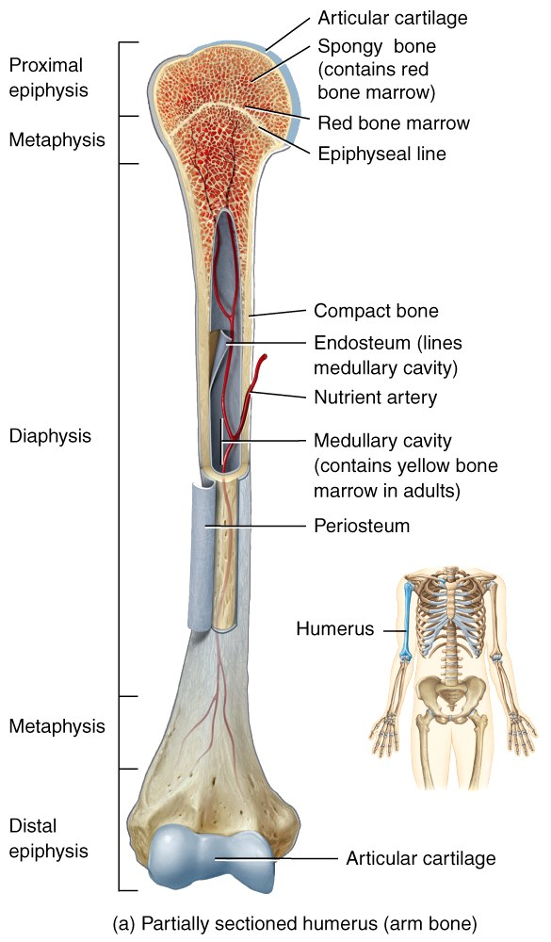
Long Bone Structure
The diaphysis is the shaft or
body of a long bone.
The epiphyses form the distal
and proximal ends of a
long bone.
The metaphyses are the areas
where the epiphyses and
diaphysis join.

Slide 24
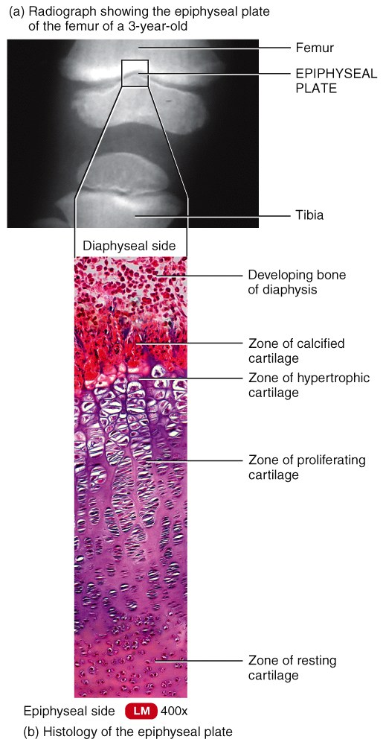
Bone Structure
In adolescents, through the end of
active growth, the epiphysis of the
long bones contains hyaline
cartilage and forms an “epiphyseal
growth plate”.
  During growth, growth plate is
  actively dividing and causing the
  bone to elongate from each end.

Slide 25
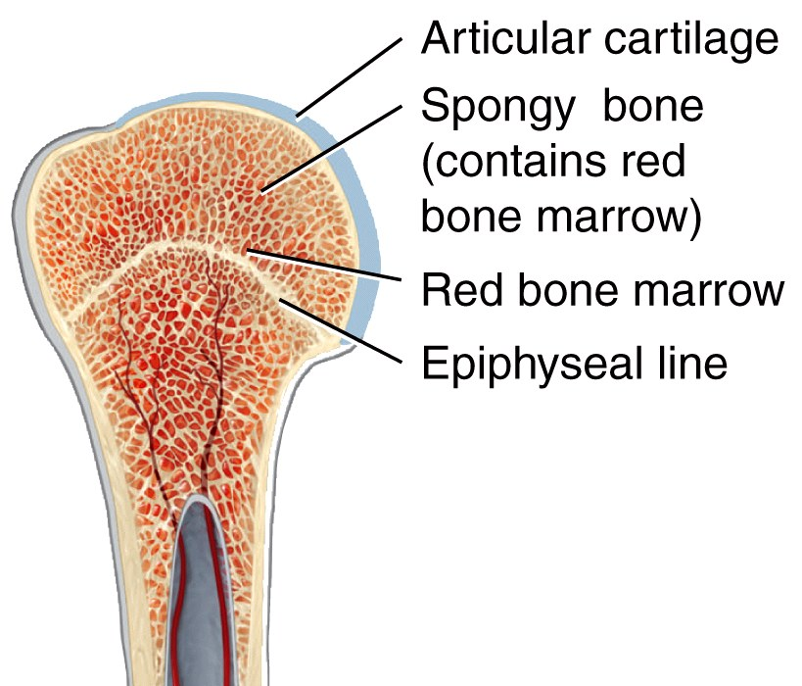
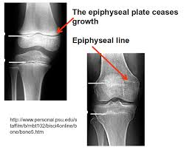
Bone Structure
In adults, the epiphyseal cartilage is no longer present and elongation of bones has stopped.
  The epiphyseal growth plate
  becomes an “epiphyseal line”,
  as growing cartilage is
  replaced by calcified bone.
    The epiphyseal line is
    visible externally and on
    X-rays.

Slide 26
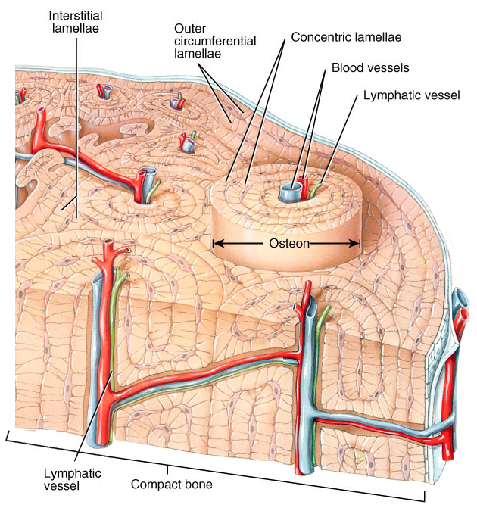
Histology of Bone Tissue
Compact Bone contains units called osteons or Haversian systems formed from concentric lamellae (rings of calcified matrix).
Interstitial lamellae
between osteons are left
over fragments of older
osteons.
Notes:
Named After Clopton Havers (1650?–1702), English physician and anatomist.

Slide 27

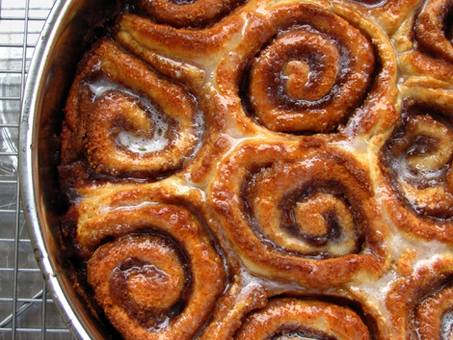
Histology of Bone Tissue: style
Compact Bone contains units called osteons or Haversian systems formed from concentric lamellae (rings of calcified matrix).
Interstitial lamellae
between osteons are left
over fragments of older
osteons.
What is inaccurate about this analogy?
Notes:
Named After Clopton Havers (1650?–1702), English physician and anatomist.

Slide 28
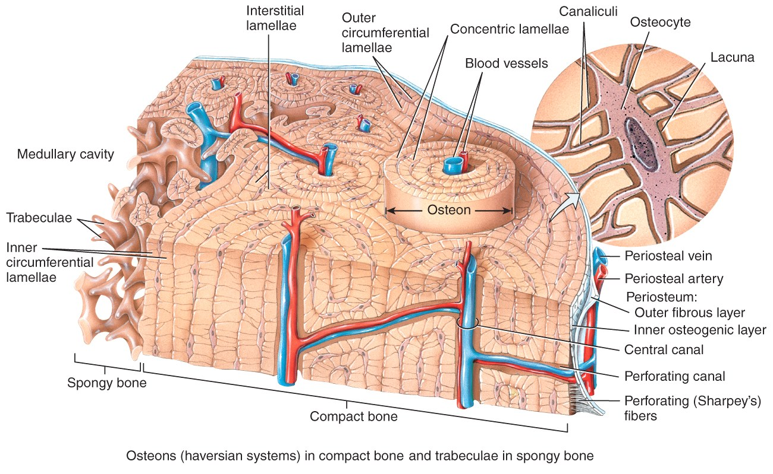
Histology of Bone Tissue
Outer circumferential lamellae encircle the bone beneath the periosteum.
Inner circumferential
lamellae encircle
the medullary
cavity.

Slide 29
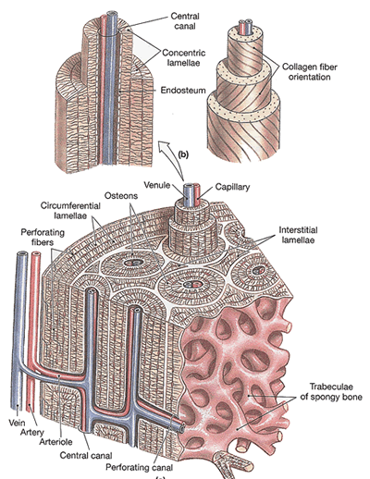
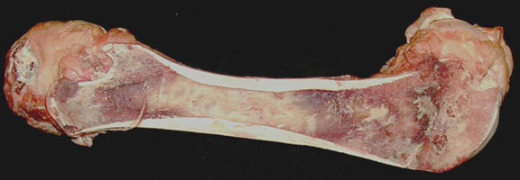
Histology of Bone Tissue
Outer circumferential lamellae
vs.
Inner circumferential
lamellae

Slide 30
Histology of Bone Tissue
Lacunae (lacuna: latin "lake or pond") are small spaces
between the lamellae which
house osteocytes.
Canaliculi are small
channels filled with
extracellular fluid
connecting the
lacunae.

Slide 31
Histology of Bone Tissue
Blood and lymphatic vessels
are found in the osteon’s
Central canal.
Perforating (Volkmann’s)
canals allow transit of
these vessels to the
outer cortex of the
bone.

Slide 32
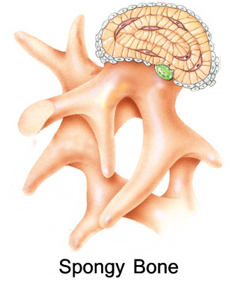
Histology of Bone Tissue
Spongy bone lacks osteons. Instead, lamellae are arranged in a lattice of thin columns called trabeculae.
  Trabeculae of spongy bone support and protect the red bone marrow and are oriented along lines of stress (helps bones resist stresses without breaking).
  Hematopoiesis (blood cell production)
  occurs in spongy bone.

Slide 33
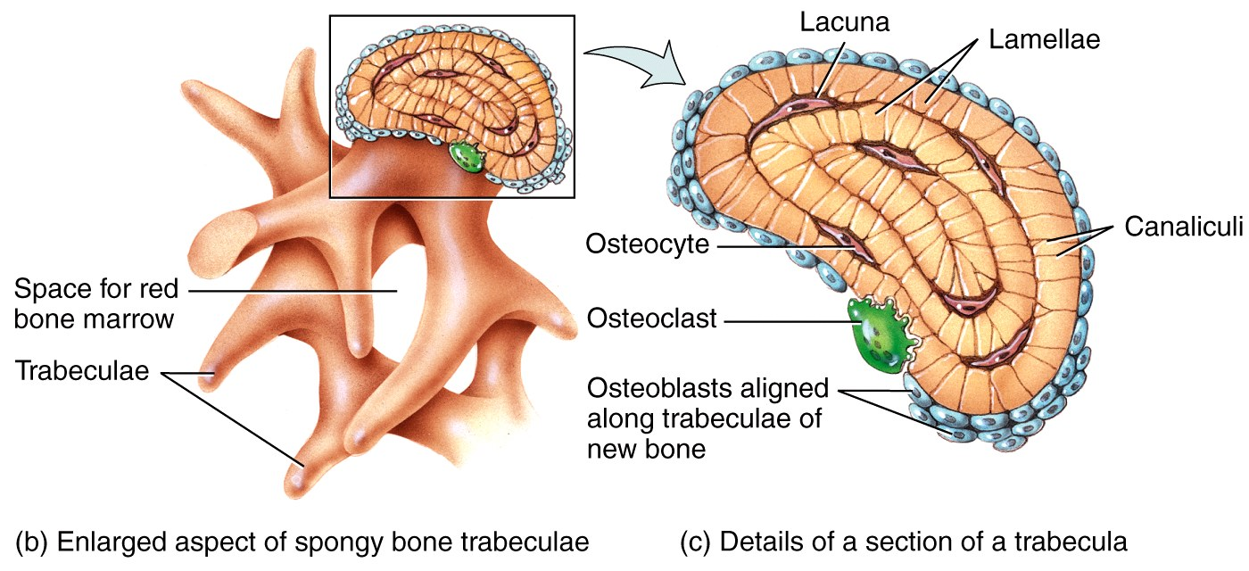
Histology of Bone Tissue
Within each trabecula of spongy bone are lacunae .
  As in compact bone, lacunae contain osteocytes that nourish the mature bone tissue from the blood circulating through the trabeculae.

Slide 34
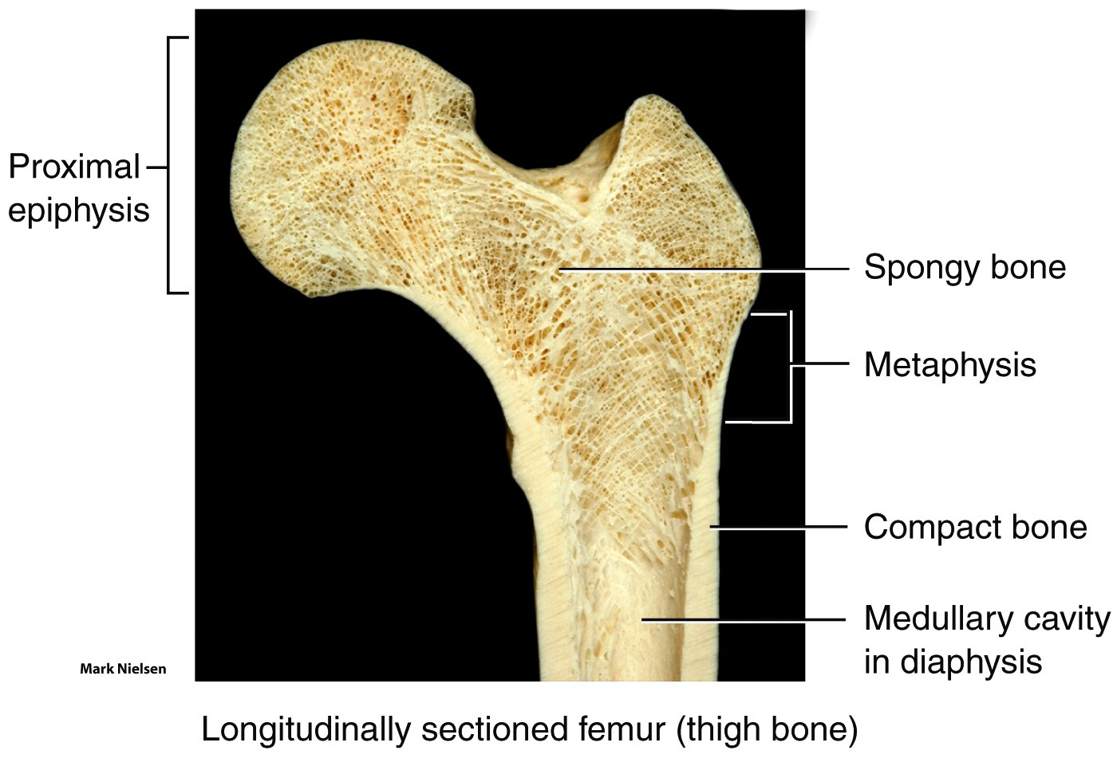
Histology of Bone Tissue
The interior of long bones is made up primarily of spongy bone. The use of spongy bone lessens overall bone weight.

Slide 35
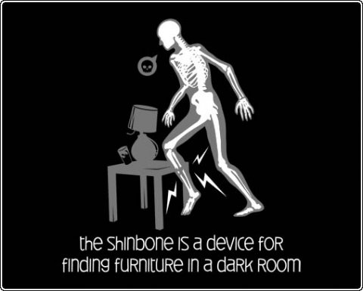
Blood and Nerve Supply of Bone
Ever wonder why this hurts so much—after all, there is little muscle to feel the pain…?

Slide 36
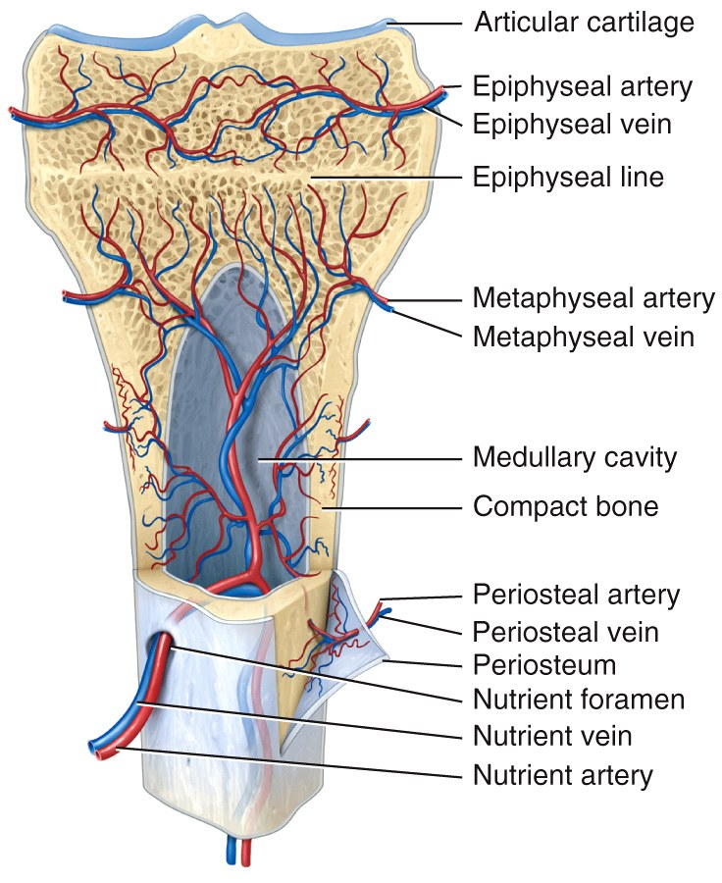
Blood and Nerve Supply of Bone
Bone is richly supplied with blood; Periosteal arteries and veins supply the periosteum and compact bone.
Nerves accompany the blood
vessels (this is often the case.)
  The periosteum is rich in
  sensory nerves sensitive to
  tearing or tension or compression!
Consider this a double whammy for pain…How is pain good?

Slide 37
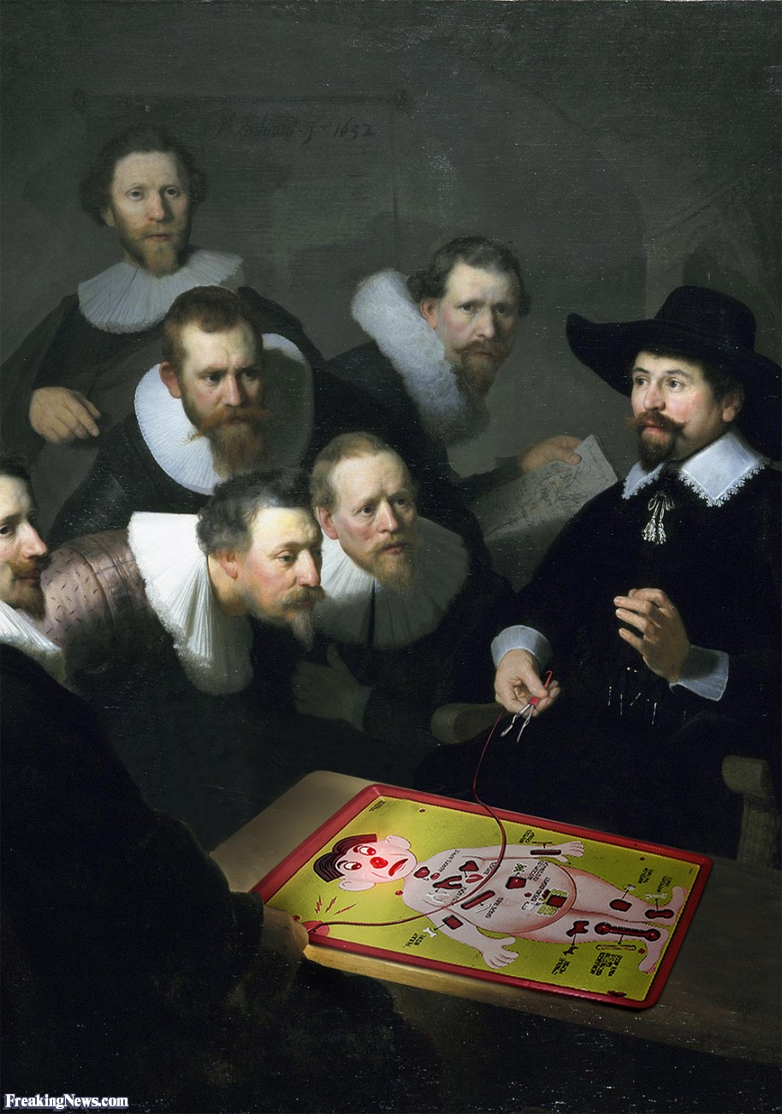
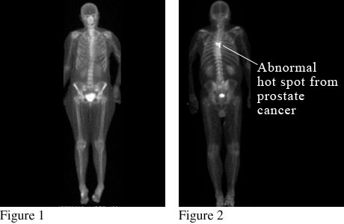
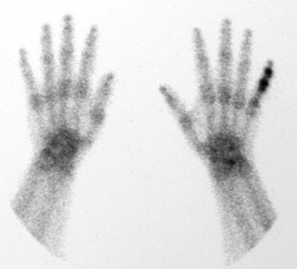
Clinical Connection
Bone Scan
A bone scan is a technique used to produce pictures of bones by first injecting a radioactive liquid substance into the body and then using a receiver to detect radioactive particles sent out by the body. Bone pain typically initiates these from a symptomatic standpoint and anything from tumors to infections to breaks and inflammations can be detected. These also aid doctors in monitoring skeletal progress during certain types of treatments.
Note the bladder…why is this so?

Slide 38
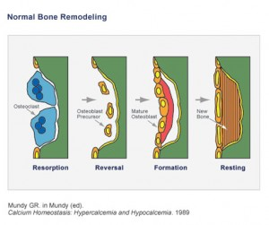
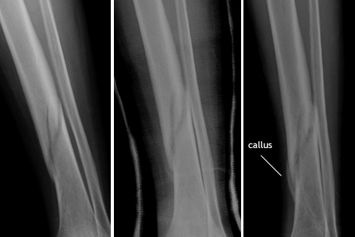
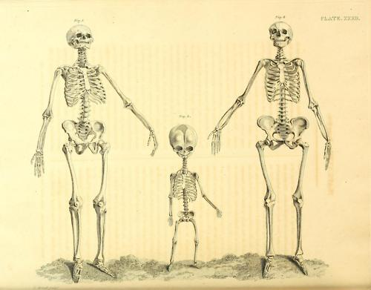
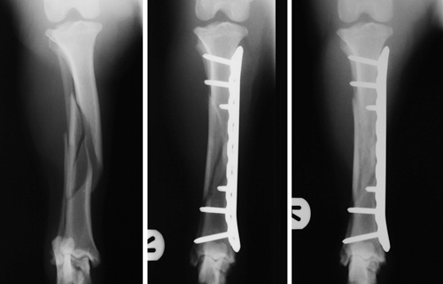
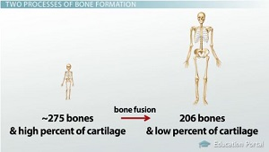
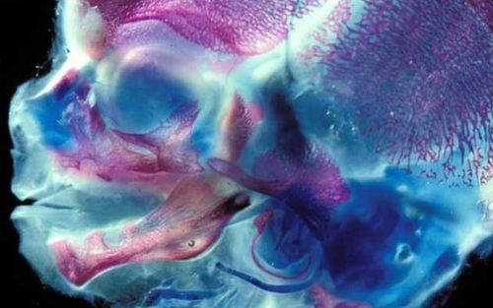
Bone Formation
Ossification or osteogenesis is the process of forming new bone. Bone formation occurs in four situations:
  Formation of bone in an embryo
  Growth of bones until adulthood
  Remodeling of bone (living tissue)
  Repair of fractures
12 week human fetus head double-stained to show newly formed cartilage (in blue) and bone (in purple)

Slide 39
Bone Formation
Osteogenesis occurs by two different methods, beginning about the 6th week of embryonic development.
  Intra-membranous ossification produces spongy bone.
    This bone may subsequently be remodeled to form compact bone.
  Endochondral ossification is a process whereby cartilage is replaced by bone.
    Forms both compact and spongy bone.

Slide 40
Bone Formation
Intra-membranous ossification is the simpler of the two methods.
  It is used in forming the flat bones of the skull, mandible, and clavicle.
  Bone forms from mesenchymal cells that develop within a membrane – without going through a cartilage stage (recall that mesenchyme is the tissue from which almost all other C.T. develop.)
  Many ossification centers.

Slide 41

Bone Formation

Slide 42
Bone Formation
Endochondral ossification is the method used in the formation of most bones, especially long bones.
  It involves replacement of cartilage by bone.
  There are one primary and two secondary centers of growth.

Slide 43

Bone Formation

Slide 44

Bone Formation
Ossification contributing to bone length is usually complete by 18-21 years of age.
Bones can still continue to thicken and are capable of repair even after the epiphyseal growth plates have closed.

Slide 45
Bone Formation
Human growth hormone is one of the body’s many anabolic hormones. Among other things, its secretion will stimulate bone growth, muscle growth, loss of fat, and increased glucose output in the liver.

Slide 46
Bone Formation
The use of growth hormone has been increasing in popularity among athletes due to the numerous “benefits” associated with its use; side effects are often not thought of when young athletes use these drugs.
HGH (Human Growth Hormone) TRUTHS & MYTHS!
http://www.faniq.com/blog/NFL-starter-claims-HGH-use-is-rampant-in-the-league-Blog-65748

Slide 47

Bone Formation
Interactions Animation
Bone Formation
You must be connected to the internet to run this animation

Slide 48
Bone Growth and Remodeling
A balance must exist between the actions of osteoclasts and osteoblasts.
  If too much new tissue is formed, the bones become abnormally thick and heavy (acromegaly).
  Excessive loss of calcium weakens the bones, as occurs in osteoporosis.
  They may also become too “soft”, as seen in the bone diseases rickets and osteomalacia.
B/w compact & spongy remodeling, any idea which takes longer? Why?

Slide 49








Clinical Connection
Hormonal Abnormalities that effect height
Recognize me? Which condition do I exhibit?
Various conditions result from over and undersecretion of HGH:
Giantism: oversecretion during childhood
Pituitary dwarfism: undersecretion during childhood
Acromegaly: oversecretion during adulthood
Achondroplasia: conversion of cartilage to bone is abnormal
Recognize me? Which condition do I exhibit?
Many achondroplasic patients undergo limb-lenghtening surgeries
This is a 3 month old with Achondroplasia…

Slide 50



Clinical Connection
Osteoporosis
Unchangeable risks
Your sex. Women are much more likely to develop osteoporosis than are men.
Age. The older you get, the greater your risk of osteoporosis.
Race. You're at greatest risk of osteoporosis if you're white or of Asian descent.
Family history. Having a parent or sibling with osteoporosis puts you at greater risk, especially if you also have a family history of hip fractures.
Frame size. Men and women who have small body frames tend to have a higher risk because they may have less bone mass to draw from as they age.
Bone is living tissue, which is constantly being absorbed and replaced. Osteoporosis occurs when the creation of new bone doesn't keep up with the removal of old bone—that is, if calcium (primarily) is being lost through urine, feces and sweat faster than it is absorbed dietarily.
Is this a part of your family history?

Slide 51



Clinical Connection
Rickets & Osteomalacia
In rickets, the growing bones of children fail to mineralise properly, which means they are too flexible. Once the child starts to walk, the long bones bend under the weight of the child, resulting in the bowed legs characteristic of the disease.
Vitamin D deficiency in adults causes a different condition, called osteomalacia – in this disease poorly mineralised bone replaces healthy bone during normal bone turnover. The resulting bone is weak and prone to fracture.
A picture from a Scottish orphanage…what could they have done to avoid this—assuming their diet was adequate?

Slide 52




Clinical Connection
Other terms
Osteoarthritis: degeneration of the articular cartilage such that the bony ends touch…
Osteomyelitis: An infection within the bone oft cause by Staph.
Osteosarcoma: Bone cancer that is most common in teenage growth spurts and manifests itself in the metaphyses of the humerus, femur, and tibia.
In 2012 Sobiech was told that he had months to a year to live, so he started the Zach Sobiech Osteosarcoma Fund and devoted his remaining days to writing and performing, raising both money and awareness for the disease. Zach passed away on May 20, 2013, just three months after the release of the duo's Fix Me Up EP. "Clouds" debuted at number 26 on the Billboard Hot 100 shortly after.
My Last Days: Meet Zach Sobiech - YouTube

Slide 53

Bone Growth and Remodeling
Interactions Animation
Bone Remodeling
You must be connected to the internet to run this animation

Slide 54
Bone Growth and Remodeling
Normal bone metabolism depends on several factors:
Minerals are an essential component.
  Large amounts of calcium and phosphorus and smaller amounts of magnesium, fluoride, and manganese are required for bone growth and remodeling.
  Hormones are key contributors to normal bone metabolism.
Bone Remodeling and Modeling - YouTube

Slide 55
Bone Growth and Remodeling
  Hormones continued…
  The sex hormones (estrogen and testosterone) cause a dramatic effect on bone growth, such as the sudden “growth spurt” that occurs during the teenage years.
    The sex hormones also promote widening of the pelvis in the female skeleton.
    They are also responsible for closing the epiphyseal plates at the end of puberty.

Slide 56
Bone Growth and Remodeling
Vitamins are also necessary for normal bone metabolism:
  Vitamin A stimulates activity of osteoblasts.
  Vitamin C is needed for synthesis of collagen.
  Vitamin D is essential to healthy bones because it promotes the absorption of calcium from foods in the gastrointestinal tract into the blood.
  Vitamins K and B₁₂ are needed for synthesis of bone proteins.

Slide 57

Calcium Homeostasis
The Skeletal System: It's ALIVE! - CrashCourse Biology #30

Slide 58
Fracture and Repair
The naming of fractures can be confusing because of the many different criteria that are used.
  Some schemes describe the anatomical appearance of the fracture:
    Partial, complete (fx is all the way through the bone), closed (simple), open (fx punctures the skin), “Green stick” (a small linear break in the bone cortex), impacted, comminuted, spiral, transverse, displaced

Slide 59

Fracture and Repair
Anatomical appearance – like breaking a green twig; one side breaks while the other bends
Greenstick

Slide 60

Fracture and Repair
Anatomical appearance – the distal part is shoved up into the proximal part.
Impacted

Slide 61

Fracture and Repair
Anatomical appearance – though not seen here, one or both bones are “open” to the outside.
Open (compound); conversely “closed” (simple) do not break the skin

Slide 62


Fracture and Repair
Anatomical appearance – the bone(s) are splintered, broken, or crushed into fragments (3+).
Comminuted

Slide 63

Fracture and Repair
A fracture caused by bone cancer…
Naming fractures, continued…
  Other fractures are classified by the disease or mechanism which produced the fracture.
    Pathological fracture (usually from a cancerous process or severe chronic disease),

Slide 64

Fracture and Repair
Naming fractures, continued…
    Stress fracture (produced from repeated strenuous activities such as running)

Slide 65
Fracture and Repair
Naming fractures, continued…
  Still other fractures describe a common pattern of injury, often involving more than one bone, and usually denoted by an eponym (someone’s name):
    Colles’ fracture of the distal radius
    Pott’s fracture of the distal fibula

Slide 66

Fracture and Repair
Eponyms – Colles’ is a fracture of the distal radius ± ulna.
Colles’

Slide 67

Fracture and Repair
Once a bone is fractured, repair proceeds in
a predictable pattern:
The first step, which occurs 6-8 hours after injury, is the formation of a fracture
hematoma as a result of
blood vessels breaking in
the periosteum and
in osteons.

Slide 68

Fracture and Repair
The second and third steps involve the formation of a callus (takes a few weeks, to as many as six months).
  Phagocytes remove cellular debris and fibroblasts
  deposit collagen to
  form a fibro-
  cartilaginous callus...

Slide 69

Fracture and Repair
  ... which is followed by osteoblasts forming a bony
  callus of spongy bone.

Slide 70

Fracture and Repair
The final step takes several months and is called remodeling :
  Spongy bone is replaced by
  compact bone.
  The fracture line
  disappears, but
  evidence of the break
  remains.

Slide 71
Exercise and Bone Tissue
Under mechanical stress, bone tissue becomes stronger through deposition of mineral salts and production of collagen fibers by osteoblasts. Unstressed bones, on the other hand, become weaker.
  Astronauts in space suffer rapid loss of bone density.
The main mechanical stresses on bone are those that result from the pull of skeletal muscles and the pull of gravity (weight-bearing activities).

Slide 72
Aging and Bone Tissue
  A decrease in bone mass occurs as the level of sex hormones diminishes during middle age (especially in women after menopause).
  Bone resorption by osteoclasts outpaces bone deposition by osteoblasts.
  Since female bones are generally smaller and less massive than males to begin with, old age has a greater adverse effect in females.

Slide 73
Aging and Bone Tissue
There are two principal effects of aging on bone tissue:
  Loss of bone mass
    The loss of calcium from bones is one of the symptoms in osteoporosis.
  Brittleness
    Collagen fibers give bone its tensile strength, and protein synthesis decreases with age.
    The loss of tensile strength causes the bones to become very brittle and susceptible to fracture.

Slide 74

Reminder: Aging and Bone Tissue
Osteoporosis is a condition where bone resorption outpaces bone deposition.
  Often due to depletion of calcium from the body or inadequate
  intake

