Slide 1

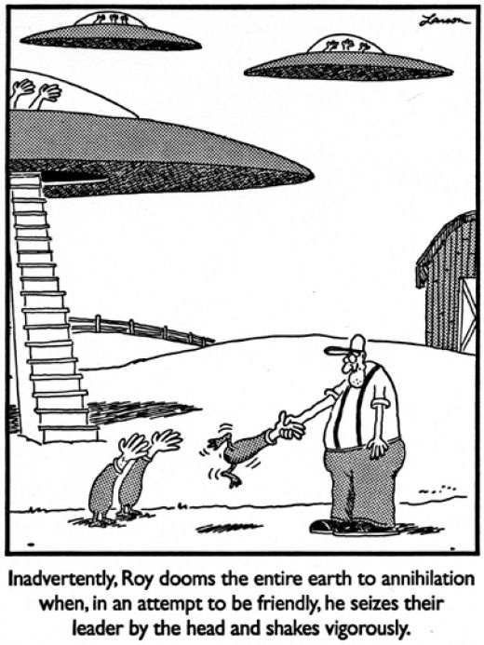
Chapter 1: An Introduction to the Human Body A&P mr. e SRCS

Slide 2
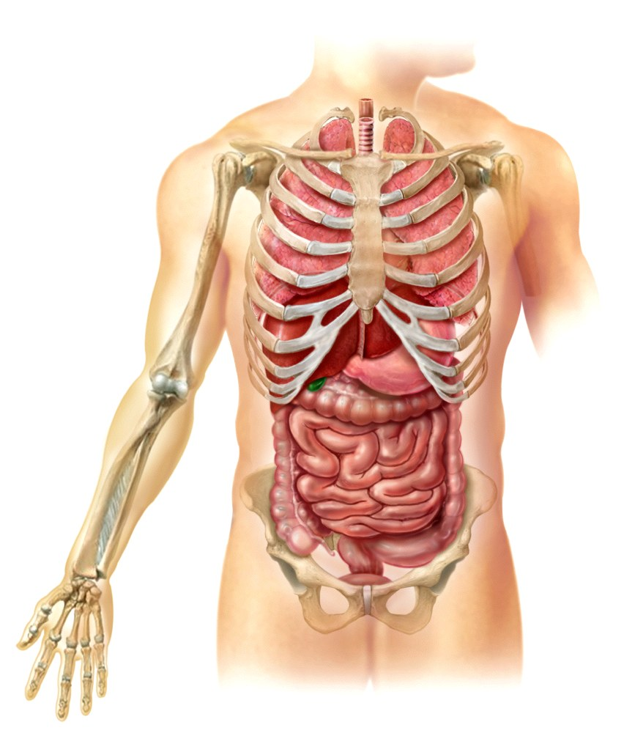
Anatomy and Physiology
Human Anatomy is the study of body structure.
    Word is derived from the Greek and means (tomia) “to cut” and (ana-) “up”
    Human Physiology is the science of body
functions (lit. “natural philosophy”).
    Including the study of homeostasis
    (keeping the organs systems of
    the body in balance; lit “same-standing still”)
Notes:
In the discussion of homeostasis, you might ask the students to give some examples of homeostatic mechanisms in every day life. Common examples are a thermostat on a furnace or cruise control in a car.

Slide 3
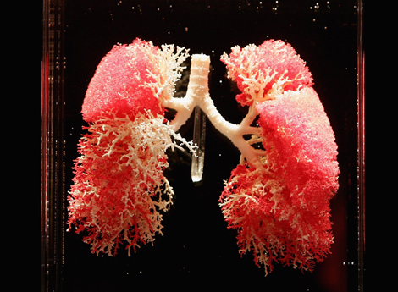
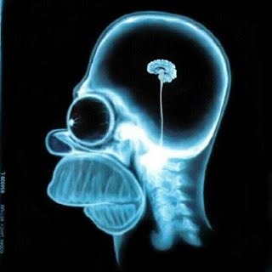
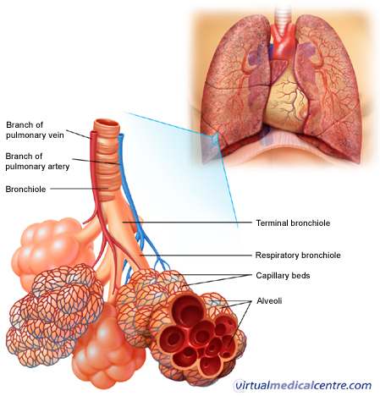
Anatomy and Physiology
Structure and function of the body are closely related: Structure mirrors function
  Bones of the skull
  are heavy and secure …
  The air sacs of the
  lungs are extremely thin …

Slide 4
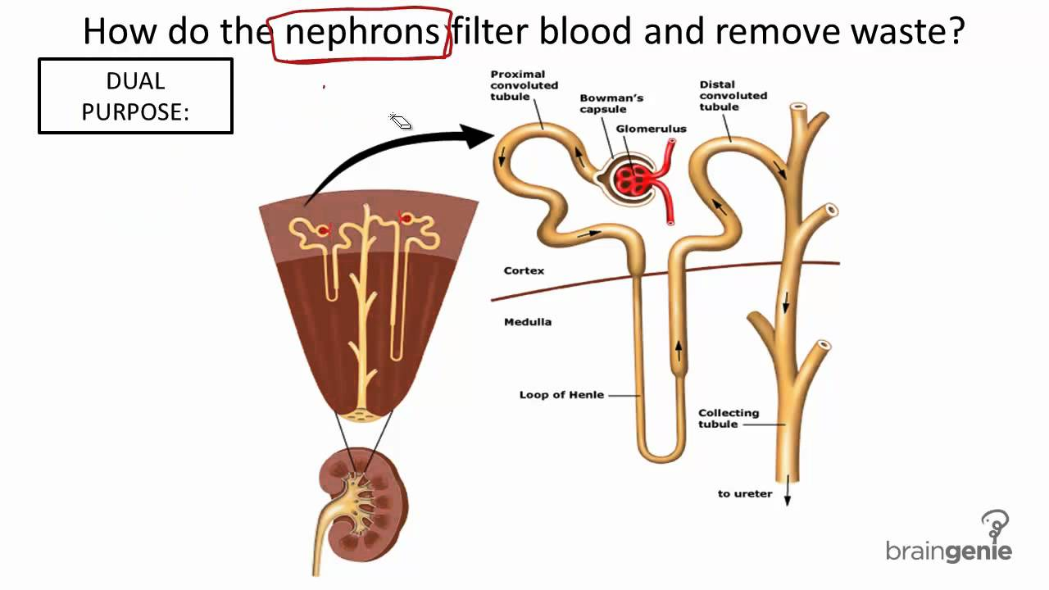

Anatomy and Physiology
Structure mirrors function
CrashCourse - YouTube
This structure is the kidney, which has the function of filtering blood and producing urine. Can you see how the function is determined by the structure, and vice versa?

Slide 5
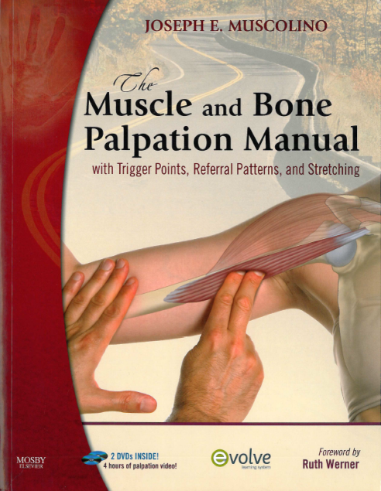
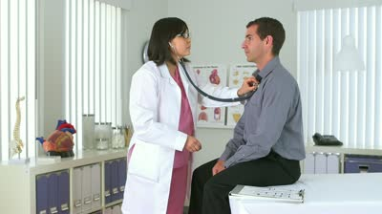
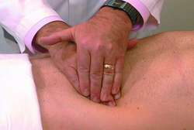
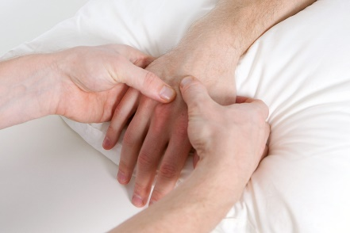
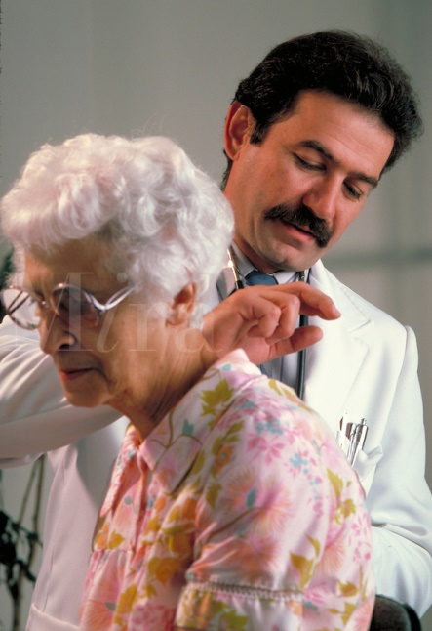

Subdivisions of Anatomy
Surface Anatomy is the study of form and markings of the body surface (without any “cutting”) , often explored through visualization or palpation (lit. palpo “touch softly”).
  Doctors may listen to sounds that either the organs produce (auscultation) or lightly tap the patient to listen for sound differences caused by fluids/denser areas (percussion)

Slide 6
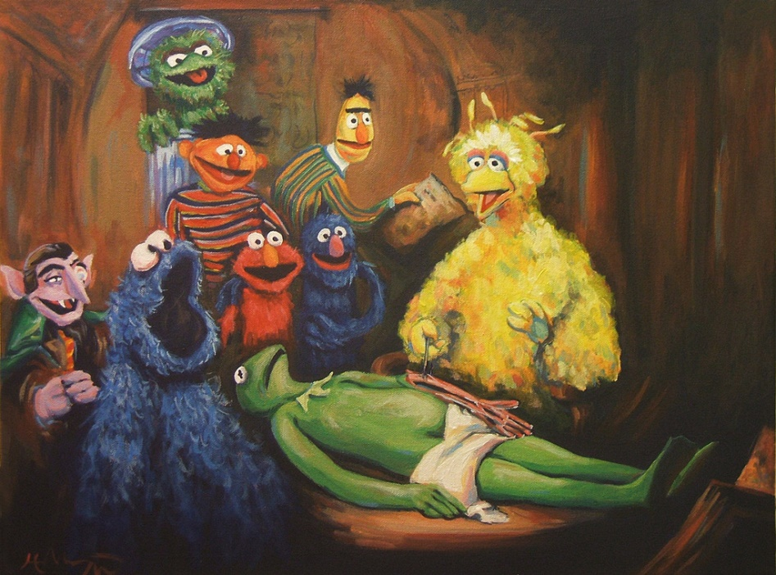
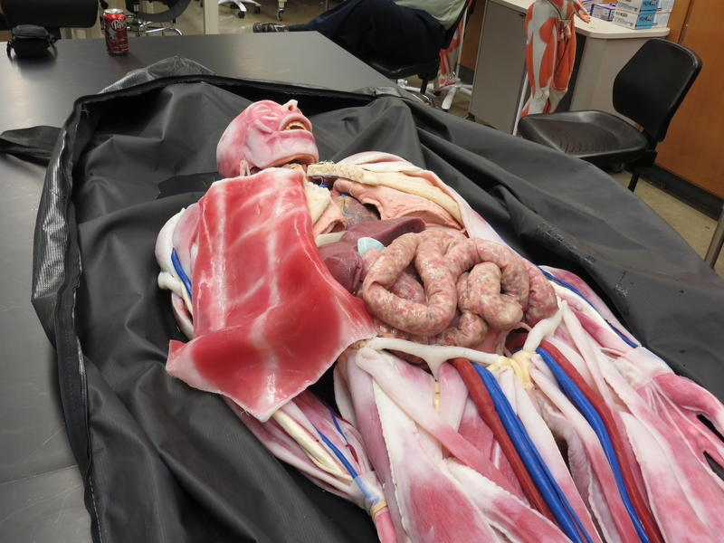
Subdivisions of Anatomy
Gross Anatomy is the study of anatomical structures visible to unaided eye. After making the appropriate surface marking the gross dissection proceeds through cutting.
Left: a synthetic cadaver being used at the University of Iowa; they run $40,000 each—but can be re-used. Genuine cadavers last only a year and create some faith-based issues as well—even though they generally cost $1000 each.

Slide 7
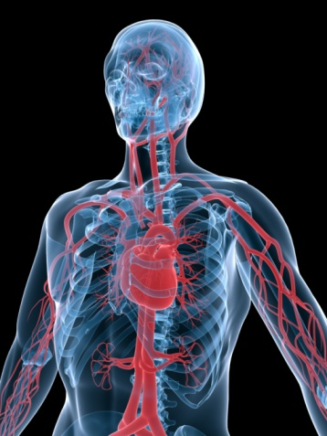
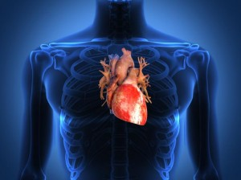
Subdivisions of Anatomy
Gross Anatomy can be studied by two general approaches:
  Systemic approach (Systemic Anatomy):
    Study all of the blood vessels, or all of the muscles, or all of the bones… at once.
  Regional approach (Regional Anatomy)
    All anatomical structures of a specific region (e.g. the thorax, or the Head and Neck) are all studied together.

Slide 8
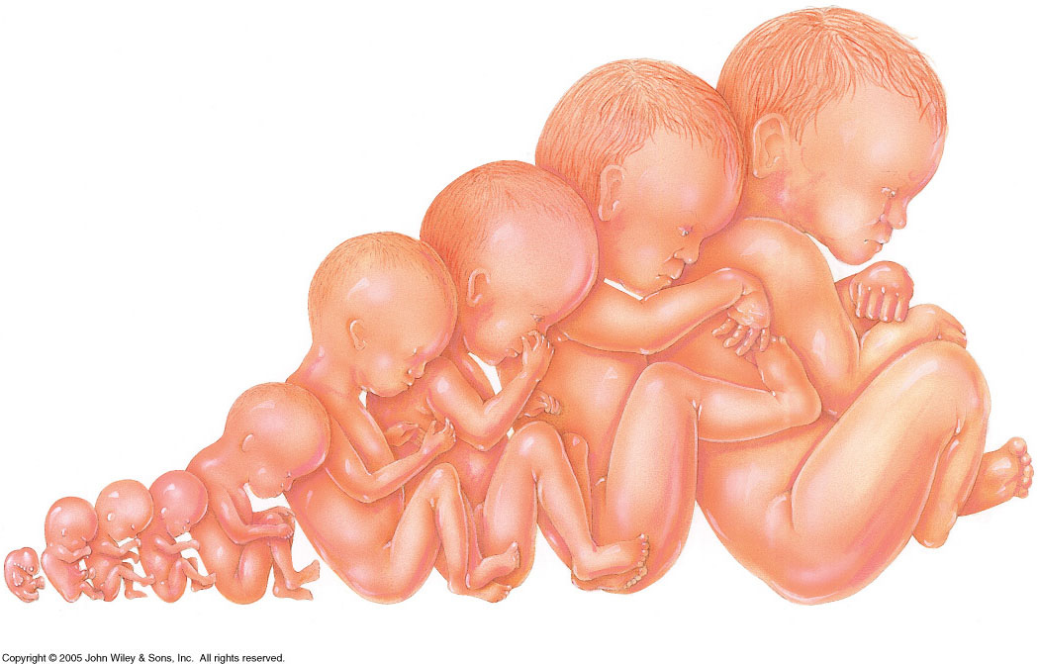
Subdivisions of Anatomy
Developmental anatomy is the study of the fertilized egg developing into its adult form.
  Embryology is a subcategory
  of developmental anatomy
  (conception to 8th
  week of gestation).
What are the moral ramifications of defining a subcategory so?
Notes:
Embryonic Period (Conception to week 8)
Fetal Period (week 8 to birth)
Neonatal Period (after birth)

Slide 9
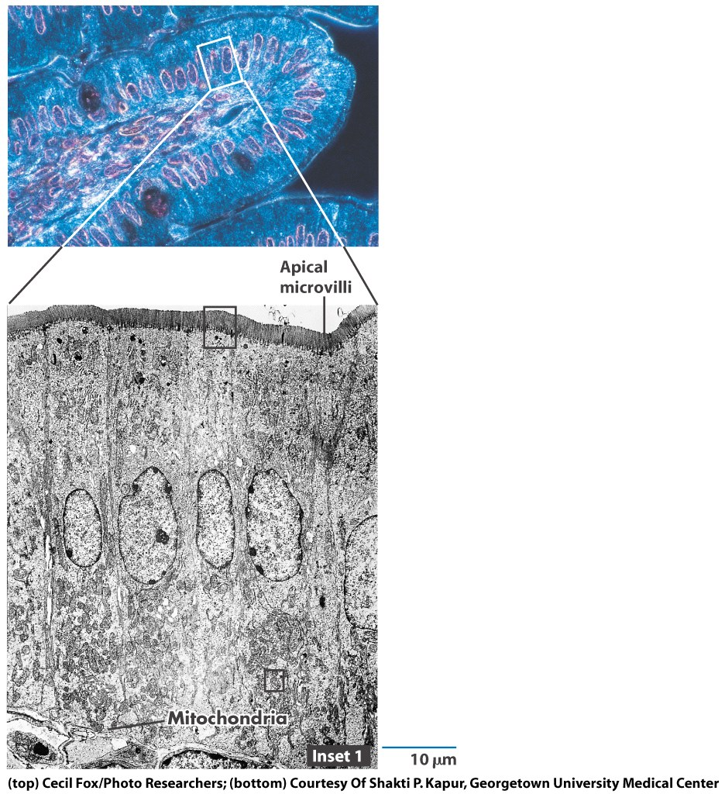
Subdivisions of Anatomy
Histology is the study of tissues.
Cytology, like histology, uses a
microscope, but restricts the study to individual cellular structures .
This micrograph is typical of an histological and cytological examination under light microscopy; upper is epithelial tissue lining the small intestine, the lower is a close up of epithelial cells

Slide 10
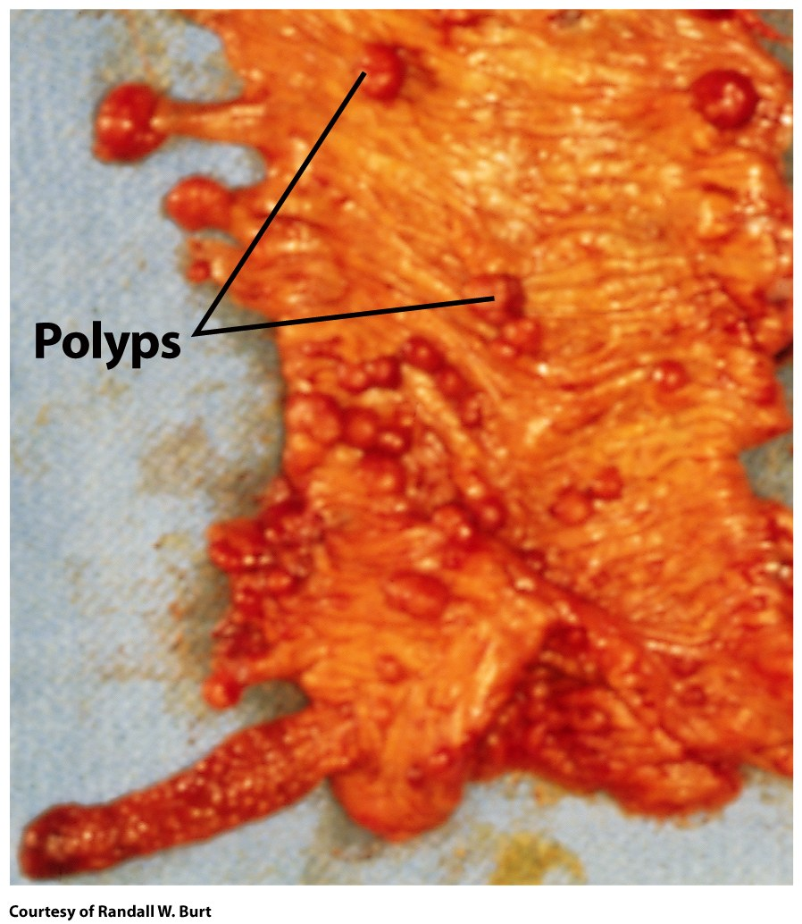
Subdivisions of Anatomy
Pathology is the study of anatomical changes due to disease .
  Pathologists use gross inspection, as well as cytologic, histologic, and laboratory
  examinations to discover the
  source of the disease.
  Immunology: study of body’s defense
  against disease
This is a section of a human colon
opened by a pathologist to reveal polyps that would become cancerous in a few years (premalignant).
Notes:
This image is from the Gerald Karp Cell and Molecular Biology visual library (in WileyPlus)

Slide 11
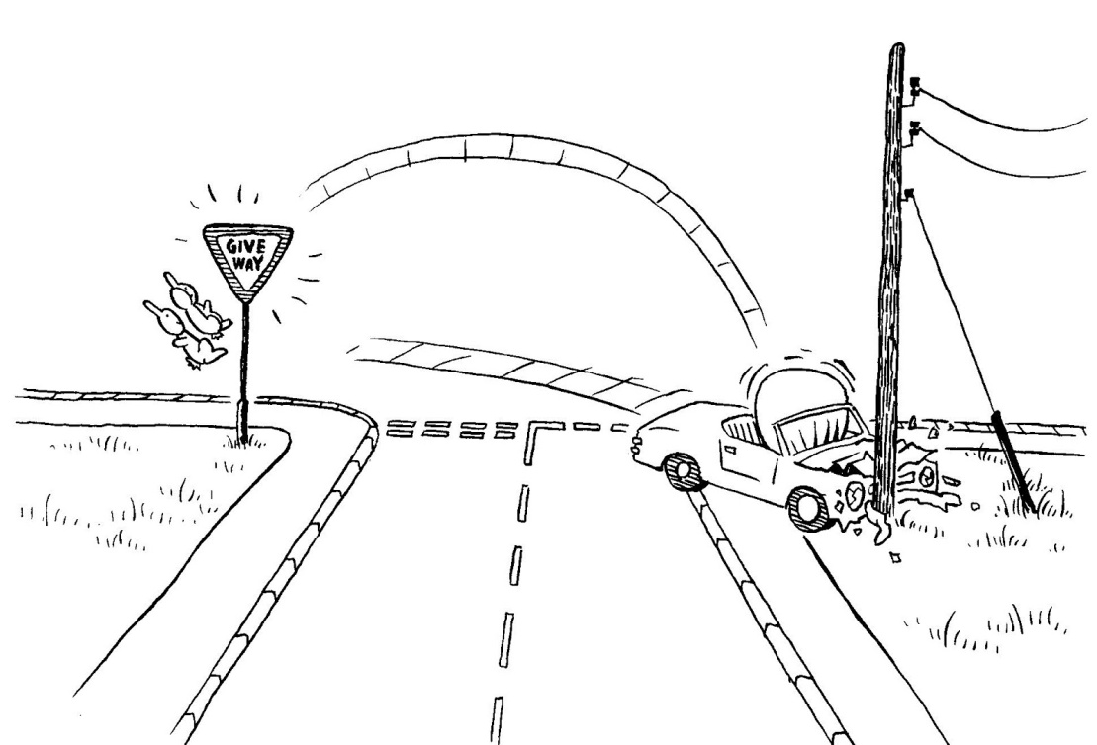
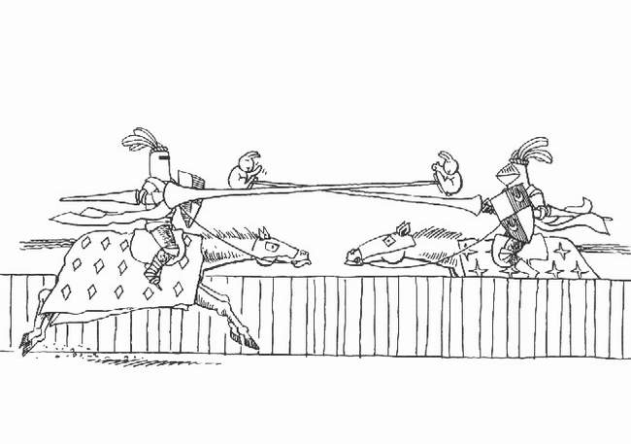

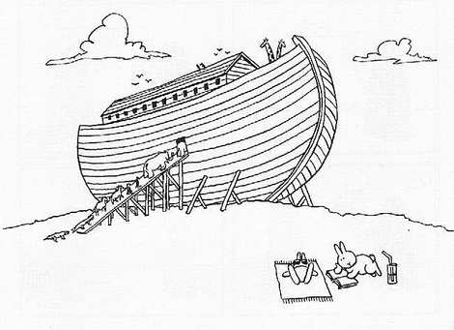
Clinical Connection
An autopsy is a postmortem (after death) examination of the body and internal organs performed by a pathologist.
An autopsy is usually done to :
  Determine the cause of death
Some require outside info…
Some are not…
Some don’t…
Some are easy…

Slide 12
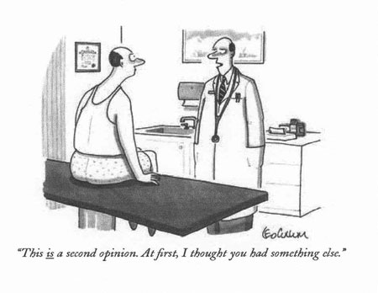
Clinical Connection
An autopsy is a postmortem (after death) examination of the body and internal organs performed by a pathologist.
An autopsy is usually done to :
  Identify diseases not detected during life

Slide 13
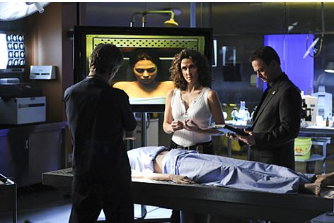
Clinical Connection
An autopsy is a postmortem (after death) examination of the body and internal organs performed by a pathologist.
An autopsy is usually done to:
  Determine the extent of injuries and contribution to death

Slide 14
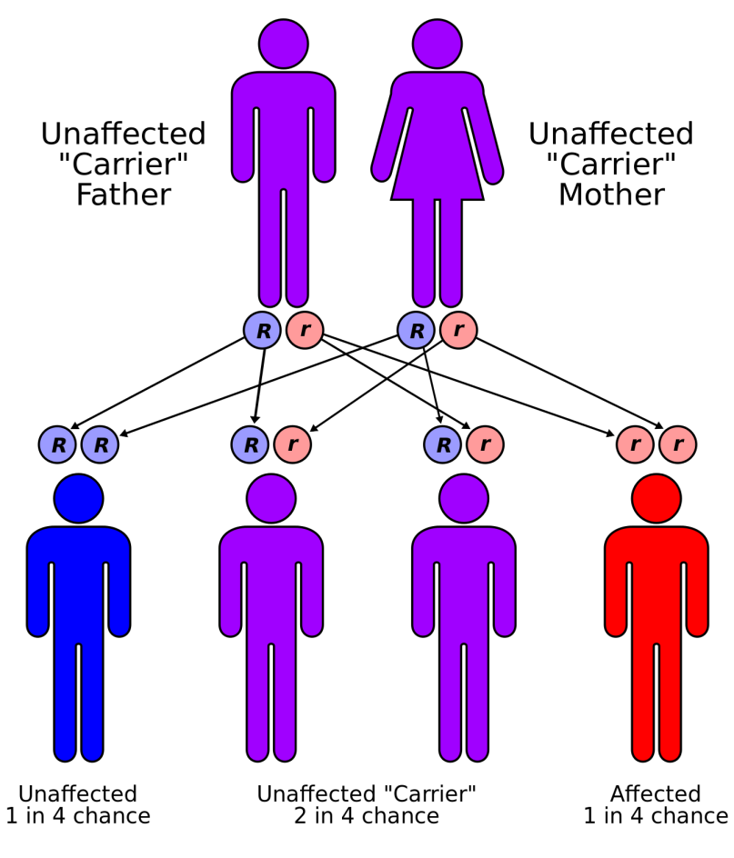
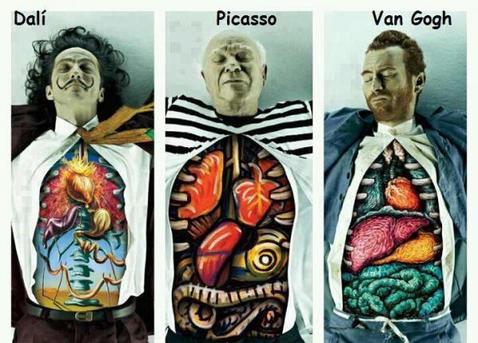
Clinical Connection
An autopsy is usually done to :
  Identify hereditary conditions not previously detected
  Educate students
  Provide statistical data

Slide 15
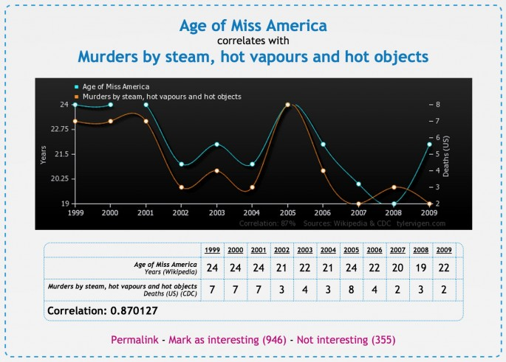
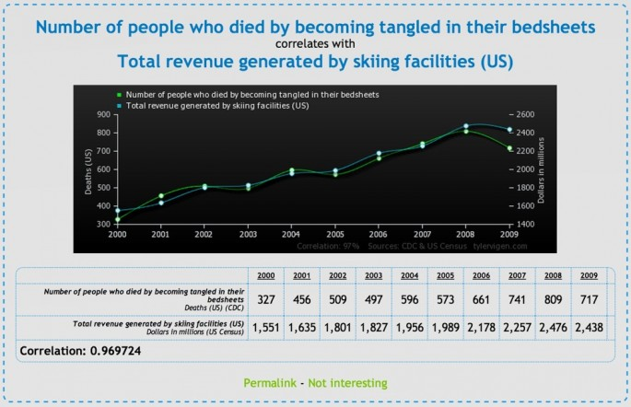
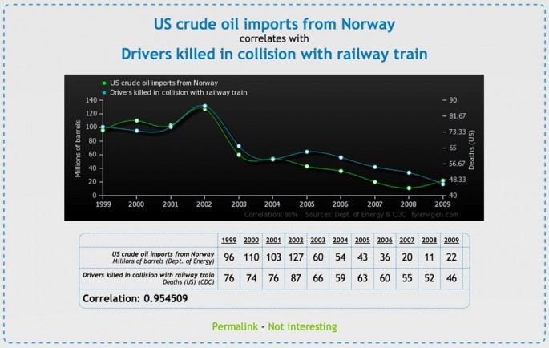
Clinical Connection
An autopsy is usually done to :
  Provide statistical data

Slide 16
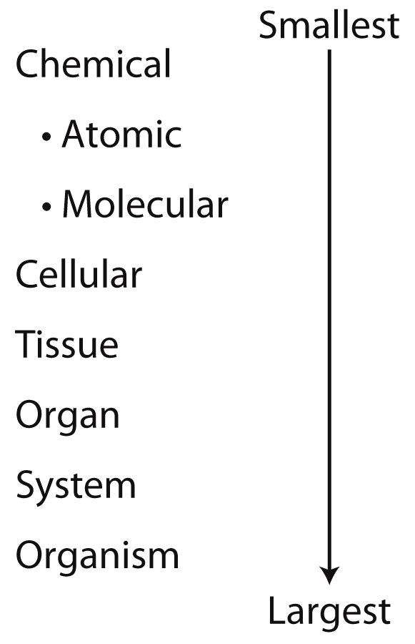
Levels of Organization
In this course, we will study Anatomy and Physiology by starting with the most basic level of organization (atoms) and “working our way up”.
If you were to draw a profound line of demarcation between any 2 levels, where would you & why?

Slide 17
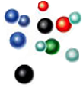
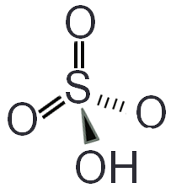
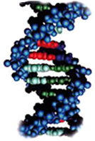
Levels of Organization
The chemical level of organization is discussed in Chapter 2:
  Atoms
  Inorganic Molecules (inorganic chemistry)
  Organic Molecules (organic chemistry)
Notes:
One of the things we do in this class is to go way back and study a little about the chemical organization of life – to better understand cells, tissues, organs, organ systems, and organisms.
Organic chemistry is the study of the “chemistry of life”… at least for carbon-based life forms!

Slide 18
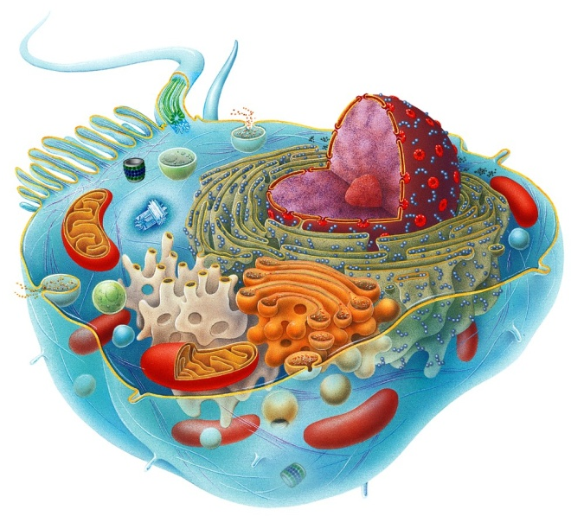
Levels of Organization
The Cell is next in complexity, in fact many billions of times more complex than molecules.
  Cells (and this is important!) are the basic structural and functional units of an organism .
    There are many different kinds of cells in the human body. A trained cytologist can
    recognize under light microscopy
    about 210 different kinds of cells.
A word about models
Notes:
- There are about 300 different looking (kinds) of cells in the body.
- It’s true that tissues are groups of cells and the materials that surround them (like the extracellular matrix of C.T.), but this clarification is not necessary to put in the slide.

Slide 19
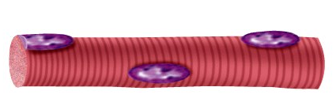
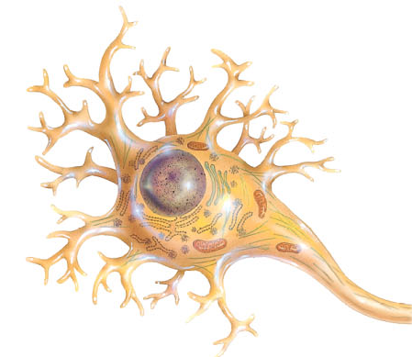
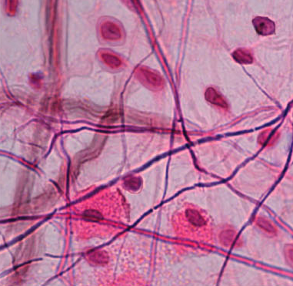
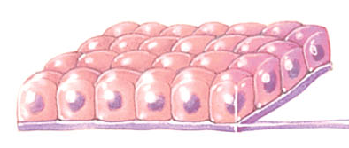
Levels of Organization
Tissues are groups of cells that work together to perform a similar function.
While there are many different types of cells, they all work to form 4 basic types of tissues:
  Epithelium
  Connective Tissue
  Muscle
  Nerves
Notes:
- There are about 300 different looking (kinds) of cells in the body.
- It’s true that tissues are groups of cells and the materials that surround them (like the extracellular matrix of C.T.), but this clarification is not necessary to put in the slide.

Slide 20
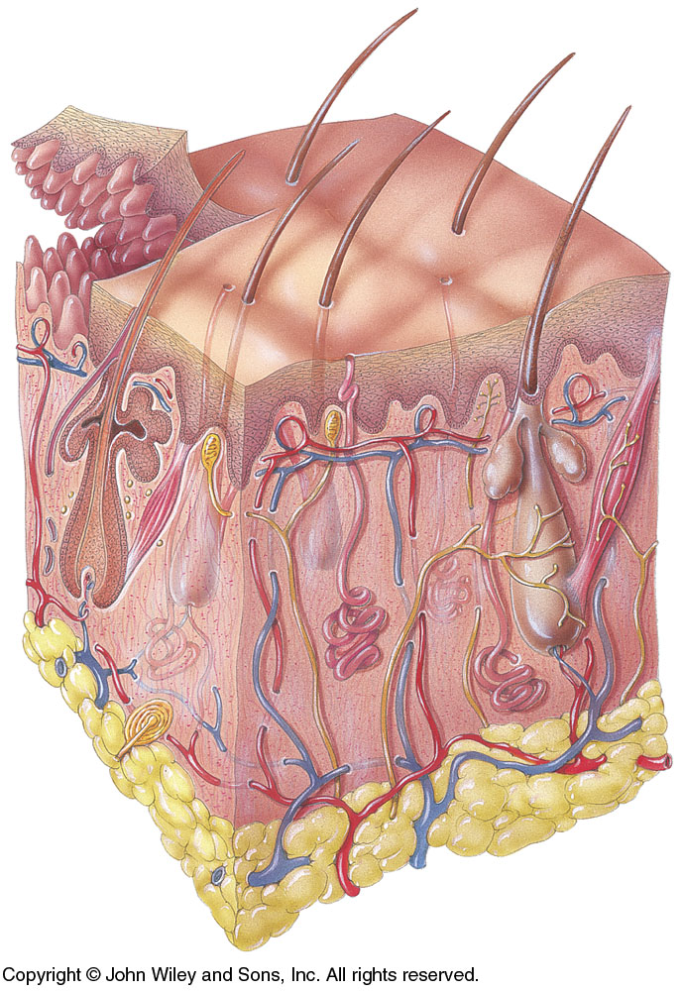
Levels of Organization
Organs are structures composed of two or more different types of tissues (all but the simplest of organs have all 4 basic tissues represented.)
  Organs have specific functions
  and recognizable shapes.
    Example: The skin contains
    Epithelium, Connective Tissues,
    Nerves, and Muscle.

Slide 21
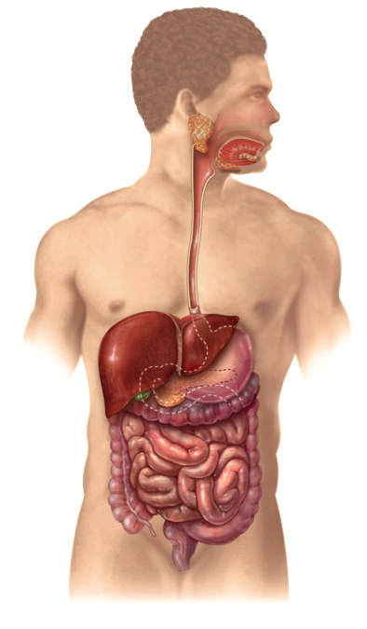
Levels of Organization
An organ system consists of related organs with a common function. For instance, the Digestive system handles all aspects of taking in and breaking down food, absorbing nutrients, and eliminating wastes.
  It includes all the organs of the mouth,
  esophagus, stomach, intestines, liver,
  gallbladder, and pancreas.
  There are 11 organ systems in
  the body.

Slide 22
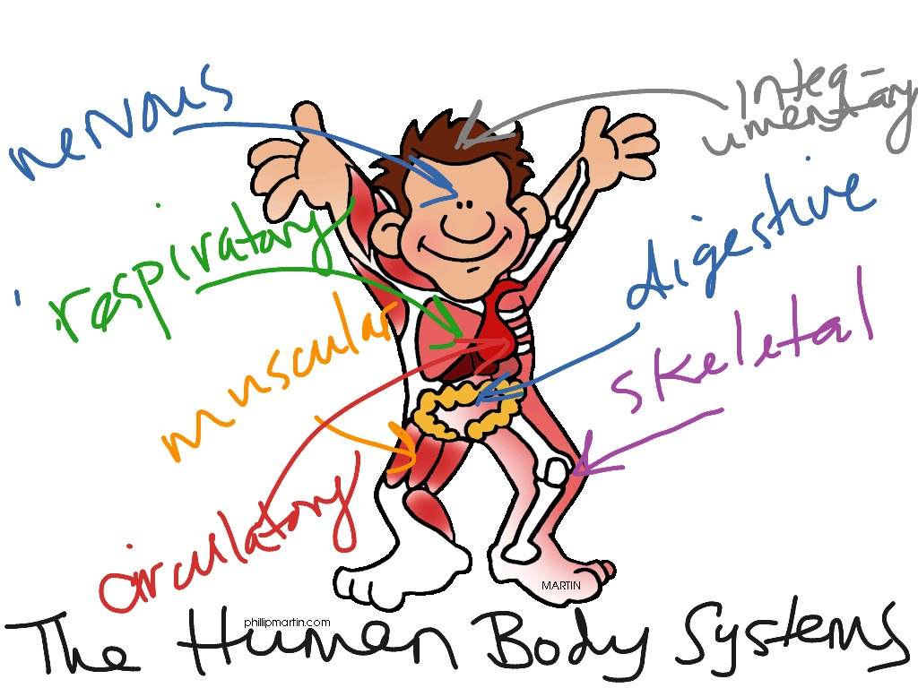
Levels of Organization
An organism consists of a collection of organ systems.
  Six important life processes:
    Metabolism
    Responsiveness
    Movement
    Growth
    Differentiation
    Reproduction
In health, all parts of the body must be functioning together in a process called homeostasis.
Notes:
One of the things we do in this class is to go way back and study a little of the chemical organization of life – to better understand cells, tissues, organs, organ systems, and organisms.

Slide 23
Essential Life Processes
Metabolism is the sum of all the catabolic (breaking down) and anabolic (building up) chemical processes that occur in the body.
Responsiveness is the body’s ability to detect and respond to changes which might represent an opportunity… or a threat!
  Decrease in body temperature
  Responding to sound
  Nerve (electrical signals) and muscle cells (contracting)

Slide 24
Essential Life Processes
Movement is any motion, including movement of tiny subcellular structures, or movement inside cells or organs.
  Leg muscles move the body from one place to another.
Growth involves an increase in body size due to an increase in size of existing cells, number of cells, or amount of extracellular material.
  In bone growth, materials between cells increase.

Slide 25
Essential Life Processes
Differentiation is the development of a cell from an unspecialized to specialized state. Cells have specialized structures and functions that differ from precursor cells.
  Stem cells give rise to cells that undergo differentiation.
Reproduction is the formation of new cells (growth, repair, or replacement) or the production of a new individual.
Introduction to Anatomy & Physiology: Crash Course A&P #1

Slide 26
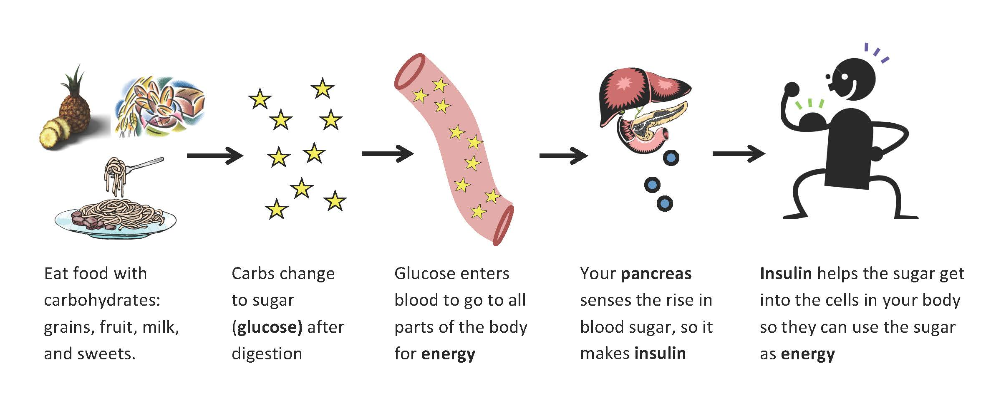
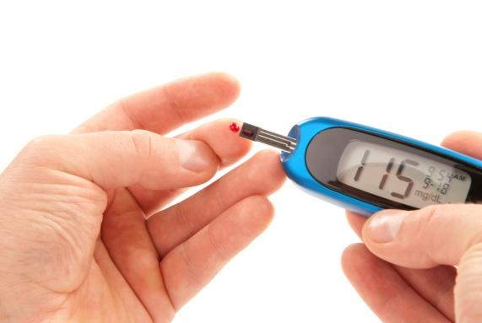
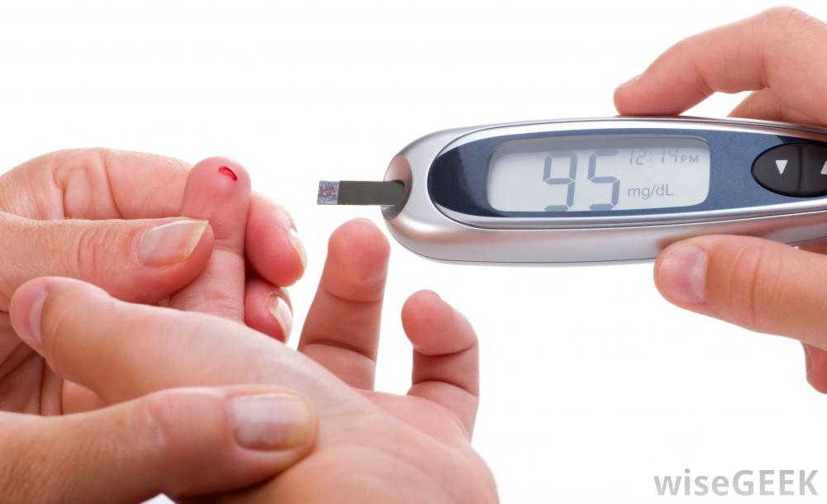
Homeostasis
A condition of equilibrium (balance) in the body’s internal environment. It is a dynamic condition meant to keep body functions in the narrow range compatible with maintaining life.
  Blood glucose levels range between 70 and 110 mg of glucose/dL of blood.

Slide 27
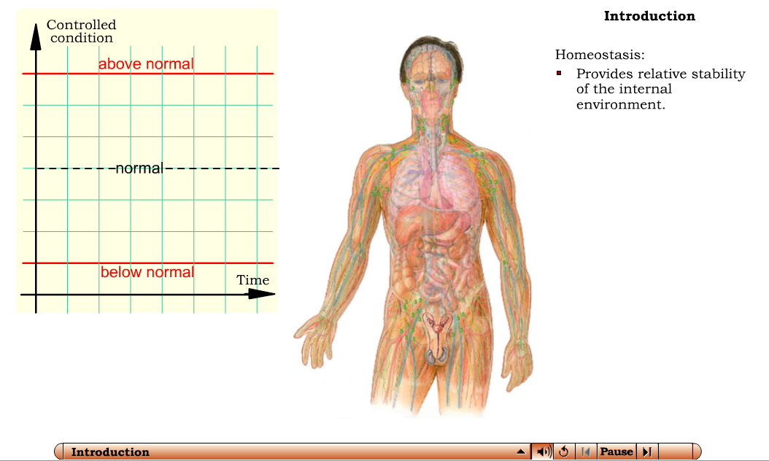
Homeostasis
Interactions Animation
Communication, Regulation and Homeostasis
You must be connected to the internet to run this animation.

Slide 28
Homeostasis
Body fluids are defined as dilute, watery solutions containing dissolved chemicals inside or outside of the cell. Maintaining the volume and composition of body fluids is important.
  Intracellular Fluid (ICF) is the fluid within cells
  Extracellular Fluid (ECF) is the fluid outside cells
    Interstitial fluid is ECF surrounding cells and tissues
Interstitial fluid (or tissue fluid) is a solution that bathes and surrounds the cells of multicellular animals. The interstitial fluid is found in the interstitial spaces, also known as the tissue spaces. On average, a person has about 11 liters (2.4 imperial gallons or ~2.9 U.S. gal) of interstitial fluid, providing the cells of the body with nutrients and a means of waste removal. (That is a little over 25 pounds…)

Slide 29
Homeostasis
Some important body fluids:
  Blood Plasma is the ECF within blood vessels.
  Lymph is the ECF within lymphatic vessels.
  Cerebrospinal fluid (CSF) is the ECF in the brain and spinal cord.
  Synovial fluid is the ECF in joints.
  Aqueous humor is the ECF in eyes.

Slide 30
Homeostasis
Control of homeostasis is constantly being challenged by:
  Physical insults such as intense heat or lack of oxygen
  Changes in the internal environment such as a drop in blood glucose due to lack of food
  Physiological stress such as demands of work or school
Disruptions are mild if balance is quickly restored.
Intense disruptions are often prolonged and result in injury, disease (poisoning or severe infections) or death.
Samsung Galaxy Note 7 Commercial 2016 Christoph Waltz

Slide 31
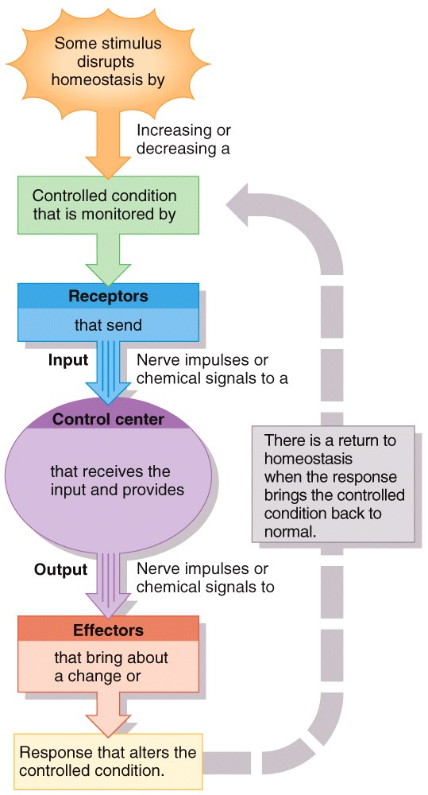
Feedback System
Cycle of events:
  Body is monitored and re-monitored.
  Each monitored variable is termed
  a controlled condition.
Three basic components:
  Receptor
  Control center
  Effector

Slide 32
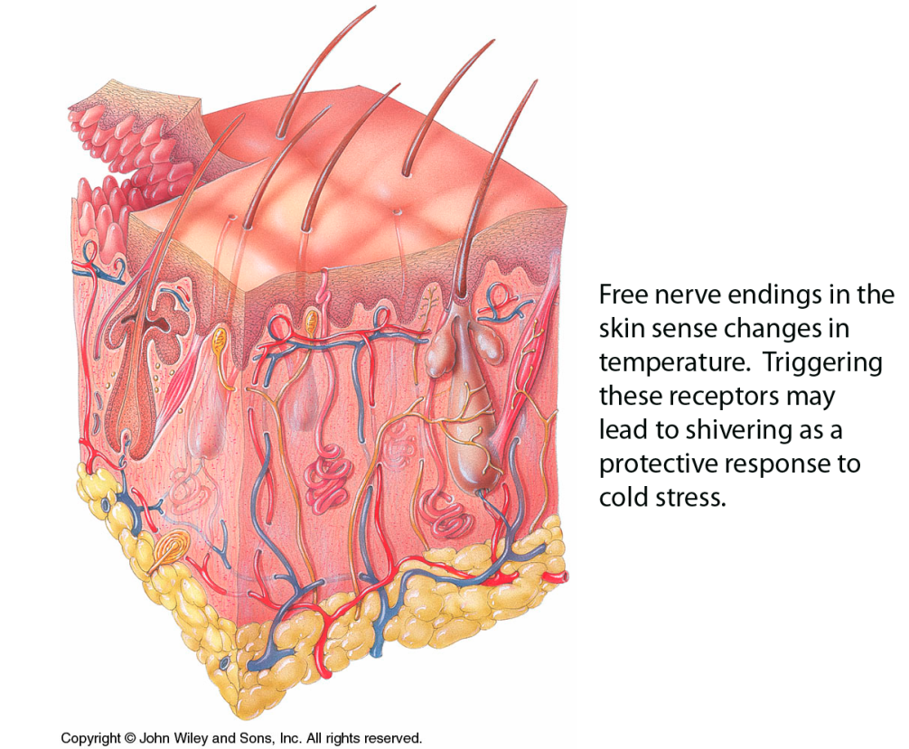
Feedback System
A receptor is a body structure that monitors changes in a controlled condition (such as body temperature) and sends input to the control center.
  Specialized nerve endings in
  the skin act as temperature
  receptors – they cause a
  nerve to fire in response
  to temperature changes.

Slide 33
Feedback System
  The control center sets the range of values to be maintained – usually this is done by the brain.
    Evaluates input received from receptors and generates output command
  Output involves nerve impulses, hormones, or other chemical agents.
    Brain acts as a control center receiving nerve impulses from skin temperature receptors.

Slide 34
Feedback System
The effector receives output from the control center and produces a response or effect that changes the controlled condition.
  Nearly every organ or tissue can serve as an effector.
    Body temperature drops (or environment cools)
    The brain sends an impulse to the skeletal muscles to contract.
    Shivering occurs to generate heat…

Slide 35
Feedback System
Negative Feedback systems:
  Reverses a change in a controlled condition; vast majority (time and #); internally regulated as controlled condition returns to normal state.
    Regulation of blood pressure (force exerted by blood as it presses again the walls of the blood vessels)
Positive Feedback systems:
  Strengthens or reinforces a change in one of the body’s controlled conditions; occur less frequently; must be externally regulated—that is, because the system reinforces the controlled condition, it must be shut down by something outside the system (eg. baby being born)
    Normal child birth
    Blood clotting
Why are these positive feedback systems? (What would happen if they weren’t?)

Slide 36
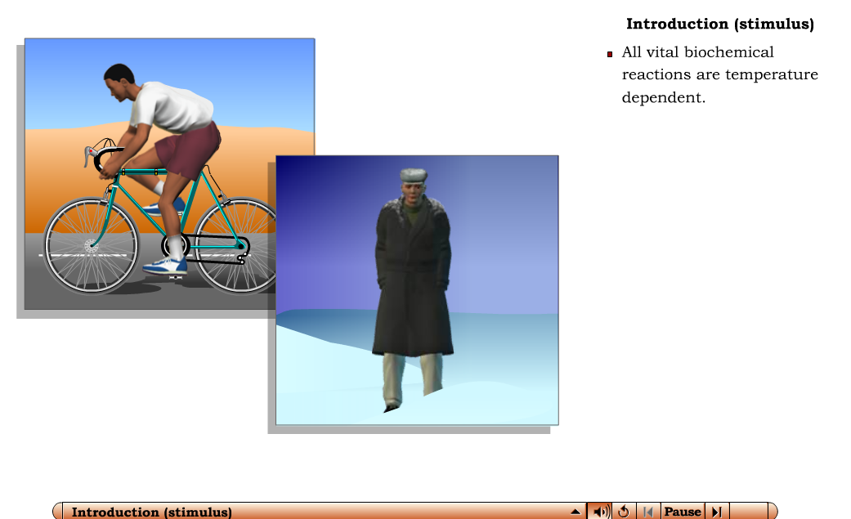
Negative Feedback – Temperature
Interactions Animation
Negative Feedback Control of Temperature
Process is explained on next slide…these are included in case you wish to view them later…
You must be connected to the internet to run this animation.

Slide 37
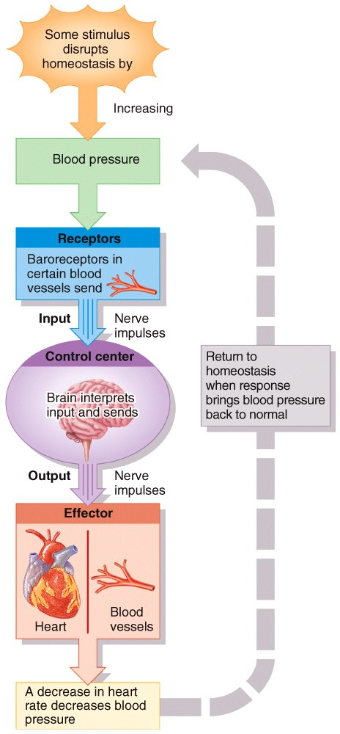
Feedback System
Blood Pressure regulation is a negative feedback system.
  External or internal stimulus increases BP.
  Baroreceptors (pressure sensitive
  receptors) detect higher BP and send a
  nerve impulse to the brain (interpretation).
  Responses sent via nerve impulses
  to the heart and blood vessels cause the
  BP to drop (homeostasis is restored.)

Slide 38
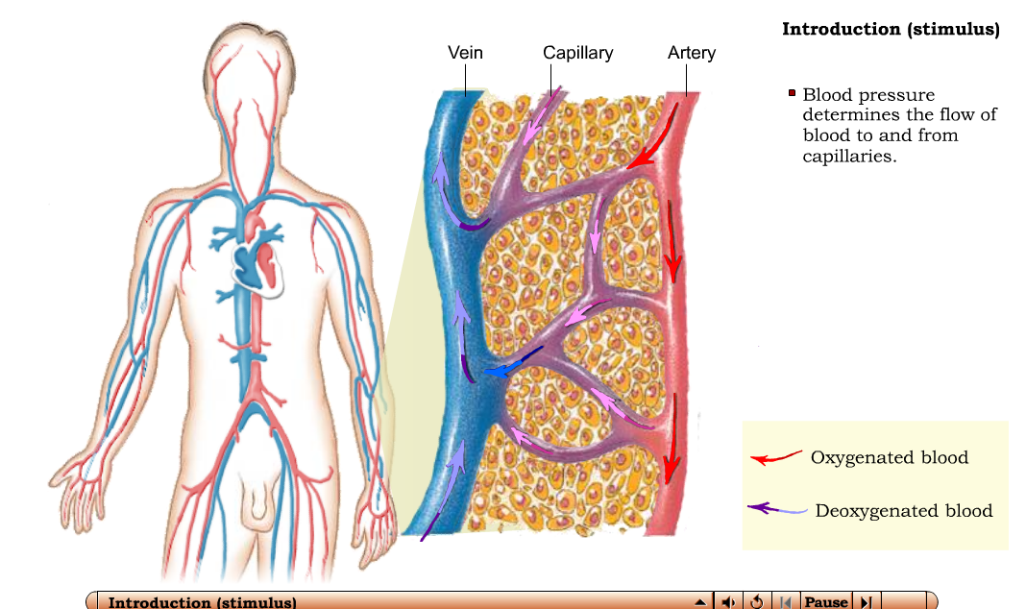
Blood Pressure Regulation
Interactions Animation
Negative Feedback Control of Blood Pressure
You must be connected to the internet to run this animation.

Slide 39
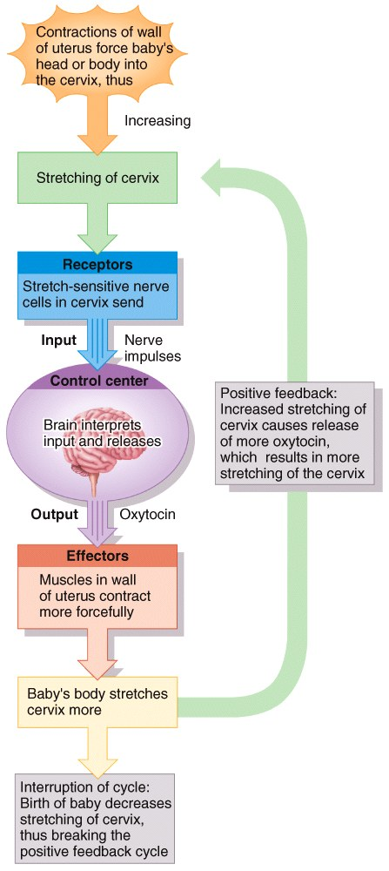
Feedback System
Childbirth is an example of a positive feedback system:
  Uterine contractions cause vagina to open.
  Stretch-sensitive receptors in cervix send
  impulses to brain.
  Oxytocin is released into the blood.
  Contractions enhanced and baby pushes
  farther down the uterus.
  Cycle continues to the birth of the
  baby (stretching stimulus ceases).

Slide 40

Positive Feedback – Labor
Interactions Animation
Positive Feedback Control of Labor
You must be connected to the internet to run this animation.

Slide 41
Clinical Connection
Diagnosis of Disease is done by assessing:
  Signs and symptoms…(a word about this on the next slide)
  Medical history
    Collecting information about event
    Present illnesses and past medical problems
  Physical examination:
    Orderly evaluation of the body and its function
    Noninvasive techniques and other vital signs (pulse)

Slide 42

Clinical Connection
Diagnosis of Disease is done by assessing:
  Signs and symptoms
  1. Signs are what a doctor sees, symptoms are what a patient experiences.
  2. While signs are the physical manifestation of injury, illness or disease, symptoms can be described as what a patient experience about the injury, illness or disease.
  3. Signs are objective (and can be measured). Symptoms on the other hand are subjective.
headache…
fever…

Slide 43


Organ Systems of the Body
Integumentary System (Chapter 5) consists of the skin and related structures (hair, nails, and glands).
  Protects body, regulates temperature, and eliminates wastes through sweat and other secretions

Slide 44

Organ Systems of the Body
Skeletal System (Chapters 6-9) consists of the bones and joints.
  Provides protection and support
  Houses cells that will
  become red blood cells,
  white blood cells, and
  platelets

Slide 45

Organ Systems of the Body
Muscular System (Chapters 10-11) consists of the named skeletal muscles, as well as
smooth muscle and cardiac muscle.
  Participates with the skeletal
  system to facilitate movement
  and maintain posture
  Generates the heat necessary
  for warm-blooded organisms to
  maintain a constant body temp.

Slide 46

Organ Systems of the Body
Nervous System (Chapters 12-17) consists of the brain, spinal cord, nerves, and sensory
organs).
  Senses and responds to body
  conditions through
  nerve impulses

Slide 47

Organ Systems of the Body
Endocrine System (Chapter 18) consists of hormone- producing cells and glands
scattered throughout the
body.
  Regulates the body
  through chemical
  mechanisms (by releasing
  hormones into the blood)

Slide 48

Organ Systems of the Body
Cardiovascular (Chapters 19-21) consists of the heart, blood, and blood vessels.
  Carries blood and nutrients to
  specific locations
  Regulates body temperature,
  and water balance

Slide 49

Organ Systems of the Body
Lymphatic System and Immunity (Chapter 22) consists of the lymphatic fluid, lymph nodes, and lymphocytes – and the other associated organs of
the immune system like the
tonsils, spleen and thymus gland.
  Transports fats and proteins
  to the cardiovascular system
  Filters blood and protects
  against disease

Slide 50

Organ Systems of the Body
Respiratory System (Chapter 23) consists of the upper airways, the trachea and major
bronchi, and the lungs.
  Extracts O₂ and
  eliminates CO₂
  In conjunction with the
  kidneys, regulates
  acid/base balance

Slide 51

Organ Systems of the Body
Digestive System (Chapter 24) consists of the esophagus, stomach and intestines, and
the accessory digestive
glands like the salivary
glands, liver, and gallbladder.
  Accomplishes the physical
  and chemical breakdown
  of food and elimination of waste

Slide 52

Organ Systems of the Body
Urinary System (Chapter 26) consists of the kidneys, ureters , bladder, and urethra.
  Involved in the collection
  and excretion of waste
  products in urine, and the
  regulation of fluid,
  electrolyte, & acid/base
  balance

Slide 53

Organ Systems of the Body
Reproductive System (Chapter 28) consists of the ovaries, uterus and vagina in the female, and the testes and penis in the male (along with associated organs and glands in both sexes).
  Reproduction of an individual or organism

Slide 54
Organ Systems of the Body
The systems of the body may appear to be separate and distinct, but the maintenance of most body functions requires the integration of many systems working together.
  For example, regulation of body temperature involves the muscular, cardiovascular, nervous, and integumentary systems all working together to produce and distribute body heat appropriately.

Slide 55

Anatomical Terminology
Anatomists use a common language referring to body structures and their functions.
  One key concept is the standard anatomical position.
  Other special vocabulary relates one body part to another.
VID: Anatomical Terms - Drawn & Defined (Updated)

Slide 56

Anatomical Terminology
Anatomical Position
  In the anatomical position, the subject stands
  erect facing the observer with the head
  level, the eyes facing forward, feet flat on
  the floor directed forward, and the arms
  at their sides, palms forward.
  All anatomical descriptions are in
  reference to this position.
Notes:
Descriptions of the human body assume it is in a specific stance (called the “anatomical position”).

Slide 57

Anatomical Terminology
Anatomical Position
Notes:
Descriptions of the human body assume it is in a specific stance (called the “anatomical position”).

Slide 58

Anatomical Terminology
Directional Terms
  Superior
  Inferior
Above, top, toward head
Below, bottom,
away from head

Slide 59


Anatomical Terminology
  Toward the front
  Toward the back
Directional Terms
  Anterior (Ventral)
  Posterior (Dorsal)

Slide 60

Anatomical Terminology
Directional Terms
  Medial
  Lateral
  Intermediate
Toward the midline
Away from midline
Between

Slide 61

Anatomical Terminology
Directional Terms
  Proximal
  Distal
Nearest to the origination
Farther from
origination

Slide 62

Anatomical Terminology
Directional Terms
  Superficial
  Deep
Towards the surface
Towards the core of the body
Superficial
Superficial
Deep
Superficial
Superficial

Slide 63
Anatomical Terminology
Regional Names
  Cephalic
  Cervical
  Cubital
  Carpal
  Patellar
  Orbital
  Thoracic
  Inguinal
Head
Neck
Elbow
Wrist
Front of knee
Eye
Chest
Groin

Slide 64
Anatomical Terminology
Regional Names
  Metacarpal
  Plantar
  Buccal
  Axillary
  Femoral
  Gluteal
  Tarsal
  Digital
  or Phalangeal
Hand/palm
Sole of foot
Cheek
Armpit
Thigh
Buttock
Ankle
Toes
or Fingers

Slide 65

Body Planes
Body Planes are imaginary flat surfaces that separate the body or body part into portions. There
are three major planes at right
angles to one another:
  Sagittal (midline)
  Transverse (horizontal)
  Frontal (coronal)

Slide 66
Body Planes
Sagittal planes divide the body into right and left sides.
  There is only one midsagittal plane,
  and it divides the body into two
  equal, mirror-image halves.
  There are an infinite number
  of possible parasagittal planes
  to the right and left of the
  midsagittal that divide the
  body into unequal “halves”.

Slide 67
Body Planes
Frontal or coronal planes divide the body (or an organ) into anterior (front) and posterior
(back) portions.
  Transverse planes (also called
  cross-sectional or horizontal
  planes) divide the body into
superior (upper) and inferior
(lower) portions.

Slide 68
Body Planes
In addition to the right angle sagittal, coronal and transverse planes, the body can also be
divided into an infinite number
of oblique planes that pass
through the body or organ at
an angle.
Sections are cuts of the body
made along a plane.

Slide 69



Organ Planes
A midsagittal section of the human brain
A frontal (or coronal) brain section
A transverse (or horizontal) brain section

Slide 70

Body Cavities
VID: Body Cavities - Drawn & Defined

Slide 71

Main Body Cavities
Cranial cavity is formed by the cranial bones.
  Protects the brain
Vertebral canal is formed by bones of vertebral column.
  Contains the spinal cord
  Thoracic cavity is formed by the sternum, ribs, and the thoracic portion of the bony vertebral column.
  Abdominopelvic Cavity extends from the diaphragm to the groin

Slide 72
Detailed Body Cavities
Thoracic cavity is formed by the sternum, ribs, and the thoracic portion of the bony vertebral column.
  Also called chest cavity
  Stabilized by the internal
  and external muscles of
  the chest

Slide 73

Body Cavities
Other cavities are contained within the thoracic cavity:
  Mediastinal cavity
    Located in the central part of the thoracic cavity
  Left and Right Pleural cavities
    Two fluid-filled spaces that surround each lung
Notes:
The Mediastinal cavity is located in the central part of the thoracic cavity
Location
Between lungs
From the sternum to the vertebral column
From the first rib to the diaphragm
The two pleural cavities are filled with the right and left pleural membranes and lungs

Slide 74
Body Cavities
  Pericardial cavity is itself located within the middle part of the mediastinal cavity in the thoracic cavity (like a set of Russian nesting dolls of decreasing size—one placed inside the other).
  Fluid-filled space that
  surrounds the heart
Notes:
This file is licensed under the Creative Commons Attribution ShareAlike 3.0 License. In short: you are free to share and make derivative works of the file under the conditions that you appropriately attribute it, and that you distribute it only under a license identical to this one. Official license
This licensing tag was added to this file as part of the GFDL licensing update.

Slide 75

Body Cavities
  The pericardial cavity is shown here nestled in the middle mediastinum:

Slide 76
Body Cavities
Abdominopelvic Cavity extends from the diaphragm to the groin and is encircled by the abdominal wall and bones and muscles of the pelvis.
  Divided into two portions:
    Abdominal cavity contains the stomach, spleen, liver, gallbladder, small and large intestines.
    Pelvic cavity contains the urinary bladder, internal organs of reproductive system, and portions of the large intestine.

Slide 77
Body Cavities
Membranes of the body cavities
  The thoracic and abdominal body cavities are lined by thin, slippery, double-layered membranes called serous membranes. These membranes adhere to the outer surface of the organs or “viscera”, and then double-back on themselves to line the body cavity wall.
    Visceral layer covers the organs within the cavities
    Parietal layer lines the cavity walls

Slide 78
Body Cavities
Membranes of the body cavities
  The right and left pleural membranes are the serous membranes that covers the lungs (visceral pleura) and the walls of the pleural cavity (parietal pleura).
  The pericardial membrane is the serous membrane that covers the heart (visceral pericardium) and the pericardial cavity walls (parietal pericardium).
  The peritoneal membrane is the serous membrane that covers the abdominal organs (visceral peritoneum) and the abdominal cavity walls (parietal peritoneum).

Slide 79

Body Cavities
Membranes of the body cavities

Slide 80
Abdominopelvic Quadrants & Regions
Identification of quadrants and regions in the abdominopelvic cavity helps clinicians describe the location of the many abdominal and pelvic organs.
There are 4 abdominopelvic quadrants and 9 regions.

Slide 81


Abdominopelvic Quadrants & Regions

Slide 82

Abdominopelvic Quadrants & Regions
    Dividing the abdomen and pelvis into regions is done using a Tic-Tac-Toe grid. It is a little more complex than using quadrants,
    but is also more specific
  There are nine
  abdominopelvic
  regions

Slide 83
Medical Imaging
Techniques and procedures used to create images of the human body
  Allow visualization of structures inside the body
  Diagnosis of anatomical and physiological disorders
  Conventional radiography (X-rays) have been in use since the late 1940’s
  BE ABLE TO DISTINGUISH BETWEEN PICS & DESCRIPTIONS OF IMAGING STYLES

Slide 84

Medical Imaging
Radiography is done using X-rays to produce an image of interior structures. They are inexpensive and quick
  Hollow structures appear black or gray
  Do not pass easily through dense structure (bone)
    At low dose, useful for soft
    tissue (breast)
      Mammography (breast)
      Bone densitometry (bone
      density)

Slide 85


Medical Imaging
Magnetic Resonance Imaging (MRI) is done using an extremely powerful magnetic field. It is a safe procedure but cannot be used on patients containing metal.
  Protons in body fluid align with field
  Used for differentiating normal and abnormal tissues (tumors, brain abnormalities, blood flow)
  2D and 3D color images can be viewed on a video monitor.

Slide 86

Medical Imaging
Computed Tomography or CT-Scans are done using a computer to organize x-rays to form a 3D image. It is used to visualize soft tissue in more detail than conventional radiography.
  Tissue intensities show
  varying degrees of gray.
  Whole-body CT scans
  expose the body to a high
  dose of x-rays.

Slide 87




Medical Imaging
Here are 3 cross sectional images of a head from the Visible Human Project. They are done using the three modalities discussed above.
From top to bottom:
  Photograph of frozen, sawed head
  CT scan of the same level/plane
  MRI scan of the same level/plane
http://vhp.med.umich.edu/
Objective 10
Notes:
The National Library of Medicine (at the NIH) did The Visible Human Project® as an outgrowth of the NLM's 1986 Long-Range Plan. It is the creation of complete, anatomically detailed, three-dimensional representations of the normal male and female human bodies. Acquisition of transverse CT, MR and cryosection images of representative male and female cadavers has been completed. The male was sectioned at one millimeter intervals, the female at one-third of a millimeter intervals.
The long-term goal of the Visible Human Project® is to produce a system of knowledge structures that will transparently link visual knowledge forms to symbolic knowledge formats such as the names of body parts.
The Visible Human Project has generated over 18000 digitized sections of the human body. This introduction and tour uses images and animals from the project to teach key concepts in human anatomy.

Slide 88

Medical Imaging
Ultrasound Scanning (sonography) is done using high frequency sound waves. It is noninvasive and painless.
  Because of its safety profile,
  it is commonly used to
  monitor the progress of
  fetal development during
  pregnancy.

Slide 89


Medical Imaging
Radionuclide Scanning is done by giving a radioactive substance (radionuclide) intravenously.
  Gamma rays emitted by tissues that take up the radionuclide are detected by a camera and displayed on a video monitor. The color intensity represents the amount of uptake.
Single-photo-emission
computerized tomography
(SPECT) is a specialized
form of this technique; lasts
longer and used for cardial imaging.

Slide 90

Medical Imaging
Positron Emission Tomography (PET scan) is done by injecting a substance emitting positively charged particles into the body. The collision between positrons and negatively charged electron in
body tissues produce gamma rays
used to form a computer assisted image;
lasts about 30 minutes; used primarily in
brain imaging.
  Used to study physiology of
  body structures (metabolism)

Slide 91

Medical Imaging
Endoscopy is done using a lighted instrument with a lens projecting an image onto a monitor.
  Colonoscopy is a study of the interior of the colon.
  Laparoscopy is a study of the organs
  in the abdominopelvic cavity.
  Arthroscopy is a study of the
  interior of a joint (knee).

Slide 92
Clinical Connection: review
Noninvasive Diagnostic Techniques are used to inspect different aspects of the body:
  Is often done to access structure and function and to search for the presence of disease.
    Palpation is gently touching body surfaces with hands.
    Auscultation is listening to body sounds (stethoscope).
    Percussion is tapping on the body surface with fingertips and listening to echoes (partic. good with detecting density differences caused by fluids)

Slide 93

(Posterior) End of Chapter 1

