Slide 1

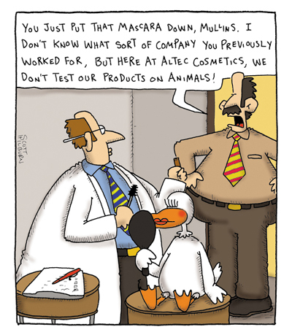
Chapter 5: the Integumentary System) A&P fall 2014 mr. e SRCS

Slide 2
Introduction
The organs of the integumentary system include the skin and its accessory structures including hair, nails and glands, as well as blood vessels, muscles and nerves.
Note that all 4 of the basic tissue types are well-represented in this organ system: Epithelium in the hair, nails, and the epidermis of the skin; the dermis contains C.T.; muscle is found attached to the hair follicles, and in the substance of arteries and veins; nerves provide an abundance of sensation.

Slide 3
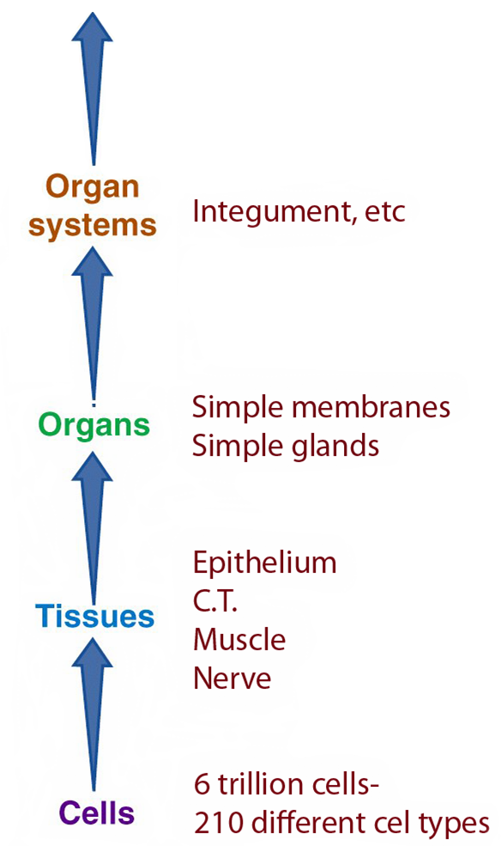
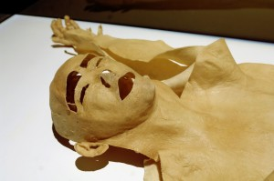
Introduction
The Integument is an organ system comprised of many organs such as hair and multiple types
of glands.

Slide 4

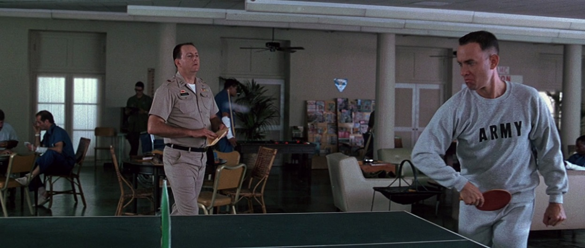
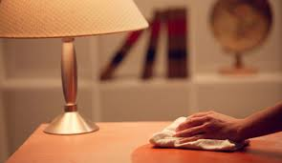
Introduction
The integument can also be thought of as a cutaneous membrane that covers the outer surface of the body.
It is the largest organ by surface area and weight.
Its area is about 2 square meters (22 square feet) and weighs 4.5–5kg (10–11 lb), about 7% of body weight.
It is 0.5–4 mm thick, thinnest on the eyelids, thickest on the heels.
We lose almost a kg of skin epithelium a year that becomes a major part of household “dust”.
As large as your average kitchen table top…or ½ a ping pong table

Slide 5
Functions
Besides protection, the skin contributes to:
Regulation of body temperature
Sensory perceptions
Synthesis of vitamin D
Emotional expression
It also serves as an important reservoir of blood.
It can be considered to be the “exterior of the soul.”
http://www.aholyexperience.com/2014/09/dear-kids-why-wait-till-marriage-what-no-one-tells-you-what-i-wish-someone-had-told-me/

Slide 6
Structures of the Skin
The skin has 3 major layers:
The outer, thinner layer is called the epidermis and consists of epithelial tissue.
The inner, thicker layer is called the dermis and consists of C.T.
The subcutaneous (subQ) layer (also called the hypodermis) is located underneath the dermis.
It is a loose areolar/adipose C.T. that attaches the skin to the underlying tissues and organs.

Slide 7
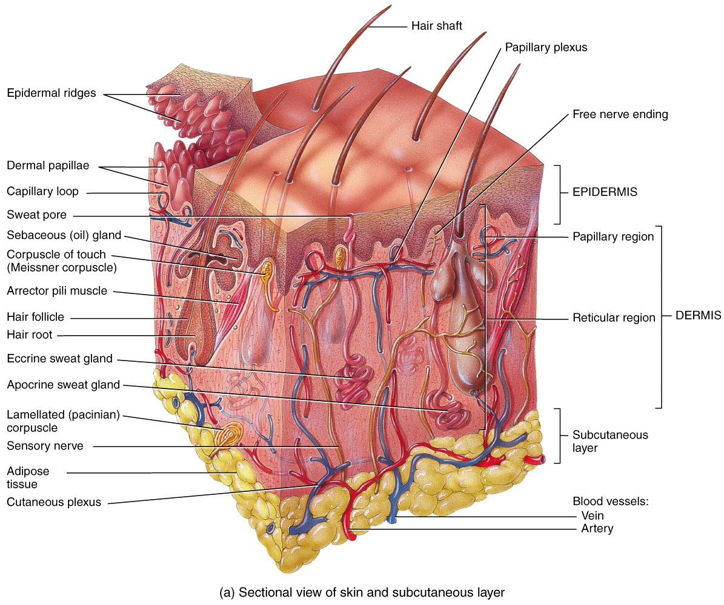
Structures of the Skin

Slide 8

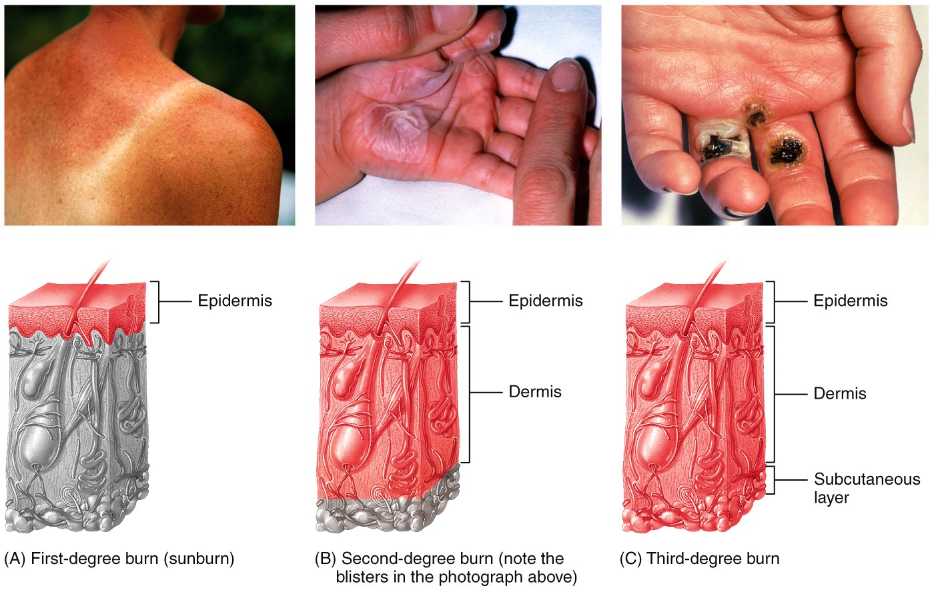
dermatology
Dermatologist are doctors who treat disorders of all layers of the integumentary system.

Slide 9
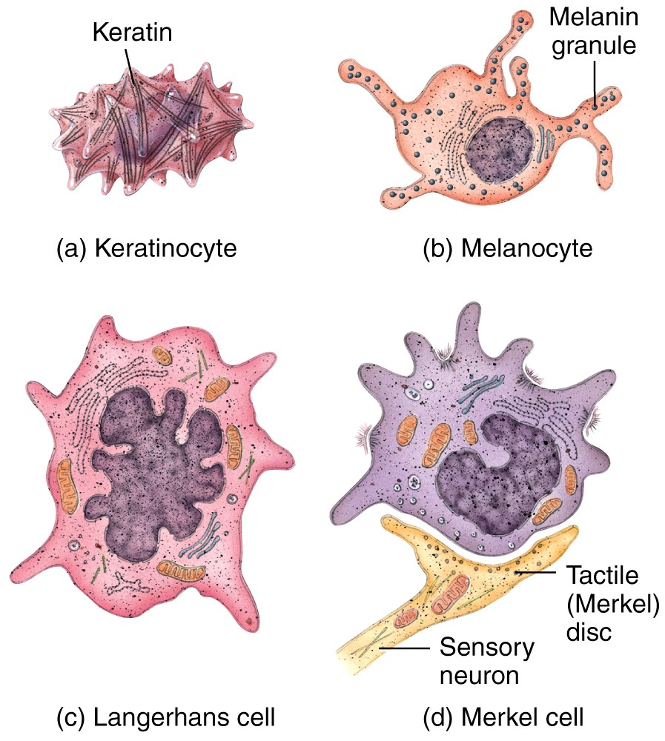
The Epidermis
The epidermis is composed of keratinized stratified squamous epithelium
which contains four
major types of cells:
Keratinocytes
Melanocytes
Langerhans cells
Merkel cells
Functions?
The Integumentary System, Part 1 - Skin Deep: Crash Course A&P #6

Slide 10
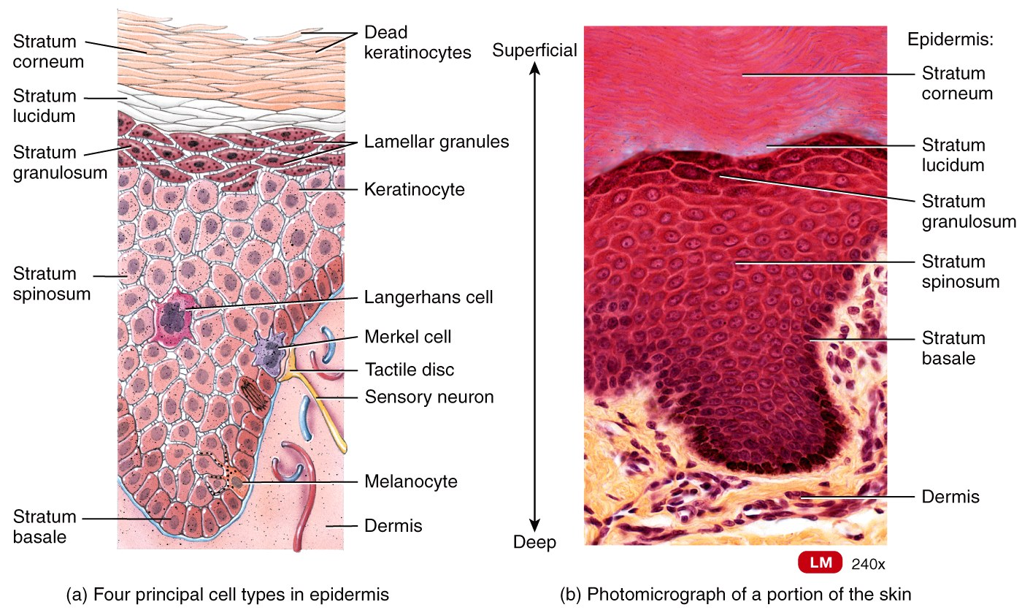
The Epidermis
Keratinocytes make up 90% of the cells. They produce keratin - a tough fibrous protein that provides protection. Originate from the Stratum Basale.
Melanocytes produce the pigment melanin that protects against damage by ultraviolet radiation. Embedded in the Stratum Basale.
Langerhans cells are macrophages that originated in the red bone marrow. They are involved in the immune responses. Originate from red bone marrow and migrate upward.
Merkel cells function in the sensation of touch along with the other adjacent tactile discs (receptors). Emedded in the basal layer.

Slide 11
The Epidermis
The epidermis is composed of four layers (5 in some places) in thin skin, and five layers in thick skin.
The stratum basale (1 layer) or stratum germinativum is always the bottom (deepest) layer. Continuous cell division occurs here and produces all the other layers.
The stratum spinosum is a layer of 8–10 keratinocytes thick just above basal layer—some cells still retain their ability to divide. Appear to have spines when prepared; layer contains Langerhans cells.
The non-dividing cells of the 3rd layer (stratum granulosum; 3-5 flattened layers) are filled with granules of keratin. Here the cells undergo apoptosis.
Orderly, genetically programmed cell death

Slide 12
The Epidermis
The stratum lucidum (4-6 cell layers) is the 4th layer but is only present in thick skin (the skin of the fingertips, palms, and soles). Why here?
The stratum corneum is always outermost, composed of approximately 25-30 layers of flat cell-remnants that are like “bags of turtle wax” (dead keratinocytes with no cellular organelles filled with only keratin protein.)
They are continuously shed and replaced by cells from deeper strata.
Functions: protect deeper layers from injury & microbial invasion.
Comprises high % of household dust!

Slide 13
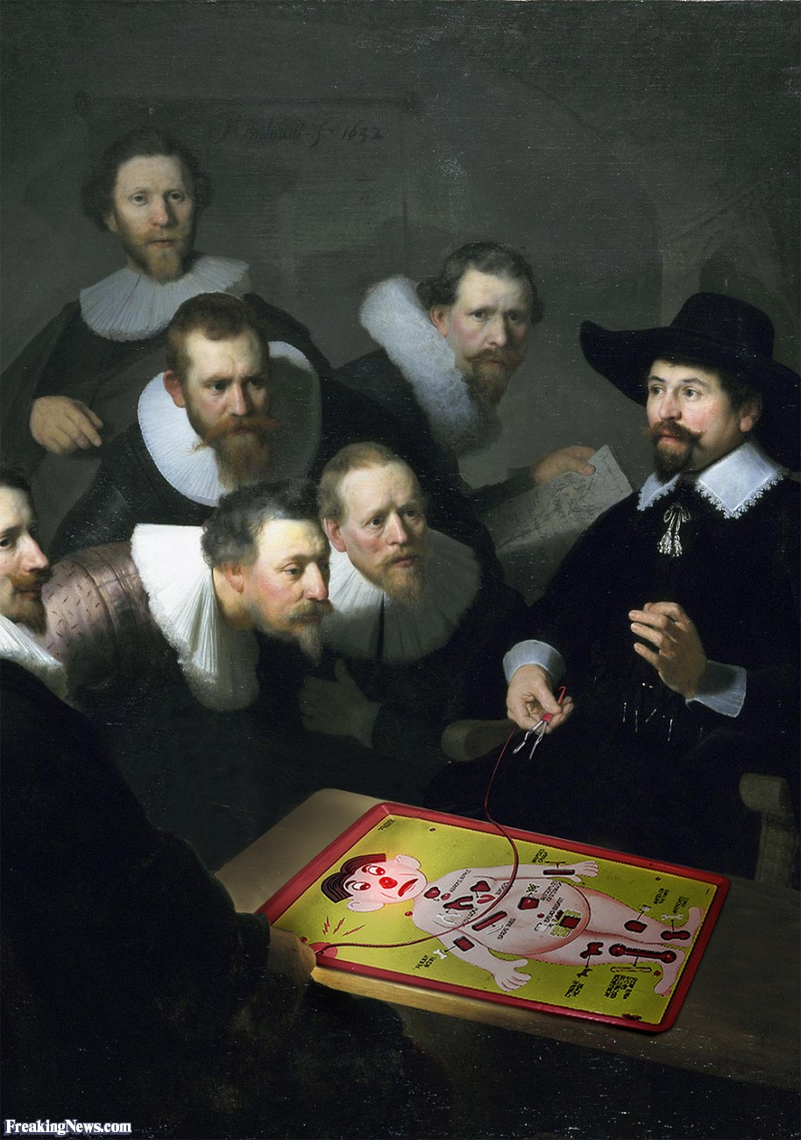
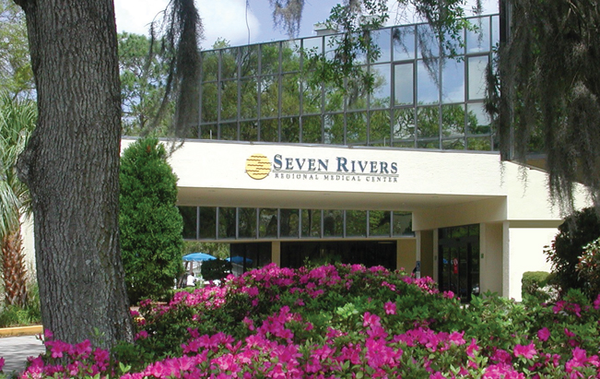
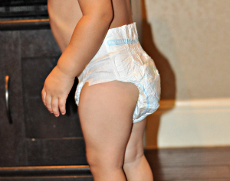

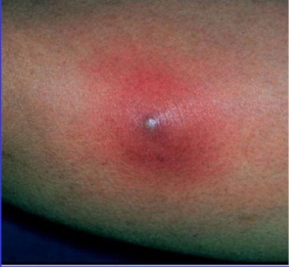
Clinical Connection
Staph Infection
Staph infections are caused by staphylococcus bacteria, types of germs commonly found on the skin or in the nose of even healthy individuals. Most of the time, these bacteria cause no problems or result in relatively minor skin infections.
But staph infections can turn deadly if the bacteria invade deeper into your body, entering your bloodstream, joints, bones, lungs or heart. A growing number of otherwise healthy people are developing life-threatening staph infections.
Treatment usually involves antibiotics and drainage of the infected area. However, some staph infections no longer respond to common antibiotics. (eg. MRSA)
From the unlikeliest place to its breeding ground…

Slide 14
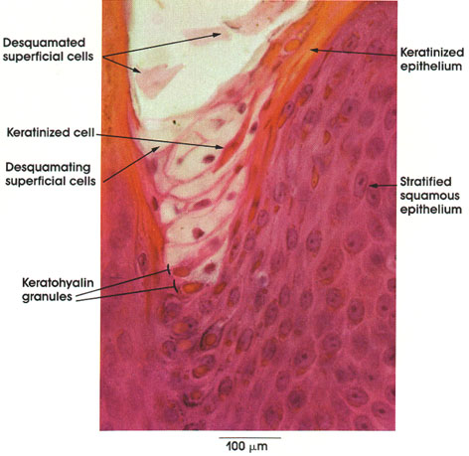
The Epidermis
Keratinization is the process of replacing viable cells in the stratum basale with more and more of the waxy keratin protein as cells move from the deepest layer to the surface layer.
Why does this happen? As layers migrate further and further from their nutrient source (blood vessels), become less active, and eventually die.
An increased rate of sloughing results in an increased rate of cell division in the stratum basale.
This process takes about 4-6 weeks in 0.1mm thick skin.

Slide 15
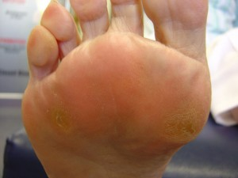
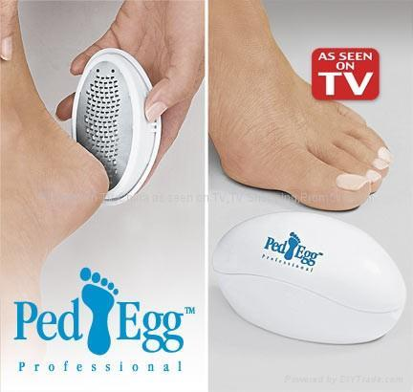
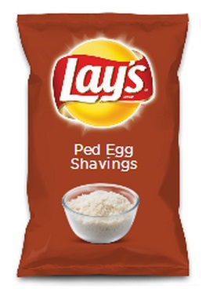
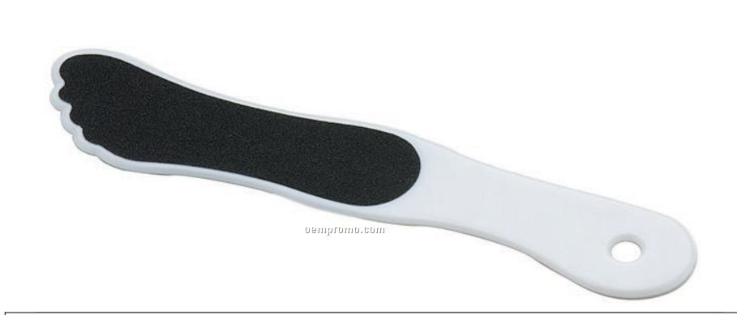
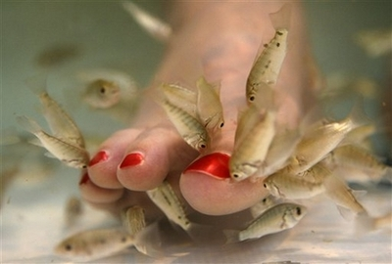
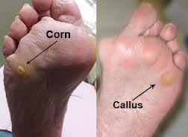
Clinical Connection
Callouses
Constant friction can stimulate a thicker buildup of keratinocytes in the stratum corneum. A callus (or callous) results.
A nail technician’s nightmare…

Slide 16
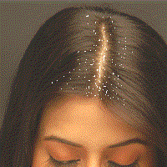
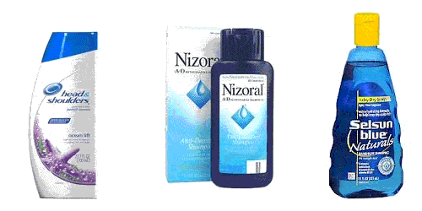
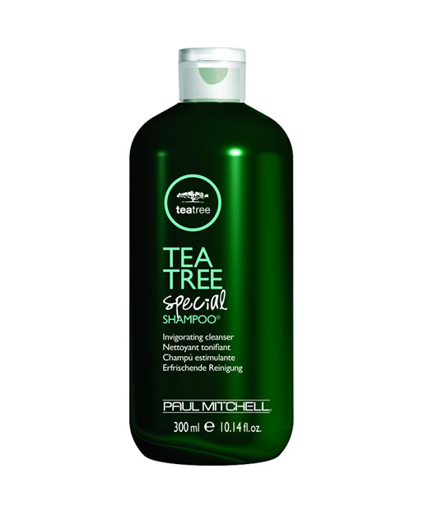
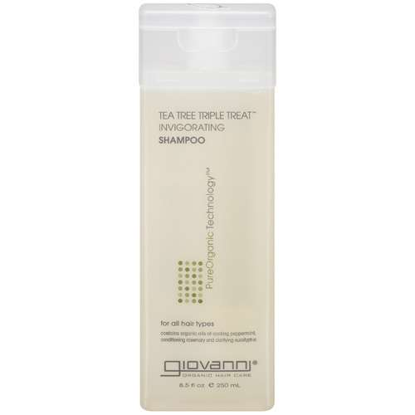
Clinical Connection
Dandruff
Dandruff is an excess of keratinized cells shed (Psoriasis) from the scalp. Human skin cells are forever renewing themselves. As skin cells in the scalp are renewed, the old (dead) ones are pushed to the surface and then out of the scalp; they are literally expelled. For people with dandruff, the new cells are produced at a faster rate than they die, resulting in more skin being shed, making dandruff more noticeable.
More common than you might think

Slide 17
The Epidermis

Slide 18
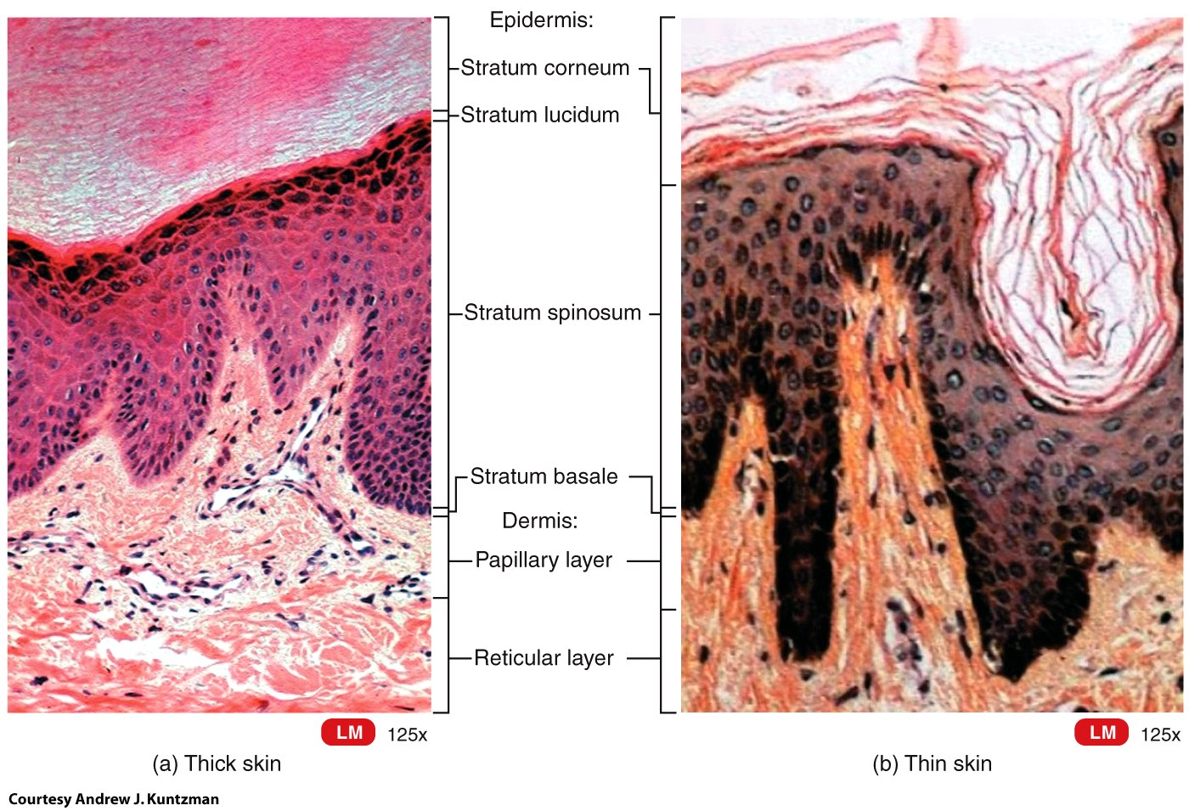
The Epidermis
Types of skin:
Thin (hairy) skin covers all body regions except the palms, palmar surfaces of digits, and soles.
Thick (hairless)
skin covers the
palms, palmar
surfaces of
digits, and
soles.

Slide 19
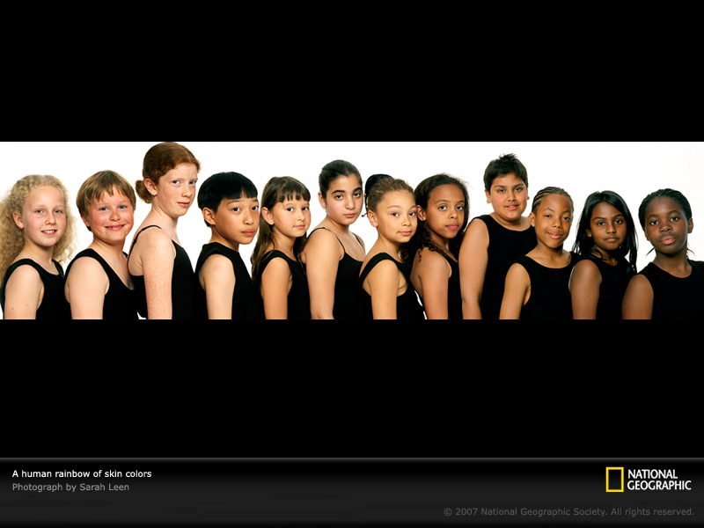
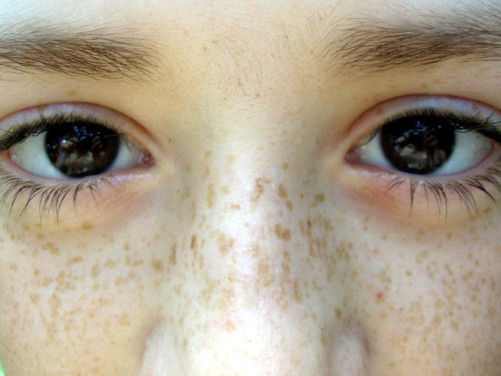
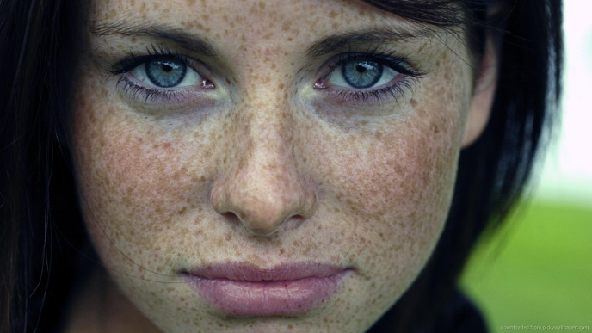
The Epidermis: pigments
Skin Pigments
Melanin is produced by melanocytes in the stratum basale; the number of melanocytes differs little between individuals therefore it is the type and amount of pigment that accounts for the vast variety of skin colors. There are 2 types of melanin:
Eumelanin (brown to black)
Pheomelanin (yellow to red)
Freckles are clusters of concentrated melanin triggered by exposure to sunlight; Having more freckles is a genetic trait.
How We Get Our Skin Color | HHMI BioInteractive Video
Notes:
Melanin is a class of compounds found in plants and animals where it serves predominantly as a pigment. The class of pigments are derivatives of the amino acid tyrosine. The most common form of biological melanin is eumelanin, a brown-black polymer of dihydroxyindole carboxylic acid, and their reduced forms. Another common form of melanin is pheomelanin, a red-brown polymer of benzothiazine units largely responsible for red hair and freckles

Slide 20
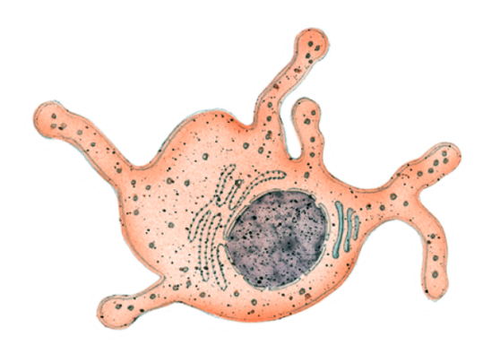
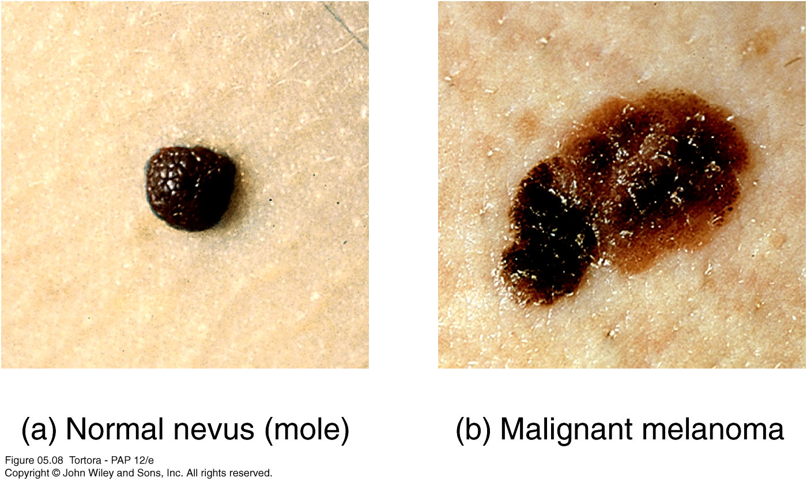
The Epidermis: Pigments
Skin Pigments
Nevi (nevus (sing.) also called “birthmarks” or moles;) are chronic lesions of the skin – they are, by definition, benign.
Malignant melanoma, is a however, is cancer
of the melanocytes and 25% arise from pre-existing nevi.

Slide 21
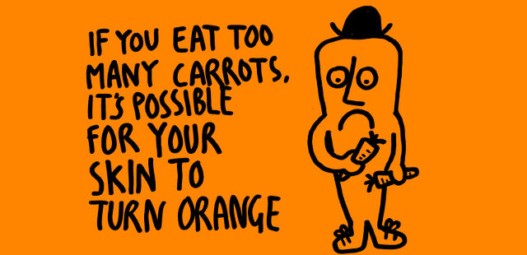
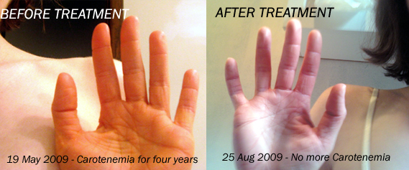
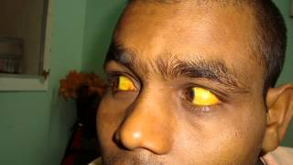
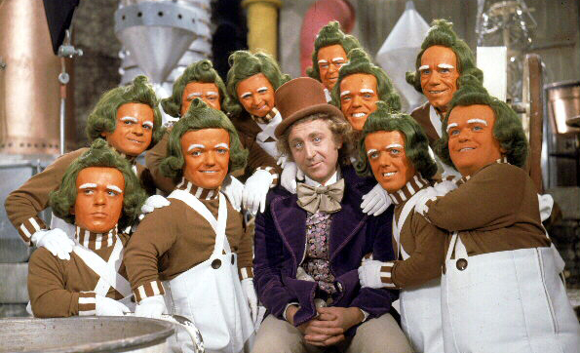
Clinical Connection
Carotenodermia
High doses of beta-carotene supplements (30 mg/day or more) and the consumption of large amounts of carotene-rich foods have resulted in a yellow discoloration of the skin known as ‘carotenodermia’. Carotenodermia is not associated with any underlying health problems and resolves when beta-carotene supplements are discontinued or dietary carotene intake is reduced.
Not seemingly toxic when you get it naturally through your diet…

Slide 22
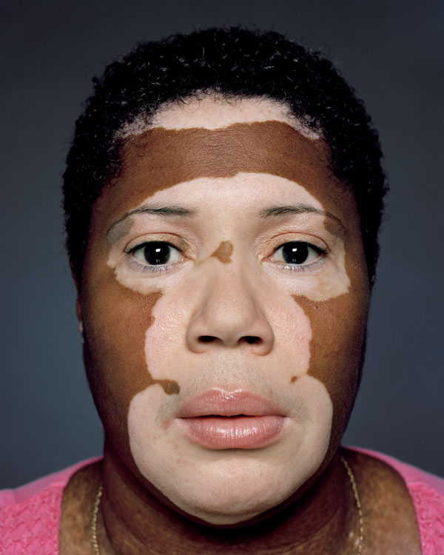
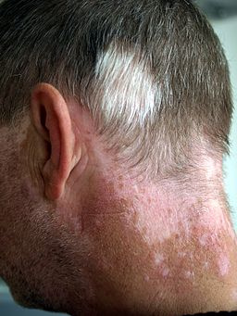
Clinical Connection
Vitiligo
Vitiligo is a chronic disorder that causes depigmentation patches in the skin. The precise pathogenesis, or cause, is not known, but is most likely a combination of genetic factors coupled with a disorder of the immune system (autoimmune disease).
I have seen this affect hair as well…

Slide 23

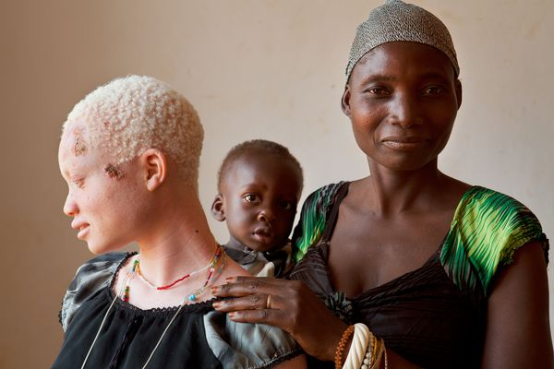
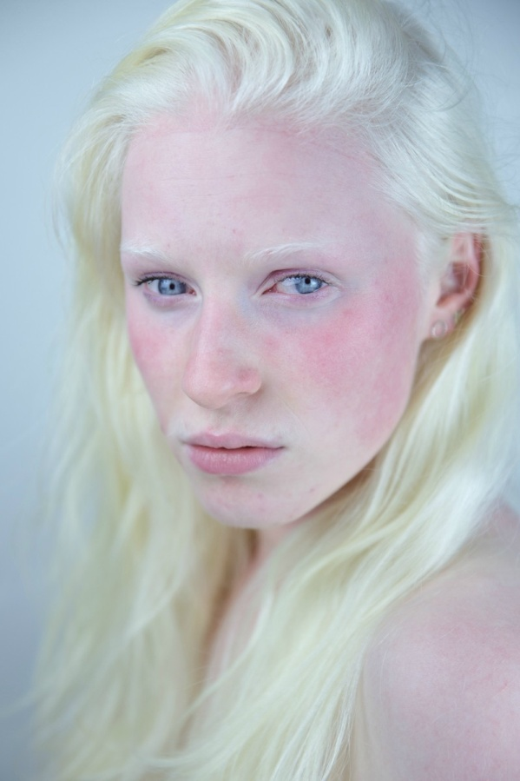
Clinical Connection
Albinism
Albinism is a congenital disorder characterized by the complete or partial absence of pigment in the skin, hair, and eyes due to a defect of an enzyme involved in the production of melanin.
Fear & Loathing: Albino Africans Survival in Tanzania (RT Documentary) - video Dailymotion
There are varying degrees of albinism…

Slide 24
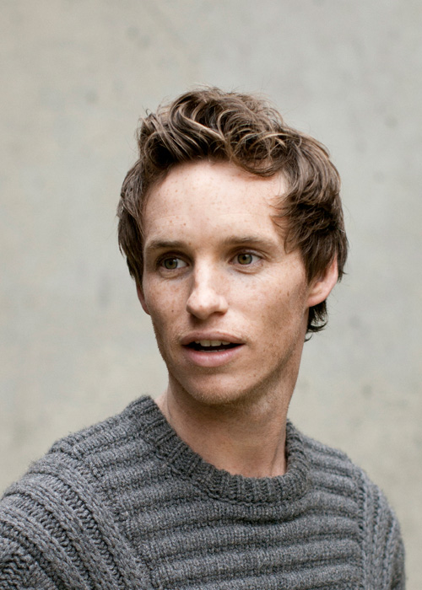
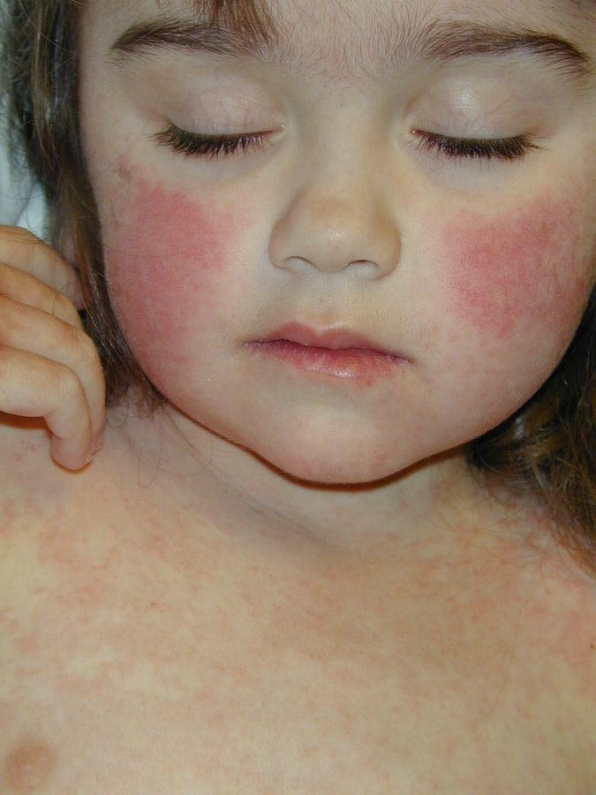

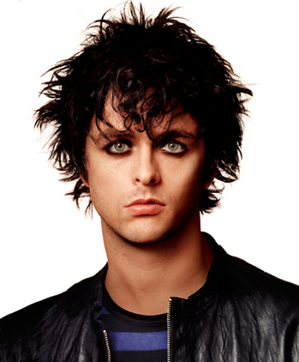
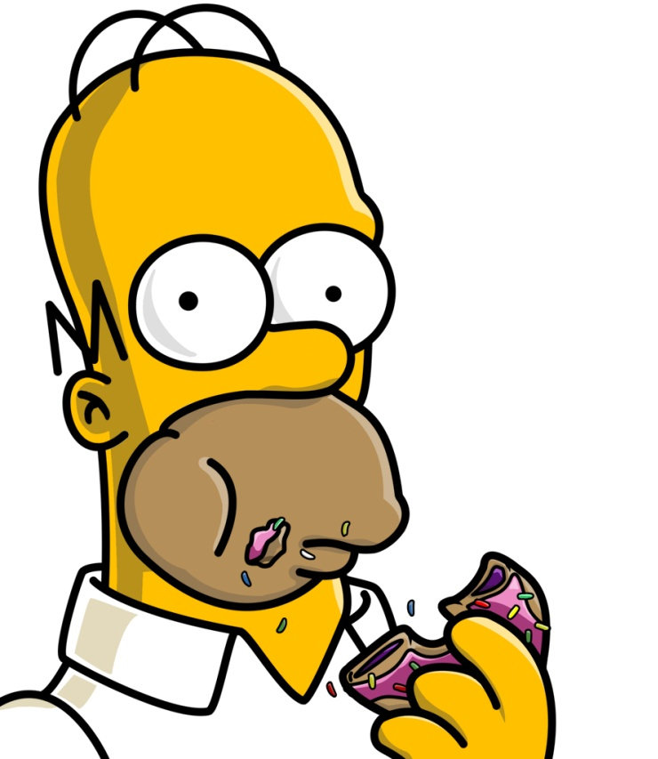
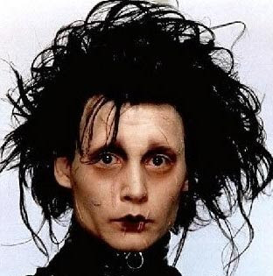
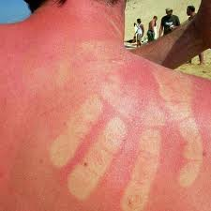
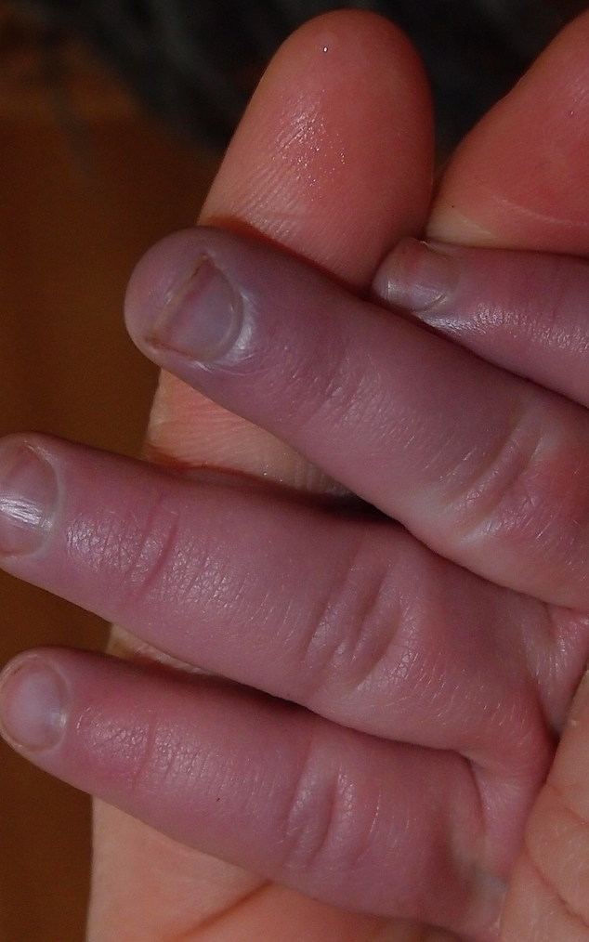
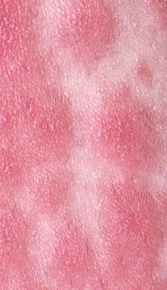
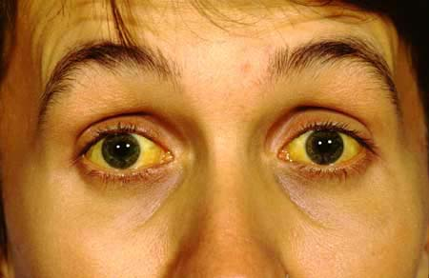
Clinical Connection
Diagnostic clues…
When an individual’s blood is not properly oxygenated, they are cyanotic…
When bilirubin (a yellow pigment) builds up in the skin, this is tell-tale liver-related and is called jaundice…
When blood vessels make their presence known ans individuals may appear flushed or mildly burnt, this is erythema…
When individuals experience shock or general malaise, they may have pallor…
There are varying degrees of seriousness…

Slide 25
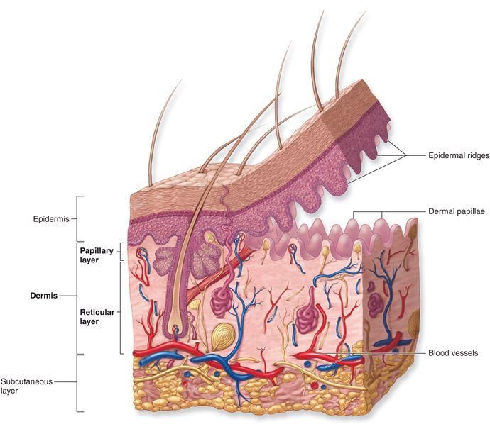
The Dermis
The dermis is composed of connective tissue containing collagen and elastic fibers.
It contains two regions: Papillary & Reticular
The papillary region lies just below the epidermis and consists of areolar connective tissue containing thin collagen and elastic fibers, dermal papillae (including capillary loops), corpuscles of touch and free nerve endings.

Slide 26
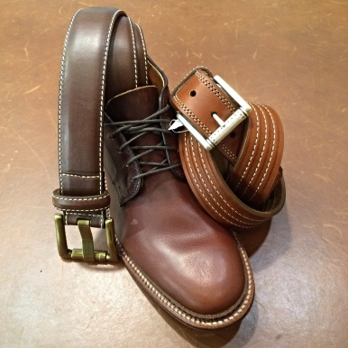
The Dermis
The reticular region consists of dense irregular connective tissue containing collagen and elastic fibers, adipose cells, hair follicles, nerves, sebaceous (oil) glands, and sudoriferous (sweat) glands.
Tears or excessive
stretching in this region
cause stretch marks
(also called striae).
Are you wearing any leather? Yup, you guessed it—the dermis of a cow. Why the dermis?

Slide 27
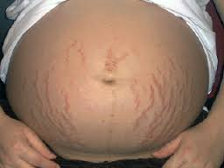


Clinical Connection
Stretch Marks
Stretch marks (striae) are pink, red or purple indented streaks that often appear on the abdomen, breasts, upper arms, buttocks and thighs and eventually fade to white or gray.
They are indicative of scarring—resulting from damage to the dermis when overstretched (pregnancy, extreme weight loss/gain) and the collagen fibers and blood vessels break…then heal (hence the color change)
These can appear on a great variety of individuals….

Slide 28

The Dermis
Lines of cleavage (also called Langer lines) are “tension lines” in the skin that indicate the predominant direction of underlying collagen fibers.
Plastic surgeons make their incisions parallel to the normal cleavage lines in order to minimize scarring.
Notes:
Dermatoglyphics - the study of the pattern of epidermal ridges

Slide 29



The Dermis
Dermal Papillae produce Epidermal ridges which form the basis for fingerprints (and footprints)
Function to increase firmness of grip by increasing friction
Internally create a stronger bond between the epidermis and the dermis in regions of high mechanical stress.
Greatly increase surface area and thereby increasing number of Meissner corpuscles therefore increasing tactile sensitivity.
https://www.nga.gov/collection/art-object-page.69637.html
Notes:
Dermatoglyphics - the study of the pattern of epidermal ridges

Slide 30

Dermatoglyphics… study of epidermal ridges…
Which do you possess?
Loops most common worldwide…
Whorls are most common in New Guinea…

Slide 31

Dermatoglyphics in design…
Design, itself, is a very tactile process. As designers (and humans in general), we’re inherently inclined to touch, feel, hold materials in our hands; it helps us perceive them, interpret them, envision how to use them. And fingerprints are ultimately central in this ability.
So whether you’re inspired by their beautiful intricacy, or by the design principles deeply embedded within each, fingerprints are integral in the design world, allowing us to identify and connect to surfaces in such a uniquely physiological way.
Fingerprints are at the very core of our understanding of textures, and at 1 in 7 billion, they are truly Mother Nature’s own personal Salute to Originals.
From http://gpidesign.com/_blog/Beneath_the_Surface/tag/surface_materials/page/3/
But pattern also plays a significant role in our interpretation of a material. The elliptical patterning of fingerprints (categorized generally as arch, loop, or whorl), allows for some ridges and valleys to always fall perpendicular to the surface, no matter the angle of the fingers. This, not only creates beautifully organic and one-of-a-kind patterns from a visual standpoint, but also allows for optimum vibrations, generating a faster, more accurate analysis of a surface.

Slide 32
The Dermis
What function do these serve?
Comprises 1/5 of dermal layer; attaches to epidermal layer
Comprises 4/5 of the dermal layer; attached to SubQ
Notes:
05_01a

Slide 33

Clinical Connection
Tattooing
A tattoo is a permanent mark or design made on your skin with pigments deposited by needles inserted past the skin's top layer and into the next. Typically, the tattoo artist uses a hand-held machine that acts much like a sewing machine, with one or more needles piercing the skin repeatedly (50-3000x per minute). With every puncture, the needles insert tiny ink droplets into the stable dermis. The process — which is done without anesthetics — causes a small amount of bleeding and slight to potentially significant pain.
https://mymodernmet.com/ariana-page-russell-skin/
Pain depends on the size, location, and complexity of the tattoo…as well as the pain threshold of the individual….

Slide 34





Clinical Connection
Tattooing
Laser removal involves degrading the ink over time by making it smaller so it can be dissolved by the immune system….

Slide 35








Clinical Connection
Tattooing
TATTOOING Close Up (in Slow Motion) - Smarter Every Day
How Laser Tattoo Removal Works - Smarter Every Day 123

Slide 36

The Subcutaneous Layer
The subcutaneous layer is also called the hypodermis, and it attaches the skin to underlying tissues and organs.
It contains blood vessels and nerves in transit to the more superficial layers.
It also contains lamellated
(pacinian) corpuscles
that detect external
pressure applied to the skin.
subQ

Slide 37

Benefits of Multiple Layers
Multiple layers in the skin allow for specialization.
Adapted to fast turn-over, the epidermis resists damage and offers protection to underlying tissues.
The dermis provides temperature stability (sud. glands) and prevents dehydration (seb. glands), and yet is
capable of limited healing.
The subcutaneous tissues insulate,
store fat, and anchor the skin.
Notes:
05_01a

Slide 38
Sensory Receptors
Unassociated with specific receptors…these aid in sensing heat, pain, and itching
Sensitive to touch
Sensitive to pressure
Practicum: any structure here fair game; incl. hair and nail pic
Notes:
05_01a

Slide 39


Clinical Connection
Skin Grafting
Split-thickness grafts are for the shallowest wounds, or those that affect only the epidermis and part of the dermis and the doctor removes only a few layers of skin from the donor site.
Full-thickness grafts require that all three skin layers -- epidermis, dermis and hypodermis -- be removed from the donor site. Full-thickness grafts are often used in cases where the cosmetic appearance of the injured area is very important, like the face. Full-thickness grafts include hair follicles, sweat glands and blood vessels that allow the graft area to look and function more normally. Split thickness grafts, since they lack underlying glands and blood vessels, tend to look flat and discolored.
The best grafts are autografts (allografts (others) and xenografts (animals) are inevitably rejected).

Slide 40



Accessory Structures of the Skin
The Integumentary System, Part 2 - Skin Deeper: Crash Course A&P #7

Slide 41

Hair
Hair is associated with the word “pili”.
It is present on most surfaces except the palms, anterior surfaces of fingers, and the soles of the feet.
It is composed of dead, keratinized epidermal cells.
Genetics determines thickness and distribution.
Hair helps with touch sensations and protects the body against the harmful effects of the sun and against heat loss.

Slide 42

Hair
The parts of a hair include:
The shaft (above the skin surface)
The follicle (below the level of the skin)
A root that penetrates into
the dermis includes:
An epithelial root sheath
A dermal root sheath

Slide 43

Hair: stuff you need to know

Slide 44

Hair: practicum practice

Slide 45

Hair
Types of hairs
Lanugo – fine, nonpigmented, downy hairs that cover the body of the fetus
Vellus hairs – short, fine, pale hairs
barely visible to the naked eye
Terminal hairs – long, coarse,
heavily pigmented hairs
Hair color is determined by the amount
and type of melanin.
https://www.inverse.com/mind-body/scientists-discover-reason-stress-hair-turn-gray

Slide 46

Hair
How Hair Grows
The average scalp has
100,000 hairs. Each
follicle produces a single
hair that grows at a rate
of half an inch per month.
After growing for two to six years, hair rests awhile before falling out. It's soon replaced with a new hair, and the cycle begins again. At any given time, 85% of hair is growing, and the remainder is resting.

Slide 47

Hair
How Much Hair Loss Is Normal?
Because resting hairs regularly fall out, most people shed about 50-100 strands every day. You'll typically find a few in your hairbrush or on your clothes. Abnormal hair loss can happen in several ways. You may notice dramatic clumps falling out when you shampoo or style. Or your hair may thin slowly over time. If you're concerned about changes in your hair, check with your doctor.
Why Do We All Have Different Hair?

Slide 48



Clinical Connection
Hair removal
Depilatory products and services range from creams that dissolve the protein in the hair shaft (unaffected root continues hair growth) to electrolysis and laser where hair follicles are rendered destroyed.
There are varying products & sevices…

Slide 49


Clinical Connection
Chemotherapy & Hair
If cancer is multiplying cells gone awry, then most cancer drugs serve to stop this wanton division. Unfortunately, this affects other organ systems in the dividing stage…thus 85% or so of scalp hairs are affected, lose their follicles, then regrow after the drug cycle is done…
The very strength of a cancer drug is what causes these side-affects …

Slide 50


Clinical Connection
Male pattern baldness
Also known as androgenic alopecia, it affects male and females and leads to thinning and/or gradual hair loss due to the early dormancy of hair follicles…
There are not only factors beyond genes, researchers are finding multiple genes themselves are involved…

Slide 51

Skin Glands
Recall from Chapter 4 that glands are epithelial cells that secrete a substance.
Sebaceous (oil) glands are connected to hair follicles.
They secrete an oily substance called
sebum which does 2 important things:
Prevents dehydration of hair
and skin
Inhibits growth of certain bacteria

Slide 52





Clinical Connection
Acne
Acne occurs when sebaceous glands get clogged with oil and dead skin cells. Bacteria take up lodging in the lipid-rich sebum and infections may result…
Washing the face with a gentle cleanser is a great way to reduce acne..however medication is sometimes necessary…

Slide 53

Skin Glands
In addition to oil glands, there are 2 types of skin sweat glands (also called sudoriferous glands). Both are simple, coiled tubular glands.
Eccrine sweat glands are the most numerous as they cover most of the body. They secrete a watery solution (600 ml per day) that helps to cool the body and eliminates small amounts of waste.
Apocrine sweat glands are located mainly in the skin of the axilla, groin, areolae, and bearded facial regions of adult males. They secrete a slightly viscous sweat.
Notes:
Apocrine sweat glands were once thought to release their secretions in an apocrine manner (see page 122 and Figure 4.5b on page 123)—by pinching off a portion of the cell. We now know, however, that their secretion is via exocytosis, which is characteristic of merocrine glands (see Figure 4.5a on page 123). Nevertheless, the term apocrine is still used.

Slide 54
Skin Glands
Sweat is actually odorless when secreted…bacteria simply take up the task of stinking it up once they get involved…
Eccrine sweat glands found all over body and release sweat in response to heating (major role) or an emotional stress such as fear or embarrassment. This latter type of sweating is referred to as emotional sweating or a “cold sweat”.
The secretory portion of apocrine sweat (odor) glands is located mostly in the subcutaneous layer, and the excretory duct opens into hair follicles, with sweat secreted during emotional stress and sexual excitement.
Much of body odor is due to apocrine sweat.

Slide 55



Skin Glands
Ceruminous glands are modified sweat glands located in the ear canal.
Along with nearby sebaceous glands, they are involved in producing a waxy secretion called cerumen (earwax) which provides a sticky barrier that prevents entry of foreign bodies into the ear canal.

Slide 56


Clinical Connection
Impacted Cerumen
Over-active cerumenous glands can produce so much wax that they clog the auditory canal…
Once impacted, a temporary loss of hearing occurs.…

Slide 57

Nails
Nails are composed of hard, keratinized epidermal cells located over the dorsal surfaces of the ends of fingers and toes.
Nail structures include:
Free edge
Transparent nail body (plate)
with a whitish lunula at its base
Eponychium (cuticle)
Nail root embedded in a fold of skin

Slide 58

Nails: practicum practice
Integumentary System

Slide 59

Anatomy Overview: Interactive Animation
The Integument and Disease Resistance
You must be connected to the internet to run this animation

Slide 60

Maintaining Homeostasis (review)
Skin damage sets in motion a sequence of events that repairs the skin to its normal (or near-normal) structure and function.

Slide 61
Wound Healing
Two kinds of wound-healing processes can occur, depending on the depth of the injury.
Epidermal wound healing occurs following superficial wounds that affect only the epidermis (1 main).
Return to normal function is the rule.
Deep wound healing occurs when an injury extends to the dermis and subcutaneous layer (3 main).
Loss of some function and development of scar tissue is the rule.

Slide 62

Epidermal Wound Healing
We will observe similar attempts at homeostasis in all the organ systems we study for the remainder of the year.

Slide 63

Deep Wound Healing
We will observe similar attempts at homeostasis in all the organ systems we study for the remainder of the year.

Slide 64
Burns
A burn is tissue damage caused by excessive heat, electricity, radioactivity, or corrosive chemicals that denature (break down) the proteins in the skin cells.
Burns destroy some of the skin's important contributions to homeostasis—protection against microbial invasion and desiccation, and thermoregulation.
Burns are graded according to their severity.

Slide 65

Burns
A first-degree burn involves only the epidermis
It is characterized by mild pain and erythema (redness) but no blisters and skin functions remain intact.

Slide 66

Burns
A second-degree burn (partial-thickness) destroys the epidermis and part of the dermis - some skin functions are lost.
Redness, blister formation, edema, and pain result.

Slide 67

Burns
A third-degree burn is a full-thickness burn (destroys the epidermis, dermis, and subcutaneous layer).
Most skin functions are lost, and the region is numb because sensory nerve endings have been destroyed.

Slide 68
Burns
According to the American Burn Association's classification of burn injury, a major burn includes:
3º burns over 10% of body surface area; or
2º burns over 25% of body surface area; or
Any 3º burns on the face, hands, feet, or perineum (which includes the anal and urogenital regions)
When the burn area exceeds 70%, more than half the victims die.
We will refer to patients with major burns as “critical”; note that a combo such as 7% 3rd degree and 18% 2nd degree would be considered critical.

Slide 69

Estimating Surface Area Percentages…(TBSA)

Slide 70

The Rule of Nines
A quick means for estimating the surface area affected by a burn in an adult is the rule of nines:
Notes:
05_10

Slide 71

The Rule of Nines
Notes:
05_10

Slide 72
Burns
A quick means for estimating the surface area affected by a burn in an adult is the rule of nines:
Count 9% if both the anterior and posterior surfaces of the head and neck are affected.
Count 9% for both the anterior and posterior surfaces of each upper limb (total of 18% for both upper limbs).
Count four times nine or 36% for both the anterior and posterior surfaces of the trunk.
Count 9% for the anterior and 9% for the posterior surfaces of each lower limb as far up as the buttocks (total of 36% for both lower limbs).

Slide 73


Clinical Connection
Transdermal Drug Administration
Most drugs are ingested or given through the Sub Q, but patches that permit drugs to be absorbed by blood vessels in the skin is becoming more common…
Common drugs include those for heart disease, motion sickness, hormone-replacement therapy , smoke-quitting and cancer pain.…

Slide 74


Clinical Connection
Sunburns
UVA’s and UVB’s (ultraviolet A & B). UVA’s rays penetrate the skin deeply and activate melanocytes…hence tanning occurs. UVB’s cause sunburn and tissue damage. Sunscreens scatter UVA’s, sunblocks scatter both types of UV rays…
Though sunscreens may prevent sunburns, is thought that they may actually contribute to skin cancer because of the false sense of security they provide.…
How the sun sees you - YouTube

Slide 75
Aging
The integumentary system changes with age:
Wrinkles develop as the collagen fibers decrease in number, stiffen, break, or fray.
Number of Langerhans cells decrease resulting in a lessened immune response.
Dehydration and cracking occurs.
Sweat production decreases—contributing to poss. heat strokes in the elderly.
A decrease in the numbers of functional melanocytes results in gray hair and atypical skin pigmentation while an increase in the size of other melanocytes cause skin blotching/spotting.
Subcutaneous fat is lost, and there is a general decrease in skin thickness.
Nails may also become more brittle and tend to grow more slowly.

Slide 76

Aging
With age, there is also an increased susceptibility to pathological conditions (as demonstrated by this decubitus ulcer).
These type of pressure
ulcers (“bed sores”)
are an all-to-common
occurrence in
nursing homes.

