Slide 1
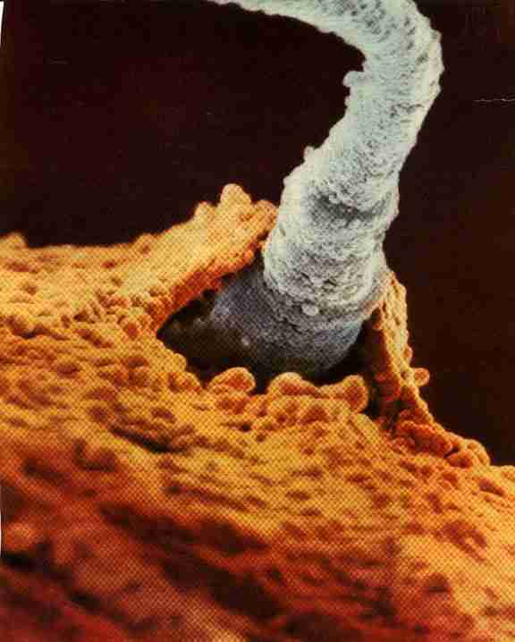
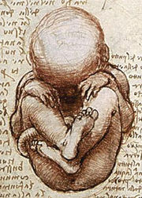
When does life Begin?
mr. e ~ bioethical discussion
Fall 2007

Slide 2
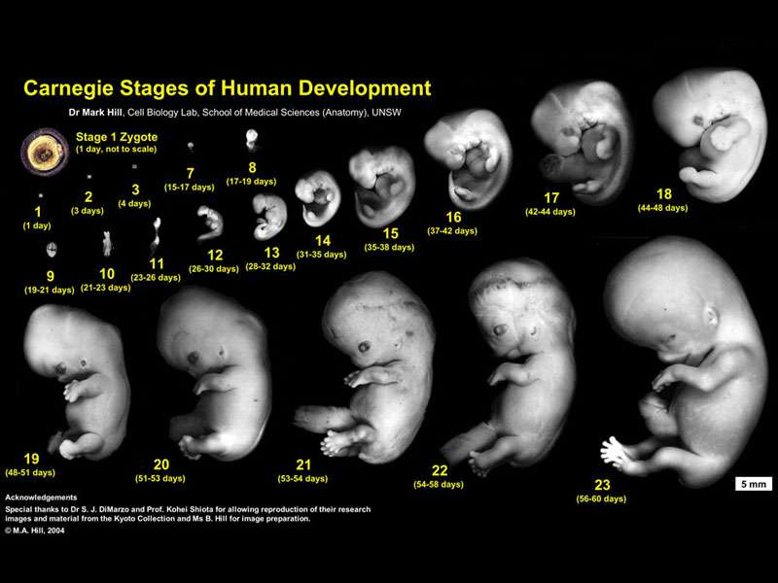
When does human life begin?
17.4 Pregnancy and birth
The question of when a human life begins is a profoundly intricate one, with widespread implications, ranging from abortion rights to stem cell research and beyond.
The way in which we choose to define the concepts of humanity/humanness & life informs when life begins perhaps more than anything.
  What does it mean to be alive? What does it mean to be human?
  Is a zygote or an embryo alive? Is a zygote or an embryo a human being?

Slide 3
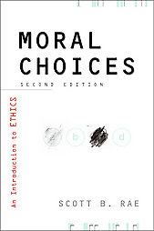
What are the traditional views of when human life begins?
17.4 Pregnancy and birth
Positions: Vary from conception to birth to some even placing it after birth (less popular since it justifies infanticide)…
The incisive question becomes…
“At what point does the fetus possess personhood?”
Because Science cannot clearly answer the question, it has been viewed (correctly) as a religious & philosophical question and (incorrectly, I believe) relegated to individual choice…
Here are the distinct views—each associated with “moments”:
Conception Implantation Viability
Brain Development Sentience Quickening
Appearance of Humanness Birth

Slide 4
What are the traditional views of when human life begins?
17.4 Pregnancy and birth
“At what point does the fetus possess personhood?”
Birth : “life begins when the fetus is born”
Subjective: differs from individual to individual; based on location
Humanness accompanies the point at which the fetus is outside the womb
This developmental model steps up the emotional difficulty of having an abortion yet passively allows for it until birth (“partial-birth” permitted)
Logically speaking, it confuses the nature of the fetus with the location of the fetus
Implications? This possibility places an obligation to protect all born fetuses because the act of birthing is tied to fetal essence… it links the imparting of essence with location (not logically sustainable)…also allows all chemical means of birth control, IVF, up to the latest of stages of abortion (because humanness accompanies emergence); denies the humanness of a fetus hours before birth vs. protects a child minutes after birth; conflates mere experience as enough to confer humanity/life: Challenge? Transfer of essence…

Slide 5
What are the traditional views of when human life begins?
17.4 Pregnancy and birth
“At what point does the fetus possess personhood?”
Appearance of Humanness : “life begins when the fetus resembles a human baby”
Subjective: differs from individual to individual; based on observer’s awareness
Humanness accompanies the point at which the fetus becomes “recognizably human”
This developmental model steps up the emotional difficulty of having an abortion
Logically speaking it also confuses the nature of the fetus with one’s awareness of the fetus (Philosophically speaking, this model confuses the knowledge of the fetus’ resemblance [Epistemology] with the essence of the fetus [Ontology])
Implications? This possibility places an obligation to protect all fetuses determined to be human by their appearance because the sensory experience of observation is tied to fetal essence… it links the imparting of essence with one’s ability to recognize morphology (not logically sustainable)…also allows all chemical means of birth control, IVF, up to later stages of abortion (because humanness accompanies the awareness of the mother); potentially brings into question the humanness of fetuses with birth defects conflates observer’s opinion as enough to confer humanity/life to object (subject/object problem); Challenge? Transfer of essence (!)

Slide 6
What are the traditional views of when human life begins?
17.4 Pregnancy and birth
“At what point does the fetus possess personhood?”
Quickening : “life begins when the mother senses the fetus beginning to move in the womb”
Subjective: differs from individual to individual; based on mother’s awareness
Humanness accompanies the point at which the fetus becomes active & mother is able to sense its activity:
Historic standard :before the advent if in vitro observation (eg. ultrasound), this was an external means of indicating the presence of life
Logically speaking, it confuses the nature of the fetus with the awareness of the fetus (Philosophically speaking, this model confuses the knowledge of the fetus [Epistemology] with the essence of the fetus [Ontology])
Implications? This possibility places an obligation to protect all fetuses sensed to be active by the bearing mother because the sensory experience of movement is tied to essence… it links the imparting of essence with one’s ability to sense movement (not logically sustainable)…also allows all chemical means of birth control, IVF, up to later stages of abortion (because humanness accompanies the awareness of the mother; usually 16-25 weeks; potentially brings into question the humanness of fetuses with mothers who have sensory-related deficiencies conflates neurological as enough (man as viewed by naturalism) Challenge? Transfer of essence…

Slide 7
What are the traditional views of when human life begins?
17.4 Pregnancy and birth
“At what point does the fetus possess personhood?”
Sentience : “life begins when the fetus begins to experience sensations, particularly pain”
Subjective: differs from individual to individual
Humanness accompanies the point at which the fetus becomes able to sense pain
Occurs later than 45 days into pregnancy…
By logic, it passively admits those in persistently vegetative state, momentarily unconscious, & even those in deep sleep as non-persons; if the objection is made to this on the basis that these could be temporary—then this developmental model must be wrong—simply due to the objection: one cannot vacillate between humanness & non-humanness
Implications? This possibility places an obligation to protect all fetuses able to sense pain because the sensory experience of harm is tied to essence… it confuses the experience of harm with the reality of harm (willfully stopping fetal development)…also allows all chemical means of birth control, IVF, up to later stages of abortion (because humanness accompanies the development of the senses); brings into question the humanness of those with sensory-related deficiencies; conflates neurological as enough (man as viewed by naturalism) Challenge? Transfer of essence…

Slide 8
What are the traditional views of when human life begins?
17.4 Pregnancy and birth
“At what point does the fetus possess personhood?”
Brain Development : “life begins when the fetus’ brain begins to function”
Objective in itself/Narrowly subjective in practice: differs slightly from individual to individual
2nd most commonly proposed decisive moment
Humanness accompanies the point at which the fetus becomes brain-active (based on the fact that death, the loss of personhood, is medically considered to be defined by brain death) (see UDDA…to follow); significant difference: brain death is irreversible while fetal brain is temporarily inactive/latent yet developing
Occurs generally 45 days into pregnancy
Implications? This possibility places an obligation to protect all fetuses able to send brain impulses because brain function is tied to essence… it also allows all chemical means of birth control, IVF, up to later stages of abortion (because humanness accompanies the medical technology available to the patient (location/culture/era and development of brain); Challenge? Transfer of essence…

Slide 9
What are the traditional views of when human life begins?
17.4 Pregnancy and birth
“At what point does the fetus possess personhood?”
Viability : “life begins when the fetus is able to live outside the womb on its own ”
Subjective: differs from individual to individual (location/technology/historical niche)
most commonly proposed/endorsed by the Supreme Court
Humanness accompanies the point at which the fetus can leave its uterine nourishment (albeit dependent on medical technology)
Occurs (now) roughly between 24-26 weeks
Implications? This possibility places an obligation to protect all fetuses able to be externally sustained because viability is tied to essence… it also allows all chemical means of birth control, IVF, up to later stages of abortion (because humanness accompanies the medical technology available to the patient (location/culture/era)
Challenge? Transfer of essence…

Slide 10
What are the traditional views of when human life begins?
17.4 Pregnancy and birth
“At what point does the fetus possess personhood?”
Implantation : “life begins when the embryo fastens itself to the uterine wall ”
Objective in itself/subjective in practice
Humanness accompanies the point at which the embryo hormonally signals its presence
Twinning occurs (most often) prior to implantation
Embryo will miscarry if not nourished
Implications? This possibility places an obligation to protect all embryos because implantation is tied to both development & essence… it also morally permits certain chemical means of birth control (RU-486) and IVF embryos are able to be discarded/experimented upon. Challenge? Transfer of essence…

Slide 11
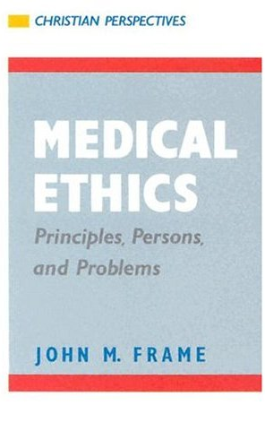
What are the traditional views of when human life begins?
17.4 Pregnancy and birth
“At what point does the fetus possess personhood?”
Conception : “life begins when the sperm fuses with the ovule”
Objective/ Subjective in practice (eg. caution: shooting when hunting)
Humanness accompanies (though not defined by) a definite informational change (23+23=46 ‘full complement of chromosomes)
Human adult is viewed (practically by all) as the end result of continuous growth of an organism from conception.
  No break that is relevant to essential nature of fetus
Implications? This places an obligation to protect all zygotes (outside of natural miscarriage) because fertilization is tied to both development & essence… it disallows certain chemical means of birth control…&IVF…abortion of any kind other than just war/protect life of mother

Slide 12
What does Scripture say about when human life begins?
17.4 Pregnancy and birth
To summarize: Steps 1 and 2 demonstrate the possibility that the unborn child is a human per­son; 3 and 4 establish the probability that he is such; and 5 and 6 establish the necessity of a certain practical policy for Christians in the light of that probability and in the light of the demon­strated continuity between fetal and post-natal life.
Scripture requires us to assume that the unborn child is a human being from the point of conception. The unborn child should be treated as a human being when questions about his life or death arise. Here is the argument:
There is no Scriptural proof that the un­born child is anything less than a human being from the point of conception.
There is no principle of Scripture, science or philosophy authorizing us to pinpoint a time between conception and birth at which a human being emerges from something less.
The Scriptures do teach that the unborn child is not merely part of his mother’s body. He has a special, independent significance.
Scientific considerations confirm this assessment of the probabilities. “When the sperm and egg nuclei unite, all of the characteristics, such as color of the eyes, hair, skin, that make a unique personality, are laid down determinatively”
Scripture not only condemns premeditated murder, but also manslaughter—destruction of human life caused by negligence.
Further confirming this conclusion is an in­teresting recent development in legal thinking…”all harm, whether to the unborn or to the born, is harm to a person” to preserve the continuity of life…
The Law, Theology and Abortion MAY 21, 2012 By John Frame

Slide 13
What does Scripture say about when human life begins?
17.4 Pregnancy and birth
Now even if our argument is faulty, the Christian should beware of supporting those movements currently urging the liberalization of abortion laws. Even if the unborn child is, in the final analysis, “only” a part of his mother’s body, the Christian cannot support the view that this fact gives the mother absolute control over the child, to treat it according to her whim. We cannot treat even our own bodies just as we like; for our bodies are God’s, not our own.15 The argument that a woman has the right to do anything she pleases with her own body breathes a spirit of rebellion against God.
Finally, let me quote the conclusion of a com­mittee report which I helped prepare, submitted for study to my denomination:
We conclude, therefore, that the Christian should regard the unborn child as a human person made in the image of God. Such a regard for the unborn child will involve rejection of abortion, except possibly to save the life of the mother. On the basis of this concern, the Christian should use his in­fluence to promote legislation which will protect unborn human life.…

Slide 14
What are the traditional views of when human life begins?
17.4 Pregnancy and birth
“At what point does the fetus possess personhood?”
Conception : “life begins when the sperm fuses with the ovule”
Psalm 139:13-16
13 For you created my inmost being; you knit me together in my mother’s womb. 14 I praise you because I am fearfully and wonderfully made; your works are wonderful, I know that full well. 15 My frame was not hidden from you when I was made in the secret place, when I was woven together in the depths of the earth. 16 Your eyes saw my unformed body; all the days ordained for me were written in your book before one of them came to be.
Psalm 51:5
Indeed, I was born guilty, a sinner when my mother conceived me.

Slide 15
What, biologically, signals human death?
17.4 Pregnancy and birth
The Uniform Determination of Death Act (UDDA)
Section 1
Determination of Death.
An individual who has sustained either (1) irreversible cessation of circulatory and respiratory functions, or (2) irreversible cessation of all functions of the entire brain, including the brain stem, is dead. A determination of death must be made in accordance with accepted medical standards.
Implications? Some would be tempted to use the biological definition of death to extrapolate in reverse when life officially began. Why is this untenable? (IE. Apples to Oranges?)
Supports: Developmental Models

Slide 16

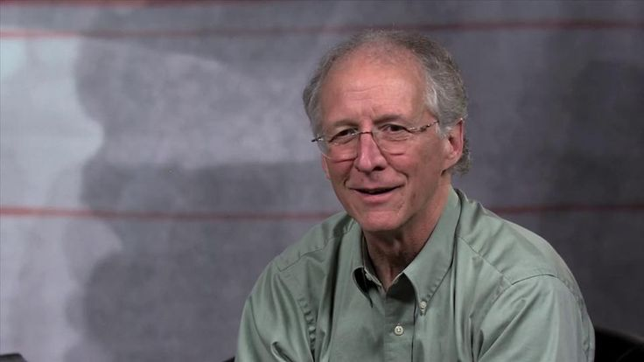

What are the traditional views of when human life begins?
17.4 Pregnancy and birth
What's your stance on birth control?
Q&A….
Abortion and the Christian (frame-poythress.org)
The Law, Theology and Abortion (frame-poythress.org)

