Slide 1
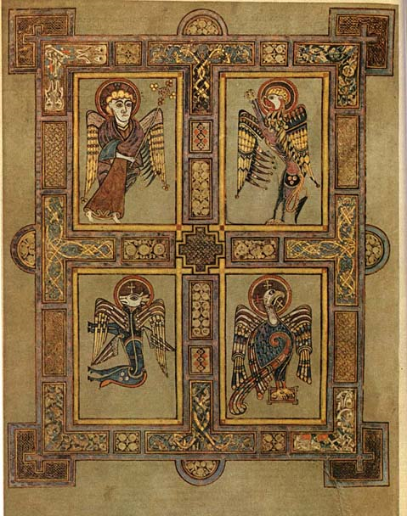
^{the} Four Gospels
Intro to
Life of Christ ~fall 2010
The Four Evangelists 8th century the Book of Kells

Slide 2
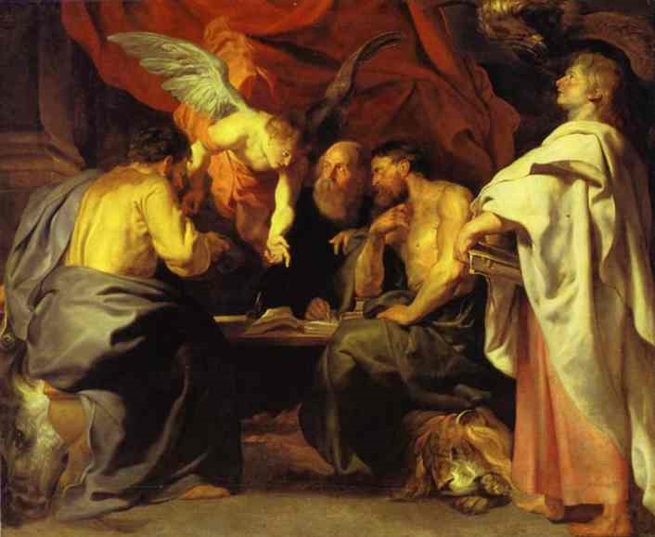
^{the} Four Evangelists
The Four Evangelists
1614
Peter Paul Rubens

Slide 3
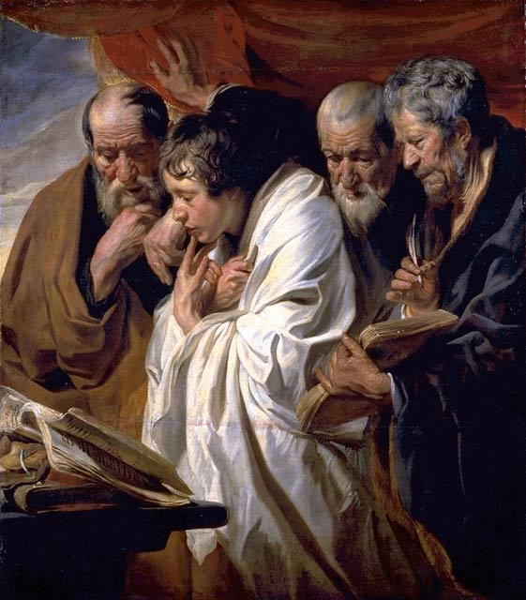
Jacob Jordaens (1593-1678): Les quatre Evangélistes

Slide 4
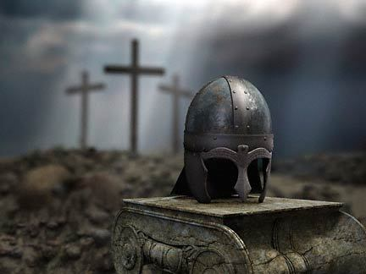
The Four Gospels: dates
Focus: events of the earthly Life of Christ
Written: later first century
A. Matthew (70 AD)
B. Mark (late 50’s- early 60’s AD)
C. Luke (60 AD)
D. John (60-90 AD)
Why, especially since Christ had been gone for 20 or more years?

Slide 5
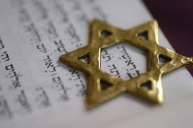
The Four Gospels: Matthew
Backstory
1 of 12 disciples
Identified in ch. 9
Audience
Wrote Aramaic version for Jews
Later wrote a more widely circulated version in Greek
Message :
Focus: of Christ is not new but a continuation of the Jewish faith; Matthew presents Christ as the Jewish Messiah; cites much OT prophecy
What Jesus said (knew shorthand
to capture conversations)
Tagline: “Jewish Messiah/King”
Ever wonder why Matthew begins with a genealogy? It goes back to Abraham …why is this significant?
It also goes back through David …why is this significant?

Slide 6
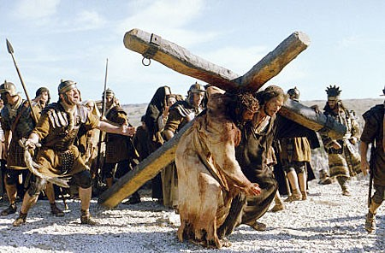
The Four Gospels: Mark
Backstory
Barnabas’ cousin; friend of Simon Peter
Part Jew, part gentile
From Peter’s perspective
Audience: Wrote to Gentiles (Romans)
Message :
Focus: Christ as suffering Servant
What Jesus did (book is written like a screenplay; full of action)
Tagline:
“Suffering Servant”
Does this make sense knowing it was from Peter’s point of view? It is written in present tense and does not include genealogies, the Christmas story…or even Jesus’ childhood…it just jumps right into Jesus’ public ministry

Slide 7
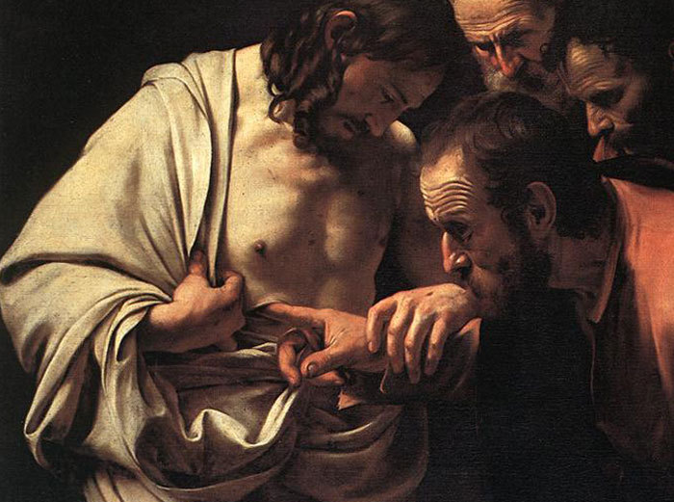
The Four Gospels: Luke
Backstory
Friend of Paul
Gentile doctor
Audience: Wrote to Gentiles (Greeks)
Message:
Focus : Christ as human being (fascinated that God would come to earth in the flesh)
Genealogy is not Royal, but human (goes back to ?)
What Jesus felt (Luke focuses on Christ’s emotions)
Tagline:
“Son of Man”
( humanity)
Does this make sense looking at the opening chapters of Luke? He starts his account with what? He includes many of the daily human activities that we take for granted…

Slide 8
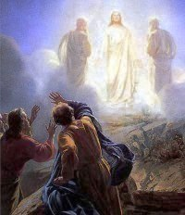
The Four Gospels: John
Backstory
1 of 12 disciples
Early Church Tradition places John as the referenced “Disciple whom Jesus loved”
Audience: Wrote to the Church
Message:
Focus: Christ as God (fascinated with Deity of Christ); favorite title: Christ as the Word
Starts with Christ’s pre-existence
and Him creating
C. Who Jesus was
Tagline:
“Son of God; Word”
If Luke stressed His humanity…why would John’s focus be important—even necessary?

Slide 9
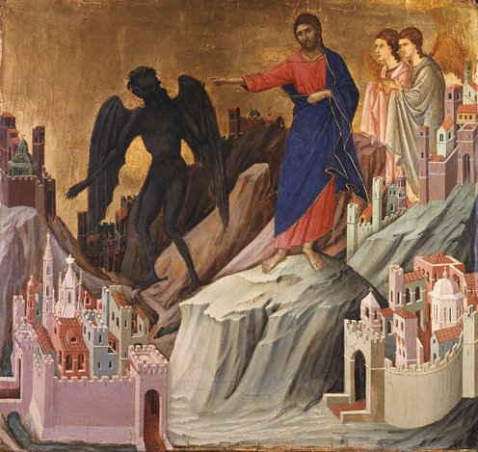
The Four Gospels
Duccio di Buoninsegna 1278-1319
Temptation of Christ on the Mountain
(from the Maestá)
1308-11
tempera on panel 46x43cm
Frick Collection, NY

Slide 10
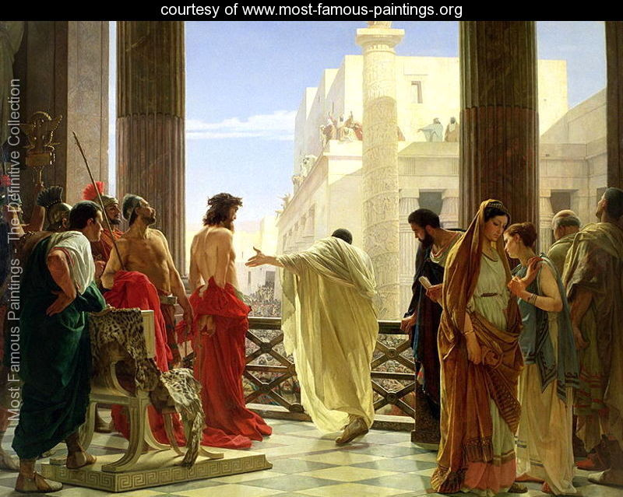
The Four Gospels
Ecce Homo (oil on canvas) by Antonio Ciseri
(1821-91) Galleria d'Arte Moderna, Florence, Italy

Slide 11
man: to highlight Christ’s humanity
lion: to highlight Christ’s kingship
ox: to highlight Christ’s sacrifice
eagle: to highlight Christ’s divinity
The Four Evangelists 8th century the Book of Kells

Slide 12
The Four Gospels

Slide 13
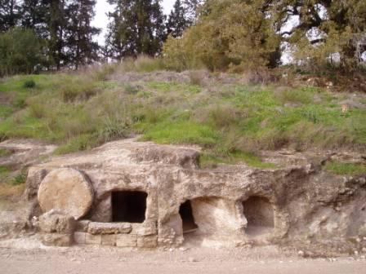
The Four Gospels

