Slide 1

Systematic Theology
Anthropology
(& Hamartiology)
Acts, Epistles, & Systematics
SRCS ~ Bible 10
mr. e ~ winter 2011

Slide 2
Introduction: Systematic Theology
2. Lecture &Discussion
3. Reading & Questions (Frame ch 7 ; or Berkhof ch )
4. Vocab (Each unit; matching)
Imago Dei likeness soul
creationism monism traducianism
dichotomy trichotomy mutual submission
primogeniture body pre-existentianism
man dignity humility
microevolution material naturalism age of accountability
impute mortal sin venial sin
double imputation original sin total depravity
inherited corruption Pelagius unpardonable sin
inherited guilt propitiation dualism
sin

Slide 3
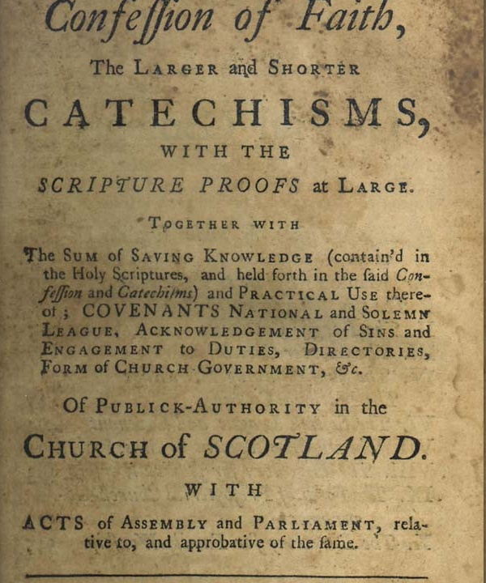
Introduction: Systematic Theology
5. Catechism (PART 1: WSC Q13-Q19
6. Bible memory (look at the green boxes in the presentation)
Genesis 1: 26-27
7. Doctrine/WCF (ch 6…)

Slide 4
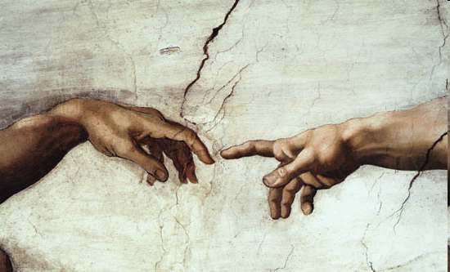
Introduction: Systematic Theology
What is this called? Anthropology
Part III: The Doctrine of Man
11. The Creation of Man
Why did God create us? How did God make us like himself? What does Scripture mean by "soul" and "spirit"?
12. Man as Male and Female
Why did God create two sexes? Can men and women be equal and yet have different roles?
13. Sin
What is sin? Where did it come from? Do we inherit a sinful nature from Adam?
What is this sub-part sometimes called?
Hamartiology

Slide 5
Systematic Theology: anthropology
MEMORY VERSE
Genesis 1:26–27: (ESV)
Then God said, “Let us make man in our image, after our likeness; and let them have dominion over the fish of the sea, and over the birds of the air, and
over the livestock, and over all the earth, and over every creeping thing that creeps upon the earth.” So God created man in his own image, in the image of God he created him; male and female he created them.
Part III: The Doctrine of Man
A. The Creation of Man
Why did God create us?
God Did Not Need to Create
Man, Yet He Created Us for His
Own Glory.
Which doctrine of God does
this point echo?
What is our purpose?
…we’ll come back to this

Slide 6
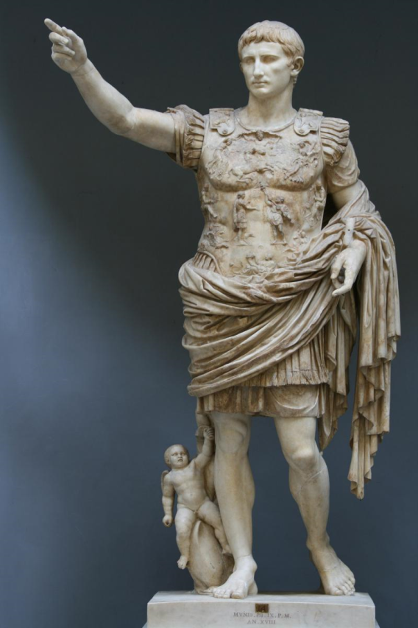
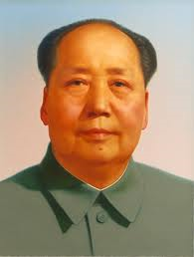
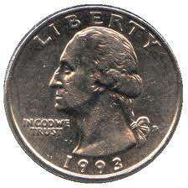
Systematic Theology: anthropology
Part III: The Doctrine of Man
The Creation of Man
What does it mean to be made in the “Image of God?”
We may use the following definition:
The fact that man is in the image of God means that man is like God and represents God.
Both the Hebrew word for “image” and the Hebrew word for “likeness” refer to something that is similar but not identical to the thing it represents.
Who are these leaders? What do they represent? Why would it be important to a leader to spread his image?

Slide 7
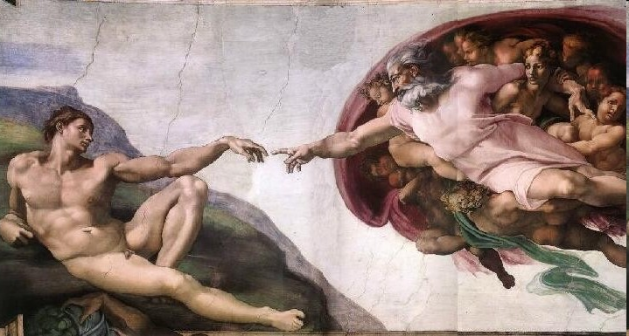
Systematic Theology: anthropology
Part III: The Doctrine of Man
B. Anthropology: Man, the Image of God
Frame spends time in the opening of this chapter speaking to the sensitive topic of Gender & language. Find a Scripture verse (other than Genesis 5:2) that uses the term ‘man’ to represent both male and female.
Creatures, with Dignity
Two levels of being In God’s economy (in other words, all reality):
a. Creator
b. Created (creature)
3. In the third full paragraph Frame very succinctly describes what it is to glorify God. Write out that statement below:
“To Glorify God is to reflect back to Him His own glory, His own love, knowledge, and power, so that He rejoices in us.”
²⁰But who are you, O man, to answer back to God? Will what is molded say to its molder, "Why have you made me like this?“
Romans 9:20

Slide 8
Systematic Theology: anthropology
Part III: The Doctrine of Man
Ever feel like you are practically invincible one instant and painfully frail the next. We are a strange mix of humility and dignity.
Pre-Fall, where is man’s humility & dignity rooted? (p.86):
Humility:
Dignity:
We are created & servants of God
Made in God’s Image (Imago Dei); made for dominion.

Slide 9

Systematic Theology: anthropology
Part III: The Doctrine of Man
5. WSC Q &A 1 below:
Q1: What is the chief end of man?
Think of something you thoroughly enjoy. Share it. How is God enjoyed through this thing or activity?
(ever wonder what it means if God doesn’t sanction what you ‘enjoy?’
it, essentially, detracts from His glory—that is the glory you’re to give Him and the enjoyment you were meant to have!
A1: Man's chief end is to glorify God, and to enjoy Him forever.
Baby laughing at Chicken Noodle
James Veitch Is A Terrible Roommate - CONAN on TBS - YouTube

Slide 10
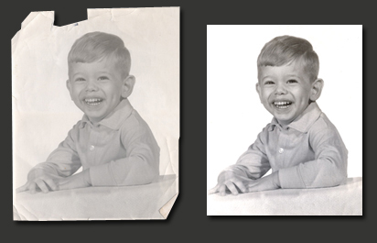
Systematic Theology: anthropology
Part III: The Doctrine of Man
The Creation of Man
C. What happened to the Image of God at the Fall?
  1. In the Fall God’s Image Is Distorted but Not Lost.
For a detailed analysis of this passage, see John Murray, Principles of Conduct
(Grand Rapids: Eerdmans, 1957), pp. 109–13.
This question is answered quite early in Genesis where God gives Noah the authority to establish the death penalty for murder among human beings just after the flood: God says “Whoever sheds the blood of man, by man shall his blood be shed; for God made man in his own image” (Gen. 9:6).
Even though men are sinful, there is still enough likeness to God remaining in them that to murder another person (to “shed blood” is an Old Testament expression for taking a human life) is to attack the part of creation that most resembles God, and it betrays an attempt or desire (if one were able) to attack God himself.
What does this mean?

Slide 11
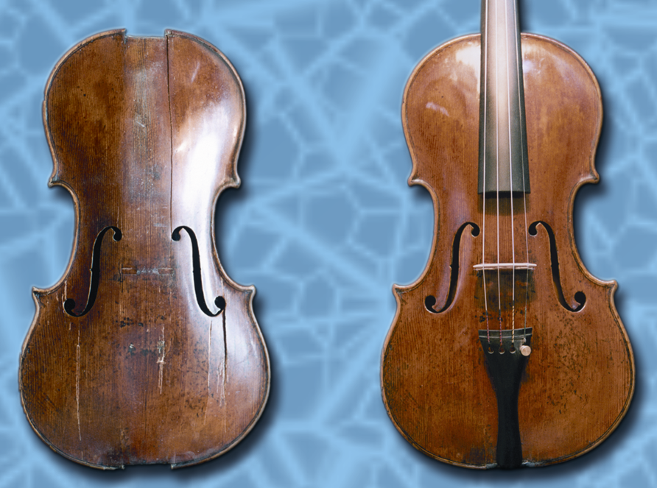
Systematic Theology: anthropology
Part III: The Doctrine of Man
When will this work be done?
In a word: Heaven!
“When he appears we shall be like him” (1 John 3:2).
The Creation of Man
2. Is that all we are--distorted?
  Redemption in Christ: a
  Progressive Recovering of More
  of God’s Image.
What does this mean?
For example, Paul says that as Christians we have a new nature that is “being renewed in knowledge after the image of its creator” (Col. 3:10). As we gain in true understanding of God, his Word, and his world, we begin to think more and more of the thoughts that God himself thinks.
What happens to us when we spend time around close friends?
Do we “finish His sentences?” or act the way He does?

Slide 12




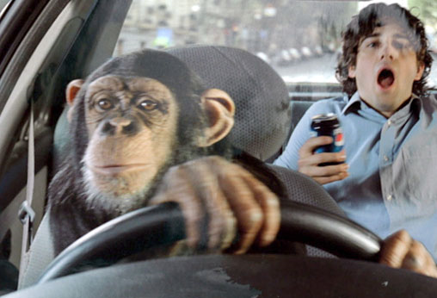
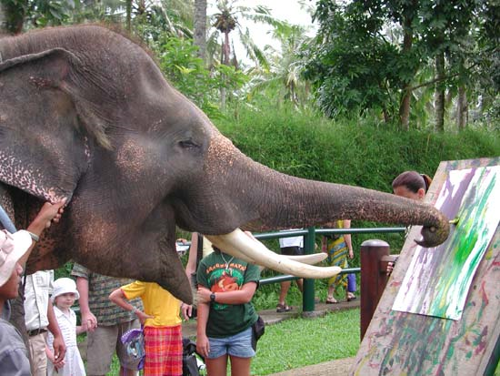
Systematic Theology: anthropology
We:
  ponder eternity
  display creativity & ingenuity
  experience emotional complexity
Part III: The Doctrine of Man
The Creation of Man
3. Specific Aspects of Our Likeness to God.
a. moral : innate knowledge of right & wrong; obligated to God, yet capable of reflecting certain aspects of His character
b. spiritual: we are immaterial & immortal; we relate to God as persons
c. mental: we are self-aware beings capable of reason
d. relational: interpersonal relationships; marriage, & place as stewards
e. physical: while this in no way implies that God has a body, our bodies reflect something of God’s character (Gen. rev.)
For example:

Slide 13

Man as Male & Female
So God created man in his own image, in the image of God he created him; male and female he created them. Genesis 1:27

Slide 14


Systematic Theology: anthropology
Part III: The Doctrine of Man
D. Man as Male & Female
Why did God create two sexes? Can men and women be equal
and yet have different roles? What cultural shift regarding manhood and womanhood has occurred and what are its consequences?
The creation of man as male and female shows God’s image in :
(1) harmonious interpersonal relationships
(2) equality in personhood and importance, and
(3) difference in role and authority.

Slide 15
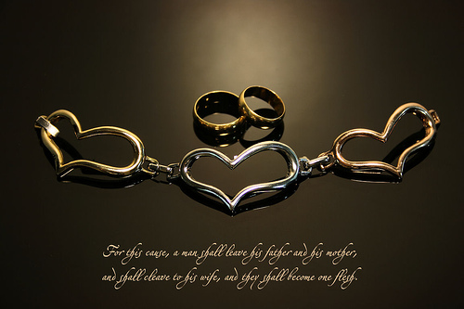
Systematic Theology: anthropology
When did God institute this?
Genesis 2:24
Job's Wife - Tim Hawkins

Slide 16
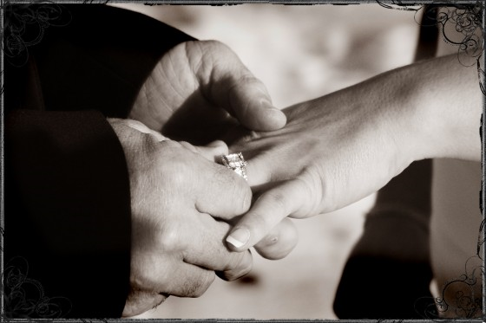

Systematic Theology: anthropology
Part III: The Doctrine of Man
D. Man as Male & Female
The creation of man as male and female shows God’s image in :
(1) harmonious interpersonal relationships
a. Highest expression: marriage (“one flesh”)
1. Profound lifelong relationship
Ever wonder, as you age, how the nature of getting together with your friends changes?
I suspect this shift is reflective of this hard-wired need.

Slide 17
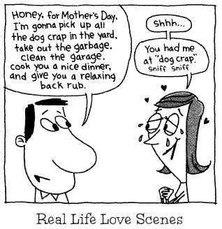
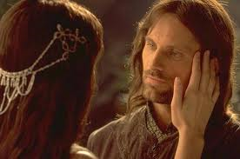
Systematic Theology: anthropology
Part III: The Doctrine of Man
D. Man as Male & Female
The creation of man as male and female shows God’s image in :
(1) harmonious interpersonal relationships
a. Highest expression: marriage (“one flesh”)
1. Profound lifelong relationship
2. Sacrifice for one another
Superman Dates -BluefishTV.com

Slide 18


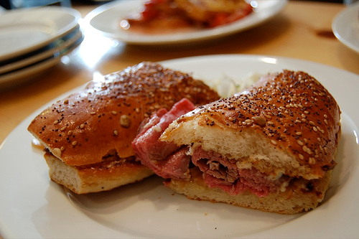
Systematic Theology: anthropology
Part III: The Doctrine of Man
D. Man as Male & Female
The creation of man as male and female shows God’s image in :
(1) harmonious interpersonal relationships
a. Highest expression: marriage (“one flesh”)
1. Profound lifelong relationship
2. Sacrifice for one another
3. Celebrate differences
Harvard Sailing Team - Boys Will Be Girls: Night Out - YouTube

Slide 19
Systematic Theology: anthropology
Part III: The Doctrine of Man
D. Man as Male & Female
The creation of man as male and female shows God’s image in :
(1) harmonious interpersonal relationships
a. Highest expression: marriage (“one flesh”)
1. Profound lifelong relationship
2. Sacrifice for one another
3. Celebrate differences
4. Specific roles (we will deal more closely with this once we have looked at our differences…)
Download a detailed book here:
https://www.desiringgod.org/books/recovering-biblical-manhood-and-womanhood

Slide 20
Systematic Theology: anthropology
Part III: The Doctrine of Man
D. Man as Male & Female
The creation of man as male and female shows God’s image in :
(1) harmonious interpersonal relationships
a. Highest expression: marriage (“one flesh”)
1. Profound lifelong relationship
2. Sacrifice for one another
3. Celebrate differences
4. Specific roles
b. Reflection of the Trinity…how?
    Objections
      “Jesus was never married”
      What about Paul’s instructions in I Cor. 7
        Does not condemn marriage (note: means of Covenant)
        Upholds worthiness of celibacy
Unity and Submission
² I am jealous for you with a godly jealousy. I promised you to one husband, to Christ, so that I might present you as a pure virgin to him. II Cor. 11:2
We will look at this unusual passage in some detail later…

Slide 21

Systematic Theology: anthropology
Part III: The Doctrine of Man
B. Man as Male & Female
The creation of man as male and female shows God’s image in :
(2) equality in personhood and importance
a. Reflects Ontological equality of the Trinity
b. Equal value & importance to God
  1. Disallows gender-driven pride or inferiority
  2. Allows for varied expression of the Image of God
²⁷ for all of you who were baptized into Christ have clothed yourselves with Christ. ²⁸ There is neither Jew nor Gentile, neither slave nor free, nor is there male and female, for you are all one in Christ Jesus. Galatians 3:27,28

Slide 22
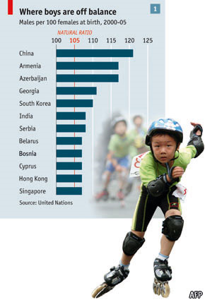


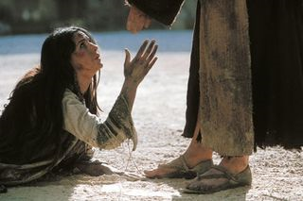
Systematic Theology: anthropology
A number of strategies have been proposed and implemented to try to address the problem of female infanticide, along with the related phenomena of sex-selective abortion and abandonment and neglect of girl children. Zeng et al.'s prescriptions for Chinese policymakers can easily be generalized to other countries where female infanticide is rife:
The principle of equality between men and women should be more widely promoted through the news media to change the attitude of son preference and improve the awareness of the general public on this issue; the principle should also be reflected in specific social and economic policies to protect the basic rights of women and children, especially female children. ...
Likewise, if a Chinese infant girl is turned over for adoption rather than being killed, she risks being placed in one of the notorious "Dying Rooms" unveiled in a British TV documentary. Chinese state orphanages have come in for heavy criticism as a result of the degrading and unsanitary conditions that usually pervade them. In one orphanage, documentary producer Brian Woods found that "every single baby ... was a girl, and as we moved on this pattern was repeated. The only boys were mentally or physically disabled. 95% of the babies we saw were able-bodied girls. We also discovered that, although they are described as orphans, very few of them actually are; the overwhelming majority do have parents, but their parents have abandoned them, simply because they were born the wrong sex." Woods estimated that "up to a million baby girls every year" were victims of this "mass desertion," deriving from "the complex collision of [China's] notorious One Child Policy and its traditional preference for sons." (See Brian Woods, "The Dying Rooms Trust".)
In 1999, Jonathan Manthorpe reported a study by the Chinese Academy of Social Sciences, claiming that "the imbalance between the sexes is now so distorted that there are 111 million men in China -- more than three times the population of Canada -- who will not be able to find a wife." As a result, the kidnapping and slave-trading of women has increased: "Since 1990, say official Chinese figures, 64,000 women -- 8,000 a year on average -- have been rescued by authorities from forced 'marriages'.
http://www.thedailybeast.com/articles/2015/08/12/the-many-reasons-why-ronda-rousey-vs-floyd-mayweather-is-a-bad-idea.html?via=newsletter&source=DDAfternoon

Slide 23
Systematic Theology: anthropology
Part III: The Doctrine of Man
D. Man as Male & Female
The creation of man as male and female shows God’s image in :
(3) difference in role and authority.
a. Relates to Economic Trinity: Just as God the Father has authority over the Son, though the two are equal in deity, so in a marriage, the husband has authority over the wife, though they are equal in personhood.
b. Man is ‘head’, woman is helpmate; “primogeniture” is assumed in the OT
1. Adam created first); echoed in I Tim 2:13
2. Adam named Eve
3. Serpent tempted Eve (role reversal)
4. God spoke to Adam (as ‘Federal head’; 1 Cor 15:22; cf. v. 49)
²² For as in Adam all die, so in Christ all will be made alive. Corinthians 15:22
¹¹ A woman should learn in quietness and full submission. ¹² I do not permit a woman to teach or to assume authority over a man; she must be quiet. ¹³ For Adam was formed first, then Eve.
the idea that the firstborn son has inheritance rights and leadership of the family for that generation which, incidentally, God upended (Seth over Cain, Isaac over Ishmael, Jacob over Esau) as He valued Covenant belief more than birth order.

Slide 24
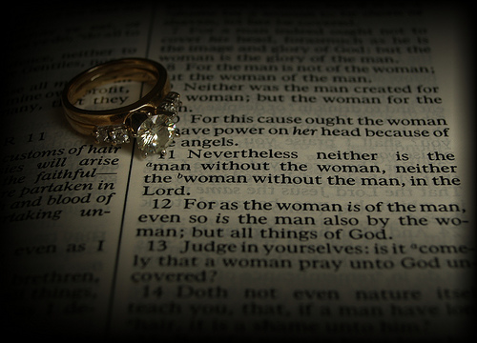
What do we do with Paul’s words in Ephesians 5:21?
“21 Submit to one another out of reverence for Christ.”
This is often referred to as “mutual submission”—sometimes used by ‘egalitarian’ proponents to imply that there is no unique kind of submission that a wife owes to her husband—undermining the husband’s role and stripping a wife of her God given protection.
However, the following context defines what Paul means by “be subject to one another” in Ephesians 5:21: he means “Be subject to others in the church who are in positions of authority over you.” This is explained by what follows: wives are to be subject to husbands (Eph. 5:22–24), but husbands are never told to be subject to wives. In fact, Paul tells wives to be subject “to your own husbands” (Eph. 5:22),24 not to everyone in the church or to all husbands! Children are to be subject to their parents (to “obey” them, Eph. 6:1–3), but parents are never told to be subject to or to obey their children. Servants are to be subject to (“obey”) their masters, but not masters to servants.25 Therefore, the idea of mutual submission (in the sense,
“everyone should be subject to everyone”) is not affirmed here.
http://www.aholyexperience.com/2014/09/dear-kids-why-wait-till-marriage-what-no-one-tells-you-what-i-wish-someone-had-told-me/
1 Corthians 11: 11, 12

Slide 25
Systematic Theology: anthropology
Part III: The Doctrine of Man
D. Man as Male & Female
The creation of man as male and female shows God’s image in :
(3) difference in role and authority.
a. Relates to Economic Trinity: Just as God the Father has authority over the Son, though the two are equal in deity, so in a marriage, the husband has authority over the wife, though they are equal in personhood.
b. Man is ‘head’, woman is helpmate; “primogeniture” is assumed in the OT
1. Adam created first); echoed in I Tim 2:13
2. Adam named Eve
3. Serpent tempted Eve (role reversal)
4. God spoke to Adam (as ‘Federal head’; (1 Cor 15:22; cf. v. 49)
c. Fall distorted roles; Redemption reaffirms former order
³Now I want you to realize that the head of every man is Christ, and the head of the woman is man, and the head of Christ is God.
1 Corinthians 11:3
And now for you who wish to be Gentlemen…I give you my top 20…

Slide 26
Systematic Theology: anthropology
20. Don’t dress to attract unnecessary attention or make some gauche statement. Wear a belt. It’s called underwear for a reason.
19. Barnes & Noble should be your best friend.
18. Try not to go straight to the sports section of the newspaper.
17. Being open-minded and aware of the world around you shows class and sophistication, but avoid seeming pretentious by being modest instead of showing off what you know. Learn at least one instrument.
16. Look people in the eyes when you greet them & shake their hand with intention.
15. “Take criticism with an open mind. You can improve from listening to superiors and by changing your actions to serve them.”
14. Be on time to meetings/rendezvous -early if you can.
13. In meetings, don’t hold conversations at the same time someone else is speaking. Let the person finish his point before giving yours. Sometimes, simply listen.
12. Don’t talk down to coworkers, including subordinates. You may be above them in rank, but as a human being, it’s a level playing field.
11. If you initiate a dinner date or meeting, then you should expect to pay. That works both ways. (But, men, still insist…and relent if she won’t back down.)
10. At a restaurant, let women order food first, and stand up when a woman leaves the table. Assist her to her chair before seating yourself.

Slide 27
Systematic Theology: anthropology
9. Keep it clean and constructive. Avoid use of slang and expletives and course speech.
8. Use a napkin—several if you must. Always ask before taking another’s (better yet, get more for all).
7. Caveman behavior at the dinner table is frowned upon. Use utensils, avoid chewing with your mouth open and don’t leave a messy plate. (Leave utensils at 5:25 when done)
6. When eating out, always tip at least 20 %. Waiters live off of customers’ kindness. Don’t make other people at your table reach into their pocket to cover your cheapness.
5. Treat older women as if they were your own mother—and younger as if they are sisters.
4. Always have a woman walk on the inside of the sidewalk and on the side of parked cars in a parking lot, basically using your body as a barrier from harm.
3. Always pick up dropped objects for ladies.
2. Always offer (insist) to carry what it is they are carrying.
Always open doors for ladies.
Nacho Libre (1/10) Movie CLIP - Buttload of Favorites (2006 ...

Slide 28

E. 1. What, then, are the ramifications for marriage?
Consider these temptations…
…these can have insidiously harmful effects, especially when they are duplicitously presented in combo….say….
Passive abuses Aggressive abuses
Laziness Male Tyranny
No initiative (Adam in Garden) Domineering
No leadership; “pass the buck” Selfish Cruelty
Blend into background Female Usurp authority
Unwilling to correct husband Disallow husband to fulfill role
Not participate in family decisions Sets the tone for the family

Slide 29
E. 2. How sacred is Marriage?*
*Taken from Frame, DCL 748-768
Marriage is a creation ordinance as it is essential to:
fulfilling the cultural mandate and a mirror of the Divine covenant
Why is Scripture so negative towards Adultery?
At its most profound level, it constitutes covenant treason. The parallel drawn is that the mentality of rebellion in the one is the same in the other…
What did Jesus think?
First recorded miracle at a wedding (Jn 2)—supplying wine was the job of the bridegroom…reinforcing His role as Groom of the Church; The consummation of history is the “marriage Supper of the Lamb” (Rev 19); we are His Bride…
To societally forbid Marriage is to violate God’s Word and command to culture…
To remain celibate is a gift and has its Kingdom purposes, but both situations are good in their context and are blessed by God
Arranged marriages are, in fact historical, but are not necessarily superior to modern virtuous dating practices—as long as the spouses love one another after the vows have been made
Gen 1:28; 2:24
Hosea 2:14-20

Slide 30
E. 2. How sacred is Marriage?*
*Taken from Frame, DCL 748-768
Marriage is a creation ordinance as it is essential to:
fulfilling the cultural mandate and a mirror of the Divine covenant
What about Polygamy?
Not common in the West (why?); A real issue that churches deal with abroad (eg. Dr. Nnoromele’s father); “in the West it is serial rather than simultaneous”
OT seems to be tolerant (mirrors allowance for divorce due to “hardness of heart”)
NT (though written to a culture that tolerated polygamy) is clear: While polygamy violates the deepest unrivalled love and commitment of the marriage vow, it disqualified one from church office—not membership.
Some churches teach that a polygamist turned believer be barred from membership & the sacraments…yet shepherded as they attend…
  This is unbiblical…Why?
  The door to Church should not be narrower than the Gates of Heaven—all who belong to Christ are to be admitted to church & the sacraments…yet they ought not be considered for church office.
  Keep in mind: polygamy is unlike other sins in that, say, a thief, can cease his thievery. A polygamist has ongoing commitments to his spouses. A sinful divorce does not remedy the sin of polygamy.
Gen 1:28; 2:24
Hosea 2:14-20
One Woman Lives With Two Husbands - YouTube

Slide 31
E. 3. What about divorce?*
*Taken from Frame, DCL 770-781
Divorce is allowed by OT & NT in some cases (granted due to “hardness of hearts”)
Never a cause for celebration (it is to be mourned as a symptom of failure)
Even when not sinful (biblical grounds), it is to be a last resort and all within the church’s power ought be done to prevent it
What are Biblical grounds?
Note: certain Pharisees taught that a man could divorce his wife for any number of reasons—his only responsibility being to issue a certificate of divorce. Jesus refutes this in Mt 5:31,32, Mk 10:2-12, Lk 16:18, Mt 19:3-9.
Exception of Matthew 5:32 & 19:9
  31 “It was also said, ‘Whoever divorces his wife, let him give her a certificate of divorce.’ 32 But I say to you that everyone who divorces his wife, except on the ground of sexual immorality, makes her commit adultery, and whoever marries a divorced woman commits adultery.
The term “sexual immorality’ above is the Greek word porneia. This ought be understood as specific sexual sins as fornication (relations b/w unmarried persons), prostitution, incest, homosexuality, bestiality, and adultery.
Remember—though permitted, divorce isn’t necessary or even desirable. Reconciliation is the emphasis and mirrors God’s forgiveness.
A believing spouse is not to initiate divorce, but may need to file to include the state into what has become her situation—the status quo, that is a broken marriage.
Desertion (whether physical or vow-related) and abuse is a breach of the marital vow (& pornography can be) and must be undertaken by the session on a case by case basis

Slide 32
E. 4. What about remarriage?*
*Taken from Frame, DCL 770-781
Remarriage is permitted after the death of one’s spouse (I Cor 7:39)
A person divorced in accordance with the Matt 19 exception is free to remarry—this applies to both the guilty and the innocent party.
(Remember…this is an exception to the general rule)
If two believing spouses have divorced, they are to remain unmarried or else be reconciled
    This seems quite harsh…and does, in fact uphold the sacredness of marriage by those who not only understand its covenantal gravity but also its original intent—but there is more to it than having to simply swallow the dire situation in which you could find yourself…
Consider I Cor 7: 10-15
10 To the married I give this charge (not I, but the Lord): the wife should not separate from her husband 11 (but if she does, she should remain unmarried or else be reconciled to her husband), and the husband should not divorce his wife. 12 To the rest I say (I, not the Lord) that if any brother has a wife who is an unbeliever, and she consents to live with him, he should not divorce her. 13 If any woman has a husband who is an unbeliever, and he consents to live with her, she should not divorce him. 14 For the unbelieving husband is made holy because of his wife, and the unbelieving wife is made holy because of her husband. Otherwise your children would be unclean, but as it is, they are holy. 15 But if the unbelieving partner separates, let it be so. In such cases the brother or sister is not enslaved. God has called you[b] to peace.

Slide 33
E. 4. What about remarriage?*
*Taken from Frame, DCL 770-781
Consider I Cor 7: 10-15
10 To the married I give this charge (not I, but the Lord): the wife should not separate from her husband 11 (but if she does, she should remain unmarried or else be reconciled to her husband), and the husband should not divorce his wife. 12 To the rest I say (I, not the Lord) that if any brother has a wife who is an unbeliever, and she consents to live with him, he should not divorce her. 13 If any woman has a husband who is an unbeliever, and he consents to live with her, she should not divorce him. 14 For the unbelieving husband is made holy because of his wife, and the unbelieving wife is made holy because of her husband. Otherwise your children would be unclean, but as it is, they are holy. 15 But if the unbelieving partner separates, let it be so. In such cases the brother or sister is not enslaved. God has called you[b] to peace.
At first blush this may seem to ignore a marriage between two believers—but let’s take an example (this is one of the myriad of practical & spiritual benefits of membership in the church):
Suppose Victor and Susan are professing believers and members of Grace Presbyterian Church and Victor deserts his wife Susan. This situation as it now stands does not fall under the I Cor. 7:15 terms because they are both regarded as believers. But Susan is not without recourse. She has the privilege and responsibility to call on the church for help. The elders call Victor to repentance, but he is adamant and, once all admonitions and rebukes have been clearly laid out, falls under discipline and is, in the end, excommunicated. From that point on, Susan and the Church regard him as an unbeliever, and the marriage becomes a mixed marriage. Victor’s desertion falls under the above terms and Susan may recognize that by filing divorce papers.
If an unbelieving spouse divorces a believing spouse, the believer is free to remarry

Slide 34
E. 5. What about celibacy?*
*Taken from http://thirdmill.org/answers/answer.asp/file/40410
For many centuries, the church has basically taught that singleness is better than marriage, but that not everyone has the "gift of singleness."
That is, the church has taught that Paul thought singleness and celibacy was an objectively better state for Christian devotion to God than was marriage.
The obvious problem with this view is it contradicts the Old Testament.
Where did the church get this idea? I Corinthians 7
The biggest problem passage regarding this topic is 1 Corinthians 7. This passage is the source of such assertions as: 1) it is good for a man not to have sexual relations with a woman; 2) Paul wished that everyone were single like him; 3) it is better not to marry; 4) those who marry have more difficult lives; 5) those who marry are less devoted to God.
What are we to do with this?

Slide 35
E. 5. What about celibacy?*
*Taken from http://thirdmill.org/answers/answer.asp/file/40410
What are we to do with this?
In fact, these interpretations of this passage are completely erroneous, being based on a misunderstanding of the context and situation to which Paul wrote. In order to read the passage properly we need to notice a couple things about 1 Corinthians itself:
1) It was written as an "occasional" letter — Paul wrote this letter to a specific church regarding particular problems that church was having due to its peculiar circumstances. It was also written largely in response to a letter that the Corinthians had written to Paul (1 Cor. 7:1).
2) Corinth and much of the rest of the Roman world was suffering from famines. This is corroborated by secular history, and by the fact that Paul was taking up the famine relief collection for Jerusalem (1 Cor. 16:1-4). (Even though the Corinthians were suffering, those in Jerusalem were evidently suffering worse from the famines.)

Slide 36
E. 5. What about celibacy?*
*Taken from http://thirdmill.org/answers/answer.asp/file/40410
What are we to do with this?
Dealing with the assertions:
it is good for a man not to have sexual relations with a woman
This was not Paul’s belief in the context of marriage—but the Corinthians’ statement—which Paul refuted
Paul wished that everyone were single like him
it is better not to marry
those who marry have more difficult lives
Considering the context of famine/ “present distress”, Paul wanted the Corinthians to place a temporary moratorium on weddings so that they would be better able to survive the "present crisis.“
those who marry are less devoted to God.
The presence of verses 29-31, which teach that Christians should maintain an eternal perspective rather than being absorbed in worldly approaches to live, further demonstrates that Paul is speaking about improper anxiety in all instances mentioned in verses 32-35. Undistracted devotion to God does not require singleness, but an eternal perspective, and both married people and single people have trouble with devotion and perspective.

Slide 37
E. 5. What about celibacy?*
*Taken from Piper, Recovering Biblical Manhood & Womanhood
The role of celibacy?
That, if you are single, you exploit your singleness to the full in devotion to God and not be paralyzed by the desire to be married.
The roles within marriage?
You love your wife the way Christ loved the church and gave himself for her; that you be a humble, self-denying, upbuilding, happy spiritual leader; that you consistently grow in grace and knowledge so as never to quench the aspirations of your wife for spiritual advancement; that you cultivate tenderness and strength, a pattern of initiative and a listening ear; and that you accept the responsibility of provision and protection in the family, however you and your wife share the labor.
You creatively and intelligently and sincerely support the leadership of your husband as deeply as obedience to Christ will allow; that you encourage him in his God-appointed role as head; that you influence him spiritually primarily through your fearless tranquillity and holiness and prayer.
The Village Porch Scene in 720p HD use next link if unworkable

Slide 38
E. 5. What about celibacy?*
*Taken from https://byfaithonline.com/beneath-gillettes-what-is-a-man-controversy/
A call to the men…an excerpt from an article by gary yagel
Consider just one aspect of Adam’s calling. In Genesis 2:15, we are told that Adam is placed in the garden to work it (ESV). The Hebrew word for “work it” is avad, which means “to make fruitful,” to “cause to flourish.” Adam is to provide what the garden, which includes its human inhabitants, needs to be fruitful. This core concept of masculinity is that we invest our greatest assets, time, effort, and energy so that all parts of the garden (or civilization) flourish.
When the broad calling of manhood is applied in the narrower sphere of the home, we see that husbands and fathers are called to provide what their wives and children need to flourish physically, emotionally, and spiritually. It is Adam’s original call to manhood — sacrificing himself so that others reach their full potential — that is to be lived out, by Christ-following men in their homes. The masculinity that Christianity restores Christian men to display is not the selfish abuse of power but self-giving manhood. Our authority and headship are assigned to us so that we can cause those under our care to thrive. That was the original calling of unfallen Adam. This is the restored masculinity for which our culture yearns, and which it desperately needs.

Slide 39

E. 6. What about culture’s view of family?*
*Taken from Stonestreet; Summit Basecamp 2019 & Wikipedia
There was a sexual revolution in earlier decades (early 20’s…then radically in the 50’s & beyond)…and the fluid times in which we live in the matters of sexuality/sexual identity are its fruit
Emergence of highly sexualized modern psychoanalysis
“Liberation” of sexual roles/desires for women
Development of birth control and STD prevention/medicines
Rise of non-traditional sexuality/countercultural movements
Normalization of pornography
Widespread acceptance/publishing in the media
Explicit sex in film and stage…

Slide 40
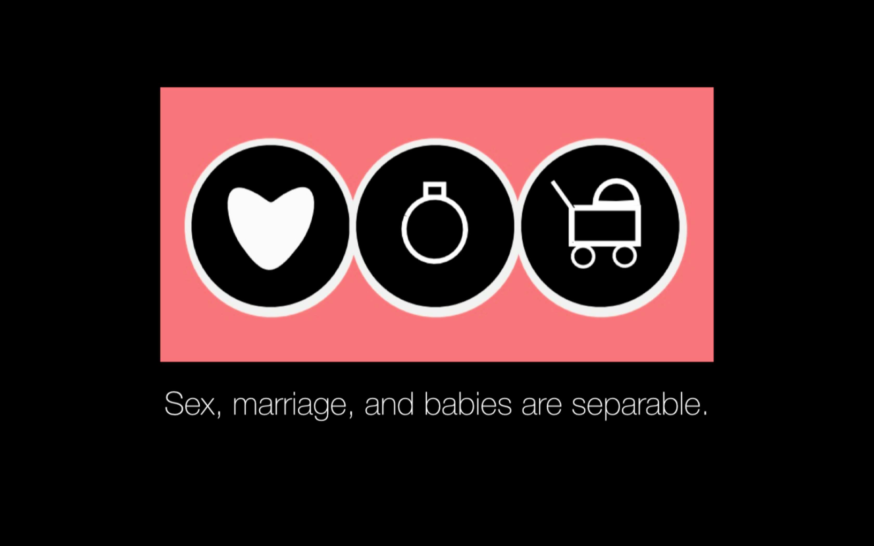
E. 6. What about culture’s view of family?*
*Taken from Stonestreet; Summit Basecamp 2019
“ideas have consequences. Bad ideas have victims” j. stonestreet
What were the ‘bad idea’ shifts inherited from the sexual revolution?

Slide 41
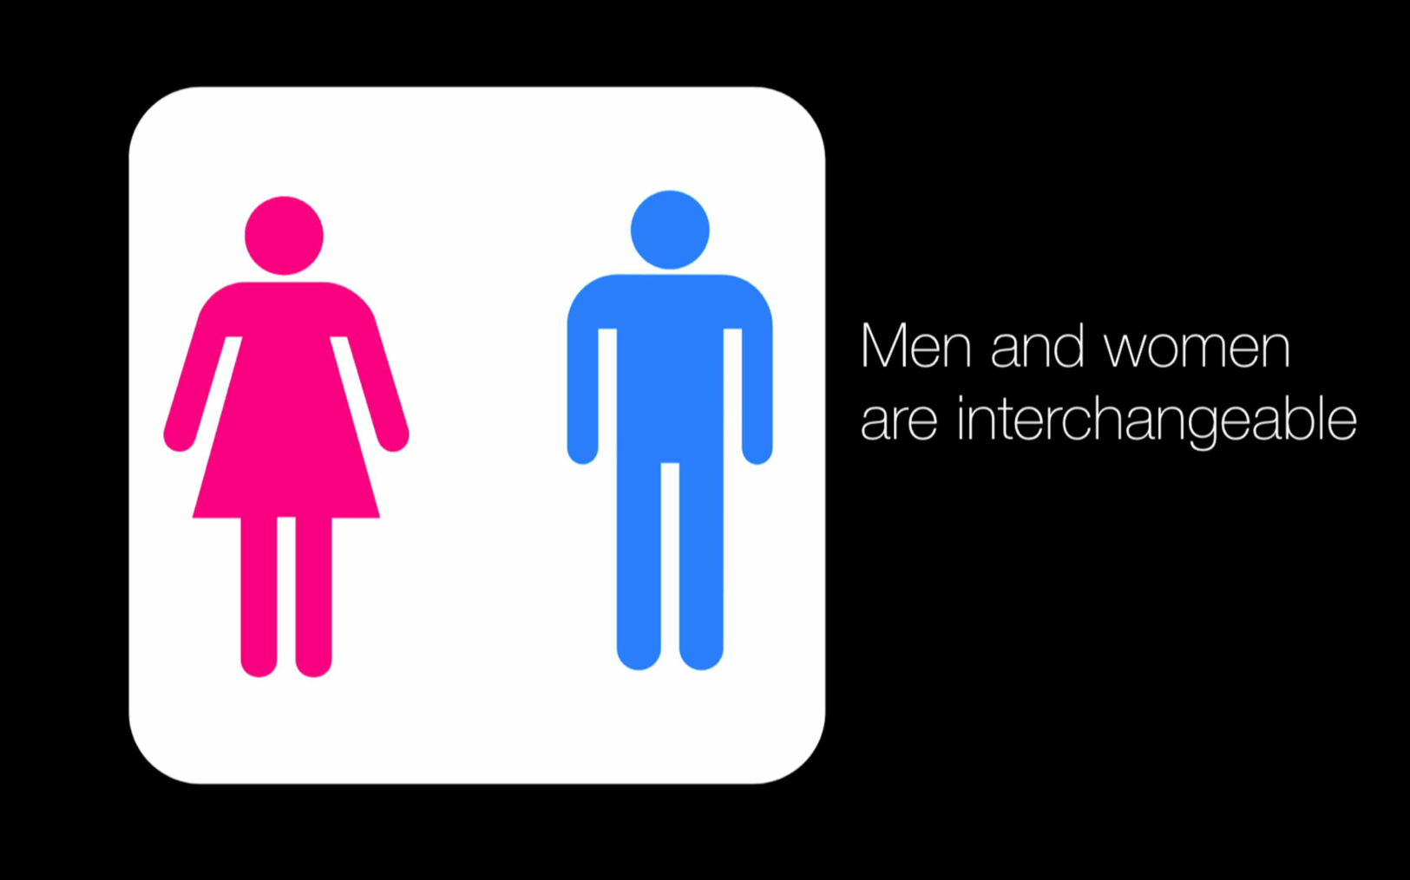
E. 6. What about culture’s view of family?*
*Taken from Stonestreet; Summit Basecamp 2019
“ideas have consequences. Bad ideas have victims” j. stonestreet
What were the ‘bad idea’ shifts inherited from the sexual revolution?

Slide 42
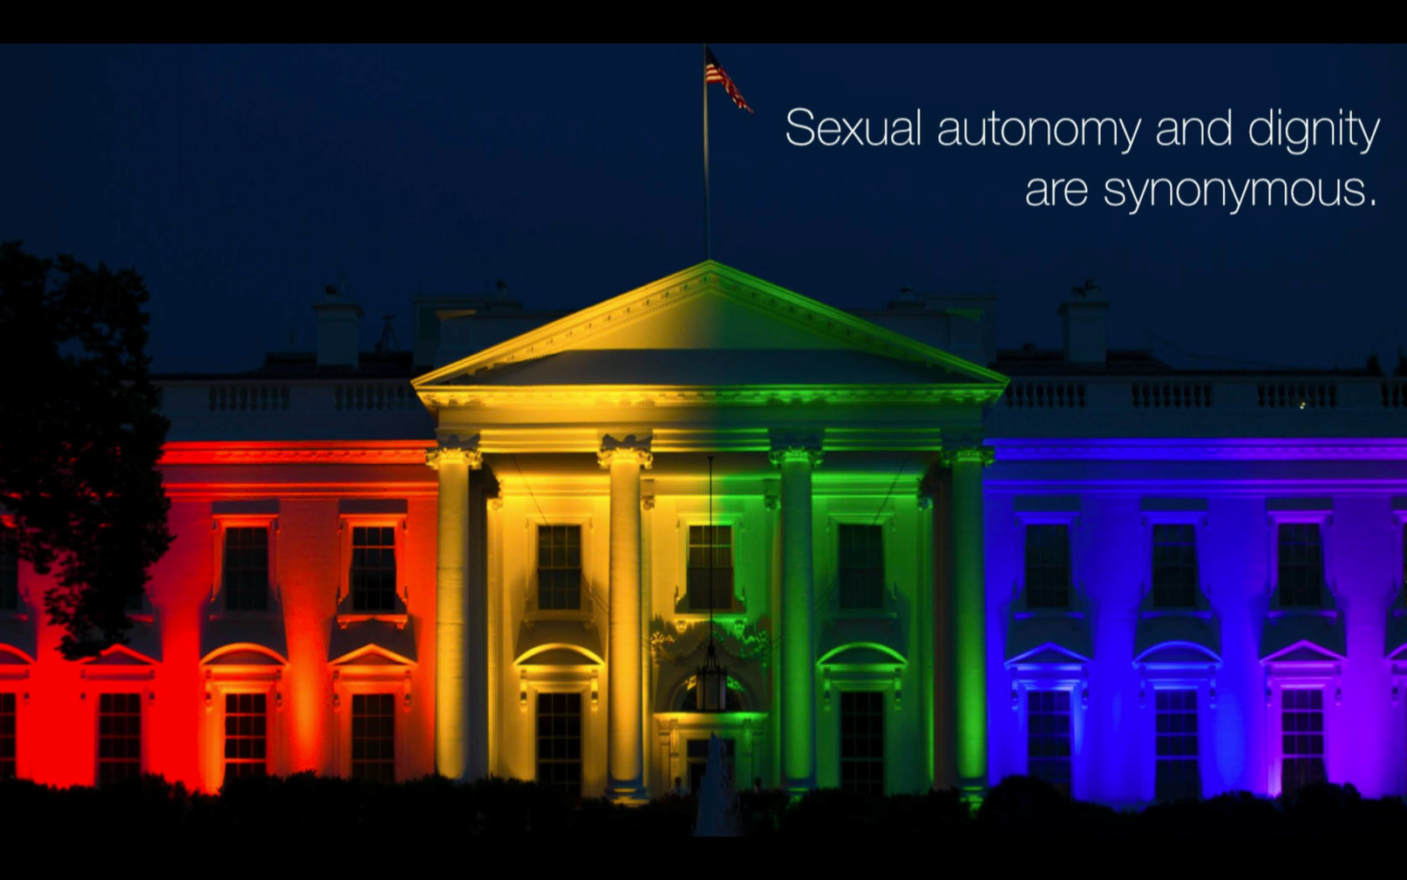
E. 6. What about culture’s view of family?*
*Taken from Stonestreet; Summit Basecamp 2019
“ideas have consequences. Bad ideas have victims” j. stonestreet
What were the ‘bad idea’ shifts inherited from the sexual revolution?
College Kids Say the Darndest Things: On Identity

Slide 43
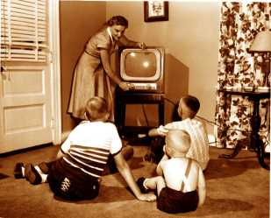
Media Moment
Pick any TV show
How do they represent celibate/marital roles?
How are they dishonorable and destructive?
How are they honorable and redemptive?
Tim Hawkins - Helper in the Car
https://youtu.be/-YFRUSTiFUs
We Believe: The Best Men Can Be | Gillette (Short Film)

Slide 44
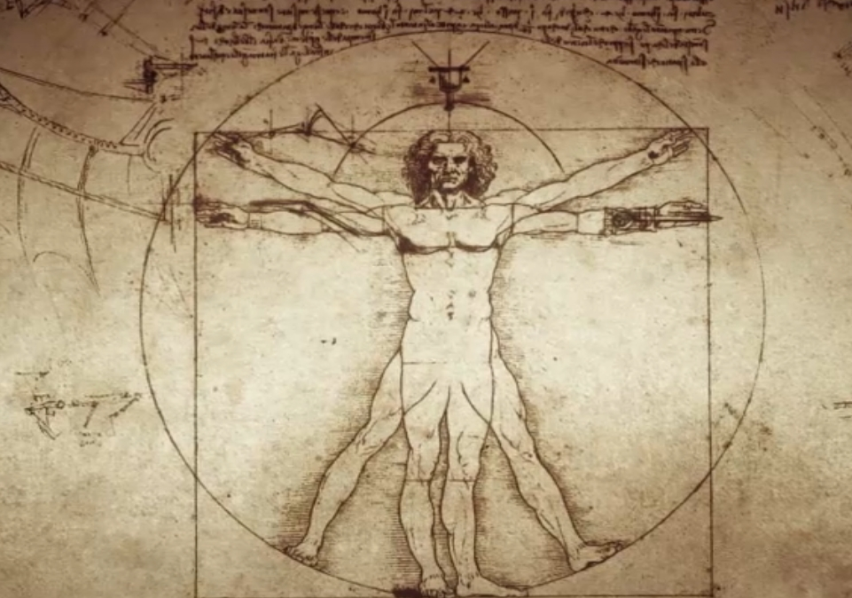
Systematic Theology: anthropology
Part III: The Doctrine of Man
F. The Essential Nature of Man
What does Scripture mean by "soul" and "spirit"?
1. Introduction: all agree we have bodies…but what is that other part—the immaterial part of us that lives on after our bodies die?
2. Three divisions (& new vocab!)
a. Monism: man is body
b. Dichotomy: man is body & soul/spirit
c. Trichotomy: man is body, soul, & spirit
Evangelical idea; held more commonly throughout the history of the church
Pagan idea; assume ‘soul’ or ‘spirit’ into one person (body)
Evangelical idea; has been a commonly held idea; few scholarly defenses today

Slide 45
Systematic Theology: anthropology
Part III: The Doctrine of Man
F. The Essential Nature of Man
What does Scripture mean by "soul" and "spirit"?
3. Biblical Data
a. Scripture uses “soul” & “spirit” interchangeably
b. At death the soul/spirit departs (& continues to function)
c. Man is said to be either “body & soul” or “body & spirit”
d. The “soul” can sin; the “spirit” can sin
e. Each is said to do what the other does
For example, in John 12:27, Jesus says, “Now is my soul troubled,” whereas in a very similar context in the next chapter John says that Jesus was “troubled in spirit” (John 13:21).
¹ Therefore, since we have these promises, dear friends, let us purify ourselves from everything that contaminates body and spirit, perfecting holiness out of reverence for God. 2 Corinthians 7:1

Slide 46
Systematic Theology: anthropology
Part III: The Doctrine of Man
F. The Essential Nature of Man
What does Scripture mean by "soul" and "spirit"?
4. An Argument for trichotomy & response
a. Hebrews 4:12
b. Response:
1. Not soul from spirit
2. See parallel (next words...)
3. Context & meaning (nothing is hidden)
¹² For the word of God is alive and active. Sharper than any double-edged sword, it penetrates even to dividing soul and spirit, joints and marrow; it judges the thoughts and attitudes of the heart.
Here’s a lesson in Hermeneutics!

Slide 47



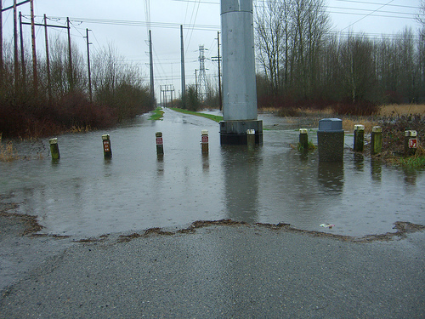

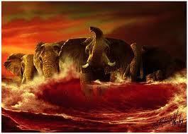

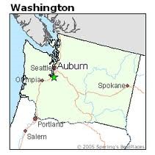
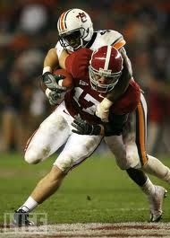

Systematic Theology: anthropology
“Tide Rolls Over Auburn”
Just because one can make an argument for a particular interpretation does not mean that it is true.
We are after a natural reading of the text—not a forced or inflicted reading. The author’s intentions are our concern as he was carried by the Holy Spirit.
I.
II.
III.

Slide 48
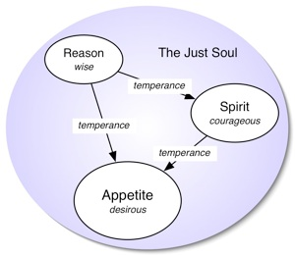
Systematic Theology: anthropology
Part III: The Doctrine of Man
F. The Essential Nature of Man
What does Scripture mean by "soul" and "spirit"?
4. An Argument for trichotomy & response
a. Hebrews 4:12
b. Response:
1. Not soul from spirit
2. See parallel (next words...)
3. Context & meaning (nothing is hidden)
Gnostics later classified people according to this tripartite characteristics: the spiritual were beyond ethical norms. The soulish were your run of the mill Christians of the pew. And the fleshly were the unconverted.
We might also note the observation of Louis Berkhof on the origin of trichotomy:
“The tripartite conception of man originated in Greek philosophy, which conceived of the relation of the body and the spirit of man to each other after the analogy of the mutual relation between the material universe and God. It was thought that, just as the latter could enter into communion with each other only by means of a third substance or an intermediate being, so the former could enter into mutual vital relationships only by means of a third or intermediate element, namely, the soul.”
Intent was not to teach on the nature of man but, rather, the clarity of the Divine Word—the author simply used terms common to man to teach his point
¹² For the word of God is alive and active. Sharper than any double-edged sword, it penetrates even to dividing soul and spirit, joints and marrow; it judges the thoughts and attitudes of the heart.

Slide 49

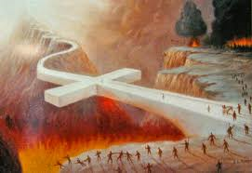

Systematic Theology: anthropology
Part III: The Doctrine of Man
F. The Essential Nature of Man
What does Scripture mean by "soul" and "spirit"?
We must hold to a view of body & spirit that upholds the overall unity of man, it will be much easier to avoid the error of depreciating the value of our intellects, emotions, or physical bodies. We will not think of our bodies as inherently evil or unimportant.
It will also help us to remember that, in this life, there is a continual interaction between our body and our spirit, and that they affect each other:
Rob Bell - Everything is Spiritual Tour
Start at 31:00….
We must remember that death itself is unnatural: it is a judicial state—it came about by sin (moral)…we return to dust because we sin—not because we are dust!
Who stands as a masterful portrait of the spiritual and physical?
Jesus—the Godman who bridged the Spiritual World to the physical world
“A cheerful heart is good medicine, but a downcast spirit dries up the bones” (Prov. 17:22).

Slide 50

Systematic Theology: anthropology
I would suggest that in the cultures and periods in which the Bible was written, burial was generally perceived as honorable and cremation was generally seen as a way to prevent the dead from being honored. However, it does not appear to me that the Bible states that these are absolute or perpetual means of honoring and dishonoring the dead. In a society that perceives cremation as an honorable way to treat the dead, cremation ought to carry no stigma. Accepting different ways of treating the dead is, in my mind, part of being all things to all people (cf. 1 Cor. 9:19-23).
I would also point out that the Bible never suggests that those whose bodies are burned will not participate in the resurrection of all believers. Although it is sometimes taught that those whose bodies are destroyed thereby forfeit the ability to be resurrected unto glory, the Bible offers no support whatsoever for this idea. On the contrary, the resurrection is promised to all who are in Christ (Rom. 6:5; 1 Cor. 15), without regard to their manner of death or to the treatment of their bodies.
answer by Ra McLaughlin
A note about death… interment…cremation vs. burial?
Cremation, historically,
is a pagan practice. It
has been
traditionally
viewed by the
Church as unnatural
and only done if
medically necessary
(plague/unable to inter).
Burial has been long the tradition of the Church because it respects
the body giving it its Imago Dei due.

Slide 51
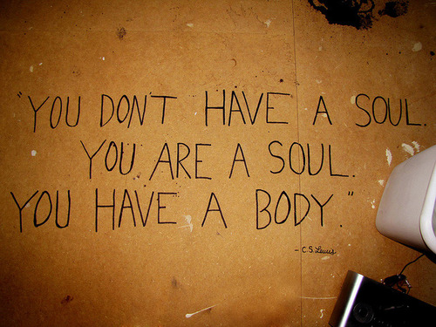
Systematic Theology: anthropology
Part III: The Doctrine of Man
F. The Essential Nature of Man

Slide 52

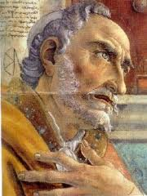
Systematic Theology: anthropology
Part III: The Doctrine of Man
F. The Essential Nature of Man
Where do our souls come from?
1. Two views have been common in the history of the church:
a. Creationism is the view that God creates a new soul for each person and sends it to that person’s body sometime between conception and birth.
b. Traducianism on the other hand, holds that the soul as well as the body of a child are inherited from the baby’s mother and father at the time of conception.
Generally, the soul is considered simple and not composed of parts. Traducianism seems to suggest that the soul of the child somehow separates itself from the soul of the parent. Furthermore, which parent, the father, the mother, or both?
However, the more troubling aspect of traducianism if its effect on Christology. If in Adam human nature as a whole sinned, it would seem that the human nature of Christ would be sinful, which is of course not true of our Lord.
See any potential difficulties here…
I would like to point out the import of the above-mentioned WCF 6.3:
III. They being the root of mankind, the guilt of this sin was imputed, and the same death in sin and corrupted nature conveyed to all their posterity, descending from them by ordinary generation.
…the guilt of sin is indeed imputed; on the other hand, the corrupted nature is "conveyed." A forensic imputation would not explain why Adam's descendants sin. Something about "ordinary generation" conveys the corrupt nature. Christ was not conceived by ordinary generation and thus does not partake of the corrupt nature. The creationist viewpoint takes on gnostic overtones in that there is a supposed pure soul corrupted by attachment to an impure body.
Scripturally speaking, I think the exegetical evidence is a bit thin for either side. We see God make a soul for Adam, but not for Eve. Also, God ceased from creative activity at the end of the Genesis account. Of course, we can find counter-examples to this, but creationism involves God involved in regular creative activity. Charlie Johnson
There is one other popular view called pre-existentianism namely, that the souls of
people exist in heaven long before their bodies are conceived in the wombs of their
mothers, and that God then brings the soul to earth to be joined with the baby’s body
as he or she grows in the womb. But this view is not held by either Roman Catholic or
Protestant theologians and is dangerously akin to ideas of reincarnation found in
Eastern religions. Moreover, there is no support for this view in Scripture.
We ought not debate this
question as it is nearly a
fool’s errand...and should
see both as speculative…
because Scripture does not
give us enough to be sure…Augustine confessed near the end of his life that he could not resolve the matter either way to his own satisfaction (Retractationes 1.1.3).

Slide 53

Systematic Theology: Hamartiology
Sin: What is sin? Where did it come from? Do we inherit a sinful nature from Adam? Do we inherit guilt from Adam?
Ravi Zacharias Drops TRUTH Bomb

Slide 54

A few observations of Life in the Garden
Before the Fall…
  God and Man had a very intimate relationship
  There was serious beauty in the garden
  Work was given before the fall
  Freedom was granted, but required restraint
  The creation of woman clearly teaches that we were made for perfect relationships
  It was all VERY GOOD!!!

Slide 55

A Detailed look @ what went wrong!
1. The Temptation
Genesis 3:1-24
¹Now the serpent was more crafty than any of the wild animals the LORD God had made. He said to the woman, “Did God really say, ‘You must not eat from any tree in the garden’?” ²The woman said to the serpent, “We may eat fruit from the trees in the garden, ³but God did say, ‘You must not eat fruit from the tree that is in the middle of the garden, and you must not touch it, or you will die.’” ⁴“You will not surely die,” the serpent said to the woman. ⁵“For God knows that when you eat of it your eyes will be opened, and you will be like God, knowing good and evil.”
Did God really say
A: 1. It attacks our basis for knowledge (recasting answers to the question, “What is true?”)
2. It attacks our basis for moral standards (recasting answers to the question, “What is right?)”
3. It attacks our basis for our identity (recasting answers to the question, “Who am I?”)
Q: What seems to be the common denominator –the fundamental root of sin?
Disbelief in God’s word

Slide 56

A Detailed look @ what went wrong!
2. The first human sin ever committed
Genesis 3:1-24
⁶When the woman saw that the fruit of the tree was good for food and pleasing to the eye, and also desirable for gaining wisdom, she took some and ate it. She also gave some to her husband, who was with her, and he ate it.
What does this verse reveal?

Slide 57
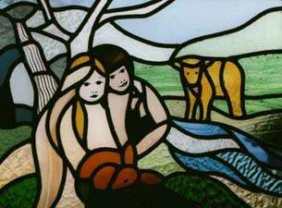
A Detailed look @ what went wrong!
3. The Result
Genesis 3:1-24
⁷Then the eyes of both of them were opened, and they realized that they were naked; so they sewed fig leaves together and made coverings for themselves.
Significance?
Shame demands covering
Inevitably we pursue a works-based theology
What I believe to be one of the saddest verses in all of Scripture

Slide 58
A Detailed look @ what went wrong!
4. A changed relationship with God
Genesis 3:1-24
⁸Then the man and his wife heard the sound of the LORD God as he was walking in the garden in the cool of the day, and they hid from the LORD God among the trees of the garden. ⁹But the LORD God called to the man, “Where are you?” ¹⁰He answered, “I heard you in the garden, and I was afraid because I was naked; so I hid.” ¹¹And he said, “Who told you that you were naked? Have you eaten from the tree from which I commanded you not to eat?”
MAN vs. _____

Slide 59
A Detailed look @ what went wrong!
5. A changed relationship with one another
MAN vs. _____
Genesis 3:1-24
¹²The man said, “The woman you put here with me—she gave me some fruit from the tree, and I ate it.” ¹³Then the LORD God said to the woman, “What is this you have done?” The woman said, “The serpent deceived me, and I ate.”
What is Adam’s initial response?
Who does he blame (careful!)?
MAN vs. _____

Slide 60
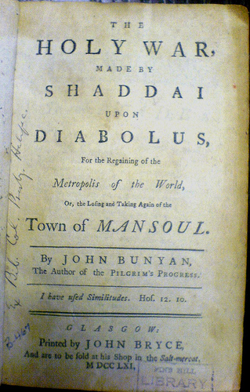
A Detailed look @ what went wrong!
6. The Curse - to the serpent
Genesis 3:1-24
¹⁴So the LORD God said to the serpent, “Because you have done this, “Cursed are you above all the livestock and all the wild animals! You will crawl on your belly and you will eat dust all the days of your life. ¹⁵And I will put enmity between you and the woman, and between your offspring and hers; he will crush your head, and you will strike his heel.”
What do we call this?....Why?...it will set the tone of the rest of history

Slide 61
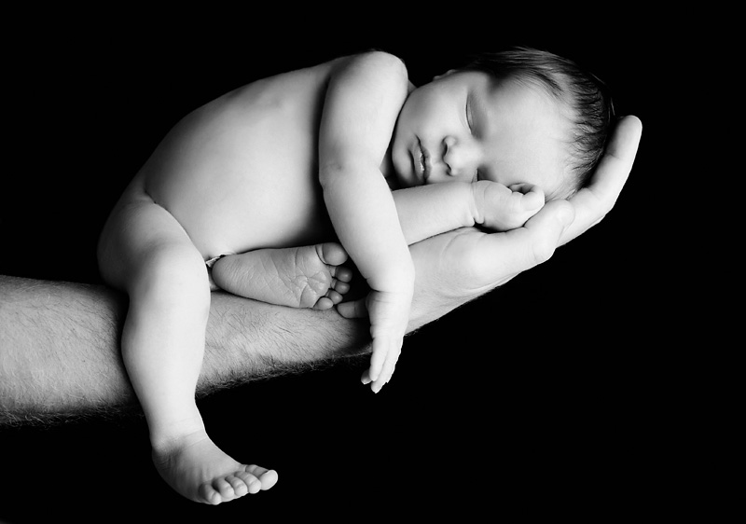
A Detailed look @ what went wrong!
7. The Curse - to the woman
Genesis 3:1-24
¹⁶To the woman he said, “I will greatly increase your pains in childbearing; with pain you will give birth to children. Your desire will be for your husband, and he will rule over you.”
This sounds peachy keen but what does it mean?
MAN vs. _____
Implication? “Without __________ there can be no ________________.”

Slide 62

A Detailed look @ what went wrong!
8. The Curse - to the man
Genesis 3:1-24
¹⁷To Adam he said, “Because you listened to your wife and ate from the tree about which I commanded you, ‘You must not eat of it,’ “Cursed is the ground because of you; through painful toil you will eat of it all the days of your life. ¹⁸It will produce thorns and thistles for you, and you will eat the plants of the field. ¹⁹By the sweat of your brow you will eat your food until you return to the ground, since from it you were taken; for dust you are and to dust you will return.”
MAN vs. _____

Slide 63

A Detailed look @ what went wrong!
9. Amazing Grace in the midst of sin
Genesis 3:1-24
²⁰Adam named his wife Eve, because she would become the mother of all the living. ²¹The LORD God made garments of skin for Adam and his wife and clothed them. ²²And the LORD God said, “The man has now become like one of us, knowing good and evil. He must not be allowed to reach out his hand and take also from the tree of life and eat, and live for ever.” ²³So the LORD God banished him from the Garden of Eden to work the ground from which he had been taken. ²⁴After he drove the man out, he placed on the east side of the Garden of Eden cherubim and a flaming sword flashing back and forth to guard the way to the tree of life.
explain.

Slide 64
A Detailed look @ what went wrong!
9. Amazing Grace in the midst of sin
Genesis 4:1-2
¹Adam lay with his wife Eve, and she became pregnant and gave birth to Cain. She said, “With the help of the LORD I have brought forth a man.” ²Later she gave birth to his brother Abel. Now Abel kept flocks, and Cain worked the soil.
What was probably going through Eve’s mind…

Slide 65
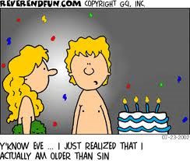
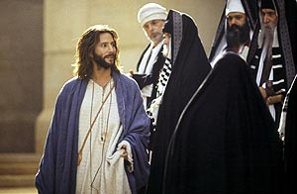
Systematic Theology: Hamartiology
What is sin?
Sin is any failure to conform to the moral law of God in act, attitude, or nature. (Exo 20:1-17, Exo 20:17)
What if I don’t act?—Is it still sin?
Jesus ramps up the Pharisees’ interpretation of the Law when he includes desire & motive as sin—as the root of the more obvious act
(eg. Anger→ murder)

Slide 66

Where are we?
A look at what happened in Genesis 3
  God did not “create” evil
  Where did evil come from?
  1. To blame God would be blasphemy.
  2. To grant evil eternality = dualism
  3. Sin did not surprise Him nor overcome His
  Omniscience or providence.
  4. Although that sin would enter the world was still
  God-ordained, it was accomplished by the voluntary
  choices of moral creatures (Angels→ mankind).
  5. Sin is irrational
  a. Satan’s rebellion makes no sense.
  b. Our rebellion makes no sense; “foolishness” (I Cor., Psalms, Proverbs)
As if evil is something we could touch…
10 “So listen to me, you men of understanding.
Far be it from God to do evil, from the Almighty to do wrong.
Job 34:10
Offers some explanation why he continues in his crusade vs. God even though he knows what Scripture declares as his fate…

Slide 67
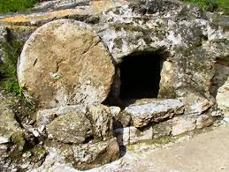

Where are we?
A look at what happened in Genesis 3
  God did not “create” evil
  Shame entered into the world
  Fear now gripped Adam and Eve
  Childbearing is to be painful
  There will be no perfect relationships
  The whole earth (ground) is cursed
  Work will be hard and life a struggle
  Death enters into the world
  They were banished from the very place
  they were created to be - the Garden of Eden
  10. Their relationship with God is now broken
As if evil is something we could touch…
Imagine a world without shame…
What did this fear cause Adam & Eve to do? N What did God’s question to them reveal?
Sorry ladies…but the blessing erases it quickly…
Isn’t this what we ultimately long for?
Was work a result of sin?
This is unnatural…(but it cannot win)
How was this an act of mercy?
What, now, is necessary to bridge the chasm?

Slide 68
Who are we?
The result of the First Sin
Total Depravity in every area of our lives
Sin is rooted in the core of our being so that there is no part of us that is left untouched by sin; explained by the term “radical corruption” in that our minds, our wills, and our bodies are affected by evil.
“The Bible teaches the total depravity of the human race. Total depravity means radical corruption. We must be careful to note the difference between total depravity and "utter" depravity. To be utterly depraved is to be as wicked as one could possibly be. Hitler was extremely depraved, but he could have been worse than he was. I am sinner. Yet I could sin more often and more severely than I actually do. I am not utterly depraved, but I am totally depraved… We speak sinful words, do sinful deeds, have impure thoughts. Our very bodies suffer from the ravages of sin.” RC Sproul

Slide 69
Who are we?
The result of the First Sin
Total Depravity in every area of our lives
Genesis 6:5
⁵The LORD saw how great man’s wickedness on the earth had become, and that every inclination of the thoughts of his heart was only evil all the time.

Slide 70
Who are we?
The result of the First Sin
Total Depravity in every area of our lives
Genesis 8:21a
²¹The LORD smelled the pleasing aroma and said in his heart: “Never again will I curse the ground because of man, even though every inclination of his heart is evil from childhood”.

Slide 71
Who are we?
The result of the First Sin
Total Depravity in every area of our lives
Psalm 14:1-3
¹The fool says in his heart, “There is no God.” They are corrupt, their deeds are vile; there is no one who does good. ²The LORD looks down from heaven on the sons of men to see if there are any who understand, any who seek God. ³All have turned aside, they have together become corrupt; there is no-one who does good, not even one.

Slide 72
Who are we?
The result of the First Sin
Total Depravity in every area of our lives
Ecclesiastes 7:20
²⁰There is not a righteous man on earth who does what is right and never sins.

Slide 73
Who are we?
The result of the First Sin
Total Depravity in every area of our lives
Ecclesiastes 7:20
²⁰There is not a righteous man on earth who does what is right and never sins.
Ecclesiastes 9:3
³This is the evil in everything that happens under the sun: The same destiny overtakes all. The hearts of men, moreover, are full of evil and there is madness in their hearts while they live, and afterwards they join the dead.
Anjelah Johnson on Prayer

Slide 74
Who are we?
The result of the First Sin
Total Depravity in every area of our lives
Isaiah 53:6a
⁶We all, like sheep, have gone astray, each of us has turned to his own way.

Slide 75
Who are we?
The result of the First Sin
Total Depravity in every area of our lives
Romans 1:29-32
²⁹They have become filled with every kind of wickedness, evil, greed and depravity. They are full of envy, murder, strife, deceit and malice. They are gossips, ³⁰slanderers, God-haters, insolent, arrogant and boastful; they invent ways of doing evil; they disobey their parents; ³¹they are senseless, faithless, heartless, ruthless. ³²Although they know God’s righteous decree that those who do such things deserve death, they not only continue to do these very things but also approve of those who practice them.
Goodness is unnatural to us. Neither example is natural to us, but decide which is more unnatural:
http://www.godtube.com/watch/?v=7YL6KGNX
http://www.godtube.com/watch/?v=911EJFNU

Slide 76
Who are we?
The result of the First Sin
Total Depravity in every area of our lives
Romans 3:23
²³for all have sinned and fall short of the glory of God.

Slide 77
Who are we?
The result of the First Sin
2. Total Inability to change on our own
Total depravity is sometimes called the doctrine of “total inability” because this condition is inextricably tied to it.
“It is because of this condition that the verdict of Scripture is heard: we are "dead in trespasses and sins" (Ephesians 2:1); we are "sold under sin" (Romans 7:14); we are in "captivity to the law of sin" (Romans 7:23); and "by nature children of wrath (Ephesians 2:3).
Only by the quickening power of the Holy Spirit may we be brought out of this state of spiritual death. It is God who makes us alive as we become His craftsmanship (Ephesians 2:1-10).”
RC Sproul

Slide 78
Who are we?
The result of the First Sin
2. Total Inability to change on our own
Jeremiah 13:23
²³Can the Ethiopian change his skin or the leopard its spots? Neither can you do good who are accustomed to doing evil.

Slide 79
Who are we?
The result of the First Sin
2. Total Inability to change on our own
Matthew 7:18
¹⁸A good tree cannot bear bad fruit,
and a bad tree cannot bear good fruit.

Slide 80
Who are we?
The result of the First Sin
2. Total Inability to change on our own
John 6:44
⁴⁴“No one can come to me unless the Father who sent me draws him, and I will raise him up at the last day.”
According to His Choice, Not Our Works... (R.C....

Slide 81
Who are we?
The result of the First Sin
2. Total Inability to change on our own
John 15:4, 5
⁴“Remain in me, and I will remain in you. No branch can bear fruit by itself; it must remain in the vine. Neither can you bear fruit unless you remain in me. ⁵I am the vine; you are the branches. If a man remains in me and I in him, he will bear much fruit; apart from me you can do nothing.”

Slide 82

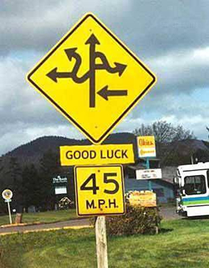
Who are we?
The result of the First Sin
3. This is the effect of “Original Sin”
Romans 5:12, 18-19
¹²Therefore, just as sin entered the world through one man, and death through sin, and in this way death came to all men, because all sinned—
¹⁸Consequently, just as the result of one trespass was condemnation for all men, so also the result of one act of righteousness was justification that brings life for all men. ¹⁹For just as through the disobedience of the one man the many were made sinners, so also through the obedience of the one man the many will be made righteous.
What do we say to the one who cries ‘unfair!’?
If God is good, Adam was our best representative.
(I hate to imagine what I would have done)
Does our track record tell us otherwise?
(best answer) If Adam’s sin was not imputed to us …how could Christ’s obedience redeem us?
(same procedure for both)
What do we call this?
Justification and Imputed Righteousness (RC Sproul)

Slide 83
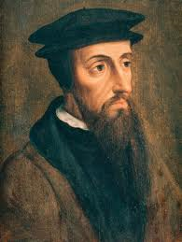

“Original sin, therefore, seems to be a hereditary depravity and corruption of our nature, diffused into all parts of the soul, which first makes us liable to God's wrath, then also brings forth in us those works which Scripture calls "works of the flesh" (Gal 5:19). And that is properly what Paul often calls sin. The works that come forth from it--such as adulteries, fornications, thefts, hatreds, murders, carousings--he accordingly calls "fruits of sin" (Gal 5:19-21), although they are also commonly called "sins" in Scripture, and even by Paul himself.”
~John Calvin, Institutes of the Christian Religion, vol 2, page 251

Slide 84
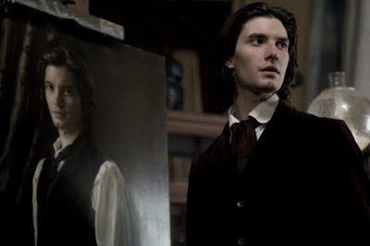
Systematic Theology: Hamartiology
The Doctrine of Inherited Sin
How does the sin of Adam affect us?
Scripture teaches that we inherit sin from
Adam in two ways.
1. Inherited Guilt: We Are Counted Guilty Because of Adam’s Sin.
2. Inherited Corruption: We Have a Sinful Nature Because of Adam’s Sin.
a. In Our Natures We Totally Lack Spiritual Good Before God
b. In Our Actions We Are Totally Unable to Do Spiritual Good Before God
Romans 5:18–19:
¹⁸ Consequently, just as one trespass resulted in condemnation for all people, so also one righteous act resulted in justification and life for all people. ¹⁹ For just as through the disobedience of the one man the many were made sinners, so also through the obedience of the one man the many will be made righteous.
In fact, unbelievers are not pleasing to God, if for no other
reason, simply because their actions do not proceed from faith in God or from love to
him, and “without faith it is impossible to please him” (Heb. 11:6, Rom 8:8).
Apart from the work of Christ in our
lives, we are like all other unbelievers who are “darkened in their understanding,
alienated from the life of God because of the ignorance that is in them, due to their
hardness of heart” (Eph. 4:18)
This is traditionally called ‘original sin’
“Not all evangelical theologians, however, agree that we are counted guilty because
of Adam’s sin. Some, especially Arminian theologians, think this to be unfair of God
and do not believe that it is taught in Romans 5. However, evangelicals of all
persuasions do agree that we receive a sinful disposition or a tendency to sin as an
inheritance from Adam, a subject we shall now consider…” Wayne Grudem

Slide 85
Systematic Theology: Hamartiology
A few final things worth noting…
Pelagianism
Infants
Are all sins equal?
Results of sinning
Warning to Unbelievers in Covenant
The Unpardonable sin.

Slide 86
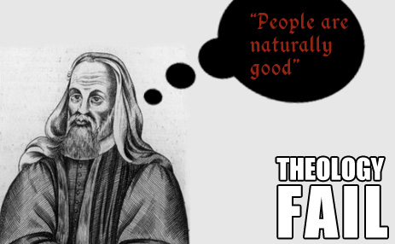

Systematic Theology: Hamartiology
A few final things worth noting…
Pelagianism
Does It Matter? Ignoring the consequences the Fall has on everyone leads to a diminishment of the multifaceted work of Christ—both in His obedient work of redemption as well as His sustaining humankind.
Pelagius’ View of Sin
Pelagius rejected the doctrines of original sin, substitutionary atonement, and justification by faith. Pelagius emphasized unconditional free will and the ability to better oneself spiritually without grace. This was in direct contrast to Augustine, who believed that humanity was completely helpless in Adam’s sin and in desperate need of grace. Specifically, Pelagius took issue with Augustine’s prayer in his Confessions, which asked God to grant humans grace to act in accordance with his divine commands: “Grant what you command and command what you will.” (Confessions, X. 40).
Pelagianism was more fundamentally concerned with the question of salvation, holding that man can take the first and the most important steps toward salvation on
his own, apart from God’s intervening grace. Pelagianism was condemned as a heresy at the Council of Carthage on May 1, A.D. 418.

Slide 87
Systematic Theology: Hamartiology
A few final things worth noting…
Infants: Are Infants Guilty Before They Commit Actual Sins?
  a. No: while they bear the weight of original sin, they are not yet guilty of the weight of actual sin (requires conscious awareness of violation of law accord. to some)
  b. Yes: while they are under a less severe judgment they still bear the guilt (inherited guilt) of Adam’s sin

Slide 88
Systematic Theology: Hamartiology
A few final things worth noting…
Infants: How does this then translate to salvation?
OPTIONS: 1. All saved (b/c they are not yet accountable)
2. Some saved (all Covenant children)
3. Some saved (b/c some are Elect—while others not)
4. None saved (b/c they cannot consciously confess)
What we do know:
More knowledge = more severe judgment
Those who sin unwittingly or unknowingly are less culpable than those who sin knowingly or defiantly (e.g. Num. 15:22ff.; Josh. 20:1-9)
God himself seems to show compassion even on the children of unbelievers on the basis of their ignorance
There is no “one-size-fits-all” prescribed ‘age of accountability’ (eg. 13 yrs)
Any infants who are saved are saved on Christ’s merit (not of their own)
There are instances of regeneration in the womb! (John the Baptist; Luke 1:15, Ps. 22:10)
Salvation patterns: typical: through hearing & children of believers

Slide 89
Systematic Theology: Hamartiology
A few final things worth noting…
Infants: How does this then translate to salvation?
There are four views held by Christians.
1. all children who die in infancy are saved.
This view teaches that God, out of His grace chooses to save all who die in infancy. While adherents affirm the seriousness of original sin and acknowledge that all infants have inherited a sin nature from Adam, they also teach that God chooses to extend special grace to these infants. Sproul says “infants who die are given a special dispensation of the grace of God; it is not by their innocence but by God’s grace that they are received into heaven.”
2. the children of believers are saved. This view is dependent upon a belief in covenant theology. This idea is implied by the fact that God does not treat his covenant people with the same strictness with which he treats others. Rather, with his covenant people, he is slow to anger and quick to show mercy. He also has a special love for the children of believers (Ps. 103:17). The Bible tells us that children are God's gift to believers (Ps. 127:3). This implies that one way that God blesses covenant members is by treating their children with mercy (compare Gen. 26:24; 1 Kings 11:12).

Slide 90
Systematic Theology: Hamartiology
A few final things worth noting…
Infants: How does this then translate to salvation?
There are four views held by Christians.
3. unbaptized infants are not saved while baptized infants may be. This is the view of the Roman Catholic Church and Protestant denominations which teach some form of baptismal regeneration (We do not embrace this)
4. We can have no assurance. This view simply states that there is not sufficient evidence in Scripture to make a firm determination. Eventually we must simply admit that this is an area in which Scripture is silent and leave it to God to work out.

Slide 91
Systematic Theology: Hamartiology
Breaking the law? Get a load of these!
A few final things worth noting…
Are all sins equal in the sight of God?
  Yes
  No
Consider…what are you up against if you choose…
Yes?
All punishments must be equal no matter the crime (lying, murder, gossip)
Scripture disagrees
Top 10 Weird Laws - YouTube

Slide 92


MYTH #3: ALL sins are EQUAL in the sight of GOD.
three possible influences:
      1. An overreaction by Protestants against the Roman Catholic distinction between mortal sins (sins that kill justifying grace) and venial sin (sins of a lesser nature that do not kill justifying grace).
      “Evangelical correctness”: A tendency within our evangelistic church culture to express common ground with unbelievers (“your sin is no worse than any other”)
      Biblical misinterpretation/misrepresentation.
      (we’ll look at these at the end)

Slide 93
MYTH #3: ALL sins are EQUAL in the sight of GOD.
Consider the consequences:
      1. Does God act as if this is true? Is God equally angry at every sin? Does the Spirit convict equally all sin?

Slide 94


MYTH #3: ALL sins are EQUAL in the sight of GOD.
Consider the consequences:
      Does anyone live like this? Is my conscience weighed down equally with all sins—particularly unrepentant sin?
Could the Church function like this?

Slide 95
MYTH #3: ALL sins are EQUAL in the sight of GOD.
Consider the consequences:
      There are many instances in the Scriptures where degrees of sin are distinguished.

Slide 96
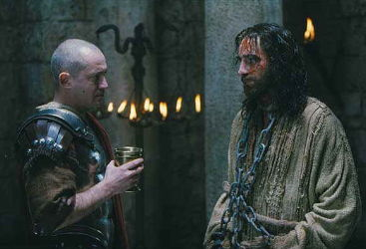
MYTH #3: ALL sins are EQUAL in the sight of GOD.
Instances in the Scriptures where degrees of sin are distinguished:
“He who has handed me over to you has committed the greater sin.” John 19:11

Slide 97
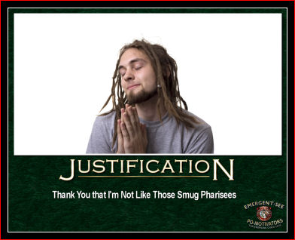
MYTH #3: ALL sins are EQUAL in the sight of GOD.
Instances in the Scriptures where degrees of sin are distinguished:
“Whoever then relaxes one of the
least of these commandments and teaches men so, shall be called least in the kingdom
of heaven” (Matt. 5:19)

Slide 98

MYTH #3: ALL sins are EQUAL in the sight of GOD.
Instances in the Scriptures where degrees of sin are distinguished:
When God showed Ezekiel visions of sins in the temple of Jerusalem, he first showed Ezekiel certain things, then said, “But you will see still greater abominations”
(Ezek. 8:6). Next he showed Ezekiel the secret sins of some of the elders of Israel and said, “You will see still greater abominations which they commit” (Ezek. 8:13). Then the Lord showed Ezekiel a picture of women weeping for a Babylonian deity and said, “Have you seen this, O son of man? You will see still greater abominations than these” (Ezek. 8:15). Finally, he showed Ezekiel twenty-five men in the temple, with
their backs to the Lord and worshiping the sun instead.

Slide 99
MYTH #3: ALL sins are EQUAL in the sight of GOD.
Instances in the Scriptures where degrees of sin are distinguished:
Certain sins in the law are distinguished in a particular context as an abomination to God (e.g. Lev. 18:22; Deut. 7:25, Deut. 23:18, Isa. 41:24).
Eg. Certain Sexual sins, Idolatry, and funding the church by abominable means

Slide 100
MYTH #3: ALL sins are EQUAL in the sight of GOD.
Instances in the Scriptures where degrees of sin are distinguished:
Blasphemy of the Holy Spirit is set apart as a more severe sin than blasphemy of the Son (Matt. 12:31)
³¹And so I tell you, every sin and blasphemy will be forgiven men, but the blasphemy against the Spirit will not be forgiven. ³²Anyone who speaks a word against the Son of Man will be forgiven, but anyone who speaks against the Holy Spirit will not be forgiven, either in this age or in the age to come.

Slide 101
MYTH #3: ALL sins are EQUAL in the sight of GOD.
Instances in the Scriptures where degrees of sin are distinguished:
¹⁶ There are six things the LORD hates,
seven that are detestable to him:
¹⁷ haughty eyes,
a lying tongue,
hands that shed innocent blood,
¹⁸ a heart that devises wicked schemes,
feet that are quick to rush into evil,
¹⁹ a false witness who pours out lies
and a man who stirs up dissension among brothers.
Proverbs 6:16-19
Ever wonder why these sins are so grievous?
¹⁶ ⁶Jesus answered, "I am the way and the truth and the life. No one comes to the Father except through me.
John 14:6

Slide 102
MYTH #3: ALL sins are EQUAL in the sight of GOD.
Instances in the Scriptures where degrees of sin are distinguished:
There are degrees of punishment in Hell based on the severity of the offense—dependent on knowledge
(Luke 12:47-48; Matthew 10:14,15)
⁴⁷"That servant who knows his master's will and does not get ready or does not do what his master wants will be beaten with many blows. ⁴⁸But the one who does not know and does things deserving punishment will be beaten with few blows. From everyone who has been given much, much will be demanded; and from the one who has been entrusted with much, much more will be asked.
¹⁴If anyone will not welcome you or listen to your words, shake the dust off your feet when you leave that home or town. ¹⁵I tell you the truth, it will be more bearable for Sodom and Gomorrah on the day of judgment than for that town.

Slide 103
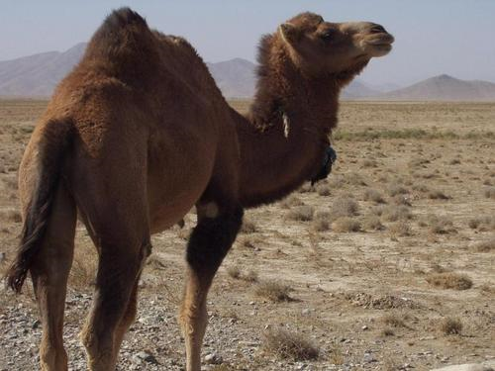
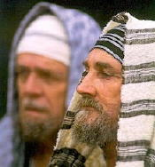
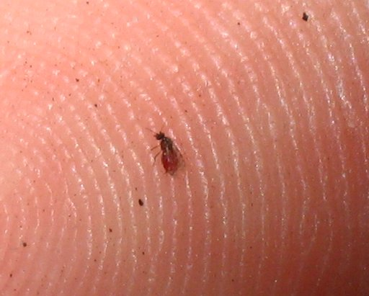
MYTH #3: ALL sins are EQUAL in the sight of GOD.
Instances in the Scriptures where degrees of sin are distinguished:
Christ often evaluates the sin of the Pharisees as greater than the sins of others. You strain out a gnat while you swallow a camel (Matt. 23:24). If all sins are equal, Christ’s rebuke does not make any sense. (See also Luke 20:46-47)

Slide 104

MYTH #3: ALL sins are EQUAL in the sight of GOD.
Instances in the Scriptures where degrees of sin are distinguished:
Similarly, Christ also talked about the “weightier things of the law” (Matt. 23:23).
If all sins are equal, then…an eye for an eye would cover it…(no need for teeth)

Slide 105
MYTH #3: ALL sins are EQUAL in the sight of GOD.
Instances in the Scriptures where degrees of sin are distinguished:
¹⁴For if you forgive men when they sin against you, your heavenly Father will also forgive you. ¹⁵But if you do not forgive men their sins, your Father will not forgive your sins.
Unforgiveness is continually referred to as a particularly heinous sin
(Matt. 6:14-15; 18:23-35).

Slide 106
Westminster Larger Catechism:
Q. 150. Are all transgressions of the law of God equally heinous in themselves, and in the sight of God?
A. All transgressions of the law of God are not equally heinous; but some sins in themselves, and by reason of several aggravations, are more heinous in the sight of God than others.

Slide 107
Q. 151. What are those aggravations that make some sins more heinous than others?
  A. Sins receive their aggravations,
  1. From the persons offending; if they be of riper age, greater experience or grace, eminent for profession, gifts, place, office, guides to others, and whose example is likely to be followed by others.
  2. From the parties offended: if immediately against God, his attributes, and worship; against Christ, and his grace; the Holy Spirit, his witness, and workings; against superiors, men of eminency, and such as we stand especially related and engaged unto; against any of the saints, particularly weak brethren, the souls of them, or any other, and the common good of all or many.
  3. From the nature and quality of the offence: if it be against the express letter of the law, break many commandments, contain in it many sins: if not only conceived in the heart, but breaks forth in words and actions, scandalize others, and admit of no reparation: if against means, mercies, judgments, light of nature, conviction of conscience, public or private admonition, censures of the church, civil punishments; and our prayers, purposes, promises, vows, covenants, and engagements to God or men: if done deliberately, willfully, presumptuously, impudently, boastingly, maliciously, frequently, obstinately, with delight, continuance, or relapsing after repentance.
  4. From circumstances of time, and place: if on the Lord's day, or other times of divine worship; or immediately before or after these, or other helps to prevent or remedy such miscarriages: if in public, or in the presence of others, who are thereby likely to be provoked or defiled.

Slide 108
Westminster Larger Catechism:
Q. 152. What does every sin deserve at the hands of God?
A. Every sin, even the least, being against the sovereignty, goodness, and holiness of God, and against his righteous law, deserves his wrath and curse, both in this life, and that which is to come; and cannot be expiated but by the blood of Christ.

Slide 109



13 “When tempted, no one should say, "God is tempting me." For God cannot be tempted by evil, nor does he tempt anyone; 14but each one is tempted when, by his own evil desire, he is dragged away and enticed. 15Then, after desire has conceived, it gives birth to sin; and sin, when it is full-grown, gives birth to death.”
James 1:13-15

Slide 110
Systematic Theology: Hamartiology
A few final things worth noting…
Are all sins equal in the sight of God?
SUMMARY:
a. As far as legal guilt: if we sin against one aspect of the law—we violate the whole law so that one transgression renders one exposed to God’s judgment; “all sins are mortal” in this sense (eg. Rich young ruler; James 2)
b. As far as heinousness: God’s view of Sin is graded in terms of the degree to which they harm our relationship with Him and others and deserve His displeasure.

Slide 111

Systematic Theology: Hamartiology
A few final things worth noting…
Are all sins equal in the sight of God?
No. WHAT GIVES?
SUMMARY:
c. These inequalities have their place (they’re good!)
1. Point us to prioritize efforts as we pursue holiness.
2. Aids in making sense of overlooking in love or need to confront in love.
3. Gives credence to church discipline.
4. Provides basis for civil laws making distinctions between those prosecutable vs. illegitimate (remember the absurd laws at the beginning?)

Slide 112
Systematic Theology: Hamartiology
A few final things worth noting…
Results of sinning (Christians in particular)
  Our Legal Standing Before God Is Unchanged
  Our Fellowship With God Is Disrupted and Our Christian Life Is Damaged
  Other’s Walk is damaged (hypocrisy cuts both ways—believers & unbelievers)
  Opportunity for repentance (but NEV ER an excuse for more grace! (Eg. Romans)

Slide 113
Systematic Theology: Hamartiology
A few final things worth noting…
5. Warning to Unbelievers in Covenant

Slide 114

Systematic Theology: Hamartiology
A few final things worth noting…
6. The Unpardonable sin.
Am I guilty? Could I become guilty?

Slide 115

Hamartiology
Adapted from RC Sproul, Essential Truths & NTAGQ
Q: “Explain the unpardonable sin of Matthew 12:31,32.”
Didn’t Christ’s sacrifice make it so that any sin is forgivable?
31And so I tell you, every sin and blasphemy will be forgiven men, but the blasphemy against the Spirit will not be forgiven. 32Anyone who speaks a word against the Son of Man will be forgiven, but anyone who speaks against the Holy Spirit will not be forgiven, either in this age or in the age to come. Matthew 12:31,32
There is a fair amount of confusion over this concept…it seems that when Christ says there is a sin unable to be forgiven ‘now and in the age to come’…we scramble to figure out what it is so we can avoid it...

Slide 116
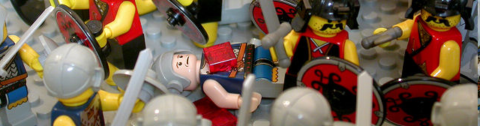
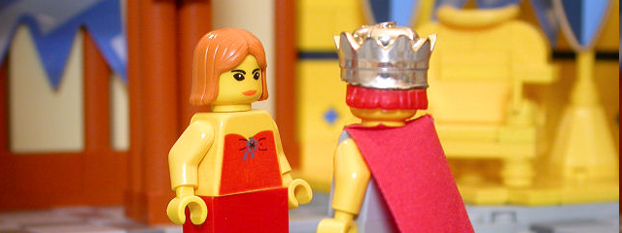
Hamartiology
Q: “Explain the unpardonable sin of Matthew 12:31,32.”
Some have proposed….
1. murder
2. adultery

Slide 117
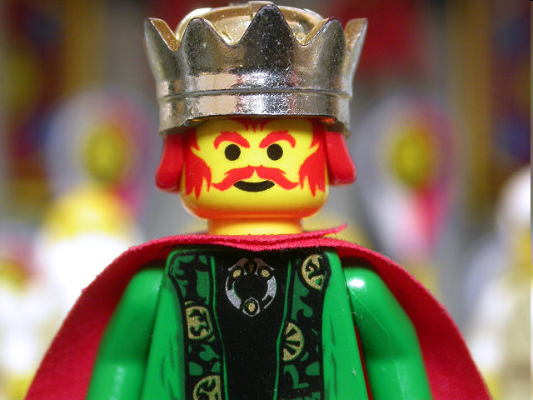
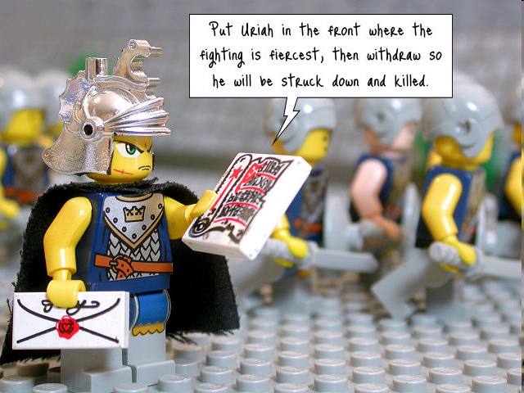

Hamartiology
Q: “Explain the unpardonable sin of Matthew 12:31,32.”
But in God’s economy….
1 Kings 11:34
" 'But I will not take the whole kingdom out of Solomon's hand; I have made him ruler all the days of his life for the sake of David my servant, whom I chose and who observed my commands and statutes.

Slide 118
Hamartiology
Q: 3. “Explain the unpardonable sin of Matthew 12:31,32.”
3. Unbelief
Gains strength from the following:
1. Persistent and final unbelief warrants the same consequences because death is an end to the opportunity of forgiveness
2. Since the Holy Spirit bears witness to Christ, to deny Christ is to reject the witness of the Holy Spirit.
Weakened, however, by the following:
Those who embrace mere ‘rejection of the Holy Spirit’ face two problems: a. Initial & final rejection not qualitatively distinguishable
        Paul while Saul (Acts 8:1-3; 9:1-20) persecuted/denied Christ…yet forgiven
Inadequate to explain Christ’s specific warning

Slide 119

Hamartiology
Q: 3. “Explain the unpardonable sin of Matthew 12:31,32.”
The confusion over this concept is lessened as we see precisely what Christ said…
31And so I tell you, every sin and blasphemy will be forgiven men, but the blasphemy against the Spirit will not be forgiven. 32Anyone who speaks a word against the Son of Man will be forgiven, but anyone who speaks against the Holy Spirit will not be forgiven, either in this age or in the age to come. Matthew 12:31,32
What is blasphemy?
1. An assault on the character of God (punishable by death according to Jewish law)
2. A crime of words: only written or oral

Slide 120

Hamartiology
Q: 3. “Explain the unpardonable sin of Matthew 12:31,32.”
[This question] “is probably an indication that they haven’t. Those who do commit such a sin would be so hardened of heart and abandoned in their sin as to feel no remorse for it.”
The confusion over this concept is lessened as we see precisely what Christ said in its context: Pharisees confront Christ…
22Then they brought him a demon-possessed man who was blind and mute, and Jesus healed him, so that he could both talk and see. 23All the people were astonished and said, "Could this be the Son of David?" 24But when the Pharisees heard this, they said, "It is only by Beelzebub, the prince of demons, that this fellow drives out demons."
Matthew 12:22-24
Earnest Christians may ask, ‘Have I done this? Am I capable of doing this?’
Blasphemy against the Holy Spirit seems to be for those enlightened by the Holy Spirit to the degree that they know Jesus is truly the Christ and then to:
1. ascribe the work of the Holy Spirit to Satan or
2. equate the two.

Slide 121
Hamartiology
Q: “Explain the unpardonable sin of Matthew 12:31,32.”
Closing thoughts:
1. Christ’s words warned the Pharisees that their accusations could condemn them beyond hope.
2. Jesus’ own words on the cross, “Father, forgive them for they know not what they do” revealed a forgiveness available to blasphemers ignorant of His true identity.
3. Christians will never commit this sin because of the restraining grace of God.
Addressing the unlikelihood ‘blaspheming the Spirit is mere unbelief Ra McLaughlin says: “ the actual nature of Hebrew parallelism is that it rarely says the same thing with different words. The typical idea behind what is commonly called "synonymous parallelism" is "A, and what's more B." That is, the "parallel" phrase does not say the same thing. Rather, it says something related but different. This would argue against equating "A" (denying Christ) with "B" (blaspheming the Holy Spirit).”
8"I tell you, whoever acknowledges me before men, the Son of Man will also acknowledge him before the angels of God. 9But he who disowns me before men will be disowned before the angels of God. 10And everyone who speaks a word against the Son of Man will be forgiven, but anyone who blasphemes against the Holy Spirit will not be forgiven. Luke 12:8-10

Slide 122
Systematic Theology
Christology
(coming to a classroom near you!)

