Slide 1

Ash Wednesday Preparation

Slide 2
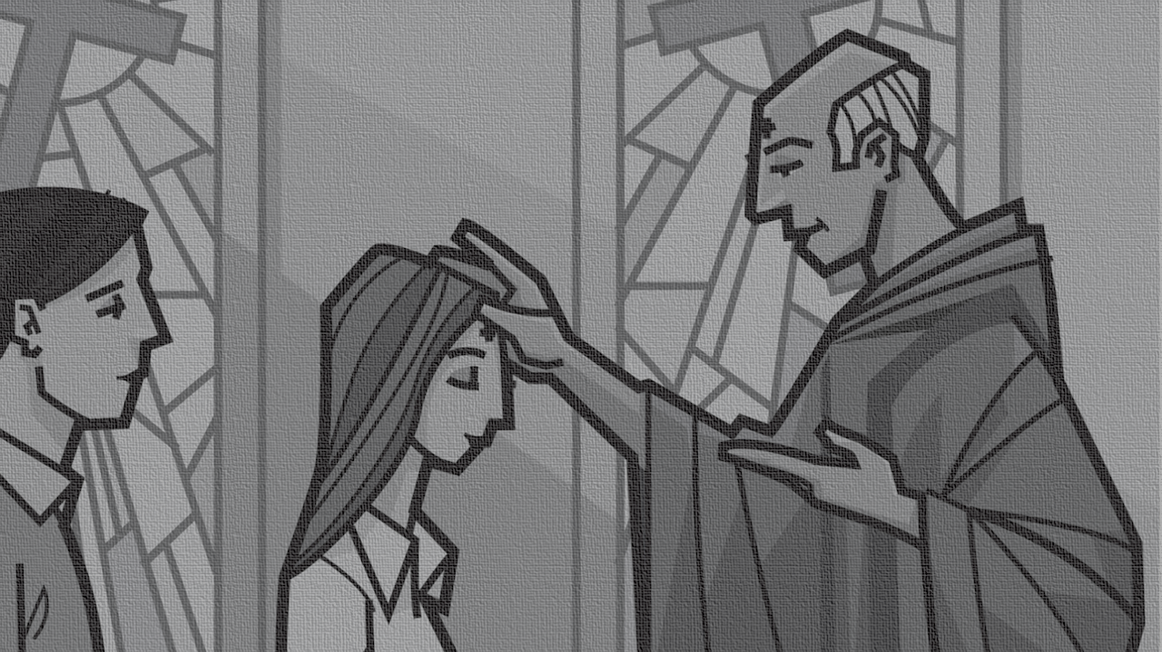
Ash Wednesday Preparation
Where did this come from?
Why is this done?
What can I expect?
Does it demand anything from Me?

Slide 3
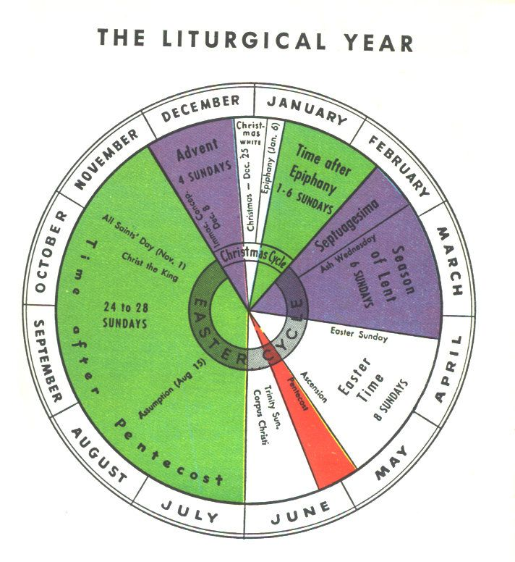
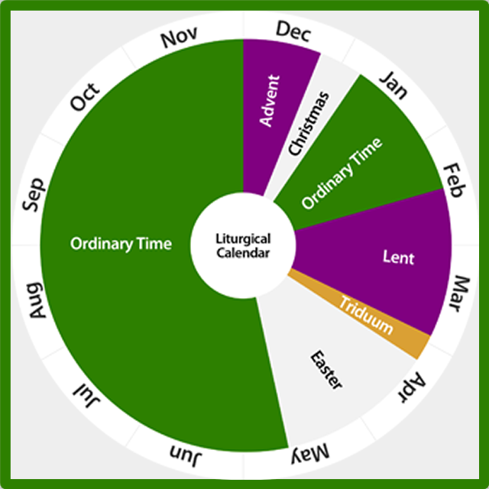
Context
Where did this come from?
Liturgical calendar
Three Main Seasons
Christmas
Easter
Pentecost
Each season begins with a significant marker…

Slide 4

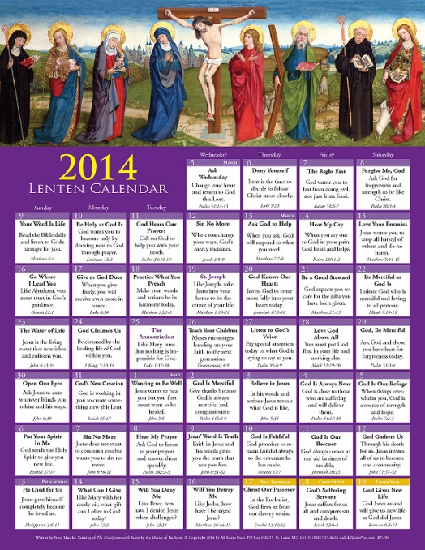

Purpose
Why is this done?
Advent: first (“hope”)
Lent: Ash Wednesday
40 days (Sundays not included)
typified by sacrifice…but acts of kindness have become a greater part of the conversation
focus is key: Christ as the object of our Worship

Slide 5

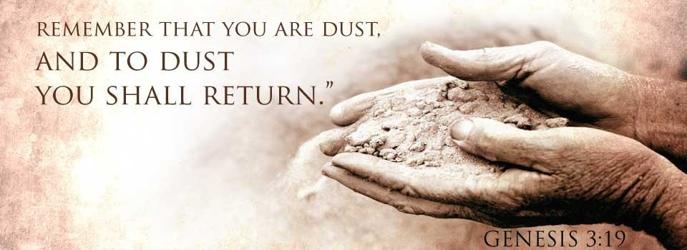
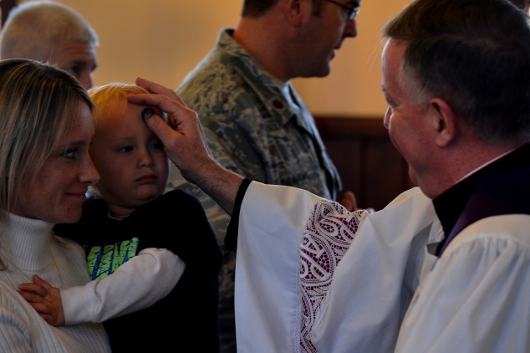
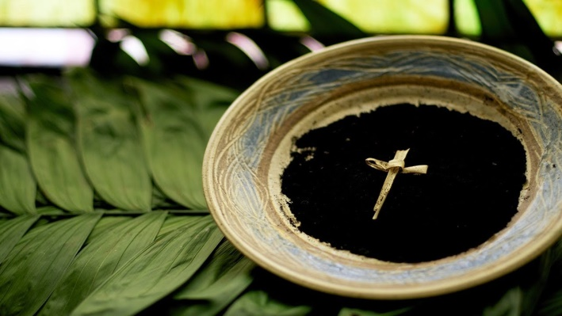
Purpose
Why is this done?
Lent: Ash Wednesday
Practice: participation is marked with either a smudge or a cross of ash placed on the worshipper’s forehead
Where do the ashes come from?
Why Ashes?

Slide 6
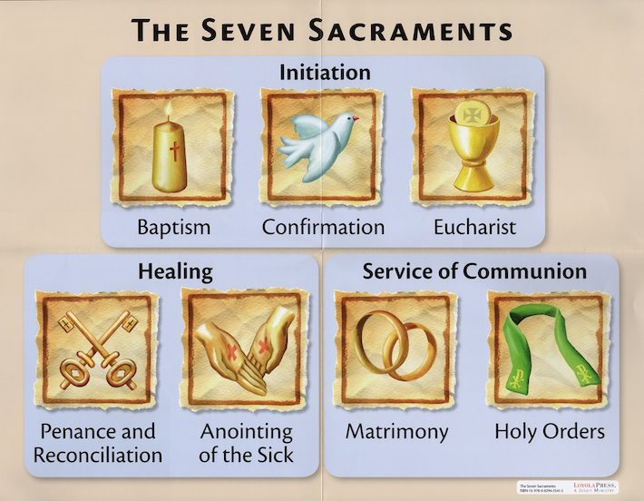
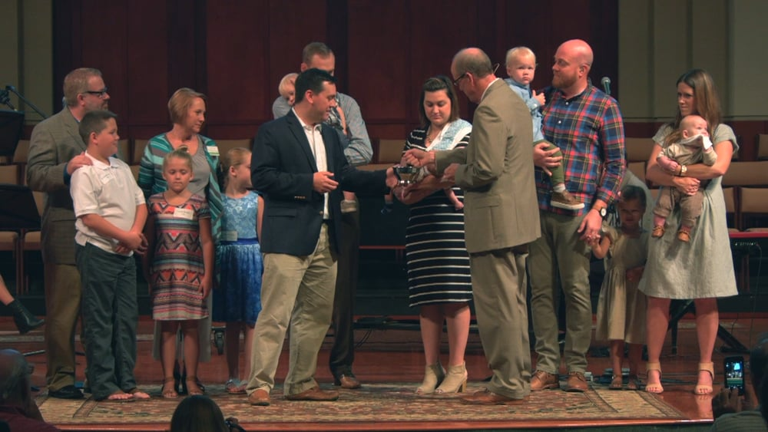
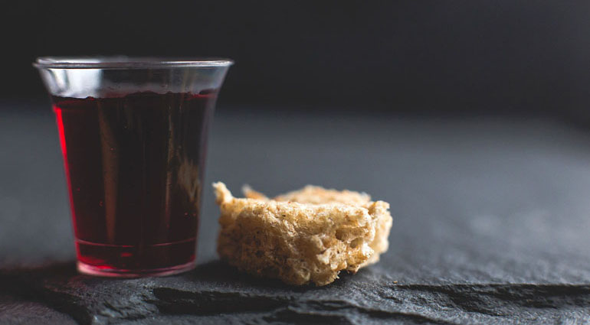
Ash Wednesday Preparation
What can I expect?
Sacraments: significant within the church
What is a Sacrament?
Baptism &Communion
Baptism Communion
“sacramentum”; outward sign of inward work
Once
Sign of entrance into Covenant Body (replaced circumcision)
Signifies cleansing
Ongoing
Identifies with death, burial, & resurrection of Christ (New Cov. Fulfillment; replaced Passover)
Tangible meal with real significance

Slide 7
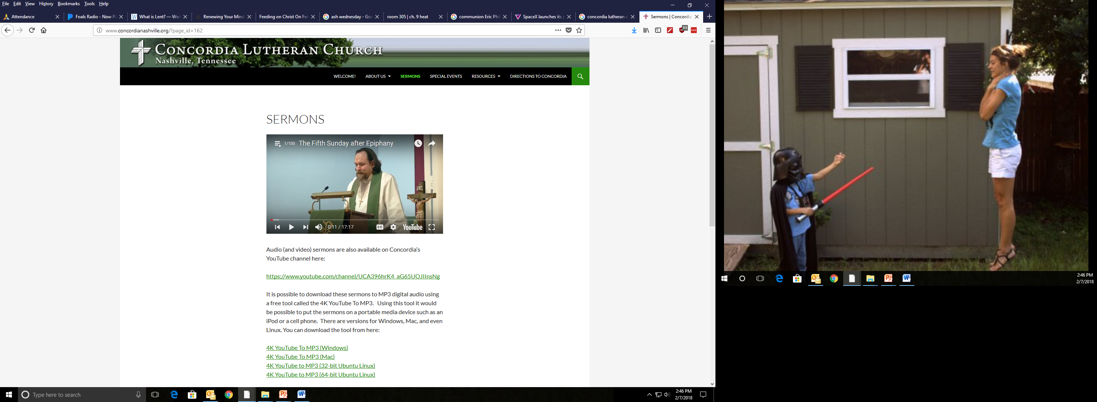
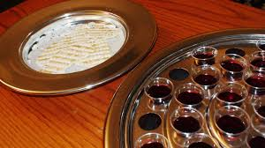
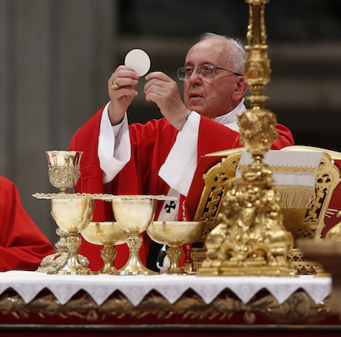
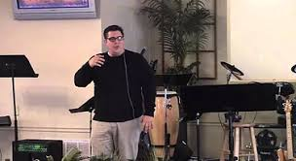
Ash Wednesday Preparation
Does it demand anything from Me? (understanding, an invitation & a warning)
Sacraments: significant within the church
Historical differences
Consubstantiation
Memorial
Transubstantiation
‘Substantive’

Slide 8
Ash Wednesday Preparation
Does it demand anything from Me?
Sacraments: significant within the church
“Fencing the Table”
23 For I received from the Lord what I also delivered to you, that the Lord Jesus on the night when he was betrayed took bread, 24 and when he had given thanks, he broke it, and said, “This is my body, which is for you. Do this in remembrance of me.” 25 In the same way also he took the cup, after supper, saying, “This cup is the new covenant in my blood. Do this, as often as you drink it, in remembrance of me.” 26 For as often as you eat this bread and drink the cup, you proclaim the Lord's death until he comes.
27 Whoever, therefore, eats the bread or drinks the cup of the Lord in an unworthy manner will be guilty concerning the body and blood of the Lord. 28 Let a person examine himself, then, and so eat of the bread and drink of the cup. 29 For anyone who eats and drinks without discerning the body eats and drinks judgment on himself. 30 That is why many of you are weak and ill, and some have died.
Can anybody take communion?

Slide 9
Ash Wednesday Preparation
A. Context
1. Liturgical calendar
2. Three Main Seasons
B. Purpose
1. Advent: first (“hope”)
2. Lent: Ash Wednesday
3. Ashes…
C. Sacraments: significant within the church calendar
1. Meaning: “sacramentum”; outward sign of inward work
2. Made up of: Baptism &Communion
a. Baptism
b. Communion
1. Historical differences
2. Fencing the Table

