Slide 1
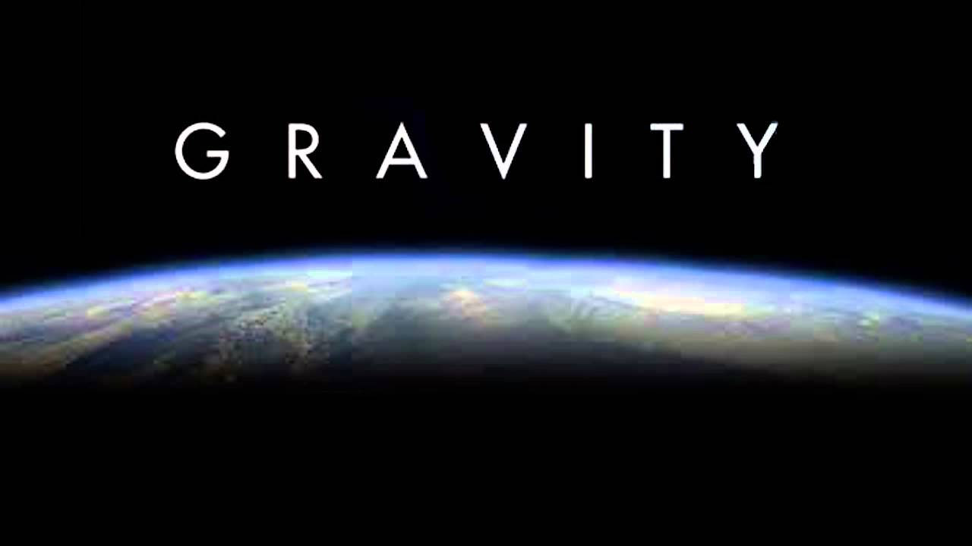
Chapter 7
mr e~SRCS
~fall 2016

Slide 2
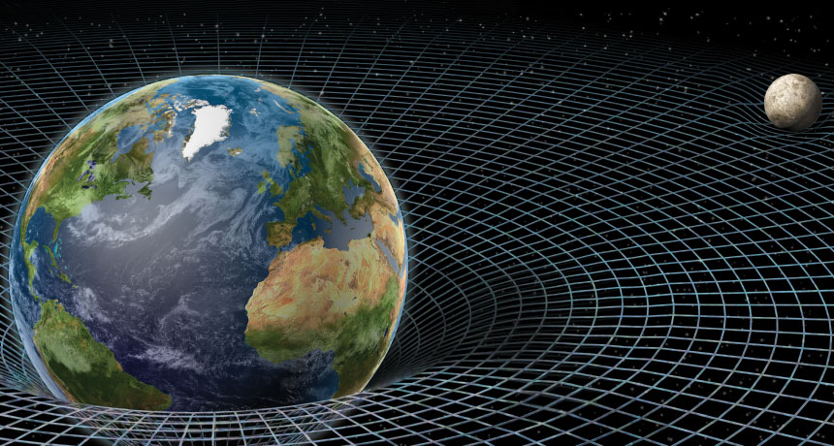
Ch 7
outline
Intro: hunting the elusive monkey
History of gravity: A few important people
The moon: what is it doing?
Newton’s law of universal gravitation
Newton’s proposal
The law
“What if? Applications”
g&d
g&m
Other manifestations
Tides
Causes
Types
If the Big Bang is true…how will it end?
Space Ping-Pong! Astronaut Tim Peake on the ISS

Slide 3
Ch 7
outline
Intro: hunting the elusive monkey
History of gravity: A few important people
The moon: what is it doing?
Newton’s law of universal gravitation
Newton’s proposal
The law
“What if? Applications”
g&d
g&m
Other manifestations
Tides
Causes
Types
If the Big Bang is true…how will it end?
Can you remember what we have already studied about gravity?
What are some of the movers and changers in regards to astrophysics?
Why does the moon stay in orbit?
Is their a gravitational relationship between every two objects that is calculable? What is the formula? How do I use it?
What is the relationship b/w Fg and masses, distance? Can an object utterly escape Earth’s g? Why not?
What are tides and how are they caused?
Is the Big Bang necessarily atheistic? What could our beginning mean for our transition to eternity? Distinguish between possible cosmic theories.

Slide 4

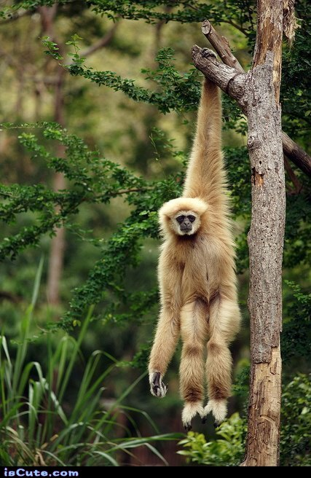
Ch 7
Suppose you are in the wilds of the Ivory Coast (West-Central African forests) hunting monkeys for the Lowry park Zoo. You’re equipped with a dart gun and sufficient tranquilizers to safely capture five adult primates. Early one morning as you peek ‘round a tree trunk, you spy a monkey hanging from a high tree limb a fair distance away. It just so happens that you pull the trigger just as the monkey let go! Supposing you hit your target, where did you aim just before you pulled the trigger?
a. Just above the monkey
b. Just below the monkey
c. Directly at the monkey
d. Far below the monkey to intercept it
Select what you think to be the answer…
outline
Intro: hunting the elusive monkey
History of gravity: A few important people
The moon: what is it doing?
Newton’s law of universal gravitation
Newton’s proposal
The law
“What if? Applications”
g&d
g&m
Other manifestations
Tides
Causes
Types
If the Big Bang is true…how will it end?
A look ahead…

Slide 5
Ch 7
a. Just above the monkey
b. Just below the monkey
c. Directly at the monkey
d. Far below the monkey to intercept it
The Answer is ____!
Why? Once the dart leaves the gun…and once the monkey leaves the tree…how many forces are acting on them?
Therefore: Both the dart and the monkey would fall the same __________ in the same amount of _______ & would meet only if the dart was ….
Furthermore: If the dart gun was a high velocity gun, the monkey would be hit closer to it’s starting point. If the gun was a slow-velocity gun, the monkey would be hit further from its starting point.
outline
Intro: hunting the elusive monkey
History of gravity: A few important people
The moon: what is it doing?
Newton’s law of universal gravitation
Newton’s proposal
The law
“What if? Applications”
g&d
g&m
Other manifestations
Tides
Causes
Types
If the Big Bang is true…how will it end?

Slide 6
Ch 7
outline
Intro: hunting the elusive monkey
History of gravity: A few important people
The moon: what is it doing?
Newton’s law of universal gravitation
Newton’s proposal
The law
“What if? Applications”
g&d
g&m
Other manifestations
Tides
Causes
Types
If the Big Bang is true…how will it end?
Now… how about this Chapter?
Hold your hands outstretched (palms facing you) in front of you with one hand twice as far from your eyes as the other. Does one appear larger? If so, which one?
The closer hand appears __________ the more distant hand.
a. four times larger than c. the same size as
b. twice the size of d. much smaller than
The answer is ____!
Why? Because of a phenomenon explained by the Inverse-Square Law!

Slide 7
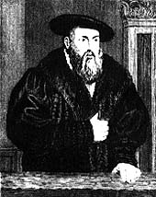
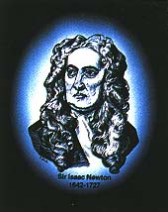
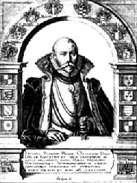
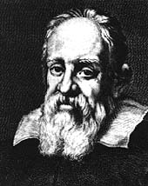
Ch 7
Try to match the appropriate historical figure with his portrait and description:
Name portrait description
a. Isaac Newton 1_____ 5____ Italian physicist; Held to revolutionary Copernican view of the
universe (heliocentric); invented telescope
b. Tycho Brahe 2_____ 6____ Pupil of Brahe; Postulated Laws of Planetary Motion; set stage for Newton
c. Galileo 3_____ 7____ contemporary of Galileo; witnessed a lunar eclipse and was inspired to study astronomy; collected amazingly accurate data w/o a telescope
d. Johann Kepler 4_____ 8____ English mathematician
and physicist; using Kepler’s Laws he developed his Universal Law of Gravitation; much of his work remained unchanged until Einstein
outline
Intro: hunting the elusive monkey
History of gravity: A few important people
The moon: what is it doing?
Newton’s law of universal gravitation
Newton’s proposal
The law
“What if? Applications”
g&d
g&m
Other manifestations
Tides
Causes
Types
If the Big Bang is true…how will it end?

Slide 8
Ch 7
Try to match the appropriate historical figure with his portrait and description:
Name portrait description
a. Isaac Newton 1_____ 5____ Italian physicist; Held to revolutionary Copernican view of the
universe (heliocentric); invented telescope
b. Tycho Brahe 2_____ 6____ Pupil of Brahe; Postulated Laws of Planetary Motion; set stage for Newton
c. Galileo 3_____ 7____ contemporary of Galileo; witnessed a lunar eclipse and was inspired to study astronomy; collected amazingly accurate data w/o a telescope
d. Johann Kepler 4_____ 8____ English mathematician
and physicist; using Kepler’s Laws he developed his Universal Law of Gravitation; much of his work remained unchanged until Einstein
outline
Intro: hunting the elusive monkey
History of gravity: A few important people
The moon: what is it doing?
Newton’s law of universal gravitation
Newton’s proposal
The law
“What if? Applications”
g&d
g&m
Other manifestations
Tides
Causes
Types
If the Big Bang is true…how will it end?

Slide 9
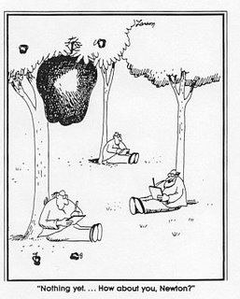
Ch 7
7.1 Demystifying the Myth
We all know that the fruit of the knowledge of good and evil was most likely not an apple…but did an apple have a role in involving another man in an altogether different sort of ‘fall’?
The story is legendary…
What most likely happened is that he connected the F pulling on falling fruit (an apple that he observed in an actual orchard) to the moon…
outline
Intro: hunting the elusive monkey
History of gravity: A few important people
The moon: what is it doing?
Newton’s law of universal gravitation
Newton’s proposal
The law
“What if? Applications”
g&d
g&m
Other manifestations
Tides
Causes
Types
If the Big Bang is true…how will it end?

Slide 10
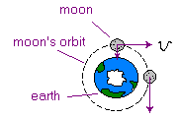
Ch 7
7.2 Falling Moon? When will it hit the ground?
Never! Why?…(and how can one describe
it as falling?)
What does the v vector represent?
__________ __________
(that is, a velocity parallel to the earth’s surface
at every point!)
outline
Intro: hunting the elusive monkey
History of gravity: A few important people
The moon: what is it doing?
Newton’s law of universal gravitation
Newton’s proposal
The law
“What if? Applications”
g&d
g&m
Other manifestations
Tides
Causes
Types
If the Big Bang is true…how will it end?

Slide 11
Ch 7
7.2 Falling Moon? When will it hit the ground?
Consider the path of the ball from the perspective of
a. person dropping the ball from inside the truck bed
b. an observer outside the truck and at 90º to the path of the truck
in each of the following:
1. Dropping a ball from a parked pickup bed: it follows a ______________ path.
Dropping a ball from a moving pickup bed: it follows a ________ path
What if the moon were not moving—what would happen then?
outline
Intro: hunting the elusive monkey
History of gravity: A few important people
The moon: what is it doing?
Newton’s law of universal gravitation
Newton’s proposal
The law
“What if? Applications”
g&d
g&m
Other manifestations
Tides
Causes
Types
If the Big Bang is true…how will it end?

Slide 12
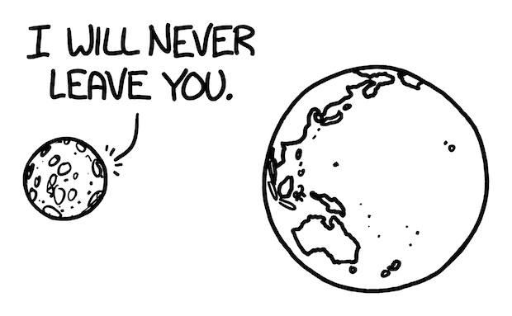
Ch 7
7.2 Falling Moon? When will it hit the ground?
What if the moon were not moving—what would happen then? Why?
outline
Intro: hunting the elusive monkey
History of gravity: A few important people
The moon: what is it doing?
Newton’s law of universal gravitation
Newton’s proposal
The law
“What if? Applications”
g&d
g&m
Other manifestations
Tides
Causes
Types
If the Big Bang is true…how will it end?

Slide 13
Ch 7
7.3 Newton’s Law of Universal Gravitation
What provided the acceleration for the apple to fall to the ground? Was this a force of the earth on the apple?
If so, then the apple must exert a force on the earth according to Newton’s law of action/reaction forces.
Newton extended these ideas to the planets orbiting the sun. He found by studying astronomical data (some of which was Kepler's ) that the force that held the earth in orbit around the sun was the same force that drew the apple toward the earth. This was the force of gravity …
outline
Intro: hunting the elusive monkey
History of gravity: A few important people
The moon: what is it doing?
Newton’s law of universal gravitation
Newton’s proposal
The law
“What if? Applications”
g&d
g&m
Other manifestations
Tides
Causes
Types
If the Big Bang is true…how will it end?

Slide 14
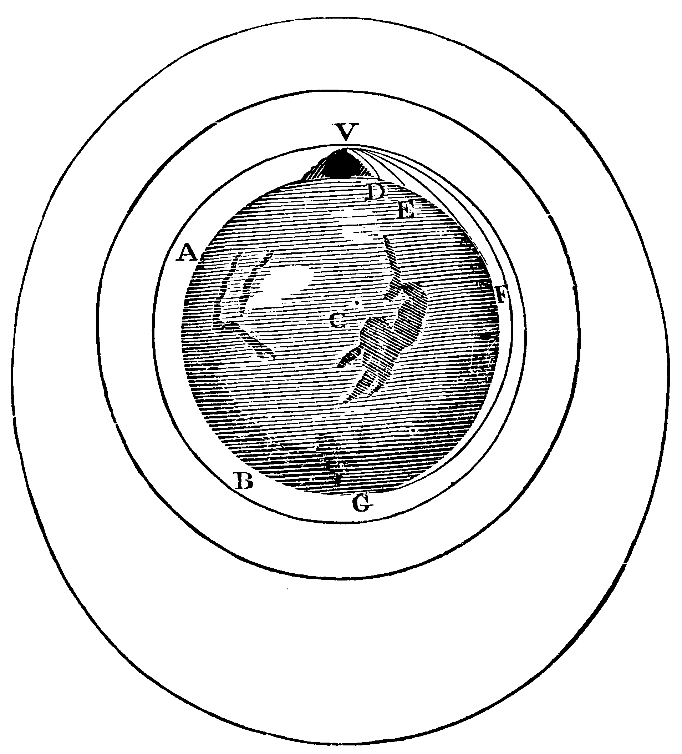
Ch 7
A survey of Newton's writings reveals the illustration at the right accompanied by an extensive discussion of the motion of the moon as a projectile.
outline
Intro: hunting the elusive monkey
History of gravity: A few important people
The moon: what is it doing?
Newton’s law of universal gravitation
Newton’s proposal
The law
“What if? Applications”
g&d
g&m
Other manifestations
Tides
Causes
Types
If the Big Bang is true…how will it end?
Newton's reasoning proceeded as follows:
Suppose a cannonball is fired horizontally from a very high mountain in a region devoid of air resistance. In the absence of gravity, the cannonball would travel in a straight-line, tangential path. Yet in the presence of gravity, the cannonball would drop below this straight-line path and eventually fall to Earth (say to D)….
2. Fire it faster… (it falls to E)
3. Even faster…(G)
4. Faster still—circular orbit (path A)
5. Faster still—elliptical orbit (outermost orbit)

Slide 15
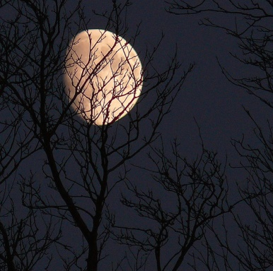
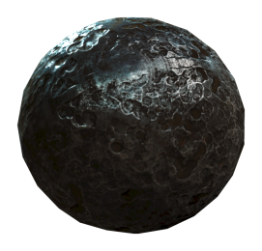
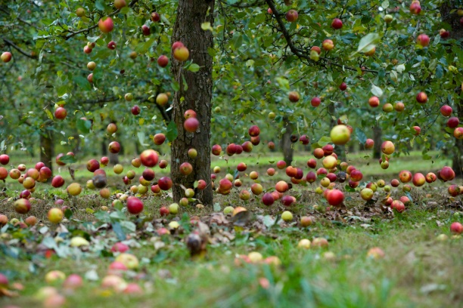

Ch 7
A survey of Newton's writings reveals the illustration at the right accompanied by an extensive discussion of the motion of the moon as a projectile.
outline
Intro: hunting the elusive monkey
History of gravity: A few important people
The moon: what is it doing?
Newton’s law of universal gravitation
Newton’s proposal
The law
“What if? Applications”
g&d
g&m
Other manifestations
Tides
Causes
Types
If the Big Bang is true…how will it end?
And if the orbiting moon can be compared to the falling cannonball, it can even be compared to a falling apple.
The same force which causes objects on Earth to fall to the earth also causes objects in the heavens to move along their circular and elliptical paths.
Quite amazingly, the laws of mechanics which govern the motions of objects on Earth also govern the movement of objects in the heavens.

Slide 16


Ch 7
7.3 Newton’s Law of Universal Gravitation
Newton’s Law of Universal Gravitation
Stated: “Every mass attracts every other mass with a force that is directly proportional to the product of the interacting masses and is inversely proportional to the square of the distances between them.”
Mathematically: F: force; m: masses
d: distance b/w their centers
What happens to the gravitational F if the mass of one body is doubled? (note; which variable is the same—so what can we do with it?)
How ‘bout (instead) the mass of the other is doubled?
What if both masses are doubled at the same time?
If one mass is doubled and the other tripled?
Now…looking at the formula, how does distance factor in? hint:
What implications does this have on the F of gravity?
outline
Intro: hunting the elusive monkey
History of gravity: A few important people
The moon: what is it doing?
Newton’s law of universal gravitation
Newton’s proposal
The law
“What if? Applications”
g&d
g&m
Other manifestations
Tides
Causes
Types
If the Big Bang is true…how will it end?

Slide 17
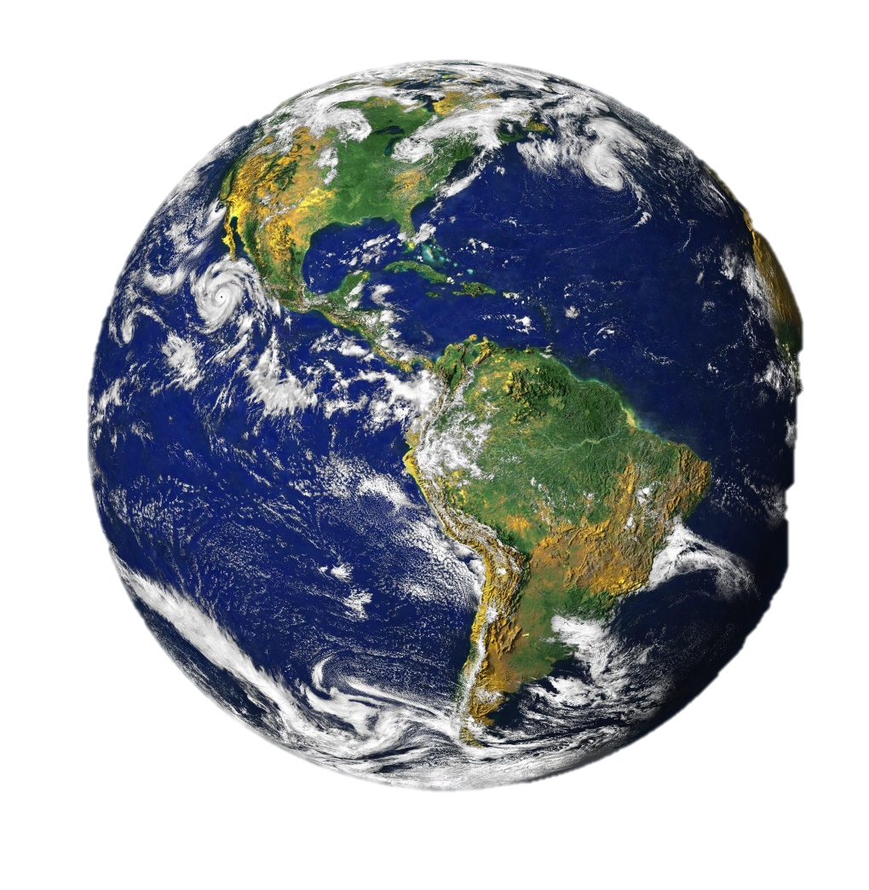
Ch 7
7.3 Newton’s Law of Universal Gravitation
Newton’s Law of Universal Gravitation
“What goes up must come down” … ever consider what it means?
What does the word “down” even mean?
outline
Intro: hunting the elusive monkey
History of gravity: A few important people
The moon: what is it doing?
Newton’s law of universal gravitation
Newton’s proposal
The law
“What if? Applications”
g&d
g&m
Other manifestations
Tides
Causes
Types
If the Big Bang is true…how will it end?

Slide 18
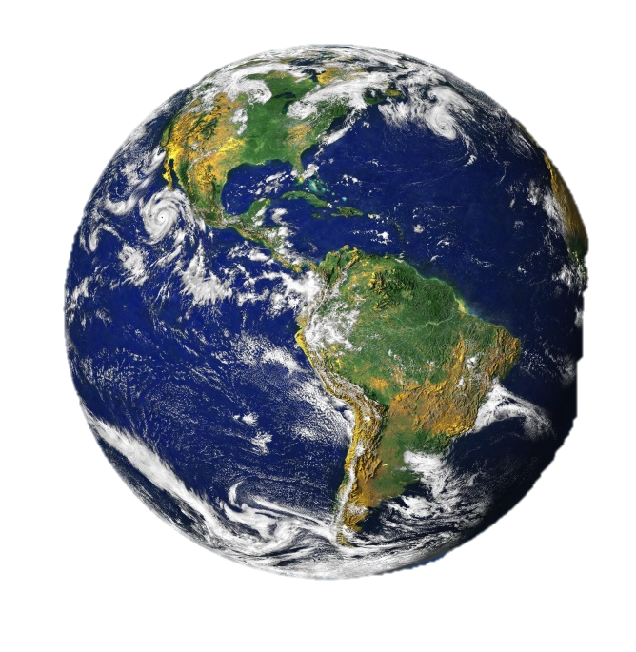
Ch 7
7.3 Newton’s Law of Universal Gravitation
Newton’s Law of Universal Gravitation
outline
Intro: hunting the elusive monkey
History of gravity: A few important people
The moon: what is it doing?
Newton’s law of universal gravitation
Newton’s proposal
The law
“What if? Applications”
g&d
g&m
Other manifestations
Tides
Causes
Types
If the Big Bang is true…how will it end?
"Down" is toward the center of the attracting mass. (red)
"Up" is the other way. (green)
"Goes" and "Come" mean the motion of "What" (the object) has been altered.
"Must" means it has no choice in the matter - it’s the law.

Slide 19


Ch 7
7.3 Newton’s Law of Universal Gravitation
Newton’s Law of Universal Gravitation
‘So, where is heaven if the world is round?’ (S. hindalong)
outline
Intro: hunting the elusive monkey
History of gravity: A few important people
The moon: what is it doing?
Newton’s law of universal gravitation
Newton’s proposal
The law
“What if? Applications”
g&d
g&m
Other manifestations
Tides
Causes
Types
If the Big Bang is true…how will it end?

Slide 20


Ch 7
7.4 Gravity and Distance (A deeper look… )
Suppose you were to fall from a dizzying height to the sidewalk below. Which F ensures that you will soon be speaking to your Creator?
outline
Intro: hunting the elusive monkey
History of gravity: A few important people
The moon: what is it doing?
Newton’s law of universal gravitation
Newton’s proposal
The law
“What if? Applications”
g&d
g&m
Other manifestations
Tides
Causes
Types
If the Big Bang is true…how will it end?
Don’t be tempted to simply go with what you are used to…

Slide 21
Ch 7
7.4 Gravity and Distance (A deeper look… )
Suppose you were to fall from a dizzying height to the sidewalk below. Which F ensures that you will soon be speaking to your Creator?
outline
Intro: hunting the elusive monkey
History of gravity: A few important people
The moon: what is it doing?
Newton’s law of universal gravitation
Newton’s proposal
The law
“What if? Applications”
g&d
g&m
Other manifestations
Tides
Causes
Types
If the Big Bang is true…how will it end?

Slide 22
Ch 7
7.4 Gravity and Distance (A deeper look… )
Gravity is a very weak force when compared to electricity and magnetism…and, furthermore, it radically decreases over distance…
By what factor does it decrease?
What does this mean—that is, what are the consequences?
outline
Intro: hunting the elusive monkey
History of gravity: A few important people
The moon: what is it doing?
Newton’s law of universal gravitation
Newton’s proposal
The law
“What if? Applications”
g&d
g&m
Other manifestations
Tides
Causes
Types
If the Big Bang is true…how will it end?

Slide 23
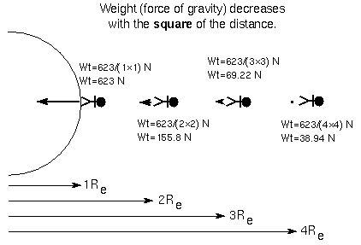
Ch 7
7.4 Gravity and Distance (A deeper look… )
Gravity is a very weak force when compared to electricity and magnetism…and, furthermore, it radically decreases over distance…
By what factor does it decrease?
outline
Intro: hunting the elusive monkey
History of gravity: A few important people
The moon: what is it doing?
Newton’s law of universal gravitation
Newton’s proposal
The law
“What if? Applications”
g&d
g&m
Other manifestations
Tides
Causes
Types
If the Big Bang is true…how will it end?
Keep in mind that while these distances are large when compared to our scales—they are easily incorporated into distances between planets, stars, and galaxies…

Slide 24

Ch 7
7.4 Gravity and Distance (A deeper look… )
Consider this concept from a photographer’s point of view…
Dilemma: black background in a studio
xavier bremont , jan 14, 1999; 06:38 a.m.
hello,
I am intending to use a studio equipped with two strobes and one softbox and my goal is to shoot black and white portrait with a totally black background (i don't want anything to appear behind my subject, it must be totally dark!). So how can i manage to achieve this with my lighting equipment, what is the best way to position the lights.
thanks a lot!
outline
Intro: hunting the elusive monkey
History of gravity: A few important people
The moon: what is it doing?
Newton’s law of universal gravitation
Newton’s proposal
The law
“What if? Applications”
g&d
g&m
Other manifestations
Tides
Causes
Types
If the Big Bang is true…how will it end?
Consider comments on a photography blog….

Slide 25
Ch 7
7.4 Gravity and Distance (A deeper look… )
Answers
Mr. Practical
Alan Gibson , jan 14, 1999; 08:59 a.m.
Get some black velvet, and hang it behind your subject. Ensure no light spills from the lights on to the velvet, by carefully positioning the lights and using barndoors.
Mr. Practical w/ Innovation
Glen Johnson , jan 14, 1999; 02:35 p.m.
A nonreflective black background is a plus, but if you have the distance, and if you light things right, you can turn a white background black. I think it was Avedon who wanted to have at least 30 feet between the subject and the background to get true deep black.
If you don't have the separation, then you end up lighting your subject to try to keep light off the background, rather than lighting your subject to try to get the effect you want on the subject. Its a lot tougher to get the result you want if you don't have the separation.
outline
Intro: hunting the elusive monkey
History of gravity: A few important people
The moon: what is it doing?
Newton’s law of universal gravitation
Newton’s proposal
The law
“What if? Applications”
g&d
g&m
Other manifestations
Tides
Causes
Types
If the Big Bang is true…how will it end?

Slide 26
Ch 7
7.4 Gravity and Distance (A deeper look… )
And suddenly…out of the mist emerges— Mr. Universal Law of Gravitation! (see below)
Steve Pfaff , jan 14, 1999; 04:16 p.m.
That s right. The trick , if you can call it that, is to have your background further away from the subject than the light which is illuminating the subject. Remember light from a light source diminishes as the inverse square. So, if your light is 10 feet from the subject and you want to make it twice (1 stop) brighter you divide 10 by the square root of 2 , and move the light in to about 7 feet (I think you may be from France? So, use meters if that s easier). Four times as bright (2 stops) divide 10 by the square root of 2 times itself (or 2) to get 5 feet. To make it dimmer, multiply and move the light away. 10, times the square root of 2 times itself (or 2), equals 20. 2 stops under.
outline
Intro: hunting the elusive monkey
History of gravity: A few important people
The moon: what is it doing?
Newton’s law of universal gravitation
Newton’s proposal
The law
“What if? Applications”
g&d
g&m
Other manifestations
Tides
Causes
Types
If the Big Bang is true…how will it end?

Slide 27
Ch 7
7.4 Gravity and Distance (A deeper look… )
And suddenly…out of the mist emerges— Mr. Universal Law of Gravitation! (see below)
Steve Pfaff , jan 14, 1999; 04:16 p.m.
…Now, if your light is 10 feet in front of the subject, then a background 10 feet behind the subject will get two stops less light than the subject (The subject is 10 feet from the light, the background 20 feet from the light. Always measure from the light.). A dead black background material will probably look totally black at two stops under. At about 4 feet behind the subject (14 feet from the light) the background will get 1 stop less than the subject (Are you following the math here? If not, don t worry just a general idea will get you through). If you put the light 5 feet in front of the subject, a background 15 feet behind the subject (20 feet from the light) will get 4 stops less light than the subject. At 4 stops under almost any dark material will look black. In fact even white looks pretty dark. Careful though, the further back you put the background the larger is has to be.
Hope this helps.
outline
Intro: hunting the elusive monkey
History of gravity: A few important people
The moon: what is it doing?
Newton’s law of universal gravitation
Newton’s proposal
The law
“What if? Applications”
g&d
g&m
Other manifestations
Tides
Causes
Types
If the Big Bang is true…how will it end?

Slide 28
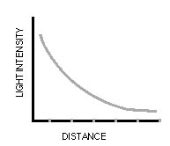

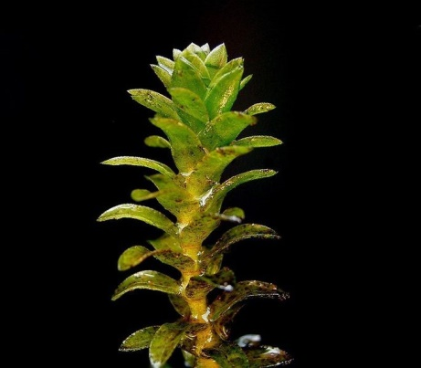
Ch 7
7.4 Gravity and Distance (A deeper look… )
Here is the principle at work in a photosynthetic study…
from www.scienceatclifton.co
…The graph shows how light intensity decreases as the lamp is moved away from the plant. You can see that the graph is not a straight line. As the distance of the lamp from the plant increases the light intensity decreases as an exponential curve. A straight line would show that light intensity was proportional to 1/distance, and this is clearly not the case.
outline
Intro: hunting the elusive monkey
History of gravity: A few important people
The moon: what is it doing?
Newton’s law of universal gravitation
Newton’s proposal
The law
“What if? Applications”
g&d
g&m
Other manifestations
Tides
Causes
Types
If the Big Bang is true…how will it end?

Slide 29

Ch 7
7.4 Gravity and Distance (A deeper look… )
One last example as to why light diminishes so quickly …
Why is this the case?
outline
Intro: hunting the elusive monkey
History of gravity: A few important people
The moon: what is it doing?
Newton’s law of universal gravitation
Newton’s proposal
The law
“What if? Applications”
g&d
g&m
Other manifestations
Tides
Causes
Types
If the Big Bang is true…how will it end?

Slide 30
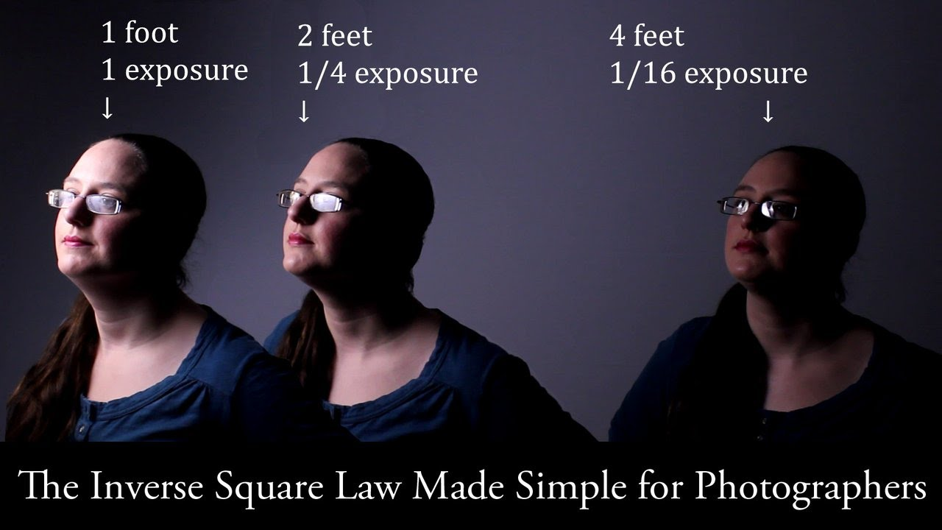
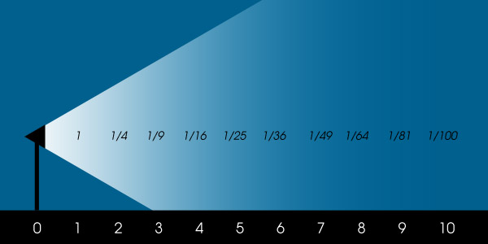
Ch 7
7.4 Gravity and Distance (A deeper look… )
Space is three dimensional, so imagine a sphere drawn around a light source that’s producing photons. As you get further away from the light source this imaginary sphere increases in size. The surface area of the sphere also increases, but it’s being illuminated by the same amount of light - the same number of our photons. It’s not a simple 1:1 relationship - the sphere is not twice as large when you get twice as far from it.
outline
Intro: hunting the elusive monkey
History of gravity: A few important people
The moon: what is it doing?
Newton’s law of universal gravitation
Newton’s proposal
The law
“What if? Applications”
g&d
g&m
Other manifestations
Tides
Causes
Types
If the Big Bang is true…how will it end?

Slide 31

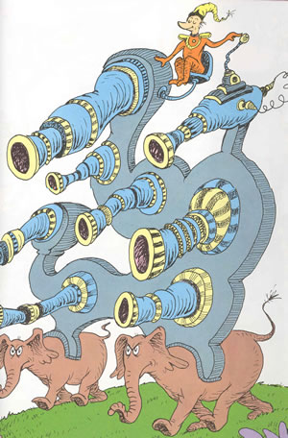

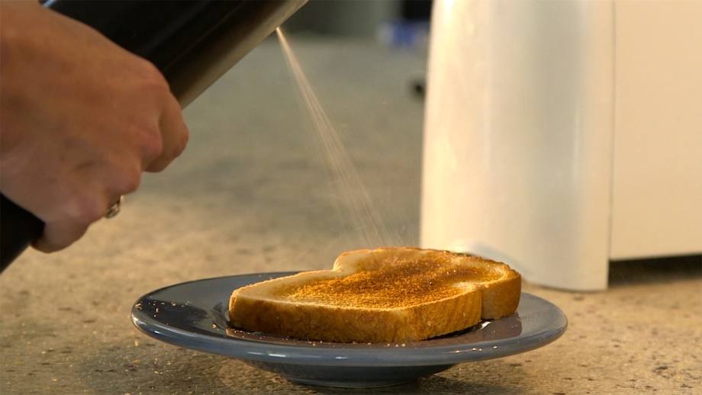
Ch 7
7.4 Gravity and Distance (A deeper look… )
Other applications?
outline
Intro: hunting the elusive monkey
History of gravity: A few important people
The moon: what is it doing?
Newton’s law of universal gravitation
Newton’s proposal
The law
“What if? Applications”
g&d
g&m
Other manifestations
Tides
Causes
Types
If the Big Bang is true…how will it end?
What if I hold the can twice as far from the object I am painting…what kind of coverage & coat do I get?

Slide 32

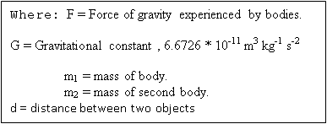
Ch 7
7.5 Universal Law of Gravitation
Gravity is a force of attraction only between bodies that have mass. The word 'gravity' comes from the Latin word "gravitas", meaning 'weight'. The force of gravity that one body exerts on another can be expressed as:
From this an important equation for finding the force of gravity on an object (e.g. planet.) How does this relate?
outline
Intro: hunting the elusive monkey
History of gravity: A few important people
The moon: what is it doing?
Newton’s law of universal gravitation
Newton’s proposal
The law
“What if? Applications”
g&d
g&m
Other manifestations
Tides
Causes
Types
If the Big Bang is true…how will it end?
Newtonian Gravity: Crash Course Physics

Slide 33
Ch 7
outline
Intro: hunting the elusive monkey
History of gravity: A few important people
The moon: what is it doing?
Newton’s law of universal gravitation
Newton’s proposal
The law
“What if? Applications”
g&d
g&m
Other manifestations
Tides
Causes
Types
If the Big Bang is true…how will it end?
7.5 Universal Law of Gravitation
From this an important equation for finding the force of
gravity on an object (e.g. planet.) How does this relate?
Newton's second law states that:
F = m * a. (2)
If you substitute the 'F' in equation 1 with 'm * a' in equation 2, you will get:
m₁ * m₂
m * a = G ____________ (3)
d²
Divide both sides by m and you will get:
G * m
a = _________ (4)
d²

Slide 34
Ch 7
7.5 Universal Law of Gravitation
From this an important equation for finding the force of
gravity on an object (e.g. planet.) How does this relate?
At a 90 degree angle: (that is, for falling objects)
a = g g: acceleration due to gravity (5)
So the new formula is:
G * m
g = _________ (6)
d²
Knowing the gravitational constant (6.67 x 10⁻¹¹), the mass of the Earth (6 x 10²⁴ kg), and your distance from the centre of the Earth (6.4 x 10⁶ m), you can work out the gravitational pull of the Earth.
Please note: Gravity is measured in Newtons(N) or kg m /s².
outline
Intro: hunting the elusive monkey
History of gravity: A few important people
The moon: what is it doing?
Newton’s law of universal gravitation
Newton’s proposal
The law
“What if? Applications”
g&d
g&m
Other manifestations
Tides
Causes
Types
If the Big Bang is true…how will it end?

Slide 35
Ch 7
7.5 Universal Law of Gravitation
From this an important equation for finding the force of
gravity on an object (e.g. planet.) How does this relate?
Knowing the gravitational constant (6.67 x 10⁻¹¹), the mass of the Earth (6 x 10²⁴ kg), and your distance from the centre of the Earth (6.4 x 10⁶ m), you can work out the gravitational pull of the Earth on a 1 kg object.
Please note: Gravity is measured in Newtons(N) or kg m /s².
Try it here: !
F = Gm₁ x m₂/d₂
What answer do you get? Recognize it? ………………………Cool huh?
outline
Intro: hunting the elusive monkey
History of gravity: A few important people
The moon: what is it doing?
Newton’s law of universal gravitation
Newton’s proposal
The law
“What if? Applications”
g&d
g&m
Other manifestations
Tides
Causes
Types
If the Big Bang is true…how will it end?

Slide 36
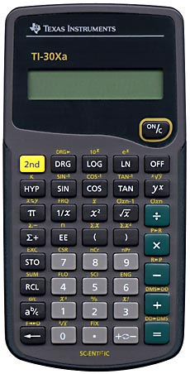
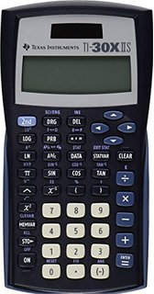
Ch 7
7.5 Universal Law of Gravitation
From this an important equation for finding the force of
gravity on an object (e.g. planet.) How does this relate?
Knowing the gravitational constant (6.67 x 10⁻¹¹), the mass of the Earth (6 x 10²⁴ kg), and your distance from the centre of the Earth (6.4 x 10⁶ m), you can work out the gravitational pull of the Earth.
Please note: Gravity is measured in Newtons(N) or kg m /s².
Calculating this…
outline
Intro: hunting the elusive monkey
History of gravity: A few important people
The moon: what is it doing?
Newton’s law of universal gravitation
Newton’s proposal
The law
“What if? Applications”
g&d
g&m
Other manifestations
Tides
Causes
Types
If the Big Bang is true…how will it end?
When usimg Scientific notation, be sure not to manually enter in “x 10”…because these button/2nd function button mean that!
Write givens
Write formula
Plug & chug
Box answer & be sure to include units
Also, be sure to calculate all at once by putting parenthesis around the denominator after squaring it!

Slide 37

Ch 7
7.5 Universal Law of Gravitation: try this on for size!
What is the Fg between you and your pencil if it was sitting on the desk 1m away??
Knowing the gravitational constant (6.67 x 10⁻¹¹), the mass of the average student (80 kg), the mass of an average pencil (0.006 kg), and your distance from the centre of the pencil (1m), you can work out the gravitational pull between you and it!.
Try it here: show work…them plug into calculator!
F = Gm₁ x m₂/d²
outline
Intro: hunting the elusive monkey
History of gravity: A few important people
The moon: what is it doing?
Newton’s law of universal gravitation
Newton’s proposal
The law
“What if? Applications”
g&d
g&m
Other manifestations
Tides
Causes
Types
If the Big Bang is true…how will it end?

Slide 38
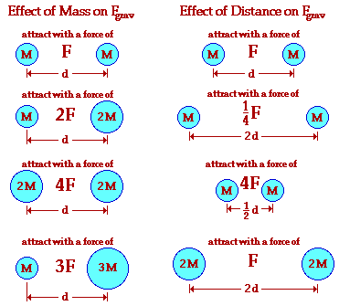
Ch 7
7.5 Universal Law of Gravitation
Review Your Understanding
outline
Intro: hunting the elusive monkey
History of gravity: A few important people
The moon: what is it doing?
Newton’s law of universal gravitation
Newton’s proposal
The law
“What if? Applications”
g&d
g&m
Other manifestations
Tides
Causes
Types
If the Big Bang is true…how will it end?

Slide 39
Ch 7
7.5 Universal Law of Gravitation
Now simplify the formula and Calculate these…
Review Your Understanding
1 . Suppose that two objects attract each other with a force of 16 units. If the distance between the two objects is doubled, what is the new force of attraction between the two objects?
2. Suppose that two objects attract each other with a force of 16 units. If the distance between the two objects is tripled, then what is the new force of attraction between the two objects?
3. Suppose that two objects attract each other with a force of 16 units. If the distance between the two objects is reduced in half, then what is the new force of attraction between the two objects?
4. Suppose that two objects attract each other with a force of 16 units. If the distance between the two objects is reduced by a factor of 5, then what is the new force of attraction between the two objects?
5. If you wanted to make a profit in buying gold by weight at one altitude and selling it at another altitude for the same price per weight, should you buy or sell at the higher altitude location? What kind of scale must you use for this work?
outline
Intro: hunting the elusive monkey
History of gravity: A few important people
The moon: what is it doing?
Newton’s law of universal gravitation
Newton’s proposal
The law
“What if? Applications”
g&d
g&m
Other manifestations
Tides
Causes
Types
If the Big Bang is true…how will it end?

Slide 40

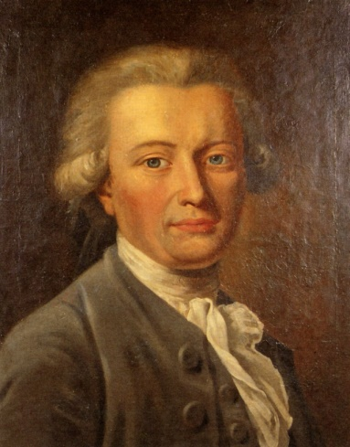
Ch 7
7.5 Universal Law of Gravitation
outline
Intro: hunting the elusive monkey
History of gravity: A few important people
The moon: what is it doing?
Newton’s law of universal gravitation
Newton’s proposal
The law
“What if? Applications”
g&d
g&m
Other manifestations
Tides
Causes
Types
If the Big Bang is true…how will it end?
The constant of proportionality (G) in this equation is known as the universal gravitation constant. The precise value of G was determined experimentally by Henry Cavendish in the century after Newton's death.
The units on G may seem rather odd; nonetheless they are sensible. When the units on G are substituted into the equation above and multiplied by m1*m2 units and divided by d² units, the result will be Newtons - the unit of force.
Knowing the value of G allows us to calculate the force of gravitational attraction between any two objects of known mass and known separation distance…

Slide 41

Ch 7
7.5 Universal Law of Gravitation
Review Your Understanding
outline
Intro: hunting the elusive monkey
History of gravity: A few important people
The moon: what is it doing?
Newton’s law of universal gravitation
Newton’s proposal
The law
“What if? Applications”
g&d
g&m
Other manifestations
Tides
Causes
Types
If the Big Bang is true…how will it end?
Sample Problem #1
Determine the force of gravitational attraction between the earth (m = 5.98 x 10²⁴ kg) and a 70-kg physics student if the student is standing at sea level, a distance of 6.37 x 10⁶ m from earth's center.

Slide 42

Ch 7
7.5 Universal Law of Gravitation
Review Your Understanding
outline
Intro: hunting the elusive monkey
History of gravity: A few important people
The moon: what is it doing?
Newton’s law of universal gravitation
Newton’s proposal
The law
“What if? Applications”
g&d
g&m
Other manifestations
Tides
Causes
Types
If the Big Bang is true…how will it end?
Sample Problem #2
Determine the force of gravitational attraction between the earth (m = 5.98 x 10²⁴ kg) and a 70-kg physics student if the student is in an airplane at 40000 feet above earth's surface. This would place the student a distance of 6.38 x 10⁶ m from earth's center.
Why are the Forces in situations 1&2 so similar in magnitude?

Slide 43
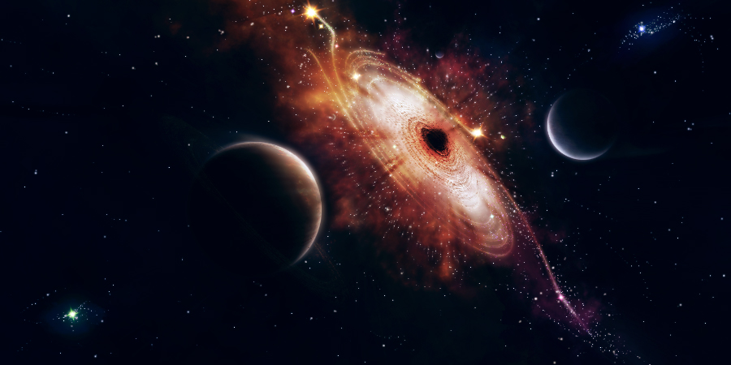
Ch 7
7.5 Universal Law of Gravitation
…here are some gravitational brain-teasers to round out this section:
outline
Intro: hunting the elusive monkey
History of gravity: A few important people
The moon: what is it doing?
Newton’s law of universal gravitation
Newton’s proposal
The law
“What if? Applications”
g&d
g&m
Other manifestations
Tides
Causes
Types
If the Big Bang is true…how will it end?
1. If our sun shrank in size to a black hole, would the Earth's orbit be affected? Explain.

Slide 44

Ch 7
7.5 Universal Law of Gravitation
…here are some gravitational brain-teasers to round out this section:
outline
Intro: hunting the elusive monkey
History of gravity: A few important people
The moon: what is it doing?
Newton’s law of universal gravitation
Newton’s proposal
The law
“What if? Applications”
g&d
g&m
Other manifestations
Tides
Causes
Types
If the Big Bang is true…how will it end?
2. What would happen to your weight if the mass of the Earth somehow increased by 10%?

Slide 45
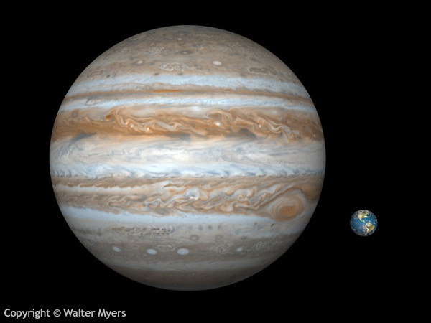
Ch 7
7.5 Universal Law of Gravitation
…here are some gravitational brain-teasers to round out this section:
outline
Intro: hunting the elusive monkey
History of gravity: A few important people
The moon: what is it doing?
Newton’s law of universal gravitation
Newton’s proposal
The law
“What if? Applications”
g&d
g&m
Other manifestations
Tides
Causes
Types
If the Big Bang is true…how will it end?
3. The planet Jupiter is more than 300 times as massive as Earth, so it might seem that a body on the surface of Jupiter would weigh 300 times as much as on Earth. But it so happens a body would scarcely weigh three times as much on the surface of Jupiter as it would on the surface of the Earth. Explain why this is so.

Slide 46
Ch 7
7.5 Universal Law of Gravitation
…here are some gravitational brain-teasers to round out this section:
outline
Intro: hunting the elusive monkey
History of gravity: A few important people
The moon: what is it doing?
Newton’s law of universal gravitation
Newton’s proposal
The law
“What if? Applications”
g&d
g&m
Other manifestations
Tides
Causes
Types
If the Big Bang is true…how will it end?
4. Suppose that you have a mass of 70 kg (equivalent to a 154-pound person). How much mass would another object have to have in order for your body and the object to attract each other with a force of 1-Newton when separated by 10 meters?
Write givens
Write formula
Plug & chug
Box answer & be sure to include units
F = Gm1 x m2/d2
1N= (6.67x10⁻¹¹) x (70 kg) (m2)/(10m)²
100 = (5 x 10⁻⁹) m2
2.14 x 10¹⁰ kg = m2

Slide 47
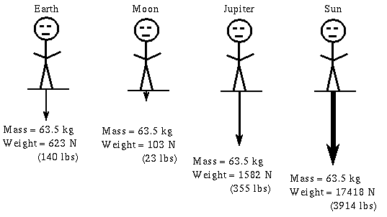
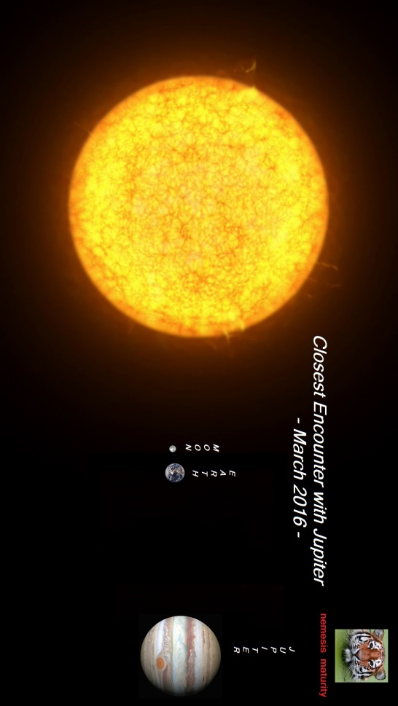
Ch 7
7.5 Universal Law of Gravitation
outline
Intro: hunting the elusive monkey
History of gravity: A few important people
The moon: what is it doing?
Newton’s law of universal gravitation
Newton’s proposal
The law
“What if? Applications”
g&d
g&m
Other manifestations
Tides
Causes
Types
If the Big Bang is true…how will it end?

Slide 48
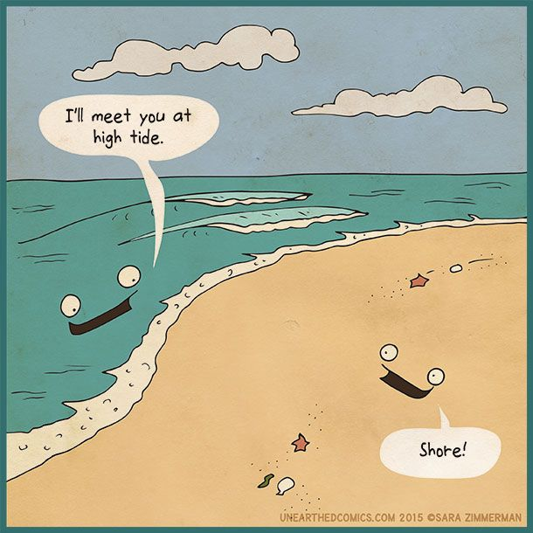
Ch 7
7.6 Tides
outline
Intro: hunting the elusive monkey
History of gravity: A few important people
The moon: what is it doing?
Newton’s law of universal gravitation
Newton’s proposal
The law
“What if? Applications”
g&d
g&m
Other manifestations
Tides
Causes
Types
If the Big Bang is true…how will it end?
What is high tide?...and what causes it? How often does it occur?

Slide 49
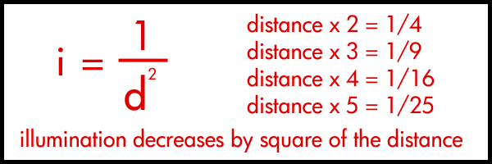
Ch 7
7.6 Tides
What causes the tides?
The simple answer is gravity - mainly the gravitational pull of the Moon.
More precisely, the cause is the fact that its gravitational force decreases with distance… How much so?
outline
Intro: hunting the elusive monkey
History of gravity: A few important people
The moon: what is it doing?
Newton’s law of universal gravitation
Newton’s proposal
The law
“What if? Applications”
g&d
g&m
Other manifestations
Tides
Causes
Types
If the Big Bang is true…how will it end?
Gravitational F

Slide 50
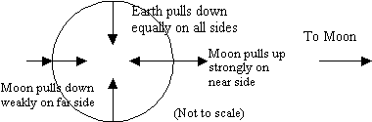
Ch 7
7.6 Tides
What causes the tides?
(The Sun also has quite a large effect, but for all practical purposes we can ignore the effects of all the other heavenly bodies). Why?
…Therefore the Moon pulls the water upwards on the near side of the Earth, and downwards on the far side, but the downward force is weaker. The Earth also pulls the water downwards equally (and much more strongly) on both sides, so the net force is always downwards, and the oceans don't fall off.
outline
Intro: hunting the elusive monkey
History of gravity: A few important people
The moon: what is it doing?
Newton’s law of universal gravitation
Newton’s proposal
The law
“What if? Applications”
g&d
g&m
Other manifestations
Tides
Causes
Types
If the Big Bang is true…how will it end?

Slide 51
Ch 7
7.6 Tides
What are these different tides called?
In order to better understand different tides we can now add in the effects of the sun…
The Sun's gravity also produces tides that are about half as strong as the Moon's and produces its own pair of tidal bulges. They combine with the lunar tides…
…to make the extremes “worse” OR temper the tidal difference
These are called, respectively, SPRING tides and NEAP tides.
outline
Intro: hunting the elusive monkey
History of gravity: A few important people
The moon: what is it doing?
Newton’s law of universal gravitation
Newton’s proposal
The law
“What if? Applications”
g&d
g&m
Other manifestations
Tides
Causes
Types
If the Big Bang is true…how will it end?

Slide 52
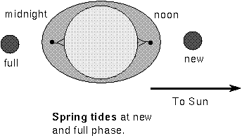
Ch 7
7.6 Tides
What are these different tides called?
These are called, respectively, SPRING tides and NEAP tides.
outline
Intro: hunting the elusive monkey
History of gravity: A few important people
The moon: what is it doing?
Newton’s law of universal gravitation
Newton’s proposal
The law
“What if? Applications”
g&d
g&m
Other manifestations
Tides
Causes
Types
If the Big Bang is true…how will it end?
At new and full moon, the Sun and Moon produce tidal bulges that add together to produce extreme tides. These are called spring tides (the waters really spring up!)
Sun & moon are lined up!

Slide 53
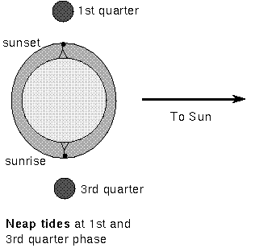
Ch 7
7.6 Tides
What are these different tides called?
These are called, respectively, SPRING tides and NEAP tides.
outline
Intro: hunting the elusive monkey
History of gravity: A few important people
The moon: what is it doing?
Newton’s law of universal gravitation
Newton’s proposal
The law
“What if? Applications”
g&d
g&m
Other manifestations
Tides
Causes
Types
If the Big Bang is true…how will it end?
When the Moon and Sun are at right angles to each other (1st & 3rd quarter), the solar tides reduce the lunar tides and you have neap tides
Middle English, from Old English nepflod "neap flood," the tide occurring at the end of the first and third quarters of the lunar month
Sun & moon are at 90º to each other!

Slide 54


Ch 7
7.6 Tides
What causes the tides?
Hewitt-Drew-it! PHYSICS 48.Ocean Tides - YouTube
Hewitt-Drew-it! PHYSICS 48.Ocean Tides - YouTube
Tides: Crash Course Astronomy #8

Slide 55
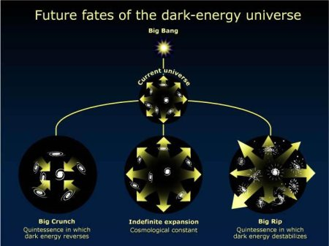
Ch 7
outline
Intro: hunting the elusive monkey
History of gravity: A few important people
The moon: what is it doing?
Newton’s law of universal gravitation
Newton’s proposal
The law
“What if? Applications”
g&d
g&m
Other manifestations
Tides
Causes
Types
If the Big Bang is true…how will it end?

Slide 56
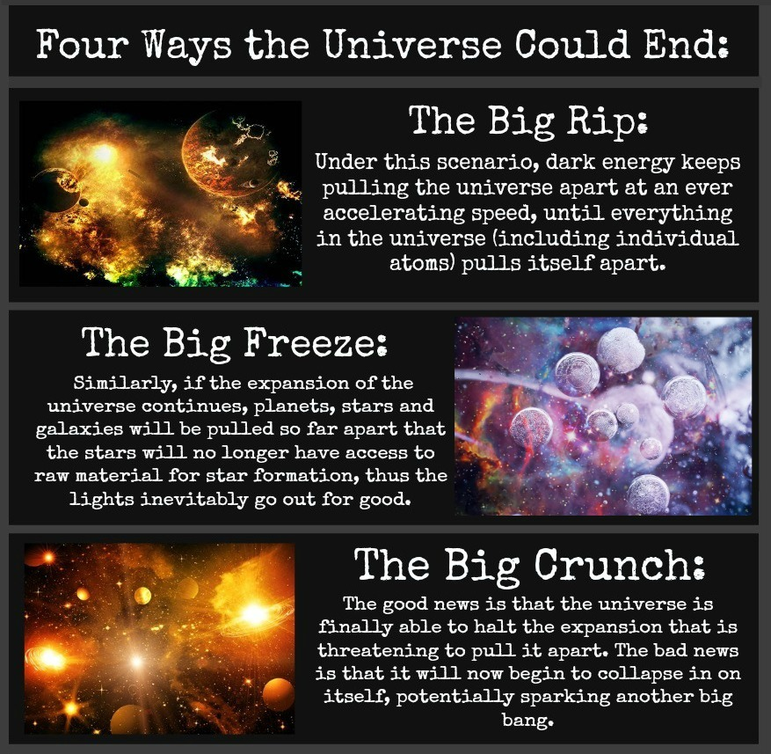
Ch 7
outline
Intro: hunting the elusive monkey
History of gravity: A few important people
The moon: what is it doing?
Newton’s law of universal gravitation
Newton’s proposal
The law
“What if? Applications”
g&d
g&m
Other manifestations
Tides
Causes
Types
If the Big Bang is true…how will it end?

Slide 57
Ch 7
One of the biggest discoveries of modern astronomy is the presence of dark energy. This is a type of energy that exists all through outerspace, which is counteracting the force of gravity and causing the universe to expand. An interesting feature of the expansion of the universe is that it can expand faster than the speed of light.
The Big Rip would be the fate of the universe if dark energy was strong enough to fully counteract the force of gravity. In billions of years every galaxy will be "moving" away from us faster than the speed of light, meaning that no particle from another galaxy will be able to interact with our own galaxy. For all intents and purposes, the extent of the observable universe will be only our own Milky Way. As time goes on, even the gravity of the Milky Way will not be strong enough to hold it together, and its stars will start receding from each other. A mere 60 million years before the final big rip, you will be able to look up into the sky and not see a single star other than the Sun.
Three months before the end of universe, the solar system will be flung apart as dark energy overcomes the gravity of the Sun. In the last minutes the Earth itself will start to disintegrate, and an instant before the end all subatomic particles will be ripped apart.
outline
Intro: hunting the elusive monkey
History of gravity: A few important people
The moon: what is it doing?
Newton’s law of universal gravitation
Newton’s proposal
The law
“What if? Applications”
g&d
g&m
Other manifestations
Tides
Causes
Types
If the Big Bang is true…how will it end?

Slide 58
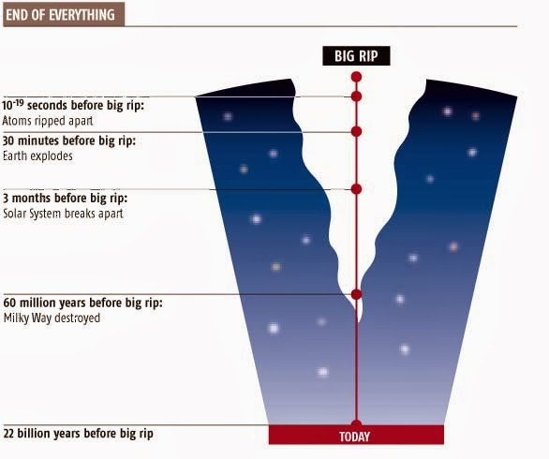
Ch 7
outline
Intro: hunting the elusive monkey
History of gravity: A few important people
The moon: what is it doing?
Newton’s law of universal gravitation
Newton’s proposal
The law
“What if? Applications”
g&d
g&m
Other manifestations
Tides
Causes
Types
If the Big Bang is true…how will it end?

Slide 59
Ch 7
Not including things like dark matter or dark energy, the universe is made up of a huge collection of atoms. In the 1850s a German physicist named Rudolf Clausius was doing work on isolated systems in thermodynamic equilibrium, and came up with a concept he called entropy. He said that any collection of atoms or molecules when completely isolated tended to become more and more disordered. As an example, a nice and orderly brick wall will tend to fall apart and become less organized over time. Entropy is a measure of this disorderliness, and will increase with time. Another way to look at the concept of entropy is with heat. When Clausius was studying thermodynamics, he explained entropy using the Second Law of
outline
Intro: hunting the elusive monkey
History of gravity: A few important people
The moon: what is it doing?
Newton’s law of universal gravitation
Newton’s proposal
The law
“What if? Applications”
g&d
g&m
Other manifestations
Tides
Causes
Types
If the Big Bang is true…how will it end?
Thermodynamics: Heat cannot flow spontaneously from a material at a lower temperature to a material at a higher temperature.
At some point in the future, the universe will reach a point of maximum entropy. This is what cosmologists call heat death. As all the atoms in the universe bump into each other, transferring heat from hot regions to cold regions, the universe will asymptotically reach a state where all energy is evenly distributed. There will be no more stars, no more black holes, no more anything other than a soup of elementary particles with a temperature very close to absolute zero.
Luckily for us, if heat death is where the end of universe is headed, it will take a long time getting there. The main reasons for this are that the universe is huge and it tends to clump up. Some stars can live for billions of years before they finally die, and many stars will just reform again once they explode.

Slide 60
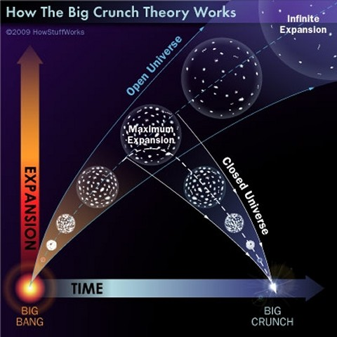
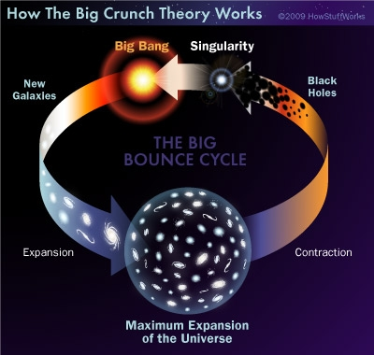
Ch 7
outline
Intro: hunting the elusive monkey
History of gravity: A few important people
The moon: what is it doing?
Newton’s law of universal gravitation
Newton’s proposal
The law
“What if? Applications”
g&d
g&m
Other manifestations
Tides
Causes
Types
If the Big Bang is true…how will it end?

Slide 61
Ch 7
The big crunch is the opposite of the big rip. Supposing that the dark energy in the universe is not strong enough to overcome the force of gravity, on a long enough time scale all matter will be drawn back together into another singularity. The Hubble Constant is the rate at which the universe is expanding due to dark energy, and our current best guess is that for every megaparsec (a million x 19 trillion miles) of space between two objects, they are receding from each other at a speed of 70.8 kilometers per second. The main factor that determines whether the universe will end in a big crunch is its density. If all the regular matter and dark matter in the universe is close enough together that dark energy cannot produce an escape velocity, the expansion of the universe will slow down and eventually reverse. All matter will come crashing back together, producing an enormous black hole.
outline
Intro: hunting the elusive monkey
History of gravity: A few important people
The moon: what is it doing?
Newton’s law of universal gravitation
Newton’s proposal
The law
“What if? Applications”
g&d
g&m
Other manifestations
Tides
Causes
Types
If the Big Bang is true…how will it end?
There is some speculation that this final singularity could go on to produce another big bang, and that the universe goes through a cyclic phase of expansion and retraction. This theory is called the big bounce, and appeals to many people because of its symmetry. However, the big bounce is based on some unproven assumptions about the nature of the universe and spacetime, and more research is needed before it can be proven or disproven. The big crunch theory itself has had some doubts cast on it based on the fact that our measurements tell us that rather than slowing down, the universe is actually accelerating in its expansion. The only thing keeping the big crunch theory alive is our complete absence of knowledge of what dark energy is or how it works.

Slide 62
Ch 7
outline
Intro: hunting the elusive monkey
History of gravity: A few important people
The moon: what is it doing?
Newton’s law of universal gravitation
Newton’s proposal
The law
“What if? Applications”
g&d
g&m
Other manifestations
Tides
Causes
Types
If the Big Bang is true…how will it end?

Slide 63
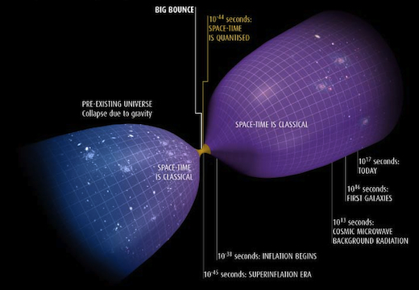
Ch 7
outline
Intro: hunting the elusive monkey
History of gravity: A few important people
The moon: what is it doing?
Newton’s law of universal gravitation
Newton’s proposal
The law
“What if? Applications”
g&d
g&m
Other manifestations
Tides
Causes
Types
If the Big Bang is true…how will it end?

Slide 64
Ch 7
D.W. Hardy is one of the few theologians who have attempted to address the question of the end of the Universe, in relation to both science and the doctrine of creation. He suggests that theology must provide a combined account of creation and eschatology that would consist of the successful integration of current understanding of cosmology (the structure and dynamics of the universe) with theology (normative conditions of the structure and dynamics of the universe grounded in normative authority) He outlines the lines on which the account might proceed. They may be summarized as:
1. Creation keeps the Universe from ending, but also brings it to an end
2. Covenant is a way to view the dynamics of the created Universe with two aspects: obligatory and promissory.
3. These dynamics result from a radical gift/self promise on the part of God, in which God gives to the other
(universe, world, humanity) varying capacities for finitude, full possibilities of development, and redemption in the
face of evil.
4. This action of God requires worship, and in this creation and eschatology return glory to God.
outline
Intro: hunting the elusive monkey
History of gravity: A few important people
The moon: what is it doing?
Newton’s law of universal gravitation
Newton’s proposal
The law
“What if? Applications”
g&d
g&m
Other manifestations
Tides
Causes
Types
If the Big Bang is true…how will it end?

