Slide 1
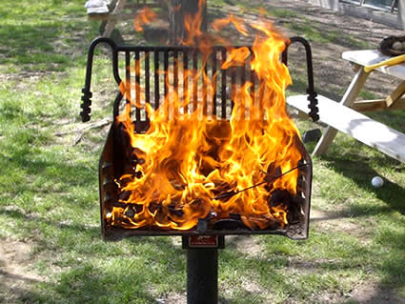
Chapter 9: heat
Physical Science
SRCS~winter 2010

Slide 2
energy
How does one define Energy?
Not source--or forms--but as a concept

Slide 3
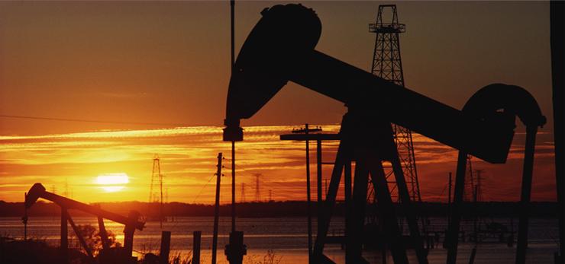
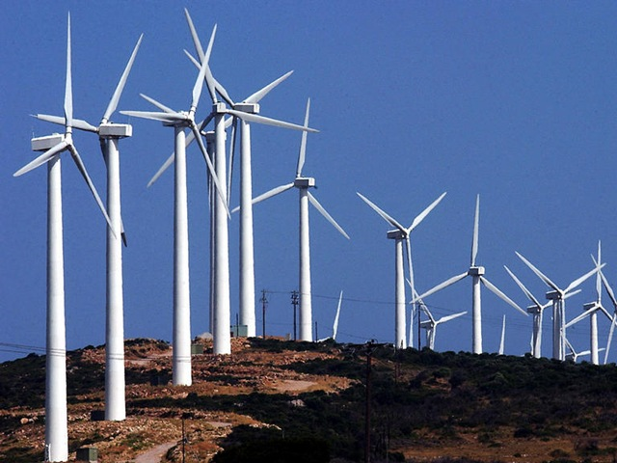
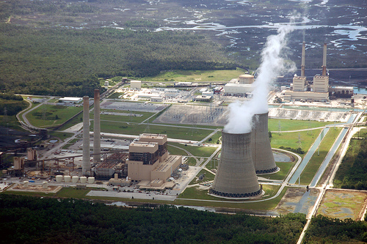
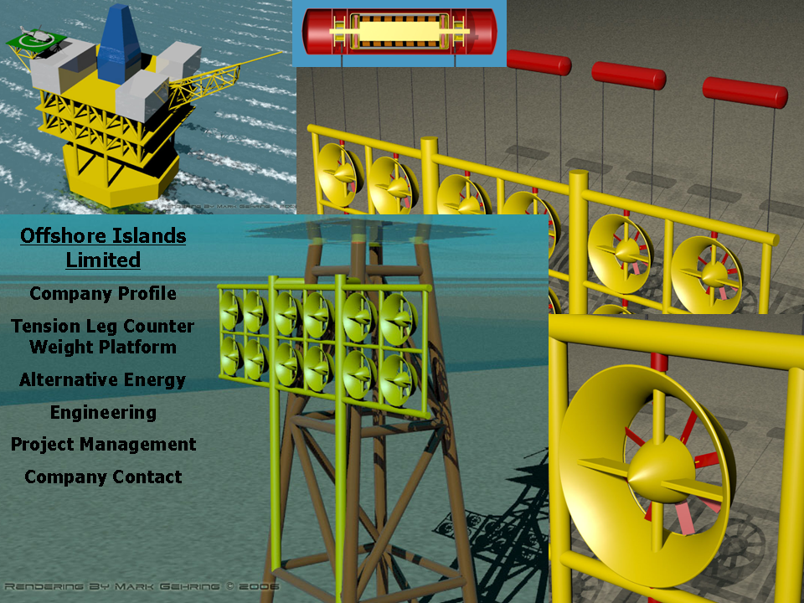
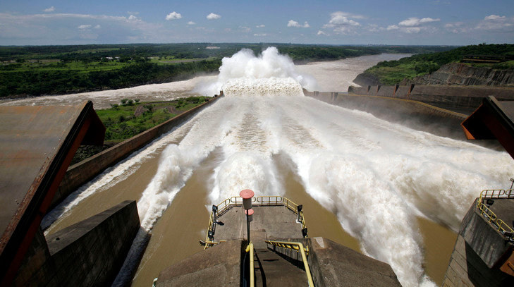
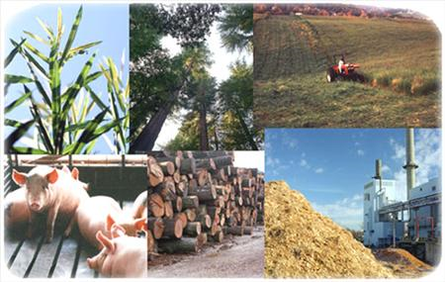
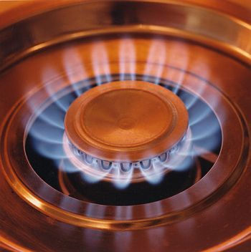
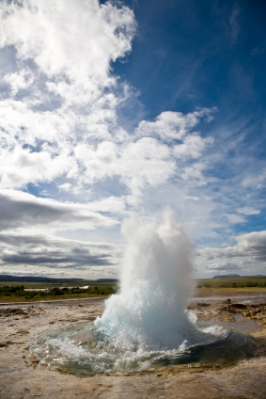

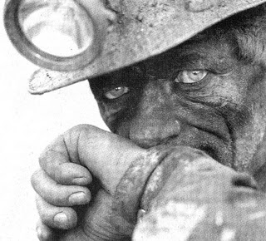
energy: its forms
20% renewable energy by 2020

Slide 4
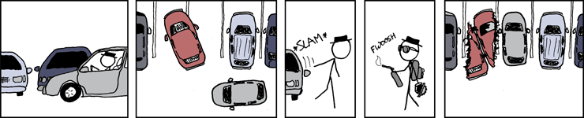
energy
Does it make you angry when someone takes gratuitously more than they need to for the most ridiculous reasons?

Slide 5
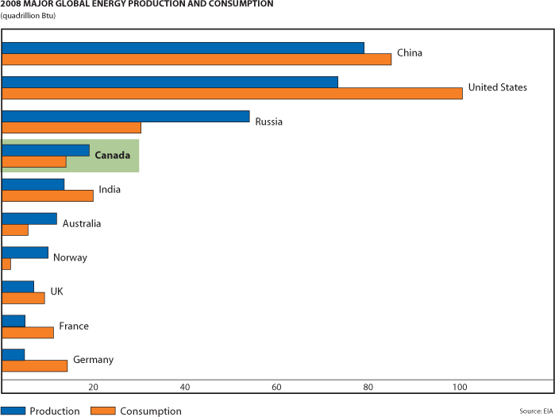
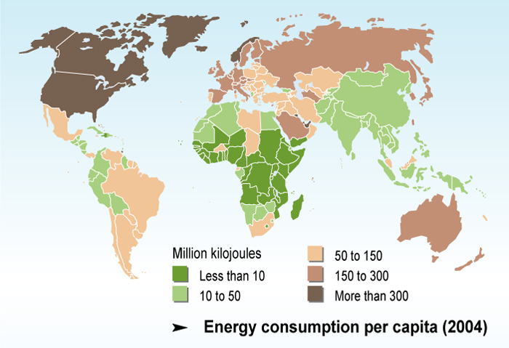
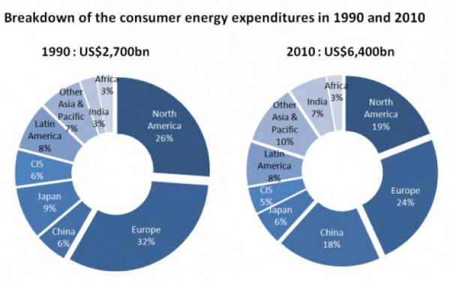
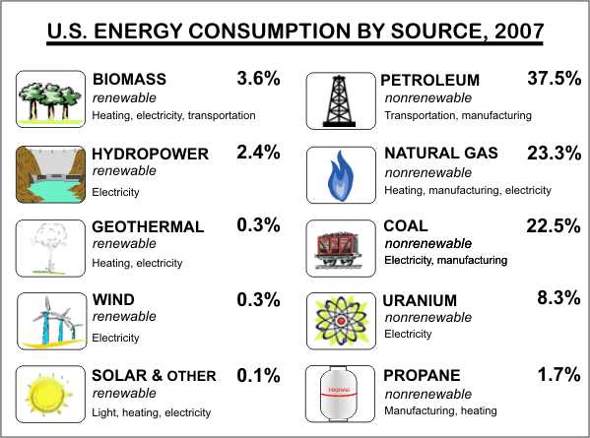
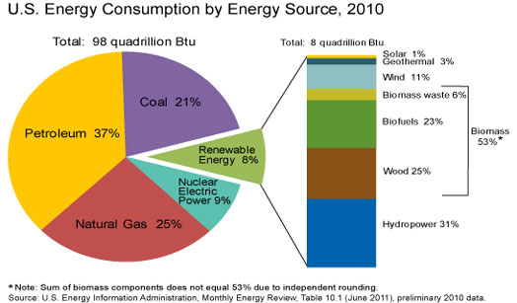
energy: US consumption

Slide 6
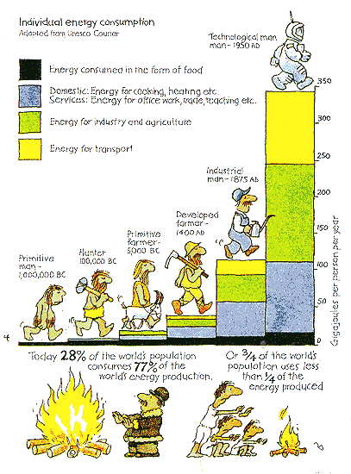
energy: individual use

Slide 7
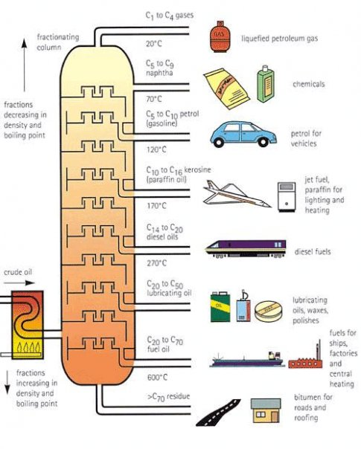
energy
Petroleum Cracking

Slide 8
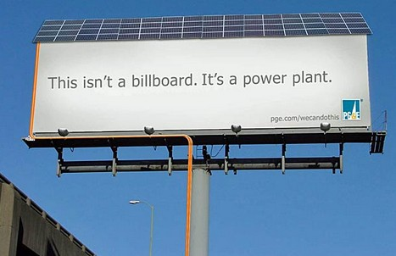
energy

Slide 9

energy

Slide 10
thermal energy
Thermal E = KE + PE
Total E = E of motion + E of storage

Slide 11

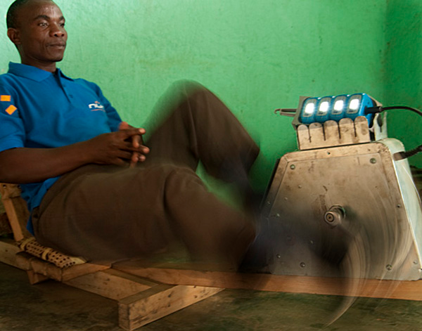

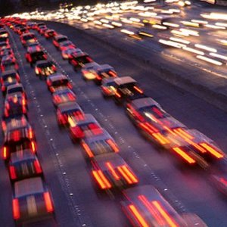
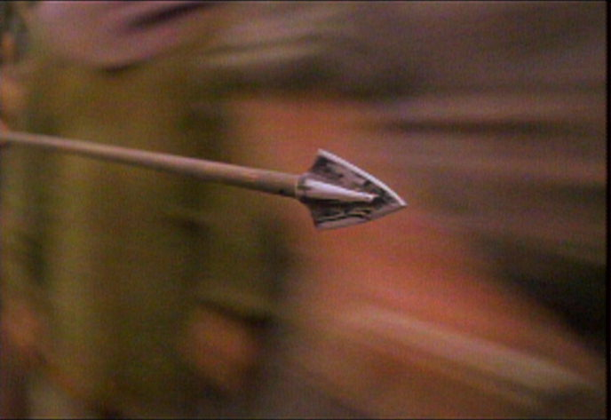
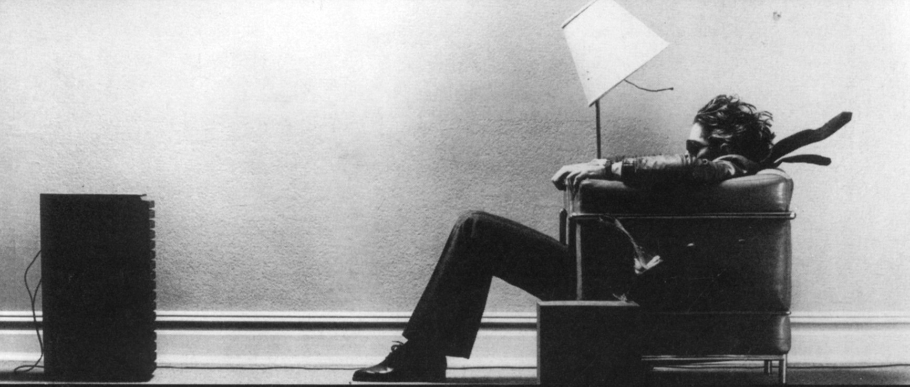

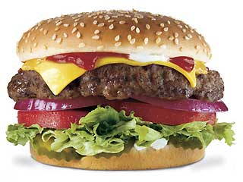
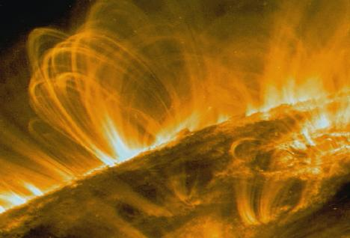

KE & PE
Thermal E = KE + PE
Categorize the following as either KE or PE:

Slide 12
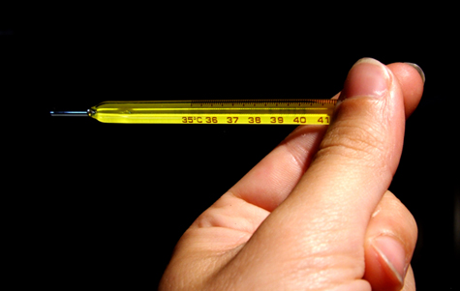
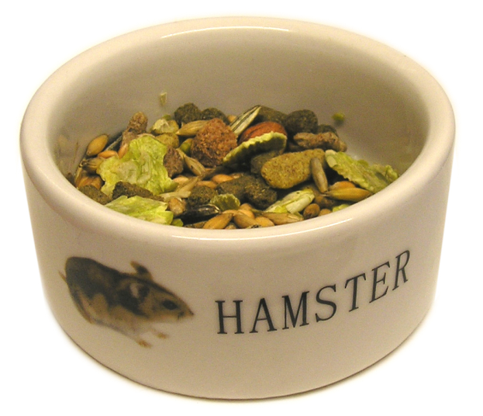
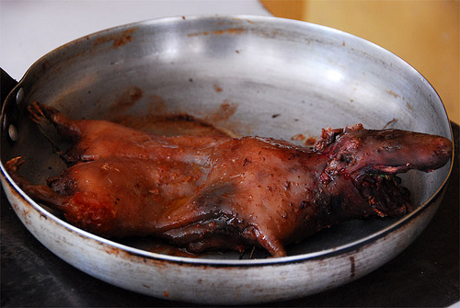
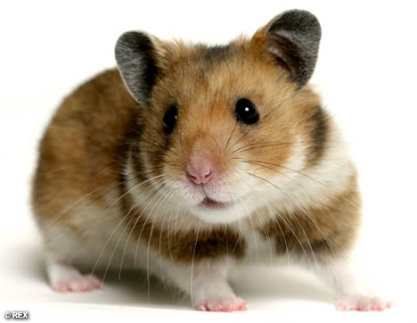
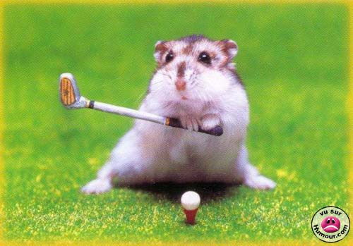
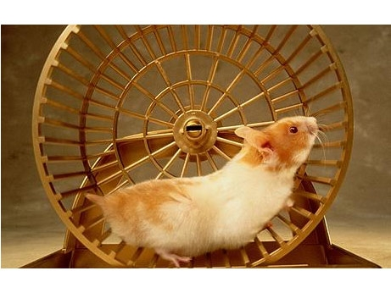
energy: transormations

Slide 13
energy
Multiple Choice Questions
1. Which statement is not true about energy a) energy is the ability to do work b) energy is neither created or destroyed c) there are many forms of energy, but they can all be put into two categories: kinetic and potential. d) potential energy is energy in motion
2. Most energy in the United States comes from nonrenewable energy sources. Which nonrenewable source uses the greatest amount of consumption? a) Petroleum b) Natural Gas c) Solar Energy d) Nuclear

Slide 14
energy
Multiple Choice Questions
3. Which is an example of kinetic energy a) energy stored in gasoline b) energy of a moving car c) energy in a battery d) water in a reservoir
4. A car that burns petroleum in order to move is an example of what energy change? a) solar energy ---> mechanical energy b) electrical energy ---> mechanical energy c) chemical energy ---> mechanical energy d) chemical energy ---> electrical energy

Slide 15
energy
Multiple Choice Questions
5. Electricity and hydrogen are different from the other energy sources because: a) they are secondary sources of energy. b) are used to store, move, and deliver energy in easily usable form. c) can only be produced from coal d) both a and b are correct

Slide 16


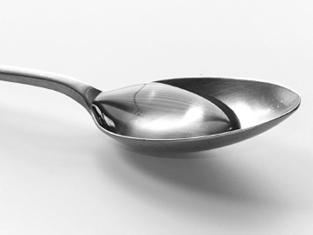
energy: T vs. heat
boiling
vs.
lukewarm
Which contains more heat?
Which is the higher T?

Slide 17
energy: T vs. heat
temperature heat
Concept
Defined
Focus
Measured by
units
Measurement of ‘hotness’& ‘coldness’
Avg. KE of particles in substance
Particulate motion
Thermometers
ºC, kelvin
E that flows from hot to cold
Movement of thermal E
Thermal E transfer
(calorimeters; thermometers over time)
joules

Slide 18
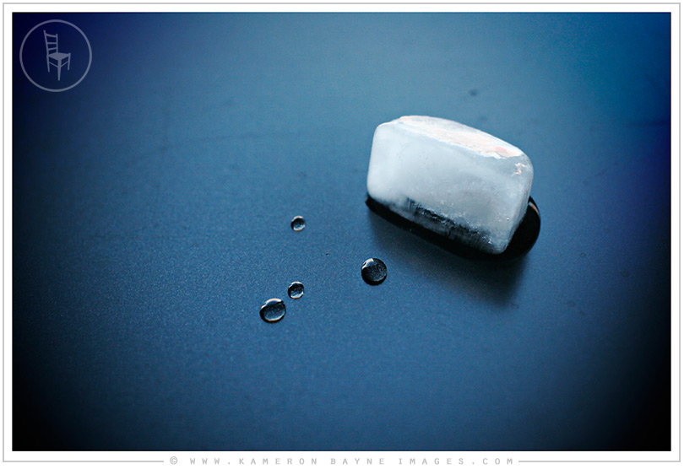
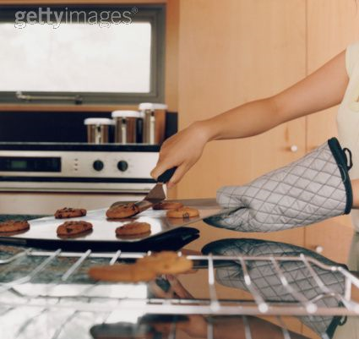
energy: T vs. heat
In which direction will heat always flow?
higher T object lower T object
http://www.google.com/url?sa=t&rct=j&q=&esrc=s&source=video&cd=4&cad=rja&ved=0CEYQtwIwAw&url=http%3A%2F%2Fwww.youtube.com%2Fwatch%3Fv%3DZvrJgGhnmJo&ei=czNDUbb-ErKm4APNyYCQDw&usg=AFQjCNGDMEGlRrqEa9eNNoPIccbdfOaHjg
http://www.youtube.com/watch?v=-0y-xPG5n5g

Slide 19
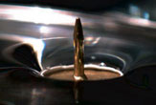
energy: T vs. heat
Could one say that heat will always flow from an object with higher E_{thermal} to an object with a lower E_{thermal}?
Say I drop a steaming hot tack in a bowl of warm water
Which has more E_{thermal}? In which direction will it always flow?

Slide 20
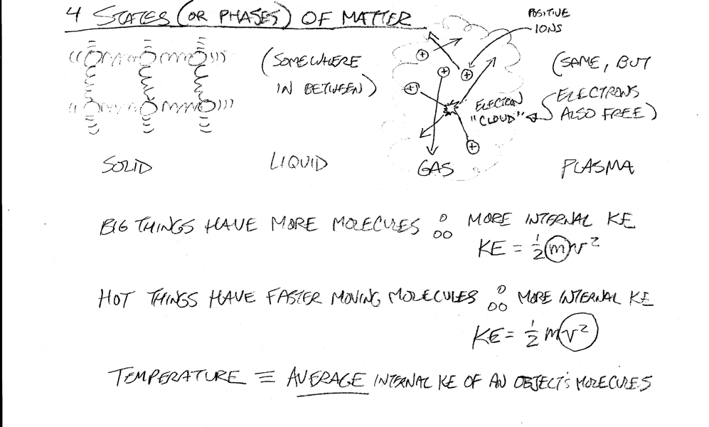
energy: T vs. heat
So what happens as particles in a substance slow down?

Slide 21
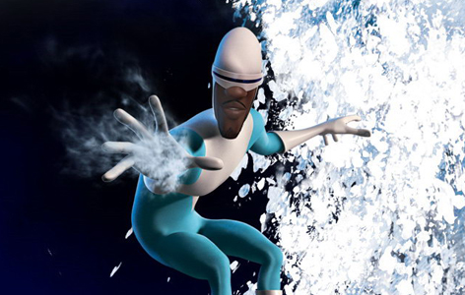
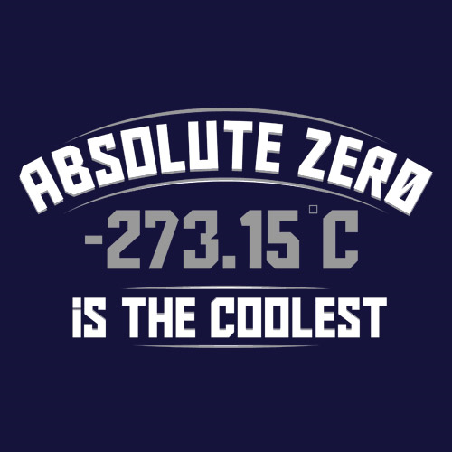
energy: absolute 0
Theoretically, one could slow down particulate motion such that…
What is this called…
Absolute Zero - The Conquest of Cold - Episode 1
Absolute Zero
watch chapter 10 in Quicktime (1:12:00)

Slide 22
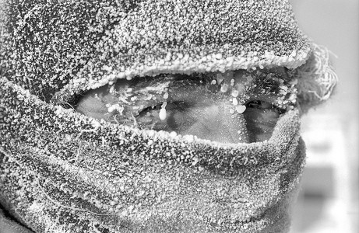
energy: absolute 0
Is there such a thing as cold?
Just as darkness is the absence of light, so cold is the absence of heat...
so refrigerators do not make food cold...they draw out the heat from their contents...

Slide 23
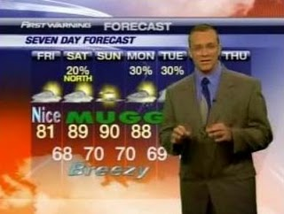
energy: absolute 0
What if your meteorologist used the Kelvin scale, which uses centigrade divisions and starts at the " No Motion — Absolute Zero " point... this is what you’d hear;
"Our over–night low temperature will be around 300 Kelvin.“
Which is 37 degrees on the regular Centigrade scale. ₍ ₂₇₃ ₊ ₃₇ ₌ ₃₀₀₎
What is so unique about the Kelvin Scale?
(it’s so unique I’m positive about it!)

Slide 24
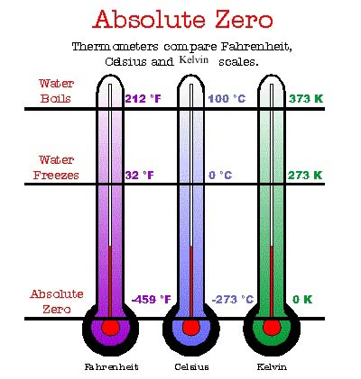
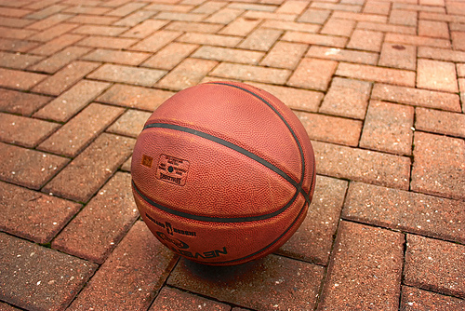
energy: absolute 0
How was this derived?

Slide 25
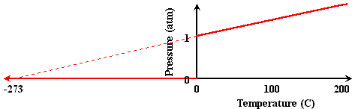
energy: absolute 0
Scientists sought to see what T it would have to be in order to reach 0 atm Pressure...

Slide 26
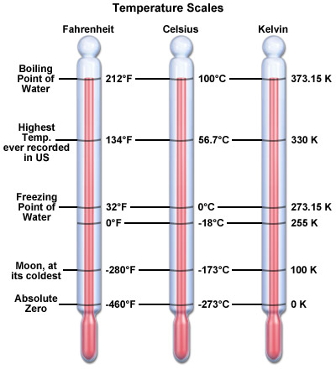
energy: T scales
Consider this perspective...
Farenheit | Celsius | Kelvin | comments
212 | 100 | 373.15 | water boils
32 | 0 | 273.15 | water freezes
-40 | -40 | 233.15 | Farenheit equals Celsius
-320.42 | -195.79 | 77.36 | liquid nitrogen boils
-452.11 | -268.95 | 4.2 | liquid helium boils
-459.67 | -273.15 | 0 | absolute zero

Slide 27
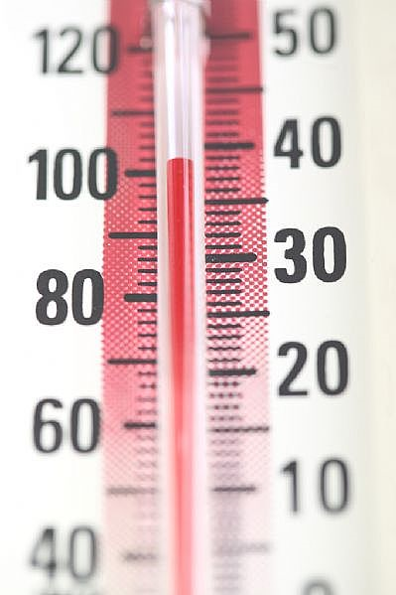
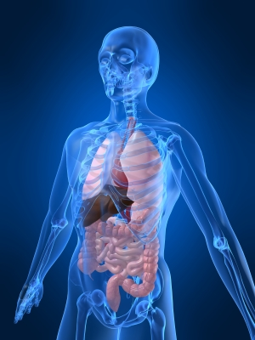
energy: T scales
Consider this perspective...
A biological comparison…
Body Temperature Regulation
Human life is only compatible
with a narrow range of temperatures:
Temperature (ºC) Symptoms
28 muscle failure
30 loss of body temp. control
33 loss of consciousness
37 normal
42 central nervous system breakdown
44 death by irreversible protein damage

Slide 28
energy: T scales
People tend to feel most comfortable at a relative humidity of about 45 percent.
Is what we feel different from
reality?...
Relative humidity is the ratio of the current absolute humidity to the highest possible absolute humidity (which depends on the current air temperature). A reading of 100 percent relative humidity means that the air is totally saturated with water vapor and cannot hold any more, creating the possibility of rain.
Humans are very sensitive to humidity, as the skin relies on the air to get rid of moisture. The process of sweating is your body's attempt to keep cool and maintain its current temperature. If the air is at 100-percent relative humidity… If the relative humidity is low…
For example, if the air temperature is 75 degrees Fahrenheit (24 degrees Celsius) and the relative humidity is zero percent, the air temperature feels like 69 degrees Fahrenheit (21 C) to our bodies. If the air temperature is 75 degrees Fahrenheit (24 C) and the relative humidity is 100 percent, we feel like it's 80 degrees (27 C) out.

Slide 29
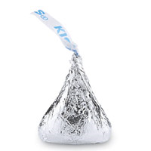
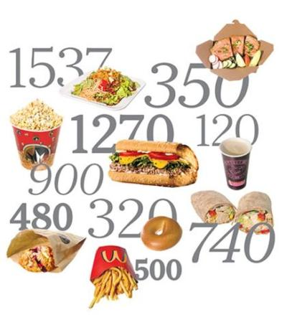
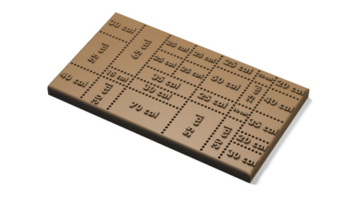
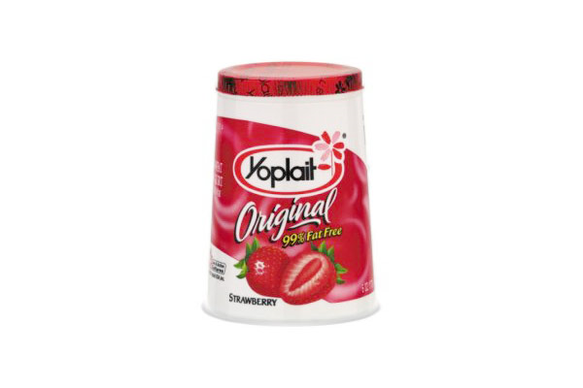
energy: heat units
What is it?...
What is a Calorie?
25 Calories
170 Calories

Slide 30


energy: heat units
What is it?...
What is a calorie?
How many calories do you burn just trying to understand what a calorie is?
First of all, we have to establish whether we are talking about Calorie with a capital C or calorie with a lowercase c.
What?
A Calorie (kilocalorie) is the amount of energy it takes to raise 1 kg. of water 1 ºC (4,184J)
A calorie (small calorie) is the amount of energy it takes to raise 1 g. of water 1 ºC (4.184J)

Slide 31
energy: dieting
The Ice Cream Diet
As we now know, it takes 1 calorie to heat 1 gram of water 1 degree centigrade. Translated into meaningful terms, this means that if you eat a very cold dessert (generally consisting of water in large part), the natural processes which raise the consumed dessert to body temperature during the digestive cycle literally sucks the calories out of the only available source, your body fat. For example, a dessert served and eaten at near 0 degrees C (32.2 deg. F) will in a short time be raised to the normal body temperature of 37 degrees C (98.6 deg. F). For each gram of dessert eaten, that process takes approximately 37 calories as stated above. The average dessert portion is 6 oz, or 168 grams.

Slide 32
energy: dieting
The Ice Cream Diet
Therefore, by operation of thermodynamic law, 6,216 calories (1 cal./g/deg. x 37 deg. x 168 g) are extracted from body fat as the dessert’s temperature is normalized. Allowing for the 1,200 latent calories in the dessert, the net calorie loss is approximately 5,000 calories. Obviously, the more cold dessert you eat, the better off you are and the faster you will lose weight, if that is your goal. Frozen desserts, e.g., ice cream, are even more beneficial, since it takes 83 cal./gm to melt them (i.e., raise them to 0 deg. C) and an additional 37 cal./gm to further raise them to body temperature. The results here are really remarkable, and it beats running hands down. Unfortunately, for those who eat pizza before their ice cream (or any hot food for that matter) it is loaded with latent calories and served above body temperature and induces an opposite effect.

Slide 33


energy: dieting
The Ice Cream Diet
But, thankfully, as the astute reader should have already reasoned, the obvious solution is to eat pizza and follow up immediately with multiple, large bowls of ice cream. We could all be thin if we were to adhere religiously to a pizza, butter beer, and ice cream diet. Or would we?
Said kiss contains enough thermal E to raise 1 liter of water 25 degrees Celsius!
Why doesn’t this work?
A Calorie (kilocalorie) is what nutritionists use...therefore the hershey’s kiss we talked about earlier: 25,000 calories to the physicist!

Slide 34



energy: demo
The Worst Breakfast in America Bob Evans Stacked and Stuffed Caramel
Banana Pecan Hotcakes
1,543 calories 77 g fat (26 g saturated; 9 g trans) 2,259 mg sodium 198 g carbs 109 g sugars It’s not a good sign when it takes you nearly five seconds to spit out the name of your breakfast. This bad boy packs in more than 75 percent of your calories for the day, along with more sugar and fat than nine glazed Dunkin’ Donuts, and nearly as much sodium as five Bloody Marys.
Read more here

Slide 35


energy: calorimeter
A simple calorimeter, consisting of two Styrofoam cups, stirrer, thermometer, and lid, shown before (left) and after assembly (right).

Slide 36


energy: demo I
Is there a difference between T & heat?
Mass c. Size e. Shape
V d. Function f. identity
vs.
Questions
When the objects are in the boiling water what is their temperature?
What factor(s) are different between the nuts and washers?
What caused the temperature to rise in each coffee cup?
Which coffee cup showed a greater rise in temperature?
5) If the washers and nuts are at the same temperature when in the boiling water, why is the increase in temperature not the same in both coffee cups.
6) Complete this sentence:
The same type of substance at the same temperature will transfer different amounts of heat if they have different ________________.
7) Looking at the statement above, what three factors (2 inherent; 1 without) determine how much heat a substance will transfer?

Slide 37

energy: thermodynamics
Thermo-dy-what?

Slide 38
energy: thermodynamics
The four principles (referred to as "laws"):
The zeroth law of thermodynamics :If two thermodynamic systems are each in thermal equilibrium with a third, then they are in thermal equilibrium with each other.
The first law of thermodynamics: Energy can neither be created nor destroyed. It can only change forms. In any process in an isolated system, the total energy remains the same.
The second law of thermodynamics: The entropy of an isolated system consisting of two regions of space, isolated from one another, each in thermodynamic equilibrium in itself, but not in equilibrium with each other, will, when the isolation that separates the two regions is broken, so that the two regions become able to exchange matter or energy, tend to increase over time, approaching a maximum value when the jointly communicating system reaches thermodynamic equilibrium.
The third law of thermodynamics: As temperature approaches absolute zero, the entropy of a system approaches a constant minimum.
…in other words…

Slide 39
energy: thermodynamics
The British scientist and author C.P. Snow had an excellent way of remembering the three laws:
You cannot win (that is, you cannot get something for nothing, because matter and energy are conserved; heat = E_{thermal} lost)
You cannot break even/go back (you cannot return to the same energy state, because there is always an increase in disorder; entropy always increases; heat cannot flow from a cold substance to a hot substance).
You cannot get out of the game (because absolute zero is unattainable).
In simplest terms, the Laws of Thermodynamics dictate the specifics for the movement of heat and work.
Basically, the First Law of Thermodynamics is a statement of the conservation of energy –
Second Law is a statement about the direction of that conservation
Third Law is a statement about [not] reaching Absolute Zero

Slide 40

energy: specific heat
The specific heat (c) of a substance is the amount of heat required to raise the temperature by one degree Celsius.

Slide 41

energy: specific heat
The specific heat of water is 1 calorie/gram °C = 4.186 joule/gram °C which is higher than any other common substance.
Meaning it can store a lot of heat without a huge rise in Temperature. As a result, water plays a very important role in temperature regulation—both bodily and globally.

Slide 42
energy: specific heat
Do you recognize the value of the specific heat (c) of water? How? (In which situations)
Why are the summers and winters often milder nearer the coast lines?

Slide 43


energy: specific heat
Now you can probably guess why the Earth’s surface is majority water:
Which takes longer to cool: a pool or the air?
2. What time of day, then, is an outdoor pool coolest? Warmest?
3. If Bermuda is close to N. Carolina—why does it have a tropical climate year round?

Slide 44
energy: demo
Try this demo on for size with your newfound formulaic enlightenment...

Slide 45


energy: demo II
Suppose I had an old tepid cup of tea and I wanted to top it off with some fresh hot tea... What would be its final T?
30 ml @ 23ºC
60 ml @ 80ºC
Using this data, calculate the theoretical final T for the hot and cool tea.
Consider them as = b/c they will reach Equilibrium
Q_{lost} = Q_{gained}
cm ΔT₁ = cm ΔT₂

Slide 46

energy: demo II
Suppose I had an old tepid cup of tea and I wanted to top it off with some fresh hot tea... What would be its final T?
Q_{lost} = Q_{gained}
cm ΔT₁ = cm ΔT₂
c ( g) (T-T) = c ( g) (T-T)
(60g) ( – T) = (30g) (T – )
(4800 – 60T) = (30T – 690)
-90T = -5490
T = 61.0ºC
This box is here to encourage you to work it out in the space to the right!
30 ml @ 23ºC
60 ml @ 80ºC
60 30
80ºC 23ºC
You will end up with a decently warm cup of tea:
90 ml of almost 61 degree tea...

Slide 47


energy: culinary thermodynamic wonder
Why do those infernal chicken pot pies burn your mouth?
The shell acts as an insulator, trapping the heat inside.
The shell doesn't feel hot to the touch, so it lulls you into a false sense of security. If you are inexperienced with the Zen of chicken pot pie dining, you will take a big bite and blast half of your taste buds into oblivion.
The secret is the pastry shell, not the liquid.
You see, the pastry shell completely encloses the liquid interior, and it has poor thermal conductivity. This has a twofold effect on the deadly tongue-destroying power of the dreaded chicken pot pie:

Slide 48






energy: thermal expansion
"Concorde measures 204ft in length - stretching between six and ten inches in-flight due to heating of the airframe. She is painted in a specially developed white paint to accommodate these changes and to dissipate the heat generated by supersonic flight."
Designers used rollers to isolate the cabin from the body, so that stretching doesn't rip the plane apart."
When substances are heated they often expand because their particles jiggle faster and move further apart.

Slide 49


energy: thermal expansion
QUANDARY: Now…suppose one cuts a hole out of a square sheet of metal… will the hole shrink or expand? Which dotted line should you choose?

Slide 50

energy: thermal expansion
Problem: I’ve got a jar of marmalade that simply won’t open…and my toast is begging for some apricots… what should I do?
Why?
Where on the lid do I unleash the aforementioned fury?
Why?

Slide 51


energy: thermal expansion
Water: the exception to the rule
The expansion of water upon freezing comes from the fact that water crystallizes into an open hexagonal form. This hexagonal lattice contains more space than the liquid state.
At what T (ºC) is Water Frozen?
At what T (ºC) is Water most dense?
BTW: what’s inside the ice 'rings?’

Slide 52

energy: thermal expansion
Which means that solid water (ice) is less dense than liquid water!
Ramifications?
1. Ice floats
2. Ponds freeze from the top down.
Larger bodies of water do not freeze even in frigid T because all the water must be cooled to 0ºC in order for ice to form.

Slide 53

energy: thermal expansion
Water expands below 0 degrees C (bloating due to ice crystals)
Water is most dense (packed together) at 4 degr. C
Water begins to expand (due to molecular motion) once heated above 4 degr. C

