Slide 1
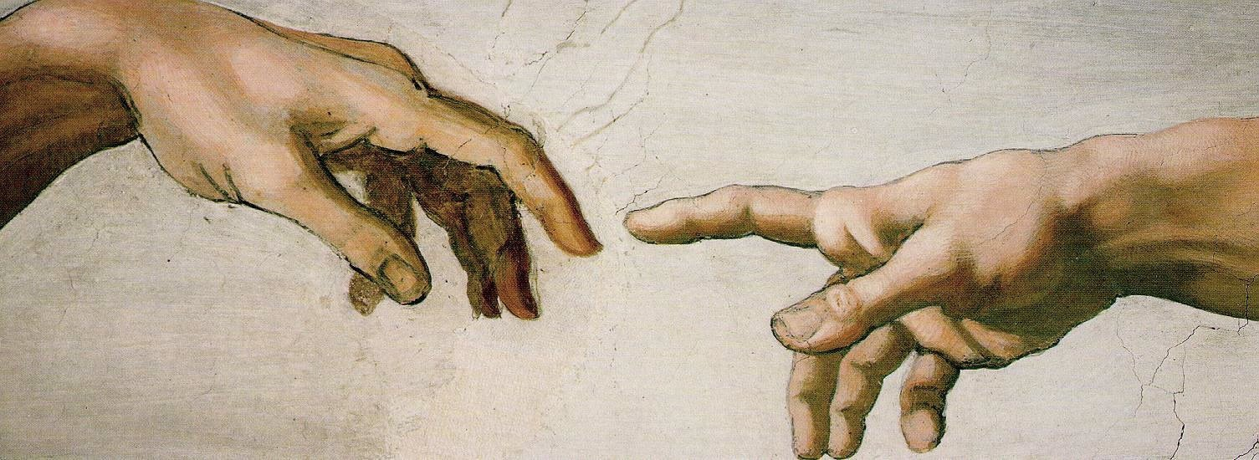
we were created
chapel - 9.13.12

Slide 2
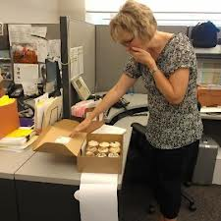
we were created
no. 1
God is eternally uncaused and exists before all He created.

Slide 3
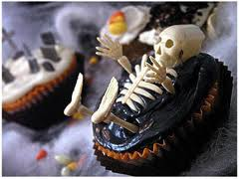
we were created
no. 2
God is living and life comes from God.

Slide 4

we were created
no. 3
God is independent, while the rest of creation is dependent on Him.
Why hast thou made me thus?

Slide 5
we were created
no. 4
God is transcendent and separate from His creation.

Slide 6
we were created
no. 5
God is imminent and actively involved in His creation.

Slide 7
we were created
no. 6
God is personal and, because God made us in His image, we have personhood and personality.

Slide 8
we were created
no. 7
God is powerful and made everything from nothing by Himself.

Slide 9

we were created
no. 8
God is beautiful and creation reflects the beauty of God.

Slide 10
we were created
no. 9
God is good and everything He makes He declares to be good.

Slide 11
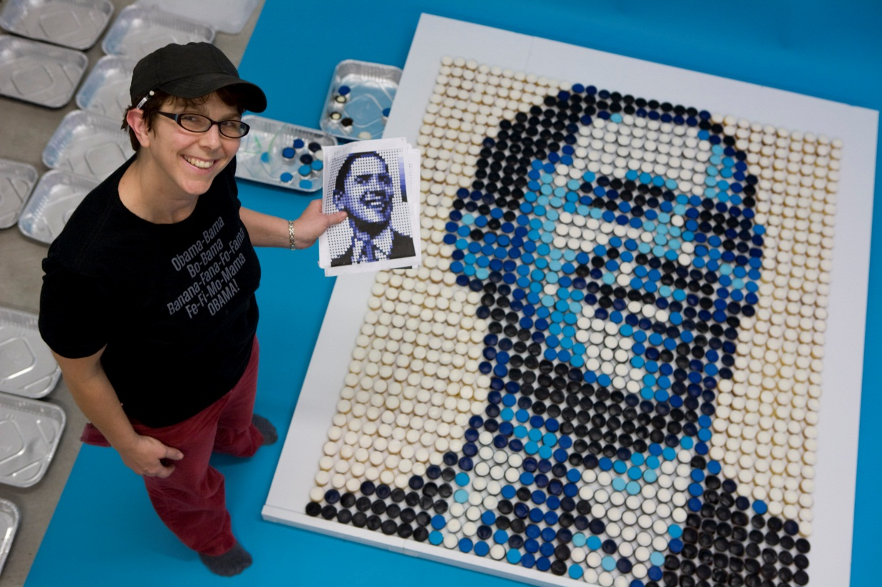

we were created
no. 10
God is orderly and His creation was orderly until sin entered into the equation, thereby marring all that God had made orderly.

Slide 12
we were created
no. 11
God is gracious and He blesses his creation.

Slide 13
we were created
But here’s what creation reveals about God. Number one, God is eternally uncaused and exists before he creation. God is eternally uncaused and preexists before his creation that he made. Secondly, God is living and life comes from God. Thirdly, God is independent, while the rest of creation is dependent on him. Fourth, God is transcendent and separate from his creation. Fifth, God is imminent and actively involved in his creation. Number six, God is personal, and because God has made us – what we’ll deal with next week – we have personhood. We’re not things, we’re people. And there’s personality because God has made us and he is personal. Number seven, God is powerful and made everything from nothing by himself. Number eight, God is beautiful and creation reflects the beauty of God. Number nine, God is orderly and his creation is orderly until sin enters into the equation, thereby marring all that God has made orderly. Number ten, God is good and everything he makes he declares to be good. So God’s not also evil, he’s just purely good. Number eleven, God is a prophet who preaches. Ten times in Genesis 1 it says that God said, and God preaches his creation into existence by the sheer force of his Word. Number twelve, God is good and everything he makes is originally good. We’ll deal with sin and its effects in the coming weeks, but God is good and what he makes is good. And thirteen, God is gracious and he blesses his creation.

